Slide 1
CHCCCS 010
MAINTAIN A HIGH STANDARD OF
SERVICE
In this unit we will look at the following:
Maintain relationships with people Act in a respectful manner
Evaluate service standards

Slide 2
Assessment
For this unit, you will be assessed on the following: Assessment Task 1- Written Questions
Assessment Task 2- Multiple Choice Questions
Assessment Task 3- Roleplayed Scenarios- Deliver services to three separate occasions
Activity 1
Activity 2
Activity 3
Activity 4
Activity 5
Activity 6
Activity 7
Activity 8
Activity 9
Activity 10
Activity 11
Learning Check Points 1
Learning Check Points 2
Learning Check Points 3

Slide 3
What is a high standard of
service?
Delivering quality patientcare and maintaining excellent service
standards is a combination of many key elements including well-trained staff, efficient policies and
procedures and effective communication.

Slide 4
There are many
characteristics that
create high standards of service
As anyone got an ideas of what these
characteristics might be?

Slide 5
MAINTAIN APPROPRIATE RELATIONSHIPS
Most roles within the health
services industry require you to spend a significant amount of
time with your patients. With
this level of contact with
patients and their families,
building a rapport with them is very important.

Slide 6
Who knows what rapport is?

Slide 7
Establish rapport with people
Establishing a rapport with people also means building trust and respect, which may encourage them to be more honest when
talking with you about their health. This in turn will help you
recommend the appropriate services to meet the patient’s needs.

Slide 8
Formal Rapport
Is when you
provide written information to patients or
colleagues in regard to
diagnosis,
treatments or referrals.

Slide 9
Informal Rapport
Is when you provide a friendly and courteous greeting and
general chit-chat about a
patient's life. It is also about
sporting team success, weekend activities and hobbies and most importantly introducing yourself and your position.

Slide 10
When establishing rapport...
Introduce yourself
Listen to what patients have to say
Always explain what is happening
Have empathy and sympathy Remain professional

Slide 11
Keep it professional
Read each of the following situations and determine if they overstep the boundaries of the professional relationship between a patient and health services worker.
Describe how you would handle each situation to ensure that it remains professional. Remember that while it is important to be clear, precise and professional it is also important not to embarrass the patient or make them feel uncomfortable.
A patient brings you a bunch of flowers to thank you for looking after them.
They have not overstepped the boundaries and I would thank them and suggest that this kind offering be a one-time situation as it would not be seen as professional from other colleagues if I kept getting flowers from certain patients.
A patient initiates a kiss on the cheek “Hello and goodbye”.
I would express to the patient that whilst a kiss may appear to be an innocent gesture, unfortunately we need to remember that we are in a health setting and that I would not want to be responsible for giving you a little germ.
A patient asks what you think they’re suffering from as the pain has worsened
Within the scope of your role, you could explain that you are not a doctor and that it could be a good idea to mention this worsening pain to your doctor when next he comes around. Or I could page him and see if he can come and see you today.
A patient asks for your opinion on the medications the doctor has prescribed
I would remind the patient that whist I may be responsible for dispensing the medication, I have very little knowledge on its effect and am unable to provide the opinion that you are seeking. I can get a health professional that specialises in medications, and you can chat with them about your concerns.
A patient asks you on a date
Whilst I find this very complimentary, unfortunately my workplace policies and procedures prohibit me from dating the patients, plus If I went on a date with you, I would be beside myself, your too good for me.

Slide 12
Keep it professional
A patient rings your mobile phone number on a Saturday night to ask for advice
I would take the call and remind the patient that we need to respect each other’s personal space and that calling out of hours is not recommended. I can’t offer advice when I am not in my professional setting as I do not have the tools I might need, and I would not want to provide advise that was incorrect or not helpful. Depending on the advice needed, I might offer it as a one of and remind the patient that if they called again out of hours I may not be so obliging. I would also remind them that there are correct protocols to follow and that I simply cannot be available to offer advise willy nilly.
You run into a patient on the street, and she asks you to join her for a coffee
If I am on a day off or doing a personal task, I would be able to join her for a coffee and we would pay Dutch. If I was on duty or on my way to my shift I would have to decline, but that the patient for the kind invitation to join them for coffee, “perhaps on another time”.
A patient asks you for a hug at the end of their appointment
Under patient/ client regulations no physical contact is permitted with patients. I would decline the hug and suggest that the patient save all their hugs for the next time they have a special visitor. The visitors deserve the hugs more than I do. I could perhaps under extreme conditions offer to hold their had briefly.
A patient asks you for a referral to another professional as they express that they are attracted to you
I would thank the patient for being transparent and honest and respect their request and seek an alternative professional support person. I could mention that I am flattered and that I think they are amazing too. Best we keep it professional, and I am able to do that if you are, otherwise if you feel uncomfortable, we can allocate someone else to your care.
A patient asks to borrow $20.00
I would tell the patient that I would love to be able to help, but if other patients found out, I would have to help them out to and that I would be left with no money and would have to borrow it back. I would suggest that it is better that they ask a friend or family member because as a professional health care worker I am not permitted to get involved with the finances of my patients.

Slide 13
Creating rapport questions
1. In your own words describe what rapport is.
Rapport is about building meaningful relationships. It enables people to feel comfortable and connected to their environment. Rapport is a way of building trust and respect.
2. Why is building rapport with patients and colleagues important?
Building a rapport is important because it enables you to work effectively and successfully within the health services industry and it ensures that the service you provide is appropriate and, in the patient or colleagues, best interest.
3. List three statements that you could use to create rapport with a patient whom you are meeting for the first time.
“Hi, Mrs Stevenson. My name is Peter and I’ll be your nurse for the next nine hours. Can I turn the television on for you? What is your favourite show?
4. What might you say or do to be friendly and courteous?
How are you today? Are you feeling comfortable? Is there something I can do or get for you? How is your morning coming along, it’s a love day isn’t it?
5. What questions might you ask to continue to build rapport overtime (e.g., at regular appointments?)
Questions about previous topics or conversations. How are you feeling since last time we spoke? Do you still require those additional pillows? Did you enjoy your walk in the park last Friday? Have you made any new friends?
6. Name two specific situations when you might need to act formally.
When providing treatment or specific care.
When there is particular information that needs to be communicated

Slide 14
Creating rapport questions
7. Name two specific situations where you might need to act informally.
Taking a patient on a casual stroll through the garden may require an informal conversation to build trust and confidence.
When providing meals or other personal services
8. In your opinion is it possible to build rapport and a professional relationship at the same time?
Building rapport is part of creating a professional relationship, both go hand in hand and are done at the same time. Acting professionally builds patient trust and confidence, which in turn builds rapport.
9. Why is it important to create professional relationships when working when with patients?
Professional relationships are key to providing health care to patients. Being professional instils trust, and confidence and can increase a patients recovery period. When patients have a of trust, they are less likely to be anxious or stressed and can allow positive energy into their recovery.
10. List three ways you can maintain your professionalism when working with patients.
Always undertake the same procedures or health care practices, which means being consistent.
Always maintain a high level of empathy and understanding
Try and remain neutral and treat all patients equally

Slide 15
Use effective communication skills

Slide 16
Speaking skills Listening skills Non- verbal communication skills

Slide 17
Are you an effective listener?

Slide 18
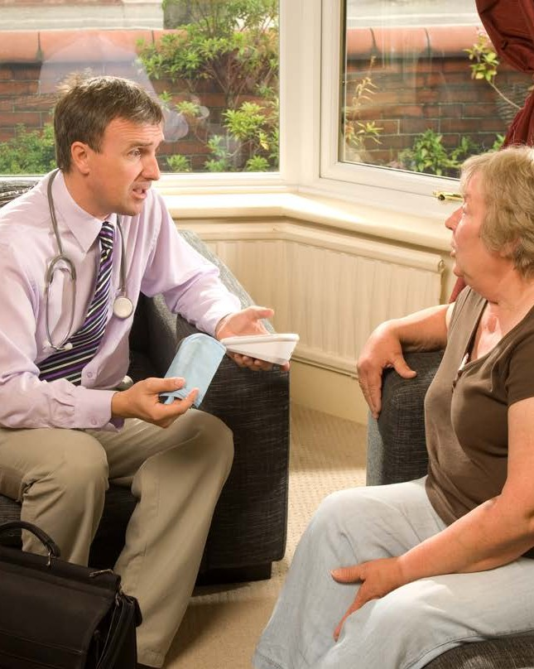
To be an effective and engaged listener...
Pay attention
Provide feedback and respond appropriately
Show that you are listening Don't interupt
Use open body language

Slide 19
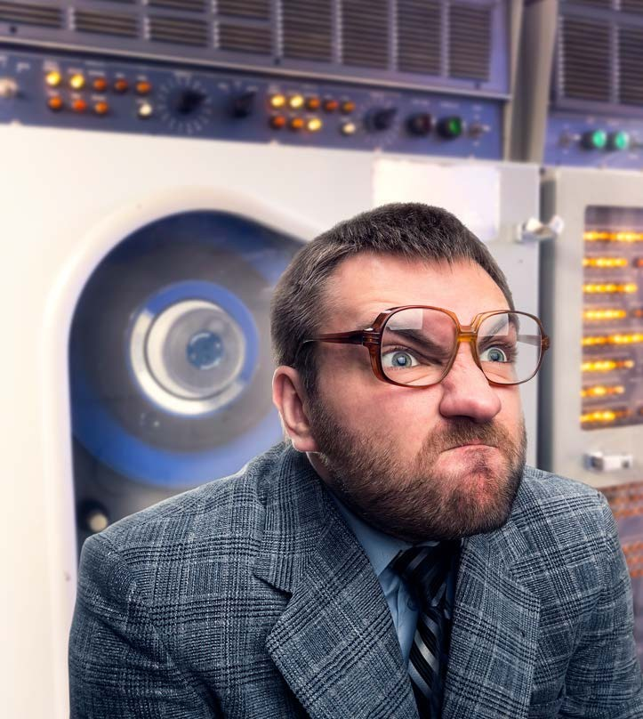
What are non- verbal communication skills?

Slide 20
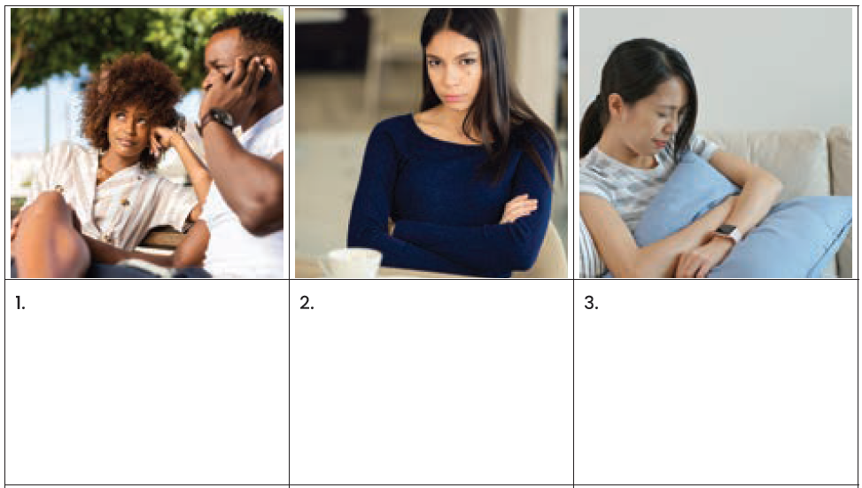
What are they not saying?
Being able to read and observe people is an important aspect of working within a patient centred industry. Examine each of the following pictures and determine what their body language, facial expressions and posture are communicating to you.
Then choose three pictures and suggest how you could use your communication skills to establish a high level of effective communication.
1. The man on the phone is being ignorant to the needs of the lady. The lady is showing signs of di-interest in what the man is saying over the phone.
2. Not happy with something or someone
3. Feelings of tiredness and perhaps she is self-comforting.

Slide 21
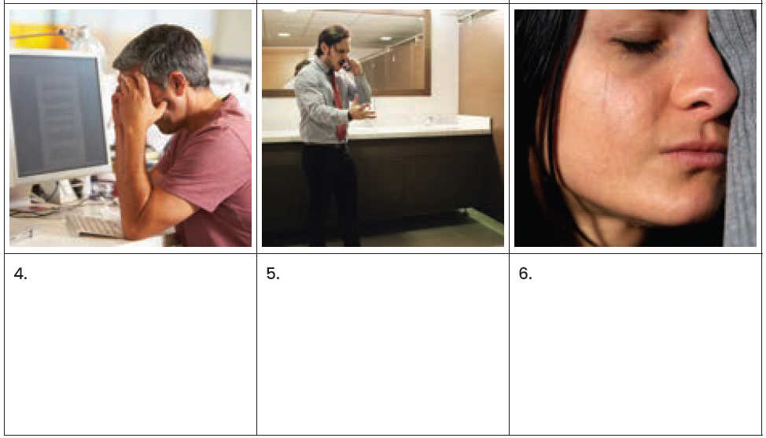
What are they not saying?
Being able to read and observe people is an important aspect of working within a patient centred industry. Examine each of the following pictures and determine what their body language, facial expressions and posture are communicating to you.
Then choose three pictures and suggest how you could use your communication skills to establish a high level of effective communication.
4. Frustrated/ anxious and perhaps overwhelmed.
5. Angry/ mis-understood/ erratic/ unreasonable
6. Emotionally exhausted/ upset and sad at the world.

Slide 22
Non- verbal communication gestures
Non-verbal communication and
gestures signals can mean one thing in one culture and something
entirely different in another.
For example, giving the thumbs up in Australia generally means well
done or that something is good. In
some Middle Eastern countries such as Iran, giving someone the thumbs up is the most disgusting of insults.

Slide 23
Eye contact Touching
Verbal Comunication

Slide 24
Be courteous in all interpersonal interactions
You can show respect for others through being supportive and
thanking them regularly for their
assistance or contributions.

Slide 25
Access interpreter skills
When working with
patients from different
cultures that cannot speak English or English is their second language you may need to access interpreter services to assist with
communication. An
interpreter is a personwho translates speechorally or into sign language.

Slide 26
Identify areas of concerns and report to supervisor
To respond to a patient’s needs you must first find out what they are in order to respond
appropriately. To do this you will
need to communicate with the
patient and identify the persons
concerns and needs and respond
within agreed levelof responsibility.

Slide 27
What might be some areas or behaviours of concern?

Slide 28
Observe and take notes
While it is important to take notes, try where possible to avoid taking too many as this can make a patient feel judged and uneasy. It is
best to take brief notes, which you can elaborate on later when you formalise your assessment or report.

Slide 29
Ask questions
Patients often require encouragement and need to be asked the right questions in
order to identify their needs. They might
forget to tell you things that are important.

Slide 30
Ask the right questions
TASK 1:
You are a youth psychologist. Elle, a 16-year-old girl, comes to you and says that she is no longer able to live at home with her parents.
Create a list of at least five questions you would ask Elle to find out more information. You may find it useful to create Elle’s responses in order for you to create additional questions to ask her.
1. Can you tell me more about what's been happening at home that's making you feel like you can't stay there anymore?
Elle: Well, my parents and I have been arguing a lot lately. It's like we can't agree on anything, and it always turns into a huge fight.
2. How long have these arguments been going on, and what typically triggers them?
Elle: It's been going on for a few months now, ever since I started pushing back on some of their rules and expectations. They get triggered when I express my opinions or try to assert my independence.
3. Have you tried talking to your parents about how you're feeling?
Elle: Yeah, but it always ends up with them dismissing my feelings or telling me I'm overreacting. It's like they don't want to listen to me at all.
4. Do you feel safe at home, physically and emotionally?
Elle: Physically, yes. But emotionally, not really. It's like I'm walking on eggshells all the time, afraid of saying or doing something that will set them off.
5. Have you considered any alternatives to living at home, like staying with a relative or a friend?
Elle: I've thought about it, but I don't want to burden anyone else with my problems. Plus, I'm not sure if leaving home is the right decision, but I just don't know what else to do.

Slide 31
Ask the right questions
TASK 2:
A health services professional such as a massage therapist or chiropractor may ask their patient to complete a pre-treatment questionnaire/survey that involves rating their pain levels, highlighting areas of concern and providing details of any medical conditions, injuries and/or illnesses. This questionnaire may form the basis for the consultation with the patient to assist them to identify their concerns and therefore their needs.
Examine the following pre-treatment questionnaire and list six follow-up questions you could ask the patient to further explore their areas of concern.
Follow-up questions:
Can you describe the type of pain you're experiencing in the areas you've marked on the diagram? For example, is it sharp, dull, throbbing, or shooting?
If your pain does radiate to other areas of your body, can you tell me more about where it spreads and what it feels like in those areas?
You mentioned radiating pain earlier; could you indicate on the diagram the initial source of your pain and the direction it travels?
In the comparative pain scale chart, you rated your current pain level. Can you give me examples of how this pain affects your daily activities?
When rating your average pain level over the last month, what specific activities or situations tend to exacerbate your pain?
Among the conditions listed, which one(s) do you currently have, and how do they impact your pain or overall well-being? Additionally, are there any other medical conditions or injuries not listed here that you think I should be aware of?

Slide 32
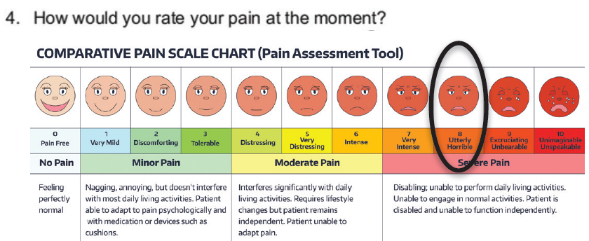
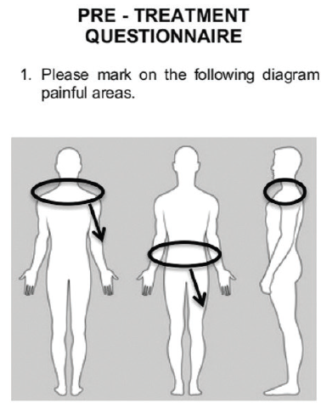
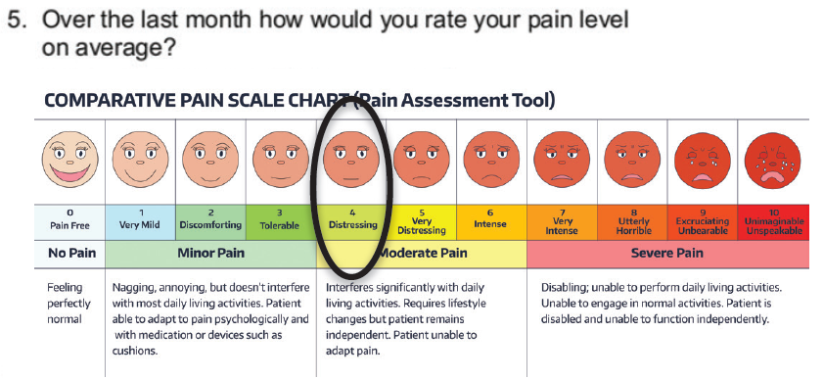
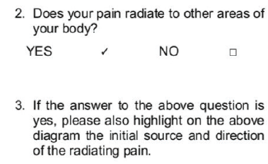
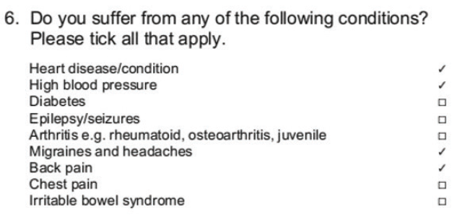
Ask the right questions

Slide 33
Ask the right questions—6 Follow-up Questions each task
Task 1:
You are a youth psychologist. Elle, a 16-year-old girl, comes to you and says that she is no longer able to live at home with her parents.
Create a list of at least five questions you would ask Elle to find out more information. You may find it useful to create Elle’s responses in order for you to create additional questions to ask her.
1. What is making you feel as though you need to leave home?
2. What is your relationship like with your parents?
3. Do you feel threatened or unsafe at home, why?
4. Are you the only child living at home?
5. Do you have your own room, or do you share with a sibling?
Task 2:
A health services professional such as a massage therapist or chiropractor may ask their patient to complete a pre-treatment questionnaire/survey that involves rating their pain levels, highlighting areas of concern, and providing details of any medical conditions, injuries and/or illnesses. This questionnaire may form the basis for the consultation with the patient to assist them to identify their concerns and therefore their needs.
Examine the following pre-treatment questionnaire and list six follow-up questions you could ask the patient to further explore their areas of concern.
1. What activities if any are you doing before or after experience such pain?
2. Are you currently taking any medications for the pain?
3. How often do you exercise and what type of exercise do you do?
4. Are you a drinker or smoker?
5. How often do you eat take out?
6. How long have you been experiencing this pain and has it always been in the areas you have indicated?

Slide 34
Take action to
resolve conflicts
Conflict can be defined as a disagreement or dispute between parties or people. These parties or people may include patients, colleagues of families that have opposing needs, ideas, beliefs, values or goals. Conflict in any workplace, business or organisation is unavoidable.

Slide 35
Negotiating
Negotiating is a key skill that can help resolve conflict. Negotiating aims to
reach a win-win resolution, where a
positive outcome can be achieved for both parties.

Slide 36
Diversion tactics
Who know what a diversion tactic is?
When might you use a diversion tactic and why?

Slide 37
De-escalation
When you identifythat a situation may be or has the potential to escalate it is importantto act quickly to defusethe situation. De- escalation is about reducingthe intensity or magnitude of the conflict.

Slide 38
Engage in conversation
Often conflict occurs simply because a person just wants to be heard. Their behaviour may also be a cry for help.
Engaging a person in conversation can allow them to calm down and focus on your questions and what they want to say which can defuse the situation.

Slide 39
Utilising a quiet space
A great strategy for responding to conflict is to take the patientto a quiet space free from noise and distraction.

Slide 40
Referring the conflict
Conflict in any workplace can be detrimental to the organisation’s productivity and success.
This is particularly important as the organisations within the health services industry deal directly with patient health and wellbeing, which makes it even more important to ensure conflict is resolved quickly and effectively.

Slide 41
Conflict situations - case studies
Using your knowledge that you have learnt about conflict resolution, analyse the following conflict situations and explain what techniques you would use to achieve a positive outcome.
Situation 1: Matt is a nurse’s assistant and works with Veronica who is his supervising nurse. Veronica becomes aware of a ward staff meeting and was told to tell Matt to attend. Veronica doesn’t tell Paul. Matt finds out and is very angry and decides to confront her. He becomes quiet upset and tells the ward manager that he wishes to longer work with Veronica.
To address the conflict between Matt and Veronica, I'd listen attentively to both, clarify the situation to ensure mutual understanding, and show empathy to build rapport. Then, I'd guide a problem-solving discussion to find solutions, mediate if needed, and offer conflict resolution skills training to improve workplace dynamics. These steps aim to foster open communication, mutual respect, and a positive working relationship, ultimately resolving the conflict.
Situation 2: Trevor has been working with Sophie for almost 2 years. Trevor has noticed that over the last few months Sophie has been very aggressive, rude and hostile towards him. He has confronted Sophie about her behaviour, but she refuses to acknowledge the problem.
To address the conflict between Trevor and Sophie, I'd emphasize active listening to Trevor's concerns and encourage direct communication with Sophie. If needed, I'd facilitate a formal meeting, utilising conflict management strategies to reach a resolution and ensure a positive outcome for their working relationship.
Situation 3: Jacinta is a physiotherapist at a rehabilitation centre. Monica is one of her elderly patients recovering from a bad fall. Monica continually argues with Jacinta about when she can return home. Jacinta wishes to keep Mary at the centre for longer as she believes that she is not fit to return home. Monica however believes that she will recover faster at home with her two sons looking after her. Monica has put in a formal complaint about Jacinta’s treatment.
To resolve the conflict between Jacinta and Monica, I'd employ active listening, empathy, effective communication, collaborative decision-making, mediation if needed, and address Monica's formal complaint to ensure her concerns are heard and her well-being prioritised, aiming for a positive outcome for both parties.

Slide 42
Respond and deal with complaints
When working in an industry that deals directly with patients it is inevitable that at some point they may make a complaint. Patients will generally complain because something has gone wrong.

Slide 43
Learning Checkpoint 1
1. What three characteristics of creating excellent service standards within the health services industry?
• Providing care fairly and ethically with a focus on patient needs
• Acting professionally with honesty, consistency, and integrity
• Communicating clearly and effectively
• Providing appropriate care
• Inviting teamwork and collaboration with colleagues
• Upholding organisational policies and procedures
• Demonstrating empathy, patience, and care
• Treating all patients with respect and dignity
• Acknowledging different cultures, values, and beliefs.
2. Building a rapport with people also …
means building trust and respect, which may encourage them to be more honest when talking with you about their health.
3. What are two strategies for building informal rapport?
• providing a friendly and courteous greeting
• general chit-chat about their life, sporting team success, weekend activities and hobbies.
• introducing yourself and your position.
4. What are three things that a health worker needs to consider when building a rapport with their patients?
• Introduce yourself and get to know your patient
• Listen to what patients have to say
• Always explain what is happening
• Have empathy and sympathy
• Remain professional

Slide 44
Learning Checkpoint 1
5. What two things that you should NOT do when developing a professional relationship with a patient?
• be quick to judge and give your opinion. When considering other people’s ideas take the time to weigh up and consider the advantages and disadvantages of their idea.
• act childish and never be offensive (e.g., don’t tell rude jokes)
• overstep or give your personal opinion on an issue when it is not required. Stick to the task at hand.
6. Explain three aspects of becoming a better active and engaged listener?
• Provide feedback and respond appropriately – ask questions to clarify information; use open questions to gain additional information; be honest in your answers/feedback.
• Pay attention – look directly at the speaker; concentrate on what they are saying, don’t silently prepare for what you will say next; avoid being distracted by side conversations or environmental factors.
• Show that you are listening – smile and nod occasionally; use positive body language and posture.
• Don’t interrupt – being an active listener means listening and not speaking. Speaking at the wrong time could interrupt a person’s train of thought or stop them from disclosing important information or verbalising how they are feeling. People often provide more information when they have the freedom to speak without interruption
• Use open body language – even if you do not agree with what the patient is saying it is important to remain open to their opinions, ideas, and views. You can do this by maintaining positive body language such as standing directly in front of them with an open stance and without your arms crossed over your chest. Don’t look away
• or get distracted and maintain eye contact at all times.
7. Developing the ability to understand and use non-verbal communication can help you…
connect with others, express what you really mean, navigate challenging situations, and build better working relationships

Slide 45
Learning Checkpoint 1
8. What can be three methods used to communicate with a patient non-verbally?
• Facial expressions
• Body movements and gestures
• Eye contact
• Posture
• Muscle tension
• Breathing
9. What does it mean to be “Empathetic”?
Being empathetic is about imagining yourself in someone’s position and considering how you would feel. The best way to show empathy for another person is to listen to them and provide open, honest, and supportive feedback. Offer to help them; this shows that you are keen to make life just that little bit easier for them.
10. In Western culture eye contact is very important, what is one aspect of eye contact that you need to consider when communicating with a patient?
• In Middle Eastern cultures eye contact is less common. Women are not to make too much eye contact with men as it can be misinterpreted as a romantic interest.
• In Asian cultures eye contact is often considered to be inappropriate, especially if the person making the eye contact is considered to be of a lower social class. For example, a student would never make eye contact with their teacher as this could be viewed as disrespectful and rude.
• In African cultures eye contact can be viewed as aggressive, disrespectful, and confrontational.
11. What is the most effective way to identify a patient’s concerns or particular needs?
Speak to them directly, spending time one-on-one with them and asking them a series of questions to establish the best way to respond and assist them.

Slide 46
Learning Checkpoint 1
12. Resolving conflict will result in three outcomes, explain one of them.
• A win-win situation: In a win-win situation both parties will come away from the conflict situation satisfied with the resolution.
• A win-lose situation: In a win-lose situation only one party will come away satisfied
• A lose-lose situation: In a lose-lose situation the conflict will either be ignored, or the parties will be unable or unwilling to compromise on an outcome.
13. What are three things that you need to consider when negotiating successfully?
• consider the goal of the negotiation
• possible alternatives
• the desired outcome
• the relationship between you and the person/party
• possible solutions and consequences. If the negotiation
• does not go as planned, you need to consider what you are willing to compromise on or give up as part of the negotiation.
14. What is the intent of a diversion tactic?
A diversion tactic is used to draw a person’s attention away from the conflict, calm them, get them talking and resolve the issue. Diversion tactics may include offering food or drink, asking the person if they would like to play a game, go for a walk, or come and see something of interest.

Slide 47
Learning Checkpoint 1
15. What are three that you can do to de-escalate a situation?
• be calm, empathetic and adopt a non-confrontational approach. It is important to not show fear and be confident when speaking with the patient.
• ensure that your body language is neutral and that you avoid giving too much eye contact as this can be misinterpreted as confrontational.
• give the patient your undivided attention, listen and acknowledge that you are listening to them without agreeing with them or giving your opinion.
• ensure that you are an appropriate distance from the patient so that you cannot be touched or reached if the situation suddenly changes.
• make use of diversion tactics if appropriate, offer food and drinks.
• seek assistance from others that could be helpful in calming the patient such as the patient’s family, friends, or colleagues.
16. Engaging a person in conversation also allows you to…
assess why the person is acting a certain way, what has created the conflict situation and what can be done to resolve the issue.
17. There may be a time when you are dealing with a conflict and need to seek further assistance. Who would be an appropriate person to seek assistance from?
• A supervisor
• An experienced staff member
• A manager or director

Slide 48
Learning Checkpoint 1
18. What are three signs that may indicate that a patient is dissatisfied with services being provided?
• Negative body language signalling disinterest or dissatisfaction, such as arms crossed and a lack of eye contact.
• Becoming disrespectful and dismissive
• They don’t seem to be listening to you or are interested in what you are saying.
• Showing frustration or anger as they leave the store, such as slamming a door or making a negative comment as they leave such as “I’m never coming back here again”.
• They are quiet even when issues occur/re-occur
• They choose not to provide feedback, or they give you below-average feedback
• They are not responding to you via email and phone
• Patients unsubscribe from your email promotions and/or send back promotional mail
19. An organisation providing health services can collect complaints in a number of ways, what are two methods a patient can provide feedback/ complaint?
• Written - on a card or piece of paper and given to a staff member or placed in a suggestion box
• Verbal - by a patient complaining directly to a staff member, supervisor, or manager
• Electronic - through email or an online survey
20. If the complaint cannot be handled straight away because it was submitted…
electronically, via the mail or a complaints box, the issue should be addressed with the staff member involved and the manager should contact the patient to assure them that their complaint was taken seriously and that is has been dealt with.
21. What does the acronym LAAAF stand for?
• Listen
• Acknowledge
• Act in response
• Action
• Follow-up

Slide 49
ACT IN A RESPECTFUL MANNER
Working in the health services industry
you will encounter a variety of patients, in a range of settings each with different
circumstances. When working with
patients,
their family and friends it is important that you always positively, actively and
consistently demonstrate respect for
individual promote
differences in all work and respectful behaviour.

Slide 50
Being respect means..
Treating patients and colleagues with kindness and dignity Smiling and being friendly
Don’t discriminate or show favouritism Being supportive and encouraging Being an active listener
Demonstrating courtesy in all interpersonal interactions with patients, families and colleagues
Being objective, fair and non-judgmental
Being accepting of different cultures, values and beliefs Always be professional

Slide 51
Demonstrate respect for individual difference
What does this mean to you?

Slide 52
Organisational Policies and
Procedures
As an employeein the health services industry, you must uphold and follow a range of relevant legislation and organisational policiesand procedures.

Slide 53
Legal and ethical considerations
There are many ethical standards you need to be aware of in the health services industry. Governing peak bodies in the industry set many of these ethical standards through their Code of Conduct and Code of Ethics. These include the Aged and Community Services Australia, Australian Nursing Federation and the Australian Council of Social Service

Slide 54
Respect - do you know what it looks like?
Most of us know how to be respectful to one another, however are you surprised at how many people don’t actually know how to act in a respectful manner? Would you be able to identify respectful behaviour if you saw it?
Instructions:
1. Your teacher is going to give you two sheets of paper that read ‘respectful’ and ‘disrespectful’.
2. You are then going to read the following scenarios that involve a particular person interacting and communicating with others.
3. You must now decide if the particular person in each scenario was acting respectfully or disrespectfully (this is an individual task and you should not share your decision at this point).
4. Your teacher will then read out each scenario and ask each student to hold up the sign that either says ‘respectful’ or ‘disrespectful’.
5. Your teacher will then ask certain students to explain their decision to the class.
Scenario 1: Mark the paramedic Mark is an experienced paramedic and is working with Ruby who has just recently graduated from university. Mark and Ruby attend a car accident where there is an injured woman and her son. Ruby starts to administer treatment and apply a bandage to the woman’s arm. Mark sees that Ruby is applying the bandage incorrectly and proceeds to interrupt and starts applying the bandage himself. His only remark to Ruby is ‘here I will do it properly”.
Scenario 2: Ava the medical receptionist Ava is the medical receptionist for a specialist orthodontic clinic in the city. Carolina, a patient of one of the orthodontists is running late for her appointment. The clinic has a policy that if a patient is running more than 15 minutes late their appointment has to be rescheduled. Carolina arrives 20 minutes late as her car broke down. Ava tells Carolina that her appointment will now have to be rescheduled. Carolina is frustrated and asks Ava why this is the case. Ava knows that she continually arrives late to her appointments and rolls her eyes in front of Carolina.

Slide 55
Respect - do you know what it looks like?
Most of us know how to be respectful to one another, however are you surprised at how many people don’t actually know how to act in a respectful manner? Would you be able to identify respectful behaviour if you saw it?
Instructions:
1. Your teacher is going to give you two sheets of paper that read ‘respectful’ and ‘disrespectful’.
2. You are then going to read the following scenarios that involve a particular person interacting and communicating with others.
3. You must now decide if the particular person in each scenario was acting respectfully or disrespectfully (this is an individual task and you should not share your decision at this point).
4. Your teacher will then read out each scenario and ask each student to hold up the sign that either says ‘respectful’ or ‘disrespectful’.
5. Your teacher will then ask certain students to explain their decision to the class.
Scenario 3: Alistair the dental nurse Alistair is a dental nurse and works with a team of nurses at the High Smiles Dental clinic. Alistair is working with Megan today and they have a busy schedule with the clinic booked out with appointments. After lunch Megan asks Alistair to cover for her, as she wants to go home early. She tells Alistair to tell the manager that she has gone home sick. Alistair knows that this is not the right thing to do and politely tells Megan that he will not be able to do that for her and she will need to discuss it with their manager. Megan gets upset with Alistair and accuses him of being unfair and rude.
Scenario 4: Phil the nurse Phil is a nurse at an aged care facility and is helping Mandy to have a shower. Phil and Mandy have a good relationship, as they have known each other for over 5 years. Phil helps Mandy into the shower and asks her to sit down on the shower chair, so he can help her undress. While trying to sit, Mandy slips over and falls to the ground. She is not hurt and begins to laugh out loud. Phil starts to laugh as well and then pulls out his phone to take a video of Mary trying to get up. She is unaware that Phil is videoing and continues to laugh until she eventually gets herself up. Phil then shows other staff members the video of Mary as he knows that she won’t mind.

Slide 56
Provide caring assistance
Duty of care is a legal
requirement. As a health services worker, you have a responsibility to your patients to reduce or limit the amount of harm or risk they
are exposed to.

Slide 57
Dignity of risk
Dignity of risk is a term used to describe a person’s right to make their own choices about their health, the services that they access, and their healthcare needs irrespective of the advice they receive from health professionals.

Slide 58
Maintain confidentiality
Workers in the health services industry have an ethical and legal responsibility to respect and maintain patient confidentiality and privacy at all times. The terms ‘privacy’ and ‘confidentiality’ do differ.
Confidentiality is an ethical duty that a person upholds such as doctors, therapists and attorneys. Upholding patient confidentiality is best practice for any activity or organisation.

Slide 59
Ways to uphold privacy and confidentiality
Not talking about the patient outside of the work environment. Only discussing patients with the appropriate people.
Conducting interviews in a private place.
Seek patient permission to share their information.

Slide 60
Disclosure
It is important for health service organisations to maintain a process called open disclosure.
Open disclosure is about ensuring open communication between patients and organisations when things don’t go to plan.

Slide 61
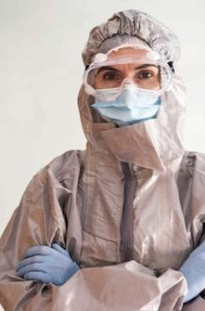
Work Health and Safety
It is the legal responsibility of all employees in the community services industry as well as all other industries within Australia to operate in accordance with acceptable work health and safety standards.

Slide 62
Work Health and Safety
Under WHS/OHS legislation you are obliged to provide: safe work premises
safe machinery, equipment and materials safe systems of work
information, instruction, training and supervision a suitable working environment and facilities.

Slide 63
Upholding patient confidentiality
For each of the following scenarios identify whether the patient’s confidentiality should be upheld.
Scenario | Uphold Confidentiality? – Yes Or No
1. Kaitlyn has been to the local clinic for an appointment. Her boyfriend Frank has turned up to the clinic to find out why she attended. | Yes
2. Debra is 17 years-old. Her parents have taken her to see a counsellor as her behaviour has been quite out of character lately. Her grades at school have dropped and they are unsure how to help her. Debra discloses to her counsellor that she is being bullied at school. | Yes
3. Jet is 15 years-old. He regularly attends the youth health centre where you work. When he takes his jumper off, his t-shirt comes up a little and you notice that he has some red welts on his back. They look quite nasty. He notices that you have seen the welts and quickly covers them up and tells you that he fell down while skateboarding. | No
4. Leslie tells you that she is a drug trafficker and feels terrible and wants someone to talk to. | No
5. Joanne is suffering from depression. You need to refer her to a mental health facility for treatment. They have requested her patient information file. | Yes, but with consent form the patient
6. Kourtney is in rehab for the third time in the last two years. During her individual counselling session she says that she doesn’t know why she is bothering as it is a waste of time as she will just start using again when she gets out, like the last two times she got out of rehab. She makes the comment that she just can’t be bothered anymore and that it’s not like anyone would miss her if she weren’t around. | No
7. A police officer enters your clinic and asks for the private contact information of one of your patients, as they are believed to have been involved in a robbery. | No

Slide 64
Human Rights
Every person has rights. Our human rights are the basic rights and freedoms that every person is entitled to. Human rights are upheld all over the world through the United Nations Universal Declaration of Human Rights. There are thirty articles (sections) of the declaration; each article outlines a different aspect of human rights.
Do you know your human rights?

Slide 65
Work role boundaries
Read each of the following scenarios and determine if each person acted within their job role responsibilities.
Scenario 1: Belinda is an aged care assistant at the View Hill residential care unit. She notices that one of the women she cares for seems depressed and sad. She decides to get her some anti-depressant medication from the facility’s pharmacy to help her feel better.
Suggested response: This is not within Belinda’s work role. It is within her work role to notice that a woman she cares for is depressed but then she should refer the woman to the appropriate health professional. It is not within her work role to be medicating patients with anti-depressant medications.
Scenario 2: Sherrie is a receptionist at a medical clinic. A patient on their way into the clinic falls and injures their knee on the front steps. Sherrie administers first aid, as she is first aid qualified.
Suggested response: It is within Sherrie’s work role to look after the patient and provide first aid as she is first aid qualified. In this instance Sherrie would administer the initial first aid response and then leave the patient in the hands of more advanced care, such as a doctor from the clinic or a paramedic.
Scenario 3: Ty works as a counsellor at a homeless shelter. On Friday night the shelter is full, so he invites three of the homeless men to sleep at his house for the night.
Suggested response: This is not within Ty’s work role to invite homeless men to stay at his personal home. As well as not being within his work role, it is also not professionally appropriate.
Scenario 4: Morgan works at a nursing home as a nurse’s assistant. When showering one of her patients she notices that she has cut her toe using nail clippers. She dries the cut and applies anti-bacterial cream and a bandage to ensure that it does not get infected.
Suggested response: This is within Morgan’s work role as a nurse’s assistant. Anti-bacterial cream does not require a health professional to prescribe or administer it. Morgan has simply applied a bandage and anti-bacterial cream as part of her work role to assist with personal care.

Slide 66
Work role boundaries
Read each of the following scenarios and determine if each person acted within their job role responsibilities.
Scenario 5: Charlotte is an occupational therapist at a rehabilitation facility. She notices that one of her patients that should be attending her sessions has not attended in the past three days. She goes to his room to check on him.
Suggested response: Checking on the welfare of a patient is within Charlotte’s work role. It is also a nice thing to do so that the patient feels that their lack of presence has been noticed. It could also motivate them to begin attending again or provide an opportunity to discuss why they have stopped coming to the sessions.
Scenario 6: Carrie is an orderly at the Royal Children’s Hospital. One of the boys she delivers dinner to is screaming because his tooth is falling out and he is in pain. She can’t see any nurses or doctors and the boy is becoming quite aggressive and is trying to pull out his own tooth. Carrie grabs a pair of medical pliers and tries to remove his tooth.
Suggested response: This is not within Carrie’s work role, as she is not appropriately qualified to administer this type of treatment. She should refer the situation to a nurse, doctor or dentist and possibly organise specific arrangements to make the boy feel more comfortable. Even though a person may be distressed or in pain this is not a reason to intervene with something that is outside of a person’s work role, which could cause more injury to the patient and result in disciplinary action.

Slide 67
Behaviours of concern - can you deal with them?
Using your knowledge that you have learnt about dealing with behaviours of concern choose four behaviours from the diagram below and describe the techniques you would use to effectively respond to the behaviour. You may wish to refer back to chapter 3 in book 1 to refresh your knowledge. Behaviours of concern:
Verbal offensiveness
Noisiness
Self-destructive behaviour
Wandering
Intrusive behaviour
Manipulation
Intoxication
Confusion.
Behaviour of concern: Confusion Techniques to respond: Ask the person a series of simple questions in a clear calm, supportive manner, treat them with courtesy and respect, approach from the front so they can see you and take them to a private area free from distractions | Behaviour of concern: Manipulation Techniques to respond: You need to be firm and clearly identify the inappropriate behaviour and outline why it is unacceptable. It is important that you make them understand how their behaviour is affecting others.
Behaviour of concern: Intrusive Techniques to respond: Identify the behaviour immediately and guide them away from it, change the topic and in a private space talk to them about their intrusive behaviour and why it is inappropriate. | Behaviour of concern: Intoxication Techniques to respond: • Stay calm and speak to the person in a low tone • Don’t be judgmental • Do not try any methods to sober them up • Try to make the person comfortable; lie them down on the side but never on the back or stomach.

Slide 68
Learning Checkpoint 2
1. What does it mean to be courteous?
• Providing your full attention when it is needed
• Having a friendly conversation when being spoken to
• Showing a genuine interest in others
• Always be mindful of a person’s personal space
2. When you act in a respectful…
manner towards patients it demonstrates that you are highly professional and that you genuinely care about their situation.
3. What three actions can you demonstrate that indicate that you are being respectful?
• Treating patients and colleagues with kindness and dignity
• Smiling and being friendly
• Don’t discriminate or show favouritism
• Being supportive and encouraging
• Being an active listener
• Demonstrating courtesy in all interpersonal interactions with patients,
• families and colleagues
• Being objective, fair and non-judgmental
• Being accepting of different cultures, values, and beliefs
• Always be professional
4. There are many ethical standards you need to be aware of in the health services industry that are governed peak bodies. What are three industry bodies?
• Aged and Community Services Australia
• Australian Nursing Federation
• Australian Council of Social Service

Slide 69
Learning Checkpoint 2
5. When responding to a behaviour of concern you have a duty of care…
to that person, however, this obligation does not supersede your own safety or the safety of others.
6. What are four things you can do to ensure your duty of care when responding to behaviours of concern especially signs of aggression?
• Follow organisational policies and procedures as well as any planned responses.
• Ensure your personal safety and the safety of others around you.
• Take any steps that are reasonable to prevent harm. Such as moving away potential objects that could be used as weapons from a person showing signs of aggression.
• Seek help when you identify a situation where a person is being abused, is self-harming or is potentially suicidal.
• Report any behaviours of concern immediately so that the situation can be managed and controlled, preventing escalation and further risk.
• Report the situation and record all required information for your employer, regulatory body and/or government authority.
7. Explain the term “Dignity of risk”.
Dignity of risk is a term used to describe a person’s right to make their own choices about their health, the services that they access, and their healthcare needs irrespective of the advice they receive from health professionals.
8. What are two strategies that could applied to maintain or uphold a patient’s privacy and confidentiality?
• Not talking about the patient outside of the work environment.
• Only discussing patients with the appropriate people.
• Conducting interviews in a private place.
• Seek patient permission to share their information.
9. What are the three main legislative Acts that mandate the confidentiality of a patient’s information?
• Health Administration Act 1982
• Health Records and Information Privacy Act 2002
• Health Services Act v 1988 (Vic)

Slide 70
Learning Checkpoint 2
10. What are the five aspects of open disclosure?
• an apology
• a factual explanation of what occurred
• a discussion of the possible effects or consequences
• an explanation of the steps taken to ensure that it doesn’t happen again
• an opportunity for the patient and their family to ask questions and describe their view of
• the situation and/or their experience.
11. Under the WHS/OHS legislation what four things a health services organisation is obliged to provide?
• safe work premises
• safe machinery, equipment, and materials
• safe systems of work
• information, instruction, training, and supervision
• a suitable working environment and facilities.
12. What are four basic human rights?
• Everyone has the right to life
• Everyone has the right to freedom of opinion and expression
• Everyone has the right to rest and leisure
• Everyone has the right to education
13. What is a work role boundary?
Your work role boundaries are your limitations and the point where your responsibilities end. These boundaries ensure that you do not work outside of your qualifications, skills and abilities and also ensure that you do not overstep your role into someone else’s, which could cause conflict in the workplace and confusion for patients.

Slide 71
Learning Checkpoint 2
14. Define the term, “Behaviour of concern”.
Behaviour of concern can be defined as behaviour where a person or persons act in a manner that threatens the physical safety of themselves and those around them, including carers, staff, family members and friends.
15. When working within the health service you will encounter many behaviours of concern, what are three?
• Aggression
• Confusion
• Intoxication
• Intrusive behaviour
• Manipulation
• Wandering
16. What is aggressive behaviour?
A person who is aggressive will most often verbally abuse others, however, in some instances this turns to physical abuse and violence. Physical aggression may include shoving, pushing, hitting, kicking, and biting. It is important that incidents of aggression are dealt with and defused quickly to prevent escalation.
17. What are three things that you could do to successful deal with a patient who is exhibiting aggressive behaviour?
• by speaking in a positive, slow, and calm voice
• asking questions
• getting the person to talk, using positive body language
• trying to make a connection with them by showing empathy,
• being positive and telling them that all you want to do is help them.

Slide 72
EVALUATE SERVICE STANDARDS
As a health services worker your purpose is to assist your patients to achieve an optimal state of physical, social and emotional health.
This may be achieved in many different ways depending on your role.

Slide 73
Formal and informal feedback methods
If you were seeking feedback what might be an informal and a formal method you could use?

Slide 74
Evaluate effectiveness of interpersonal interaction
What does this all mean?

Slide 75
Mentoring
Mentoring is about transferring knowledge from one individual to another, through explanation and demonstration, offering the individual an opportunity to learn as they are supported and assisted by a more experienced colleague.

Slide 76
Personal and
reflective behaviour strategies
Personal and reflective strategies are great ways for staff to help monitor and evaluate their performance and interactions with patients. These involve staff members completing a self-evaluation of their performance at work.

Slide 77
Develop your own personal reflection
Develop a series of ten questions to gain feedback about student performance at school. You may like to include questions about strengths, weaknesses, time management, concentration, work ethic, effort in class, progress etc. Once you have created your personal reflection, complete the following questions:
Questions:
1. If a teacher at school gave you the personal reflection sheet you just created would you find it difficult to be honest if you knew that both your teacher and parents would read it? Explain why/why not?
................................................................................................................................................................................................................................................................................................................................................................................................................................................................................................................................
2. Do you think that personal reflection is an effective way to gain feedback in the workplace? Explain why/why not?
................................................................................................................................................................................................................................................................................................................................................................................................................................................................................................................................
3. Why do you think it is important to get people to think about their performance in the workplace instead of just telling them?
................................................................................................................................................................................................................................................................................................................................................................................................................................................................................................................................
4. Do you think that a personal reflection alone is enough to measure performance? Explain why/ why not?
................................................................................................................................................................................................................................................................................................................................................................................................................................................................................................................................

Slide 78
Develop your own personal reflection
Develop a series of ten questions to gain feedback about student performance at school. You may like to include questions about strengths, weaknesses, time management, concentration, work ethic, effort in class, progress etc. Once you have created your personal reflection, complete the following questions:
Questions:
5. What are some advantages of personal reflection?
................................................................................................................................................................................................................................................................................................................................................................................................................................................................................................................................
6. What are some disadvantages of personal reflection?
................................................................................................................................................................................................................................................................................................................................................................................................................................................................................................................................
7. Briefly describe a situation at work where you think it may not be appropriate to conduct a personal reflection.
................................................................................................................................................................................................................................................................................................................................................................................................................................................................................................................................
8. What occupation within the health services do you believe personal reflection would be most useful for? Give a brief explanation.
................................................................................................................................................................................................................................................................................................................................................................................................................................................................................................................................

Slide 79
Seek advice to enhance own work performance
At some point in your career within the health services industry you may be required to seek and receive advice or assistance from a supervisor, colleague and other appropriate sources when carrying out your role.

Slide 80
What to consider when receiving
and seeking assistance

Slide 81
Create an evaluation
Loretta is physiotherapist and runs her own clinic. She has a large client base and is wanting to find out how she could improve on her own performance and service when treating patients. Create a survey, questionnaire or set of interview questions to gain feedback from patients that Loretta could use at the conclusion of her appointment.
Ensure that your evaluation allows her to gain feedback on:
• Communication with patients
• Patients’ overall experience with Loretta
• Information given to patients
• Rapport with the patients
• Explanation of diagnosis and treatment
• Consideration of patient needs and concerns
• Patient satisfaction
• Likelihood of the patient returning to be treated by Loretta
• Likelihood of patient referring a friend or family member to Loretta
Your evaluation should be presented as a professional document and must contain at least 15 questions.

Slide 82
Create an evaluation
Patient Feedback Survey
Thank you for choosing Loretta's Physiotherapy Clinic for your treatment. Your feedback is important to us as we continuously strive to improve our services. Please take a few moments to complete this survey honestly and thoughtfully.
How satisfied are you with the communication between you and Loretta during your appointment?
Very satisfied Satisfied Neutral Dissatisfied Very dissatisfied
2. Overall, how would you rate your experience with Loretta as your physiotherapist?
Excellent Good Fair Poor
3. Did Loretta provide you with clear and understandable information about your condition and treatment plan?
Yes, very clear Yes, somewhat clear No, not very clear No, not at all clear
4. How would you rate the rapport between you and Loretta during your appointment?
Excellent Good Fair Poor
5. Did Loretta explain your diagnosis and treatment options to your satisfaction?
Yes, completely Yes, somewhat No, not very well No, not at all
6. Did Loretta consider your needs and concerns during your treatment session?
Yes, always Yes, sometimes No, rarely No, never
7. On a scale of 1 to 10, how satisfied are you with your overall experience at Loretta's Physiotherapy Clinic?
8. How likely are you to return to Loretta's clinic for future treatment?
Very likely Likely Neutral Unlikely Very unlikely
9. How likely are you to recommend Loretta's Physiotherapy Clinic to a friend or family member?
Very likely Likely Neutral Unlikely Very unlikely
10. Were your treatment goals discussed and addressed during your appointment?
Yes, fully addressed Yes, somewhat addressed No, not very well addressed No, not at all addressed
11. Did Loretta provide a comfortable and welcoming environment during your appointment?
Yes, very comfortable and welcoming Yes, somewhat comfortable and welcoming No, not very comfortable and welcoming No, not at all comfortable and welcoming

Slide 83
Create an evaluation
12. Did you feel respected and valued as a patient during your appointment with Loretta?
Yes, very much so Yes, to some extent No, not very much No, not at all
13. Were any potential side effects or risks of treatment adequately explained to you?
Yes, completely Yes, somewhat No, not very well No, not at all
14. How satisfied are you with the overall outcome of your treatment session?
Very satisfied Satisfied Neutral Dissatisfied Very dissatisfied
15. Is there anything else you would like to share about your experience at Loretta's Physiotherapy Clinic?
Thank you for taking the time to complete this survey. Your feedback is invaluable to us as we strive to enhance our services and provide the best possible care to our patients.

Slide 84
Maintain agreed standard of support and service
When it comes to maintaining a high standard of service in the health industry everyone in
the industry or that works in a health care
setting needs to be able to agree on what these standards are.
Of course, you have learned that most of the service standards are underpinned by the
relevant legislative requirements, which makes them non- negotiable.

Slide 85
Learning Checkpoint 3
1. What is the objective behind evaluating the effectiveness of your interactions with others?
The main objective of your role and responsibilities is to provide the highest service standards, at all times. Evaluating the effectiveness of your interactions with others enables you to improve your service offerings and allows you to maintain a consistent service standard and to make continuous improvements with the intent of achieving an optimal health service.
2. Getting feedback on your work performance is essential to providing a high standard of service. What are four informal methods of gaining such feedback?
• A conversation with a supervisor or patient
• Lunch or coffee breaks with a colleague or supervisor
• Informal meetings
• A chat or discussion while working
3. When self-reflecting, what can a diary or journal be useful for?
It is great self-reflection tool as past entries can be used to develop future practices by reflecting on what worked and what didn’t work.
4. How would you best describe “Mentoring”?
Mentoring is about transferring knowledge from one individual to another, through explanation and demonstration, offering the individual an opportunity to learn as they are supported and assisted by a more experienced colleague. A mentor could assist a health services worker to evaluate their performance by reflecting on strengths and weaknesses.
5. What does a personal or reflective behaviour strategies involve?
These involve staff members completing a self-evaluation of their performance at work. Reflecting on oneself can be very effective if the individuals are honest and are able to review themselves critically.

Slide 86
Learning Checkpoint 3
6. Within your role with a health service provider you might seek assistance from time to time. What are five reasons you might seek advice or assistance?
• Patient care
• Policies and procedures
• Standards of service
• Equipment
• Behaviours of concern
• Medical terminology
• Carrying out routine tasks
7. Who or what maybe an appropriate or knowledgeable source?
• The police and security staff
• Work (Occupational) Health and Safety officers and representatives
• Ambulance or other medical staff on hand
• Experts or specialists in the management of particular area
• Counsellor’s
8. Seeking assistance in any workplace is an opportunity to learn. What three aspects of seeking assistant needs to be considered?
• Don’t delay.
• Be strong and confident.
• Be specific about what you need help with and for how long.
• After seeking assistance act on and incorporate the advice into your work
• After seeking assistance, it is important that you adjust your own work to incorporate Remember to ask follow-up questions.
9. Why is it important to maintain agreed standards of service?
It builds patient trust in your organisation and in the services that are being offered. It also helps an organisation establish a strong and ongoing reputations.

Slide 87
Assessment 1 Written Questions
1. What are three things that you can do to establish rapport with patients?
• Introduce yourself and get to know them
• Listen to what patients have to say
• Always explain what is happening
• Have empathy and sympathy
• Remain professional
2. Describe three effective communication skills that you can use to ensure a high level of quality service.
• Speaking skills- being clear, upfront, and honest
• Listening skills- being active and engaged
• Non-verbal communication skills- use wordless communication or body language
3. Describe the role of an interpreter and give an example of when you would seek their services.
An interpreter is a person who translates speech orally or into sign language. When working with patients from different cultures that cannot speak English or English is their second language you may need to access interpreter services to assist with communication.
4. What are four ways of identifying an individual’s concerns or needs?
What a patient is telling you and their demeanour, their body language and general behaviour. What a patent is saying or how they are saying it can demonstrate areas of concern. In some cases, it might not be what the patient is saying that reveals the area/s of
concern or need, it could be the way they are acting, for example, they might be fidgeting, defensive, clenching their fists or seem withdrawn.
5. When taking action to resolve a conflict, when would you refer the situation to an appropriate other, to whom and why?
If the conflict was starting to affect an employee’s work or if the conflict was impacting the safety and well-being of all involved. Refer the conflict situation to a supervisor, another more experience staff member, the manager, or a doctor.

Slide 88
Assessment 1 Written Questions
6. Explain the importance of responding and dealing with service complaints in line with organisational policy.
Recognising signs of patient dissatisfaction means that you can be proactive and ask them to speak and verbalise their complaint, so it can be dealt with quickly and effectively. A customer complaint can be very useful to an organisation, even though they are often negative, they can allow the organisation to act on feedback and make improvements. Organisations can collect complaints in different ways, depending on the nature of the organisation and what will be the easiest method for the patient to provide the feedback.
7. What are four things that you can do to demonstrate a positive, active, and consistent respect for individuals with personal and cultural differences?
• Treating patients and colleagues with kindness and dignity
• Smiling and being friendly
• Don’t discriminate or show favouritism
• Being supportive and encouraging
• Being an active listener
• Demonstrating courtesy in all interpersonal interactions with patients,
• families and colleagues
• Being objective, fair and non-judgmental
• Being accepting of different cultures, values, and beliefs
• Always be professional
8. Explain three ways you can maintain an individual’s confidentiality and privacy.
• Not talking about the patient outside of the work environment.
• Only discussing patients with the appropriate people.
• Conducting interviews in a private place.
• Seek patient permission to share their information

Slide 89
Assessment 1 Written Questions
9. Describe three ways that you can demonstrate courtesy when interacting with others.
• Providing your full attention when it is needed
• Having a friendly conversation when being spoken to
• Showing a genuine interest in others
• Always be mindful of a person’s personal space
10. What assistance of care should you provide to an individual who is demonstrating behaviours of concern?
Find a way to show gratitude and an appreciation for your patient. This makes them feel important and provides them with a sense of belonging. For example, you could thank them for arriving on time for their appointment, making your job easier or for their excellent
conversation that has made your day brighter and more enjoyable.
11. Describe three things that you can do to ensure your duty of care when responding to behaviours of concern especially signs of aggression.
• Follow organisational policies and procedures as well as any planned responses.
• Ensure your personal safety and the safety of others around you.
• Take any steps that are reasonable to prevent harm. Such as moving away potential objects that could be used as weapons from a person showing signs of aggression.
• Seek help when you identify a situation where a person is being abused, is self harming or is potentially suicidal.
• Report any behaviours of concern immediately so that the situation can be managed and controlled, preventing escalation and further risk.
• Report the situation and record all required information for your employer, regulatory body and/or government authority.

Slide 90
Assessment 1 Written Questions
12. Why is it important to monitor and evaluate the effectiveness of your interactions with others, when providing a high standard of service?
It is important that when working in a health services environment that you can monitor and evaluate the effectiveness of your interactions with other. The main objective of your role and responsibilities is to provide the highest service standards, always. Evaluating the effectiveness of your interactions with others enables you to improve your service offerings and allows you to maintain a consistent service standard and to make continuous improvements with the intent of achieving an optimal health service.
13. Why should you seek assistance from your supervisor when enhancing your own work performance?
Seeking assistance from your supervisor on your work performance will enable you to become more proficient and perform your role more effectively. Advice offered can also help you work through a situation in the most appropriate way.
14. What is an example of when you would adjust your own work performance to address advice on performance issues?
For example, you may have received advice from a colleague on how to best deal with a difficult patient that is in your care. From this advice you may alter the way you communicate with this patient, which will result in more effective interactions with them in the future.

Slide 91
Assessment 2 Multiple Choice Questions
1. Which of the following are characteristics of excellent service standards? (Select three)
a) Inviting teamwork and collaboration with colleagues
b) Having knowledge of different cultures, values, and beliefs
c) Acting professionally with honesty, consistency, and integrity
d) Treating all patients with respect and dignity
2. Which statement best describes how to best access interpreter services? (Select one)
a) Access the Transatlantic and Interpreting Services (TIS) provider that provides interpreting services to people who can speak English at www.tisnational.gov.au
b) The best way to access interpreter services is to ask your supervisor or someone who has used the service before.
c) Access the Translating and Interpreting Services (TIS) provider that provides interpreting services to people who do not speak English at www.tisnational.gov.au
d) Access to information brochures that have been translated into a variety of languages at www.tisnational.gov.au
3. What are three cultural differences in Australia (Select three)
a) Eye contact
b) Touching
c) the business WHS policy
d) Non-communication and gestures
4. What are two legal and ethical Human Right considerations? (Select two)
a) Everyone has the right to rest and leisure
b) your colleague
c) the business WHS policy
d) Everyone has the right to freedom of opinion and expression

Slide 92
Assessment 2 Multiple Choice Questions
5. What are two legal and ethical Work Health and Safety (WHS) legislations you are obliged to provide? (Select two)
a) Unsafe machinery, equipment, and materials
b) Information, instruction, training, and supervision
c) A suitable working environment with lunch facilities
d) Safe work premises
6. What are three organisational procedures that need to be followed when responding to behaviours of concern? (Select three)
a) Ensure additional support is readily available
b) Used closed ended questioning strategies
c) Make the patient feel safe and supported
d) Keep calm
7. What are three organisational procedures for dealing with service complaints? (Select three)
a) Any verbal complaints made in person should be listened to attentively
b) Notes of the complaint should be taken for future reference
c) All patient complaints should be recorded and played back to the client
d) All patient complaints should be taken seriously
8. Which of the following are roles and responsibilities of yourself and others when working within the Community Services industry? (Select three)
a) Spend a significant amount of time with your patients
b) Build trust and respect with all involved in health care services
c) Keep your patience comfortable and connected to their environment
d) Building a rapport with patients and their families
9. When would you refer an individual’s situation or issue to an appropriate other? (Select three)
a) When it is your time to finish work because you don’t want to work overtime
b) When the situation becomes detrimental to the organisation’s productivity, and service standard
c) To ensure the conflict is resolved quickly and effectively
d) When there becomes an increased safety risks to yourself and others

Slide 93
Assessment 3 Roleplayed Case Studies
You are required to read each of the following case studies. Partner up with another student and role play each case study delivering a high standard of service to each client/patient. During each interaction (role play) you must consider:
• Verbal communication - the language you used, how you used it, if you utilized any communication skills such as questioning, paraphrasing, active listening, and clear and concise communication.
• Non-verbal communication - did you smile and provide eye contact; how did you stand, and did you use any gestures?
• How did you ensure that you were non-discriminatory in your interaction?
• How were you supportive and inclusive?
To meet the requirements of this assessment task you will need to demonstrate your understanding and ability to:
• Maintain appropriate relationships
• Act in a respectful manner
• Evaluate service standards
At the conclusion of each role-play, you are then to complete a set of questions relating the role plays below and provide your responses in a Word document. The interpretation of each roleplay will have an impact on the types of responses provided.
• Case study 3A- Paediatric Ward
• Case study 3B- Theatre Technician
• Case study 3C- Allied Health

Slide 94
Assessment 3 Roleplayed Case Studies
Case study 3A- Paediatric Ward
You are a nurse's assistant on a paediatric ward of a hospital. A parent of one of the children in your care has asked if something could be organised to celebrate his birthday. You know that the ward has strict rules about bringing in outside food and making too much noise, as it is important that all of the children have a quiet environment to rest and recuperate. The parent does not
seem to understand you and is getting anxious. They see no reason that they cannot bring their cultural meals in to celebrate their child’s birthday.
• Describe how you used appropriate verbal communication to assist the client?
Respecting cultural differences by acknowledging the parent's desire for cultural celebrations within hospital policies.
• Is there a characteristic of excellent standards of service mentioned?
Use clear verbal communication to explain rules calmly, avoiding medical jargon.
• What might be the cultural misunderstanding and is an interpreter needed?
Maintain neutrality and respect in tone to avoid discrimination, showing empathy for the parent's wishes while explaining policies kindly.
• Identify at least two non-verbal communication cues you used to provide a high standard of service
Employ non-verbal cues like eye contact and a reassuring tone to convey empathy.
• How did you ensure that you communicated in a non-discriminatory way?
Using correct tone of voice and showing empathy. Address cultural misunderstandings with interpreters if needed to ensure accurate communication.
• How did you ensure that you were supportive during your interaction with the client?
Support the parent inclusively by actively listening, offering alternatives that comply with policies, and involving them in decisions.
• How did you ensure that your communications where inclusive?
Empathise with the situation and re-enforce the rules and what could happen to the child if they are not followed and if the organisation just let anyone bring any food onsite.

Slide 95
Assessment 3 Roleplayed Case Studies Case study 3B- Theatre Technician
You are an operating theatre technician. You have just finished preparing the surgical room for an elective C-Section delivery. They have just brought the patient in, and she is lying on the surgical table ready for the procedure to begin when you are told that the surgery will need to be delayed as the lead obstetrician is stuck in another surgical room with a patient whose surgery has not gone to plan. The patient in front of you becomes very upset and anxious.
• Describe how you used appropriate verbal communication to assist the client?
Explanation and Reassurance: Communicate clearly and calmly with the patient to explain the situation. You might say, "I understand this is disappointing and stressful. The lead obstetrician is currently occupied, but we're doing everything we can to ensure your safety and comfort. “
Time Estimate: Provide an estimate of how long the delay might be, if possible. This helps manage expectations and reduce anxiety.
• Are there any privacy, confidentiality concerns, if yes, what were they?
Privacy: Ensure the patient's privacy by speaking quietly and directly to them without discussing sensitive details where others can overhear.
Confidentiality: Avoid discussing details of the delay or the reasons behind it in a way that could breach patient confidentiality.
• Identify at least two non-verbal communication cues you used to provide a high standard of service.
Maintaining Eye Contact: Establishing and maintaining eye contact shows attentiveness and empathy.
Facial Expressions: Use a calm and reassuring facial expression to convey empathy and support.
• How did you ensure that you communicated in a non-discriminatory way?
Neutral and Respectful Tone: Ensure your tone remains neutral, respectful, and non-judgmental throughout the interaction.
Avoiding Assumptions: Refrain from making assumptions or judgments about the patient's feelings or reactions to the situation.
• How did you ensure that you were supportive during your interaction with the client?
Active Listening: Listen actively to the patient's concerns and acknowledge their feelings. Repeat back their concerns to show understanding, like, "I can see this is upsetting for you.“
Offering Support: Offer reassurance and support, such as asking if there's anything specific they need or if there's someone they'd like to contact for support.
• How did you ensure that your communications where inclusive?
Respecting Individual Needs: Consider the patient's individual needs and preferences in how you communicate with them.
Language and Clarity: Clear and easy to understand, avoiding medical jargon that could confuse or intimidate the patient.

Slide 96
Assessment 3 Roleplayed Case Studies Case study 3C- Allied Health
You are an allied health assistant. Your role is to prepare patients for their appointment with the allied health professional by recording the medical history, taking their temperature, blood pressure and heart rate. This information is then passed onto the allied health professional that continues with the appointment. On this day you introduce yourself to Harriet a new patient. You begin to ask her about her medical history and attempt to take her temperature. She stops you and tells you that you are not the doctor and that she wants the doctor to examine her and not you.
• Describe how you used appropriate verbal communication to assist the client?
Clarification and Explanation: Apologise for any misunderstanding and clarify your role. You might say, "I apologise for any confusion. I'm here to assist in preparing you for your appointment. The doctor will see you shortly, but I'll need to gather some basic information first to help them."
• What were the behaviours of concern?
Harriet's insistence on only being examined by the doctor suggests she may feel uncomfortable or uncertain about the assistant's role in her care. This behavior indicates a need for clear communication and reassurance.
• Identify at least two non-verbal communication cues you used to provide a high standard of service.
Open and Approachable Body Language: Maintain an open posture, facing Harriet directly, to convey attentiveness and readiness to listen. Respectful Gestures: Use gestures such as nodding to show understanding and agreement with her concerns, which can help build rapport and trust.
• How did you ensure that you communicated in a non-discriminatory way?
Respect for Patient Autonomy: Acknowledge Harriet's preference and assure her that her wishes will be respected. Avoid any tone or language that might imply judgment or dismissal of her concerns. Professional Language: Use professional language that reinforces your role as an allied health assistant without assuming the responsibilities of a doctor.
• How did you ensure that you were supportive during your interaction with the client?
Empathetic Response: Express empathy for Harriet's feelings and concerns. You could say, "I understand you prefer to see the doctor directly. I'll make sure they are informed and ready for your appointment.“ Offering Assistance: Offer any additional assistance or information she may need to feel comfortable, such as explaining the process or offering to address any other questions or concerns she might have.
• How did you ensure that your communications where inclusive?
Respectful Engagement: Engage with Harriet in a manner that acknowledges her preferences and respects her autonomy in decision-making regarding her healthcare. Clear Communication of Roles: Clearly outline your role as an allied health assistant in supporting the healthcare team, while emphasising the doctor's role in direct patient examination and care.

