Slide 1
CHCCCS 020
RESPOND EFFECTIVELY TO BEHAVIOURS OF CONCERN
In this unit we will look at the following:
identifying behaviour and planning response applying response
reporting and reviewing incidents.

Slide 2
Learning Check Point 1
Learning Check Point 2
Learning Check Point 3
Activity 1 Activity 4
Activity 2 Activity 5
Activity 3 Activity 6
For this unit, you will be assessed on the following: Assessment Task 1: Written questions
Assessment Task 2: Project
Assessment Task 3: Demonstration/Observation
Assessment

Slide 3
WHAT IS A BEHAVIOUR OF CONCERN?

Slide 4
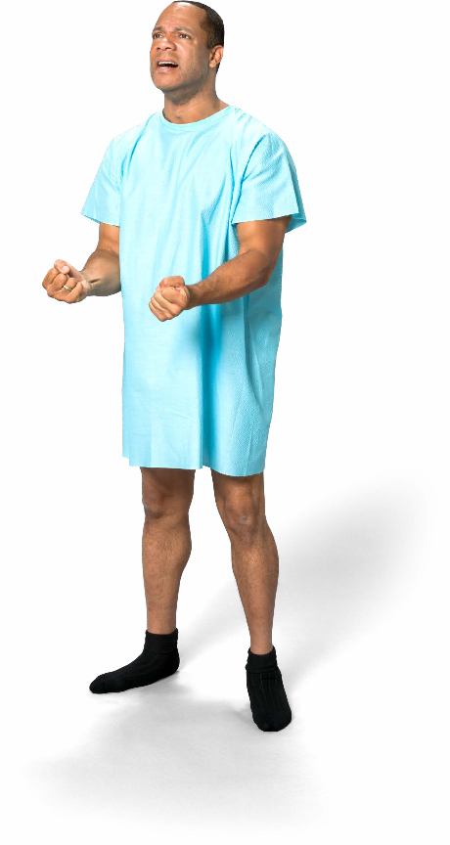
IDENTIFY BEHAVIOUR AND PLAN RESPONSE
Behaviour of concern can be defined as 'behaviour where a person or persons act in a manner that threatens the
physical safety of: themselves
carers staff
family members friends'.

Slide 5
Behaviours of Concern
To respond to behaviours of concern it is imperative that you know what to look for so you can act quickly, manage the incident and prevent it from escalating.
Behaviours of concern may include:
aggression
confusion or other
cognitive impairment disinhibited
behaviour
intoxication
manipulation
intrusive behaviour noisiness
self-destructive behaviour
wandering
verbal offensiveness.

Slide 6
Reflection – Behaviour Expressed as Aggression
Think back to when you had to deal with a patient who has lived experience of mental health challenges and sometimes expresses aggression.
If you haven’t had experience working with someone with mental health challenges, you may choose a co-worker or fellow student.
1. Briefly describe the situation in which the behaviour occurred.
2. Did you feel able and qualified to deal with the situation? Why or why not?
3. Describe your response to the situation.
4. What was the outcome of the situation?
Answer guide:
1. Students should describe the situation in terms of where it took place, who was the aggressor (e.g. a patient, co-worker or student).
2. Students should explain why (or why not) they felt they were able and qualified to deal with the situation (e.g. lack of training, lack of experience dealing with such people).
3. Students should describe their response, including any verbal and non-verbal communication, if they sought assistance etc.
4. Students should explain if it was a positive outcome or not, and the reasons for that outcome.
https://www.youtube.com/watch?v=0zBMZCzeQO4

Slide 7
Watch – Wandering in Dementia
It is important to know to assist someone who wanders due to dementia
You are to watch the video at the link below:
https://www.youtube.com/watch?v=5d2cMSgNh2U
Mrs Warrick is the patient who wanders in the video, and Leah and Sarah are the healthcare professionals.
In the video, Leah is starting to look visibly distressed that she cannot locate the patient, and at this point she runs into Sarah, one of the nurses.
• What information does Sarah have about Mrs Warrick that helps them eventually locate her?
• What are the first things that they say to her when they find her?
• Was this appropriate? Why do you think this?
• What is the benefit of talking to other colleagues when dealing with behaviours of concern, and how does this video highlight this?
Answer guide:
• The time the patient last took her medication; she enjoys sitting outside.
• They greeted the patient, commented on the weather, and explained where they were.
• Yes, it was appropriate as it kept the patient calm and assured her she was in a safe, familiar place.
• The benefit is that other colleagues will have knowledge, ideas and suggestions to help with the situation, and the helpful words from colleagues can be reassuring for the staff member who may be very distressed by the situation.

Slide 8
Respond Appropriately to Behaviours of Concern
WhAt fACtOrS ShOUlD yOU COnSIDer when reSpOnDIng tO behAvIOUrS
Of COnCern?
When you identify a behaviour of concern you will need to act quickly, calming the client and responding appropriately to the situation in line with your organisation’s policies and procedures.
How you respond to a behaviour of concern will not always be the same, as aspects of the incident will be different,
requiring you to be flexible and select an appropriate response for each situation you are in.

Slide 9
Respond Appropriately to Behaviours
of Concern
As a general guideline when responding to any behaviour of concern you should:
identify the behaviour ensure safety
act
communicate clearly seek assistance
report and record debrief.

Slide 10
Organisational Policies and Procedures
Organisational policies and procedures within health services environments will have planned responses for common behaviours of concern.
Staff should be made aware of planned responses: when undertaking orientation or induction to the organisation
at regular intervals as part of staff meetings and training opportunities
in the organisation’s staff handbook.

Slide 11
Organisational Policies and Procedures
What is a policy?
What is a procedure?
What are some examples of policies and
procedures that you have had to abide by to date?

Slide 12
Staff Support
How does the support of other staff impact how you respond to a behaviour of concern?
What resources might be utilised when dealing with a behaviour of concern, and who else might be able to assist besides other staff?

Slide 13
Prioritise your Safety
When responding to behaviours of concern, you must give priority to your personal safety and the safety of others.
To keep yourself safe when responding to behaviours of concern you should:
be prepared be alert
know your patients
stay calm and in control don't stand directly in
front of someone
survey the area
have an exit strategy
ask staff for assistance
avoid attending to a patient without notifying someone of your
whereabouts
defend yourself

Slide 14
Learning Checkpoint 1
1. Define the term ‘behaviour of concern’.
Behaviour of concern can be defined as ‘behaviour where a person or persons act in a manner that threatens the physical safety of themselves and those around them, including carers, staff, family members and friends. Behaviours of concern do not only cause potential harm while posing a risk to Work Health and Safety, but they also stop patient’s from receiving the best quality of care, thus affecting their health outcomes.
2. What are the 10 behaviours of concern?
• aggression
• confusion or other cognitive impairment
• disinhibited behaviour
• intoxication
• manipulation
• intrusive behaviour
• noisiness
• self-destructive behaviour
• wandering
• verbal offensiveness.

Slide 15
Learning Checkpoint 1
3. Aside from clients and patients, who else might you need to deal with who might display some of the behaviours of concern that we have covered? List 3 that you think might be most displayed in those other than patients.
Family and friends of a client/patient may also display behaviours of concern. The most common behaviours you are likely to see are aggression, intoxication, intrusive behaviour and verbal offensiveness.
4. List 10 ways you can protect your safety when responding to areas of concern.
• be prepared
• be alert
• know your patients and/or clients
• stay calm and in control
• don't stand directly in front of someone
• survey the area and make sure it is safe
• have an exit strategy
• ask staff for assistance
• avoid attending to a patient without notifying someone of your whereabouts
• defend yourself

Slide 16
APPLYING A RESPONSE
When selecting and applying a response to an identified behaviour of concern, you should
ensure that your response reflects
organisational policies and procedures.
When dealing with a behaviour of concern it is important that you:
follow the appropriate
organisational policies and procedures
communicate effectively
seek assistance when required select an appropriate strategy to suit the behaviour of
concern.

Slide 17
Legal and Ethical Considerations
How do the below things apply to your role?
Ethical standards Duty of Care
Confidentiality and privacy Human rights

Slide 18
Seeking Assistance
When you identify a behaviour of concern you may need to seek assistance or refer the situation to someone else, including:
supervisors, managers and senior staff co-workers
the police and security staff
work health and safety officers and representatives
ambulance or other medical staff and more.
WhO In the heAlth ServICeS InDUStry IS It ApprOprIAte
tO Seek ASSIStAnCe frOm AnD hOw mIght yOU DO thIS?

Slide 19
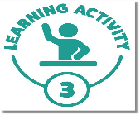
Quiz – Protecting Your Safety
Let's do a little quiz on protecting your safety. Once you have done this, discuss the answers as a class.
Situation | True | False
If you are visiting a particular patient that you have not met with before, it is a good idea to familiarise yourself with their condition and check their history for any instances of behaviours of concern. | X
If you can see that a person has a weapon remove yourself immediately from the situation, find a safe place and available security staff and police if necessary. | X
Concentrate on the person who is exhibiting the behaviour of concern, but shift your focus off them to decrease the potential of them hurting you. |  | X
Behaviours of concern will most commonly come from patients and clients that an employee may be familiar with. | X
When facing a person who is abusive or aggressive the best way to approach them is by matching their tone and getting angry at them. |  | X
Standing directly in front of someone who is displaying behaviours of concern will help to defuse the situation. |  | X
If you are in a quiet meeting room with a patient, always position yourself closest to the door in case you need to leave. | X
If you feel that you may be in danger, consider getting a member of the security team or a police officer to attend to the patient with you. | X
You only need to advise someone else how long you expect to be gone for when visiting a patient with a history of substance abuse. |  | X
Under law, you are permitted to defend yourself and do what is deemed to be "reasonably necessary" in the event of a physical attack on your safety. | X

Slide 20
Dealing with Behaviours of Concern
Dealing with behaviours of concern should always be done promptly, firmly and diplomatically, whilst taking into account any relevant
organisational policies and procedures.
To be firm you should: keep it short
don't repeat yourself
use controlled and confident body language stick to what you say
stick to your guns and stand your ground.

Slide 21
Dealing with Behaviours of Concern
To be diplomatic:
always think about your actions
stick to the facts, be clear and decisive use positive language
use neutral and open body language listen and be understanding.
HOw DO yOU Apply DIplOmACy tO the SItUAtIOn when
DeAlIng wIth behAvIOUrS Of COnCern?

Slide 22
Communication
Good communication skills are key to resolving most behaviours of concern and defusing a situation quickly and effectively.
Effective communication includes: verbal communication
non-verbal communication listening
questioning
paraphrasing.

Slide 23
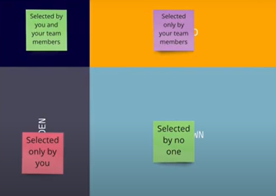
Reflection – The Johari Window Model
The Johari Window Model is a tool to enhance an individual’s perception of others. This model is based on two principles:
1. trust can be acquired by revealing information about you to others
2. learning about yourself from others feedback.
Each person is represented by the Johari model through four quadrants or windowpanes. Each four windowpanes signify personal information, feelings, motivation and whether that information is known or unknown to oneself or others in four viewpoints.
1. Visit the website below and read about the Johari Window Model. The website also offers an explanation of the four quadrants.
Website: https://www.communicationtheory.org/the-johari-window-model/ https://www.tobysinclair.com/post/how-to-use-johari-window-to-build-self-awareness
2. Select 6 adjectives that describe who you are.
3. Ask a diverse set of people to select 6 adjectives that describe who you are.
4. Categorise the results into the four Johari Window Quadrants.
5. Discuss the results with the group to elicit deeper insights.
6. Use this input to form an action plan on how to increase alignment.

Slide 24
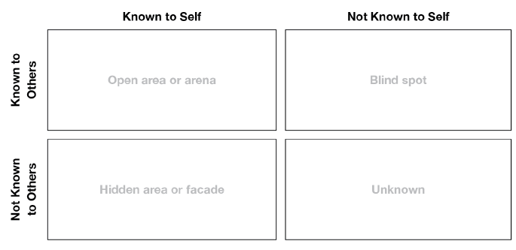
Reflection – The Johari Window Model
Answer guide:
• This activity allows the participants to understand their own behaviours.
• It is to reiterate that not everyone understands all aspects of themselves, and behaviours associated with their blind spots and unknown areas.
• Responses to behaviours of concern should consider that the person and staff assisting the person both have blind spots and unknown areas.
• Staff should be aware of their own self when responding to behaviours of concern.
• This activity also encourages the participant to seek feedback and adjust own response.
• For example, not taking verbal abuse from a client with dementia too seriously as it is an uncontrolled, blind spot and unknown behaviour for the person as a result of dementia.
I know
I don’t know
Others know
Others don’t know
Notes:
https://www.tobysinclair.com/post/how-to-use-johari-window-to-build-self-awareness

Slide 25
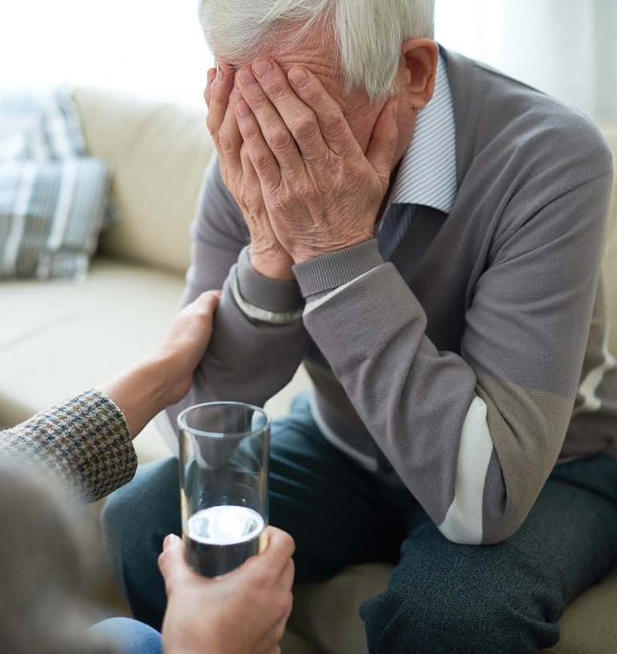
Adopt a Strategy
Whatever strategy you choose, it is important that you: abide by organisational policies and procedures
maintain your personal safety and the safety of those around you
stay calm and show empathy.
You must ensure that your actions are seen as being
reasonable, fair and equitable, taking into consideration a person’s human rights, your duty of care obligations
and ethical responsibilities.

Slide 26
Adopt a Strategy
Common strategies that could be used include:
diversion tactics de-escalation
engaging in conversation using a quiet space.

Slide 27
Learning Checkpoint 2
1. Ethical considerations mostly relate to the treatment and care of patients and include statements that relate to:
• Respect for patients
• Valuing diversity
• Behaving in a non-judgemental way
• Showing empathy
• Providing support
For each of these topics, explain a situation that might be applicable in a healthcare environment.
• Respect for patients: Answers could apply to almost every situation in healthcare.
• Valuing diversity: Answers may include situations that involve sex, race, religion and culture.
• Behaving in a non-judgemental way: Answers may include situations where a patient’s views or beliefs differ to the person providing customer service or healthcare.
• Showing empathy: Answers could apply to most situations in healthcare but are most applicable to situations that require defusing.
• Providing support: Answers could apply to most situations in healthcare but may also apply to family and friends.
2. When responding to behaviours of concern, communication amongst relevant parties is critical. Name 4 parties that might be involved in the patient’s care.
• colleagues
• supervisors
• health professionals
• a patient’s family
• emergency personnel may all be involved in a patient’s care.

Slide 28
Learning Checkpoint 2
3. When dealing with clients or patients, you may need to seek assistance from other people, as long as they are legitimate sources. What does this mean? Who might be considered a legitimate source?
A legitimate source is one that is recognised as expert in the field and someone in a position of authority who can provide you with further guidance. In seeking the assistance of others, it is important to note that you are not to seek advice from anyone who is not privy to the patient’s personal information as this could be seen as a breach in patient confidentiality.
People in the health services industry you could seek assistance from include:
• supervisors, managers and senior staff
• co-workers
• the police and security staff
• work health and safety officers and representatives
• ambulance or other medical staff on hand
• experts or specialists in the management of specific behaviours of concern such as those who specialise in working with children with autism or those with dementia.
• counsellors
• the patient’s family and friends.

Slide 29
REPORT AND REVIEW INCIDENTS
When an incident occurs, a health facility is required by law to document the incident through an incident report.
An incident report is a formal document detailing the behaviour of concern that occurred and its result; whether it was an injury, loss, damage or a near miss.

Slide 30
Incident Report
An incident report should include:
the person reporting the incident the person affected
a description of the incident any injuries sustained
the location of the incident
the date and time of the incident actions taken
why the incident occurred an incident rating.

Slide 31
Incident Report
When documenting the information, it is important that you:
complete all sections of the incident report ensure that the report is concise
be as specific as you can
ensure that all information is factual
complete the incident report in a timely manner
proofread the report
don't just submit the report.

Slide 32
Notifiable Incidents
A “Notifiable Incident” is an incident that resulted in: the death of a person
a person requiring medical treatment within 48 hours of exposure to a substance a person requiring immediate treatment as an in-patient or a person requiring
immediate treatment for:
the amputation of any body part a serious head or eye injury
de-gloving or scalping electric shock
a spinal injury
the loss of a bodily function serious lacerations.
These serious incidents must be reported to WorkSafe in Victoria.

Slide 33
Reviewing an Incident
There are a number of reasons that it’s important to review incidents.
What do you think these might be?
What improvements could come from reviewing an incident in the health services industry?

Slide 34
Debriefing
When an incident occurs, it is important that staff are supported and offered an opportunity to debrief. A debrief is a
conversational opportunity for workers to speak about their experience,
whether it be positive or negative.
It should be the priority of any
organisation to ensure workers have access to debriefing mechanisms and
associated support and/or development
activities after an incident.
The organisation can then provide the appropriate response to support the
worker to recover from the incident and return to their normal duties.

Slide 35
Watch – Best Practice
It is important to carefully handle situations where patients are showing aggression. You are to watch the video at the link below: https://www.youtube.com/watch?v=qDQissx0wH0
Victor has been brought to the hospital as he was found screaming on a street corner. In the first part of the video, Victor is sitting on the bed not saying anything. When the doctor walks in and starts talking, Victor gets visibly distressed and is screaming he wants to go home.
1. How does the doctor approach this; what does he do well, and what does he do poorly?
2. How does he change his approach in the second video? Is this more effective? Why/why not?
Answer guide:
• In the first video, the doctor’s approach is quite assertive.
• He clicks his fingers in Victor’s face to try to get his attention.
• He says a number of times that Victor can’t leave until he answers his questions.
• He also repeats that Victor needs to settle down, until he finally calls security.
• Everything is done poorly, except when he introduces himself at the start of the video.
• In the second video, he sits down so he is less intimidating to Victor, he uses empathy and open questioning until Victor says his head hurts.
• Dr Leaf offers to help and applauds Victor for staying calm.
• He says they’re there to help. Victor opens up and the doctor is able to ask him the right questions to help him. Victor apologises.
• Dr Leaf is able to ascertain he should call Victor’s sister to come and get him.
• It is a more effective approach as Victor sees the doctor wants to work with him, not against him for a good outcome.

Slide 36
Roleplay – Jenny’s Experience
The situation
Jenny has presented to her local hospital emergency department with severe pain in her lower back. Jenny is well known to the staff here, as she is a regular visitor, especially when she is not taking her medication.
Jenny has been waiting 2 hours to see someone, as it is a weekend and the department is being overrun with emergency cases which are seen as a higher priority than hers.
Jenny approaches the triage desk and starts yelling expletives at the staff, asking, "Why the f*&k haven't I been seen to yet? Why are these other f*&kers more important than me? I was here first and surely I'm more important than some old person who looks like they're about to die anyway!”
Instructions
1. With your partner, roleplay the scene. You should both take a turn of being the healthcare worker.
2. After you have done this, work with your partner to write a list of what each of you did well, and perhaps what you could change next time.
3. As a class, discuss the roleplays and the situation, and see if you all took the same approach.
The key to de-escalating a situation is effective communication. You should:
• Be calm, empathetic and adopt a non-confrontational approach. It is important to not show fear and be confident when speaking with the patient.
• Ensure that your body language is neutral and that you avoid giving too much eye contact as this can be misinterpreted as confrontational.
• Give the patient your undivided attention, listen and acknowledge that you are listening to them without agreeing with them or giving your opinion.
• Ensure that you are an appropriate distance from the patient so that you cannot be touched or reached if the situation suddenly changes.
• Make use of diversion tactics if appropriate.
• Seek assistance from others that could be helpful in calming the patient such as the patient’s family, friends and regular caregivers.

Slide 37
Learning Checkpoint 3
1. What are 4 changes that may be made after the review of an incident?
Changes that may occur include:
• Additional training or more in-depth training for staff.
• Increasing the availability of resources, for example, if a patient became aggressive because of the lack of availability of packs of cards, the organisation could look at the viability of purchasing more.
• Increases in security.
• Changes to organisational policies and procedures.
• Better monitoring of patients and their behaviour.
• Mentoring for staff and potentially adopting a team-treating approach, where two staff will work together with a patient providing support and additional assistance in case of an emergency.
• Better communication between staff and health professionals to allow patients’ individual needs to be met, and for responses to behaviours of concern to be specific to the individual.
• Creating more opportunities for patient enjoyment. For example, if a patient wandered off maybe it was because they were bored. By providing them with entertainment such as games and other resources, would they maybe be less likely to wander off?
• Provide patients with opportunities to socialise. If patients are happy in their environment, they are less likely to exhibit aggression, anger, verbal offensiveness or wander off.

Slide 38
Learning Checkpoint 3
2. In many instances of dealing with behaviours of concern, you will need to be firm with the other person. Name 4 ways that you can do this.
Answers may include:
• Always think about your actions. Take your time, even if it’s ten seconds. Take a deep breath and think about what you are going to say. When confronted by a situation, people often respond quickly, doing or saying something that they regret later. To avoid this, take the time to consider the situation and how best to respond.
• Stick to the facts, be clear and decisive. Avoid bringing your emotions or personal feelings into a situation. Don’t waver; be clear about the situation and how to respond. Remember however, to be diplomatic, it is important to not be confrontational, aggressive or rude. Diplomacy is about working with someone and cooperating with them to find a solution.
• Use positive language. For example, instead of saying “that is a terrible idea” you might say “I don’t think that’s the best idea, how about we look at it again”.
• Use neutral and open body language. Provide eye contact and relax your shoulders and arms. Avoid making jokes, laughing or smiling too much as this makes you appear more friendly than diplomatic. Remember that you are not making friends; you are simply using this approach to defuse a situation in the quickest and least confronting way.
• Listen and be understanding while still getting across your point but be clear that you don’t agree with them. For example, you might say “I can see where you are coming from, but your behaviour and how you have approached the situation is unacceptable”.

Slide 39
Learning Checkpoint 3
3. A great strategy for responding to a behaviour of concern is to take the patient to a quiet space free from noise and distraction. What are 3 things that you should do to ensure your personal safety in this type of situation?
Answers may include:
• Notify co-workers and/or your supervisor that you are taking the patient to a quiet space and let them know exactly what room you are using.
• Notify the appropriate security staff and even have them stationed nearby in case you need them. Where possible, don’t allow the patient to see the security staff as it could make them more agitated.
• Ensure that you have access to a phone, duress or personal alarm in case you need to call for help.
• Position yourself in the room to ensure that you have an appropriate amount of personal space so that you cannot be touched or reached. Position yourself close to the door and where possible, arrange furniture so that there is something positioned between you and the patient, such as a table.

Slide 40
Assessment 1 Knowledge Questions
1. What is a behaviour of concern, and why is it important to identify these in the workplace?
A behaviour of concern can be defined as ‘behaviour where a person or persons act in a manner that threatens the physical safety of themselves and those around them, including carers, staff, family members and friends. They are potentially dangerous, and they pose a Work Health and Safety risk; they also stop patient’s from receiving the best quality of care, thus affecting their health outcomes.
2. We have established that there are nine (9) main behaviours of concern, and that each one has some basic strategies that can be adopted to handle situations you may be faced within the workplace. Fill in the following table summarising each behaviour of concern, and common strategies that could be used to deal with situations surrounding these. The first one has been done for you as an example.
Aggression
Aggression as behavior marked by anger or violence that can harm others physically or emotionally. Strategies include protecting oneself, maintaining a safe distance, speaking calmly, showing empathy, using positive body language, avoiding aggression in response, and employing diversional tactics to move the individual to a calm, safe space.
Confusion and Cognitive impairments
Confusion and cognitive impairment as conditions where individuals struggle with clear thinking, decision-making, memory, and communication. Strategies include treating them with respect, using a calm and reassuring tone, approaching them from the front, asking simple and direct questions, guiding them to a private and distraction-free area, and employing simple distractions to facilitate this transition.

Slide 41
Assessment 1 Knowledge Questions
Intoxication
Caused by high levels of alcohol or drugs, significantly impairs a person's ability to act or reason normally, making dealing with them challenging and potentially risky. Strategies for handling intoxicated individuals include staying calm, avoiding judgment, not attempting to sober them up (as it's ineffective), ensuring their comfort, especially if they're vomiting, offering water, and protecting them from harm.
Manipulation
Involves using persuasion, deception, and coercion to fulfill one's own desires at the expense of others, often disregarding their needs. Manipulators employ tactics such as lying, bribery, blackmail, and guilt-tripping to achieve their goals. Strategies for addressing manipulation include addressing it promptly, being firm in identifying the behavior, explaining why it's unacceptable, and ensuring the manipulator understands the impact of their actions on others.
Intrusive behaviour
Involves invading someone's personal space to intimidate or make them uncomfortable. It includes getting too close, touching, hovering, or asking personal questions. This behavior lacks respect for privacy and can cause fear and unease. Strategies for addressing it include immediately identifying the behavior, diverting the conversation, privately discussing its inappropriateness, and offering alternatives to promote awareness of its impact.

Slide 42
Assessment 1 Knowledge Questions
Noisiness
Involves making loud and excessive sounds to intimidate, dominate, or convey a point aggressively, which can distress others and harm their well-being, especially children. It includes yelling, shouting, stomping, and banging. Strategies for addressing noisiness include remaining calm, discussing the issue privately, asking for a reduction in noise, and speaking calmly to encourage a peaceful resolution.
Self-Destructive behaviour
Involves deliberate or impulsive actions that can harm a person physically, socially, or emotionally. It may be subconscious or intentional, with serious and lasting consequences if left unaddressed. Strategies for dealing with self-destructive behavior include early intervention, close monitoring, providing support and encouragement, discussing the situation in a private setting involving their support network, and seeking medical or emergency assistance if necessary. Additionally, behavioral therapies, counseling, coping skills, and positive thinking techniques can be helpful in addressing this behavior.
Wandering
Involves a person roaming or walking off, often due to significant memory loss and mobility. Strategies for dealing with wandering include calmly approaching the person, gently guiding them back, using diversional tactics, refraining from scolding them, determining the reason for their wandering, and monitoring them to prevent future episodes by making environmental adjustments if necessary.

Slide 43
Assessment 1 Knowledge Questions
Verbal offensiveness
Verbal offensiveness encompasses rude, offensive, and vulgar speech, including swearing, insults, and name-calling, while verbal abuse is aggressive verbal attacks used to control or manipulate someone. Strategies for addressing verbal offensiveness involve staying calm, being clear and firm in instructions, diverting the situation to a quieter location, and seeking assistance from security or the police if necessary.
3. There are times that you may need to seek assistance from others or refer a situation to them.
• Name four (4) people within the health industry that you may seek assistance from.
• Name four (4) issues that need to be referred to one of the appropriate professionals you identified.
You may seek assistance from:
• Supervisors, managers and senior staff
• Co-workers
• The police and security staff
• Work Health and Safety officers and representatives
• Ambulance or other medical staff on hand
• Experts or specialists in the management of specific behaviours of concern such as those who specialise in working with children with Autism or those with dementia.
• Counsellors
• The patient’s family and friends

Slide 44
Assessment 1 Knowledge Questions
Reasons for this may include:
• The expertise to handle the situation is beyond your capabilities and you need help.
• You are unsure of how to handle the situation and need to seek the advice of someone who may have dealt with a similar situation in the past.
• You feel that someone may be better equipped to handle the situation more effectively because of the skills they possess and/or the relationship that they share with the client who is exhibiting the behaviour of concern.
• The situation is dangerous and there is a threat of physical violence.
• Someone has been seriously injured and requires medical attention.
• The organisation’s policies and procedures dictate that a particular person is to be contacted in the event of an incident such as the supervisor on duty or facility manager.
4. There are legal and ethical considerations relevant to recognising and responding to behaviours
of concern. These include Duty or Care, Human Rights and Work Health and Safety. How does
each one of these apply to your role as a health services worker?
Duty of Care in health services entails reducing harm or risk to clients and patients by foreseeing potential dangers.
Human Rights must be upheld when dealing with individuals exhibiting concerning behavior, requiring fairness, equity, and respect.
Work Health and Safety laws ensure safety in organizations, with employers responsible for providing adequate training and ensuring compliance with policies to address behaviors of concern and maintain a safe environment for employees and visitors.

Slide 45
Assessment 1 Knowledge Questions
5. When dealing with behaviours of concern, positive communication is imperative to achieving a successful outcome for everyone. Use the information from your Student Resource to complete the statements in the table below.
Verbal communication is defined as what you say and how you say it.
The way you look, listen, move and react to another person tells them more about how you’re feeling than words alone.
Effective listening is just as important as what you say.
When using verbal communication, you should use simple language that a patient can easily understand.
Effective questioning is a key-way to find out information about a person’s behaviour of concern.
An example of a probing question would be “what made you react in such an aggressive way?”.
To be a successful communicator you need to listen actively not passively.
When dealing with behaviours of concern you will need to adapt your non-verbal communication depending on the situation and the patient that you are responding to.
A leading question attempts to lead the respondent in a certain direction of thinking, generally in line with your way of thinking.
Paraphrasing is about putting things that someone else has said into your own words.
When using verbal communication, it’s important to be friendly, open and assertive while adapting your communication style to meet the needs of your client.

Slide 46
Assessment 1 Knowledge Questions
6. How would you find out what your organisations reporting processes are when dealing with behaviours of concern? Give one (1) example of an organisation reporting process?
The reporting guidelines should be outlined in the organisation's policy and procedure manual. If not, you would ask a manager, HR rep or peer for guidance.
An example could include using a form or template, verbally reporting an incident or using a website or application.
7. Name three (3) ways that you can ensure the safety of yourself and others whilst being
employed as a health services worker. Who might you enlist to assist with this?
Answers may vary but could include:
• Advising peers or co-workers how long you intend to be with a patient or client
• Taking a peer or security with you if you fear a situation may escalate
• Placing yourself closest to the door in meetings incase you need a quick exit path
• Ensure you have access to a phone, personal duress alarm or personal alarm
• You may enlist the assistance of peers, security or family members/friends of the patient to help with safety.
8. Why is it important to deal with behaviours of concern promptly, firmly and diplomatically, and what is a suitable tactic to implement to assist with this? Please list an example of this.
This is important as when a situation is dealt with immediately, it limits the chances of escalation.
To deal with a situation promptly it can be useful to implement a suitable de-escalation tactic. For example, distraction can be a great option if suitable for the client and situation, such as offering a child who is throwing a tantrum a snack or asking them if they want to play a game.

Slide 47
Assessment 1 Knowledge Questions
9. What is deemed to be a notifiable incident?
This is important as when a situation is dealt with immediately, it limits the chances of escalation. To deal with a situation promptly it can be useful to implement a suitable de-escalation tactic. For example, distraction can be a great option if suitable for the client and situation, such as offering a child who is throwing a tantrum a snack or asking them if they want to play a game.
10. It is important to review incidents so that an organisation can determine strategies to deal with them better in future, or to avoid them happening again. What are three (3) pieces of information relating to the incident that can be gathered and reported to assist with this?
Information gathered may include:
• Potential causes or triggers for the incident
• What occurred just before the behaviour?
• What factors might have triggered the behaviour?
• What was the environment like?
• What were the actions of worker involved in the situation?
It should be viewed as an opportunity to identify areas for improvement, educate the employee and support them to deal with a similar situation more effectively in the future.

Slide 48
Assessment 1 Knowledge Questions
11. Reviewing an incident should also not be about finding the mistakes and judging the employee for how they reacted and handled the situation. How should it be viewed instead? What are three (3) improvements that can come from reviewing incidents effectively?
It should be viewed as an opportunity to identify areas for improvement, educate the employee and support them to deal with a similar situation more effectively in the future.
Improvements that could come from reviewing an incident in the health services industry could include:
• Additional training or more in-depth training for staff.
• Increasing the availability of resources, for example, if a patient became aggressive because of the lack of availability of packs of cards, the organisation could look at the viability of purchasing more.
• Increases in security.
• Changes to organisational policies and procedures.
• Better monitoring of patients and their behaviour.
• Mentoring for staff and potentially adopting a team-treating approach, where two staff will work together with a patient providing support and additional assistance in case of an emergency.
• Better communication between staff and health professionals to allow patients’ individual needs to be met, and for responses to behaviours of concern to be specific to the individual.
• Creating more opportunities for patient enjoyment. For example, if a patient wandered off maybe it was because they were bored. By providing them with entertainment such as games and other resources, would they may be less likely to wander off?
Provide patients with opportunities to socialise. If patients are happy in their environment, they are less likely to exhibit aggression, anger, verbal offensiveness or wander off.

Slide 49
Assessment 2 – Project
Project Part 1: Please answer the four (4) questions in the Project Template.
Project Part 2: Based on the scenario and roleplay you chose from Task 3: Demonstrations, fill in the Employee Incident Report Template with the appropriate details. If there are details that you do not have (e.g. incident number, date/time) you may make these up.
Project Part 1:
You must answer the following questions in your own words and in full sentences using the Project Template. You should assume your assessor has no prior knowledge of the subject area.
a. Based on the policies and procedures outlined for senses.org.au, what should you do once you have been involved in an incident relating to a behaviour of concern?
You must advise your supervisor as soon as possible after the incident, even if you managed to diffuse the situation. Incidents which involve behaviour of concern must be reported using the Incident Report Form within 24 hours of the incident occurring.
b. Who would you review these incidents with, what is the aim of this review and would it be appropriate for you to offer suggestions relating to management of the situation?
You would review the incident with your supervisor, the Regional Area Supervisor, and potentially with the client, significant people in the client’s life and other relevant staff members. The aim is to gather information about the behaviour of concern and assess the possible factors which may have triggered the behaviour. It is also to take appropriate steps to discuss debriefing mechanisms and appropriate supports. It would be appropriate for you to offer suggestions relating to this as long as they were within the scope of your role or your area of responsibility.

Slide 50
Assessment 2 – Project
c. In relation to the policies and procedures outlined for senses.org.au, what are the debriefing mechanisms, associated supports and development activities that may be offered to the client, involved employees, other clients and any other people involved such as victims and witnesses?
Supervisor may decide it is necessary to refer the client to their GP, specialist or another professional, especially if it is considered that the behaviour is related to the client’s current medication.
If the behaviour is on-going, pervasive and impacting on the client’s quality of life, the Regional Area Supervisor can make a referral to the Senses Clinical Psychologist for Positive Behaviour Support and Psychology services.
If the client is living with their family, there needs to be discussion with the family regarding the behaviours and the behaviour support plan. The actions tailored for the Community Living Service outlined on pages 8 and 9 may be relevant or may provide a guide for the development of an action plan.
In the event of an incident, the Regional Area Supervisor and/or Manager should offer debriefing to those people involved. The object of this process is to acknowledge and validate any reactions and prevent cumulative stress. Staff members involved in the incident can be offered counselling services; information and assistance in referral can be provided by the Regional Area Supervisor or Manager.
d. When reporting and reviewing incidents, it is appropriate to seek advice and assistance from legitimate sources. Who might this be and what would you need to consider?
A legitimate source is one that is recognised as expert in the field and someone in a position of authority who can provide you with further guidance. This might be a doctor, specialist, psychologist or a variety of people in allied health fields. In seeking the assistance of others, it is important to note that you are not to seek advice from anyone who is not privy to the patient’s personal information as this could be seen as a breach in patient confidentiality.

Slide 51
Assessment 2 – Project
You must complete this assessment AFTER you have completed Assessment Task 3: Demonstration.
Based on the scenario and roleplay you chose from Assessment Task 3: Demonstrations, fill in the Employee Incident Report Template with the appropriate details. If there are details that you do not have (e.g. incident number, date/time) you may make these up.
Obviously, none of these roleplays have an ending written for them; it is up to you to create the ending, showing how you dealt with the situation, and how you’d adequately report on the incidents in line with workplace policies and procedures.

Slide 52
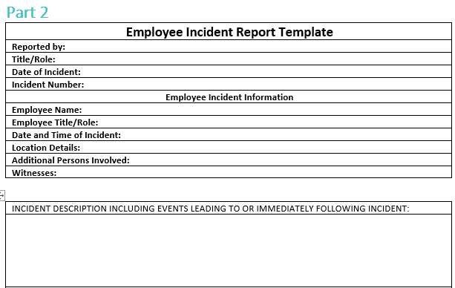
Assessment 2 – Project

Slide 53
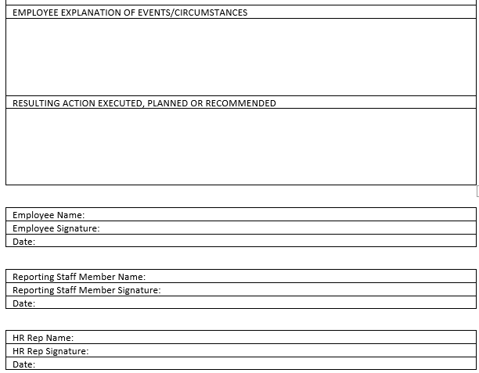
Assessment 2 – Project

Slide 54
Assessment 3 – Demonstration
You will be demonstrating your ability to effectively address different behaviors of concern in various workplace scenarios through role-playing exercises. The behaviors include:
• Aggression
• Confusion or other cognitive impairment
• Intoxication
• Intrusive behaviour
Your assessor will select five role-plays from the nine available. Each scenario will simulate a workplace environment such as:
• A patient’s room in an aged care home
• A storeroom in an aged care home
• A hospital waiting room
• A patient’s room in a rehabilitation centre
• A medical clinic waiting room
• A pathology lab waiting room
• A patient’s room in a hospital
• An aged care facility
You'll have access to necessary resources and may involve others in your response as appropriate. Your performance will be assessed using a checklist based on your ability to plan and execute responses, follow policies and procedures, engage with the client, and provide constructive feedback in a review session afterward. You'll also need to participate in at least one related support or development activity. If resources or personnel are unavailable during the role-play, you should verbally state how you would address the situation in a real-life scenario.
• Manipulation
• Noisiness
• Self-destructive behaviour
• Verbal offensiveness
• Wandering

Slide 55
Assessment 3 – Demonstration
Role Play Scenarios
Each of the scenarios is based around a different behaviour of concern; you must be observed demonstrating effective resolution of each situation.
If the scenario needs to change slightly to suit female or male participants, this will be clearly marked.
The nine (9) roleplay scenarios are detailed below – role play five (5) of these while being observed:
Roleplay 1: Aggression
Simulated workplace requirements: Roleplay should be held in an area that reflects a patients room in an aged care facility. Patient may be located in a bed or in a day chair whilst eating their lunch.
Female Participant
You are working as an orderly at an aged care facility. A patient named Tony is often quite rude and inappropriate. He has a history of flashing his personal body parts at workers and using inappropriate and offensive language of a sexual nature. As you are giving Tony his lunch, he grabs you hard on the bottom and tells you that you are ‘looking hot today’. You tell him that this is not appropriate and he becomes very aggressive, yelling verbal abuse at you, and calling you all sorts of nasty names. Plan your response, then be observed managing this situation as a role play.
Male Participant
You are working as an orderly at an aged care facility. A patient named Tarina is often quite rude and inappropriate. She has a history of flashing her breasts at workers and using inappropriate and offensive language of a sexual nature. As you are giving Tarina her lunch, she grabs you hard on the bottom and tells you that you are ‘looking hot today’. You tell her that this is not appropriate and she becomes very aggressive, yelling verbal abuse at you, and calling you all sorts of nasty names. Plan your response, then be observed managing this situation as a role play.

Slide 56
Assessment 3 – Demonstration
Roleplay 2: Confusion or other cognitive impairment
Simulated workplace requirements: Roleplay should be held in an area that reflects a storeroom.
Female Participant/Male Participant
You work in an aged care home as a personal caregiver and you love your job. One evening, you walk into the storeroom where all the spare linen is kept as one of the residents has spilled their dinner on their bed, and the cleaning staff who would normally change linen have left for the evening. When you enter, you hear a quite whimpering coming from the corner of the storeroom, and to your surprise, you see one of the residents, Mrs. Moore, huddled in the corner looking frightened and confused. She is reasonably new here, and you know she has been placed here because she has advanced dementia. Plan your response, then be observed managing this situation as a role play.
Roleplay 3: Intoxication
Simulated workplace requirements: Roleplay should be held in an area that reflects a hospital waiting room. The participant should be located behind a desk, and there should be chairs on the other side for the family and friends of the hospital patient’s.
Female Participant/Male Participant
You are working on the reception desk in emergency at Mercy General Hospital and it has been a busy night. There was a multi-car pile-up on one of the major freeways nearby, and the occupants of a number of the vehicles were brought to your emergency department. About an hour after they started arriving by ambulance, a man comes up to you and enquires about a woman who was brought in. He is slurring his words and it is quite clear that he is drunk. You ask if he is a relative of the woman and he says no, he is a friend. You advise him that unfortunately you are unable to comment about her condition, and that if he knows her family, he should reach out to them. The man is not happy with this response and starts screaming that he wants to know where she is, and that if you don’t tell him, you’ll be sorry. Plan your response, then be observed managing this situation as a role play.

Slide 57
Assessment 3 – Demonstration
Roleplay 4: Intrusive behaviour
Simulated workplace requirements: : Roleplay should be held in an area that reflects a hospital room with a bed for the patient and a chair for the family member.
Female Participant
You’re a 23-year-old nurse in a rehabilitation hospital. Joey is a 25-year-old man who has down syndrome, and he is in rehab after having surgery on his pelvis, which he fractured when he was a passenger in a bad car accident. His father, who is his primary caregiver, is in his mid-50’s, and seems to have taken a shining to you. Whilst he is both pleasant and friendly, recently he has started asking you questions that are quite personal in nature, and frankly, it’s starting to make you feel a little uncomfortable. At his last visit, he asked you if you were married or had a partner, to which you answered, ‘not at the moment’. Today you go in to do Joey’s observations, and he asks you outright whether you’d consider dating ‘a successful, good looking man in his 50’s?’ It is clear that he is talking about himself. Plan your response, then be observed managing this situation as a role play.
Male Participant
You’re a 23-year-old nurse in a rehabilitation hospital. Joey is a 25-year-old man who has down syndrome, and he is in rehab after having surgery on his pelvis, which he fractured when he was a passenger in a bad car accident. His mother, who is his primary caregiver, is in her mid-50’s, and seems to have taken a shining to you. Whilst she is both pleasant and friendly, recently she has started asking you questions that are quite personal in nature, and frankly, it’s starting to make you feel a little uncomfortable. At her last visit, she asked you if you were married or had a partner, to which you answered, ‘not at the moment’. Today you go in to do Joey’s observations, and she asks you outright whether you’d consider dating ‘a good-looking woman in her 50’s who still likes to get up to mischief?’ It is clear that she is talking about herself. Plan your response, then be observed managing this situation as a role play.

Slide 58
Assessment 3 – Demonstration
Roleplay 5: Manipulation
Simulated workplace requirements: Roleplay should be held in an area that reflects a medical clinic waiting room. The participant should be located behind a desk, and there should be chairs on the other side for the clinic’s patient’s.
Female Participant/Male Participant
You are a medical receptionist at a clinic where woman arrives for her doctor’s appointment an hour late. She is adamant that she had the right time but cannot produce the reminder text thatshe said she got. She very politely explains that she will just sit and wait until the current person comes out, and then slot into the next spot. When you tell her that it unfortunately doesn’t work like that, she leans over the counter and says in a low voice that she will pay you $50.00 to let her go next, as she doesn’t want to have to come back another day. You politely explain that you are sorry she feels inconvenienced, however, you just can’t do that. She then leans in again, and quietly says that she knows the owner of the practice and that she will have you sacked for being insolent. Plan your response, then be observed managing this situation as a role play.
Roleplay 6: Noisiness
Simulated workplace requirements: Roleplay should be held in an area that reflects a pathology lab waiting room. The participant should be located behind a desk, and there should be chairs on the other side for those waiting to get their blood tests done.
Female Participant/Male Participant
You work on the reception desk at a pathology lab. Patients can not make an appointment, they instead just come in from the street, take a number and wait their turn. The doors open at 8.00am. On this particular day, a young man comes in at 8.05am and he is shocked to see there are already 12 patients ahead of him. He questions you as to whether they’re all waiting to have blood tests and you confirm that yes, they are. He asks how this is possible when the doors don’t open until 8.00am and you advise that many people start to queue from around 7.45am. He is disgruntled but takes a number and sits down putting his headphones in his ears. After a minute or two, he starts to tap his foot against the leg of the coffee table in front of him, and then he starts clapping his hands on the top of it, in time to a beat that only he can hear. He then starts laughing very, very loudly in a maniacal manner. People start looking at him and he stares back and continues to laugh. Plan your response, then be observed managing this situation as a role play.

Slide 59
Assessment 3 – Demonstration
Roleplay 7: Self-destructive behaviour
Simulated workplace requirements: Roleplay should be held in an area that reflects a hospital room. It should have a bed and a chair.
Female Participant/Male Participant
A patient named Frankie was admitted to hospital overnight after a drug overdose. She is now recovering and expected to stay in hospital for the next three days. You attempt to speak to her about her overdose and offer her help through the hospital’s AOD (Alcohol and other drugs) outpatient program. Frankie tells you that the overdose was a mistake and that she has never taken drugs before and that the overdose only happened because she accidently forgot that she was on antibiotics for a chest infection, and that they reacted badly with the small amount of ice that she tried. You observe that she has track marks up and down her arms, note that she is underweight and has grey circles under the eyes. She looks to be a regular drug user and it is obvious to you that she is lying about her situation. Plan your response, then be observed managing this situation as a role play.
Roleplay 8: Verbal offensiveness
Simulated workplace requirements: Roleplay should be held in an area that reflects a hospital room. The patient should be in bed waiting to be taken for their CT scan.
Female Participant/Male Participant
You are an orderly at St Andrews Private Hospital and you love the diverse people that you meet whilst doing your job. Stella is a patient in her 60’s who has been in the hospital for around 6 weeks as she has a heart condition that is not improving. She can be a lovely lady, however, her moods vary dramatically and when she is in a bad mood, she has a very sharp tongue. You go to her room today to take her for a CT scan and it’s clear she’s not in a good mood. You greet her cheerfully anyway, to which she tells you not to be so cheerful as it shows her disrespect because she has nothing to be cheerful about. Then without missing a beat, she tells you that you’re late - which you’re not - and that clearly, you’re useless at your job and it’s a wonder you can maintain employment. Without allowing you to respond, she then says that it also looks like you’ve been eating ‘way too many pies’ and that if you’re not careful you’ll spend the rest of your life single and lonely because nobody will want to be with a fat ugly person. At this point you’ve heard enough. Plan your response, then be observed managing this situation as a role play.

Slide 60
Assessment 3 – Demonstration
Roleplay 9: Wandering
Simulated workplace requirements: : Roleplay should be held in an area that reflects an aged care patient’s room. There will need to be ample space around this however that can be used as other ‘areas’ in the aged care home where the participant can look for the lost patient.
Female Participant/Male Participant
Mr Norris is a 90-year-old man who resides in the aged care home you work in. Although you’re not meant to have favourites, you’re always happy if you see that you’re rostered on his wing. You go into his room to say good morning and you’re surprised to see that he’s not there, as it’s only 8.30am and he normally would’ve just finished breakfast. After looking in all the possible places within his room and his ensuite, you decide that it’s time to look elsewhere for him. Plan your response, then be observed managing this situation as a role play.

