Slide 1
Weighted graphs, networks and the shortest path problem
9I
Notes:
Need easy way
https://dashboard.blooket.com/set/62785454cc586c6f6e9fe30f
https://dashboard.blooket.com/set/63106e86bc04be1521577c76
https://dashboard.blooket.com/set/6298172432c39b7095e5a3af
https://dashboard.blooket.com/set/642529e75bf02f4152087ba7
https://dashboard.blooket.com/set/601b6f1e5e7ef20012922832

Slide 2
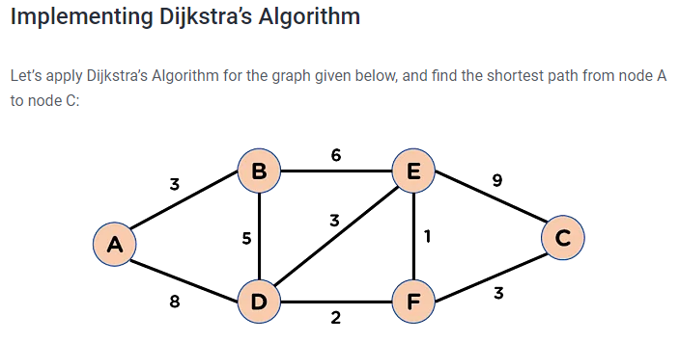
Notes:
A-d-f-c
A-b-e-f-c
13

Slide 3
Learning Intentions
Weighted Graphs
The shortest paths
Dijkstra’s Algorithm
Finding Hamilton Cycles
https://www.youtube.com/watch?v=bZkzH5x0SKU

Slide 4
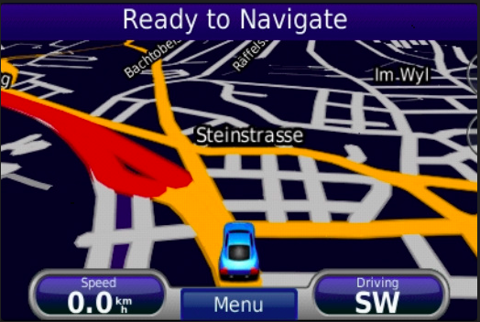
Real life Application
Geographical Maps.
IP routing to find Open shortest Path First.
Telephone network.

Slide 5
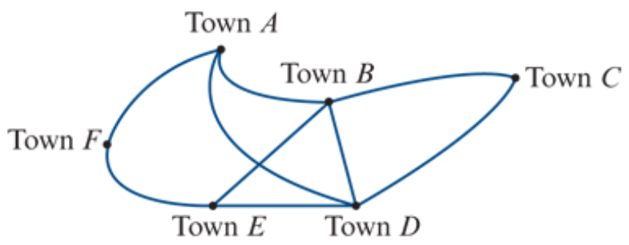
Weighted graphs and networks
A weighted graph is a graph where a number is associated with each edge. These numbers are called weights.
A network is a weighted graph in which the weights are physical quantities, for example, distance, time, cost.

Slide 6
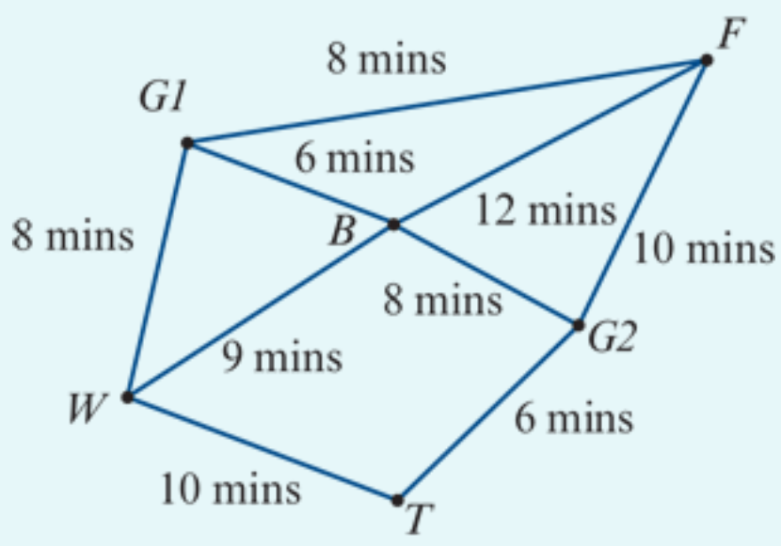
Interpreting a network
The network opposite is used to model the tracks in a forest connecting a suspension bridge (𝐵), a waterfall (𝑊), a very old tree (𝑇) and a fern gully (𝐹).
Walkers can enter or leave the forest through either Gate 1 (𝐺1) or Gate 2 (𝐺2).
The numbers on the edges represent the times (in minutes) taken to walk directly between these places.
a. How long does it take to walk from the bridge directly to the fern gully?
b. How long does it take to walk from the old tree to the fern gully via the waterfall and the bridge?
a. The edge is 𝐵-𝐹. The time taken is 12 minutes.
b. The path is 𝑇-𝑊-𝐵-𝐹. The time taken is 10+9+12=31 minutes.

Slide 7
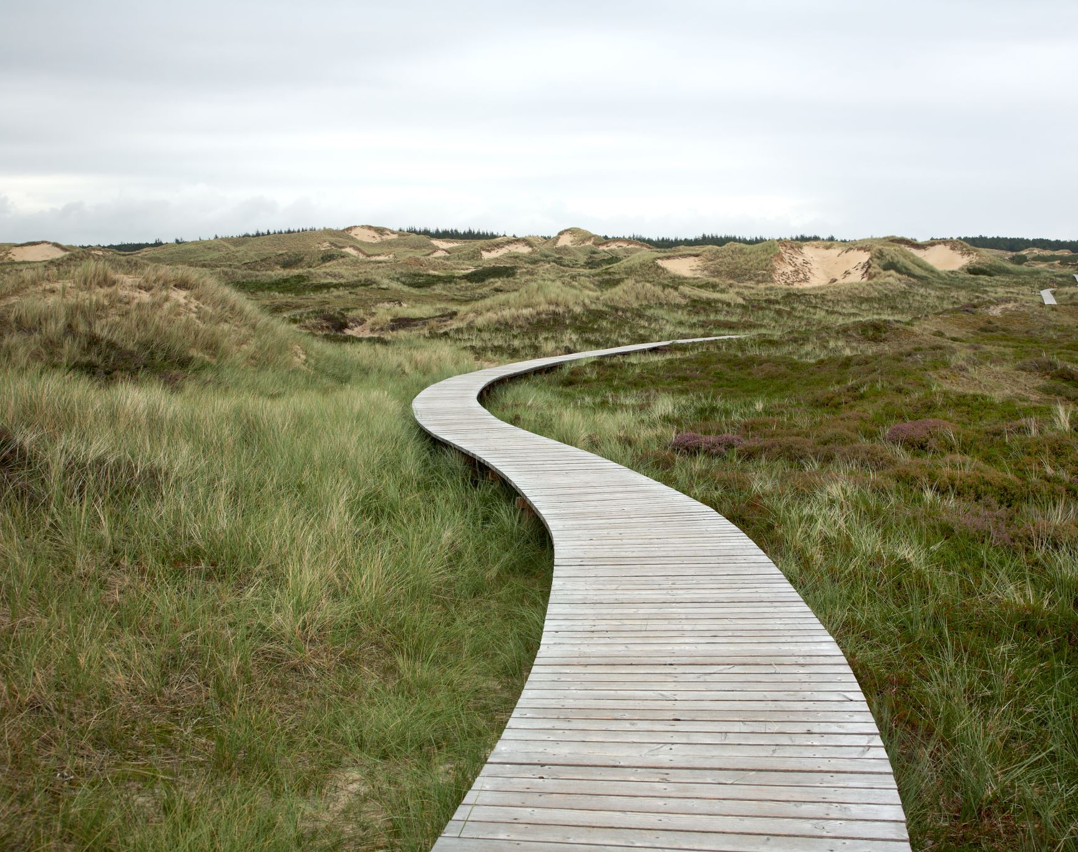
The shortest path problem
Determining the shortest distance or time or the least cost to move around a network is called the shortest path problem.

Slide 8
Finding the shortest path by inspection
Find the shortest route between Town 𝐶 and Town 𝐹 in the previous network opposite.
𝐶-𝐷-𝐸-𝐹: The distance is 6+9+7=22 km. 𝐶-𝐵-𝐸-𝐹: The distance is 5+4+7=16 km. 𝐶-𝐵-𝐴-𝐹: The distance is 5+7+6=18 km.
The shortest path is 𝐶-𝐵-𝐸-𝐹.
Notes:
https://www.youtube.com/watch?v=wtdtkJgcYUM
https://www.youtube.com/watch?v=pVfj6mxhdMw

Slide 9
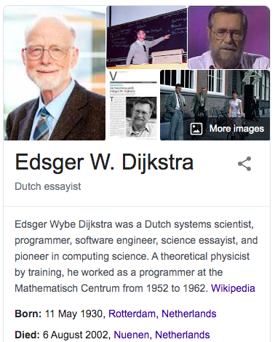
Finding the shortest path by Dijkstra’s Algorithm

Slide 10
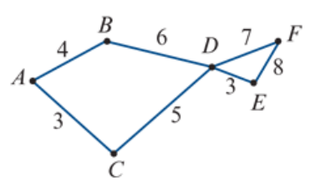
Finding the shortest path by Dijkstra’s Algorithm
Find the shortest path from vertex 𝐴 to vertex 𝐸 in this network. The numbers represent time in hours.
$${10}^{B}$$
$$4^{A}$$
$${15}^{D}$$
$${19}^{E}$$
From Starting vertex.
The shortest edge first.
Write distance from the starting vertex.
Label the last vertex passing by.
Cover all edges from this vertex.
Find the next shortest distance vertex to start over again.
Until all vertices and edges covered.
$$8^{C}$$
0
$${11}^{D}$$
3+5+3=11 Hours
$$3^{A}$$
$${Weights from starting vertex}^{the last passing by vertex}$$

Slide 11
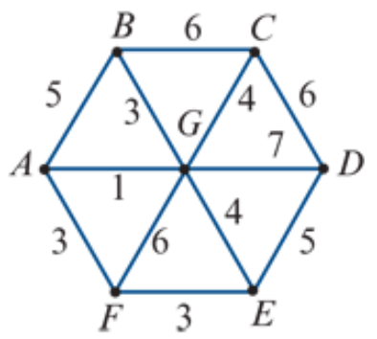
Finding the shortest path by Dijkstra’s Algorithm
Find the shortest path from vertex 𝐵 to vertex 𝐹 in this network. The numbers represent time in minutes.
0
$$6^{B}$$
$$7^{G}$$
From Starting vertex.
The shortest edge first.
Write distance from the starting vertex.
Label the last vertex passing by.
Cover all edges from this vertex.
Find the next shortest distance vertex to start over again.
Until all vertices and edges covered.
$${12}^{E}$$
$$4^{G}$$
$$5^{B}$$
$$3^{B}$$
$${10}^{G}$$
$${12}^{C}$$
3+1+3=7 minutes
$$7^{A}$$
$$9^{G}$$
$${10}^{F}$$
$$7^{G}$$
$${Weights from starting vertex}^{the last passing by vertex}$$

Slide 12
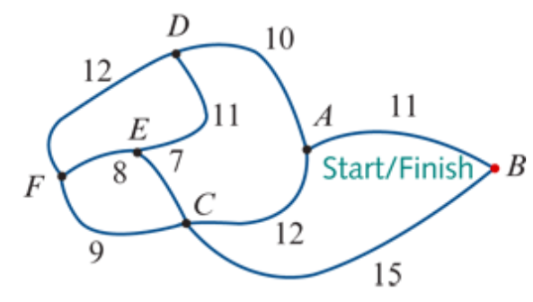
Finding Hamilton Cycle
A
C
B
D
C
A
E
F
E
F
F
B
E
A
D
F
F
D
F
E
C
D
E
A
F
D
C
A
B
D
C
A-D-E-F-C-B-A
A-B-C-F-E-D-A
A-D-F-E-C-B-A
A-B-C-E-F-D-A
B
A
A
A
E
D
D
E
C
A
B
A
F
A
A
E
D
A
B
A
A
A
A

Slide 13
exercises & Summary Book
1. Ex 9I
2. Summary notes for Homework.

