Slide 1
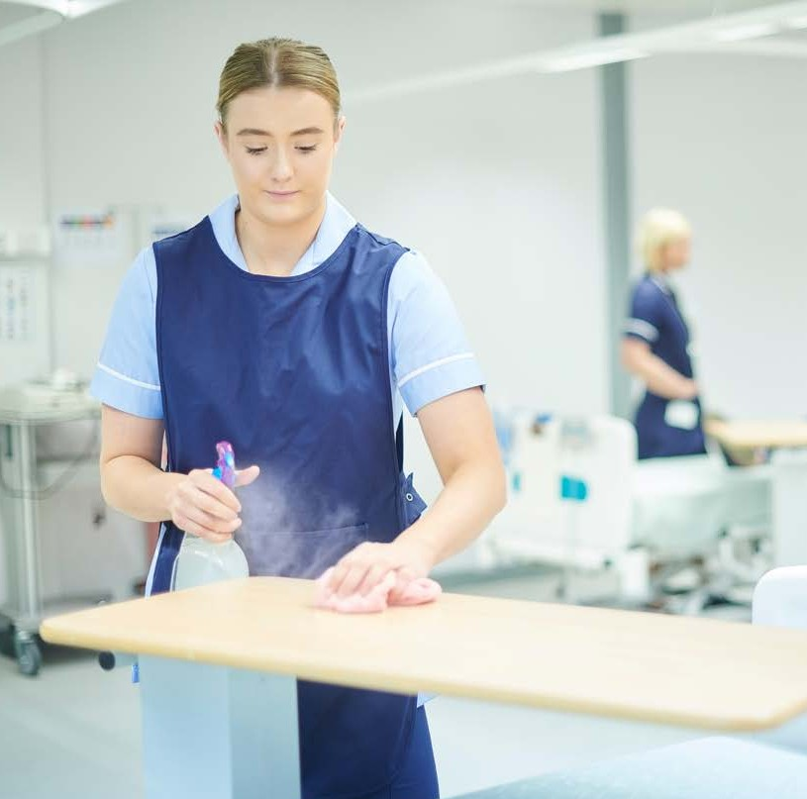
HLTINF006 - Apply basic principles and practices of infection
_{un}p_{it} revention and control
Infection prevention and control policies and procedures Identify infection hazards and assess risks
Follow procedures for managing risks associated with specific hazards

Slide 2
Assessment
For this unit, you will be assessed on the following: Assessment 1
Knowledge Questions Assessment 2
Performance Demostration
Activity 1
Activity 2
Activity 3
Activity 4
Learning Checkpoint 1
Learning Checkpoint 2
Learning Checkpoint 3
Learning Checkpoint 4

Slide 3
Access Better Health Channel for more discussion points. Additional information here
With the COVID-19 Pandemic how did people become more aware of infection prevention and control policies and procedures. What procedures did people
start to follow?

Slide 4
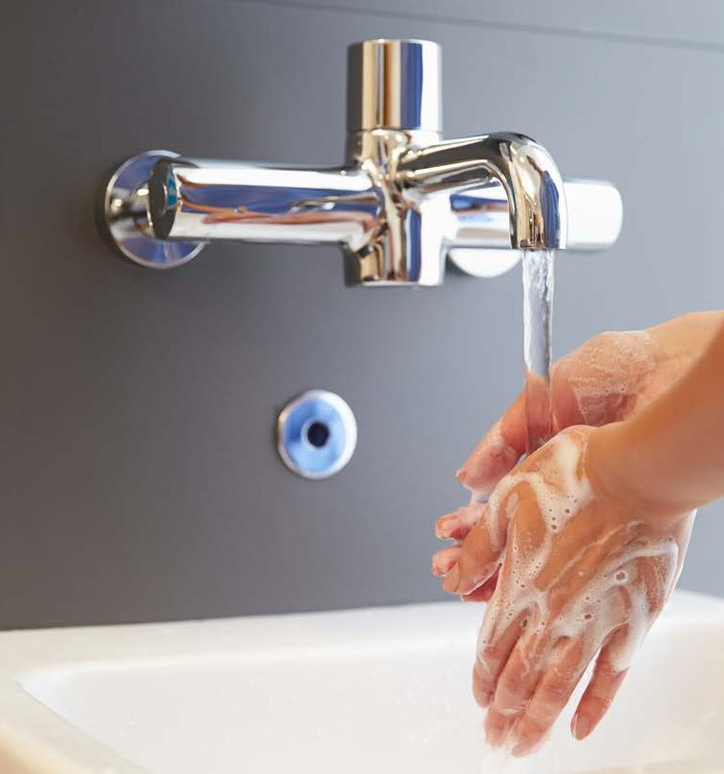
Overview
Aim of the health industry is to: provide high quality care
reduce the impact of ill health and disease
Each year there are around 200,000 healthcare- associated infections (HAIs) in Australian acute healthcare facilities.¹
Infection control procedure in the workplace is governed by the Occupational Health and Safety Act (2004) in Victoria and Work Health and Safety Act 2011 in other states and aims to prevent pathogens from being spread in the first place.
1. National Health and Medical Research Council

Slide 5
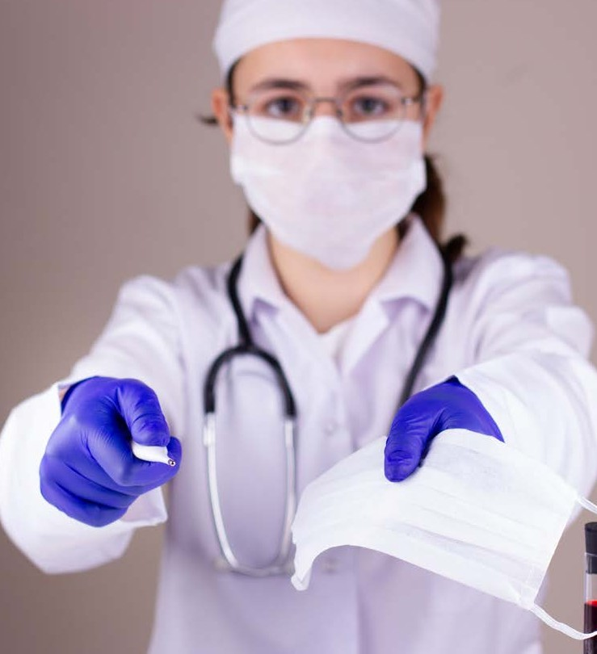
Roles and responsibilities
Your responsibilities include:
Identifying and responding to infection risks according to infection control policies that are based on State legislation, National Standards, and local regulations
Provide a safe environment for staff, clients, and any visitors
Following infection control policies and procedures at all times
Follow vaccination and other preventative guidelines as set out by the government and the workplace
1. National Health and Medical Research Council

Slide 6
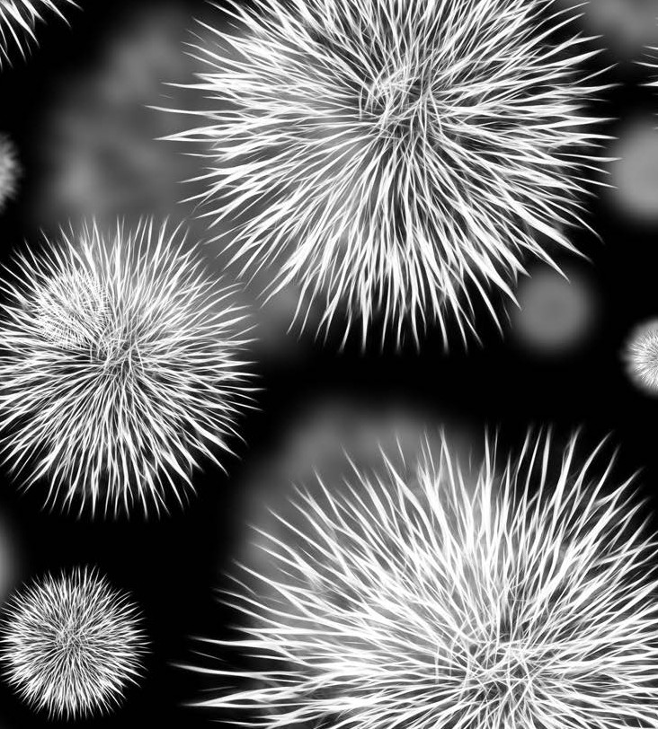
What is an infection?
Infection is a process in which bacteria, viruses, fungi and other microorganisms enter the body.
Microorganisms or agents are tiny living cells that cannot be seen by the naked eye.
Infections develop when these microorganisms attach themselves to healthy cells and, depending on the type of microorganism, begin to multiply.
They must overcome our body’s many defence mechanisms to cause illness.
Infections that result in illness or disease occur when microorganisms get past our bodies natural defences.

Slide 7
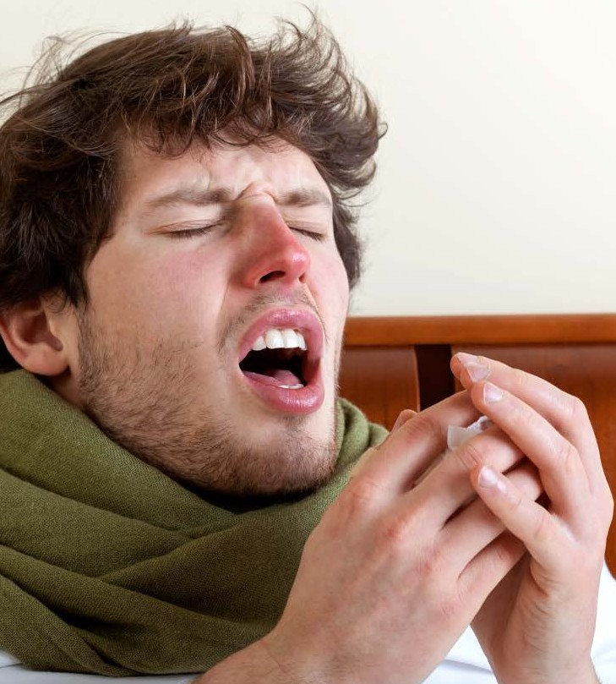
Chain of infection
Susceptible host
Reservoir
Infectious agent
Mode of transmission
Portal of entry
Portal of exit

Slide 8
Our body’s defence mechanisms
The skin Inflammation
The respiratory system Antibodies
Our body’s defence mechanisms- Watch video Introduction to Body Defenses and Barrier Defense

Slide 9
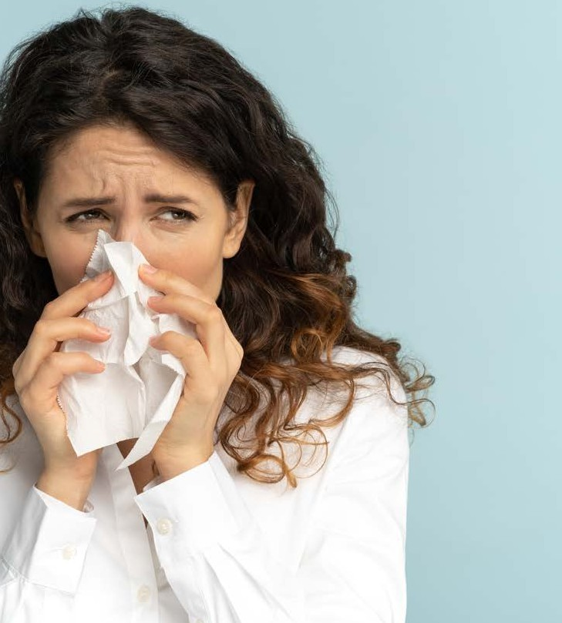
How is infection spread?
Direct contact Indirect contact Airborne
Droplet transmission Contaminated food or water Transmission by animals or insects
How is infection spread?- Access more information here. Watch an interesting video on how infection is spread here.

Slide 10
Vectors and diseases spread in humans and animals
A disease vector is any living organism that carries and spreads infectious microbes to another living organism
Most common vectors are insects that suck blood, such as mosquitoes and ticks.
Vector-borne diseases can be spread in two ways:
mechanically and biologically

Slide 11
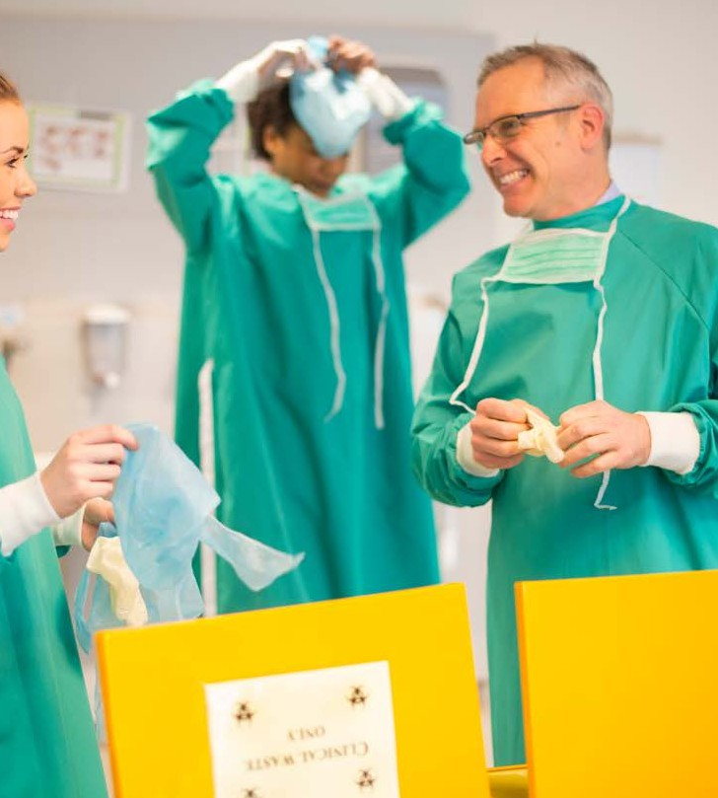
What Is Infection Prevention And Control?
Infection prevention and control aims to prevent or break the chain of infection. Successful infection prevention and control require various strategies across all healthcare industry levels and should be adopted by all health services workers.
These Infection control strategies include: Hand hygiene practices
Respiratory hygiene and etiquette Disposal of contaminated waste Personal protective equipment (PPE) Sharps handling and disposal Protocols for blood exposure Cleaning, sterilising and disinfecting of equipment, and environment
Notes:
Discuss Australian Guidelines for the Prevention and Control of Infection in Healthcare (2019). More information here.
Access Infection Prevention and Control from Australian commission on Safety and quality in health care and/or Infection control guidelines from Victorian dept of health or similar from your state.

Slide 12
Follow standard and additional precautions for infection prevention and control
Standard precautions are work practices that provide a first-line approach to infection prevention in the health services industry
Watch video: Standard precautions
Watch video: Transmission based precautions
Watch video: Contact and droplet precautions
Notes:
Access Victorian Dept of health site for: Infection control - standard and transmission-based precautions & Additional precautions

Slide 13
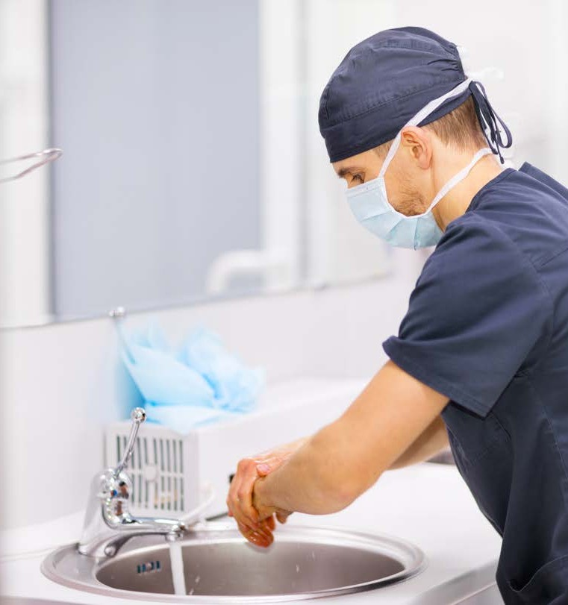
Hand Hygiene
One of the first-line approaches of standard precautions in the health services industry is hand hygiene.
Every health services organisation will have strict policies and procedures
outlining hand hygiene practices.
It is your responsibility to ensure you know and understand these
precautionary practices.
Access learning modules on Hand Hygiene Australia and complete the activities: https://www.hha.org.au/online-learning/complete-a-module
Notes:
Hand hygiene- Access Hand Hygiene Australia for discussion points

Slide 14
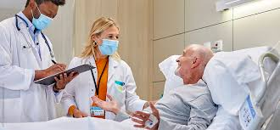
Five moments
The five moments of hand hygiene are:
Moment 1: Before touching a patient or client
Moment 2: Before a procedure or treatment
Moment 3: After exposure to blood or body fuids
Moment 4: After touching a patient
Moment 5: After touching a patient's surroundings
Five moments of hand hygiene – Access videos here.

Slide 15
Hand Hygiene Washing Procedures
There are four main types of hand washing procedures:
Waterless Routine
Clinical Surgical
Hand hygiene washing procedures- Watch an instructive visual video on the exact procedure for hand washing
Waterless
Routine
Clinical
Surgical

Slide 16
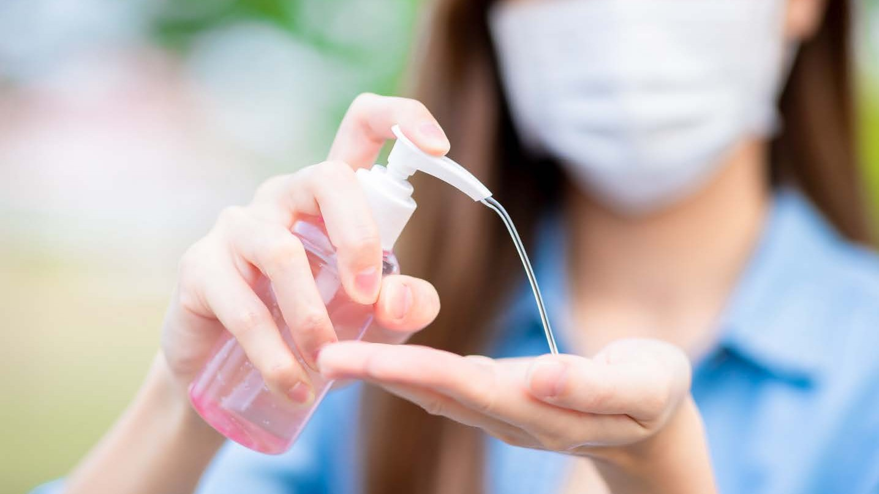
Hand hygiene product selection
Hand hygiene products should be evaluated for safety, quality and effectiveness.
Plain soap
Has small antimicrobial activity
Antimicrobial hand cleanser
Used for non-surgical and surgical hand antisepsis
Alcohol-based products
alcohol-based rubs eradicate micro- organisms more efficiently and cause less skin irritation than soap and water hand washin

Slide 17
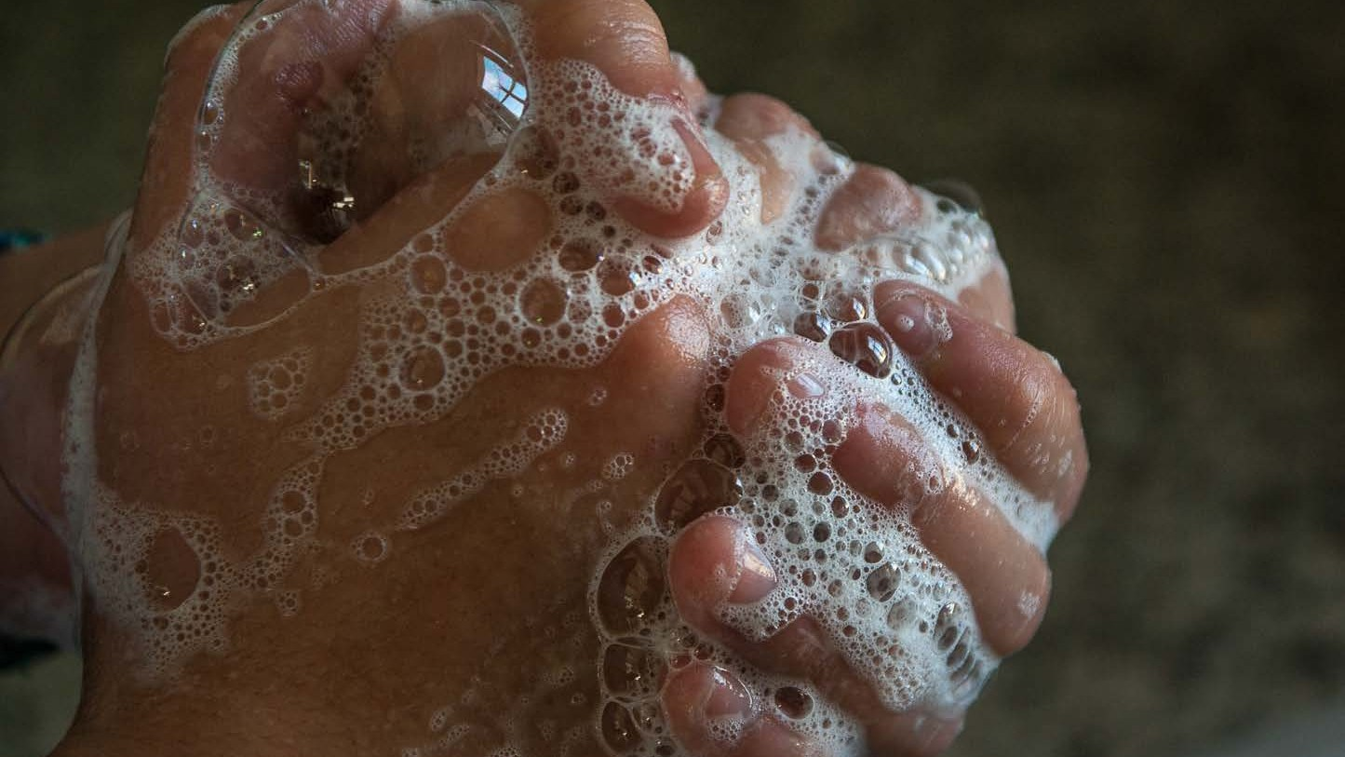
Frequent hand washing with soap, antibacterial washes and sanitisers is extremely effective for cleaning our hands but also washes away our
skin's protective coating.
Health services workers that frequently wash their hands can develop a condition called
Dermatitis.
Notes:
Looking after your skin: Causes and symptoms of dermatitis & Hand care procedures- Access more information here.

Slide 18
Causes of Dermatitis
Symptoms of Dermatitis
Redness or rash
Flaking, scaly and broken skin Blisters
Bleeding and cracked skin as a result of extreme dryness
Soreness or itchiness at the site
Frequent hand washing
Allergy to ingredient in hand washes, sanitisers and antimicrobial soaps
Using hot water to wash hands Wearing gloves when hands are wet
Not regularly applying moisturiser to the skin

Slide 19
Hand Care Procedures
Regular application of these moisturisers
can effectively help care for your hands and reduce the risk of developing Dermatitis:
Hand lotions Creams Emollients

Slide 20
Cuts and Abrasions
Open wounds are portals that allow bacteria and other harmful microorganisms to enter the body.
It is crucial to cover any cuts or abrasions
immediately using waterproof sterile band-aids, dressings or bandages.

Slide 21
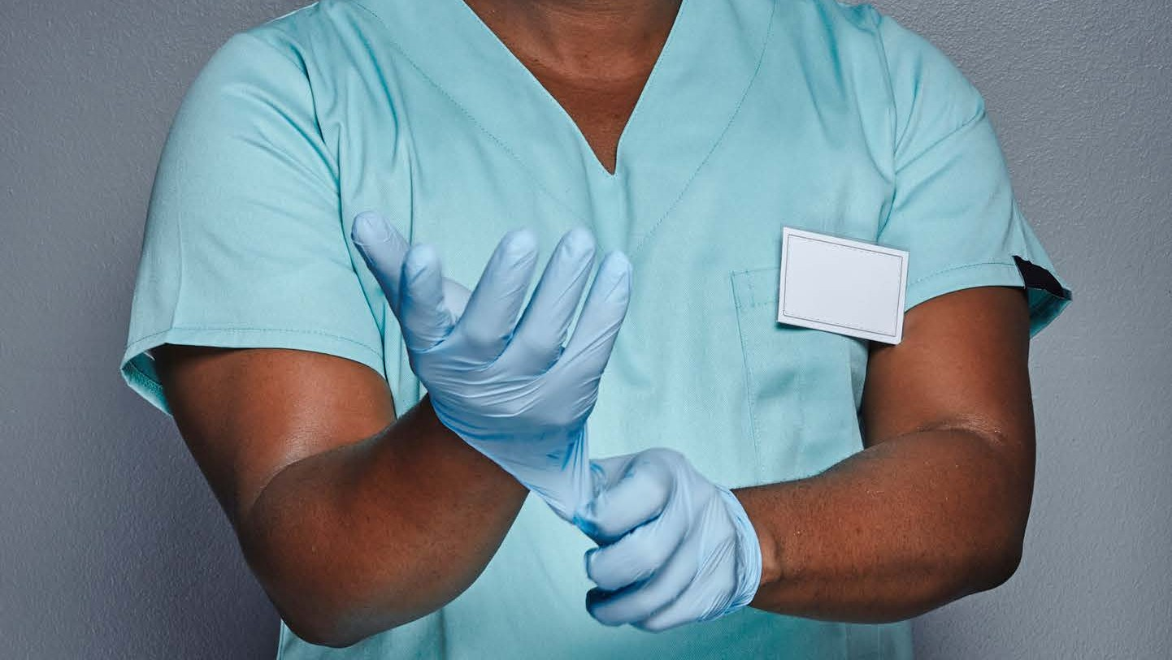

Slide 22
Learning Activity 1 Hand Hygiene and Preventing and Controlling Infections Standard
Access the Preventing and Controlling Infections Standard information from the ACHQC website here: https://www.safetyandquality.gov.au/standards/nsqhs-standards/preventing-and-controlling-infections-standard
For each of the actions listed on this page and provide an example from your work role on how you can achieve or support those actions. Use the table below to document your responses.
Action | Your role to support this action | Your employer’s role in this action
Integrating clinical governance | Following all clinical protocols according to policy and procedures | To ensure an infection prevention and control policy that includes risk assessment and risk management strategies based on the hierarchy of controls
Applying quality improvement systems | Reporting and documenting infection hazards and risks | Monitoring and continuous improvement of infection control processes
Partnering with consumers | Seek feedback from consumers. | • Actively involve patients in their own care • Meet the patient’s information needs • Share decision-making
Surveillance | Documenting and reporting on healthcare-associated and other infections | Collecting, monitoring and reporting data on healthcare-associated and other infections relevant to the size and scope of the organisation
Standard and transmission-based precautions | Following standard and transmission-based precaution policy and procedures | Developing, implementing, and monitoring of infection control and prevention policy and procedures
Hand hygiene | Following hand hygiene procedures according to policy and procedures | Training and enforcing hand hygiene procedures

Slide 23
Learning Checkpoint 1
1. Define the term infection.
An infection is the process in which bacteria, viruses, fungi and other microorganisms enter the body.
2. What are the three key defense mechanisms the body has against infection.
• The skin - our skin has multiple layers and acts as a physical barrier to block bacteria and other microorganisms.
• Inflammation is a way our immune system responds to harmful microorganisms in our body.
• The Respiratory system, our nose, mouth, throat and lungs all act as physical barriers for microorganisms
3. Describe three ways an infection can be spread.
• Direct contact: This occurs when physical contact occurs between infected individuals. For example, kissing, shaking hands or sexual contact.
• Indirect contact: This occurs when an infectious agent is transferred to an object or surface.
• Airborne: Infection can be spread through airborne particles that contain infectious agents.

Slide 24
Respiratory Hygiene
The following respiratory hygiene /
cough etiquette procedures should be followed at all times:
Cover nose and mouth when coughing or sneezing
Dispose of tissues immediately Cough or sneeze into the inner elbow rather than the hand
Complete hand hygiene procedures after contact with secretions,
contaminated surfaces or objects
Access more information here. Watch video: Hand hygiene and proper respiratory etiquette 101

Slide 25
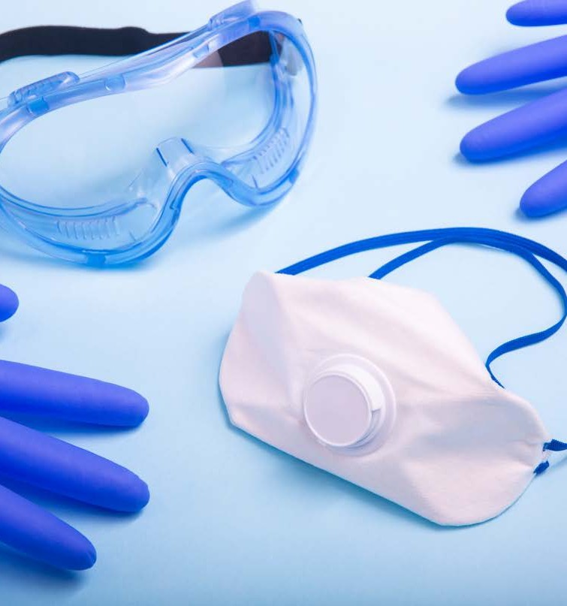
PPE Equipment
There are a number of key pieces of PPE equipment including :
Gloves
Aprons and Gowns Masks
Protective Glasses Surgical Hats
Health services organisations are
required by law to provide PPE clothing and equipment that meet strict
Australian standards.

Slide 26
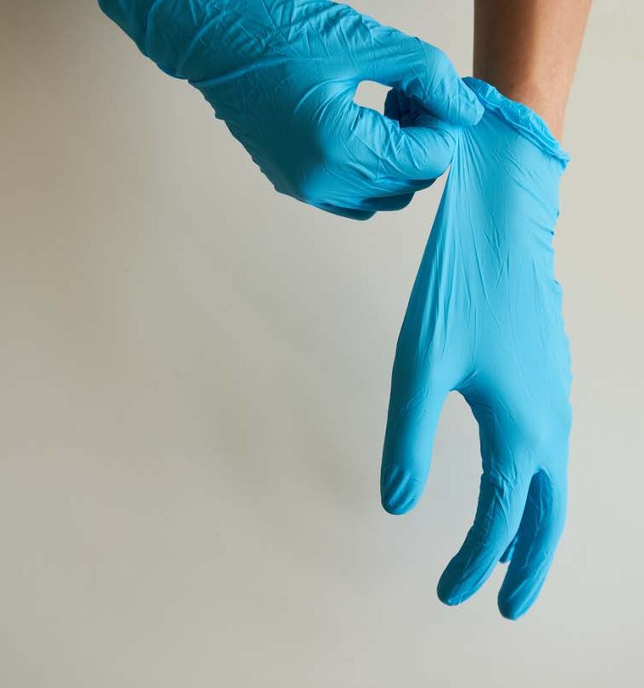
Gloves
Standard precautions recommend that gloves be worn in the following
situations:
Immediately before surgical
procedure and removed once procedure is completed
Contact with sterile instruments and equipment
Contact with broken skin, wounds and mucous membranes
All tasks that have a risk of exposure to blood, vomit and other body fluids
Types of gloves
Watch: Types of Disposable Gloves | GloveOn
Glove procedure
Watch: Donning and Doffing Exam Gloves
Watch: Sterile gloving
Discuss uses of different types of gloves- Watch video here.

Slide 27
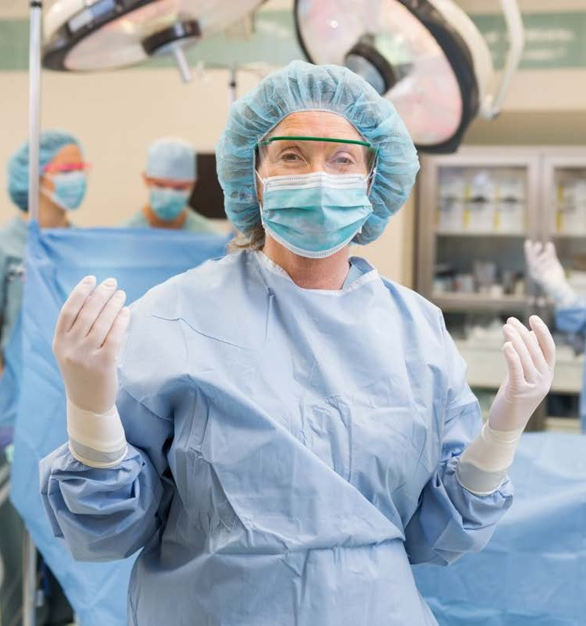
Aprons and Gowns
The main function is to act as a barrier between different sources of
contamination.
All plastic gowns and aprons used by health services workers must be sterile and can only be used once.
The goal to correctly applying your
gown / apron is to keep the own sterile and minimise the risk to both the
patient and professionals.
It is important to understand that when using multiple pieces of PPE that the
apron or gown is the last on along with gloves.
Aprons and gowns: Watch: Which Apron?- (Please note this video is based on NHS (UK) Hospital setting, please contextualise to your local context.)

Slide 28
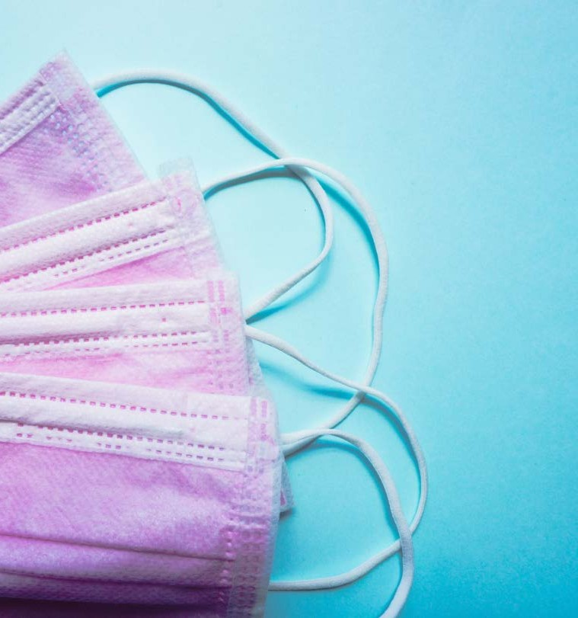
Masks
Masks are designed to protect the
wearer's mouth and nose from splatters of body fluids, respiratory secretions or droplets.
The majority of face or surgical masks are disposable and should only ever be used once.
Watch: Donning and Doffing Facial Protection – Mask alone-

Slide 29
Protective Glasses
Protective glasses act to protect the eyes from splatters of body fluids or chemicals.
Ensure they fit firmly around your head so they don't fall or slip.
Watch: Eye Protection in a Medical Setting

Slide 30
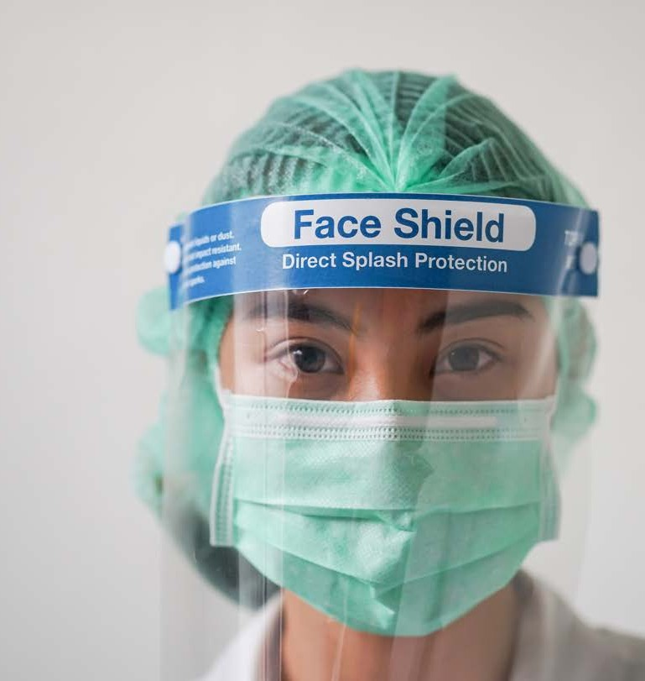
Face shields
When worn together with a properly
fitted surgical mask, face shields offer protection to others, as well
as to the wearer.
Advantages of face shields are as follows:
Offers droplet protections Can see the wear's facial expressions
Some face shields can be reused after cleaning
Provides eye protection

Slide 31
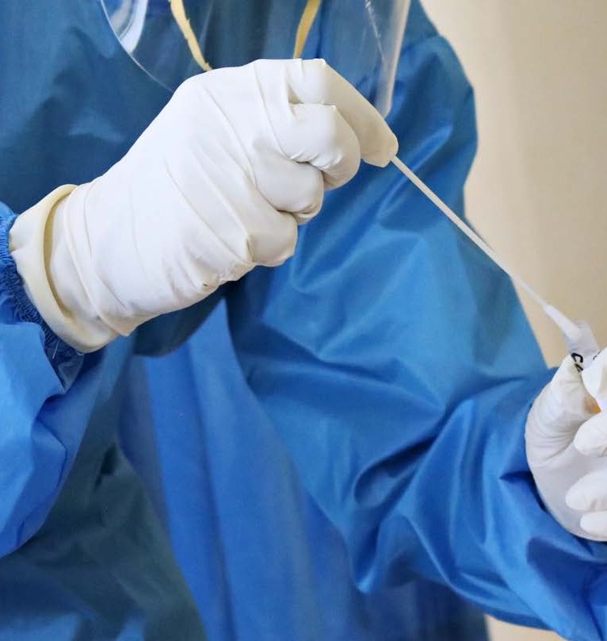
Changing PPE
To make sure that your PPE will provide you with the proper protection you will need to check the following:
Dispose of any damaged PPE
according to your organisations policies and procedures
Replace your PPE after each patient
Immediately remove any wet, dirty or contaminated PPE
If the PPE is reusable, ensure it is
placed in the appropriate location to be processed and properly cleaned.

Slide 32
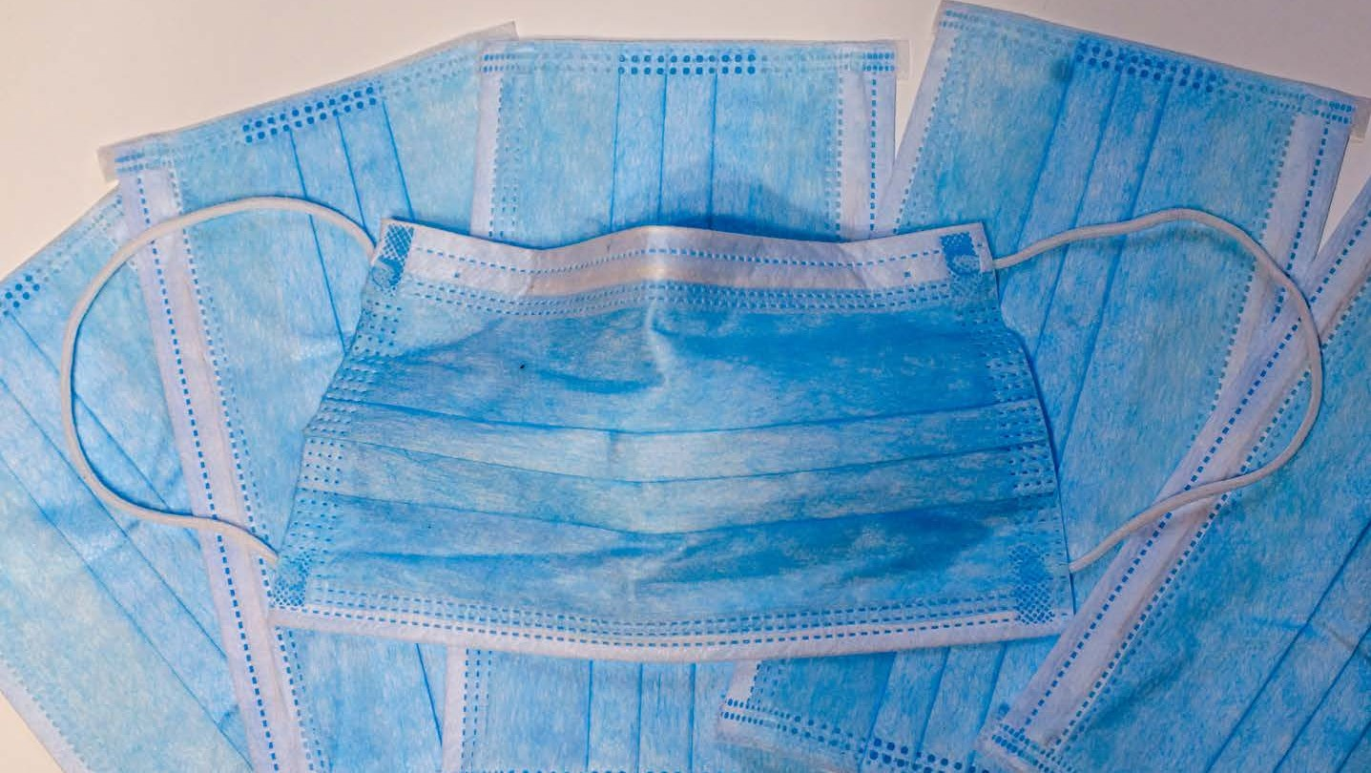
What is donning and doffing PPE?
Discuss correct procedure for donning and doffing PPE. Watch video- “How and when to wear Personal Protective Equipment (PPE)” presented by Alison McMillan, Australia’s Chief Nursing and Midwifery Officer.
https://www.youtube.com/watch?v=mNZJj3NL1IE

Slide 33
Environmental cleaning
A patient's environment includes the immediate area around them and any equipment that they come into direct/indirect contact with on a daily basis.
Bedrails Beds Chairs
Medical charts Handrails
Taps Toilets
Bedside remote controls PPE
Linen
Watch: DHHS Tasmania, Public Health Services - Environmental Cleaning Education
Notes:
Access Australian commission on safety and quality in healthcare’s Environmental cleaning and infection prevention and control resources.

Slide 34
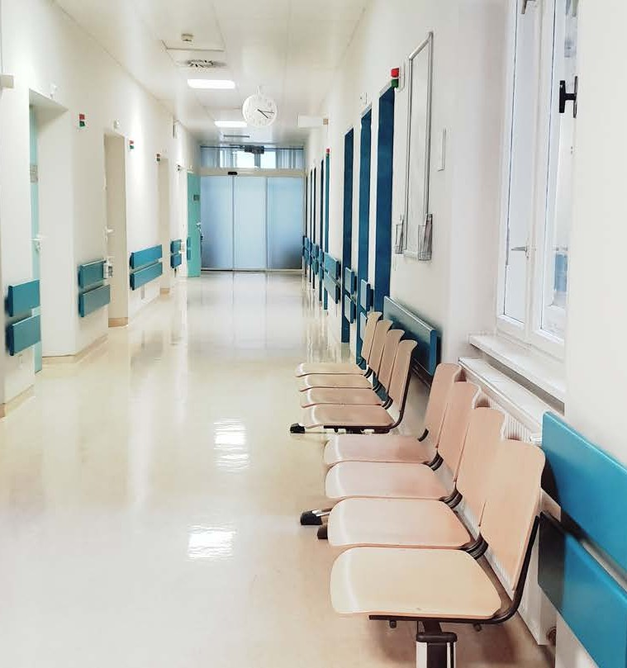
Routine surface cleaning
Routine surface cleaning can be divided into two categories:
Surfaces with minimal skin contact (i.e. floors, walls and ceilings)
Surfaces with frequent skin contact (i.e. high risk surfaces)

Slide 35
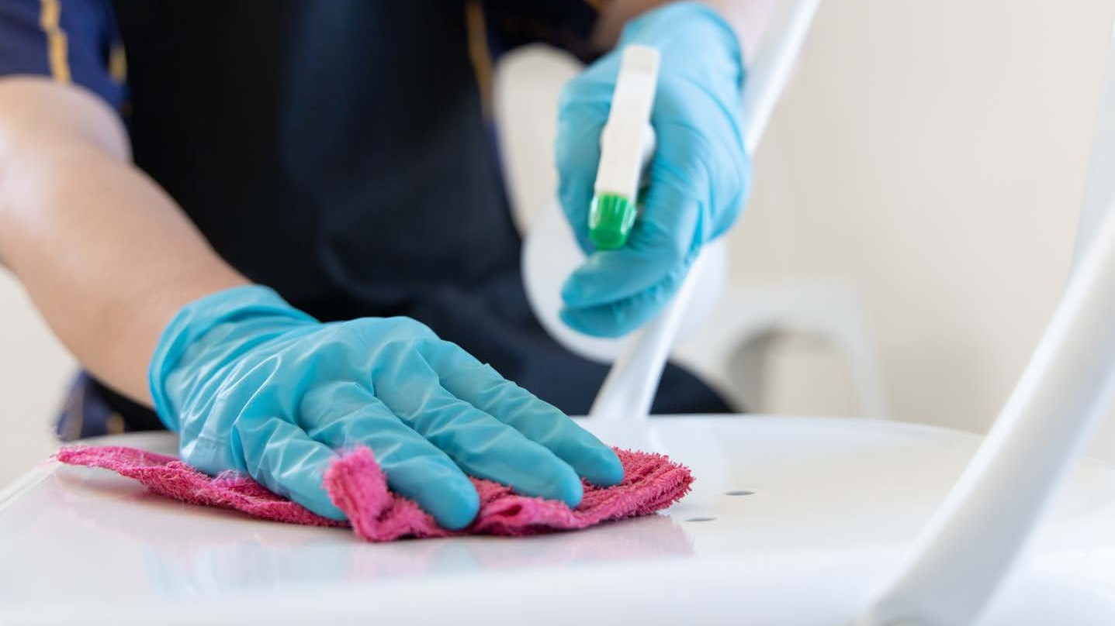
How do you clean for minimal touched surfaces?

Slide 36
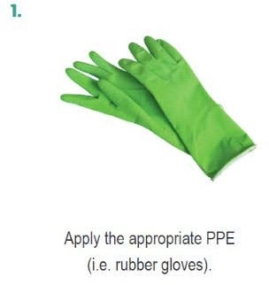
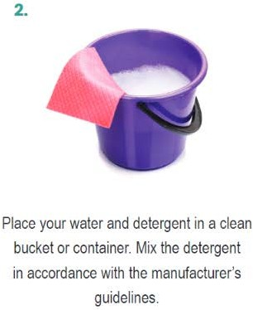
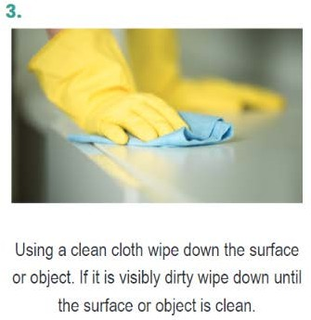
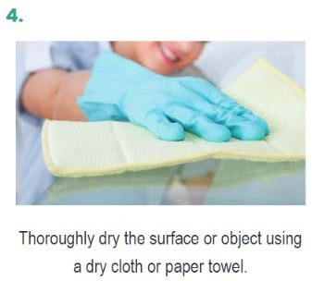
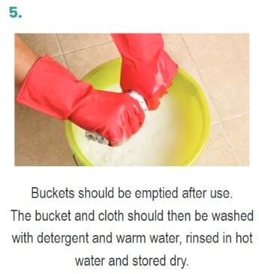
Technique for frequently touched surfaces
Combining the use of PPE and following the correct cleaning procedures helps prevent contamination of clothing, exposing of skin and mucus membranes and the transfer of harmful pathogens.

Slide 37
_{Enhanced} Enhanced cleaning
_{undertaken} cleaning and disinfection process is when there is an outbreak of infections
as COVID. Removal of ^{such} such as the virus that causes COVID-19 ^{germs} cleaning followed
_{by} requires thorough
disinfection. Coronaviruses can survive on
surfaces for many hours but are readily inactivated
cleaning ^{by}disinfection
and

Slide 38
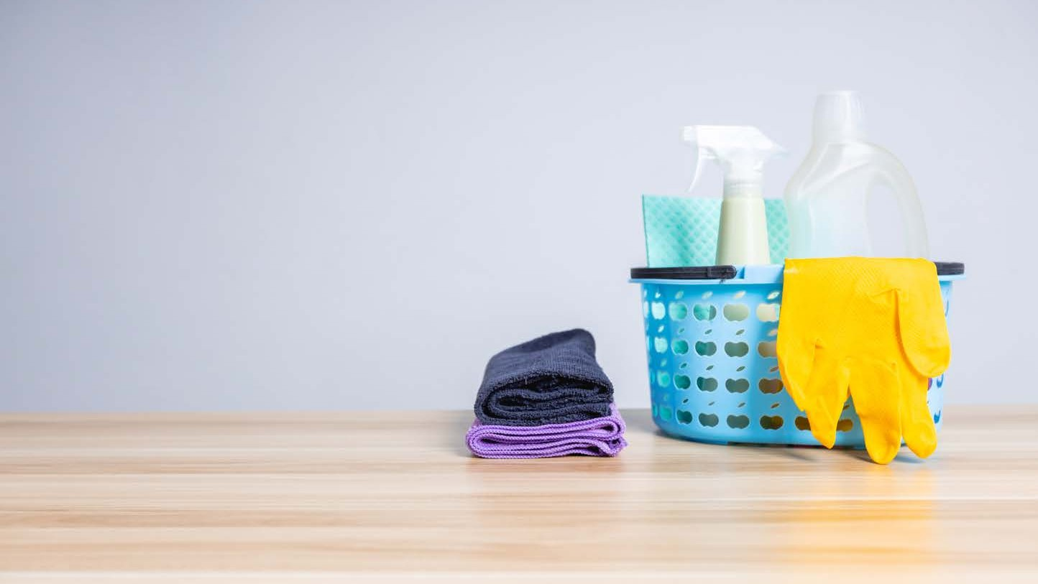
Enhanced cleaning
Enhanced cleaning and disinfection process is undertaken when there is an outbreak of infections such as COVID. Removal of germs such as the virus that causes COVID-19 requires thorough cleaning followed by disinfection.
Coronaviruses can survive on surfaces for many hours but are readily inactivated by cleaning and disinfection

Slide 39
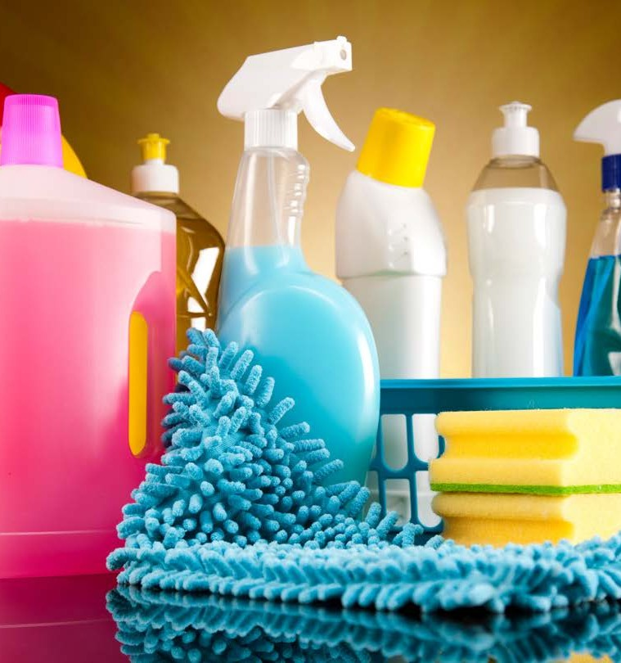
Using sanitisers and disinfectants
Correctly cleaning surfaces or objects that are suspected of being
contaminated should include either:
A two step clean
A two-in-one clean
.

Slide 40
Managing blood and bodily fluids spill
Apply the appropriate PPE Ensure the affected area is safe
Use a disposable absorbent material to clean up the spill
Dispose of the contaminated material in accordance with correct procedure
Clean the area using a detergent-disinfectant solution
Thoroughly dry the area or display the correct signage
Managing blood and bodily fluid spills- Watch: Safe Management of Blood and Body Fluid Spillages HD OR Enware - ZeoMed - Biohazard Spill Kit Training Video

Slide 41
Cleaning frequency, times and schedules
Depending on the environment all health services organisations will have areas cleaned as part of a regular schedule such as floors, bathrooms, and toilets.
Cleaning will also take place in response to an incident or accident.
All health services organisations must complete regular cleaning in order to be compliant with various health regulations and to also maintain a safe environment for patients, visitors and workers.
Cleaning schedules may contain information about: Tasks that must be completed
Classification of areas (i.e. low, moderate or high risk area) Dates and times of when cleaning is scheduled
Personnel performing specific tasks
Contact information of personnel or service if cleaning is not performed on a scheduled date and time

Slide 42
Cleaning logs
A cleaning log is a document that details all cleaning tasks that must be completed in a particular room,
space or area.
Cleaning logs require the following information:
The name of the staff member completing the task When completed Staff must place a tick or their initials next to the task
The date and the time they completed the cleaning must be recorded

Slide 43
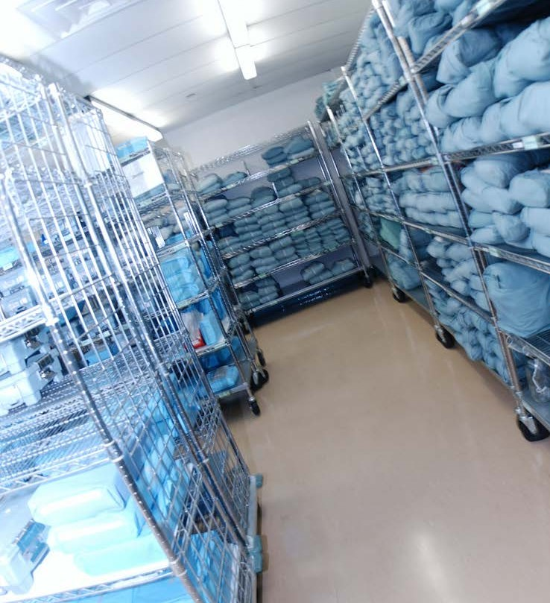
Patient Linen
This procedure applies to the handling and transportation of all patient linen:
Appropriate PPE must be worn when handling contaminated linen.
All used linen is immediately bagged at the location of use into an appropriate laundry wastebasket
Used linen must not be rinsed or sorted in patient-care areas or washed in
general purpose washing machines.
Linen contaminated with blood, bodily
fluids, urine or faeces should be placed into specially marked leak-proof or
yellow biohazard laundry bags and
immediately placed in the appropriate wastebasket.
Hand hygiene must be performed
immediately following the handling of used linen, even if PPE ) was used.
Watch: Discharge Patient Room Cleaning
Notes:
Queensland health provides these guidelines.

Slide 44
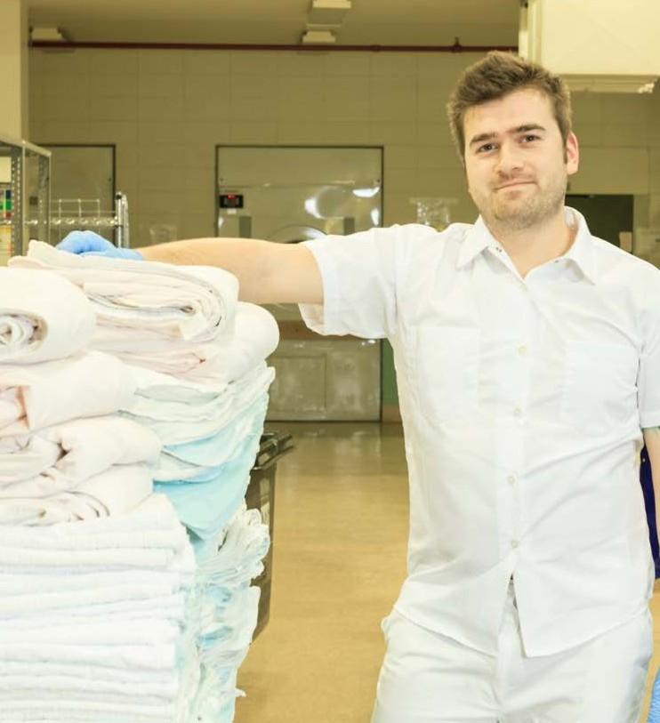
Linen Service
Most organisations use speciality linen services that collect, clean and dry
patient linen.
These specialty services process used linen and clean them in commercial
washing machines.
They use high-level disinfectant
solutions and chemical sterilisers such as hydrogen peroxide.
Specialty linen services must adhere to strict infection prevention and control practices.
Notes:
Linen services- Princes Laundry processes linen for health care organisations, read more at: http://princeslaundry.com.au/

Slide 45
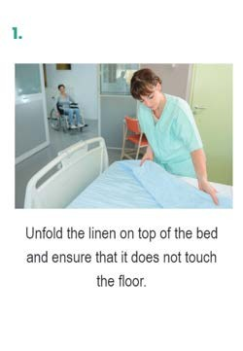
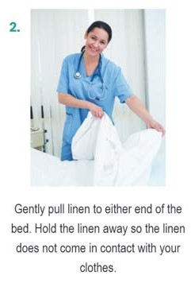
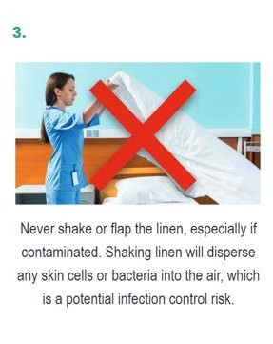
Making Beds
Watch- Making a hospital bed
Watch- Removing Linen
Watch- The Six Cs Handling Soiled Linen- This video is US version, you can find a local one if required. DHHS Tasmania, Public Health Services - Waste and Linen Management Education
Making a bed isn't just as simple as changing the sheets. You must know the correct procedure to prevent and control spread of infection, this includes:
Removing linen
Wearing appropriate PPE

Slide 46
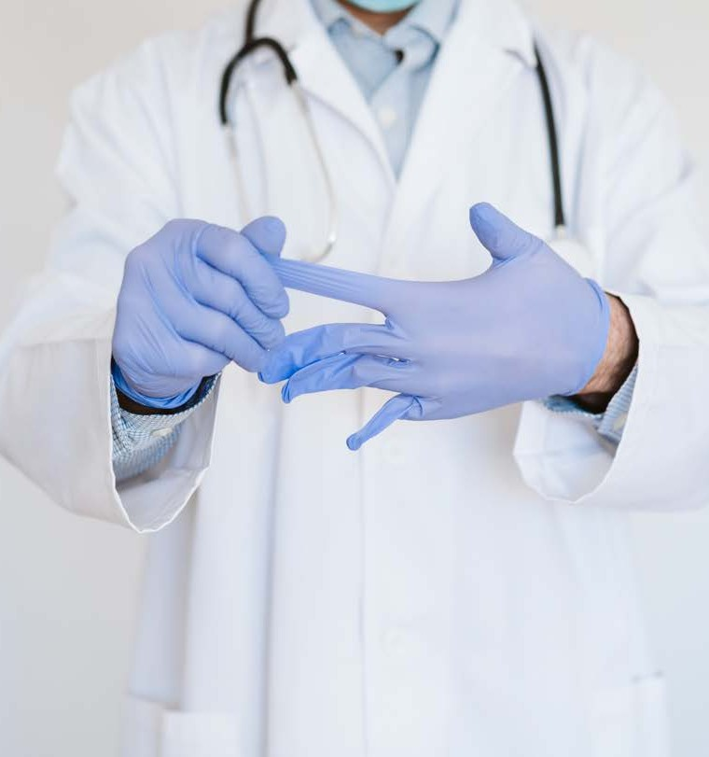
Contaminated waste
The handling and disposing of waste varies according to the type of waste.
When working in the health service industry there are specific types of waste including:
clinical waste general waste
cytotoxic waste
pharmaceutical waste needles and sharps

Slide 47
Clean Zones
Clean zones are designated areas for non-contaminated materials and should be relatively free of contaminants.
Clean zones can be work stations and benches to entire rooms or areas. These zones must be kept clean at all times.
Notes:
Clean zones & Contaminated zones- Access an example here

Slide 48
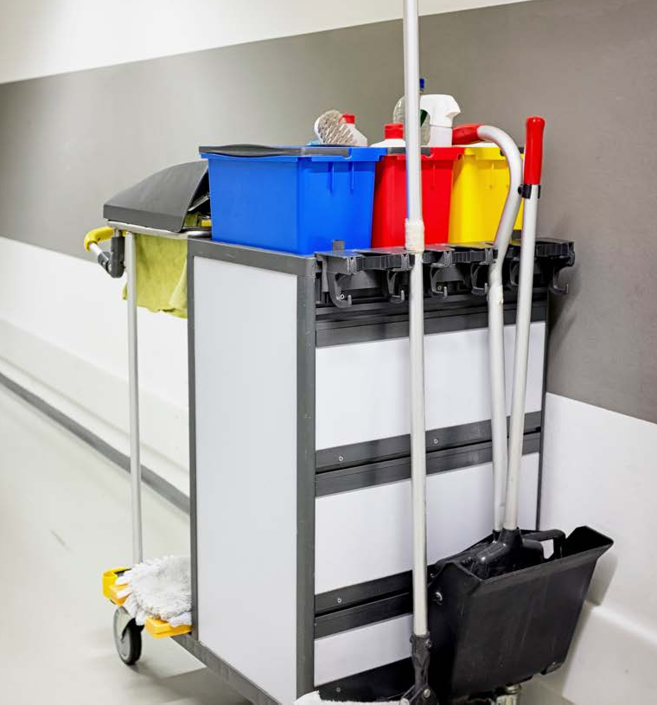
Contaminated Zones
Contaminated zones may include: cleaner’s rooms
medical trolleys or trays used in surgical procedures for
contaminated items (i.e. scalpels, gauze pads and bandages)
specially marked laundry bags, containers or bins
used linen storage areas
waste disposal rooms or areas
utility rooms that temporarily store contaminated waste

Slide 49
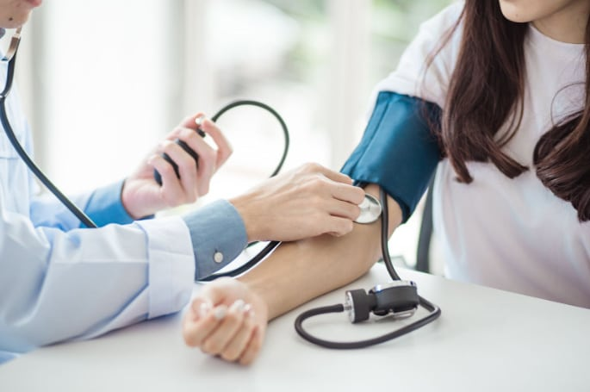
Reprocessing of reusable medical devices
Reusable medical devices (RMDs) are used for diagnostic and/or treatment purposes for multiple patients and are expected by the device manufacturer for reprocessing and reuse.
Examples
Arthroscopes Biopsy forceps Gastroscopes Specula
Bed pans
Blood pressure cuffs

Slide 50
Learning Activity 2 Environmental Cleaning and Waste Disposal
Part A: Access the Preventing and Controlling Infections Standard information from the ACHQC website here:
https://www.safetyandquality.gov.au/standards/nsqhs-standards/preventing-and-controlling-infections-standard
For each of the actions listed on this page and provide an example from your work role on how you can achieve or support those actions. Use the table below to document your responses.
Action | Your role to support this action and examples
Aseptic technique | Preventing infections entering the patient by using appropriate infection control protocols where required such as invasive procedures
Invasive medical devices | Reprocessing them as critical by cleaning them as soon as possible after with detergent solution. Sterilise using moist heat after cleaning.
Clean and safe environment | Following cleaning protocols based on risk levels and applying standard and transmission-based precautions
Workforce screening and immunisation | Follow all vaccination requirements as required by the employer
Infections in the workforce | Follow standard and additional precautions to prevent the spread, report and document when aware of infections in the workplace
Reprocessing of reusable medical devices | Follow reprocessing guidelines set out based on the function of the device as critical, semi-critical and non-critical.

Slide 51
Learning Activity 2 Environmental Cleaning and Waste Disposal
Part B: Your task is to read and analyse the case study below about Madi.
You will need to draw on the knowledge and information you have learnt about environmental cleaning and the disposal of contaminated waste. You must then answer the questions below.
‘Madi is a nurse’s assistant at the Armadale Cosmetic Clinic. The clinic has a day procedure ward that cares for patients undergoing or recovering from a number of small surgical procedures. She provides direct care to patients, although cleaning and maintaining rooms in the recovery ward takes up much of Madi’s day.
When patients are admitted to the day procedure ward, Madi is in charge of changing used patient linen and towels and cleaning the room to ready it for the next patient. She often comes into direct contact with the patients, as she assists the nurses with patient recovery after surgery. Madi must also check and maintain the spill kits in the recovery ward.
On this particular day, Madi is looking after Tara, who has just had a rhinoplasty procedure (nose job). Tara requires her bandages to be changed every two hours and must be given an injection of morphine to reduce any pain and help her recover’.
1. When Madi cleans a room in preparation for the next patient, outline the procedure she would use to effectively carry out the task.
She would complete an environmental clean, making sure to clean bedrails, beds (including a change of bed sheets), chairs, medical charts, handrails, taps, toilets and bedside remote controls. She would also need to make sure that linen such as sheets and towels are clean and sterilised.
2. Outline the types of high-risk surfaces Madi would need to clean in the clinic and patient rooms.
Doorknobs, light switches, handrails, remote controls and taps are all examples of high-risk surfaces and objects found in health services environments.
3. Name three types of waste that the Armadale Cosmetic Clinic would generate on a daily basis.
Pharmaceutical waste, general waste and clinical waste.
4. When Madi is making a bed for a patient outline the procedure she would need to use when transporting and processing the used linen.
She must unfold the linen on top of the bed and ensure that it does not touch the floor. Madi must pull the linen to either end of the bed and hold the linen away so that the linen does not contact her clothes. It is also vital that she does not shake or flap the linen to make sure she does not disperse any skin cells or bacteria into the air.

Slide 52
Learning Activity 2 Environmental Cleaning and Waste Disposal
Part B: Your task is to read and analyse the case study below about Madi.
You will need to draw on the knowledge and information you have learnt about environmental cleaning and the disposal of contaminated waste. You must then answer the questions below.
5. To safely dispose of soiled or used linen briefly explain the type of bag or container Madi should use for this task.
Linen contaminated with blood, bodily fluids, urine or faeces should be placed into a specially marked leak-proof or yellow biohazard laundry bag and immediately placed in the appropriate waste basket.
6. Before Madi assists the nurse in helping change Tara’s bandages, what types of PPE would she need to apply and why?
She will need to use gloves and an apron before handling the bandages exposed to blood or dead skin cells.
7. One of Madi’s daily tasks is to check and maintain the spill kit in the recovery ward. Explain what items and materials Madi will need to make sure are in the kit.
‘Madi then assists the nurse to administer Tara’s morphine injection. The nurse realises that she has forgotten her gloves and asks Madi to hold the needle. The nurse returns and gives Tara her injection. Madi is then asked to dispose of the needle in the sharps container on the trolley. Madi sees that the sharps container is very full, with needles coming out of the top. She tries to bend the needle to help it fit into the waste container’.
8. Explain why the nurse has not followed the correct procedure when handling the needle.
The nurse should have been wearing gloves before handling the needle.
9. Outline some possible consequences of a sharps injury if Madi accidentally pricked herself with a used needle.
Madi would expose herself to the risk of sharps injuries and to bloodborne infections such as hepatitis B, hepatitis C and HIV.
10. Should Madi bend the needle and then dispose of it in the overflowing sharps container? Explain your answer.
No, she should dispose of the overflowing container first to avoid any risk of accidentally pricking herself and exposing others to this potential danger.
11. Briefly explain a circumstance where Madi would have to take additional precautions to safely clean the patient’s rooms in the clinic.
If there has been any accidental blood or bodily fluid spills from the patient while she was resting in the room.

Slide 53
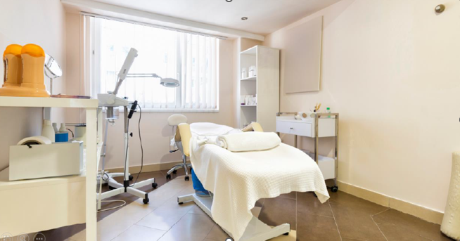
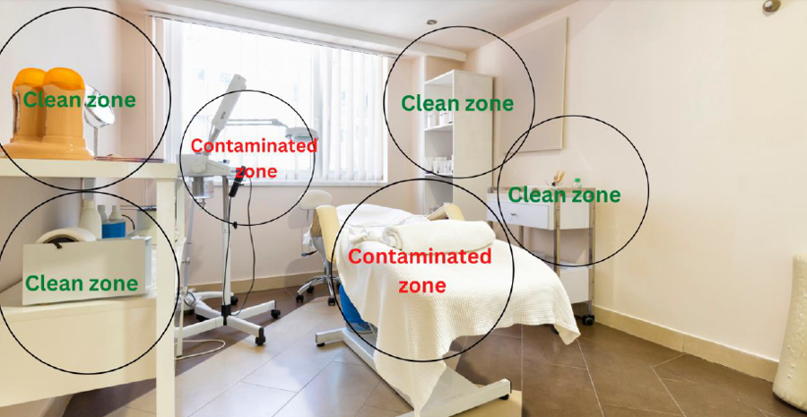
Learning Activity 2 Environmental Cleaning and Waste Disposal
Part C:
Identify as many clean and contaminated zones in this picture.

Slide 54
Learning Checkpoint 2
1. Explain the difference between sterilisation and disinfection.
Disinfection is the process of eliminating or reducing harmful microorganisms from objects and surfaces while sterilisation is the process of killing microorganisms.
2. Explain the term standard precaution. Provide an example.
Standard precautions are work practices that provide a first-line approach to infection prevention in the health services industry. For example hand hygiene means you wash your hands before and after treating patients.
3. According to Hand Hygiene Australia list the five moments for hand hygiene.
• Before touching a patient or client
• Before a procedure or treatment
• After exposure to blood or bodily fluids
• After touching a patient
• After touching a patient’s surroundings

Slide 55
Learning Checkpoint 2
4. Outline the four main types of hand washing procedures.
• Waterless hand washing involves the use of alcohol-based hand sanitisers.
• Routine hand washing must be done if your hands are visibly dirty, before and after touching a patient, after going to the toilet, handling medical instruments or equipment, and contacting any body fluids such as saliva or blood.
• Clinical hand washing is particularly important before and after you come into contact with open wounds, changing bandages and dressings and assisting patients with toileting.
• A surgical wash or scrub is required before any surgical or invasive procedure.
5. Why must you cover any cuts or abrasions before providing care to patients.
To prevent the transmission of infectious agents. Open wounds are portals that allow bacteria and other harmful microorganisms to enter the body, which is why it is crucial to cover any cuts or abrasions immediately.
6. Outline the correct procedure for respiratory hygiene.
Cover the nose and mouth when coughing or sneezing. Always use tissues to contain any respiratory secretions, dispose of tissues immediately, if no tissues are available cough or sneeze into your inner elbow not hand, complete hand hygiene procedures after contact with respiratory secretions and contaminated objects or surfaces.

Slide 56
Learning Checkpoint 2
7. List four forms of PPE used in health services environments.
• Gloves • Aprons and gowns • Masks • Protective glasses
8. List five objects that would be categorised as a high-risk surface in health service environments.
• Doorknobs • Light switches • Handrails • Remote controls • Taps
9. Describe the purpose of a spill kit.
To enable workers to safely and quickly clean up any spill.
10. Outline the three common types of waste generated by health service organisations.
• Clinical waste - Clinical waste may include blood, bodily fluids, secretions, excretions and human tissue. It may also contain contaminated linen.
• General waste - Any rubbish or waste that is generated by the daily operations of a health service organisation is considered general waste. General waste such as, paper and glass, food waste or other unwanted items are usually not contaminated and have minimal potential to cause a spread of infection.
• Cytotoxic waste - Any waste including linen, clothing, dressings, bandages, or needles may have been exposed to cytotoxic medication or bodily fluids containing cytotoxic agents.

Slide 57
Learning Checkpoint 2
11. When handling clinical waste, explain why it should be handled and processed with extreme care.
Any form of clinical waste is a high infection risk and must be disposed of correctly. Clinical waste may include blood, bodily fluids, secretions, excretions and human tissue.
12. List three types of sharps that would be used in the health services environment.
• Needles
• Scalpels
• Syringes
13. Briefly explain why all sharps must be discarded immediately after use.
Using needles and sharp medical devices, such as scalpels in the health services industry exposes workers to the risk of sharps injuries and to blood borne infections such as hepatitis B, hepatitis C and the HIV virus.
14. Explain the difference between a clean and contaminated zone.
Clean zones are designated areas for non-contaminated materials and should be relatively free of contaminants. Contaminated zones are areas designated for processing contaminated items. A specially marked laundry bag containing contaminated linen ready for cleaning is an example of a contaminated zone.

Slide 58
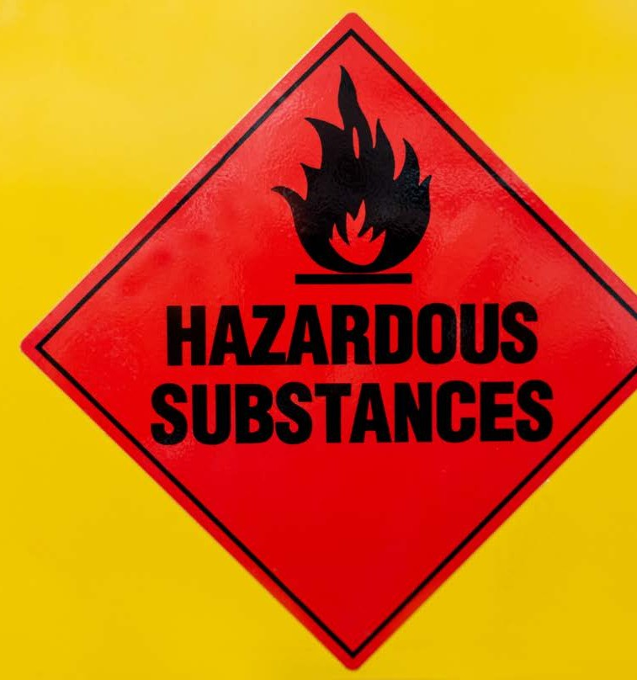
Identify infection hazards and assess risk
It is important to know the difference between a hazard and a risk so
workers can be conscious of the hazards in their environment and understand the risk they pose.
Hazard: A source or situation with the potential to cause harm.
Risk: A chance or probability that a
hazard will cause harm, illness or injury and is measured by likelihood and
consequence.
Infection hazards- Watch video biological hazards.

Slide 59
Common hazards in the workplace
Throughout the workforce there are a number of common hazards that exist across all industries and sectors. They include:
Manual handling Extreme temperatures Noise
Machinery and equipment Gravity

Slide 60
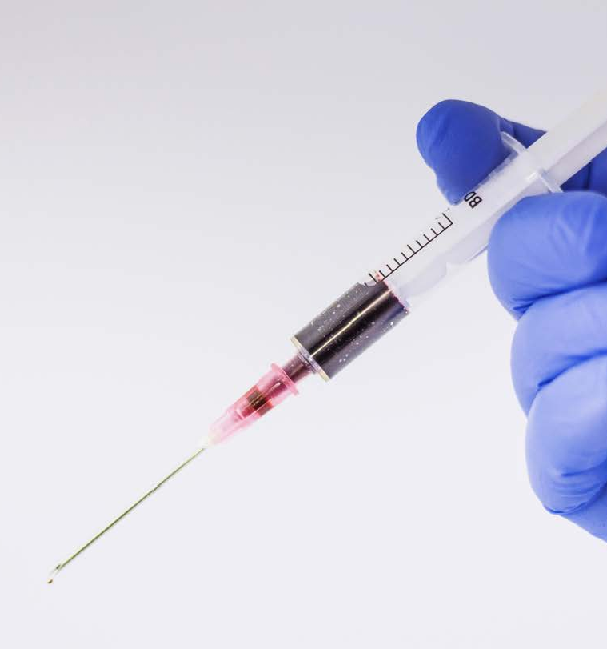
Infection hazards
Health services workers complete many tasks that expose them to different hazards.
There are particular infection hazards within the health services industry that can pose risks to workers.
They include: Sharps
Airborne pathogens, such as influenza and meningitis
Clinical, cytotoxic and general waste
Direct contact with patients Food

Slide 61
Identify the hazard
Hazard identification in a workplace should be an ongoing process that should be completed at various times.
Hazard identification methods may include: Talking with staff and other workers Conduct physical inspections
Document and report any activities or tasks that put workers and patients at risk Reviewing records of accidents and ‘near misses’
Media
Publications such as online hazard alerts

Slide 62
Risk Assessment
A risk assessment is about finding aspects of an organisation that have the potential to negatively impact the health and safety of workers and patients within a working environment.
Risk assessment is about looking at each hazard identified and evaluating the potential risks that may occur and the level of harm they may cause.
Conducting a risk assessment is a
systematic process that follows three key steps.
Identify the hazard (hazard identification)
Assess the risk. Determine the likelihood of the risk occurring, turning into an
accident, injury or loss, the potential
harm or consequences and rate the risk based on the potential severity of the
harm.
Determine and implement control options to eliminate or minimise the risk.
Risk assessment- Access Safety and quality risk assessment, download here.

Slide 63
Conducting a risk assessment
Conducting a risk assessment is a
systematic process that follows three key steps.
1. Identify the hazard (hazard identification) 2. Assess the risk. Determine the likelihood
of the risk occurring, turning into an
accident, injury or loss, the potential harm or consequences and rate the risk based on
the potential severity of the harm.
3.Determine and implement control options to eliminate or minimise the risk.

Slide 64
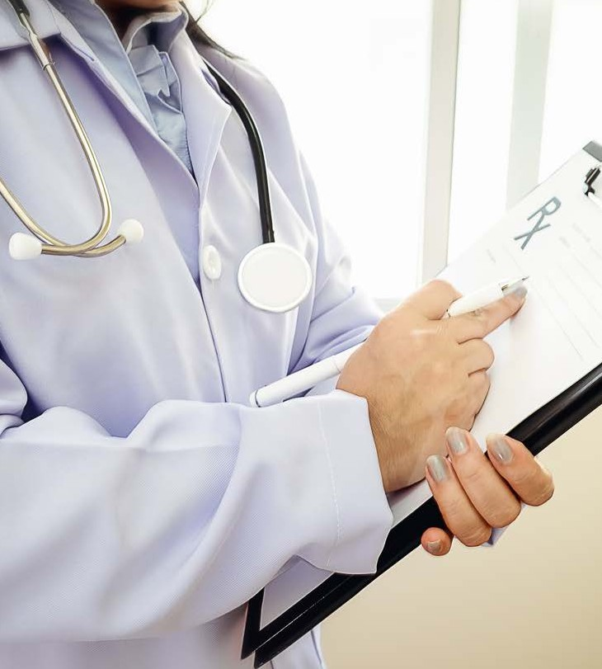
Assess the risk
The likelihood of a risk can then be determined in a number of different ways:
Quantitatively: The likelihood of the risk occurring is expressed in numbers that identify the probability of the risk occurring. These likelihoods may be expressed as percentages, fractions or ratios or a ranking between 0 and 1.
Ranking: If a number of hazards or risks have been identified they can be ranked from the most likely to occur to the least likely.
Qualitatively: The likelihood of the risk occurring is categorised using descriptive words e.g. high, medium, low, rarely, moderate and likely, using a matrix like the one below.

Slide 65
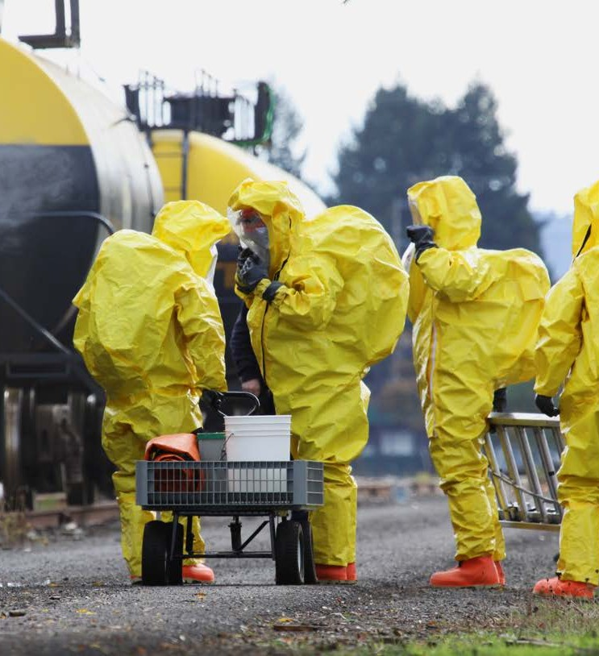
Severity of harm
Once the likelihood of a risk occurring has been determined the consequences need to be considered.
The consequences of a risk can be determined through research and an understanding of the risk.
Just as likelihood can be ranked, so can the consequences of a risk.
This ranking is based on the amount of loss a risk may cause (e.g. loss of time, loss of workers and patients), the severity of harm from identified hazards (insignificant, minor, moderate, major or catastrophic) and the number of people who might be exposed and affected by the risk.

Slide 66
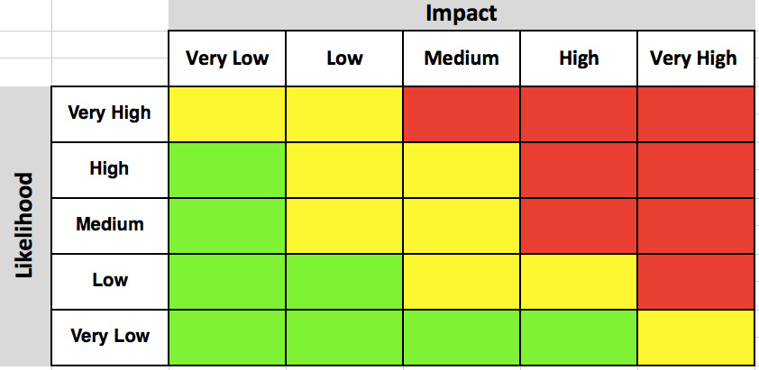
Risk analysis matrix
Once the likelihood and consequences of a risk have been determined the risk can be rated according to organisational procedures.
Risks are usually rated using a risk analysis matrix; these will vary depending on the industry and the potential for illness, injury loss, and accidents within the specific
workplace or organisation.

Slide 67
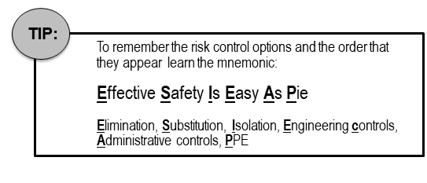
Risk Control Options
Some risk control options are more effective and reliable than others.
The hierarchy of control from WorkSafe provides a number of options for managing and controlling hazards and risks within the workplace.
The options are ranked from the highest level (Level 1) of protection and reliability to the lowest (Level 3).

Slide 68
Risk assessment methods
Methods may include, but are not limited to:
Using a checklist
Using risk assessment software systems Adopting the ‘what if’ approach

Slide 69
After care procedure for contamination sharps injury
If you or another health services worker has sustained a contaminated sharps injury the following infection prevention and control procedure should be followed immediately.
Wash the wounded area of your skin with warm water and soap
Seek help from a first aid officer if needed
Inform your supervisor and lodge a report
Seek immediate medical attention from a doctor
Fill out an incident or accident report
Notes:
Exposure and after care - other body fluids- Access Managing exposures to blood and body fluids or substances from Dept of Health

Slide 70
Risk control in infectious diseases
Reduction of hazardous procedures to a minimum
Immunisation of works at significant risk of infection
Isolation of the source of infection Good engineering design
Provision of one-use/disposable equipment to prevent reuse

Slide 71
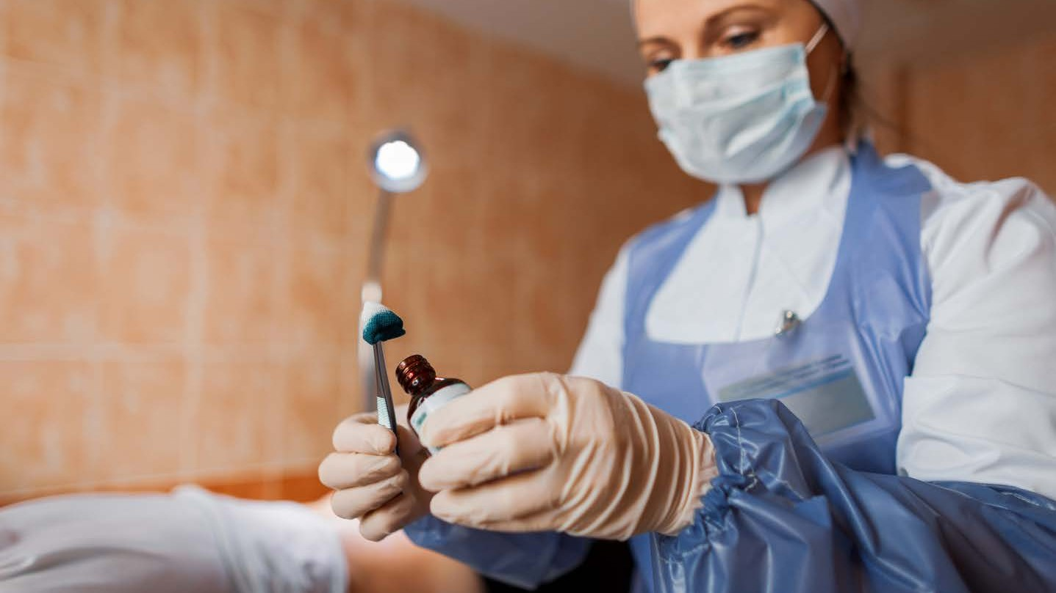
What is the purpose of the aseptic technique?

Slide 72
Learning Activity 3 Controlling Risk
In small groups, read each of the scenario’s below, and determine which risk control options would be most suitable and why.
RISK 1: Mary is an orderly who cuts her finger while cutting some food to assist a patient.
Level 2: Isolation, remove Mary from the task to receive first aid and dispose all contaminated food. Should Mary be deemed fit to get back to her work, she must wear appropriate PPE (Level 3) to cover the dressed wound. This is to ensure further contamination of food service area is reduced including ensuring Mary receives the appropriate medical care.
RISK 2: Andrew is a nurse’s assistant at an aged care facility and is changing a dressing on a patient with a pressure sore.
Level 3: PPE- Andrew should wear PPE while attending to open wounds. Pressure sores are infectious and sometimes with oozing pus. Open wounds thus must always be attended to using barriers such as PPE to reduce spread of infections to staff and other areas of the facility.
RISK 3: While cleaning a patient’s room, Nakita finds a spill of urine on the bathroom floor.
Level 1: Elimination- Nakita should remove body fluid using spill kit immediately. Urine is sterile while inside the bladder, but once it leaves the body is considered infectious and must be removed from surface immediately if spill noticed. This ensures people do not tread on urine spill and spread infections to other clean areas.
RISK 4: Jake, an operating theatre technician, sees an absorbent gauze pad contaminated with blood and human tissue in the general waste bin.
Level 3: administrative control: all workers are re-trained in the procedure for safely disposing of clinical waste. This is to ensure this error does not occur again and serves to reiterate safe handling of infectious waste.

Slide 73
Learning Checkpoint 3
1. What is the difference between a hazard and a risk.
A hazard is a source or situation with the potential to cause harm, a risk is a chance or probability that a hazard will cause harm, illness or injury and is measured by likelihood and consequence.
2. Outline four (4) common workplace hazards that exist in the workforce.
• Manual handling meaning repetitive bending and lifting
• Working in extreme temperatures
• Exposure to noise can cause hearing damage
• Operating machinery and equipment can result in injury
• Gravity meaning falls, slips and falling objects
3. Outline three (3) infection hazards that exist in the health services industry.
• Sharps - Sharps that are handled or disposed of incorrectly can cut or puncture the skin, putting workers at risk of infection. Needles, scalpels and razor blades can penetrate the skin’s surface causing an infection portal for blood borne infections such as hepatitis and HIV.
• Airborne pathogens - Pathogens such as influenza, rubella, and meningitis are all airborne, which means they can be transmitted through the air. They can also be transmissible through ventilation systems and air-conditioning.
• Clinical cytotoxic waste - Waste containing blood, bodily fluids, secretions, and excretions will act as an ideal reservoir for harmful pathogens. Clinical waste contains materials such as linen, bandages, PPE and medical equipment that has been contaminated and is an infection hazard.

Slide 74
Learning Checkpoint 3
4. Explain why clinical waste can be an infection hazard to workers.
Clinical waste contains materials such as linen, bandages, PPE and medical equipment that has been contaminated and is an infection hazard. For example, if you were assisting a surgeon and transferring a bag of clinical waste from an operating theatre the contents of the bag could be an infection hazard.
5. Outline the three (3) key steps when conducting a risk assessment.
• Identify the hazard
• Assess the risk by determining the likelihood of the risk occurring, turning into an accident, injury or loss, the potential harm or consequences and rate the risk based on the potential severity of the harm.
• Determine and implement control options to eliminate or minimise the risk
6. The hierarchy of control can be used to select a suitable risk control option. Outline the five (5) levels of the hierarchy of control from highest to lowest.
• Elimination – Removal of the hazard or cause of potential harm completely.
• Substitution - Replacement of the item or object with something that has the same function but reduces the level of harm.
• Isolation - Creating a barrier between harm and employees or others in the workplace.
• Engineering Controls - Changes to equipment, materials or resources to reduce the harm.
• Administrative controls - Implementation of training, changes to rosters, timing, policies or procedures.
• Personal protective equipment - Implement the use of personal protective equipment
7. The use of PPE is considered one of the least effective risk control measures in the hierarchy of control. Discuss why this may not always be correct in terms of the use of PPE in the health services industry.
Personal protective equipment is one of the most important risk control methods a health service worker must implement in the health services industry. Working in this industry infection control and prevention of pathogens spreading is vital, meaning health service workers must always use PPE whilst working.

Slide 75
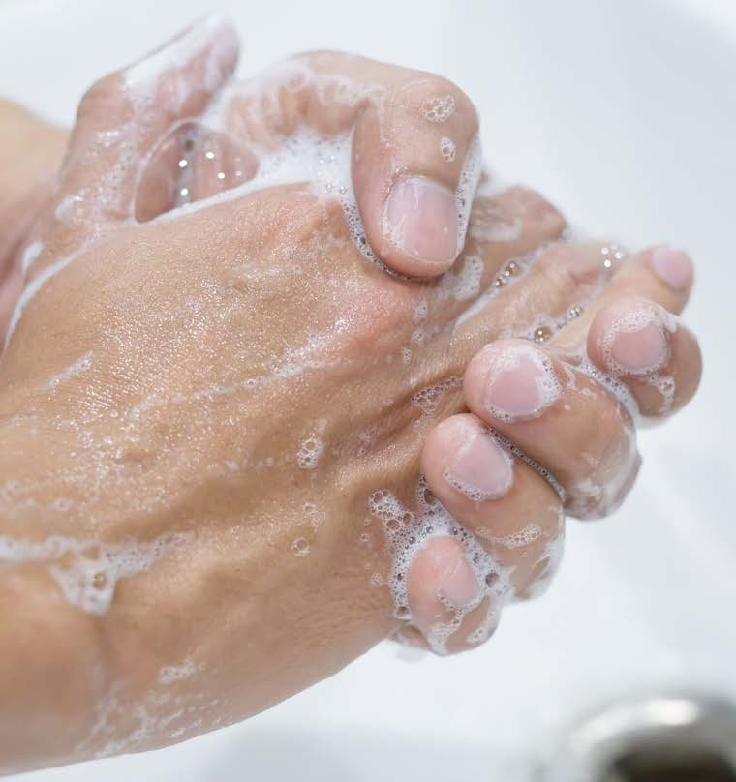
Exposure and after care
- other body fluids
Below are some guidelines to reduce the
risk of infection after exposure to any body fluids.
Avoid coming into direct contact with other workers or patients
Remove any contaminated clothing to minimise further exposure
Wash the area of exposure with warm water and soap
If body fluids have come in contact with any mucosal surfaces such as the eyes, nose or mouth seek medical advice from a doctor immediately
Report the incident to a supervisor and fill out an incident report
Notes:
Exposure and after care - other body fluids- Access Managing exposures to blood and body fluids or substances from Dept of Health

Slide 76
Additional after care procedures
Workers that have been exposed to blood and body fluids may feel very anxious,
helpless and distressed, especially if they are waiting for test results to check if
they have been infected.
This can impact their physical, emotional and psychological well-being and can
cause mental illnesses such as post-
traumatic stress disorder (PTSD). It can also impact their ability to carry out their duties and tasks.
Seeing a counsellor or psychologist may be important for workers who have been exposed to blood or body fluids.

Slide 77
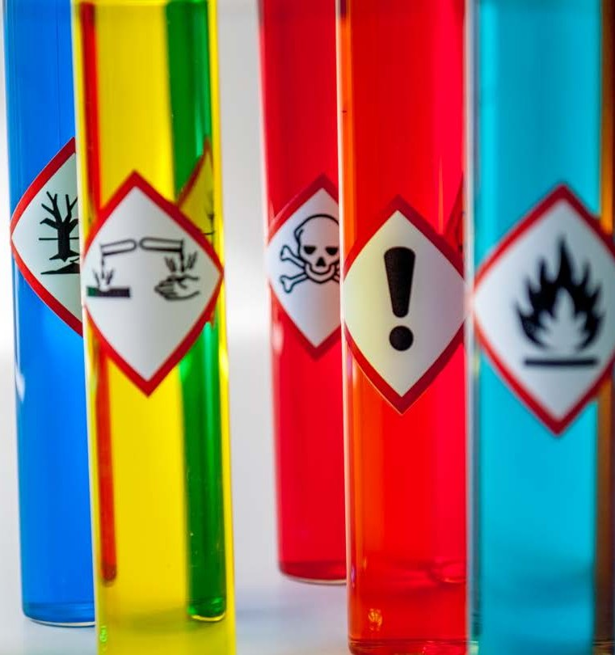
Signage
Some of the common signs that are used within the health services industry include:
Biological Cytotoxic Radiation Toxic / Poison Corrosive
Notes:
Signage- Access Australian commission on safety and quality in healthcare’s Standard and Transmission-Based Precautions and Signage

Slide 78
Specific health services related hazards
Some specific health services related hazard precautions include:
Airborne Precautions Contact Precautions Droplet Precautions

Slide 79
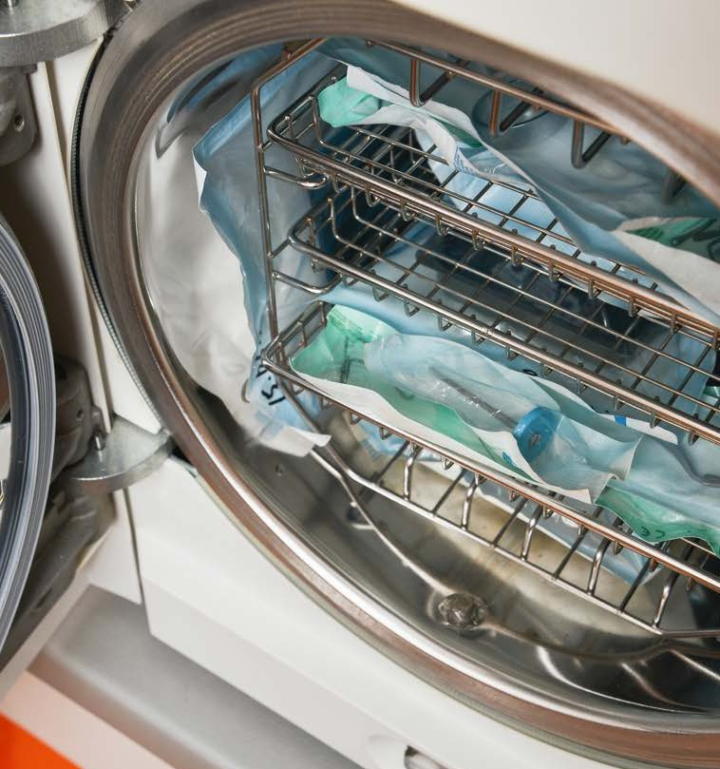
Aerosols and splatter risks
There are some simple, yet very effective actions health service organisations can take to help reduce the risk of infection
transmission via aerosols and splatter.
They include: Isolation Cleaning
Sterilisation

Slide 80
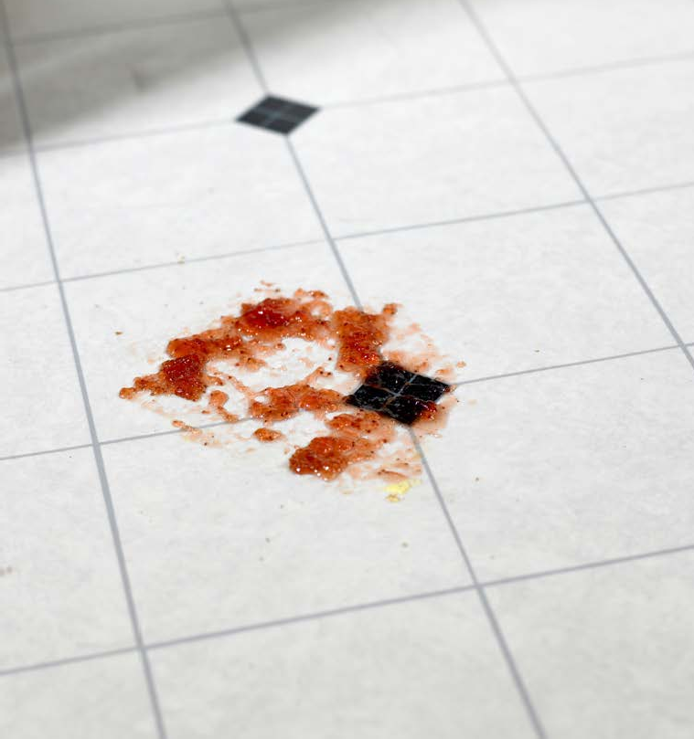
Spills
The procedure for cleaning up the spill will vary depending on the following:
type of spill (i.e. food, chemicals or blood)
size of the spill
nature of the chemical or substance involved
surface (i.e. carpet, tiles, concrete)
area or the environment where the spill has occurred (i.e. patient's room,
operating theatre or administration area)
Spills- Procedures for removing and cleaning spills- Access week 2 resources: Watch: Safe Management of Blood and Body Fluid Spillages HD OR Enware - ZeoMed - Biohazard Spill Kit Training Video

Slide 81
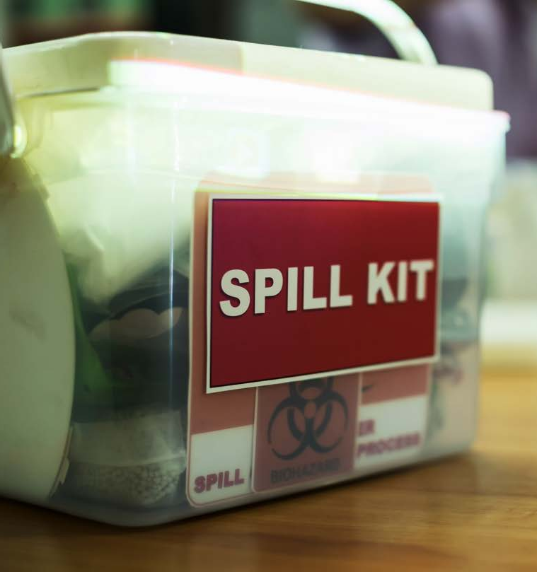
Procedures for removing and cleaning spills
Place the appropriate hazard sign to warn workers and patients of the spill
Access the nearest spill kit 3. Apply the appropriate PPE
4. Dispose of the waste according to the organisation's policies and procedures.

Slide 82
Health services performance monitoring
Public health services and hospitals
covered under the Health Services Act are subjected to performance
monitoring.
Victorian Health Services Performance Monitoring Framework (the Framework) looks at:
Clinical quality Safety
Timely Access to care Patient experience

Slide 83
Non-compliances or breaches
Individual
Where individual staff are identified as not complying
Organisational
Where a healthcare organisation fails to follow or monitor their practices such
as infection control

Slide 84
Learning Activity 4 Managing risks, communication and reporting
1. Refer to the ‘Infection Control Policy’ available on your portal and list the procedures that must be followed for the following:
Risks | Procedures
Patient and visitor hand hygiene | Patients should be provided with the means to perform hand hygiene after going to the toilet or using a bedpan or urinal, before eating, after sneezing, blowing their nose or coughing into hands, and after touching / handling animals. Visitors and volunteers must be provided with the means to perform hand hygiene and be encouraged to perform hand hygiene before and after contact with patients and their surroundings
Management of health workers with symptomatic illness | • Staff communication of their suspected or known communicable disease or MRO • The mitigation of transmission risks of communicable diseases and MROs • Human resource issues such as redeployment, sick leave and return to work management. • Staff non-participation in certain clinical procedures (e.g. exposure prone procedures) that is mandated by policy or legislation.
Bed management and patient flow | When considering patient movement or transfer, the receiving department, transport service, or department head must be notified of a patient’s infection or colonisation status before transfer. The admission and / or transfer of a patient must not be delayed or compromised by a patient’s suspected or known infection or colonisation status. Patient placement decisions must be made in conjunction with local patient flow team and infection prevention and control unit to ensure timely patient transfers and admissions.

Slide 85
Learning Activity 4 Managing risks, communication and reporting
2. List the person or authority to whom reports must be made and advice sought including how that reporting and communication may occur in each of the following situations of risks and incidents
Situation | Whom to report to and seek advice from | How reporting and communication may occur
Outbreak of a transmissible disease (Gastroenteritis, COVID-19) | Supervisor, other staff, families/carers and Regulatory authority | Emails, reports and online e-reporting on government website, Appropriate signage must be placed at the entrance to the patient room or zone to communicate the type of transmission-based precautions required
You’re feeling unwell | Supervisor, GP | Phone, email
You receive a minor cut on your hand while working | Supervisor, GP | Verbal, incident report
While cleaning instruments covered in blood, a splash of water hits your eyes | Supervisor, GP | Verbal, email, phone call, incident report
Incorrect use of PPE by staff | Supervisor | Hazard identification form, risk assessment form, incident report, staff meetings and training
A staff member confides that they are feeling unwell but came to work anyway because they did not want to use up their sick leave | Supervisor | Verbal, email
A staff member does not wash hands between patients | Supervisor | Verbal, email

Slide 86
Learning Checkpoint 4
1. Explain how the ‘what if’ approach works when performing a risk assessment.
This method of conducting a risk assessment is where workers brainstorm as a group and identify things that could go wrong in the workplace and the impact that they would have.
2. Outline one advantage of using a checklist to conduct a risk assessment.
A checklist allows the person conducting the risk assessment to focus on specific areas of the organisation that are most dangerous and ensures that they don’t forget to check any elements.
3. Outline the common causes of contaminated sharps injuries.
This can occur when people use, disassemble, or dispose of needles. In other cases needles may have not been disposed of properly and a health worker comes in contact with needles hidden in garbage or linen.
4. Explain why you think it is important to fill out an incident report after you have sustained a sharps injury or been exposed to blood or body fluids.
So that there is an accurate record of the incident. The incident report can be potentially used to adapt workplace practices, make workers aware of potential hazards and avoid the same incident from the same source occurring in the future.

Slide 87
Learning Checkpoint 4
5. Describe the aim of hazard signs and symbols in the health services industry.
Signs can be an extremely effective way of communicating crucial information and warnings in the workplace and they are important risk control measures. They can also be interpreted quickly by anyone irrespective of the language they speak.
6. If you are implementing airborne precautions explain the type of PPE that would be appropriate to use.
Gloves, aprons and masks.
7. Explain why contaminated water can be just as hazardous as blood or body fluid.
Water is an ideal breeding ground for bacteria meaning bacteria thrives in this type of environment.
8. Outline the five points you must consider when removing and cleaning a spill.
Type of spill, size of the spill, nature of the chemical or substance involved, surface, area of the environment where the spill has occurred.

Slide 88
Assessment 1 Knowledge Questions
1. Which national standard governs the responsibility of health organisations to prevent infections?
The National Safety and Quality Health Service (NSQHS) Standard 3: Preventing and Controlling Infections Standard.
2. For each of the infectious situations below who would you report them to?
Infectious situation | Report to
You are feeling unwell | Supervisor
You have a needle stick injury | Supervisor and GP
Infectious disease outbreaks within the healthcare facility | • Supervisor, • Responsible person such as the CEO or other executives and • Federal/state government-department of health
A client has contracted the flu | • Supervisor, and • Family member or carer

Slide 89
Assessment 1 Knowledge Questions
3. Infectious diseases in the context of work health and safety can include: (choose all that apply)
a) HIV/AIDS
b) TB
c) Uterine cancer
d) Enteric infections
e) Glaucoma
f) Hepatitis A, B and C
g) Flu and COVID
4. The easiest and most efficient way to stop the spread of infectious diseases is to wash your hands; this can be done with soap and water or with a hand sanitiser. Describe the correct way to clean your hands with each method in the table below.
Hand cleaning method | How to clean hands | When it should be used
Soap and water | Use plenty of soap so that you get lots of foam, scrub your hands for 20 seconds. Then, rinse with warm-hot water, dry and moisturise your hands | When hands are visibly dirty or greasy. After handling or cleaning possible contaminated objects.
Hand sanitiser | Must have at least 60-70% alcohol/ethanol. Cover hands completely with the sanitiser and rub hands to ensure every surface has been covered. Let the sanitiser dry on the hands. | When the hands are already clean and may have been contaminated.

Slide 90
Assessment 1 Knowledge Questions
5. When should you wash your hands with soap and water rather than a hand sanitiser in clinical situations? Choose three (3) correct answers.
a) when hands are visibly dirty or greasy.
b) when hands could be contaminated with blood or other body fluids.
c) after going to the bathroom or cleaning a bathroom.
d) Use a sanitiser anytime; it doesn't make any difference which one you use.
e) Use soap and water every time with a sanitiser afterwards.
f) Use only soap and water when your hands are clean, and you have been delivering food.
6. For the three (3) things listed below that must be examined before washing your hands, describe what actions should be taken and why based on infection control guidelines.
Things to be checked | What should you do? | Why?
Jewelry | Take off all or as much jewelry as possible. | Viruses and bacteria can hide in the folds or crevasses of jewelry and come out later to contaminate others.
Open wounds | Cover them with a waterproof dressing. | Viruses and bacteria can enter our bodies through open wounds.
Fingernails | Ensure they are short, clean and do not have nail polish on. | Long fingernails can harbour bacteria, as can nail polish, especially when chipped. In addition, nail polish can chip off and contaminate items.

Slide 91
Assessment 1 Knowledge Questions
7. For each of the PPE listed below provide a description of when and why you should use it.
PPE | When it should be used | Why
Gloves | When handling infectious materials such as bodily fluids and chemicals. | To stop you from becoming infected or your hands damaged.
Waterproof aprons or gowns | When handling bodily fluids or using harsh chemicals that can spill or splatter. | To protect you and your clothes from damage or infection.
Face Masks | When cleaning very dirty or dusty areas. If you have COVID-19, have been in close contact with someone with Covid-19 or are in isolation having just returned to Australia. If cleaning the room of an infectious person. | To protect your eyes from dirt and dust. To stop you from spreading COVID-19 to others. Extra protection against getting the disease.
Safety glasses or face shield | When handling chemicals. | Chemicals may splash into your eyes

Slide 92
Assessment 1 Knowledge Questions
8. Explain both types of routine surface cleaning listed below.
Surface cleaning of minimal touch surfaces: Walls, floors, and ceilings be vacuumed once a day to remove any dust, dirt or debris. Once the area has been thoroughly vacuumed, it should be mopped using a diluted detergent. Most hard surfaces can be adequately cleaned with warm water and detergent. Wet floors are extremely hazardous, so it is critical to dry the
surface after it has been cleaned. Carpets must be vacuumed on a daily basis, ensuring that all dirt and debris is removed. Steam cleaning or wet cleaning of carpets.
Surface cleaning of frequently touched surfaces (high-risk surfaces): Should be cleaned at least once a day using a detergent solution designed for general purpose cleaning. You must use the detergent solution with water and a damp cloth to properly clean the surface. Detergent soaked wipes can also be used to clean small surfaces, objects and equipment. It is important
to remember when performing any routine surface cleaning that you apply the appropriate PPE, such as rubber or disposable gloves, apron or protective glasses.
9. Following are the steps you need to take to clean up a small amount of bodily fluid. Put the numbers 1 – 7 against each step to indicate the order they should be taken in?
Steps to clean up a small amount of bodily fluid | Order
Select and put on appropriate PPE, (i.e. put on gloves and if there is a possibility of splashing, wear a gown and facial protection) | 2
Disinfect the entire spill area with a TGA approved hospital-grade disinfectant and allow it to stand for the amount of time recommended by the manufacturer | 6
Remove gloves and perform hand hygiene | 7
Wipe up the spill immediately with absorbent material | 3
Assemble the materials required for cleaning the spill | 1
Place contaminated absorbent material into a waterproof container or plastic bag for disposal | 4
Clean the area with a warm detergent solution using a disposable cloth or sponge | 5

Slide 93
Assessment 1 Knowledge Questions
10. If you come into contact with bodily fluids through touching them to your eyes, mouth or nose, a wound on your hand or even being accidentally stuck with a needle, what are the first four things you should do?
1 Take off any contaminated clothing or PPE.
2 Rinse the exposed area thoroughly.
3 Report to workplace supervisor. Document the incident and include: • Date, time and type of exposure. • How the incident occurred. • Name of the source individual (if known). The source person is the person from which the blood or body fluid came.
4 The exposed person should seek medical advice or treatment.
11. All used linen should be handled with care to avoid the dispersal of microorganisms into the environment. List four (4) things you need to do when handling dirty linen to ensure that viruses are not spread.
1 All used linen is considered contaminated; therefore, minimal handling is recommended.
2 Appropriate PPE must be worn when handling soiled linen to prevent skin and mucous membrane exposure to blood and body fluids; this could include gloves, aprons, or gowns.
3 Used linen is 'bagged' at the use location and placed directly into an appropriate laundry receptacle (i.e. used linen should never be placed on the floor).
4 • Linen that is heavily contaminated with blood or other body fluids that could leak must be contained in a leak-proof bag and secured before transport. • Hand hygiene is performed following the handling of used linen.
12. Why is it important to keep clean materials such as paperwork, clean equipment and supplies separate from possibly contaminated items such as used cleaning equipment?
You do not want the items in the clean zone to be contaminated, and you do not want the contaminated items to spread their contamination to other areas.

Slide 94
Assessment 1 Knowledge Questions
13. Read the descriptions of the different microorganisms below, then match the name of each one to their description.
• Bacteria • Virus • Parasite • Fungus
15. Read the descriptions in the table, then match each term in the list below to the meaning.
• Infectious • Colonised • Diseased
16. Many diseases need a susceptible host to spread; list five (5) categories of people likely to be susceptible hosts.
1 The aged
2 The very young
3 Those who have a medical condition that may lower their immunity
4 Those who are recovering from surgery, wounds or medical treatment
5 Pregnant women
Name of microorganism | Description of microorganism
Fungus | Includes the yeasts, rusts, mildews, moulds and mushrooms.
Virus | Are even smaller than bacteria and require living hosts, such as people, plants or animals, to multiply.
Parasite | Are animals or plants which must live on or in another plant or animal to survive.
Bacteria | Are single-celled microorganisms that thrive in many different types of environments, including extreme heat or cold. The bacteria can form spores which can also cause disease.
Meaning | Term
When a person has a disease but does not show any symptoms. | Colonised
A person has a disease and shows symptoms. | Diseased
The time when a person has a disease and can pass it on to someone else. | Infectious

Slide 95
Assessment 1 Knowledge Questions
14. Below are different ways that infections can move from one person to another. Match the name of the type of transmission occurring from the list below and then describe why it would occur and what should have been done to prevent the spread of infection.
• Contact • Airborne • Droplet or contact • Surface or object contamination • Penetrating injuries • Vectors (animal, bird, insect or parasite)
Scenario | Name of transmission | Why transmission happens and what could be done to prevent it
Mark was being taught how to clean at the hospital, and he was told not to shake out the sheets when stripping the beds. | Airborne | Any virus or bacteria on the sheets would get flicked into the air and contaminate himself or other people or items. Linen should be handled carefully without shaking it and slowly folding inward while striping and outward while making the bed
Julie sneezed and covered her mouth with her hands. She washed her hands quickly with warm water only before she went on to help the next person. | Contact | Julie did not wash her hands properly with soap and water. Unfortunately, water only will not kill a virus. She then could spread it by contact to the next customer. Julie should have used cough etiquette by sneezing in her elbow and not used her hands, if she did she should have washed her hands right away using soap and water. Julie should have washed her hands again using soap and water before helping the next person.
Doug picked up a client’s tray that the client had just coughed on soon after he covered his mouth to stifle a yawn. | Droplet and/or contact | The virus can move through droplets from the cough to an object and be picked up by Doug. So when he touched his mouth, it could have infected him. Doug should be wearing gloves while removing used utensils or tray from client’s room and wash hands after discarding them. Doug should use the cough etiquette while yawning if unable to control.
Rani and Sima attended a training session wearing cloth masks, Rani had to leave early and Sima stayed for the refreshments. Only Sima was diagnosed with COVID after 2 days. | Airborne | Cloth masks can reduce the risks however are not 100% effective. The timing of exposure to the virus was longer for Sima than for Rani. Sima may also have touched the front of her mask or other surfaces and not washed hands before eating and touching other areas of her face. Sima should also have maintained social distancing while attending the training.

Slide 96
Assessment 1 Knowledge Questions
14. Below are different ways that infections can move from one person to another. Match the name of the type of transmission occurring from the list below and then describe why it would occur and what should have been done to prevent the spread of infection.
• Contact • Airborne • Droplet or contact • Surface or object contamination • Penetrating injuries • Vectors (animal, bird, insect or parasite)
Scenario | Name of transmission | Why transmission happens and what could be done to prevent it
Manny and Jana are completing a terminal cleaning of a patient room. Jana is new and still learning. She finds a used needle and cap on the bedside. Seeing the exposed needle she recaps the needle and while doing so her index finger is pricked and starts bleeding. She is diagnosed with Hepatitis B. | Penetrating injuries | Blood-borne infections such as Hepatitis or HIV/AIDS can be transferred from needle prick injuries. Needles should never be re-capped and should be disposed of right away into a sharps container.
Sam is visiting a patient who lives on a farm. She pets a friendly pig in the front yard. After returning she suffers from fever, headache, weakness, sweating, muscular pains and depression. She is diagnosed with Brucellosis. | Vector-animal and contact | In Australia, the disease is transmitted to people from infected cattle or pigs. Sam may have contracted the disease while petting the pig. Sam should have avoided petting or should have washed her hands immediately after touching the animal.
Julian is health conscious and likes to consume food in its freshest form. He prepares cheese from unpasteurised milk. He shares his cheese with people he works with at the Hospital after which there is an outbreak of Salmonella. | Vector-animal | Salmonella can be caused by consuming unpasteurised dairy products prepared from the milk of cattle carrying the disease. Julian should have pasteurised the milk before using it and should not have shared with staff when the food is not safe.

Slide 97
Assessment 1 Knowledge Questions
14. Below are different ways that infections can move from one person to another. Match the name of the type of transmission occurring from the list below and then describe why it would occur and what should have been done to prevent the spread of infection.
• Contact • Airborne • Droplet or contact • Surface or object contamination • Penetrating injuries • Vectors (animal, bird, insect or parasite)
18. Hasan has just finished his PSA shift in the Emergency Department (ED). Today there were at least two cases of stabbing treated in the ED and while cleaning the area, Hasan’s uniform on the abdominal area was splashed with blood droplets. He takes his uniform home as usual in his work bag and washes it with the rest of the family’s clothes. • What issues do you see in this situation and how should it have been managed?
Hasan should have been wearing PPE such as a gown, mask and goggles or face shield which would have limited splashes of blood which could be carrying diseases. As his uniform has been contaminated with blood or body substances, the hospital facility laundry must be used. Where such facility is not available Hasan should take contaminated clothing home in a sealed bag and after 1-day should wash them separately with detergent and hot water.
Scenario | Name of transmission | Why transmission happens and what could be done to prevent it
Asha works as a Health Support Worker in the community sector and is helping a client clean their aviary. The client develops headaches, fever, chills, weakness, muscle aches, a dry cough, chest pain and breathlessness and is diagnosed with Psittacosis. | Vector-bird and Airborne | Psittacosis (also known as ornithosis) is a disease caused by the bacterium Chlamydia psittaci, carried by birds. Humans most commonly catch the disease by inhaling dust containing feathers, secretions and droppings from infected birds. Older people generally experience more severe illness and was not wearing a mask. Both Asha and the client should be wearing masks and gloves while cleaning aviary. If possible a professional should have been employed to complete this task.
Helen is on a community shift and is supporting a client with occupational therapy. Part of this therapy is to help client learn cooking skills. Just prior to commencing cooking, the client was gardening and Helen is unsure if the client washed their hands properly. They proceed with the cooking and taste the meal together. Both suffered severe gastrointestinal infection. | Direct contact, food and soil | Helen wasn’t sure of client washing their hands properly after gardening activities which may have resulted in pathogen being transmitted from soil to food. Helen should have instructed the client to wash hands after gardening and prior to touching food.

Slide 98
Assessment 1 Knowledge Questions
17. The chain of infection describes how infections occur. Match the part of the chain from the list with its description in the table below.
Parts of the chain of infection:
• Susceptible Host • Portal of Exit • Reservoir (source) • Portal of Entry • Mode of Transmission • Infectious Agent
19. a) What is an aseptic technique?
a) An aseptic technique aims to prevent pathogenic organisms, in sufficient quantity to cause infection, from being introduced into susceptible body sites by the hands of staff, surfaces of equipment. It protects patients during clinical and non-clinical procedures by utilising infection prevention and control measures that minimise the presence of micro-organisms.
Infectious Agent | These are the microorganism (e.g. virus, bacteria, or fungi)
Reservoir (source) | A host which allows the microorganism to live, and possibly grow, and multiply. Humans, animals and the environment can all be reservoirs for microorganisms.
Portal of Exit | A path for the microorganism to escape from the host. This can happen through the mouth, if a person coughs or sneezes, through a cut, if a person is bleeding, during nappy changes or toileting.
Mode of Transmission | How the infectious agent is transmitted from one person to another. It can be in droplets, direct or indirect contact, or through airborne transmission.
Portal of Entry | A place for the microorganism to get into a new host, similar to the portal of exit.
Susceptible Host | Someone with a weakened immune system who is susceptible to the infectious agent.

Slide 99
Assessment 1 Knowledge Questions
19. b) Explain the five (5) essential principles of aseptic technique in your work role as a healthcare professional.
b) The five essential principles of aseptic technique are:
1. Sequencing
• Performing a risk assessment
• Pre-procedure preparation
• Performing the procedure
• Post procedure practices, handover and documentation
2. Environmental Control
• Prior to aseptic procedures, ensure there are no avoidable nearby environmental risk factors
3. Hand Hygiene
• Perform hand hygiene before a procedure and after a procedure or body fluid exposure
4. Maintenance of Aseptic Fields
• Cleaning and/or disinfection of equipment and client prior to procedure(s)
• Establishing an aseptic field
• Use of sterile equipment
• Maintenance of the aseptic field, including protecting the key sites and key parts
• Use of a non-touch technique
5. PPE
• Correct selection and use of sterile and non-sterile PPE

Slide 100
Assessment 1 Knowledge Questions
20. List the steps for correctly donning and doffing PPE while supporting a patient/client who is in COVID isolation.
Donning PPE
• Before starting, perform hand hygiene. Wash your hands with soap and water or use an alcohol-based hand rub.
• Next put on gown. Fully cover your torso from neck to knee and arms to the end of the wrists. Wrap the gown around your back. Fasten the gown at the back of your neck and waist.
• Put on your surgical mask or P2/N95 respirator. Mould the flexible band to the bridge of your nose. Ensure the mask is fitted snug to the face and below the chin
• Next put on your protective eyewear or face shield. Place the protective eyewear or face shield over your eyes and face and adjust to fit.
• Finally, you need to put on gloves. Extend these to cover the cuff of your long-sleeved gown.

Slide 101
Assessment 1 Knowledge Questions
20. List the steps for correctly donning and doffing PPE while supporting a patient/client who is in COVID isolation.
Doffing PPE
• Start removing PPE when you're still in the patient or resident’s room. Do this as far away as possible from the patient such as the door to exit the room.
• When taking off or doffing PPE, the principle is to avoid contaminating your clothes, skin or mucous membranes with potentially contaminated PPE.
• Do not touch the front of the gown, eye protection or mask.
• Take off gloves remembering that the outside of the gloves are contaminated – they should not be touched with bare hands. Using a gloved hand, grasp the palm of the other gloved hand and peel off the first glove.
• Hold the removed glove in your gloved hand. Slide the fingers of the ungloved hand under the remaining glove at the wrist and peel off the second glove over first glove.
• Discard the gloves into a waste bin or receptacle.
• Perform hand hygiene.
• Take off gown without touching the front or sleeves of the gown and touching the inside of the gown only.
• Turn the gown inside out. Fold or roll it into a bundle and discard into a waste bin or receptacle.
• And again, perform hand hygiene.
• Now leave the patient or resident’s room.
• Perform hand hygiene again after leaving the room.
• Remove the protective eye wear or face shield from the back (if it has an elastic band) or by the side arms without touching the front of the eye wear or shield. Dispose off or send for reprocessing if it is reusable
• Perform hand hygiene.
• Take off your surgical mask or respirator without touching the front and dispose off the mask into a receptacle.
• And finally, perform hand hygiene once again.

Slide 102
Assessment 1 Knowledge Questions
21. List the product and steps for enhanced cleaning of surfaces when there has been an outbreak of an infectious disease (flu/covid).
Removal of germs such as the virus that causes COVID-19 requires thorough cleaning followed by disinfection. Coronaviruses can survive on surfaces for many hours but are readily inactivated by cleaning and disinfection.
The disinfectant used should be one for which the manufacturer claims antiviral activity, meaning it can kill the virus (such as chlorine-based disinfectants, which are commonly used. According to National Safety and Quality Health Standards (NSQHS), Australian Guidelines for the Prevention and Control of Infection in Healthcare, new conditional recommendation includes sodium hypochlorite disinfection being used as an adjunct (additional) to standard cleaning in healthcare facilities.
• Wipe the area with the solution using disposable paper towels or disposable cloth.
• Dispose of gloves and mask in a leak-proof hazardous plastic bag.
• Wash your hands thoroughly using soap and water and dry with disposable paper or single-use cloth towel. If water is unavailable, clean your hands with an alcohol-based hand rub and wash hands as soon as hand washing facilities are available.
22. Explain your responsibilities for the following towards infection prevention and control.
Personal hygiene | Maintain personal care and cleanliness by showering daily, use of clean clothing or uniform, managing and laundering work clothing daily and not attending work when ill.
Uniforms | In areas where there is a high risk of repeated exposure to blood and other body substances, it is recommended that uniforms be worn as well as the appropriate personal protective equipment. Healthcare workers should wear a clean uniform for each shift. They must follow the “bare below the elbows” strategy to allow for proper hand hygiene practices.
Footwear | Footwear suitable for the duties being carried out must be worn and must be designed to minimise the risk of injury from dropped sharps, as well as minimise the risk of exposure to blood and body substances
Ties and lanyards | Where possible, wearing lanyards and neckties should be avoided as data indicates that they may enable transmission of infection

Slide 103
Assessment 1 Knowledge Questions
22. Explain your responsibilities for the following towards infection prevention and control.
23.List the five (5) moments of hand hygiene and for each of the five (5) moments of hygiene explain the reasoning/rationale behind each.
Before touching a patient: Hand hygiene protects the patient from infectious agents on the healthcare worker's hands.
Before a procedure: Hand hygiene prevents microorganisms from entering the patient's body during procedures.
After a procedure or body fluid exposure: Hand hygiene protects the healthcare worker and environment from patient body fluid contaminants.
After touching a patient: Hand hygiene prevents the spread of potentially infectious agents from the patient to the healthcare worker or environment.
After touching a patient’s surroundings: Hand hygiene removes germs picked up from the patient’s surroundings, reducing the risk of spreading infections.
When feeling unwell | Staff should not attend work when unwell as there is the likelihood of spreading their infection to others at work including susceptible hosts such as patients or clients.
You feel a sneeze or cough coming | When coughing or sneezing, use a tissue to cover the nose and mouth • Dispose of the tissue correctly and wash hands
You feel a sneeze or cough coming but don’t have a tissue | If you don’t have a tissue, cough or sneeze into your elbow. After coughing, sneezing or blowing your nose, wash your hands with soap and water
You feel a sneeze or cough coming but don’t have access to handwashing facilities | Use alcohol-based hand cleansers if you do not have access to soap and water and wash hands as soon as hand washing facilities are available.

Slide 104
Assessment 1 Knowledge Questions
24. What three (3) things can you do to care for your hand and why?
Broken skin on patients or healthcare staff increases the risk of developing a healthcare-associated infection (HAI) as microorganisms can penetrate the surface of broken skin and cause infections.
Hand care procedures, for example, may include:
• Using suitable water-based hand creams that are registered on the Australian Register of Therapeutic Goods regularly to avoid drying
• Using warm water for hand washing
• Drying hands thoroughly after hand washing
• Wearing heavy-duty utility gloves when handling irritant chemicals
• Covering cuts and abrasions (replacing dressings regularly).
25. For each of the categories of reprocessing of reusable medical devices, explain the process and list two (2) examples of medical devices in each of those categories.
Level of risk | Process | 2 examples of medical devices
Critical | Clean as soon as possible after with detergent solution. Sterilise using moist heat after cleaning. | List could include any 2 of the following but not limited to: Catheters, surgical instruments, probes, biopsy forceps,
Semi critical | Clean as soon as possible after with detergent solution. Sterilise using moist heat after cleaning. If the device is moist heat sensitive, a high level instrument grade chemical or low temperature | List could include any 2 of the following: Breathing valves, sleep therapy equipment, colonoscopes, gastroscopes, specula thermal disinfection can be used.
Non-critical | Clean as soon as possible after with detergent solution. If necessary, disinfect with compatible low-level or intermediate-level disinfectant after cleaning | List could include any 2 of the following: Bed pans, commodes, BP cuffs, thermometers, stethoscopes

Slide 105
Assessment 1 Knowledge Questions
26. Match the waste to the correct waste receptacle below according to waste management procedures.
• Used blood glucose monitoring strip
• Emesis (vomit) bag
• Hazardous waste bin
• Recycling bin
• Discarded tissue
Type of waste | Waste receptacle
Used blood glucose monitoring strip | Sharps bin
Discarded wound dressing | Hazardous waste bin
Emesis (vomit) bag | Cytotoxic waste receptacle
Cardboard packaging of non-sterile gloves | Recycling bin
Discarded tissue | General waste

Slide 106
Assessment 2 Performance Demonstration (Observation)
In this assessment, you will be doing three different tasks.
• Task A – Risk assessment and specific enhanced cleaning such as dealing blood or other bodily fluids and sharps where there is a known infection risk, followed by hazard/incident reporting
• Task B and C - Responding to two different identified infection risks in the workplace.
Task A
Part 1 - You are a nurse's assistant at a Caring Hearts healthcare service. Today you are assisting the nurse in the COVID isolation ward. While the nurse was collecting a blood sample for a patient there was a blood spill on the chair, 4-wheeled frame and the floor beside the chair. The patient was admitted as a known HIV/AIDS patient and is currently also diagnosed with COVID-19.
You are required to demonstrate the following:
1. Hand hygiene and don full PPE ready to enter the COVID isolation room.
2. You are to do a risk analysis of the area; this will include being able to:
• Identify the hazards within the room. • Identify the associated risks based on these hazards. • Identify the severity of harm posed.
• Identify the control measures that could be put in place to deal with the hazards that have been identified.
• What are your responsibilities concerning infection prevention and control in this scenario?
• Identify and manage clean and contaminated zones
3. Prepare the equipment and materials needed to clean the blood spill.
4. Select and use the appropriate PPE for the cleaning tasks undertaken.
5. Place appropriate signs to warn of cleaning taking place.
6. Clean the area using enhanced cleaning procedures for COVID and blood-borne diseases
• Clean client equipment • Clean in an efficient and hygienic manner • Maintain clean and contaminated zones
7. Dispose of all waste, including contaminated waste, using the correct procedures.
8. Demonstrate correct doffing of PPE and hand hygiene
9. Clean and store all cleaning equipment, products, and documents

Slide 107
Assessment 2 Performance Demonstration (Observation)
In this assessment, you will be doing three different tasks.
• Task A – Risk assessment and specific enhanced cleaning such as dealing blood or other bodily fluids and sharps where there is a known infection risk, followed by hazard/incident reporting
• Task B and C - Responding to two different identified infection risks in the workplace.
Task A
Part 2 - A colleague who is working with you to assist you with the enhanced cleaning process in this patient’s room confides in you that the disinfectant was out of date but couldn’t be bothered looking for a new batch of disinfectant. You know that this is a breach of infection control procedures. So, you access a fresh batch of disinfectant from the cleaning supplies area which is not out-of-date and clean the area again. You then put in a new order form for depleting disinfectant and in your request to the supplier, you enter a note to collect the out-of-date disinfectant containers for effective disposal.
Download and complete the hazard/incident report form template provided for the breach you have witnessed and upload to the portal for your Supervisor (Trainer) for assessment.

Slide 108
Assessment 2 Performance Demonstration (Observation)
• Task B and C - Responding to two different identified infection risks in the workplace.
You will be demonstrating your response to two (2) different identified infection risks in the workplace. These tasks will be directed and allocated by your workplace supervisor and/or your assessor.
Some examples of tasks which may be allocated for this purpose could include but are not limited to:
• Infection control procedures in a high-risk area using transmission-based enhanced cleaning procedures
• Standard and additional precautions while working with high-risk, high-needs clients
• Infection control procedures while performing or assisting with client support and therapy programs which includes cleaning procedures
• Reprocessing of reusable equipment or instruments
• Responding to exposure risks and follow-up
Criteria:
During this demonstration, your Assessor will be specifically observing your ability to:
• Follow standard and additional precautions for infection prevention and control
• Identify infection hazards and assess risks
• Select and prepare all the equipment and materials needed to clean an area appropriately.
• Select and use the correct PPE for the type of cleaning
• Use appropriate signage to alert others to their cleaning.
• Follow the procedures to handle and clean client equipment.
• Follow the procedures for cleaning the items in the area using the procedures required for the type of cleaning undertaken.
• Identify and manage clean and contaminated zones.
• Dispose of all waste appropriately, including contaminated waste.
• Remove all PPE according to organisational procedures
• Clean and store equipment and products appropriately.
• Identify incidents and breaches of infection control procedures followed by documentation procedures where possible.

