Slide 1
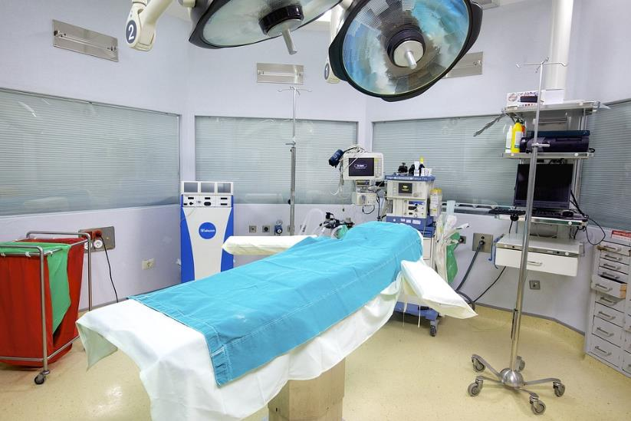
HLTHSS003 - PERFORM GENERAL CLEANING TASKS IN A CLINICAL SETTING
Prepare to clean
Clean and maintain surfaces in clinical areas Ensure maintenance of cleaning standards Manage waste
Store equipment and cleaning agents safely

Slide 2
Assessment
For this unit, you will be assessed on the following: Assessment 1
Knowledge questions Assessment 2
Observation

Slide 3
Activity 1
Activity 2
Activity 3
Activity 4
Activity 5
Activity 6
Activity 7
Activity 8
Activities & learning Check points
Learning Check Point 1
Learning Check Point 2
Learning Check Point 3
Learning Check Point 4
Learning Check Point 5

Slide 4
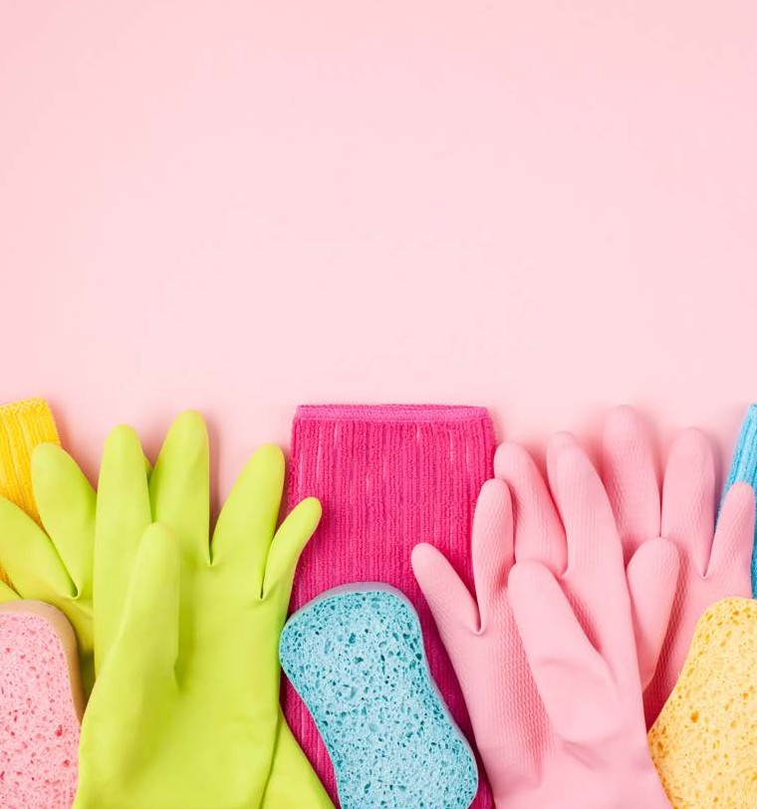
Preparing to clean
Before you begin cleaning, assess the area you will be working in.
Identify any potential hazards, delicate items, or specific cleaning requirements. Take note of any specific cleaning products or tools needed
You will also need to ensure that you are familiar with your workplace policies and procedures.
Video: Standard precautions
Notes:
You can access a sample PD here: https://careers.alfredhealth.org.au/job/53161/VIZCVUSNV/patient-services-assistant

Slide 5
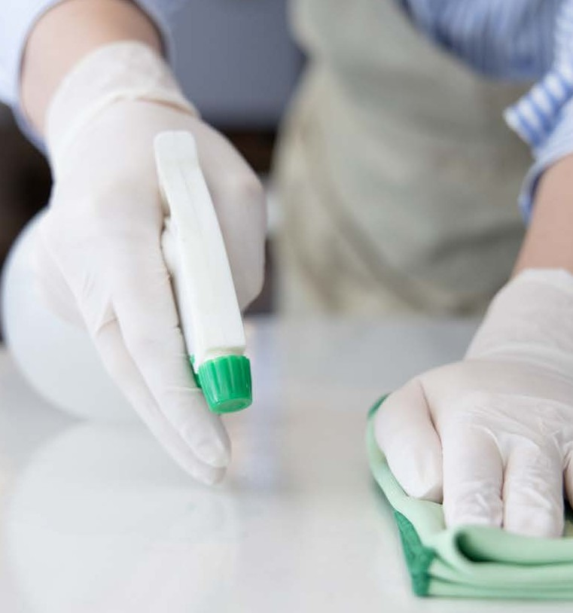
Roles and responsibilties
What is your responsibility?
Tasks could include:
Cleaning or sanitising patient rooms
Disinfecting high touch surfaces
Handling and disposing of medical waste
Record keeping
Cleaning logs and schedules
Infection control procedures

Slide 6
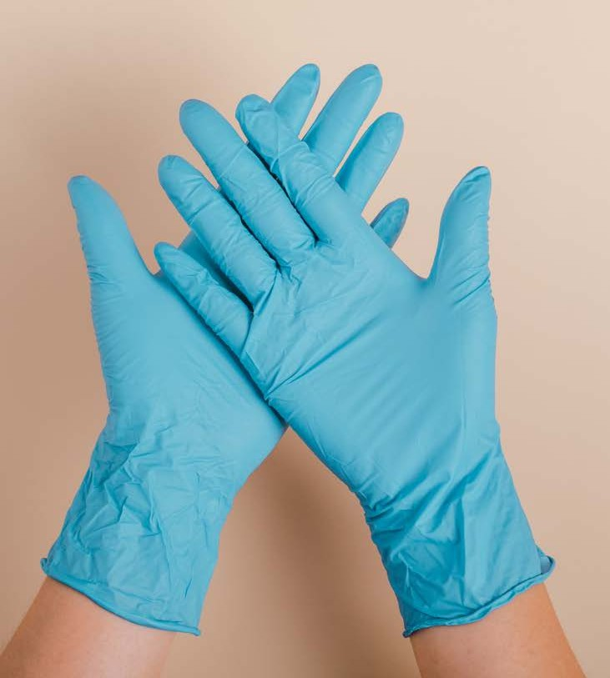
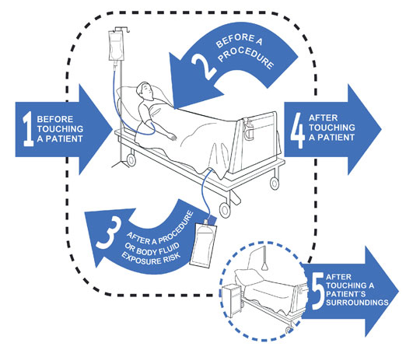
Standard precautions
Hand Hygiene 5 moments
Personal Protective Equipment (PPE) Gloves
Aprons and gowns Masks
With loops
With elastic bands/ties Protecitive glasses

Slide 7
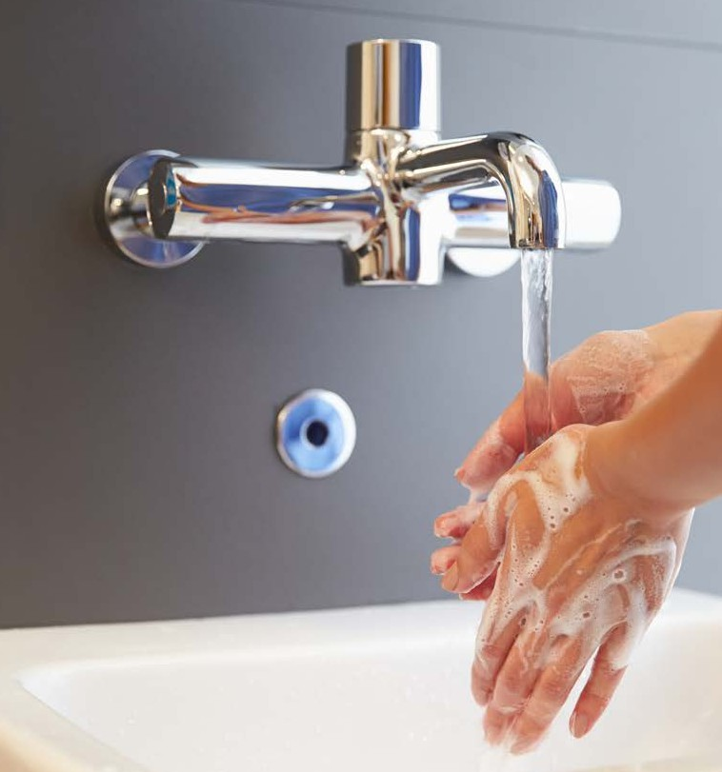
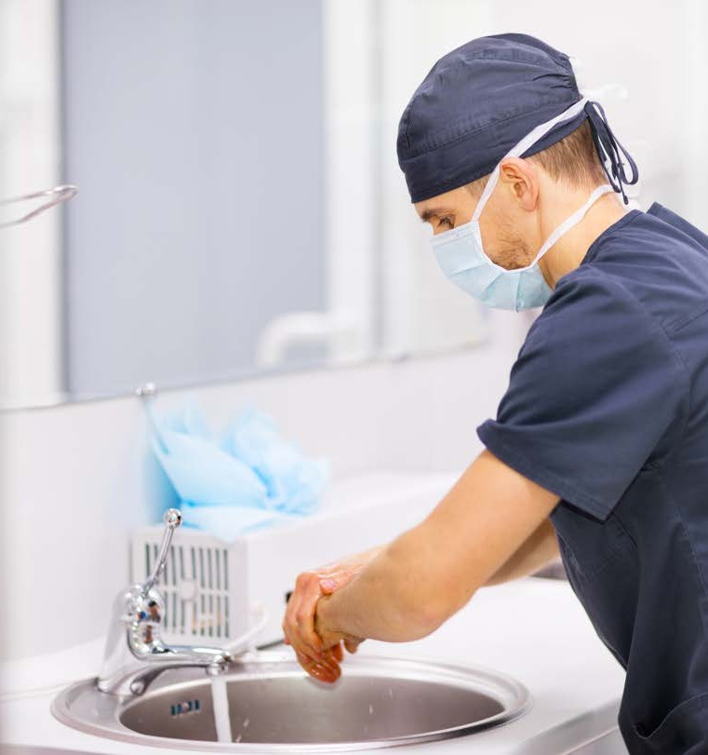
Hand Hygiene
One of the first-line approaches of standard precautions in the health services industry is hand hygiene.
Every health services organisation will have strict policies and procedures
outlining hand hygiene practices.
It is your responsibility to ensure you know and understand these
precautionary practices.
Hand Hygiene Australia
https://www.youtube.com/watch?v=IisgnbMfKvI
https://www.youtube.com/watch?v=G6z5-RikOsg
https://nhhi.southrock.com/cgi-bin/RunProgress.cgi?msecs=6a7582b5ac995c701bff72df668d4843&objid=4692330
Notes:
Access learning modules on Hand Hygiene Australia and complete the activities: https://www.hha.org.au/online-learning/complete-a-module

Slide 8
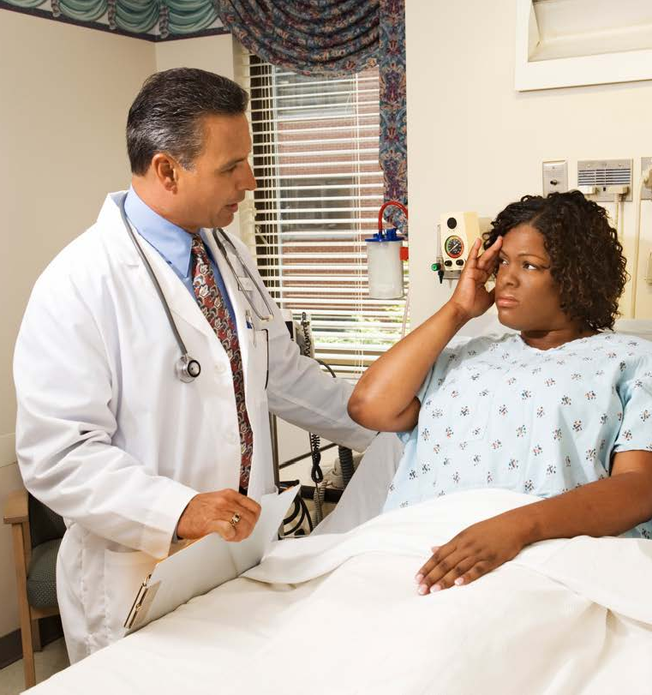
Five moments
The five moments of hand hygiene are:
Moment 1: Before touching a patient or client
Moment 2: Before a procedure or treatment
Moment 3: After exposure to blood or body fuids
Moment 4: After touching a patient
Moment 5: After touching a patient's surroundings
Five moments of hand hygiene – Access videos here.
Hand hygiene washing procedures- Watch an instructive visual video on the exact procedure for hand washing
Waterless
Routine
Clinical
Surgical

Slide 9
Hand Hygiene Washing Procedures
There are four main types of hand washing procedures:
Waterless Routine
Clinical Surgical

Slide 10
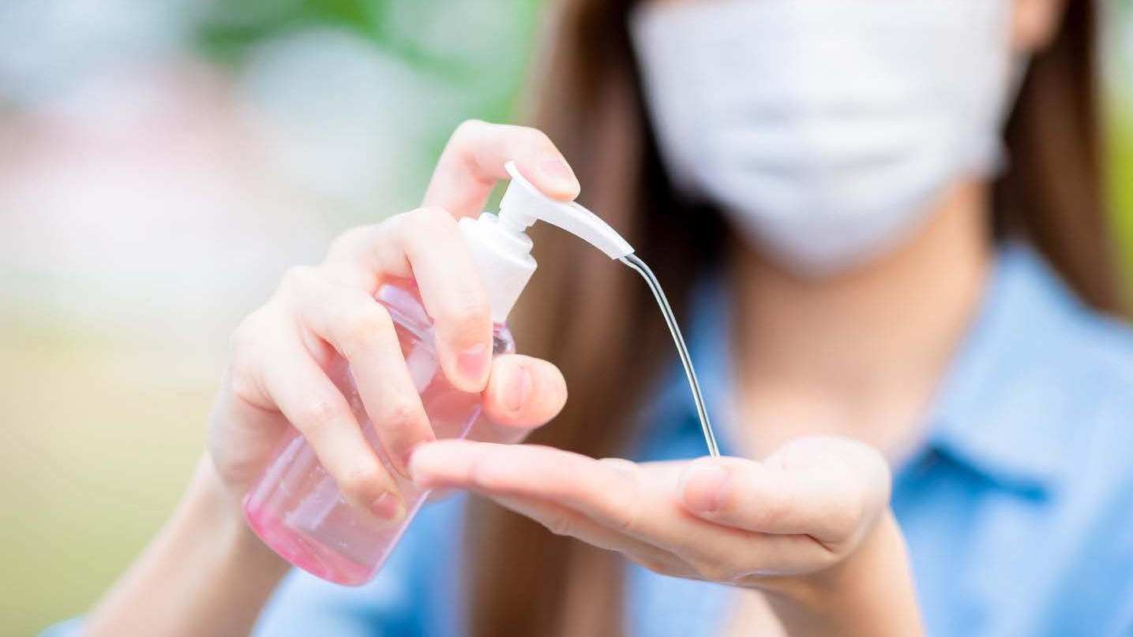
Hand hygiene product selection
Hand hygiene products should be evaluated for safety, quality and effectiveness.
Plain soap
Has small antimicrobial activity
Antimicrobial hand cleanser
Used for non-surgical and surgical hand antisepsis
Alcohol-based products
Alcohol-based rubs eradicate micro- organisms more efficiently and cause less skin irritation than soap and water hand washin

Slide 11
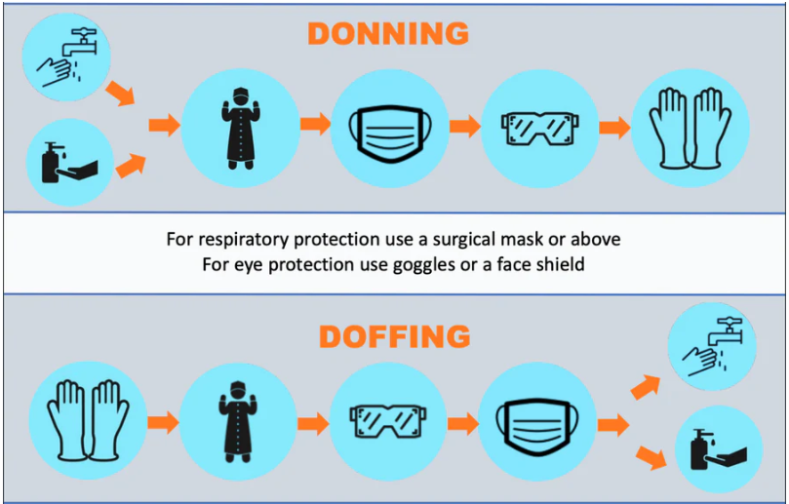
PPE Equipment
There are a number of key pieces of PPE equipment including :
Gloves
Aprons and Gowns Masks
Protective Glasses Surgical Hats
Health services organisations are
required by law to provide PPE clothing and equipment that meet strict
Australian standards.
PPE- Watch “Wearing Personal Protective Equipment in Allied Health”: This is a video for Health
professionals which describes how and when to wear Personal Protective Equipment (PPE) as
presented by Alison McMillan, Australia’s Chief Nursing and Midwifery Officer. Starting 3:58
https://www.youtube.com/watch?v=mNZJj3NL1IE

Slide 12
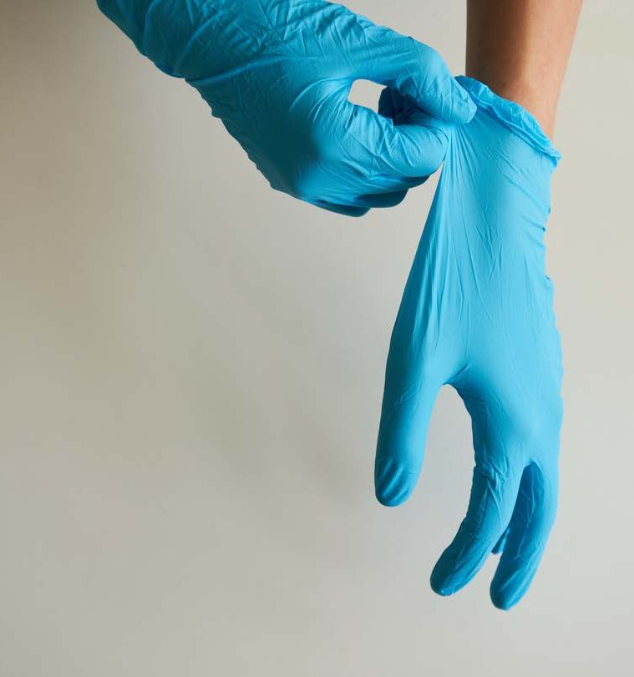
Gloves
Standard precautions recommend that gloves be worn in the following
situations:
Immediately before surgical
procedure and removed once procedure is completed
Contact with sterile instruments and equipment
Contact with broken skin, wounds and mucous membranes
All tasks that have a risk of exposure to blood, vomit and other body fluids

Slide 13
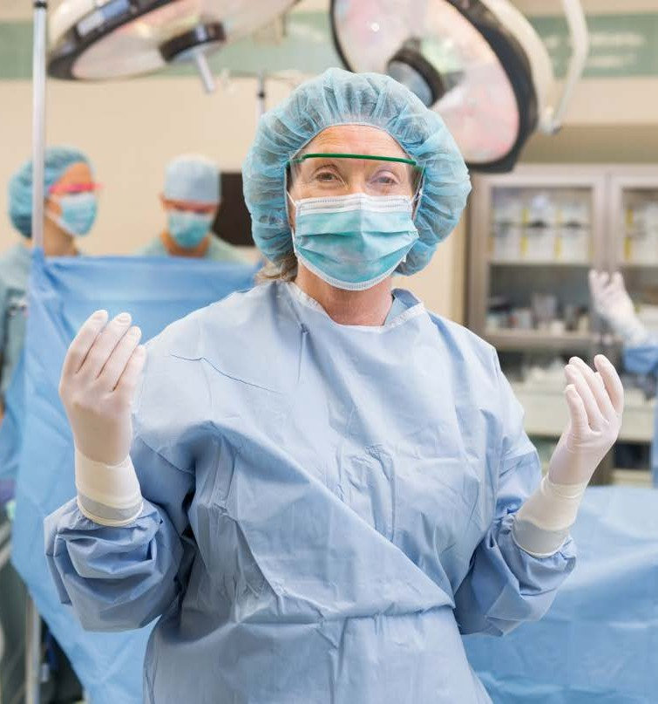
Aprons and Gowns
The main function is to act as a barrier between different sources of
contamination.
All plastic gowns and aprons used by health services workers must be sterile and can only be used once.
The goal to correctly applying your
gown / apron is to keep the own sterile and minimise the risk to both the
patient and professionals.
It is important to understand that when using multiple pieces of PPE that the
apron or gown is the last on along with gloves.

Slide 14
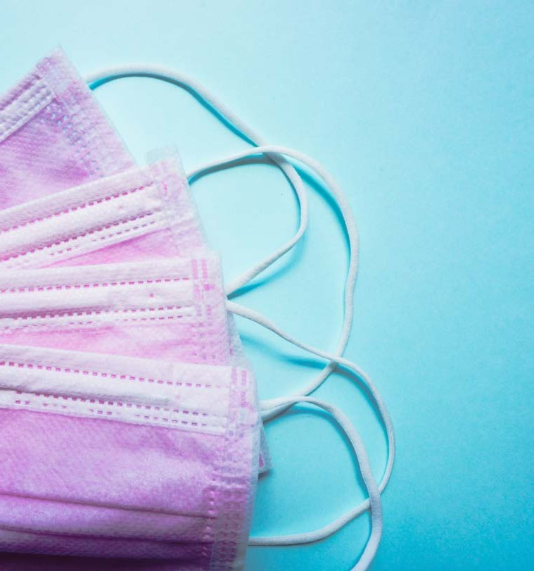
Masks
Masks are designed to protect the
wearer's mouth and nose from splatters of body fluids, respiratory secretions or droplets.
The majority of face or surgical masks are disposable and should only ever be used once.

Slide 15
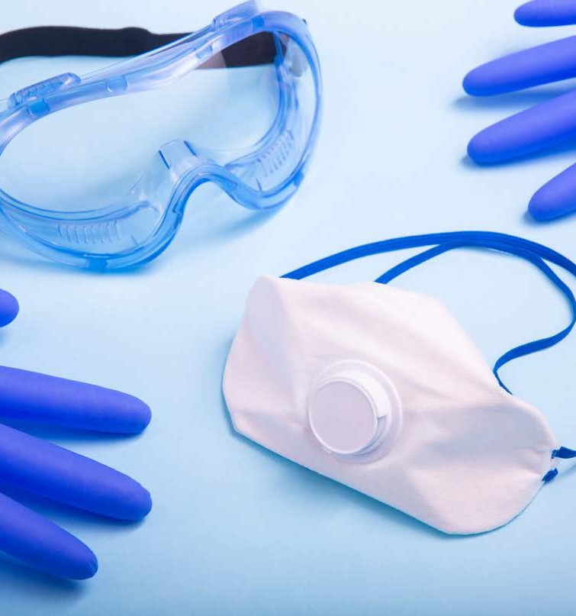
Protective Glasses
Protective glasses act to protect the eyes from splatters of body fluids or chemicals.
Ensure they fit firmly around your head so they don't fall or slip.

Slide 16
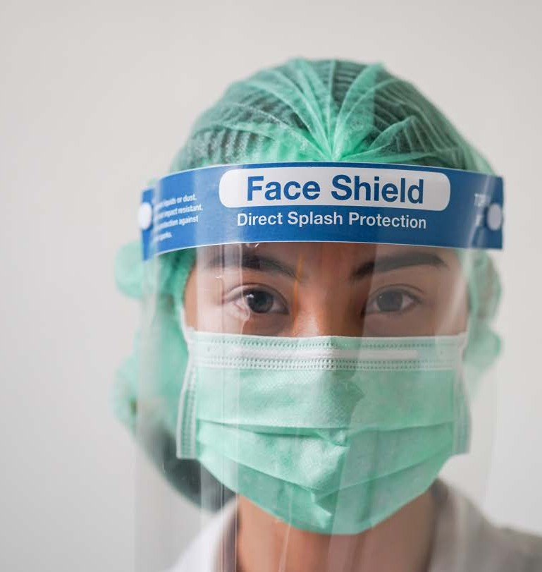
Face shields
When worn together with a properly
fitted surgical mask, face shields offer protection to others, as well
as to the wearer.
Advantages of face shields are as follows:
Offers droplet protections Can see the wear's facial expressions
Some face shields can be reused after cleaning
Provides eye protection

Slide 17
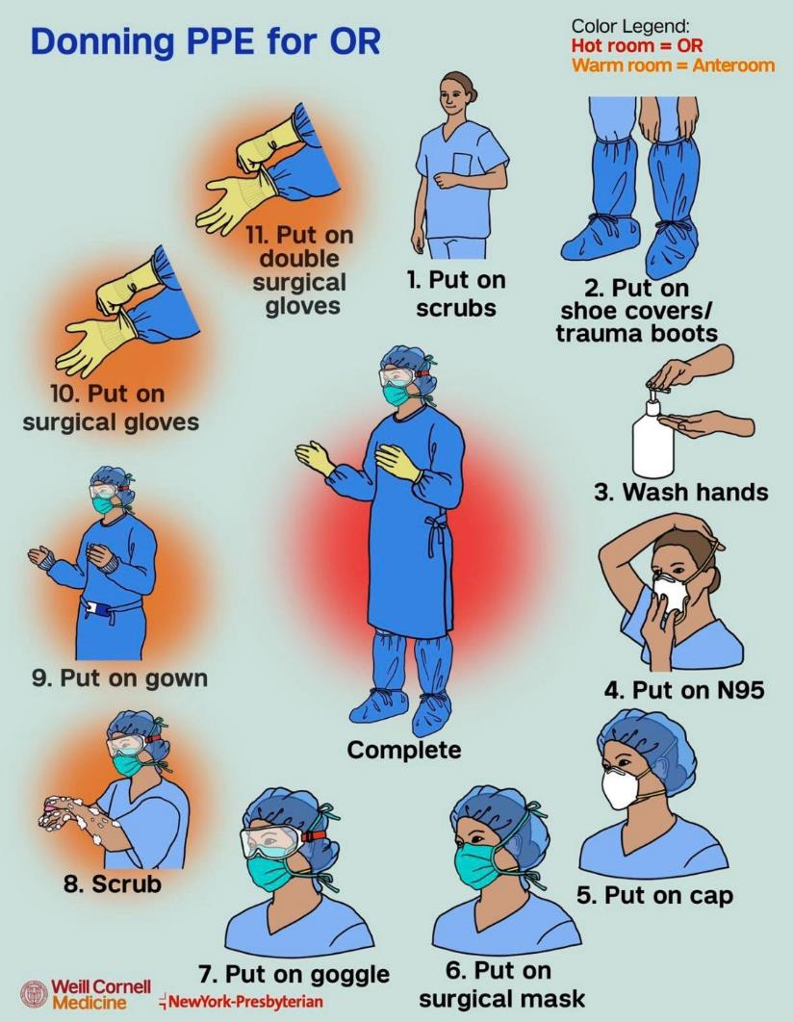
Changing PPE
To make sure that your PPE will provide you with the proper protection you will need to check the following:
Dispose of any damaged PPE
according to your organisations policies and procedures
Replace your PPE after each patient
Immediately remove any wet, dirty or contaminated PPE
If the PPE is reusable, ensure it is
placed in the appropriate location to be processed and properly cleaned.

Slide 18
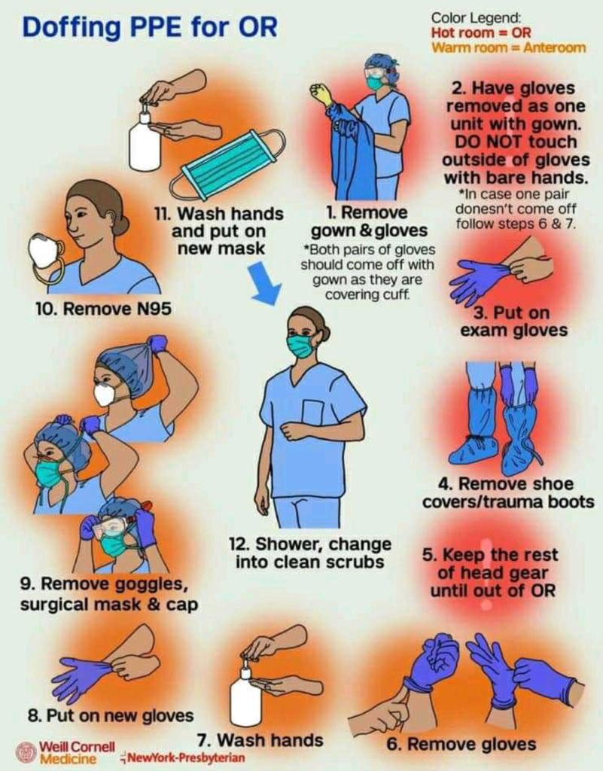
Changing PPE
To make sure that your PPE will provide you with the proper protection you will need to check the following:
Dispose of any damaged PPE
according to your organisations policies and procedures
Replace your PPE after each patient
Immediately remove any wet, dirty or contaminated PPE
If the PPE is reusable, ensure it is
placed in the appropriate location to be processed and properly cleaned.

Slide 19
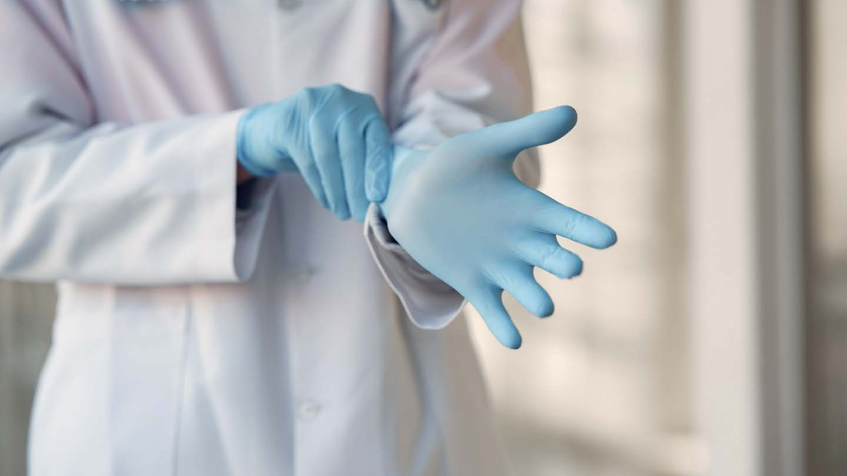
1 Practical – Hand Hygiene
Part A: Complete the online learning module provided by Hand Hygiene Australia and submit a copy of your certificate to your trainer:
https://www.hha.org.au/online-learning/complete-a-module
Part B: Practise the steps of hand washing, applying PPE (gloves and removing).
You will need to
1. Perform Hand Washing.
2. Apply gloves.
3. Remove gloves.
4. Dispose of gloves.
1

Slide 20
Learning Checkpoint 1
1. What is hand hygiene?
Hand hygiene refers to the practice of cleaning hand’s to reduce the risk of infection and
transmission of diseases.
2. What are the key factors to consider when selecting personal protective equipment (PPE) for a
particular task or situation?
• Type of hazard that could be present e.g. bodily fluid is present
• Type of protection needed e.g. just gloves
3. What are the best practices for using and maintaining PPE to ensure maximum protection for the
user?
• Donning and doffing PPE
• Following instructions of equipment
• Ensure PPE is in good condition to use e.g. not damaged
1

Slide 21
Watch video: Environmental Cleaning in Healthcare Part 1: Set up the Cleaning Cart: https://www.youtube.com/watch?v=_O4B0Nmfr40
Check and set up cleaning equipment
Inspect equipment
Assemble the equipment
Test the equipment
Adjust settings as necessary
Use equipmnet according to instrcutions
Clean and maitain the equipment

Slide 22
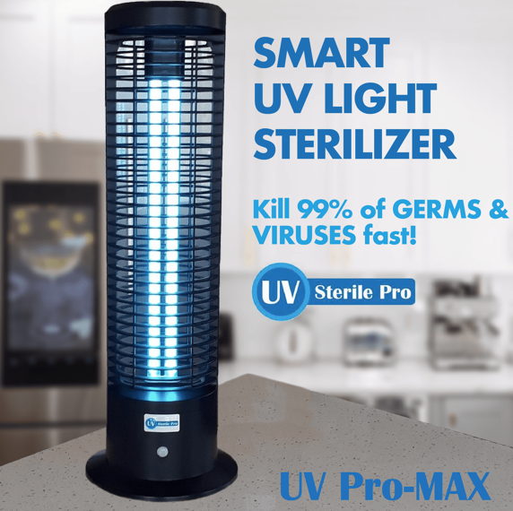
Types of equipment
Vacuums (HEPA) Mircofibre cloths UV light santisizers

Slide 23
2 Written Task– Working with surfaces
For each of the following surfaces, write down whether or not it’s minimally touched or frequently
and how you would clean it.
1. Carpeted Floors
• Frequently touched, vacuum cleaner
2. Front reception desk
• Frequently touched, detergent followed by disinfectant.
3. Waiting room chairs
• Frequently touched, detergent followed by disinfectant.
4. Spill on the tiles
• Minimally touched, detergent solution
5. Windows
• Minimally touched, detergent solution
1

Slide 24
Cleaning agents
Chemical mixed on the job or premixed Neutral pH detergents
Acidic cleaners Graffiti remover Bleach solutions Disinfectant wipes Ultraviolet disinfection

Slide 25
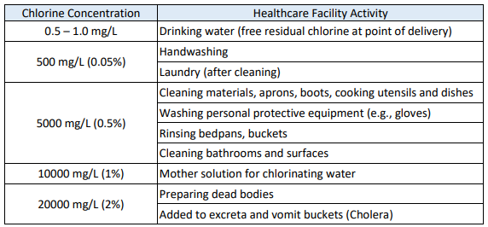
3 Research – Chlorine Calculator
https://bungalow.com/articles/protect-your-home-from-coronavirus-with-these-epa-approved-household
Using the following link Chlorine dilutions calculator (health.vic.gov.au) research some common household disinfectants to see the amount of water needed to dilute.
Chlorine, a commonly used disinfectant, can inactivate both bacteria and viruses given sufficient contact time and concentration.
1

Slide 26
4 Written Tasks – Cleaning Agents
Read through each of the following scenarios and provide what cleaning agents you would select and why.
1. Cleaning a patient's room after they were discharged
Cleaning Agent: Hospital grade disinfect and detergent
Reason: hospital-grade disinfectant will help kill any bacteria and viruses that may be present in the room. A detergent cleaner will help remove any dirt and grime from surfaces.
2. Cleaning medical equipment after use
Cleaning agents: Alcohol wipes or a bleach solution
Reason: Alcohol wipes or a bleach solution are effective in killing bacteria and viruses that may be present on medical equipment. They are also easy to use and can quickly disinfect equipment.
3. Cleaning a bathroom in a healthcare facility
Cleaning agents: A hospital-grade disinfectant and a toilet bowl cleaner
Reason: Bathrooms are high-touch areas that can harbor a lot of germs and bacteria. A hospital-grade disinfectant will help kill these germs, while a toilet bowl cleaner will help remove any stains or build up in the toilet bowl.
4. Cleaning a patient care area after a case of infectious disease
Cleaning agents: A disinfectant or a bleach solution
Reason: After a case of infectious disease, the area must be thoroughly disinfected to
prevent the spread of the disease. A disinfectant or a bleach solution is effective in killing the pathogen responsible for the disease.
1

Slide 27
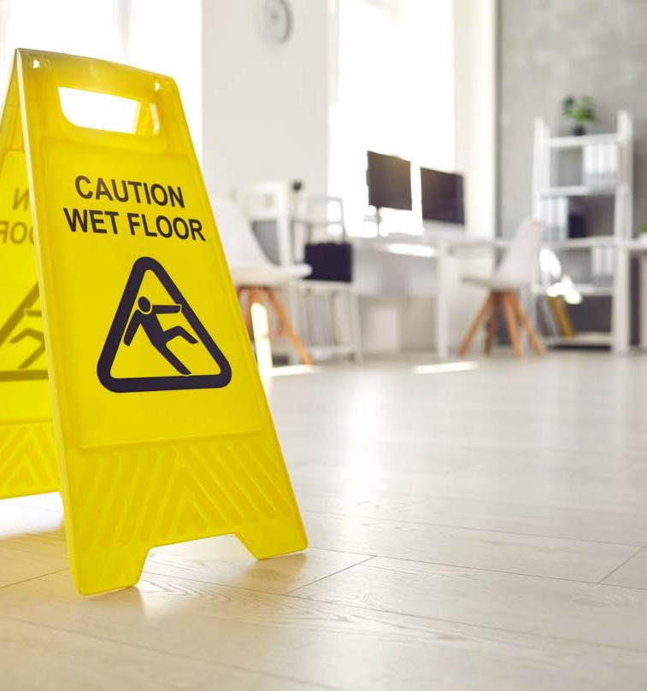
Signage
Determine the area to be cleaned
Choose appropriate barricades
Set up the barricades
Install warning signs
Secure the area
Remove barricades and signs

Slide 28
5 Practical Task – Setting up to clean
In small groups practice setting up the signs you would use for the following situations.
• Spill on the floor
- In progress cleaning sign
• Cleaning a bathroom
- In progress cleaning sign
• Cleaning a COVID-19 room
- In progress cleaning sign
Depending on what signage you have available, provide the options for the students to set up.
1

Slide 29
Learning Checkpoint 2
1. What factors should be considered when selecting cleaning agents in a healthcare setting?
• Minimally or frequently/high risk touched surface
• Type of surface
• Any transmission-based precaution
• Acute or non-acute setting
2. What types of cleaning agents are commonly used in healthcare settings?
• Detergents
• Disinfectants
• Sanitisers
3. What is the difference between cleaning and disinfecting?
• Cleaning refers to the removal of germs (bacteria and viruses), as well as dirt and grime, from surfaces using a water and detergent solution. While disinfecting involves using chemical agents to kill germs on surfaces. It's important to clean before disinfecting because dirt and grime can interfere with the effectiveness of disinfectants.
1

Slide 30
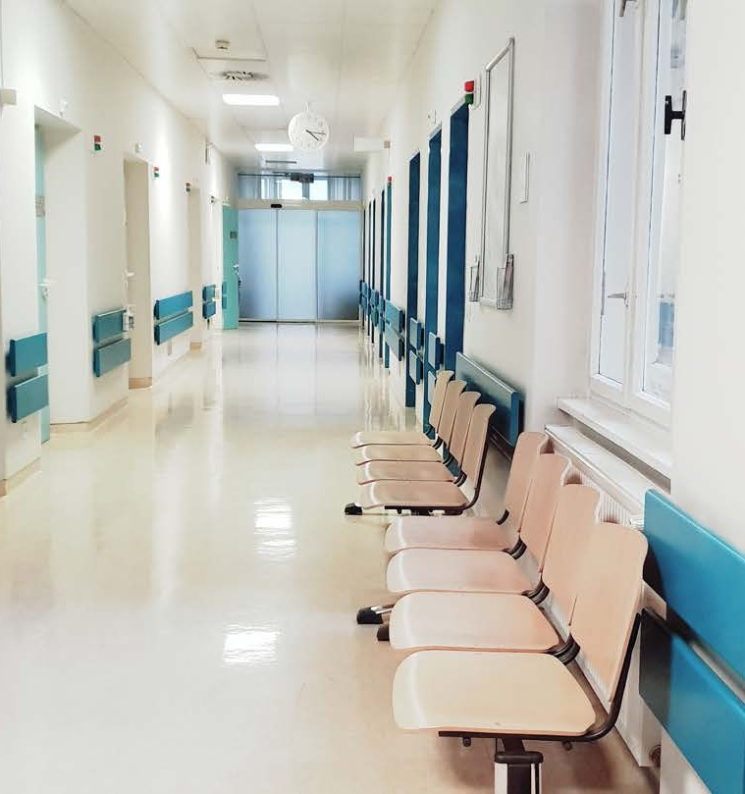
Routine surface cleaning
Routine surface cleaning can be divided into two categories:
Surfaces with minimal skin contact (i.e. floors, walls and ceilings)
Surfaces with frequent skin contact (i.e. high risk surfaces)
Notes:
Explain different surfaces
How to clean minimally touched surfaces
Technique for frequently touched surfaces
Cleaning technique considerations
Enhanced cleaning processes
What products should you use to clean and disinfect?

Slide 31
How do you clean for minimal touched surfaces?
Watch video: Environmental Cleaning in Healthcare Part 3: Clean Patient/ Resident Room (Occupied): https://www.youtube.com/watch?v=7waDSzAh28k&t=186s
Watch video: Environmental Cleaning in Healthcare Part 4: Clean Patient/ Resident Room (Discharged): https://www.youtube.com/watch?v=RQui81K3Fh0
Watch video: Environmental Cleaning in Healthcare Part 5: Clean Patient/ Resident Room (Isolation): https://www.youtube.com/watch?v=dXqy1wXyXZg
Watch video: Environmental Cleaning in Healthcare Part 6: Clean Patient/ Resident Restroom: https://www.youtube.com/watch?v=n-K8cRyZsw0
Watch video: How to clean a Hospital/Nursing Home bed: https://www.youtube.com/watch?v=sJtX2zi9Z9E

Slide 32
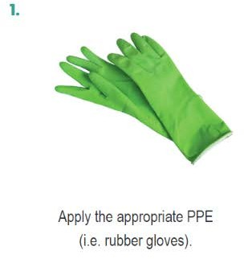
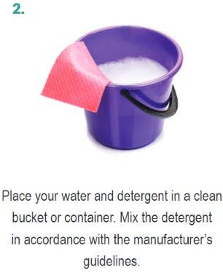
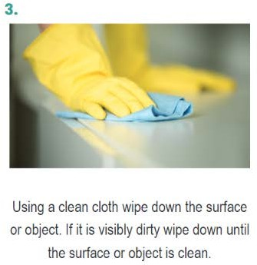
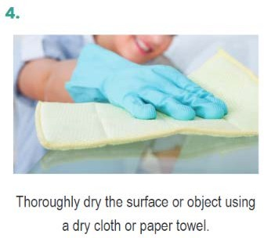
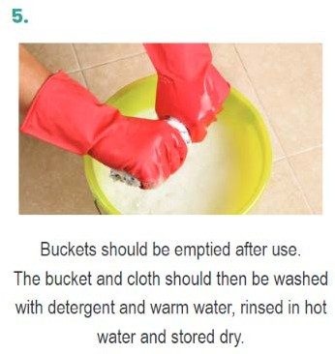
Technique for frequently touched surfaces
Combining the use of PPE and following the correct cleaning procedures helps prevent contamination of clothing, exposing of skin and mucus membranes and the transfer of harmful pathogens.

Slide 33
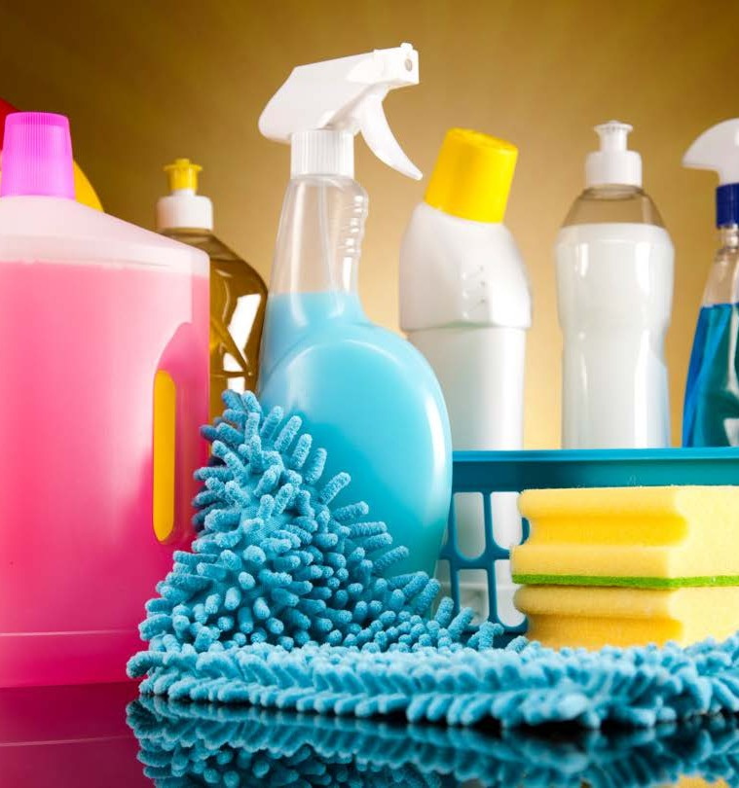
Using sanitisers and disinfectants
Correctly cleaning surfaces or objects that are suspected of being
contaminated should include either:
A two step clean
A two-in-one clean
.

Slide 34
6 Research activity – Disinfectants
Use the following website to research some of the disinfectants that you can use against COVID-19. List four of them below.
https://www.tga.gov.au/disinfectants-use-against-covid-19-artg-legal-supply-australia
1

Slide 35
Learning Checkpoint 3
1. What is environmental cleaning in healthcare?
Environmental cleaning refers to all the objects around within that environment.
2. What is the difference between minimal touch surfaces and frequently touched?
• Surfaces with minimal skin contact (i.e. floors, walls and ceilings)
• Surfaces with frequent skin contact (high-risk surfaces)
3. What steps would you take to clean a high-risk surface?
• Apply appropriate PPE
• Place your water and detergent in a clean bucket. Mix detergent accordingly.
• Use a clean cloth wipe down the surface or object. If its visibly dirty wipe down until the surface or object is clean.
• Thoroughly dry the surface or object using a dry cloth or paper towel
• Buckets should be emptied after use. The bucket and cloth should then be washed with detergent and warm water, rinsed in hot water and stored to dry.
1

Slide 36
After care procedure for contamination sharps injury
If you or another health services worker has sustained a contaminated sharps injury the following infection prevention and control procedure should be followed immediately.
Wash the wounded area of your skin with warm water and soap
Seek help from a first aid officer if needed
Inform your supervisor and lodge a report
Seek immediate medical attention from a doctor
Fill out an incident or accident report

Slide 37
7 Class Discussion – Sharps
Watch the following video on Safe disposal of sharps.
As a class have a discussion about the different types of sharps that you might encounter while
working in a health care setting. List different types of sharps in healthcare here.
Safe Disposal of Sharps | Diabetes Australia
1

Slide 38
Managing blood and bodily fluids spill
Apply the appropriate PPE Ensure the affected area is safe
Use a disposable absorbent material to clean up the spill
Dispose of the contaminated material in accordance with correct procedure
Clean the area using a detergent-disinfectant solution
Thoroughly dry the area or display the correct signage
Managing blood and bodily fluids spill
Watch video: How to clean up Blood Spills/ 10 steps to clean blood spills ￼ @NursingMCQs: https://www.youtube.com/watch?v=t1BzYfVepsM

Slide 39
Cleaning frequency, times and schedules
Depending on the environment all health services organisations will have areas cleaned as part of a regular schedule such as floors, bathrooms, and toilets.
Cleaning will also take place in response to an incident or accident.
All health services organisations must complete regular cleaning in order to be compliant with various health regulations and to also maintain a safe environment for patients, visitors and workers.
Cleaning schedules may contain information about: Tasks that must be completed
Classification of areas (i.e. low, moderate or high risk area) Dates and times of when cleaning is scheduled
Personnel performing specific tasks
Contact information of personnel or service if cleaning is not performed on a scheduled date and time

Slide 40
Cleaning logs
A cleaning log is a document that details all cleaning tasks that must be completed in a particular room,
space or area.
Cleaning logs require the following information:
The name of the staff member completing the task When completed Staff must place a tick or their initials next to the task
The date and the time they completed the cleaning must be recorded

Slide 41
Learning Checkpoint 4
1. What is a cleaning log?
A document that contains all the records and activities of cleaning in a particular area.
2. Why is it important to maintain a cleaning log?
Cleaning logs help communicate with other workers the tasks that have been done and which ones are yet to be completed.
3. What information should be included in a cleaning log?
Cleaning logs require the following information:
• The name of the staff member completing the task
• When completed Staff must place a tick or their initials next to the task
• The date and the time they completed the cleaning must be recorded
4. What information is included in a cleaning schedule?
Cleaning schedules may contain information about:
• Tasks that must be completed
• Classification of areas (i.e. low, moderate or high-risk area)
• Dates and times of when cleaning is scheduled
• Personnel performing specific tasks
• Contact information of personnel or service if cleaning is not performed on a scheduled date and time
1

Slide 42
Learning Checkpoint 4
5. What PPE should be worn when managing blood spills?
• Gloves
6. What disinfectant solution should be used to clean up blood spills?
• Detergent and disinfectant solution
7. What measures should be taken to prevent blood spills from occurring in the first place?
• Ensure safe injection practices are following
• Wearing appropriate PPE
1

Slide 43
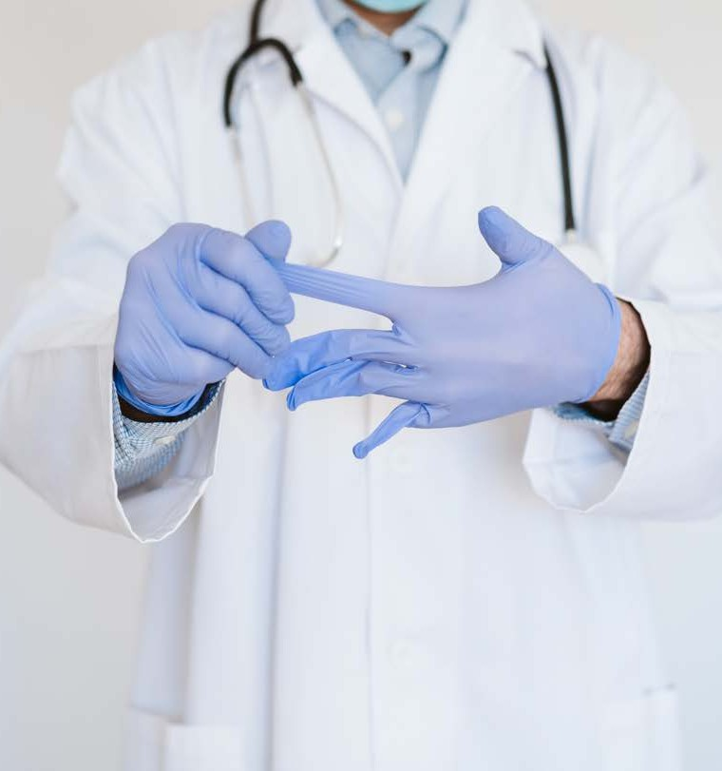
Contaminated waste
The handling and disposing of waste varies according to the type of waste.
When working in the health service industry there are specific types of waste including:
clinical waste general waste
cytotoxic waste
pharmaceutical waste needles and sharps

Slide 44
8 Research – Waste Management
Access the following waste management guide
https://www.health.vic.gov.au/planning-infrastructure/guides-to-waste-management
Find for each of the following categories: Recycling, clinical waste, and related waste. Document one type of waste, its management on onsite and any related legislation or policies and procedures.
1

Slide 45
Clean Zones
Clean zones are designated areas for non-contaminated materials and should be relatively free of contaminants.
Clean zones can be work stations and benches to entire rooms or areas. These zones must be kept clean at all times.

Slide 46
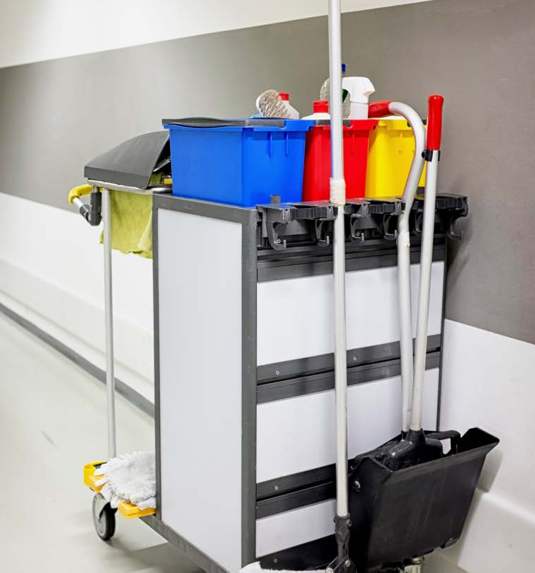
Contaminated instruments and equpiment
Contaminated instruments and equipment may include:
linen
bandages dressings
drinking glasses needles
medical charts

Slide 47
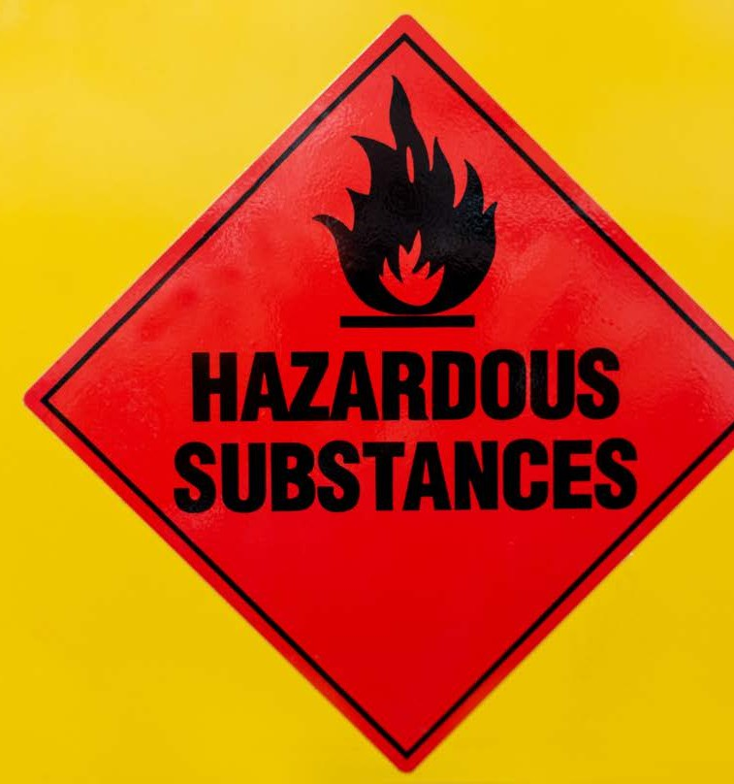
Hazards
It is important to know the difference between a hazard and a risk so
workers can be conscious of the hazards in their environment and understand the risk they pose.
Hazard: A source or situation with the potential to cause harm.
Risk: A chance or probability that a
hazard will cause harm, illness or injury and is measured by likelihood and
consequence.

Slide 48
Common cleaning hazards
Slippery surfaces Loose electrical fittings Broken glass
Shar surfaces
Fumes from cleaning

Slide 49
Identify the hazard
Hazard identification in a workplace should be an ongoing process that should be completed at various times.
Hazard identification methods may include: Talking with staff and other workers Conduct physical inspections
Document and report any activities or tasks that put workers and patients at risk Reviewing records of accidents and ‘near misses’
Media
Publications such as online hazard alerts

Slide 50
Risk Assessment
A risk assessment is about finding aspects of an organisation that have the potential to negatively impact the health and safety of workers and patients within a working environment.
Risk assessment is about looking at each hazard identified and evaluating the potential risks that may occur and the level of harm they may cause.
Conducting a risk assessment is a
systematic process that follows three key steps.
Identify the hazard (hazard identification)
Assess the risk. Determine the likelihood of the risk occurring, turning into an
accident, injury or loss, the potential
harm or consequences and rate the risk based on the potential severity of the
harm.
Determine and implement control options to eliminate or minimise the risk.

Slide 51
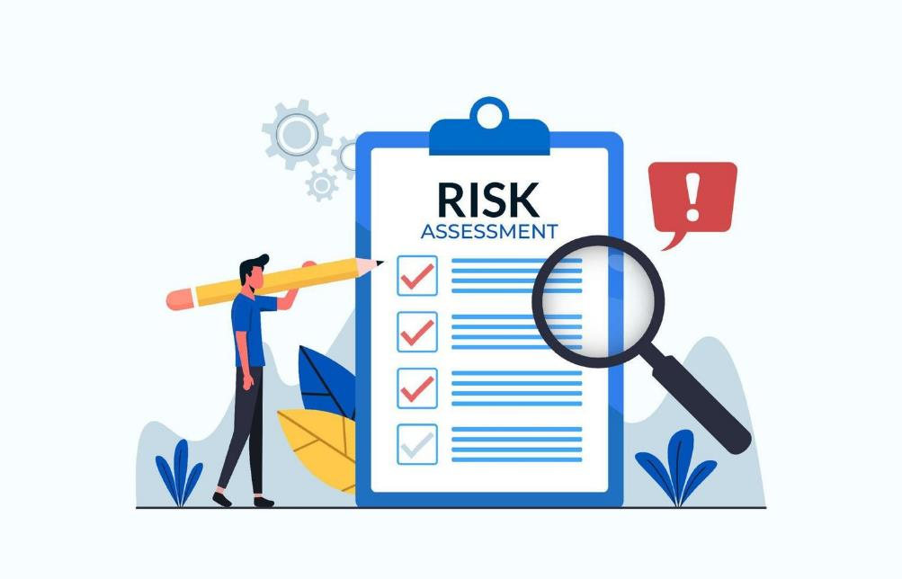
Conducting a risk assessment
Conducting a risk assessment is a
systematic process that follows three key steps.
Identify the hazard (hazard identification)
Assess the risk. Determine the likelihood of the risk occurring, turning into an
accident, injury or loss, the potential harm or consequences and rate the risk based on
the potential severity of the harm.
Determine and implement control options to eliminate or minimise the risk.

Slide 52
Assess the risk
The likelihood of a risk can then be determined in a number of different ways:
Quantitatively: The likelihood of the risk occurring is expressed in numbers that identify the probability of the risk occurring. These likelihoods may be expressed as percentages, fractions or ratios or a ranking between 0 and 1.
Ranking: If a number of hazards or risks have been identified they can be ranked from the most likely to occur to the least likely.
Qualitatively: The likelihood of the risk occurring is categorised using descriptive words e.g. high, medium, low, rarely, moderate and likely, using a matrix like the one below.

Slide 53
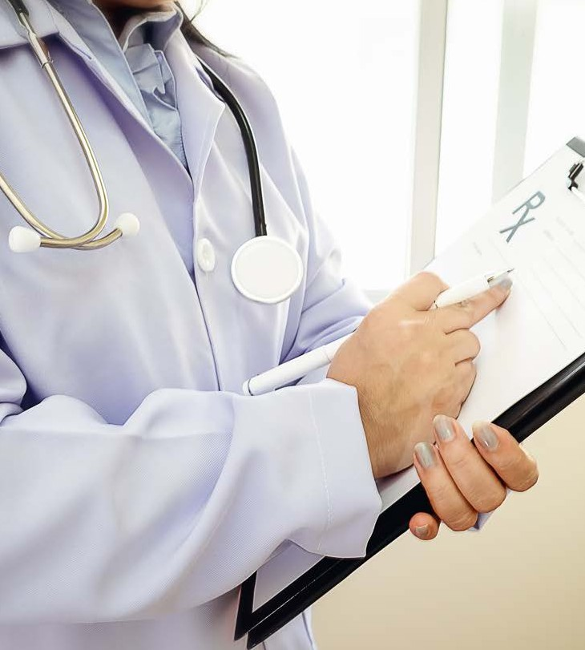
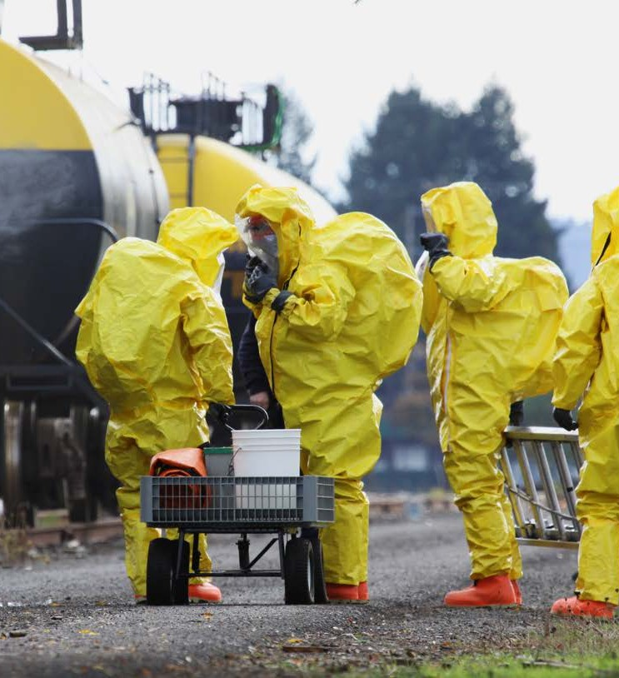
Severity of harm
Once the likelihood of a risk occurring has been determined the consequences need to be considered.
The consequences of a risk can be determined through research and an understanding of the risk.
Just as likelihood can be ranked, so can the consequences of a risk.
This ranking is based on the amount of loss a risk may cause (e.g. loss of time, loss of workers and patients), the severity of harm from identified hazards (insignificant, minor, moderate, major or catastrophic) and the number of people who might be exposed and affected by the risk.

Slide 54
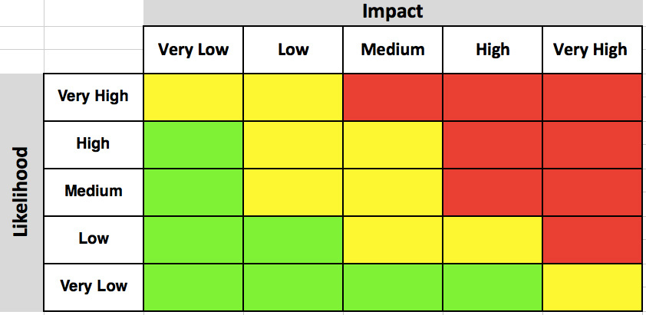
Risk analysis matrix
Once the likelihood and consequences of a risk have been determined the risk can be rated according to organisational procedures.
Risks are usually rated using a risk analysis matrix; these will vary depending on the industry and the potential for illness, injury loss, and accidents within the specific
workplace or organisation.

Slide 55
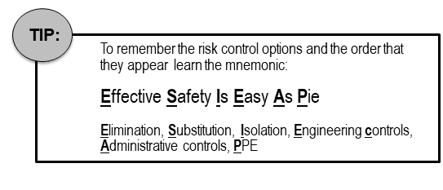
Risk Control Options
Some risk control options are more effective and reliable than others.
The hierarchy of control from WorkSafe provides a number of options for managing and controlling hazards and risks within the workplace.
The options are ranked from the highest level (Level 1) of protection and reliability to the lowest (Level 3).

Slide 56
Risk assessment methods
Methods may include, but are not limited to:
Using a checklist
Using risk assessment software systems Adopting the ‘what if’ approach

Slide 57
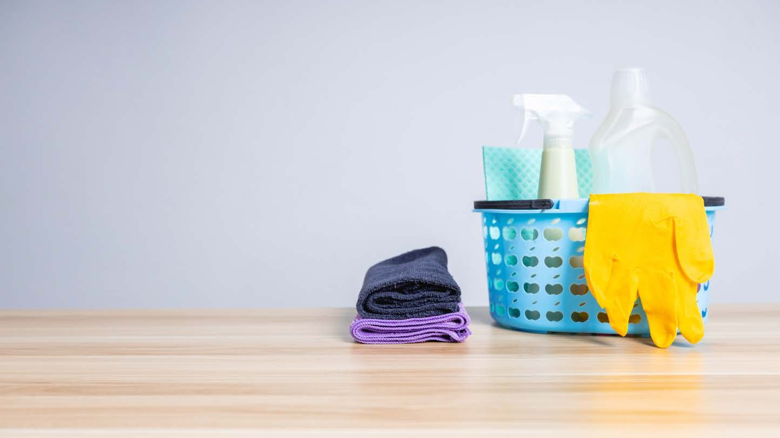
Gross Tissue Samples
Gross tissue samples are taken from individuals to use as a diagnostic tool, these samples are collected by medical professionals such as pathologists.
Examples of gross tissue samples include: Biopsy specimens
Surgical specimens Autopsy specimens Organ specimens Skin biopsies Muscle biopsies.
Bone biopsies

Slide 58
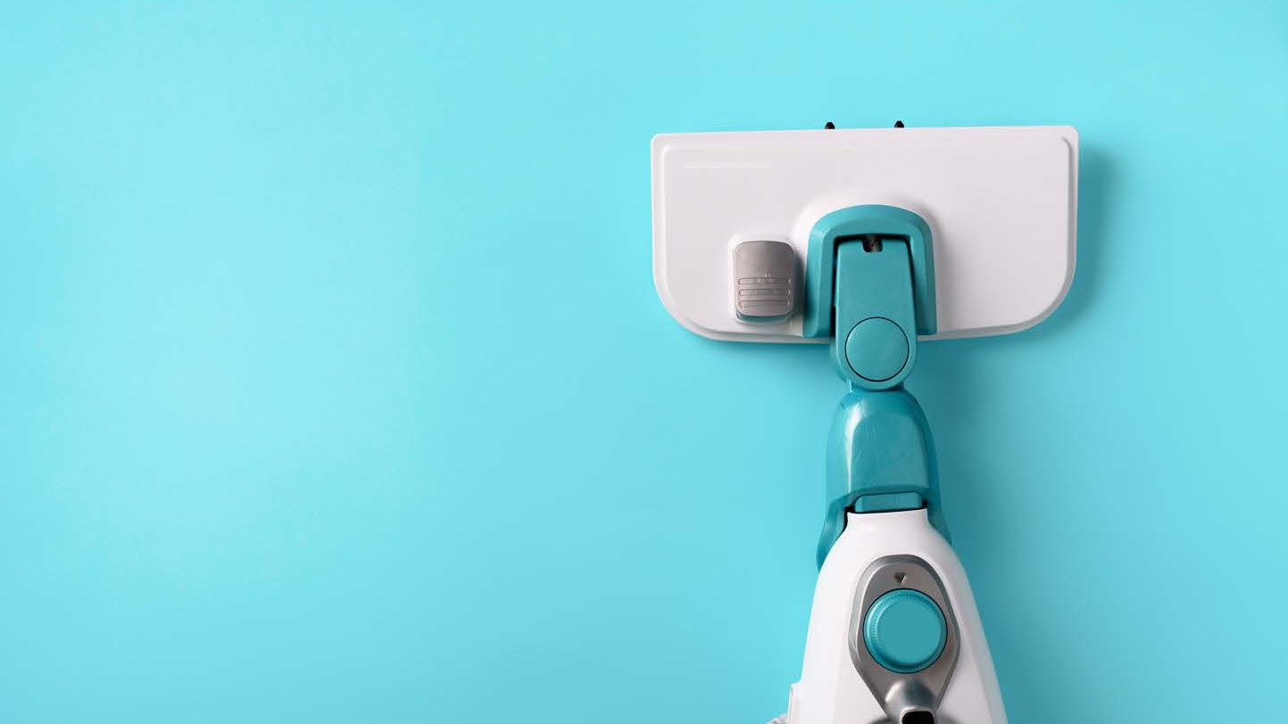
Manual handling
Manual handling refers to any action that involves the use of physical force to lift, lower, push, pull, carry, or move objects or people.
Common manual handling tasks for cleaning: Bending and reaching
Mopping Sweeping Vacuuming
Lifting
Moving furniture Repetitive tasks
Scrubbing Wiping Dusting

Slide 59
Learning Checkpoint 5
1. What is clinical waste, and why is it important to manage it appropriately?
Clinical waste is the waste from healthcare activities that can be dangerous. It includes things like used needles, contaminated bandages, human tissues, and expired medications.
Preventing Infections: Proper disposal stops the spread of diseases.
Safety: Correct disposal prevents injuries from sharp objects.
Environmental Protection: Proper handling prevents pollution.
2. What are the different types of clinical waste?
• Blood • Bodily fluids • Gross tissue samples
3. What is the process of disposing of sharps?
• When handling sharps the appropriate PPE must be used at all times.
• Sharps must not be passed directly from hand to hand
• Used sharps must be discarded into a sharp’s disposal container immediately after use
• Do not bend or manipulate sharps for disposal
• Sharps containers must not be filled above the marks that indicates that the bin is nearly full
4. Why is it important to follow manual handling procedures?
To prevent yourself from injury.
1

Slide 60
Assessment 1 Knowledge Questions
1. Which of the following is included in organisation procedures relating to cleaning schedules and
routines? Select the correct answers.
a) Selecting appropriate cleaning agents
b) Identifying the type of surface
c) Determining the frequency of cleaning required
d) Identifying any sharps that may be present
e) Personnel performing the task
DEFAULT QUESTION: Provide two (2) items of what is included in a cleaning schedule and routines procedures.
• Tasks to be completed
• Classification of areas
• Dates and times of when cleaning is scheduled
• Personnel performing the task
• Contact information if cleaning is not performed
2. When would it be appropriate to use:
a) Disinfectant
b) Detergent
a) A disinfectant should be used when contamination of infectious agents are suspected.
b) A detergent most commonly is used to for the removal of dirty and organic matter.
1

Slide 61
Assessment 1 Knowledge Questions
3. What cleaning procedure do you need to follow high risk surface in an acute setting?
a) Use detergent
b) Disinfectant only
c) Use detergent and then disinfectant
d) Use disinfectant and then detergent
DEFAULT QUESTION: What defines a high-risk surface?
Surfaces with frequent skin contact
4. How should sharps be disposed of?
a) Regular waste bin
b) Sharps container
c) Zip lock bag
d) Wrapped up in some paper towel
DEFAULT QUESTION: When do sharps need be disposed?
Immediately after use
5. Explain why it’s important to follow manual handling procedures while cleaning.
To prevent yourself from getting injured.
6. Provide two (2) ways you can protect yourself from infections during cleaning?
Answers might include:
• Hand Hygiene
• Wearing PPE
• Cleaning equipment after use
1

Slide 62
Assessment 1 Knowledge Questions
7. Which of the following is a recommended safety precaution when handling gross tissue
samples?
a) Wearing gloves
b) Wearing an apron
c) Using bare hands
d) Using disinfectant wipes
DEFAULT QUESTION: Provide one (1) example of infection control when cleaning gross tissue
samples?
• Wearing appropriate PPE i.e. gloves
8. What types of equipment is suitable for general cleaning in a healthcare setting for cleaning
carpet?
a) Feather duster
b) Vacuum cleaner with HEPA filter
c) Microfibre cloth
d) Robot vacuum
DEFAULT QUESTION: Provide one (1) example of equipment that you could use to clean a
table?
• Microfibre cloth
9. For a frequently touched surface in an acute setting what type of cleaning agent would you use?
Detergent followed by a disinfectant.
1

Slide 63
Assessment 1 Knowledge Questions
10. What are two (2) important factors to consider when following manufacturing guidelines for cleaning equipment and agents?
• Following instructions of use on cleaning agents and equipment
• Storage requirements
• Safety protocols e.g., wearing PPE
11. What are two (2) cleaning responsibilities within your work role?
• Following infection control procedures
• Recording of cleaning activities through cleaning logs
• Disposing of medical waste by following workplace policies and procedures
12. When cleaning clinical waste, body fluids and tissue, what do you need to be aware of?
a) Cross-contamination
b) Transmission of infection
c) Appropriate cleaning agents
d) All of the above
DEFAULT QUESTION: Why are clinical waste, body fluids and tissue considered cleaning hazards and why do they need specific cleaning agents?
Because they carry infectious microorganisms and can transmit them to the person handling them while cleaning or cross contaminate other surfaces and require specific disinfection and cleaning agents.
1

Slide 64
Assessment 1 Knowledge Questions
13. For each of the following cleaning hazards outline one potential risk.
Cleaning Hazard | Risk
Slippery surfaces | Risk of falls
High bacteria growth | Risk of infection
Client’s cleaning chemical mixtures | Cleaning procedures are not followed
Unlabelled cleaning chemical containers | Improper handling or chemicals due to miss labelling
Allergic reactions | Risk of Allergic reaction
Broken Glass | Risk of cuts
High bacteria growth | Risk of infection
Needle stick injury | Risk of infection from cross contamination
Loose electrical fittings | Risk of electrocution and tripping hazard
1

Slide 65
Assessment 1 Knowledge Questions
14. Proved one (1) example of a sharp surface other than a needle.
• Scalpel
• Broken Glass
• Broken Equipment
15. Explain the difference between chemicals mixed on the job or premixed.
Mixing chemicals on the job involves combining different chemicals to create a specific solution or product. Whereas pre-mixed chemicals are those that are already mixed and packaged before they are used.
16. What is a benefit of using a neutral pH detergent?
• It’s gentle on the environment.
• It can be used on delicate surfaces.
17. What active ingredient is in an acidic cleaner?
a) Hydrochloric acid
b) Phosphoric acid
c) Sulfuric acid
d) All of the above
DEFAULT QUESTION: Name one (1) active ingredient in an acidic cleaner.
• Hydrochloric acid
• Phosphoric acid
• Sulfuric acid
18. How does graffiti remover work?
Graffiti removers contain powerful chemicals that are designed to break down and dissolve the paint or ink used in the graffiti, making it easier to remove with a scrub brush or pressure washer.
1

Slide 66
Assessment 2 Performance Demonstration
During this task, you will be required to demonstrate your ability to:
• To undertake cleaning of a clinical setting with the following hazards
o Clinical waste o Body fluid spill o Sharps
In this assessment, you will be doing three (3) different cleaning tasks.
1. Clinical Waste 2. Body Fluid Spill 3. Sharps
For each of the cleaning tasks you will need to:
1. Prepare for cleaning.
• Wear appropriate PPE. • Check and set up cleaning equipment. • Select cleaning agents.
2. Clean and maintain surfaces
• Identify surface type and texture. • Select cleaning equipment, agent, and method. • Clean surfaces and dry.
3. Ensure maintain of cleaning standards.
• Maintain the cleanliness of wear areas • Clean unit or location to achieve low bacteria condition.
• Ensure surfaces and areas are regularly cleaned
• Follow infection control procedures to minimise to cross-contamination
4. Manage waste
• Assess waste for risks and handle • Remove waste to maintain a clean and study areas to ensure
• Spot clean waste receptable and replace liners
5. Store equipment and cleaning agents safely
• Dry and clean equipment before storage
• Store cleaning agents in accordance with manufacturer instructions and organisational policy.
1

Slide 67
Assessment 2 Performance Demonstration
Case Study
You are a nurse's assistant at a Caring Hearts healthcare service. Today you are assisting with the clean-up of a client room. The room has been left unclean. The previous patient has left urine all over the floor in the bathroom. The nurse has left behind the syringe (sharps) and there is blood on the table next to the syringe. You need to clean up the room and make it ready for the next client.
You’ll need to refer to the: Caring Hearts Cleaning Standards and Cleaning schedule.
1

