Slide 1
Approximations, decimal places and significant figures
10A
Notes:
https://www.transum.org/software/SW/Starter_of_the_day/Students/Rounding.asp

Slide 2
Let’s Review Measurements:
Every measurement has UNITS.
Every measurement has UNCERTAINTY.

Slide 3
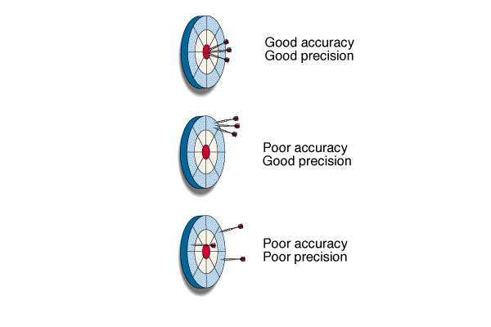
Accuracy and Precision in Measurements
Accuracy: how close a measurement is to the accepted value.
Precision: how close a series of measurements are to one another or how far out a measurement is taken.

Slide 4
Maths Estimations
Rounding
Decimal places
Significant figures
Scientific notations

Slide 5
DEMO
Rounding using Decimal Places.
YOUR TURN
Round this number to 2 decimal places.
Round this number to 1 decimal place.
Stay or round up?
Stay or round up?
CHECK
CHECK
1.36801
2.79
1.37
2.8
1.36801 (2dp) = 1.37
2.79 (1dp) = 2.8
1) ‘Cut’ the number.
2) Use the first cut digit to check
whether to round UP.
(Remember: a 5 means the last digit is rounded up)

Slide 6
DEMO
Rounding using Decimal Places.
YOUR TURN
Round this number to 2 decimal places.
Round this number to 2 decimal places.
Stay or round up?
Stay or round up?
CHECK
CHECK
1.36801
8.5547
1.37
8.55
1.36801 (2dp) = 1.37
8.5547 (2dp) = 8.55
1) ‘Cut’ the number.
2) Use the first cut digit to check
whether to round UP.
(Remember: a 5 means the last digit is rounded up)

Slide 7
Significant Figures are used to indicate the precision of a measured number or to express the precision of a calculation with measured numbers.
In any measurement
the digit farthest to the right is considered to be estimated.
0
1
2
2.0
1.3

Slide 8
When to use Significant figures
  To a mathematician 21.70, or 21.700 is the same.

Slide 9
But, to a scientist 21.70cm and 21.700cm is NOT the same
21.700cm to a scientist means the measurement is accurate to within one thousandth of a cm.

Slide 10
How do I know how many Sig Figs?
Rule: Nonzero integers (1-9) always count as significant figures.
  3456 has 4 sig figs (significant figures).
.

Slide 11
How many sig figs?
7
40
0.5
0.00003
7 x 10⁵
7,000,000
1
1
1
1
1
1

Slide 12
How do I know how many Sig Figs?
There are three classes of zeros.
a. Leading zeros are zeros that precede all the nonzero digits. These do not count as significant figures.
  0.048 has 2 sig figs

Slide 13
How do I know how many Sig Figs?
b. Captive or sandwiched zeros are zeros between nonzero digits. These always count as significant figures.
  16.07 has 4 sig figs.

Slide 14
How do I know how many Sig Figs?
c. Trailing zeros are zeros at the right end of the number. They are significant only if the number contains a decimal point.
  9.300 has 4 sig figs.
  150 has 2 sig figs.

Slide 15
How do I know how many Sig Figs?
  300. Contains three significant figures.
  Notice the decimal made the 2 zeros significant. If the number was written as 300 without the decimal then it would only have one sig fig.
.

Slide 16
How many sig figs here?
3401
2100
2100.0
5.00
0.00412
8,000,050,000
4
2
5
3
3
6

Slide 17
How many sig figs here?
1.2
2100
56.76
4.00
0.0792
7,083,000,000
2
2
4
3
3
4

Slide 18
Mathematicians are Lazy!!!
They decided that by using powers of 10, they can create short versions of long numbers.

Slide 19
Rules for Scientific Notation
To be in proper scientific notation the number must be written with
* a number between 1 and 10
* and multiplied by a power of
ten
23 X 10⁵ is not in proper scientific notation. Why?

Slide 20
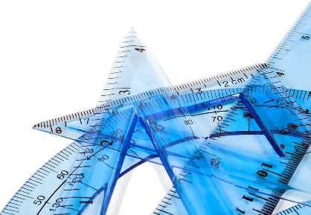
For example:
4.5 x 10³
The number 4,500 is written in scientific notation as ________________.
The coefficient is _________.
4.5
The coefficient must be a number greater than or equal to 1 and smaller than 10.
The power of 10 or exponent in this example is ______.
3
The exponent indicates how many times the coefficient must be multiplied by 10 to equal the original number of 4,500.

Slide 21
Rules to Write Scientific Notation!
If a number is greater than 10, the exponent will be _____________ and is equal to the number of places the decimal must be moved to the ________ to write the number in scientific notation.
positive
left

Slide 22
Rules to Write Scientific Notation!
If a number is less than 10, the exponent will be _____________ and is equal to the number of places the decimal must be moved to the ________ to write the number in scientific notation.
negative
right

Slide 23
Rules to Write Scientific Notation!
1. Move the decimal to the right of the first non-zero number.
2. Count how many places the decimal had to be moved.
3. If the decimal had to be moved to the right, the exponent is negative.
4. If the decimal had to be moved to the left, the exponent is positive.

Slide 24
Soooo
137,000,000 can be rewritten as
1.37 X 10⁸

Slide 25
Now You Try
Using scientific notation, rewrite the following numbers.
347,000.
3.47 X 10⁵
902,000,000.
9.02 X 10⁸
61,400.
6.14 X 10⁴

Slide 26
Try These
4,000
4 X 10³
2.48 X 10³
2,480
6.123 X 10⁶
6,123,000
306,000,000
3.06 X 10⁸

