Slide 1
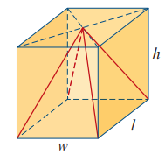
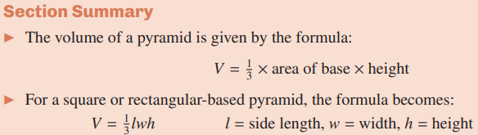
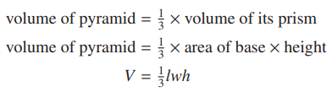

Slide 2
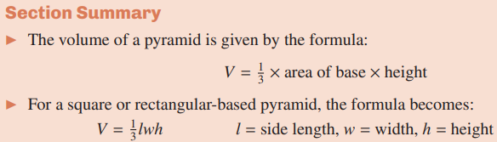

Slide 3
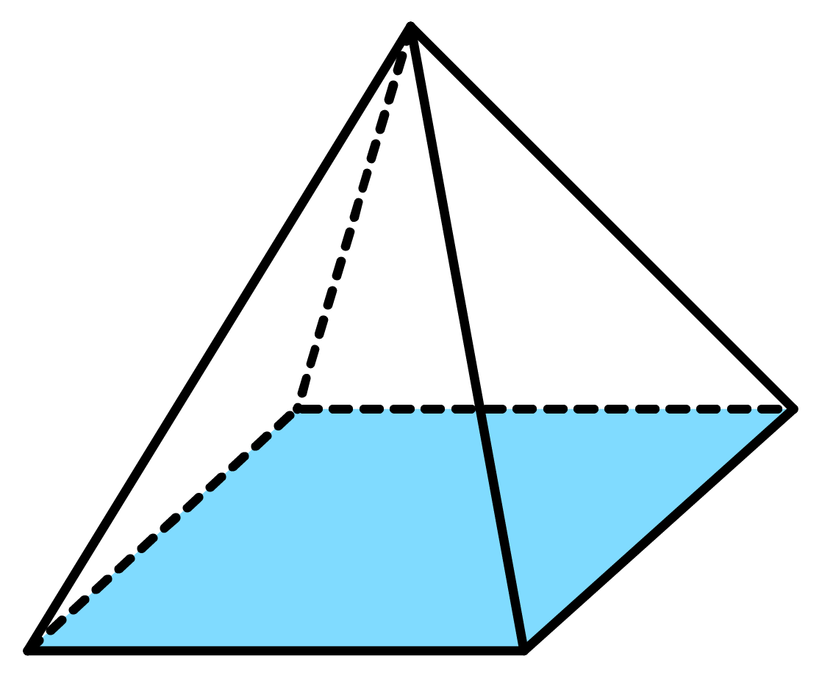




Recall the formula for the area of a triangle.
Imagine that we ‘transfer’ the formula into 3D to find the
volume of a pyramid.
$h$
$b$
Area of triangle $=$ ½ $×$ base $×$ height
Volume of Pyramid $=$ ⅓ $×$ base area $×$ height
½ in 2D
⅓ in 3D
Notes:
This is a very ‘relaxed’, or non-mathematical, approach to the volume of a pyramid. I have found that students remember the formula and how to use it this way.
I do appreciate it is very alternative.

Slide 4
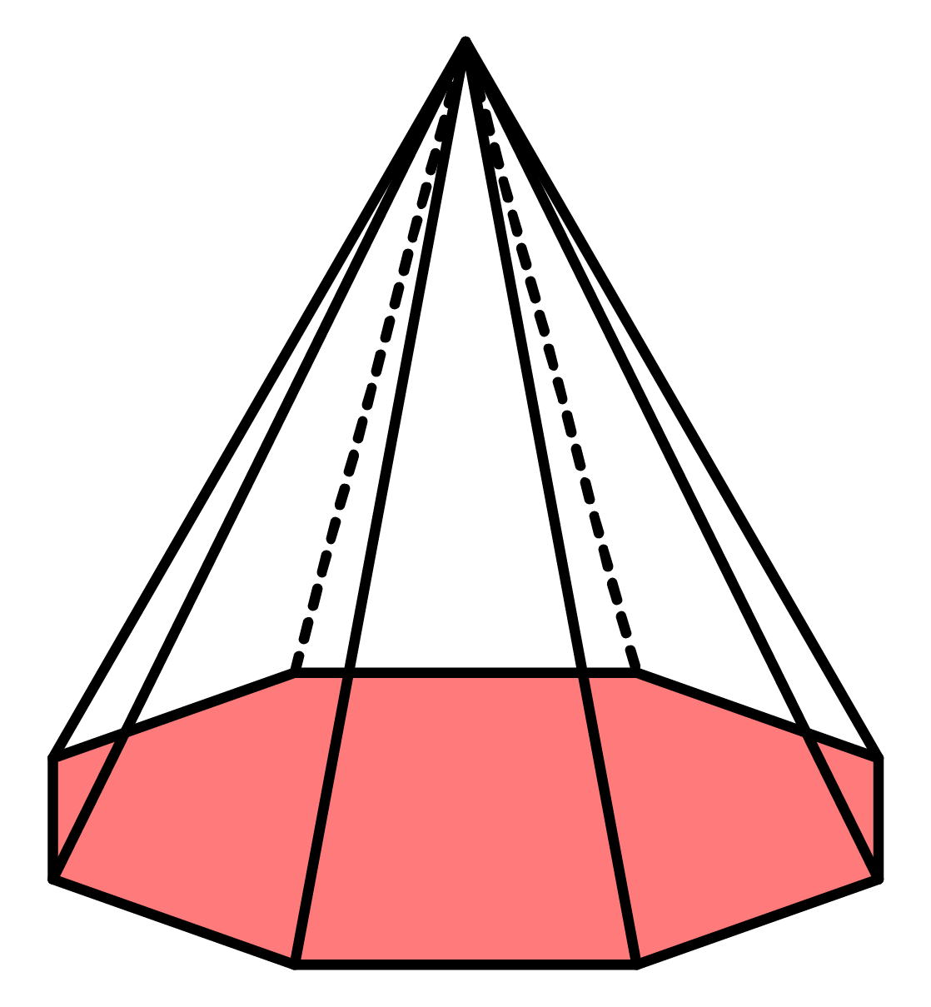
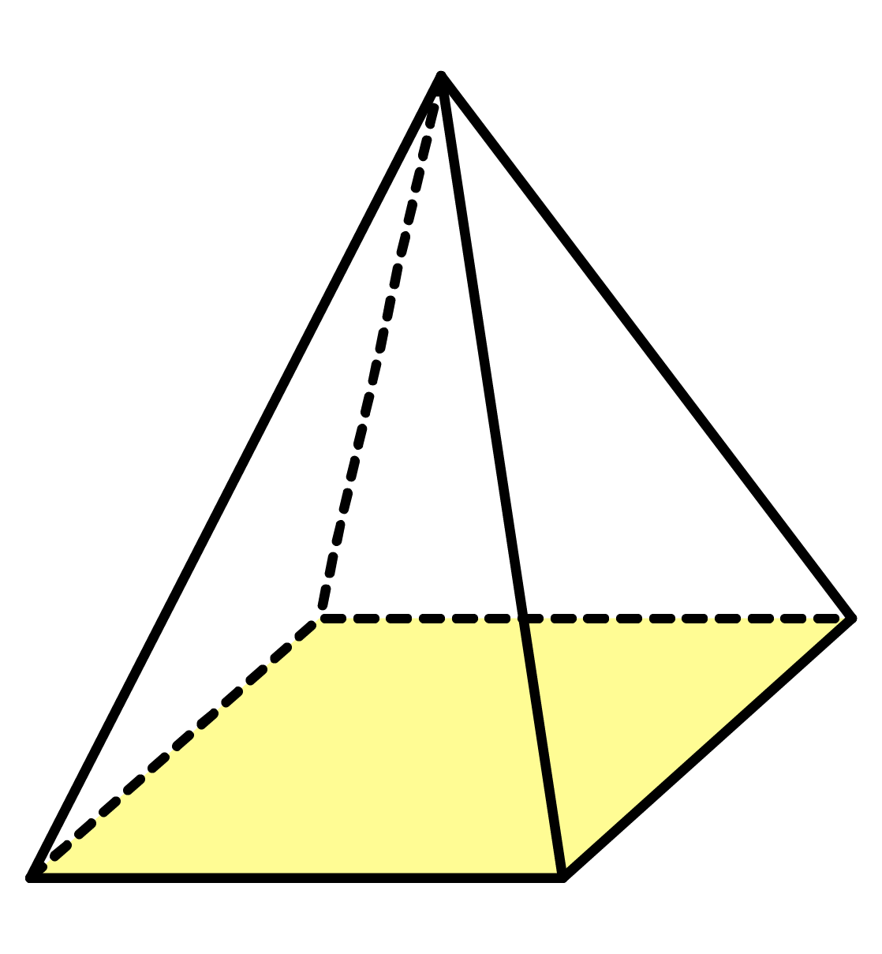







Volume of Pyramid $=$ ⅓ $×$ base area $×$ height
Ex1
Find the volume of the pyramid.
Ex2
Find the volume of the following square-based pyramid.
Solution
Solution
10cm
8in
Area
15cm²
6in
Volume $=$ ⅓ $×$ 15 $×$ 10
Area of
$=$ 6 $×$ 6
Volume $=$ ⅓ $×$ 36 $×$ 8
Volume $=$ 50cm³
$=$ 36 in²
Volume $=$ 96in³

Slide 5
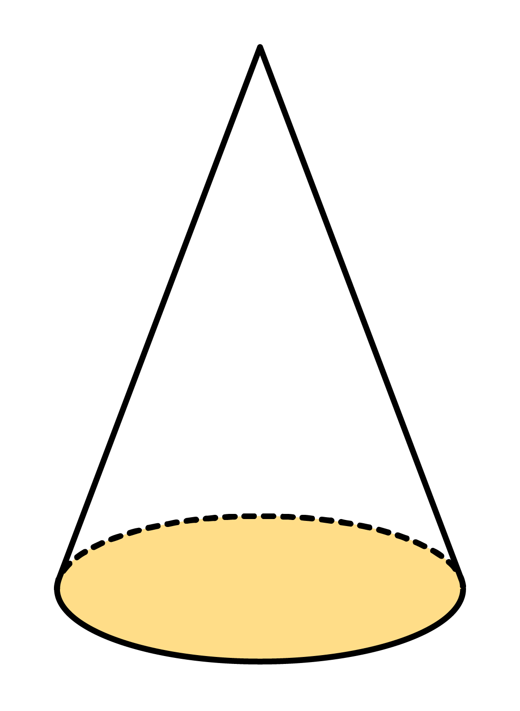
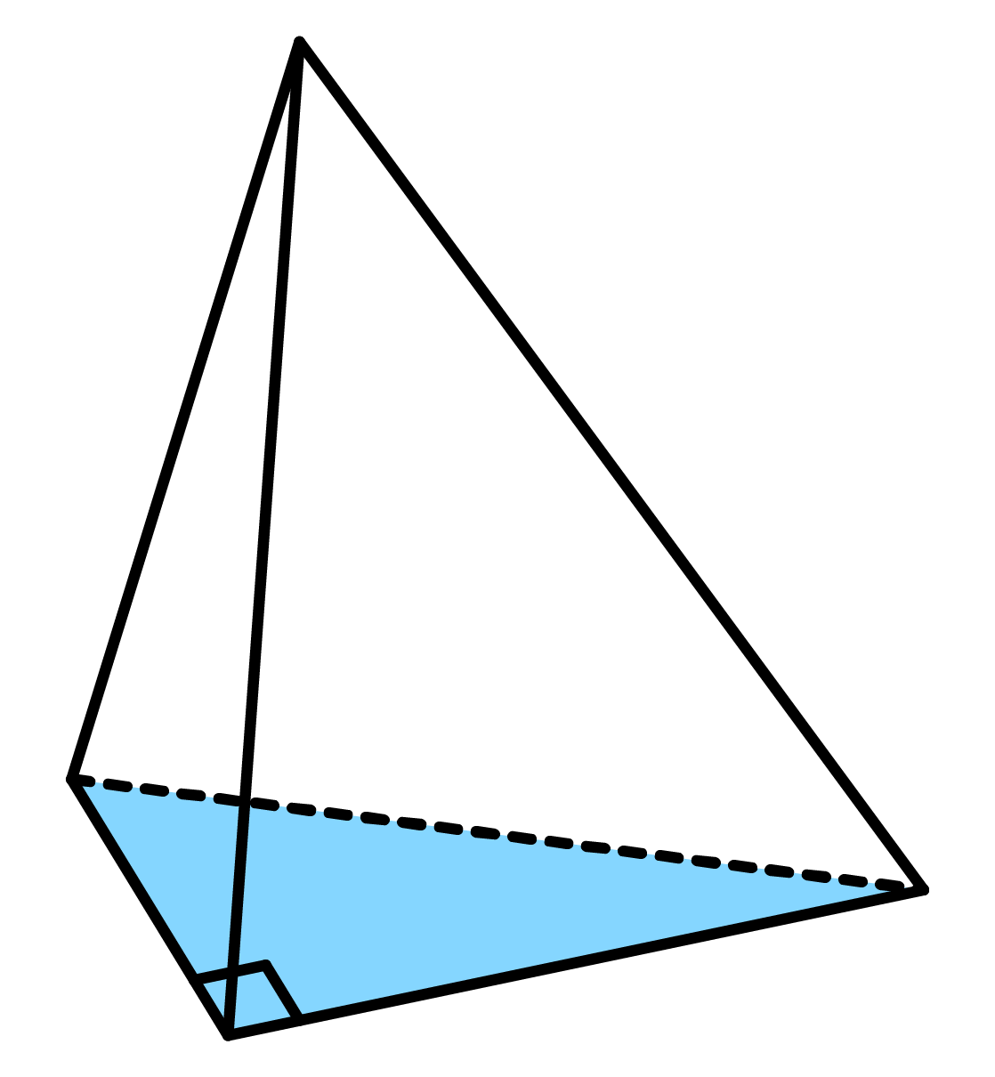
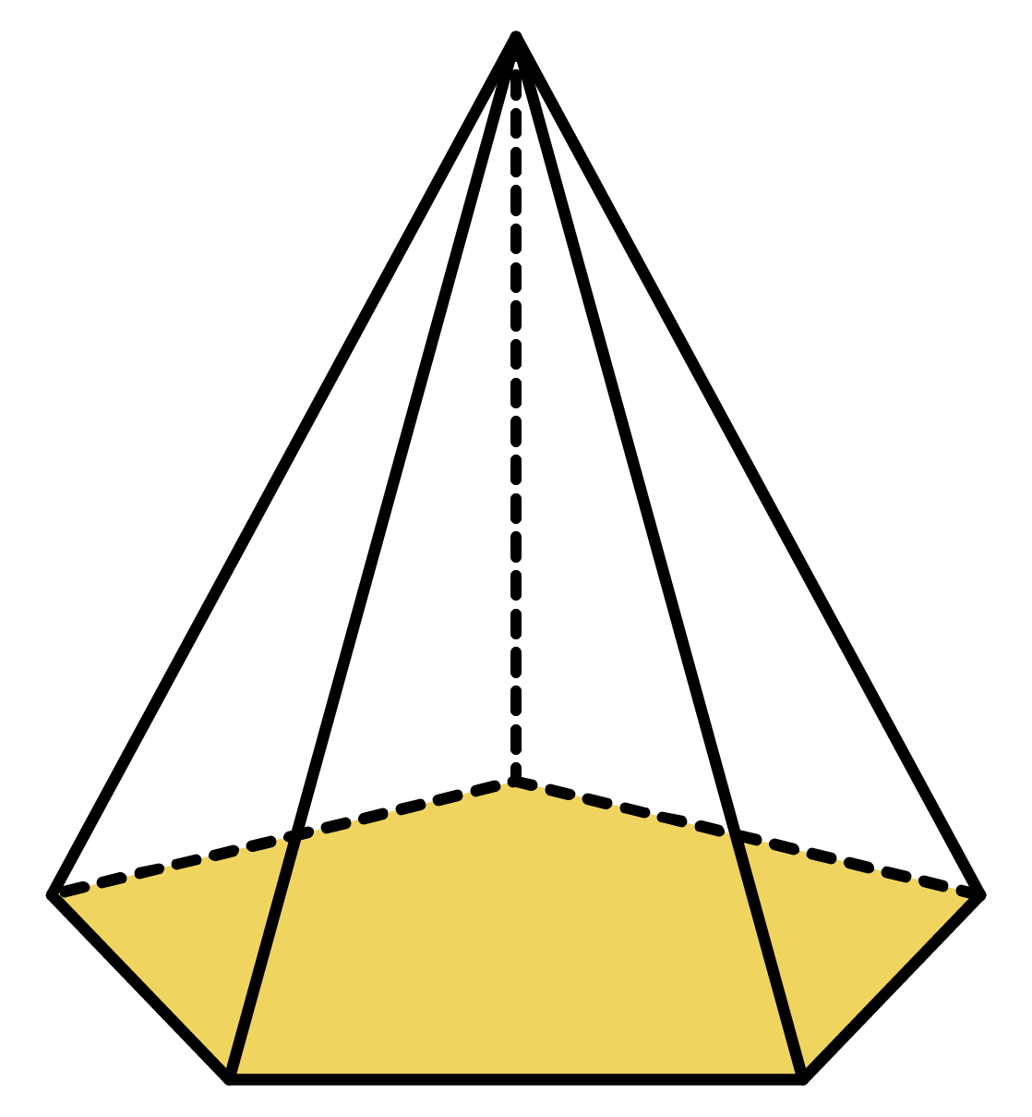
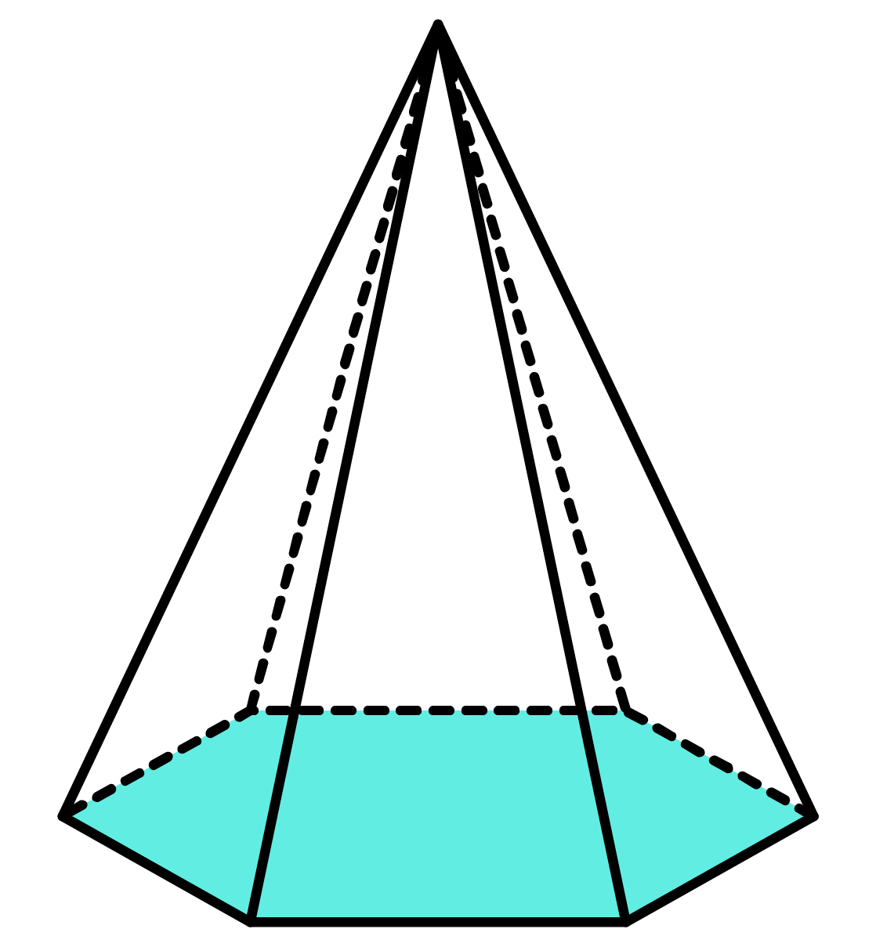










Q1
Work out the volume of each of the following pyramids.
[a]
[b]
[c]
[d]
[e]
Solution
Solution
Solution
Solution
Solution
8cm
11m
12ft
15in
8yd
Area
Area
Area
Area
Area
13.5yd²
18cm²
12m²
18in²
22ft²
Volume $=$ ⅓ $×$ 18 $×$ 8
Volume $=$ ⅓ $×$ 12 $×$ 11
Volume $=$ ⅓ $×$ 22 $×$ 12
Volume $=$ ⅓ $×$ 18 $×$ 15
Volume $=$ ⅓ $×$ 13.5 $×$ 8
Volume $=$ 48cm³
Volume $=$ 44m³
Volume $=$ 88ft³
Volume $=$ 90in³
Volume $=$ 36yd³

Slide 6
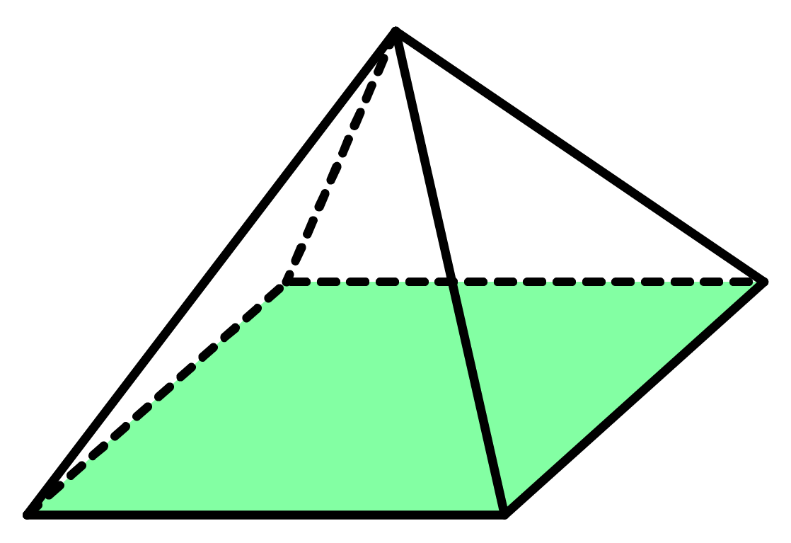






Q2
Work out the volume of each of the following pyramids.
[a] Square-based pyramid
[b] Square-based pyramid
[c] Square-based pyramid
Solution
Solution
Solution
9cm
6m
10yd
7cm
8m
Base area $=$ 64m²
6yd
Base area $=$ 49cm²
Base area $=$ 36yd²
Volume $=$ 147cm³
Volume $=$ 128m³
Volume $=$ 120yd³

Slide 7
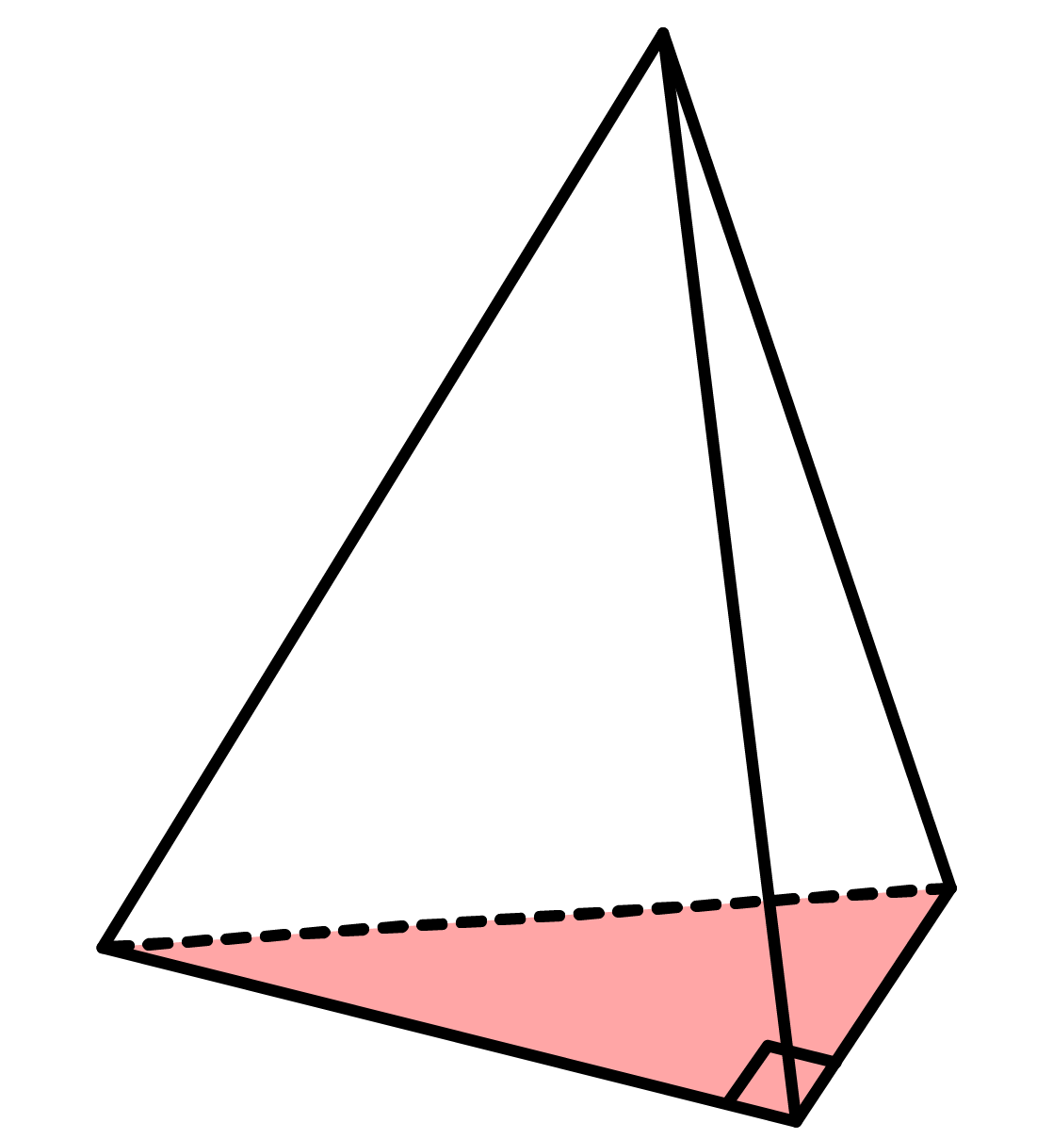







Q2
Work out the volume of each of the following pyramids.
[d] Right-triangular-based pyramid
[e] Right-triangular-based pyramid
[f] Cone
Solution
Solution
Solution
5mm
9cm
11in
4cm
3in
6mm
7cm
10in
Base area $=$ 15in²
Base area $=$ 9$π$mm²
Base area $=$ 14cm²
Volume $=$ 55in³
Volume $=$ 15$π$mm³
Volume $=$ 42cm³
$=$ 47.1mm³

Slide 8










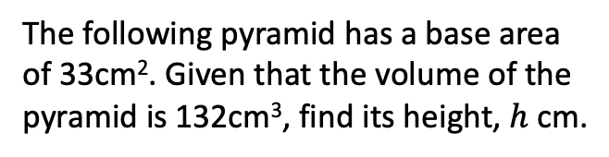


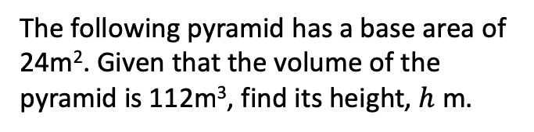


Ex3
The following pyramid has a base area of 24m². Given that the volume of the pyramid is 112m³, find its height, $h$ m.
Q3
The following pyramid has a base area of 33cm². Given that the volume of the pyramid is 132cm³, find its height, $h$ cm.
Solution
Solution
Volume
Volume
112m³
132cm³
$h$m
$h$cm
Volume $=$ ⅓ $×$ 24 $×$ $h$
Volume $=$ ⅓ $×$ 33 $×$ $h$
112 $=$ 8$h$
132 $=$ 11$h$
$÷$ 8
$÷$ 8
Area
$÷$ 11
$÷$ 11
Area
24m²
33cm²
14 $=$ $h$
12 $=$ $h$
Height $=$ 14m
Height $=$ 12cm

Slide 9









Q4
Work out the height of each of the following pyramids given their volume.
[a] Volume $=$ 105m³
[b] Volume $=$ 168in³
[c] Volume $=$ 108mm³
Solution
Solution
Solution
$h$m
$h$in
$h$mm
Area
Area
Area
15m²
63in²
27mm
Height $=$ 21m
Height $=$ 8in
Height $=$ 12mm

