Slide 1

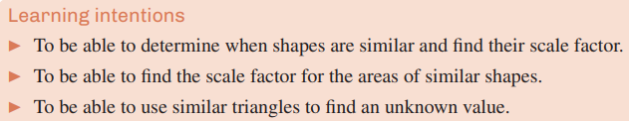
10H Similar figures

Slide 2

Similar figures
Shapes that are similar have the same shape but are different sizes. The three frogs below are similar figures.

Slide 3
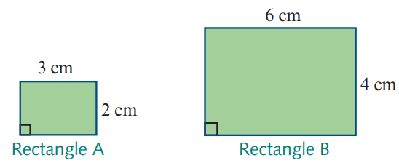
Similar figures
Polygons (closed plane figures with straight sides), like the rectangles in the diagram below, are similar if:
1. corresponding angles are equal
2. corresponding sides are proportional (which means that each pair of corresponding side lengths are in the same ratio).
Ratio of side lengths = 6 : 3 which simplifies to 2 : 1
Ratio of side lengths = 4 : 2 which simplifies to 2 : 1

Slide 4
Scale factor of length
scale factor = k = $\frac{\text{a} \text{length} \text{o} \text{f} \text{the} \text{second} \text{shape}}{\text{corresponding} \text{length} \text{o} \text{f} \text{the} \text{first} \text{shape}}$ = $\frac{6}{3}$ = 2

Slide 5
12”
24”
24
12
Scale factor = NEW
OLD
= 2

Slide 6

Spiderman is
3”wide and 7” high.
We want a copier to
enlarge the picture and fill
the length of a page
is 11”high. Find the scale
factor. At what % will you
set the copier?

Slide 7
3”wide and 7” high.
We want it 11”high.
Find the scale factor.
New
Old
11
7
=
=
1.571
New is 1.571 times as big.

Slide 8
3”wide and 7” high.
We want it 11”high.
Find the % setting for the copier.
11
7
= 1.571 = 157.1%
round to 157%

Slide 9
Similar Figures
E F
A B
C D
G H
Corresponding ∠ s =.
Sides are proportional.

Slide 10
ABCD ~ EFGH
A B
E F
10
13
12
C D
G H
Find GH
big 13
small 10
GH
12
=

Slide 11
big 13
small 10
GH
12
=
GH = (12)(13)
10 GH = 156
GH = 15.6

Slide 12
105⁰
E F
A B
105⁰
75⁰
C D
G H
Find ∠ E
= 105⁰
Corresponding ∠ s =.

Slide 13
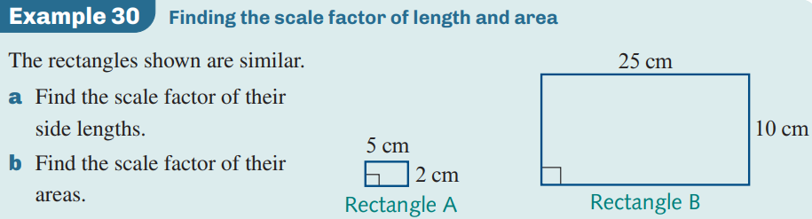
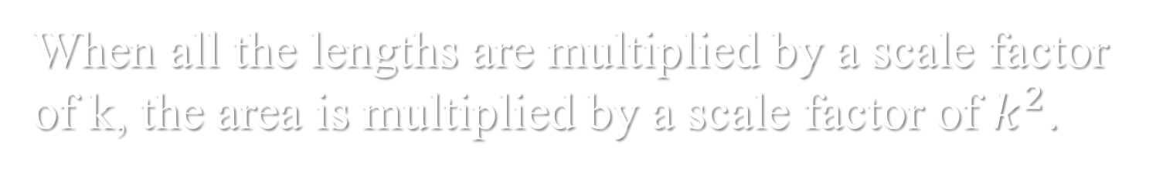
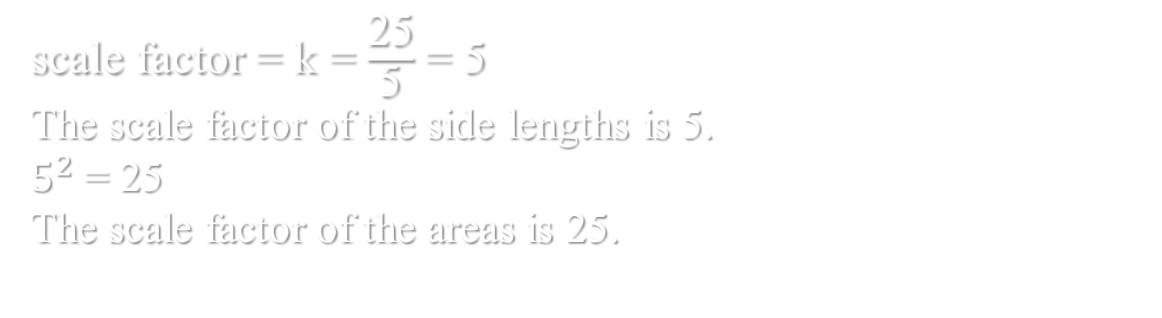
Area scale factor
When all the lengths are multiplied by a scale factor of k, the area is multiplied by a scale factor of $k^{2}$.
scale factor = k = $\frac{\text{25}}{\text{5}}$ = 5
The scale factor of the side lengths is 5.
$5^{2}$ = 25
The scale factor of the areas is 25.

Slide 14
