Slide 1
10J Similar solids

Slide 3
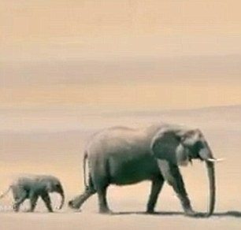
What are Similar Shapes?
Similar shapes are shapes that have been enlarged by a scale factor
Their lengths are different, but the angles always remain the same size
Real-life applications
It is used in aerial photography to see the distance from the sky to the ground.
It is used in construction to measure out the room and scale size.
It is used in light beams to see the distance from light to the target.

Slide 4

Calculating Scale Factors
Scale factor is the amount the shapes are enlarged by.
Every side of the shape is enlarged by the same scale factor
Shape a and b are mathematically similar.
a
b
Shape a and b are mathematically similar.
4cm
9cm
a
b
5cm
20cm
Let x = scale factor
We know that 5 x something = 20
4x = 9
That something is called a scale factor.
÷ 4
Let x = scale factor
x = $\frac{9}{4}$
The scale factor is $\frac{\text{9}}{\text{4}}$.
5x = 20
The scale factor is 4.
÷ 5
x = 4

Slide 5
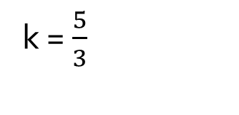
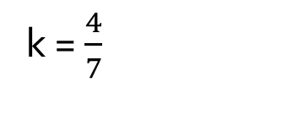

Check-Up! Find the scale factor of enlargement for the following similar shapes(from a to b):
Shape a and b are mathematically similar.
a
b
a
b
Let k = scale factor
8cm
k = $\frac{5}{3}$
Let k = scale factor
16cm
3cm
k = $\frac{16}{8}=$ 2
5cm
a
b
a
7cm
Let k = scale factor
6cm
k = $\frac{9}{6}$ = $\frac{3}{2}$
9cm
k = $\frac{4}{7}$
b
4cm
Let k = scale factor

Slide 6
Calculating Lengths Using Scale Factors

Slide 7

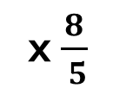
Using scale factors to calculate length
E.g. 1
Shape A and B are mathematically similar. Calculate the missing length
Let k = scale factor
A
B
k =$\frac{8}{ 5}$
8cm
?
x $\frac{8}{ 5}$
8 x $\frac{8}{ 5}$ = $\frac{64}{5}$
5cm
=$12\frac{4}{5}$
x $\frac{8}{ 5}$
8cm
= 12.8cm

Slide 8


Using scale factors to calculate length
Shape A and B are mathematically similar. Calculate the missing length
E.g. 2
Let k = scale factor
4cm
9cm
k =$\frac{9}{ 4}$
x $\frac{9}{ 4}$
6 x $\frac{9}{ 4}$ = $\frac{54}{4}$
6cm
=$\frac{27}{2}$
?
x $\frac{9}{ 4}$
= 13.5cm

Slide 9


Going Backwards: Divide by the scale factor instead of multiplying
Shape A and B are mathematically similar. Calculate the missing length
E.g. 3
Let k = scale factor
3cm
k =$\frac{8}{ 3}$
x $\frac{8}{ 3}$
8cm
?
7 ÷ $\frac{8}{ 3}$ = $\frac{21}{8}$
7cm
÷ $\frac{8}{ 3}$
= 2.625cm

Slide 10
Shape A and B are mathematically similar. Calculate the missing lengths:
5.2cm
?
6cm
a
b
a
b
a
4cm
10cm
3.5cm
2cm
5cm
Let k = scale factor
3cm
10cm
k = $\frac{10}{6}→\frac{5}{3}$
Let k = scale factor
?
Let k = scale factor
b
k = $\frac{2}{3.5}→\frac{4}{7}$
?
k = $\frac{10}{4}→\frac{5}{2}$or 2.5
5 x $\frac{5}{3}=\frac{25}{3}$
$→8\frac{1}{3}cm$
3 x $\frac{5}{2}=\frac{15}{2}$
$→$7.5cm
5.2 x $\frac{4}{7}$
$=$ 2.97cm (2dp)
2cm
?
a
b
a
9.1cm
b
Let k = scale factor
6.2cm
10cm
k = $\frac{6.2}{9.1}→\frac{62}{91}$
Let k = scale factor
15.5cm
7.8 x$\frac{62}{91}=\frac{186}{35}$
k = $\frac{15.5 }{10}→$ 1.55
7.8cm
?
$→$5.31cm (2dp)
2 x 1.55
= 3.1cm

Slide 11
Calculating Area’s Using Scale Factors

Slide 12
If k is the scale factor for length, the area scale factor would be…
k²

Slide 13

Using scale factors to calculate area
area of A x area scale factor = area of B
E.g. 1
Shape A and B are mathematically similar. Calculate the area of shape B.
Let k = scale factor
Area = 75.2cm²
x $\frac{25}{16}$
k =$\frac{10}{8}→\frac{5}{4}$
A
B
Area = ?
$$\frac{25}{16}$$
k² =
?
75.2 x $\frac{25}{16}$
=$117.5cm$²
8cm
10cm

Slide 14

Using scale factors to calculate area
Shape A and B are mathematically similar. Calculate the area of shape B.
E.g. 2
Let k = scale factor
A
x $\frac{49}{9}$
Area = 31.5cm
B
k =$\frac{14}{6}→\frac{7}{3}$
Area = ?
6cm
k² =$\frac{49}{9}$
14cm
31.5 x $\frac{49}{9}$
= 171.5cm²

Slide 15
Each pair of shapes is mathematically similar. Calculate the missing areas.
5cm
area=
8.8cm²
area =?
2.5cm
1.5cm
Let k = scale factor
area=
22.4cm²
area =?
area = 46.5cm²
6cm
18cm
k = $\frac{8}{5}$
k² = $\frac{64}{25}$
8cm
46.5 x $\frac{64}{25}$
Let k = scale factor
area =?
Let k = scale factor
?
= 119.04cm²
k =$\frac{18}{6}→$ 3
k = $\frac{1.5}{2.5}→\frac{3}{5}$
k² = $\frac{9}{25}$
22.4 x $\frac{9}{25}$
k² = $9$
8.8 x $9$
= 79.2cm²
= 8.064cm²
Let k = scale factor
Let k = scale factor
area = 46.5cm²
area = 46.5cm²
area = ?
k = $\frac{3.5}{8}→\frac{7}{16}$
k = $\frac{15.3}{4.25} →\frac{18}{5}$
8cm
area = ?
3.5cm
k² = $\frac{49}{256}$
k² = 12.96
46.5 x $\frac{49}{256}$
4.25cm
46.5 x 12.96
= 8.90cm² (2dp)
15.3cm
= 602.64cm² (2dp)

Slide 16
Calculating Volume’s Using Scale Factors

Slide 17
Length scale factor: k
Area scale factor: k²
So the volume scale factor is:
k³

Slide 18
Using scale factors to calculate volume
Volume of A x Volume scale factor = Volume of B
Shape A and B are mathematically similar. Calculate the volume of shape B.
E.g. 1
Let k = scale factor
B
k =$\frac{12}{5}$
A
Volume = ?
k³ =$\frac{1728}{125}$
Volume = 210cm³
210 x $\frac{1728}{125}$ = 2903.04cm³
5cm
12cm

Slide 19
Using scale factors to calculate volume
Volume of A x Volume scale factor = Volume of B
Shape A and B are mathematically similar. Calculate the volume of shape B.
E.g. 2
Let k = scale factor
k=$\frac{9}{12}→\frac{3}{4}$
Volume = 210cm³
k³ =$\frac{27}{64}$
12cm
Volume = ?
9cm
210 x $\frac{27}{64}$ = 88.59cm³ (2dp)

Slide 20
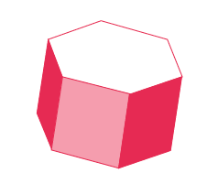
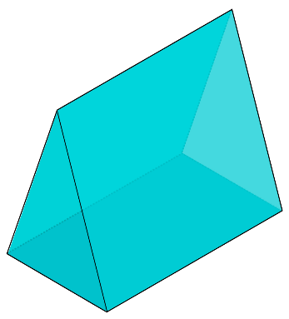
Calculate the missing lengths of each pair of mathematically similar shapes (2dp where necessary):
Volume = 38cm³
Let k = scale factor
Let k = scale factor
Volume
= ?
Volume
= 82cm³
Volume = ?
k = $\frac{5}{3}$
k³ = $\frac{125}{27}$
5cm
k = $\frac{6}{5}$
k³ = $\frac{216}{125}$
3cm
82 $÷ \frac{125}{27}$
38 x $\frac{216}{125}$
= 65.664cm³
5cm
= 17.712cm³
6cm
Volume
= 50cm³
3.5cm
Let k = scale factor
Let k= scale factor
Volume = ?
5.5cm
k = $\frac{5.5}{3.5}$
k³ = $\frac{1331}{343}$
Volume = ?
k = $\frac{3}{8}$
k³ = $\frac{27}{512}$
8cm
Volume
= 64cm³
64 $÷$ $\frac{1331}{343}$
50 x $\frac{27}{512}$
3cm
= 16.49cm³ (2dp)
= 2.64cm³

Slide 21
Cuboids
The two cuboids are similar because:
they are the same shape (both are cuboids)
the ratios of the corresponding dimensions are the same.

Slide 22
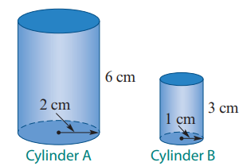
Cylinders
These two cylinders are similar because:
they are the same shape (both are cylinders)
the ratios of the corresponding dimensions are the same.

Slide 23
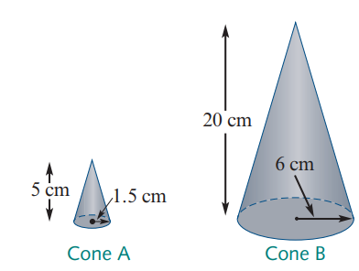
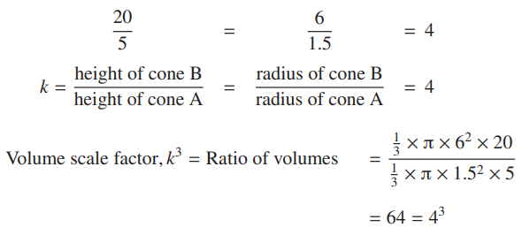
Cones
These two cones are similar because:
they are the same shape (both are cones)
the ratios of the corresponding dimensions are the same.

