Slide 1
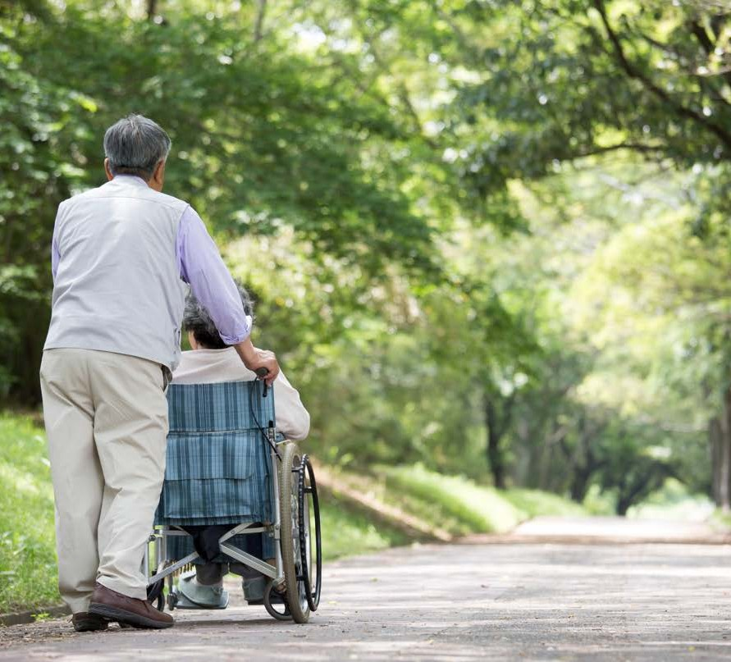
CHCCCS 002
ASSIST WITH MOVEMENT
In this chapter we will look at the following:
Prepare to assist a person with movement Assist with movement
Complete assistance with movement

Slide 2
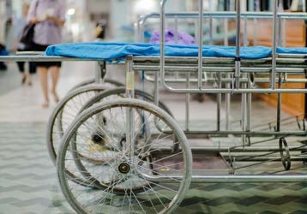
For this unit, you will be assessed on the following:
Activity 1
Activity 2
Activity 3
Activity 4
Activity 5
Activity 6
Assessment 1
Written questions Assessment 2
Observations
Learning Checkpoint 1
Learning Checkpoint 2
Learning Checkpoint 3
Assessment

Slide 3
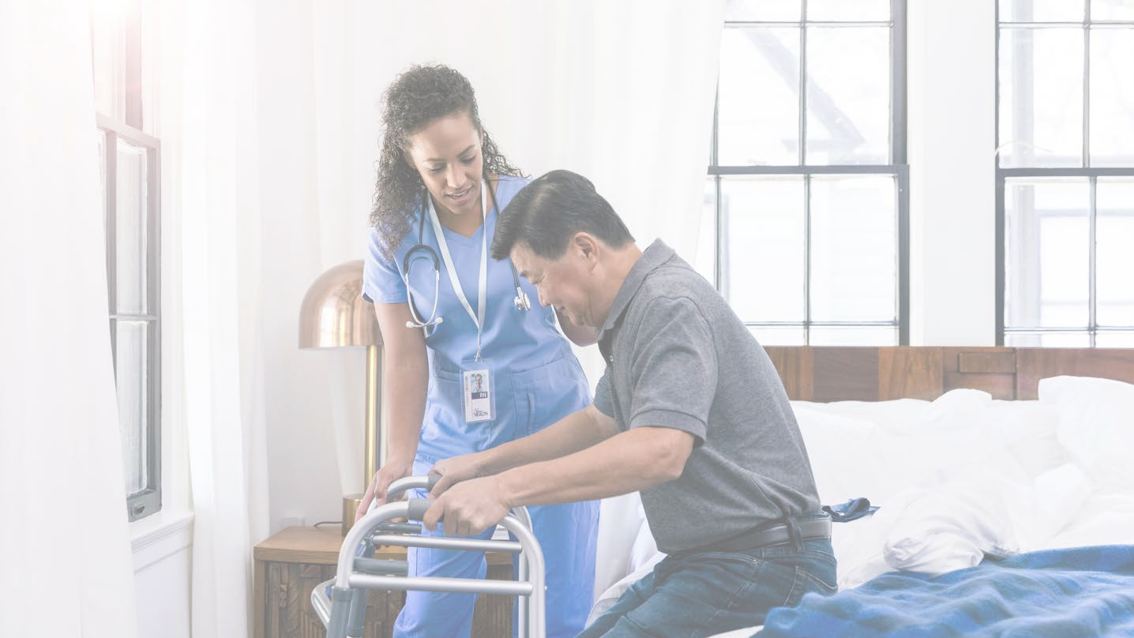
WHAT ARE RISK FACTORS WHEN ASSISTING A PERSON WITH MOVEMENT?
Watch video of hand washing video
Notes:
ASK – What are risk factors when assisting a person with movement?
ASK- How would you determine the patients or client’s ability?
Facilitate students to create a checklist of all the things that they think is necessary to do prior to assisting a person with movement.

Slide 4
Preparing to
assist a person with movement
Is the movement necessary?
Assess all elements of the movement Assess risk factors
Refer to the individualised movement plan
Follow organisational policies and procedures
Patients ability Equipment
Watch all the iVET super clinic instructional video 1 (Preparing to move)
https://ivetsuperclinic.ivetinstitute.com.au/instructional-videos/

Slide 5
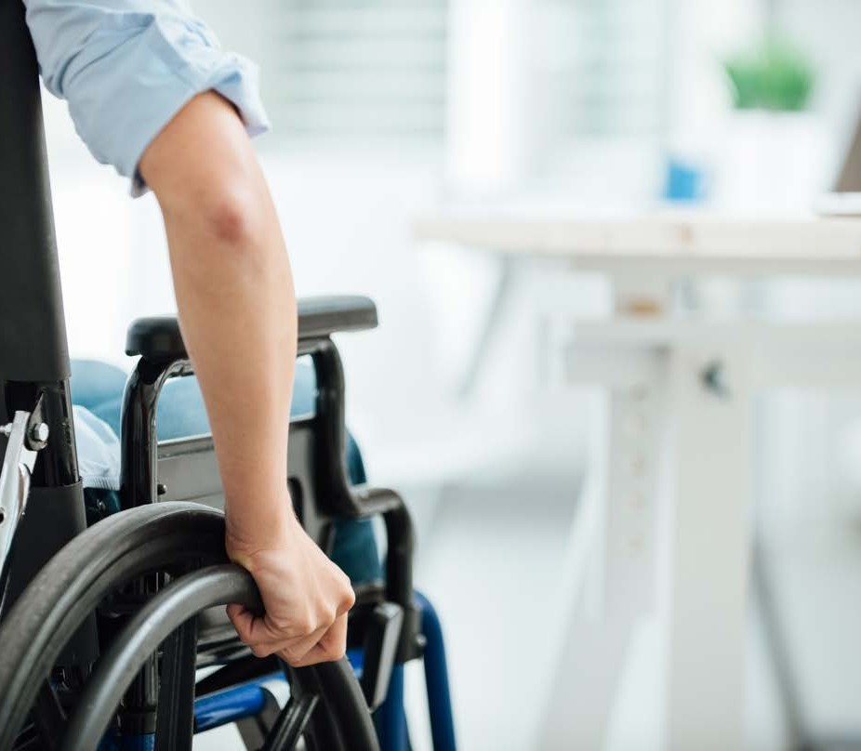
Skills and Knowledge
I t is also important that you ensure you have up to date skills and knowledge to carry out the movement.
Under no circumstances should you just ‘ fake i t t i l you make i t ’ so to speak.
This can have disastrous consequences and could see a patient put at r isk.

Slide 6
Organisational Policies and Procedures
There are a range of organisational policies and procedures that relate to your role when assisting with movement. While each organisation will have their own policies for assisting with movement, many industries still share the same policy such as 'No lift policy'.
You'll need to be familiar with the following: duty of care
informed consent
privacy, confidentiality and disclosure supervisory and reporting protocols
infection control.
Notes:
Discuss differences between Privacy, Confidentiality and disclosure. Provide examples of each. You will find more information here and here.
Explain disclosure in healthcare and the use of patient information for the purposes of collection. More information here.

Slide 7
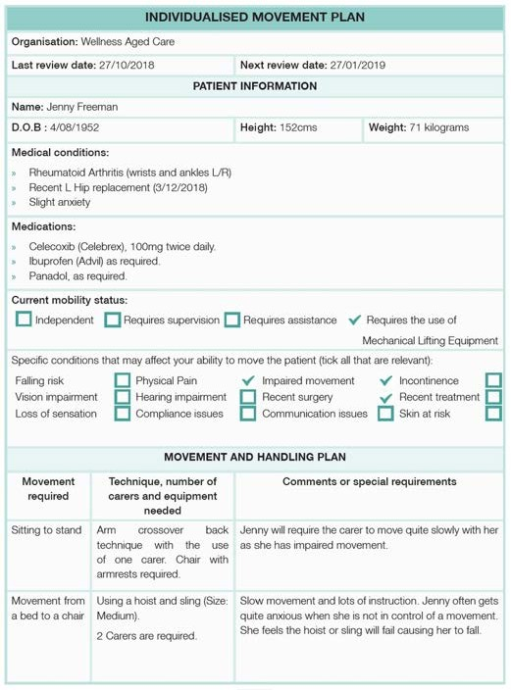
Individualised movement plans
Notes:
ASK -Why should you check a movement plan before assisting with a move?

Slide 8
Learning Activity 1 Knowledge Application – Understanding a Movement Plan
Refer to the individualised movement plan in the student resource.
1. How would you transfer Jenny from a bed to a chair?
• Based on her individualised movement plan, students should recognise that Jenny needs a hoist and sling to move from a bed to a chair.
2. What do you need to consider when moving Jenny?
• Slow movements and lots of instructions
• Jenny is prone to getting anxious when she’s not in control of her movement.
• She thinks the hoist or sling will fail, causing her to fall.
3. What other pieces of information in the plan would impact your transfer?
• Height and weight
• Hip replacement

Slide 9
WHY IS IT IMPORTANT TO PREPARE EQUIPMENT BEFORE USE?
Notes:
Access the No Lifting Policy and discuss the importance of protecting your own body

Slide 10
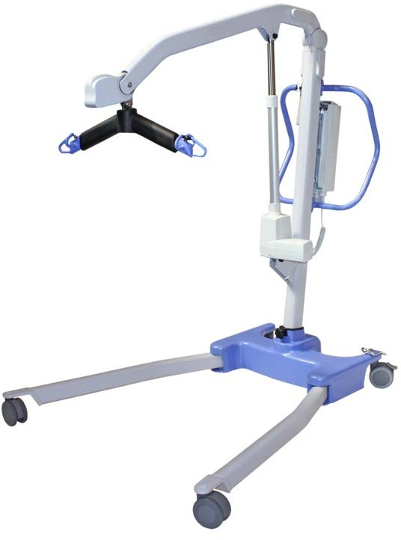
Preparing equipment
The following equipment requires preparation prior to use:
Mechanical lift devices Slide sheets
Chairs with armrests Wheelchair
Shower chair Mobility walker Motorised bed
Notes:
Show students the different type of equipment that can be used with assisting with movement
Use this as an opportunity to start explaining how the equipment works, who might use it, how you might assist an person to use it.
Discuss why organisational policies and procedures are important to be across when working in the healthy industry. How could not be across your workplace policies and procedures
Discuss all the different equipment types, including advantages and disadvantages of each one.

Slide 11
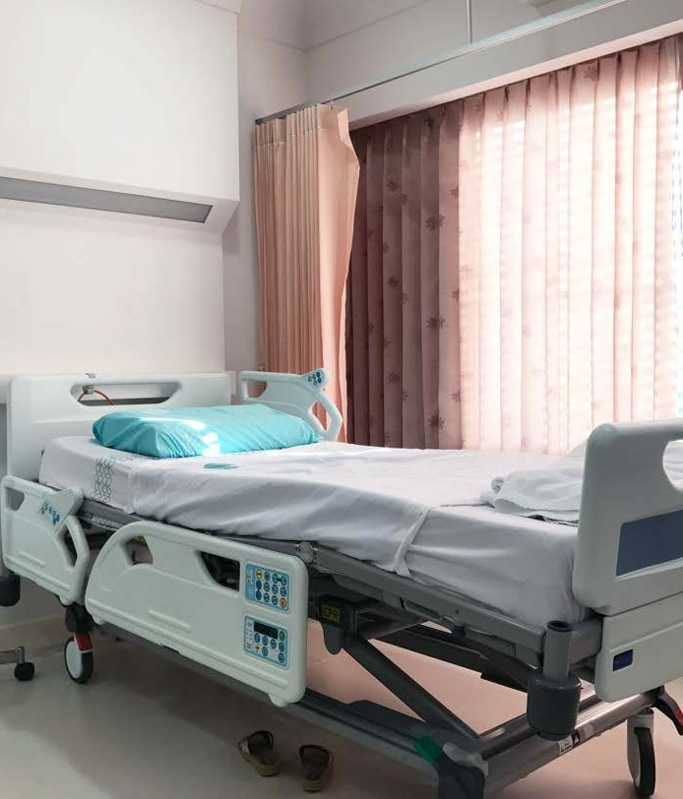
Prepare the enviornment
Ensure all equipment is in the require place
Clear the room off clutter Ensure the room is clean
Ensure the room is quiet, for clear communication

Slide 12
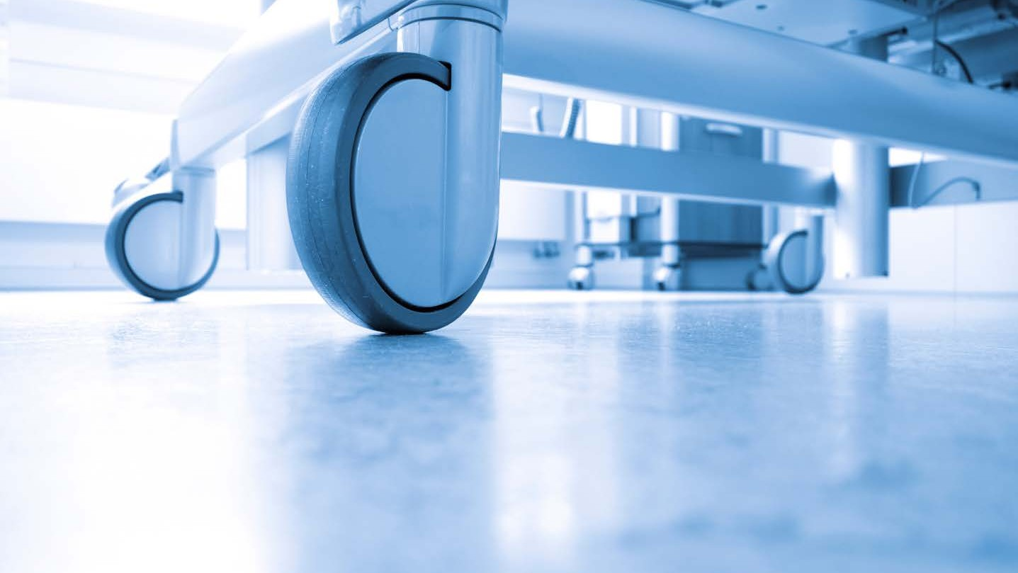
Explain the movement
You' l l | need to speak directly | to | the | patient | and | inform | them | of
what | is going to happen.
You' l l to ensure they are comfortable with the movement and they are aware what is happening. While a patient might not be
physically | assisting | with | the | movement | i t ' s | important | they | are | on
the same | page.

Slide 13
Seek Consent and Cooperation
You must seek consent and cooperation of a person before you can assist with moving them.
To do this you can simple ask the patient if they are okay for you to touch them while you assist them with the movement.
Notes:
ASK – Why do you need to get consent prior to a move? What do you do if you have a patient that won’t cooperate?

Slide 14
Learning Activity 2 Knowledge Application – Create a Communication Protocol
As the head of the department, your supervisor has asked you to create a communication protocol for assisting with patient movements. This protocol should include the steps or rules that should be followed by all staff when communicating with patients. Your protocol should include elements related to:
• How best to communicate?
• Conducting an assessment of the communication environment.
• What information should be communicated?
• How to clarify the information communicated?
• How to seek consent and ensure the patient’s cooperation?
Protocol should include at least six (6) steps.
• Speak slowly.
• Repeat instructions.
• Gain permission before moving/gain consent.
• Verbalise what is happening will undertaking the movement.
• Provide positive reinforcement.

Slide 15
Learning Checkpoint 1
1. Why is it so important for healthcare workers to know how to assist with movement safely?
To prevent manual handling injuries and to ensure that patient movements and transfers are done effectively and safely.
2. When preparing to assist a person with movement highlight six (6) things that should be done.
1. The requirements of the movement should be confirmed.
2. You should assess risk factors.
3. You should check the individual’s movement plan.
4. You should select, prepare, and adjust equipment.
5. You should appropriately prepare the environment.
6. Explain the movement to the patients.
7. Seek their consent and corporation.
3. Describe three (3) risk factors that a carer preparing to move a person in an aged care facility might need to be aware of.
• The environment – They would need to be aware of potential trip hazards that might exist in a person’s room such as clothes on the floor.
• The patient/client’s ability – They will need to consider if the patient has the physical capacity to conduct the move.
• Their own ability – They will need to consider if they have the correct training, experience and general health to conduct the move.
4. Why it is important to review a person’s individual movement plan prior to assisting them to move? Highlight three (3) pieces of information that you might find on an individualised movement plan.
Reviewing a person’s individualised movement plan will ensure that you have all the necessary information to plan and execute a movement successfully and safely.
An individualised movement plan may detail:
• A person’s current mobility status
• Any specific conditions that may affect their ability to move such as physical pain.
• Details of the movement techniques often used, the number of carers required, and equipment needed.

Slide 16
Learning Checkpoint 1
5. List four (4) conditions that may affect your ability to move someone.
• Physical pain
• Loss of sensation
• At risk of a fall
• Compliance issues
• Recent surgery
• Impaired movement
• Requires two carers.

Slide 17
Assist with movement
When assisting a patient it's important to:
Maintain communication throughout the move Continue to explain the movement
Give them a heads up what is going to happen Ensure they are comfortable
Ask them if they feel any pain or discomfort
Watch all the iVET super clinic instructional videos
https://ivetsuperclinic.ivetinstitute.com.au/instructional-videos/
Password: superIVET

Slide 18
What transfers or movements can you assist a person with?

Slide 19
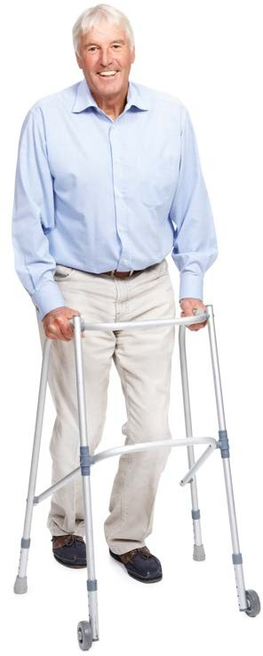
Move a person to a standing position Supervised Stand
Supervising a patient who is uninjured to get up off the floor
Assisting a person in an emergency
Use a hoist or a mechanical lifter for transfers Assist with repositioning
Assisting a person to use crutches and a mobility walker Assisting a person to walk
Move a person to a seated position
Transfer a person from a wheelchair to a stationary chair and shower chair
Placing a person in a wheelchair Moving by wheelchair
Assisting with active and passive movement

Slide 20
Learning Activity 3 Practical – Sit to Stand
With a partner, have a go each at being the patient and the carer. Practice getting the patient from a sit to a stand for the following:
• A supervised stand
• Stand with 1 carer
Discuss with your partner the approach you might take with an individual who might be elderly and have poor balance or strength. What would you change?

Slide 21
Learning Activity 4 Case Study – What to Do
Lorna is a patient requiring assistance to stand up from a seated position. She has very limited mobility and is a larger woman. She will require the assistance of two carers to stand up.
List at least five (5) steps involved to carry out the movement using an appropriate safe handling technique.
• Patient to place hands on the arm rests and look straight ahead Patient to lean forward and move or shuffle to the front the chair.
• The patient's upper body should be over the top of their knees.
• Carers should stand on either side of the patient in the lunge position.
• Carers are to place their inside arm on the patient's opposite hip (forming a cross on the patient's back) and other hand on their shoulder.
• Instruct the patient to rock gently back and forward, counting 1,2 and on 3 the patient should stand.

Slide 22
Learning Activity 5 Case Study – Making a Moven
Harry is a patient requiring assistance to transfer from bed to the toilet. He is a very tall man, taller than most. He uses a mobility walker to get around the aged care facility.
What transfer would you need to perform to help Harry to get to toilet?
Answers may vary depending on how mobile the students think Harry is.
They should include:
• Bed to stand
• Assisting with mobility walker
• Stand to sit (on the toilet)
• Students may include that Harry needs to go from lying in bed to seated in bed.

Slide 23
Learning Checkpoint 2
1. Identify three (3) important factors which should be considered when selecting a sling to be used with a mechanical lifting device.
• What movement or transfer is it being used for?
• The size of the patient i.e., their height, weight, and hip size.
• The medical condition of the patient and the amount of support required.
2. What is a slide sheet? Identify three (3) instances where a slide sheet could be used.
A slide sheet is a piece of fabric with a silicon coating that has minimal friction. It is used to transfer and move patients easily without the need for manual handling. It can be used to:
• Pull a patient out of a confined space after a fall where a hoist cannot be used.
• Transfer patents onto beds
• Reposition a patient in a chair.
3. Identify two (2) advantages and disadvantages of using slide sheets to assist with movement.
Advantages: • Simple and easy to use. • Effective in assisting patients to move. • Can be used in a range of different ways to assist with a variety of movements. • Relatively cheap and be disposable. Complying with infection prevention and control. • Decreases the needs for manual handling. Reducing the incidence of injury.
Disadvantages: • Not suitable for all movements. • Requires an appropriate level of training and competency to be able to use them safely and effectively. • If used on patients with pressure sores it could be quite painful. • Patients who are heavy will require additional manual handling which has the potential to cause serious injury. • If the same sheet is used for another patient it has the potential to cause infection control issues.

Slide 24
Learning Checkpoint 2
4. Choose two (2) pieces of equipment that may be used in a healthcare setting and highlight three guidelines that should be followed to ensure that they are used safely.
Teacher discretion required as student answers will vary.
Chairs with armrests
• The chair should be sturdy and stable. The patient should be able to put weight on the chair through either of the armrests without affecting its stability.
• The height of the chair should be adjusted so that the patient is able to put their feet flat on the floor.
• If the chair is being used in a transfer it should always be positioned in close proximity to the patient and on the side of their body that is strongest or where it feels most natural.
Wheelchair
• Inspect the wheelchair prior to use to ensure that it is in good working order. Check any stitching, straps and fabric to sure that it is not broken or has obvious signs or wear and tear that could affect its use.
• Ensure that the wheelchair is sturdy, has an appropriate range of movement and can be manoeuvred easily.
• If the wheelchair is being used in a transfer it should always be positioned in close proximity to the patient and on the side of their body that is strongest or where it feels most natural.
• Once the wheelchair is in the correct position the brakes should be engaged. You should also move the footrests up to ensure that the path to the chair for the patient is safe and easy.
• Once the transfer is complete make sure that you replace the footrests to their correct position.

Slide 25
Learning Checkpoint 2
5. Suggest three (3) ways to prepare the environment prior to assisting with movement.
• Ensuring that all equipment is in the required place. Making it both accessible and easy to use. For example, if performing a transfer from a wheelchair to a stationary chair ensure that the chair is at a right angle to the patient’s position, on their strong side and as close as possible to them without interfering with their ability to move safely.
• Clearing the room of clutter such as tables, chair, food trays and any clothing lying around to ensure that the movement can be conduct smoothly without obstacles.
• Ensuring that the room is quiet so that any noises or sounds don’t interfere with the carers ability to communicate with one another and their patient.
• Ensuring that the room is clean. Dust and dirt on surfaces and the floor could cause a patient to trip and fall during movement. Maintaining a clean environment is essential for patient safety.
6. Suggest three (3) things that you should do when explaining the movement to a patient or client.
• Do so slowly, clearly, and precisely.
• Make sure that the patient can hear you and that the environment is not too noisy.
• Clarify their understanding.

Slide 26
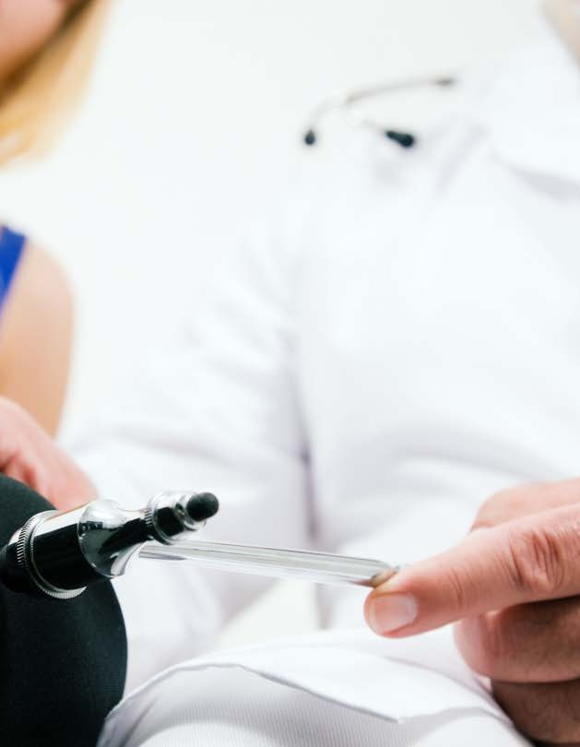
Complete assistance with movement
It's important to evaluate the movement, return all equipment to its designated area, and clean the
equipment. Ensure you've checked the equipment for an faults, and report accordingly.
Think about the movement itself and reflect on
how to make it safer more effective in the future. How would you change it for a different patient?

Slide 27
Learning Activity 6 Reflecting
Reflect how you went with your sit to stand technique in the previous activity. Consider answer the following questions:
• The technique that was used and if it was effective.
• Were you prepared for the movement, or were there elements that you could have been better prepared for?
• Did you select the best equipment for the movement, or should have you used equipment?
• How well did you perform the movement?
• Were there any problems that you encountered, and how best they could be avoided in the future?

Slide 28
Learning Checkpoint 3
1. What is consent? How could you obtain consent from a patient or client prior to assisting them with movement?
Consent is where a person agrees for you to assist them, giving you permission. You can obtain consent simply by asking the patient if it is okay for you to touch them and assist them with the movement.
2. How can you ensure that a patient or client’s consent it valid?
• By providing them with enough information to make the decision.
• Ensuring that they are capable of making the decision.
• Making sure that they are acting voluntarily.
3. In the instance where a person does not have a capacity to provide consent, how can consent be obtained?
Consent is implied if it is considered to be in the “best interest” of the person. Any movement should be discussed with the person’s family and healthcare professional to determine if the movement is in the client’s best interest.
4. Why is it important to gain a person’s cooperation prior to assisting with movement?
Cooperation is imperative to executing a successful and safe movement. If a person fails to cooperate during a movement it could cause injury to them or to your as the carer assisting them.
5. Identify three (3) ways you could ensure that a patient is comfortable and safe during a movement or transfer.
• Using pillows to support and prop a person up.
• Where possible use slide sheets underneath a bed sheet to avoid friction burns.
• Re-checking the size of the sling to ensure that it is appropriate.
• Encourage the patient to move around in the sling and get comfortable before you hoist and move them.
• Use slings with attached comfort supports. A number of slings come with headrests and leg supports.
6. Explain how you could encourage a patient to assist during a move or transfer.
You can encourage someone by making positive comments and praising their efforts, not matter how small they are.

Slide 29
Learning Checkpoint 3
7. Why would it be important to evaluate a movement after completing it? List three (3) elements that should be considered when evaluating it.
Evaluating the movement allows you to reflect on the movement and how to make it safer or more effective in the future.
When evaluating the movement you should consider:
• The technique that was used and if it was effective?
• Whether you were prepared for the movement or were their elements that you could have been better prepared for?
• Whether you selected the best equipment for the movement.
• Whether the movement could have been done better and if so how.
• Whether your assessment of the patient’s abilities was accurate.
• Was the patient’s individualised movement plan accurate or does it need to be updated?
• Whether there were any problems that you encountered and how best they could be avoided in the future.
8. Identify two (2) reasons why it is important to return equipment to its appropriate place as soon as the movement has been completed.
• So that it does not become a hazard that someone could trip or fall over.
• So that the next person who needs to use it can easily locate it.
• To ensure that is it not damaged, misused or misplaced.
9. Identify two (2) things that should be considered when designating a storage area for equipment.
• Where the equipment will most likely be used and how the storage area should be in close proximity.
• Where the storage area is suitable for the type and size of the equipment.
10. Identify two (2) ways that equipment in a healthcare setting may be cleaned.
• Washed in a washing machine.
• Wiped down with hospital grade disinfectant.

Slide 30
Learning Checkpoint 3
11. Suggest three (3) things that you should do when you identify an equipment fault.
• Report the fault in accordance with your organisation’s policies and procedures.
• Complete an incident report form.
• Tag and isolate the equipment so that is it not accidently used by another staff member who is not aware of the fault.

Slide 31
Assessment Task 1: Knowledge Questions
1. Why is understanding biomechanics and soft tissue joint structure important when assisting to move a person?
Students should identify that they need to have a basic understanding of how the body works.
The ways in which the joint is able to move is important when moving someone from one position to another.
2. When moving a person with a slide sheet, what do you need to be careful of with the patient’s skin?
When moving someone you need to ensure that you are not harming their skin. When using a slide sheet, you should ensure the sheet is not in direct contact with their skin. They should be protected by their clothing, or a normal bedsheet placed between them and the slide sheet.
3. Why would you need to be across infection control procedures while assisting with movement?
You need to ensure you are protecting yourself from any infection the patient may have.
Students may also answer with ‘to prevent the spread of infection’.
4. If a patient has a fall while you are assisting them to move from the bed to the chair, would you need to report this? Who would you report this to?
Yes. You would need to report this incident to your supervisor or manager.
5. How would you apply duty of care in the workplace?
When assisting a patient, you have the responsibility for that individual to foresee any harm or injury and try to reduce or limit appropriately.
6. While working in a health care setting, you are privy to confidential information. Why do you need to ensure the privacy and confidentiality of a patient’s information?
By law, you must ensure all information about a patient is kept confidential.
7. When can you disclose information about a patient?
You can disclose information to another health provider within the organisation you are working for and directly to the individual.
8. You are working in an aged care facility, and you need to move a resident from their bed to the toilet. They normally require a wheelchair to be moved, but there are no wheelchairs available now. Identify one (1) risk factor with moving this individual without a wheelchair.
• Risk of falls for the individual
• Manual handling risk of harm for yourself

Slide 32
Assessment Task 1: Knowledge Questions
9. You have come across a patient that has had a fall in the bathroom. It is a very tight room with little space. They appear to be okay, but they are unable to get up themselves. There is not enough room to put a hoist into the room. Identify one (1) way you adjust your technique to
help this person?
Answers will vary but may include:
• Ask them to move themselves.
• Get another carer.
• Using a slide sheet.
10. What should you do if a patient is falling?
Do not try to stop them from falling.
11. What are two (2) places you might assist a patient with active and passive movement?
• Hospital rehabilitation setting
• Aged care facility
12. What piece of equipment might you use to reposition a patient while they are in bed?
Slide sheet
13. In the situation where an emergency has occurred, and you need to move a patient off the floor into a wheelchair, what should you do first?
a) Move the individual
b) Just wait for an emergency worker
c) Follow DRSABCD
d) Ask someone else to do it
DEFAULT QUESTION: What step should you take to ensure your safety in an emergency situation?
Watch out for danger so C)

Slide 33
Assessment Task 1: Knowledge Questions
14. A patient is needing to be weighed on a chair scale. They currently require assistance when walking. What mobility aid might you use to help them get to get to the chair scale?
Mechanical hoist, wheelchair, or mobility aid.
15. When using crutches, how high should the handgrips be for a patient?
They should be in line with the top of their hips
16. What is one (1) way you can assist a patient to walk?
a) Letting them lean on you.
b) Holding hands.
c) Standing in front of them while holding both their hands.
d) Standing next to them, with your hand in a fist and minimal weight-bearing.
DEFAULT QUESTION: What is a safe way to assist a patient to walk?
Standing next to them, with your hand in a fist and minimal weight-bearing.
17. When might you be required to use a mechanical hoist?
If a patient’s individualised movement plan requires them to be transferred via a hoist.
18. You are assisting a patient who’s unable to walk due to recent surgery how might you transfer them safely from their rehabilitation session back to their room?
By using a wheelchair or trolley.
19. What would you do first when moving a patient from a wheelchair to a chair or bed?
The position of the wheelchair next to the bed or chair as close as possible.

Slide 34
Assessment Task 1: Knowledge Questions
20. What are the steps to assist a patient from sit to stand that requires just supervision?
1. Ensure the chair is a suitable height and has arm rests.
2. Patient to lean forward and shuffle to the front of the chair.
3. Ensure the patient’s body is over their knees and their feet are shoulder width
apart.
4. Instruct patient to gently to back and forward. On the count of 3 push themselves to stand.
21. You are assisting to move a patient into a wheelchair. You have placed it as close as you can to them. What is the next step?
Put on the breaks.
22. When transferring a patient from a wheelchair to a shower, what else do you need to be careful of outside assisting with the movement?
a) How large the shower is?
b) Water on the floor.
c) What shampoo to use?
d) Do they need a shower cap?
DEFAULT QUESTION: What is one (1) risk of a transfer from a wheelchair to the shower?
Risk of trips or falling on water on the floor.
23. An individual has suffered a sprained ankle while playing soccer. What type of mobility aid might you get them to use to assist them with movement?
Crutches

Slide 35
Assessment Task 2: Performance Demonstration
During this demonstration, your Assessor will be specifically observing your ability to:
• Prepare to assist a person with movement.
• Assist with movement.
• Complete assistance with movement.
For the following, you will be required to complete one the following role play. You’ll play the role of the allied health assistant.
Refer to the handouts with the role plays and the individualised movement plans for Bill or Alice.
You will also need to familiarise yourself with the workplace policies and procedures. You are required to complete six (6) transfers or assisting with movement. You may wish to use the following table to mark of the movements you’ll be completing with your patient. Your assessor will inform you of what equipment is available.
Prior to the movement, you’ll need to:
• Access the individualised movement plan for your patient.
• Refer to iVet Superclinic Policies and Procedures.
• Confirm the requirements and risk factors of moving the patient with your supervisor.
• Select, prepare, and adjust the equipment ready to transfer
• Ensure the environment is ready for transfer.
• Explain the transfer procedure and answer any questions if asked.
• Ensure consent and cooperation have been given by the patient

Slide 36
Assessment Task 2: Performance Demonstration
During the transfer you’ll need to:
• Ensure transfer is conducted according to safe working practices
• Complete the transfer using safe handling methods and equipment
• Ensure the patient is comfortable and safe during the transfer
• Encourage patient to assist with the movement where possible
• Encourage patient to assist with the movement where possible
• Communicate with patient throughout the duration of the movement
After the transfer
• Ensure all equipment is returned to its appropriate space/storage location
• Clean equipment according to organisation policy and procedures
• Report any equipment faults immediately in accordance with organisation procedures, industry standards and guidelines Resources
• Individualised Movement Plan – Bill
• Individualised Movement Plan – Alice
• Role Play Scenario’s
Resources
• Individualised Movement Plan – Bill
• Individualised Movement Plan – Alice
• Role Play Scenario’s
• iVet Superclinic Policies and Procedures
o Incident Injury and Hazard Reporting Procedure
o Cleaning and Disinfecting Equipment Procedure

Slide 37
Assessment Task 2: Performance Demonstration
Situation | Role Play 1 | Role Play 2
1. assisting a person up off the floor https://www.youtube.com/watch?v=QPlVYE8BGmM
2. assisting a person to be weighed on chair weighing scales https://www.youtube.com/watch?v=ZXFGzJkqWkA
3. Assisting a person to change position in bed https://www.youtube.com/watch?v=arqG_2ftfOY
4. assisting a person to use crutches or other walking aids https://www.youtube.com/watch?v=71jgM2lHRK4
5. assisting a person or coworker to use a hoist or mechanical lifter for transfers https://www.youtube.com/watch?v=EZ6FptTLc08
6. moving a person to a seated position https://www.youtube.com/watch?v=5aveve6g-RA
7. moving a person by wheelchair or trolley https://www.youtube.com/watch?v=Ykfa-__4qx0
8. moving a person between wheelchair or trolley and bed https://www.youtube.com/watch?v=-dpSup2Tcas
9. moving a person to a standing position https://www.youtube.com/watch?v=91dt6RQTBnY
10. transfers from wheelchair to shower chair and toilet https://www.youtube.com/watch?v=oOVOtHFz8rY
11. assisting a person who is falling https://www.youtube.com/watch?v=o6PRQ0CRn5w
Watch all the iVET super clinic instructional videos
https://ivetsuperclinic.ivetinstitute.com.au/instructional-videos/
Password: superIVET

