Slide 1
CHCPRP 005 ENGAGE WITH
HEALTH PROFESSIONALS AND THE HEALTH SYSTEM
In this unit we will look at the following:
Using health care systems and services Interacting with health professionals
Making referrals to health professionals

Slide 2
Assessment
Activity 1
Activity 2
Activity 3
Activity 4
Activity 5
Activity 6
Activity 7
Activity 8
For this unit, you will be assessed on the following: Assessment Task 1- Written Questions
Learning Checkpoint 1
Learning Checkpoint 2
Learning Checkpoint 3
Assessment Task 2- Project (s)
Asessment Task 3- Observation/ demonstration

Slide 3
Introduction
When working within any health care system, it is vital that you are able to engage effectively with other health professionals and are able to
respond to clients needs, which includes providing professional referrals and writing individual
referral reports.
Public Health in Australia - YouTube
Notes:
ASK- what does it mean to engage with health professionals and the health system?
Engage with health professionals and health systems
Identify health care system
Public health system (public health in Australia video Public Health in Australia - YouTube
Explain different government bodies responsible for overall health and wellbeing of the community. Click on each for more information: Department of Families, Fairness and Housing; Dept of Health; Services Australia; Australian Govt Dept of Health
Discuss the various portfolios the Australian Govt Dept of health holds.
Provide an overview of Australian health system. Discuss how every citizen’s health is supported from birth to death. Provide examples for various health requirements.
Trainer to speak to the table in SR on page 5 and discuss levels of government and their roles within the health system

Slide 4
WHY IS IT ESSESNTIAL TO ENGAGE WITH HEALTH
PROFESSIONALS AND THE
HEALTH SYSTEM?

Slide 5
ENGAGE WITH HEALTH
PROFESSIONALS AND THE
SYSTEM
To work effectively in an assistant role within the health
services industry, it is important that you understand how the Australian health care system works. Throughout this unit,
we will explore its function, structure, and how it will affect your own practice.
Allied health professionals Allied Health Professionals - A Universe of Opportunities for your AHP career - YouTube
Dental services Victoria ( oral health services during COVID -19 Oral health services during COVID-19: screening, triaging, and reception (video 1 of 3) - YouTube
Notes:
Allied health professionals Allied Health Professionals - A Universe of Opportunities for your AHP career - YouTube
Dental services Victoria ( oral health services during COVID -19 Oral health services during COVID-19: screening, triaging, and reception (video 1 of 3) - YouTube
Benefits of continued professional development
Interact with health professionals – Access Professional Communication and Team Collaboration: https://www.ncbi.nlm.nih.gov/books/NBK2637/ AND Assessment, communication and person-centred practice: https://www.health.vic.gov.au/patient-care/assessment-communication-and-person-centred-practice
Establish effective relationships with health professionals- Access DOH

Slide 6
Identify Health
Care Systems
Before you are even able to engage with health care professionals about
any health care service or system, you will need a basic understanding of the main roles of government in
Australia’s health system.

Slide 7
WHAT IS THE DIFFERENCE
BETWEEN PUBLIC AND PRIVATE HEALTH SYSTEMS?
The benefits of private health cover - YouTube
Notes:
ASK- can anyone tell me the difference between a public and private health system?
Private health system (the benefits of private health The benefits of private health cover - YouTube

Slide 8
Public Health
System
A health care system is defined by the World Health Organisation as ‘all
activities whose primary purpose is to promote, restore and/or maintain
health.' Further, ‘a good health care system delivers quality services to all people, when and where they need
them.’

Slide 9
Private Health
System
The public sector is further assisted through the private sector. Australians can choose to purchase additional health coverage through private health funds that include companies such as BUPA, Medibank and NIB. The
private sector is vital to the functioning of the Australian health care system as it
decreases the pressure on public health
resources, which in turn increases access to health services and decreases waiting times.

Slide 10
Research and Maintain Health Sevice
and Support Information
When working in the health services industry, is it important that you identify health care systems and services with links to your own practice. Your own practice is your
occupation, what you do in your role, the work tasks you complete and your responsibilities
Notes:
ASK- what are three government incentives available to encourage Australians to purchase private health cover?
Research and maintain health service and support information

Slide 11
Available Health Care and
Allied Health Professionals
Health care professionals include, but are not limited to:
Psychologists
Physiotherapists
Pharmacists
Social Workers
Aboriginal and Torres Strait Islander health practitioners
Occupational therapists
Medical radiation practitioners
Chiropractors
What is the Consumer-Directed Care Plus program? - YouTube
Notes:
ASK- who can tell me five allied health professionals?
Available health care and allied health professionals
Consumer Directed Care (CDC) (what is the CDC program? What is the Consumer-Directed Care Plus program? - YouTube

Slide 12
Available health
services
As well as Medicare and the PBS, the Australian government also supports
the health of Australians through a
range of specialised health services.

Slide 13
CAN YOU THINK OF SOME OTHER HEALTH SERVICES?
Notes:
Dental services Victoria
Victorian Aids and Equipment Program (VA&EP)
Financial and eligibility requirements
Offer current and accurate health services information
Provide clear and accurate health services information
Maintain, extend, and update health service knowledge

Slide 14
Consumer Directed Care (CDC)
Consumer Directed Care delivers tailored Home Care Packages for older people; these
are subsidised by the Australian government. Home Care Packages help people to stay in their homes as they get older. These packages provide them with a flexible approach to
home help where they get to choose the way their care and services are provided.
Consumer Directed Care will assist clients to design a Home Care Package that suits their needs, goals and budget.

Slide 15
WHAT DO HOME CARE PACKAGES
INCLUDE?
Notes:
ASK- what does a home care package include? – More information can be found on My Aged Care website: https://www.myagedcare.gov.au/help-at-home/home-care-packages

Slide 16
Dental Services
Victoria
Dental health is important for preventing tooth decay and gum disease. Maintaining good
dental health and visiting a dentist regularly can be quite expensive. Dental Services
Victoria provides dental services and
treatment to all Victorians free of charge for priority groups, and at a discounted rate for others.
Notes:
ASK- what common Australian groups have priority when it comes to dental treatment?
Dental services Victoria-More information can be found here: https://www.health.vic.gov.au/primary-and-community-health/dental-health
Victorian Aids and Equipment Program (VA&EP)
Financial and eligibility requirements

Slide 17
Victorian Aids and Equipment
Program (VA&EP)
People with disabilities, the elderly and those who have sustained an injury or illness often require aids to assist them to complete daily tasks. An aid is an item or product that can assist or support someone to improve their quality of life. Aids can include
things like wheelchairs and scooters, hoists, rails, shower seats and speech generating devices.

Slide 18
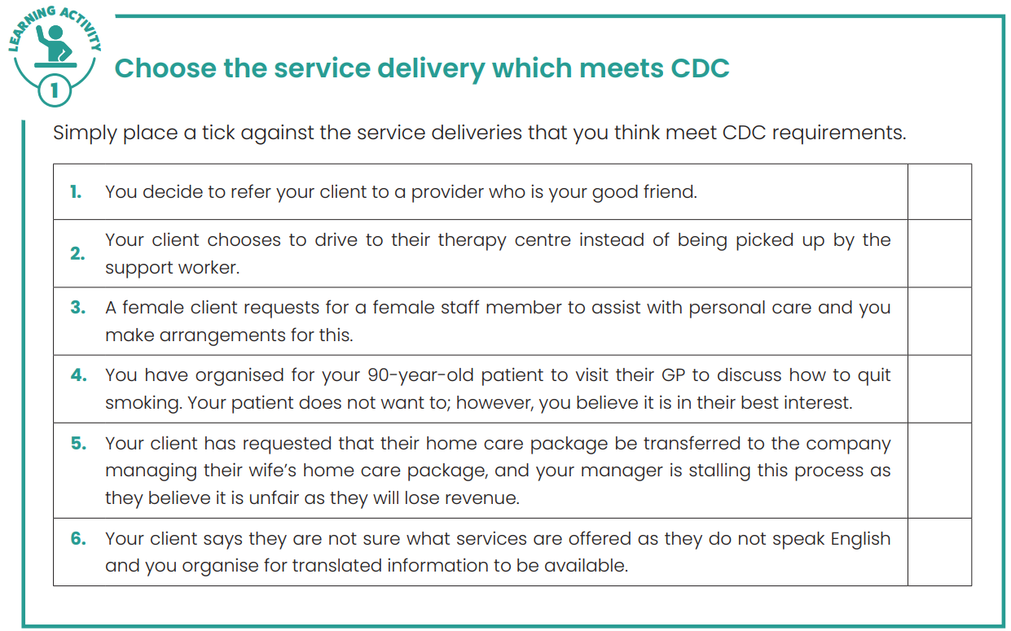
˅
˅
˅

Slide 19
Financial and Eligibility Requirements
While the government does offer a number of subsidised health services, they may not be accessible to everyone. When providing information to clients about available health services and subsidies available, it is important that you always provide clear and
accurate information about any financial and eligibility issues.
Watch video: Medicare Card and Health Care Card
Notes:
ASK- if you hold a health care card what does the card allow you? -More discussion points can be found at: https://www.servicesaustralia.gov.au/health-care-card
Trainer to speak to the income test matrix – Concessions and benefits information can be found at: https://services.dffh.vic.gov.au/concessions-and-benefits
Watch video: Medicare Card and Health Care Card
Offer current and accurate health services information
Provide clear and accurate health services information
More information can be found on Health direct website and watch all videos and discuss what information would a health and community services worker provide a client listed on the website: https://www.healthdirect.gov.au/australias-healthcare-system
Students can view in more detail AHP types, services and item numbers at 2007-11-Allied.pdf (mbsonline.gov.au)

Slide 20
Offer Current and Accurate
Health Services
Information
As a professional health care provider, it is paramount that the health care
organisation that you are working for is able to offer the most current and
accurate health services information.

Slide 21
Learning Activity 2 : Explore Health and Allied Health Professionals
In this activity, we are going to explore the range of different health and allied health professionals that work in Australia.
1. Form small groups; ideally 3 or 4.
2. Each group will need a notebook and a pen.
3. At the start of each round, your assessor will choose a letter.
4. They will then set a timer. As they are about to start this, they will give the class the letter they have chosen, then say, “Go,” as they start the 1-minute timer.
5. During the 1-minute period, a scribe for each team should print the name of as many health and allied health professionals that the group can name, beginning with the letter that the assessor has announced at the start of the round.
6. At the end of the 1-minute, scribes are to stop writing immediately.
7. Each group is to take turns reading out their answers, and the assessor will write these down in a place that is visible for all the class to see.
8. Groups receive one point for each answer that is unique.
9. At the end of each round, the assessor should write all group scores on the board, creating a healthy level of competition.
10. They may choose to run as many rounds as there is time for. At the end of the nominated rounds, the group with the highest number of points will be declared the winners.
By the end of the game, you should have a much better understanding of the scope of health professionals available to clients.
What are some strategies you would use to communicate with your friends?
https://www.healthdirect.gov.au/allied-health
https://www.verywellhealth.com/types-of-doctors-1736311

Slide 22
Provide Clear and Accurate Health
Services Information
Working in a health care environment means providing clients and other health care professionals with clear and accurate health services information.
It is essential that before you enter into the world of health care, you have an understanding of specific health service information

Slide 23
Maintain, Extend and
Update Health
Service Knowledge
The health care industry is always changing. The introduction of new health care services, and
changes to government budgeting and funding
means that access to particular health services can change. As an employee within the industry, it is
important that you keep up-to-date with all current information and take the time to identify
opportunities to maintain, extend and update your knowledge.
Notes:
ASK- what does establishing effective working relationships mean?
Share information using health language and terminology
Interact with health professionals
Establish effective relationships with health professionals
Share information using health language and terminology

Slide 24
Benefit of Continued Professional
Development
Benefits of continued professional development in the health services industry include:
Clients and patients receive the most up-to-date information which ensures appropriate treatment, resulting in
successful outcomes.
Health professionals continuing to enhance their knowledge and skills
which allows them to provide a better quality of care for clients and patients.
Notes:
ASK- who can explain the health services professional development activities opportunities?
Maintain, extend, and update health service knowledge
Discuss training, PD opportunities for health and community services workers, where to access this information, joining networks or organisations, subscribing to newsletters etc. Good examples of free training are: Community Door; ACT Health website; DOH online training for aged care workers; Head space online training for allied health professionals

Slide 25
Learning Checkpoint 1
1. What are three health care responsibilities of the Australian government?
• Sets national policies
• Is responsible for Medicare (including subsidising medical services and joint funding, with states and territories, of public hospital services)
• Funds pharmaceuticals through the Pharmaceuticals Benefit Scheme
• Funds community- controlled Aboriginal and Torres Strait Islander primary health care
• Supports access to private health insurance
• Regulates private health insurance
• Organises health services for veterans
• Is a major funder of health and medical research, including through the National Health and Medical Research Council
• Regulates medicines, devices, and blood
2. What does Medicare ensure?
Medicare ensures that all Australians have access to health professionals, services, and hospitals free of charge, or in some cases, at a heavily subsidised rate. This includes doctors, specialists, optometrists (for eye tests only) and dentists (specialised services only).
3. Each level of government is responsible for funding and regulating a range of different health related services. What are three things that a local government is responsible for?
• Organisation of local immunisation programs
• Maintain roads and public areas to ensure safety
• Local child and maternal health services.
4. What do the initials MLS stand for? Explain its function within the health care system.
Medicare Levy Surcharge (MLS): Higher-income earners (over $90,000 for singles and $180,000 for families) who do not have an appropriate level of private health insurance may be required to pay an additional surcharge. The MLS is additional to the Medicare Levy required by all taxpayers. The additional surcharge is to encourage those who can afford it to pay for health care and use the private hospital system to reduce the demand on the public system.

Slide 26
Learning Checkpoint 1
5. If you worked as a nurse’s assistant, how might you be able to assist patients leaving hospital?
• Bathing/showering/toileting equipment
• Home care including assistance with personal activities such as grooming and bathing
• Meal preparation
• Home modification services
6. What does Consumer Directed Care deliver?
It delivers a tailored Home Care Package for older people. These are subsidised by the Australian government. Home care packages help people to stay in their homes as they get older. These packages provide them with a flexible approach to home help where they get to choose the way their care and services are provided.
7. List three groups that priority access to specialised Health Care Services.
• Aboriginal and Torres Strait Islanders
• Children (0-12 years) and young people
• Homeless people and people at risk of homelessness
• Pregnant women
• Refugees and asylum seekers
• Registered clients of mental health and disability services
8. What is an aid? Provide an example.
An aid is an item or product that can assist or support someone to improve their quality of life. Aids can include things like wheelchairs and scooters, hoists, rails, shower seats and speech generating devices.

Slide 27
Learning Checkpoint 1
9. List one example of a service delivery that meets CDC requirements.
• Your client chooses to drive to their therapy centre instead of being picked up by the support worker
• A female client requests for a female staff member to assist with personal care and you make arrangements for this.
• Your client says they are not sure what services are offered as they do not speak English and you organise for translated information to be available.
10. What is one thing that you need to be eligible for the Victorian Aids and Equipment Program (VA&EP) ?
• be a permanent resident of Victoria or
• hold a Permanent Protection Visa or Humanitarian Visa or be an asylum seeker and
• require assistive technology on a permanent or long-term basis for a health or ageing related need.

Slide 28
Learning Activity 3 Research – Applying to the Victoria Aids and Equipment Program
People with a disability who do not meet National Disability Insurance Scheme (NDIS) eligibility criteria due to age, residency status or functional impairment level can also apply to the VA&EP. In pairs or groups decided by your trainer you are required to research information about three of the key topics below and provide a brief overview of their functionality within the Health Care System.
• Allied Health Regional Workforce Development programs.
• Mobile Learning Units
• Ultrasound Education Groups
• Specialists Continuing Medical Education (CME) Support:
• Rural Continuing Medical Education (CME) grants.
• Nursing and Midwifery Workforces
• GP Learning and Australian General Practice Training
Complete the following course to get NDIS certificate first:
https://training.ndiscommission.gov.au/course/index.php?categoryid=3

Slide 29
INTERACT WITH HEALTH
PROFESSIONALS
When interacting with other industry professionals, regardless of the nature of the
industry, it is essential that you are able to converse and interact in a professional manner.

Slide 30
HOW WOULD YOU ESTABLISH
EFFECTIVE RELATIONSHIPS WITH HEALTH PROFESSIONALS?

Slide 31
Establishing Effective
Working Relationships
Being honest and open
Trusting others and being respectful
Valuing the opinions and inputs of others
Taking the time to get to know co-workers and create and build rapport
Refraining from overstepping or giving your personal opinion on an issue when it is not required
Being tolerant. In a workplace environment you will be required to work with people that you don’t always
“click” with or whose personalities you don’t quite understand.

Slide 32
Share Information Using
Health Language and
Terminology
When sharing information, it is important that you use accepted
industry language and terminology. Part of this is recognising that while everyone is working in the same industry, many of the roles are diverse requiring different levels of education and training.

Slide 33
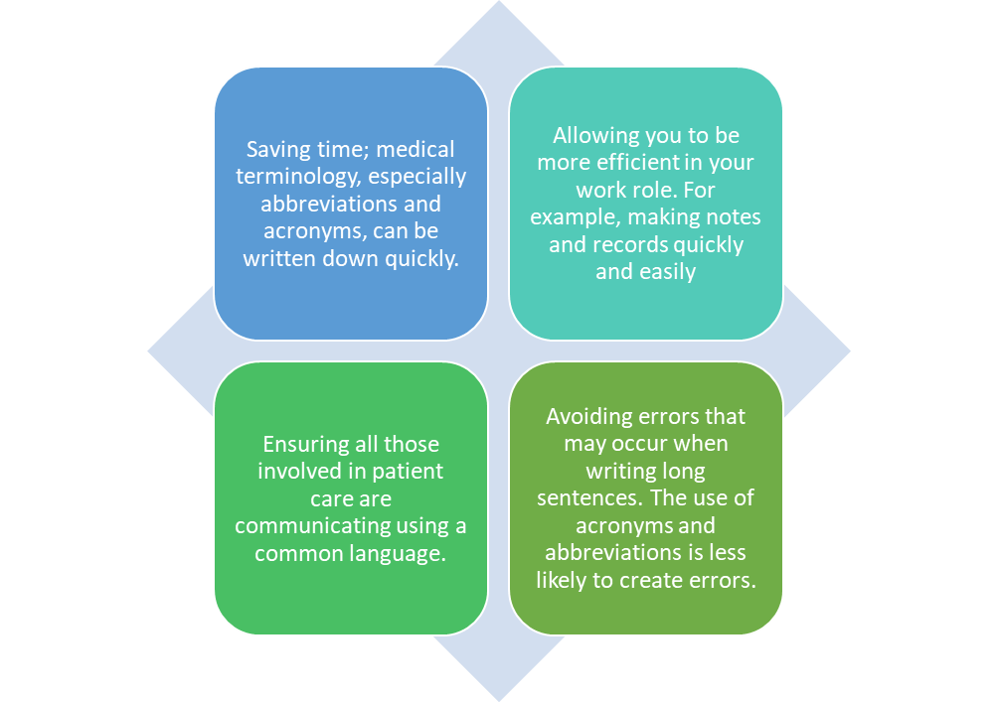
Share
Information Using Health
Language and Terminology

Slide 34
HAVE YOU EVER WONDERED
WHAT TYPE OF TERMINOLOGY AN X-RAY ANALYSIS USES?

Slide 36
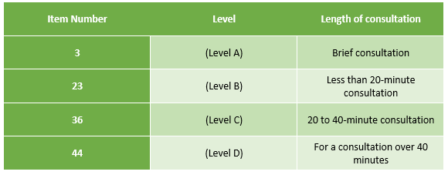
Billing and Medicare
Notes:
ASK- who can explain the benefits of knowing medical terminology by heart?
Billing and Medicare- how it works
Bulk billing explained- https://www.servicesaustralia.gov.au/bulk-bill-payments-to-health-professionals?context=20

Slide 37
Learning Activity 4 Health Care Codes and Abbreviations
It is important that you understand a range of different codes and abbreviations that are used in the healthcare industry. Here you are required to research medical terminologies and information and provide your understanding of what the following terms or codes stand for.
Medicare code 73806 | Pregnancy test by 1 or more immunochemical methods
mg | Milligrams
qhs | each night at bedtime
Ant knee | Anterior Knee
q6h | Every 6 hours
Medicare code 16500 | routine antenatal attendance
mdi | metered dose inhaler
pc/tds | After food /three times a day
acl | anterior cruciate ligament

Slide 38
Work Collaboratively When Seeking
and Sharing Health Information
To work effectively in the health services industry, the ability to work with others, communicate effectively and work collaboratively is imperative. Collaboration is about people working together in partnership to achieve an objective.

Slide 39
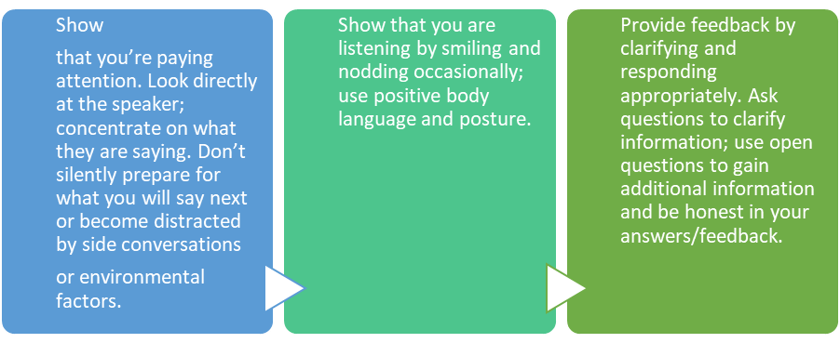
What Does it Mean to be an Active Listener?

Slide 40
How Effective Communication can be Achieved

Slide 41
In Person, Face-
to-Face
This method is a safe and effective way to share information as it offers an
opportunity to clarify the information, ask questions and acquire more detail.
Information is given in real time, so there is no waiting for a reply. While it is the
most effective method from a
communication sense it is not always
used by medical professionals as it can be time consuming.

Slide 42
Learning Activity 5 Effective Communication Skills
Benefits:
• Develops communication
• Sharpens listening skills
• Focuses on integrity
Instructions:
1. Your trainer will ask you and others in your class to spread throughout a large open space
2. Your trainer will say, “WALK,” and to stop they will say, “STOP.”
3. Your trainer will issue a series of these two commands, in any order, for 20 to 30 seconds to help you and the group practise responding.
4. When ready, the trainer will announce that you will now swap the meaning of those commands, so “WALK” means stop walking and “STOP” means to walk.
5. Challenge yourself and the individuals in your group continue to be as accurate and as fast as possible responding to each command.
6. When ready, the trainer will announce two new commands: -“NAME” invites everyone to say their own name out loud; and -“CLAP” invites your group to perform one simultaneous clap.
7. You are to practise these two new commands together with “WALK” and “STOP.”
8. Finally, the trainer will announce for you to swap the meaning of the last two commands, i.e., when they call “NAME” everyone claps and vice versa.
9. Continue playing for several minutes.
10. Next, try different variations, for example, you could ask the trainer to use medical terminology.
11. Reflect in a group the importance of active listening and adopting effective communication skills in a health and community setting and consequences. Terminology within the health and community sector constantly changes, and we need to be actively listening and update
our responses to these requirements regularly.
Notes:
Work collaboratively when seeking and sharing health information
Active listening (watch active listening how to communicate effectively Active Listening: How To Communicate Effectively - YouTube
How effective communication can be achieved:
Discuss why patients or consumers of healthcare struggle to communicate with their health professional. Access information here. Monash health’s research on health communication can be found here. Now using this information mind map what influences affect a healthcare worker’s communication in the workplace.
More information on communicating effectively in mental health compiled by NSW health can be accessed here. Another video here.
Watch video on Reflective Listening: Relationship and Communication Skills here.
Access more information on motivational interviewing here.
Watch video influences on interpersonal communication. As an example, review communication changes in dementia, access link here. Discuss strategies for communicating with an individual living in a memory support unit. Another good resource for discussion here is Centre for cultural diversity in Ageing, access link here. Access their resources and discuss various influences on communication when there are multiple factors or complex care to be taken into account; a CALD person who is ageing and has dementia.
Trainer to speak to table effective communication strategies

Slide 43
Learning Checkpoint 2
1. Identify what effective working relationships mean in a health care setting.
• Making your communication clear and communicate often.
• Trusting others and be respectful
• Valuing the opinions and input of others
• Taking the time to get to know co-workers and create and build rapport.
• Refraining from overstepping or giving your personal opinion on an issue when it is not required.
• Being tolerant. In a workplace environment you will be required to work with people that you don’t always “click” with or whose personalities you don’t quite understand
2. What are three benefits of knowing medical terminology of by heart?
• Saving time; medical terminology especially abbreviations and acronyms can be written down quickly.
• Allowing you to be more efficient in your work role. For example, making notes and records quickly and easily
• Ensuring all those involved in patient care are communicating using a common language.
• Avoiding errors that may occur when writing long sentences. The use of acronyms and abbreviations are less likely to create errors.
3. What are the three Health industry language and terminology areas?
• Clinical
• Laboratory
• Pharmaceutical
4. When billing Medicare, what level and length of consultation is associated with item #23?
Medicare item #23 is a level B, and the consultation time is less than 20 minutes.
5. What does it mean to you when referring to “respect your role?”
Respect your role refers to being a health care professional that does not offer conflicting information or devalue their decisions and opinions, especially if they do not have the formal training or qualifications to do so.

Slide 44
Learning Checkpoint 2
6. What is one thing that you can do to be a more effective listener?
• Show that you’re paying attention. Look directly at the speaker; concentrate on what they are saying. Don’t silently prepare for what you will say next or become distracted by side conversations or environmental factors.
• Show that you are listening by smiling and nodding occasionally; use positive body language and posture.
• Provide feedback by clarifying and responding appropriately. Ask questions to clarify information; use open questions to gain additional information and be honest in your answers/feedback.
7. Why is it important that health professionals recognise the different work undertaken by their colleagues?
It is important to recognise that everyone works differently and may not tackle tasks in the same way that you would. It is important to be respectful of the methods of others and not impose your own work style on them. Instead consider allowing them time to work in the manner they are comfortable with and offer support and suggestions for improvement where appropriate.

Slide 45
MAKE REFFERALS TO HEALTH
PROFESIONALS
When referring clients, it is important that you consider:
What service would be best to refer the client to? You should base this on the client’s need as well as their location, any budgeting limitations and assessment indicators.
What are the wishes and preferences of the client?
What are the wishes and preferences of the client’s friends, family and any health professionals involved in treating them?
Notes:
ASK- what could be the consequence if you made recommendations that you were not qualifies to make?
ASK- what could be a health cares limitations when it comes to making recommendations or referrals for clients in their care?

Slide 46
Determine Need
for Referral
When determining the need to refer a client to another or additional health
service, asking the right questions is the key to ensuring that you are making the right referral. You will have the health
data and the science behind your decision but having a clear and
transparent conversation with your client will improve your ability in making the
right referral.
Notes:
Work collaboratively when seeking and sharing health information
How effective communication can be achieved
Make referrals to health professionals
Determine need for referral to other health service professionals
Clearly communicate the need for referral

Slide 47
What is important to consider when making client referrals?
Ensure referral occurs with consent
Write clear and accurate referral report
Ensure structured. Logical language and information
Determine need for referral to other health service professionals
Clearly communicate the need for referral
Watch video on communication mistakes in healthcare and the consequences as an extension on communication.
Watch video of a Role play example of exaggerated poor clinical communication, make a list of what went wrong here and what communication skills should be used here to help a patient or client. Mind map what other issues could arise.
Notes:
ASK- there are a number of things that need to be considered when refereeing a health care client. What are three considerations?
Make referrals to health professionals
Determine need for referral to other health service professionals
Clearly communicate the need for referral
Watch video on communication mistakes in healthcare and the consequences as an extension on communication.
Watch video of a Role play example of exaggerated poor clinical communication, make a list of what went wrong here and what communication skills should be used here to help a patient or client. Mind map what other issues could arise.

Slide 48
Clearly Communicate the
Need for Referral
A client’s big question posed to any
health professional, is “Why do I need to be referred to this additional service?” It will be at that point in the consultation
that you need to be able to provide
information that not only supports the needs of the client, but also builds
further trust and confidentiality.

Slide 49
Ensure Referral Occurs with Consent
When referring a client, you should ensure that the referral occurs with their consent and within confidentiality standards. Clients should be made aware that their personal health information is being disclosed as part of the referral report.

Slide 50
Write Clear and Accurate
Referral Report
Referrals ensure that people only use
certain health services or seek the advice of health professionals when it is
required. Referrals prevent people from using unnecessary resources and
spending vital health care funding that could be used more effectively.

Slide 51
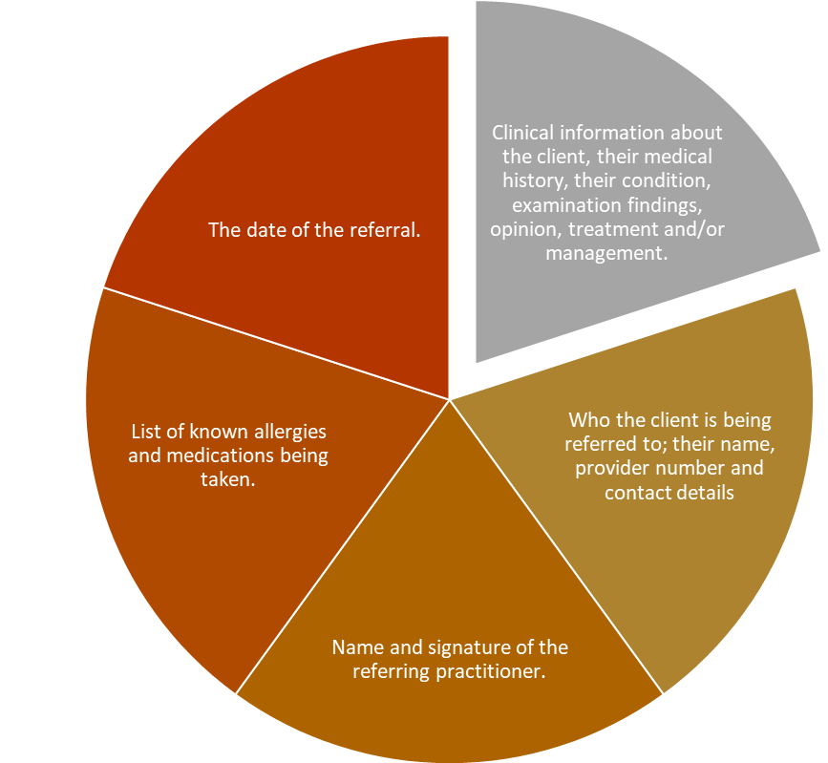
Medicare Benefit Criteria
To ensure that the referral provides all necessary information and meets the
criteria to access Medicare benefits, it needs to contain specific information.

Slide 52
Ensure Structured Logical Language
and Information
The referring health professional is
required to put together a report and list the patient’s details, conditions, reason for referral and a brief synopsis of their medical history such as any allergies,
medical conditions, or surgeries.

Slide 53
Learning Activity 6 IVET Super Clinic
You are required to log into the IVET super clinic and access the referral form template. Spend time in small groups looking over the template and discussing information in needs to contain.
• Visit this link: https://ivetsuperclinic.ivetinstitute.com.au/
• Password: superIVET
• You need to go to Resource Hub, Click on Clinic Forms, then Patient Referral is the last on the list.
A copy / sample of a Referral Form (Appendix 2) is available on the following page.

Slide 54
Learning Activity 7 Complete a Referral Form for Ms. Beverly Taylor
It’s time to do a roleplay.
Your trainer will put you into pairs. While in pairs you will need to nominate who will play the doctor and who will play the patient. This means that you will get to either role pay Ms. Beverly Taylor (patient) or Dr Sandross (doctor). After the roleplay, if you are playing the doctor, you are required to pretend to type up a referral (using the template provide) and hand it to the patient, explaining what they need to do with it, and that they will ensure they receive a copy of any results etc. so they are up to date with the patient’s outcome.
To ensure all students get the opportunity of pretending to type up Ms Taylors referral, students will swap roles accordingly.
A copy / sample of a Referral Form (Appendix 2) is available on the following page.
Scenario: Ms. Beverly Taylor
A patient by the name of Beverly Taylor went to the doctor one day because she had been getting very bad headaches. The doctor firstly asks Beverly how her headaches have been since their last consultation. She responds, “there has been no change since last time Dr”.
Her doctor, Dr Sandross takes a look at Ms Taylor and sends her to have a CT scan to investigate further. He informs Beverly to make another appointment to discuss the CT scan results in person.
A few days pass Dr Sandross calls Beverly to inform her that her scans have come back, and it all appears that everything is ok.
Dr Sandross says, “because the headaches are still occurring, I think it would be best to refer patient you to see a neurologist for further investigation.
Dr Sandross informs Beverly of the;
• rationale/need for referral
• referral benefit
• process for referral
• details of who they are being referred to

Slide 55
Make Recommendations within Scope
of Practice
There are limitations that exist in every role within the health care system. A limitation is a
boundary and/or something that is restricted and may be out of your control. Those who
choose to work in the health services industry have chosen to do so because they want to help people and being told that this may not be possible can be hard to accept.

Slide 56
Learning Activity 8 Practice Using IVET Super Clinic Referral Form Templates
In this activity you need to go to the IVET- Super-Clinic, down load the Referral Form you accessed in activity 6 and practice filling in the information based on the scenario provided below. You could do one and then swap with a class mate and have them provide feedback.
• Visit this link-https://ivetsuperclinic.ivetinstitute.com.au/ Password: superIVET
Scenario- Walter Mclean
Using the Referral Form that you have uploaded or sourced from the student portal. Fill in all the relevant information and discuss Walters current health concerns to establish the services that you think would best assist his current health issues. Depending on Walter’s health concerns identified by his doctor additional Referral Forms may need to be completed. Walter McClean has been recommended by his doctor to undertake Chronic Disease Management/ GP Management Plan: MBS item 721.
Information you need to include in the Referral Form:
GP Details
• Provider number; 4925958A
• Doctors name; Dr Barry Rodrigues
• Address: 18 Belville Rd, Burswood West, 3960
Patient Details
• Name; Walter Mclean
• Address: 296 Rawson Street, Burwood East, 3962, Melbourne, VIC
• Medicare # 8695231 1
Allied Health Professionals
• Research and recommendations accordingly.
Walter’s active problems
Date diagnosed | Health Concerns | Findings
2014 | Hypertension
06/01/2020 | Cholelithiasis | Incidental findings
06/03/2020 | Impaired fasting Glycaemia
08/04/2021 | Fatty Liver | Moderate with some liver enlargement
08/04/2021 | Moderate right osteoarthritis of knee | MRI- medial patellofemoral compartment, medial meniscal abnormality

Slide 57
Learning Checkpoint 3
1. Complete this sentence. It is important to remember that part of making a good referral...
is making the client feel comfortable with the process; you don’t want them to feel like you are hand balling them unnecessarily.
2. Name one legislation or act that mandates how the confidentiality of a client’s information is upheld.
• Health Administration Act 1982
• Health Records and Information Privacy Act 2002
• Health Services Act 1988 (Vic)
3. What is the general rule of referrals?
As a general rule, referrals are valid for 12-months, however, a GP can decide to create a referral for longer than 12-months or an indefinite referral for someone who is chronically ill and requires continuing care.
4. When making a referral, it is essential that the referral contains specific information. What are three types of information that should be on a referral?
• Clinical information about the client, their medical history, their condition, examination findings, opinion, treatment and/or management.
• The date of the referral.
• List of known allergies and medications being taken.
• Who the client is being referred to; their name, provider number and contact details
• Name and signature of the referring practitioner.
5. What are three things that a health care professional might be limited by?
• Qualifications, expertise, and experience.
• The government, Medicare and the PBS including what is covered, funding, out of pockets costs to patients and waiting times.
• The availability of treatment.
• Eligibility and funding issues, such as a patient being ineligible for a drug trial as their condition has advanced too far or not being able to access the best drugs available for their conditions as they are not subsided under the PBS and are too expensive for them to purchase.
• Legislation and codes of ethics
Notes:
ASK- what are the three legislations that mandate how a client’s information is held?
Discuss differences between Privacy and Confidentiality. Provide examples of each. Elicit or mind map for more examples in a healthcare setting. You will find more information here. Watch the video here.
Explain disclosure in healthcare and the use of patient information for the purposes of collection. More information here. Discuss examples from news or other sources and explain the consequences of breach of patient/client right to privacy and confidentiality
Write clear and accurate referral report (watch how to write a referral letter video Medical Referral Letter - YouTube
Medicare benefit criteria- Access Services Australia for more discussion points: https://www.servicesaustralia.gov.au/whats-covered-medicare?context=60092
Trainer to discuss the specific information pertaining to Medicare benefit criteria.
Ensure structured. Logical language and information
Trainer to talk through the example Referral Form

Slide 58
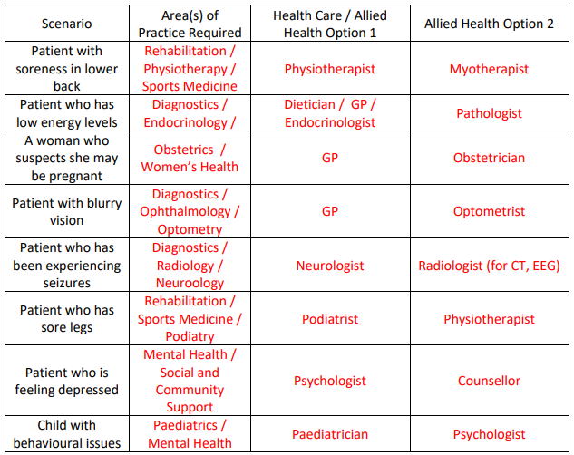
Writt 1 Questions
1. When working in the health care industry, it is important to understand the range of health care professions and allied health services available, including how they interrelate within areas of practice. Below are some health issues a patient may have. List two (2) interrelated health care or allied health professionals within their area of practice and that may be appropriate for the patient to see to for diagnosis, investigation and/or treatment.

Slide 59
Written Questions
Writt 1
2. Name a way that you could establish effective relationships with workers from different sectors and levels within the health care industry?
If they were people that you were going to be regularly referring people to, you could make a phone call to introduce yourself, or make a time to meet them in person. If it was in the scope of your role, you might also meet other providers at workshops/conferences etc.
3. Both services, and current and emerging issues have a tendency to change rapidly within the health industry. As such, maintaining up-to-date information is an imperative part of your role.
a. Name three (3) ways that you can maintain, extend, and update your knowledge. Why is doing this important?
You can do this by attending workshops, short courses, conferences, seminars, mandatory workplace learning activities as well as self-directed learning through the reading of articles, internet research and reviewing industry standards and frameworks. It is important because the health care industry is always changing. The introduction of new public concerns and health care services, and changes to government budgeting and funding means that the requirements of and access to particular health services can change. As an employee within the industry, it is important to keep up to date with all current information so that what you are telling your patients is correct and takes into account all options.
b. Use one of the methods you identified in the first part of this question to identify two (2) current and two (2) emerging health industry issues.
• Areas of or priorities for funding
• Representing women’s issues and sisues of other cultures / equity issues
• Demographic changes including increased demand for aged services
• Technology costs and availability
• Medical research impediments and funding concerns
• Demand on existing services particularly in the area of mental health or whole of person health Demand on existing services based on geographical location

Slide 60
Written Questions
Writt 1
4. When discussing financial and eligibility issues with a patient, what should you always request that they do to ensure accuracy of information? Why is it sometimes not possible to give them exact figures?
When discussing financial and eligibility issues with a patient, it is always good to refer them back to the department or supplier of the services they are enquiring about. This is because many services and schemes are means tested and as you do not have a full understanding of a patient’s financial situation, it is impossible to provide exact figures or guarantees of what they’re eligible for.
5. Describe two (2) ways to work collaboratively with others to seek and share information?
Answers will vary but may include:
Be respectful of others and value their expertise. You should value their role and not offer conflicting information or devalue their decisions and opinions. Listen actively and work with them to find the best outcome for the patient.
Be an active listener. Pay attention, show that you are listening and provide feedback. The best way to work collaboratively with others is to listen to them and build on what they are saying to find the best outcome for the patient.
6. When interacting with other health professionals, it is important to use accepted industry language and terminology when sharing information.
a. Why is this important?
When communicating with other health professionals, it is important to use accepted industry language so that what you are saying cannot be mistaken, and your message is clear.
b. Would you use industry language when communicating with a patient? Why/why not?
You would not use the same language however with a patient, as they will not understand all the terminology or ‘jargon’ that is used between healthcare professionals. Instead, you should speak to them in simple, plain English and check for their understanding.

Slide 61
Written Questions
Writt 1
7. When referring a patient to another healthcare provider, what steps should you take with them?
Why is this important?
When referring a patient, it is important that you:
• Communicate with them in clear terms about why you believe a referral is needed, how it will benefit them and why it is the best option.
• You should outline the process for referral, which may include you writing a letter of referral, making an appointment, or requesting that the health service contacts the patient directly.
• You should outline any important information about the service such as its location, expected waiting time and any eligibility requirements.
• You should let patients know about any costs associated with accessing the service, especially if there are out-of-pocket costs that are not covered by Medicare.
• You should also ensure that the referral occurs with their consent and within confidentiality standards.
8. Name four (4) things that should be listed in a referral letter when referring a patient to another healthcare provider.
Answers will vary but may include:
• Clinical information about the patient, their medical history, their condition, examination findings, opinion, treatment and/or management.
• List of known allergies and medications being taken.
• The date of the referral.
• Name and signature of the referring practitioner.
• Who the patient is being referred to; their name, provider number and contact details

Slide 62
Written Questions
Writt 1
9. What is private health insurance and what are three (3) benefits of having it?
Answers will vary but may include:
Private health insurance is extra health cover people can buy.
Three (3) benefits of having it are:
• It provides rebates on health services.
• It allows individuals to choose their own doctor, the choice of hospital and the choice of the timing for procedures.
• It also negates their need to pay an extra levy if they earn over the threshold.
10. Australia adopts a universal health care system through Medicare and the Pharmaceutical Benefits Scheme (PBS). These universal public health care systems are accessible to all Australians.
a. Who funds these?
The public health sector is funded by all levels of the Australian Government (Commonwealth); they provide almost 70% of all health care funding, with the additional 30% being contributed by both state/territory and local governments. The taxpayer also contributes via the 2% Medicare Levy.

Slide 63
Written Questions
Writt 1
11. The government has three (3) main incentives available to encourage Australians to purchase private health insurance.
a. Name and outline the key points of each.
• A rebate (i.e. discount): Depending on an individual or family’s income and their age, private health insurance policy holders may be eligible for a rebate. This eligibility is means-tested.
• Medicare Levy Surcharge (MLS): Higher-income earners (over $90,000 for singles and $180,000 for families) who do not have an appropriate level of private health insurance may be required to pay an additional surcharge. The MLS is additional to the Medicare Levy required by all taxpayers. The additional surcharge is to encourage those who can afford it to pay for health care and use the private hospital system to reduce the demand on the public system.
• Lifetime Health Cover: An incentive introduced by the Commonwealth Government to encourage Australians to purchase private health insurance early in life and maintain it as they become older. It is designed to stop people from purchasing private health insurance only once they get older, and are more likely to need health care services, as well as those who join up for a short period of time to have treatment and then subsequently leave. The Lifetime Health Cover incentive requires a person to purchase private health insurance (by the 1st of July following their 31st birthday and maintain it for life. This benefits them by paying the lowest premium for life. Those who take out private health insurance after the 1st of July following their 31st birthday are required to pay an additional 2% on their premium for every year after this time. For example, someone who takes out private health insurance at 40 years of age may pay 20% more on their premium.

Slide 64
Written Questions
Writt 1ns
12. Understanding the scope of your own role is important, especially when dealing with other healthcare professionals.
a. If you were a GP referring a patient to an orthopaedic surgeon, would it be suitable to say “I am referring the patient to you to have a knee reconstruction”? Why/why not?
No, this would not be appropriate. Although you suspect that this might be the long-term solution, this is outside of your scope of expertise. Instead, you would say “I am referring the patient to you to identify potential solutions/treatments for his torn ACL”.
b. Thinking about your preferred area of practice (or one which you pick for this task), what sorts of referrals would expect to make within the context of that role? Give at least three (3) examples of making referrals working within your own role in the health care system:
Answers will vary depending on the area of practice. The student must limit their examples to the specific area of practice they choose and the boundaries of that role. For example, as a dental assistant they might refer to a GP for further investigation of an infection issue, or a practising dentist for diagnosis of a condition or refer to a orthodontist for investigation of overbite or underbite issues.

Slide 65
2 Project 1
• Your response should be written in email format with short paragraphs and dot points addressing each area of the case study and the questions or concerns raised.
• You should try to include at least one (1) source of additional information which you could use to further support communication with the patient. This could be a brochure, handout, factsheet, website or similar.
Scenario 1:
You work as a care assistant in a Rehabilitation Centre for patients aged 65 and above. Part of your role is to assess what services they may require at home to allow them to continue living independently.
Investigate information that you would need to provide them as part of your consult, including the types of care and services available, how they can find out if they’re eligible for government funded aged care and how to apply for assistance.

Slide 66
2 Project 1
• Your response should be written in email format with short paragraphs and dot points addressing each area of the case study and the questions or concerns raised.
• You should try to include at least one (1) source of additional information which you could use to further support communication with the patient. This could be a brochure, handout, factsheet, website or similar.
Scenario 2
You work as an assistant in a clinic that provides speech therapy, occupational therapy, and psychology services to children. Your team care for a large number of children who have autism; in many cases they see them through from the point of diagnosis until they reach the later years
of schooling. It can be an overwhelming time for parents and understanding what services they are eligible for can be daunting.
You have recently been liaising with the parent of a three-year-old girl. Her daughter has just been diagnosed with autism, and she’s trying to work out what funding she might be eligible for.
Investigate information that you would need to provide her as part of your role, including the types of services available, what funding they may receive and what it can be spent on.

Slide 67
2 Project 1
• Your response should be written in email format with short paragraphs and dot points addressing each area of the case study and the questions or concerns raised.
• You should try to include at least one (1) source of additional information which you could use to further support communication with the patient. This could be a brochure, handout, factsheet, website or similar.
Scenario 3:
You work as a dental assistant in a busy clinic that deals predominantly with children. In your role, you meet the child/patient, explain what is going to happen in the chair, assist the dentist throughout the appointment, and then work with the parent at the end to finalise payment for the service. Many of your young patients are eligible for the Child Dental Benefits Scheme, but not all of them qualify.
Investigate information on this scheme that you would need to provide the parents/carers of your patients, including how the Child Dental Benefits Scheme works, what funding they may receive if eligible and what it can be spent on.

Slide 68
2 Project 2
You must write three (3) referrals using the template titled IVET Superclinic Referral Form.
Your report must:
• Clearly communicate the need for referral, explaining why the referral is requested
• Detail the client's consent (provided during the consultation in Assessment Task 3)
• Adhere to confidentiality standards
• Use clear, appropriate and accurate information about the results of the doctor's assessment
• Be structured logically
• Include two (2) recommendations that are within the scope of your expertise e.g. please contact the doctor if you have any further health concerns etc. Do not provide medical recommendations outside of the scope of your role as a health care assistant.
Please note that the referral date for each of these scenarios in 03/06/2020. watch how to write a referral letter video Medical Referral Letter - YouTube

Slide 69
2 Project 2
You must write three (3) referrals using the template titled IVET Superclinic Referral Form.
Your report must:
• Clearly communicate the need for referral, explaining why the referral is requested
• Detail the client's consent (provided during the consultation in Assessment Task 3)
• Adhere to confidentiality standards
• Use clear, appropriate and accurate information about the results of the doctor's assessment
• Be structured logically
• Include two (2) recommendations that are within the scope of your expertise e.g. please contact the doctor if you have any further health concerns etc. Do not provide medical recommendations outside of the scope of your role as a health care assistant.
Please note that the referral date for each of these scenarios in 03/06/2020. watch how to write a referral letter video Medical Referral Letter - YouTube

Slide 70
2 Project 2
You must write three (3) referrals using the template titled IVET Superclinic Referral Form.
Your report must:
• Clearly communicate the need for referral, explaining why the referral is requested
• Detail the client's consent (provided during the consultation in Assessment Task 3)
• Adhere to confidentiality standards
• Use clear, appropriate and accurate information about the results of the doctor's assessment
• Be structured logically
• Include two (2) recommendations that are within the scope of your expertise e.g. please contact the doctor if you have any further health concerns etc. Do not provide medical recommendations outside of the scope of your role as a health care assistant.
Please note that the referral date for each of these scenarios in 03/06/2020. watch how to write a referral letter video Medical Referral Letter - YouTube

Slide 71
3 Observation
You are required to complete a demonstration as evidence of your skills and ability to perform the associated tasks.
You must take part in role play to demonstrate identifying the need for and obtaining consent to make a referral.
You must choose one (1) of the three (3) scenarios outlined in Project 2 to base the roleplay on.
In this role play, you are to play the role of the allied health care assistance identified in the case studies. The other person, who will be nominated by your assessor, will play the role of a patient.
The roleplay is to be held in a simulated environment that resembles an allied health office. There should be a desk with a chair on one side for the allied health assistant and another on the other side for the patient.
You will also require access to a blank notebook and a pen to take patient notes.
Using the information in the case study, you must discuss the issues identified by the doctor and consulting allied health care professional with the patient, take note of any additional history, which they should provide from the information outlined in the case study and draw conclusions about any additional referrals to both health and other services.
When it comes time to discuss referrals with them, you should ensure that you:
• Clearly communicate the need for referral to the patient and explain your rationale
• Ensure referral occurs with consent of patient
You should tell them at the end of the role play that you will write the referral and have it reviewed by the Allied Health Professional. You will then send the approved referral electronically to the doctor/healthcare expert you’re referring them to. You should explain to them that the reception staff will provide them with a copy of the approved referral in the post or by email which will have the details of where they are being referred so they will be able to call to make an appointment.

