Slide 1
HLTWHS 001 PARTICIPATE IN WORKPLACE HEALTH AND
SAFETY
In this unit we will look at the following: following safe work practices
implementing safe work practices contributing to safe work practices in the workplace
reflecting on own safe work practices.

Slide 2
Activity 1
Activity 2
Activity 3
Activity 4
Activity 5
Activity 6
Activity 7
Activity 8
Activity 9
Activity 10
For this unit, you will be assessed on the following: Assessment 1
Questions and Answers Assessment 2
Observation/Demonstration
Learning Checkpoint 1
Learning Checkpoint 2
Learning Checkpoint 3
Learning Checkpoint 4
Assessment

Slide 3
Introduction
This student resource covers the knowledge
required to participate in workplace health and
safety within your organisation. This means having an understanding of your organsational Workplace Health and Safety (WHS) policies, procedures and practices, with a view to contributing to the health and safety of yourself and others. It also requires you to identify and reflect on your own safe work
practices and explore ways that you may recognise indicators or make changes to minimise risk and
harm to yourself and others.

Slide 4
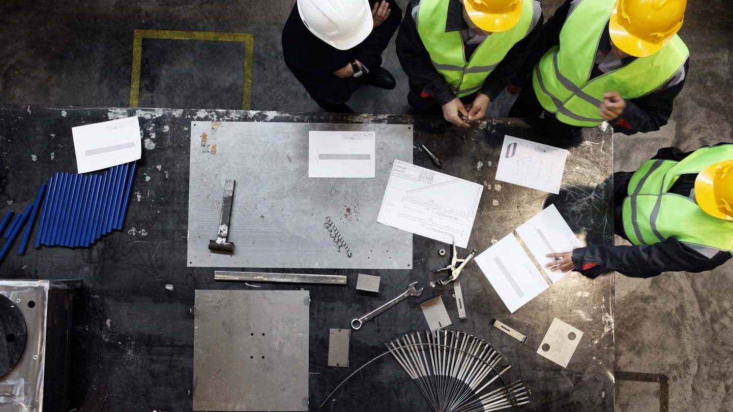
WHY DO WE NEED HEALTH AND SAFETY PROCEDURES IN
THE WORKPLACE?

Slide 5
The key principles of WHS
The Workplace Health and Safety Act 2011 is built on five key principles:
All people including workers and the general public, should have the highest level of protection against risks to health and safety.
Those that manage or control things that create health and safety risks in the workplace are responsible for eliminating those risks. Where they can’t be
eliminated, they are responsible for reducing those risks were reasonably practicable.
Employers should be proactive in promoting health and safety in the workplace.
Watch YouTube video: Australian WHS Legislation Made Simple
Notes:
Review your state WorkSafe website or equivalent and discuss how it is relevant to own industry
WHS Laws keep us safe, discuss as relevant to your state
Watch YouTube video: Australian WHS Legislation Made Simple

Slide 6
The key principles of WHS (cont.)
Information and ideas about risks and how to control them should be shared between employees and employers.
Employees are entitled, and should be encouraged, to be represented in relation to health and safety issues.

Slide 7
Duty of care
The manager or supervisor is responsible for the day-to-day implementation of safety measures.
Management must also provide training,
information and safety equipment. If management is made aware of unsafe work conditions and fail to act, they will be held responsible. Employees
also have a duty of care; with respect to their
own safety and that of other workers or any other person who comes on-site or in contact with their business operations.
Notes:
Access Duty of Care on Comcare website and discuss each duty in detail. Explain the consequences of not adhering to these requirements
Provide examples or news items of any recent breaches in duty of care in WHS of staff/clients and discuss what actions were/should be taken. 9News item on severe breach of duty of care by employer.
Provide copies of sample policies and procedures and discuss the contents. Elicit key learnings on how policies and procedures shape our actions at work. List any relevant examples.

Slide 8
Codes of practice
In addition to legislation, codes of practice provide documented advice on
methods of achieving the minimum acceptable levels of safety performance. While the legislation explains the ‘what’, codes of practice describe the ‘how’. If WHS
legislation is breached, the code of practice can provide evidence to show that an employer or employee has breached their duty of care. They might be used to
provide evidence that an organisation is not meeting minimum requirements. On the other hand, if an organisation is prosecuted, but can prove that it has been
following codes of practice, it is considered to be complying with its responsibilities.
Watch YouTube: Responsibilities of the person conducting a business or undertaking (PCBU).
Notes:
Access Compliance codes and discuss how they shape our work within the sector
Watch YouTube: Responsibilities of the person conducting a business or undertaking (PCBU).
Access safe@work learning modules and choose any or all of the topics for this week and test student knowledge towards the end of session.

Slide 9
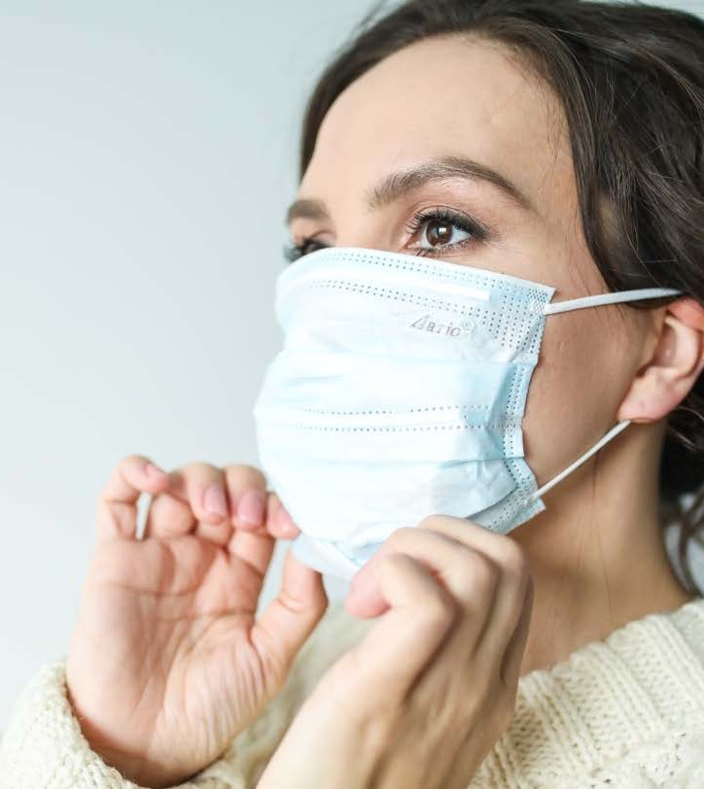
WHS information access
In order to properly support WHS
procedures in the workplace, staff must be able to locate and share information.
However, it is not enough for the
management or human resources to simply provide the information. They
must also demonstrate that they follow the policies and procedures through
leading by example.

Slide 10
WHS consultation
Watch this short YouTube video explaining the requirement and responsibilities of the employer.
Current legislation requires WHS
consultation, which can be encouraged
through WHS committees, and/or Health and Safety Representatives (HSRs).
Employees should be involved in WHS policy development, decision-making, and suggesting improvements. The
people who work with the processes
know them best, and therefore know the safety issues involved.
Watch this short YouTube video explaining the requirement and responsibilities of the employer.
Notes:
Discuss why WHS Consultation is important. Watch this short YouTube video explaining the requirement and responsibilities of the employer. Discuss how occurs in the workplace for examples in meetings, surveys etc.

Slide 11
WHS consultation (cont.)
Teams should be consulted about:
their safety needs - physical and psychological
their training needs
safety program development safety improvement needs
hazards and risk assessments audit and assessment results compliance requirements.

Slide 12
WHS committees and representatives
WHS committees and/or representatives are intended to formalise the means for consultation and cooperation
between management and workers. A
health and safety committee must have at least 50% elected employee
representation.
Their role is to ensure, through liaison with management, that WHS
requirements are met. The committee
represents the interests of workers who are encouraged to report perceived
workplace issues.

Slide 13
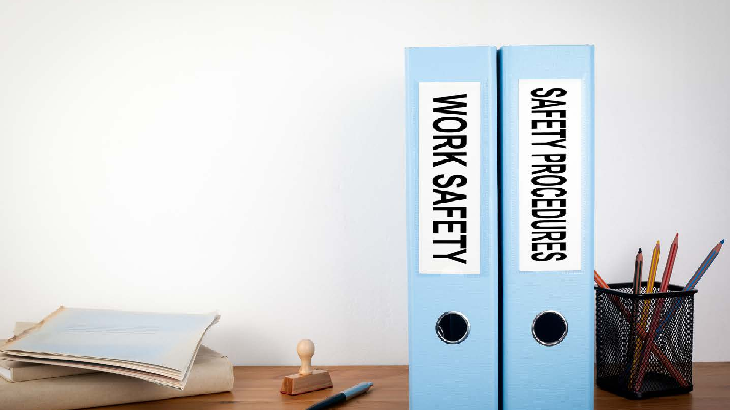
Monitoring WHS
It is important that supervisors monitor their team to ensure that they are adhering to the
organisation’s WHS procedures and safe work practices.
It is not good enough for them to sit in their work environment and wait for an accident to occur.
They need to continually monitor the
effectiveness of the work practices in the
organisation to ensure that they are maintaining the health, safety and security of all personnel.

Slide 14
WHS policies
Examine the WHS policies and procedures from following link. What do they say about the way that you operate? Are there specific details about the use of equipment or facilities. Is there anything that you were unaware of?
https://www.safeworkaustralia.gov.au/safety-topic/industry-and-business/health-care-and-social-assistance/whs-duties

Slide 15
Hazard
Indentification
Hazards have the potential to cause serious harm, in terms of human
injury, illness or disease.
Hazard identification is important as it can prevent future accidents or
incidents
Notes:
Discuss the features of an incident report, what information does it collect and how is this information processed? For example there is mandatory reporting to government bodies of any serious incidents that occur in the workplace.
Access IVET Superclinic and download incident report from the resources tab.
Password: superIVET

Slide 16
Learning Activity 2 Reporting Procedures for Hazard Identification
Search the Internet for ‘incident hazard report forms’, view and analyse at least three different incident hazard report forms.
Then complete the following questions:
1. What details must be included about the incident/hazard? Include at least four.
• Patient’s personal details (name, phone number, gender etc.)
• Name of witness
• Date/time of incident
• Body part injured/nature of the injury
• Cause of injury/description
• Location of accident
2. Why is it important to document the exact location and type of injury?
The location needs to be checked straight away to prevent further incidents. The hazard can be dealt with immediately.
3. Why is it important to document if first aid was administered and by whom?
To ensure that the hospital or the medical practitioner you have referred the patient to has a record of what treatment was administered straight away as this may affect the treatment that they administer. The person who administered it is also important for legal reasons: were they qualified to administer the treatment?
4. Why is it important that a senior member of staff, supervisor or manager is made aware of the incident?
To ensure that the area/location of the incident can be assessed to prevent further injury. They can also make other staff members aware of the incident immediately to prevent more injuries. They can also investigate the incident, talk to witnesses and determine the cause of the incident (e.g. mechanical, environmental, work performance).

Slide 17
Learning Activity 2 Reporting Procedures for Hazard Identification
5. What are two other elements that must be recorded on the incident hazard report form?
• Action to present re-occurrence.
• Worker’s compensation information.
• Whether further investigation is required or not.
6. Why is it important to document and record workplace accidents?
• It is a legal requirement.
• As a reference in legal matters or worker’s compensation claims.
• To assist with hazard identification and risk assessment in the future.

Slide 18
Learning Checkpoint 1
1. Why are you required to follow workplace policies and procedures in your workplace?
To protect and prevent potential injuries occurring in the workplace.
2. What should you do if you identify a potential hazard in your workplace?
You should report it to your supervisor, either in person or on a hazard report.
3. What do you do if the fire alarm sounds in your workplace?
Follow the instructions of your workplace emergency procedures.
4. What is duty of care for an employee?
Duty of care for an employee is with respect to their own safety and that of other workers or any other person

Slide 19
COMMON WORKPLACE HAZARDS
Biological
Physical (manual handling) Environmental
Psychosocial Violence
Burnout Radiation
Hazardous Chemicals

Slide 20
TYPES OF WORKPLACE HAZARDS
BIOLOGICAL
Biological - Micro-organisms can cause hepatitis, legionnaires’
disease, Q fever, HIV/AIDS or allergies. Infectious waste includes all animal and human waste
PHYSICAL
Muscle injuries (in the back and neck), sprains and strains
from.Manual Handling (the overuse or repetitive movement of an object or person) or a Trip/Fall from uneven surfaces
ENVIRONMENTAL
Weather, terrain and ground surfaces all play a role in the safety issues tha if left uncheked can expose people to broken bones,
ligament damage or muscle sprains and strains
PSYCHOSOCIAL
The effects of stress, violence and work related fatigue all effect the productivity and performance of a person which can lead to safety
concerns within the workplace.

Slide 21
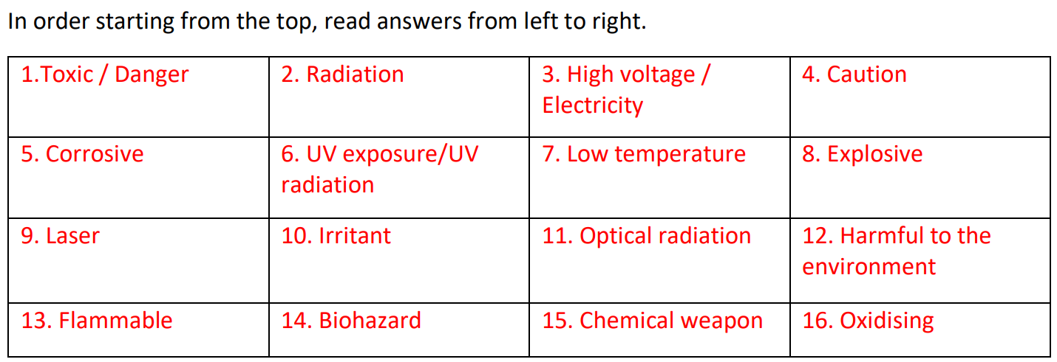
Learning Activity 3 Know your hazard signs
How well do you know your safety signs? Your task is to identify the different hazard signs below and the hazard they are communicating. You will then answer the questions below.

Slide 22
Learning Activity 3 Know your hazard signs
Questions:
1. List four household items that have any of the above symbols. Which symbols do they have?
• Easy Off Bam – Active foam soap scum (Flammable)
• deodorant (Flammable)
• bleach – (Irritant)
• dishwashing liquid (Toxic)
• weedkiller (Toxic)
2. Which items are biohazards?
• sharps
• medical waste
• blood stained items
• gloves after treating an injured person.
3. Why is it important that people are able to recognise the above safety signs?
So that they can easily identify what items to avoid contact with or handle with care to prevent injury and accidents.
4. What should you do if you are unsure of what a safety sign means?
Ask a co-worker or manager. Look it up on the internet or displayed safety sign.
5. How important is PPE when handling substances with the above safety signs?
PPE is very important when handling substances. PPE requirements vary depending on which safety sign is displayed. Some are more dangerous than others. PPE requirements should be checked prior to making any contact with the substance.

Slide 23
Learning Activity 3 Know your hazard signs
Questions:
6. Choose one of the above signs and highlight the PPE that should be worn when handling the substance.
Answers to this question will vary depending on the sign chosen. Sample response:
Danger/Toxic – Gloves, Goggles
7. How could a workplace induct employees and make them aware of the above safety signs? Why would this be important?
Give them pictures of the safety signs they would need to be familiar with in the workplace environment and let them know exactly what the safety sign means and any PPE or precautions that need to be taken when handling the substance. Inducting new employees to safety signs would be extremely important to ensure their safety in the workplace and minimise accidents.

Slide 24
HIERARCHY OF CONTROLS
LEVEL 1 CONTROLS
Elimination
Remove the hazard or cause of potential harm completely.
LEVEL 2 CONTROLS
Safe Work Australia provides a
number of options for managing and controlling hazards and risks within the workplace. The options are
ranked from the highest level of
protection and reliability to the lowest.
Substitution
Replacement of the item/object with something that has the same function but deduces the level of harm.
Isolation
.
Create a barrier between harm and employees or others in the workplace.
Engineering Controls
Changes to equipment, materials or resources to reduce the harm.
LEVEL 3 CONTROLS
Administrative Controls
Remove the hazard or cause of potential harm completely.
PPE
Implement the use of personal protective equipment - ie: protective glasses, ear plugs etc.

Slide 25
Learning Activity 4 Risk Control, You Decide
For each of the following potential hazards in the health services workplace decide which risk control would be most appropriate and briefly explain why. Choose from the following risk control options: eliminate, substitution, isolation, engineering controls, administrative controls or PPE. Refer back to the hierarchy of control to help you explain your answers.
1. Keira is a medical receptionist for a women’s medical clinic in Melbourne. One of Keira’s main tasks it to photocopy and organise information brochures for new patients and their families. She has recently spoken to the doctor who owns the clinic, as she is concerned about the amount of time she is spending per day in front of the photocopier. She is pregnant and worried that the frequent exposure to radiation is dangerous for the health of her baby and herself.
• Eliminate – The facility could get all of the photocopying done off-site or they could delegate the job to a staff member who is not pregnant.
• Isolate – The facility could buy Keira a radiation vest to prevent harm to her baby or a radiation detector.
• Administrative controls – The facility could suggest that Keira starts the photocopying, leaves the room and returns when the job is completed.
2. Cooper is a nurse’s assistant who has been given four extra 12-hour shifts in the last month. He is concerned about the workload being hazardous for his health and wellbeing. He has voiced his concern with his ward supervisor.
• Eliminate – Remove the extra shifts he has been given and allocate them to someone else.
• Administrative controls – Give Cooper some extra time during the day to ensure that he has adequate time to rest. Alternatively Cooper could be allocated additional time off after he has completed the additional shifts.
3. Montana is a cleaner at the Hillside rehabilitation centre. Yesterday she spoke to the manager about the handling and disposing of cleaning chemicals, as her eyes burn for 5 – 10 minutes after being exposed.
• PPE – Montana should be given safety glasses and long gloves to use when handling the cleaning chemicals.
• Substitution – the centre could swap the existing cleaning products for more organic ones that are likely to cause less irritation.

Slide 26
Learning Activity 4 Risk Control, You Decide
4. Tom is a dental assistant at the High Smiles dental clinic in South Melbourne. He assists the dentist in many different procedures such as cleaning, tooth extractions and fillings. Last week Tom was assisting in a tooth extraction and noticed his hands getting very itchy from
the gloves he was wearing. He then had to excuse himself from the room and take his gloves off. Later that day his hands were covered in red blotches and were still itchy. He asks the clinic manager what types of gloves are supplied to the clinic. The manger tells Tom that they are latex disposable gloves.
• Substitution – The dental clinic could purchase different gloves for Tom to wear so that his hands are not irritated.
• Elimination/administrative controls - Change Tom’s job role so that he is not required to wear gloves.

Slide 27
Learning Checkpoint 2
1. Outline the definition of a ‘hazard’.
Sample response: A hazard is something that has the potential to cause serious harm, in terms of human injury or ill health.
2. Briefly explain the legislation that protects employees from unsafe working conditions.
Work Health and Safety Act
3. List three examples of designated personnel who may be used to identify potential hazards in the workplace.
• Team leaders, supervisors and managers
• Health and safety representatives (HSRs)
• Health Services Commission members (HSCs)
• Organisation WHS personnel
• Any other person designated by the organisation
4. How could you identify hazards in the workplace?
• brainstorming
• questionnaires
• audits
• physical inspections
• records of accidents and "near misses"
• professional consultants
• industry specialists
• publications
• case studies
• media
• systems analysis

Slide 28
Learning Checkpoint 2
5. What is the largest cause of workplace accidents in Victoria?
Manual Handling
6. Explain the term ‘manual handling’. What injuries can manual handling cause?
Sample response: Manual handling is an overexertion or repetitive movement. It can cause muscular strain. Injuries caused by incorrect manual handling include: back and neck problems, hernias, disc and ligament damage and muscle sprains and strains.
7. Outline the three types of hazards that you might encounter in the health services industry. Give an example of each.
Sample responses:
• Biological – direct contact with infectious wastes such as body fluids (ie: urine, blood, faeces) when providing first aid assistance. Direct contact with these types of wastes can make a person vulnerable to diseases such as HIV/AIDS and hepatitis.
• Psychosocial hazards such as the violent behaviour of patients which have the potential to cause injury to yourself and others around you.
• Manual handling injuries – when moving heavy and awkward pieces of equipment or when assisting patients to move.
8. Explain compassion fatigue and explain how it could affect a patient.
Sample response:
• Compassion fatigue is where a worker’s compassion decreases over time, often due to continuous exposure to trauma and trauma victims. It could make them less sympathetic and caring towards
• patients. This could leave the patient feeling that no one cares about them and their situation which could affect their mental health and wellbeing.

Slide 29
Learning Checkpoint 2
9. Outline three ways you could minimise trips and falls in a health services workplace.
Sample responses:
• Ensure the ground is free of trip hazards such as uneven carpet or floorboards
• Ensure wet floors are adequately sign posted.
• Check grounds for potholes and uneven pavement.
• Remove any items on the floor such as rubbish, boxes etc.
• Ensure patients have access to clearly marked ramps with handrails, with reflective lighting.
10. Explain the strategy you take to deal with a potentially violent situation or patient.
Sample response:
• Contain, manage and defuse violent outbursts by ask questions, getting the person talking, using positive body language and try to make a connection with them as a way to calm them
11. How can stress be managed?
Sample responses:
• Good nutrition - Not eating properly causes low blood glucose levels, which can cause you to feel lethargic, tired and irritable. Eating healthy foods, high in fibre will cause blood glucose levels to rise slowly over a long period of time; this allows you to feel more energetic for longer.
• Regular exercise - Physical activity is proven to lower stress levels and reduce stress related illnesses such as headaches, gastrointestinal problems and insomnia. Physical activity releases endorphins that help you to feel happier and more positive.
• Adequate sleep - A lack of sleep has been linked with many behaviour related illnesses such as obesity, hypertension and anxiety. Ensuring that you get at least 7-8 hours can help you better manage and cope with stress. It will also help you to stay physically, emotionally and socially healthy.
• Limiting alcohol intake - Alcohol is a depressant, which slows down your central nervous system. Alcohol also impairs your movement, speech, judgment and memory. It can also heighten the feeling of stress and lead to mood changes.

Slide 30
Learning Checkpoint 2
12. Give a brief overview of the Safe Work Australia hierarchy of control and its three levels.
There are three levels of control. Level 1 is the highest level of protection and reliability.
• Level one is elimination of the hazard
• Level 2 involves substitution, isolation or the implementations of engineering controls to deal with the hazard.
• Level 3 involves changes to administrative controls and the use of personal protective equipment.
13. If you identified a spill as a hazard, outline the control method you think would be the most appropriate. Refer back to the hierarchy of control.
Elimination – Removal of the hazard completely by cleaning up the spill using an appropriate method for the type, size and nature of the spill.
14. Outline two types of PPE commonly used in the health services industry.
• head protection
• face and eye protection
• respiratory protection such as a barrier mask or shield
• hearing protection
• hand protection
• clothing and footwear.

Slide 31
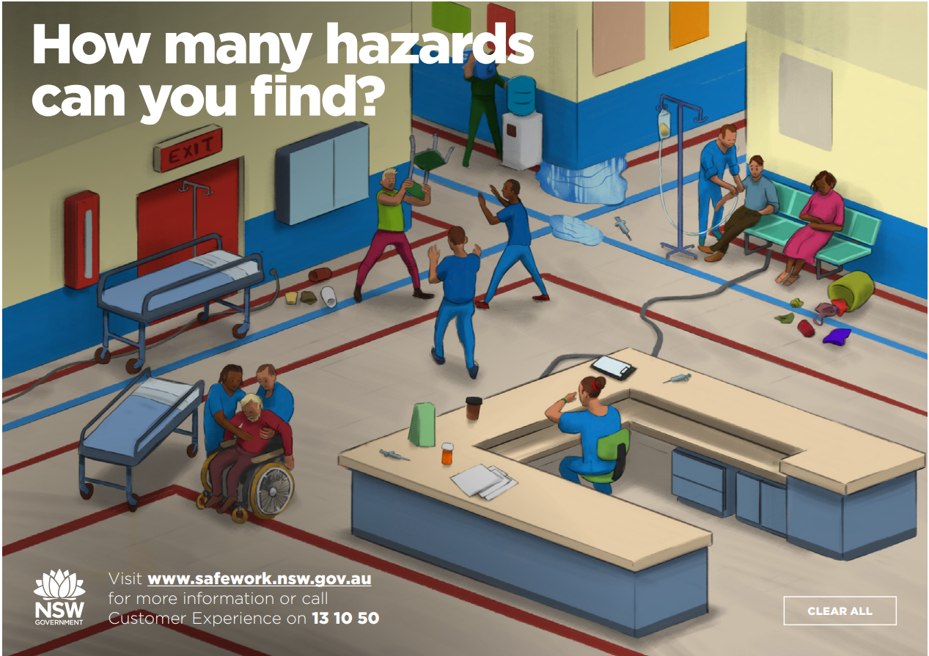
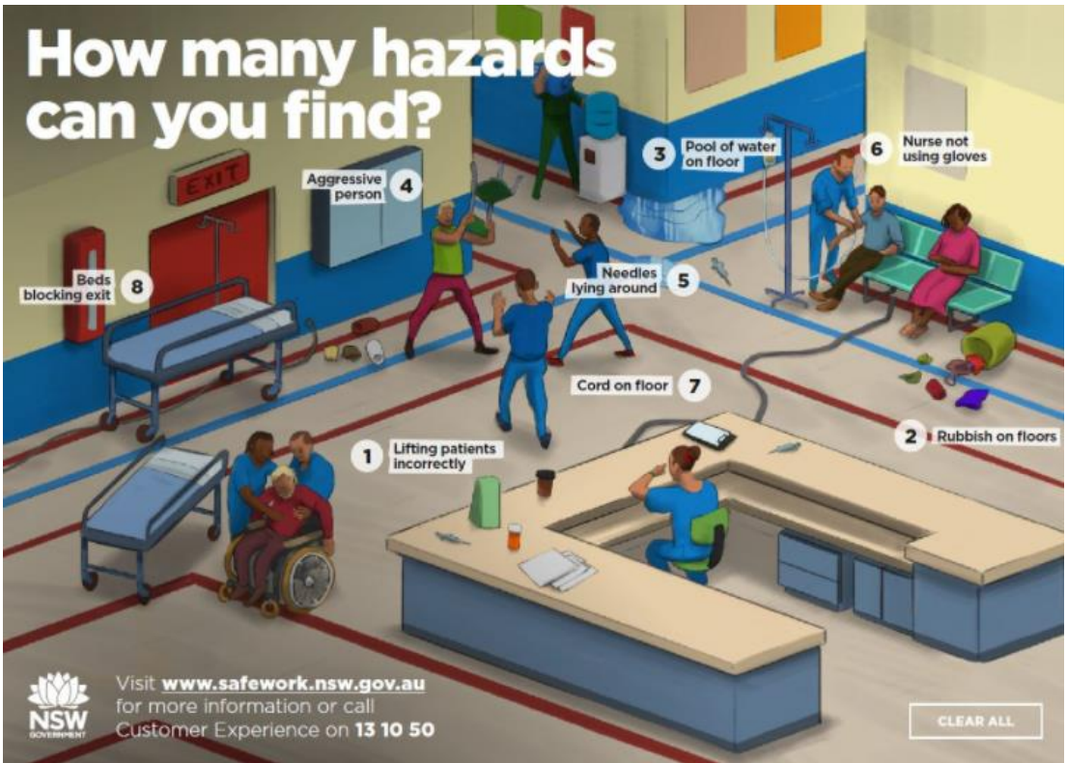
Learning Activity 5 Workplace Hazards, Identify Them All
Your task is to inspect the workplace below and identify the possible hazards. Draw a line and label the different hazards. Then use the boxes below to list each of the potential infection hazards you identified and briefly explain why they are a risk.

Slide 32
Learning Activity 5 Workplace Hazards, Identify Them All
Your task is to inspect the workplace below and identify the possible hazards. Draw a line and label the different hazards. Then use the boxes below to list each of the potential infection hazards you identified and briefly explain why they are a risk.
Workplace hazard | Why is it a hazard?
workers lifting a patient incorrectly | Workers are at risk of causing injury to themselves by trying to lift the patient incorrectly.
Rubbish left on the floor | The spill poses a serious risk to workers, patients and visitors as they risk tripping or falling over as a result of the spill.
Pool of water on the floor - slip hazard | The spill poses a serious risk to workers, patients and visitors as they risk tripping or falling over as a result of the spill. There is also no hazard signage to alert people of the hazard.
Workers approaching an aggressive person | The angry patient is a potential risk to the health services workers as they may act violently or aggressively if in pain or affected by drugs or alcohol.
Needles and medicine laying around | This is a hazard because the sharps could potentially be contaminated and have not been disposed of in the correct waste container.
Nurse not using gloves | Nurse could be exposed to contamination by not wearing gloves and therefore at risk of infection.
Cord on the floor | The cord poses a risk to patients, workers and visitors as it could cause a fall, which could result in injury.
Bed blocking a fire exit | If a fire was to occur individuals would not be able to easy exit the building.

Slide 33
WHAT IS AN EMERGENCY?
Notes:
Access Workplace emergency procedures and discuss how an emergency plan can be formulated. Discuss various types of workplaces and visualise what these emergency plans look like. For eg; an Aged Care facility located in a bushfire area must have good emergency plans for bushfires in place. Watch YouTube video.
Written accounts of work health and safety activities, near misses and incidents are important records for workplaces. Access keeping records here.

Slide 34
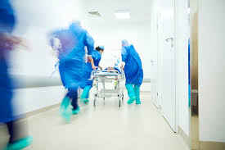
What is a workplace emergency?
The emergency situations that you are likely to come across will depend on both the place and the industry you are working within.
A workplace emergency can be defined as an
event that occurs, causing danger to employees, clients/students/participants or the general
public. It risks causing physical damage to
property and people and it can also potentially disrupt workplace operations.

Slide 35
Emergency procedures
Each workplace will have a set of procedures to follow during a workplace emergencies.
They will include procedures for the following emergencies:
A fire
A evacuation
Security breach
Threatening patient behaviour

Slide 36
Learning Activity 6 Emergency Procedures
Research your school, TAFE or workplace emergency evacuation procedures. You might be able to find an official procedure or you may need to ask people within the workplace about the procedure.
1. Who is responsible for initiating the emergency procedure?
2. How is this information explained to all students, staff and other employees?
3. Describe the details of the evacuation procedure? (i.e. who instructs you when to evacuate? Are you allowed to take your belongings? How do you get out of the building?)
4. How often does a practice evacuation drill take place?
5. Where is the official safe meeting point? Explain why you think this location was chosen.
6. How are students, staff and other employees accounted for, once at the safe meeting point?
7. Outline two changes that you would make to the current procedure to make it more efficient.

Slide 37
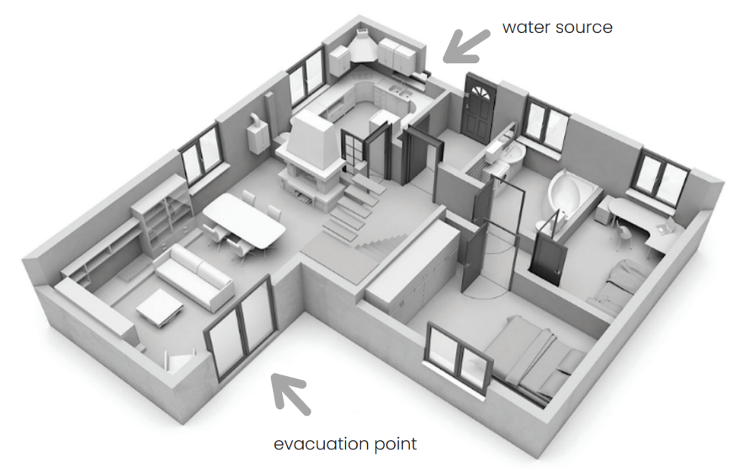
Learning Activity 7 Create Your Own Home Evacuation Plan
All students plan will vary. But must include the following:
• Fire alarms
• Sources of water
• Fire blanket or extinguishers
• Two evacuations options per room
• A spot for a safe meeting area outside the home.
Step 1: Start by drawing a simple floor plan of your home; include all doors and windows in your drawing. See an example below:
Step 2: On your diagram indicate all fire alarms, fire blankets, extinguishers and sources of water.
Step 3: On your floor plan indicate at least two evacuation options from every room.
Step 4: Select a safe meeting area outside your home.
Questions:
1. Were you able to easily identify two evacuation options? What area of your home would be the most difficult to evacuate from? Why?
2. How did you select your meeting area?
3. How could you communicate this evacuation plan to the rest of your family? Why would it be important to do so?

Slide 38
Learning Activity 8 Emergency Codes
This activity will allow you to further explore emergency codes. Based on the Epworth Hospitals emergency codes detailed within this student resource. You are to identify the most appropriate code for each emergency situation read out by your teacher. Instructions:
1. Get yourself into a group of 3-4
2. Have one scribe for your group.
3. As a group listen carefully to the emergency scenarios read out by your teacher.
4. Your teacher will begin to countdown from ten down to zero.
5. As a group you have ten seconds to decide the correct emergency code that would apply to the scenario. When you teacher gets to zero, ensure you’ve written down your answer.
6. Your group will be awarded one point for every correct answer.
Emergency scenarios:
1. There is a severe thunderstorm and power to the Epworth Hospital has been cut. There are no lights operating but there is a back up generator that is supplying power to some medical equipment. - Yellow
2. An unarmed man has entered the South Pacific rehabilitation centre and is very aggressive. He is yelling and shouting at the receptionist saying he has a bomb and he is going to detonate it! - Purple
3. A patient on the ward of the hospital has just been diagnosed with Tuberculosis, which is a highly infectious disease. This patient has been in contact with a number of other patients and workers in the hospital. - Yellow
4. A ward assistant of a surgical ward smells smoke. They walk out into the hallway and see thick black smoke filling the rooms of the ward. - Red
5. A patient in the emergency department has become extremely violent and has threatened a number of staff with a knife. - Black
6. While cleaning a laboratory within a hospital, a cleaner has accidentally spilled a large container of dangerous and corrosive chemicals. The chemicals start to eat away at the floor and then give off fumes and a strong smell. There are patient rooms close by. - Yellow
7. After a large downpour of rain, a wing of the hospital becomes flooded. - Yellow

Slide 39
Learning Activity 8 Emergency Codes
8. An oven has caught fire in the kitchen of the hospital. It begins to spread to the staff dining room. - Red
9. A gunman has been on a shooting rampage in a street near the hospital and has reportedly started to make his way towards the hospital car park. - Brown
10. Police and firefighters have ordered the evacuation of a local hospital due to a bushfire that is now burning out of control. – Orange
11. A cleaner at the hospital has noticed mice droppings in and around the kitchen area and staff dining room. He opens a storage cupboard to find a nest of mice, which begin to run out into the hallways. - Yellow
12. A man claiming he works for a courier company has delivered an unmarked box to the front reception of the Epworth Hospital in Richmond. The receptionists ask to see the man’s identification. The man refuses and proceeds to leave the box on the ground near the desk. The lid of the box is open and the receptionists can see a white substance in the bottom. –Orange
13. A patient is being treated for a drug overdose in the emergency department, a friend who has accompanied the patient is also under the influence of drugs and starts to become violent and begins to throw objects around the room. - Grey
14. A patient in ward rings their call bell for the nurse. The patient tells the nurse that they can smell gas. The nurse also starts to smell gas. - Yellow
15. The air conditioning unit of the hospital has just been tested and serviced. The technician reports to the hospital manager that he has detected bacteria particles in the air conditioner filter system which could cause an infection outbreak. - Yellow

Slide 40
Learning Checkpoint 3
1. Identify three emergency situations in the health services industry.
• serious injuries
• events requiring evacuation
• fires and explosions
• hazardous substance and chemical
• spills
• explosion and bomb alerts
• security emergencies
• internal emergencies
• external emergencies and natural
• disasters
2. Explain why an infection outbreak would be an emergency in a health services environment.
Sample response:
An infection outbreak is of serious concern as it can be transmitted from person to person easily and quickly, especially with the constant use of heating and cooling systems within many health facilities. Also people within health care settings like hospitals may already have their immune systems compromised making them more exposed to contracting infections. This could lead to a serious threat to life.
3. Briefly explain how the productivity of an organisation may be affected by an emergency.
Sample response:
Where an evacuation is needed time will be taken from the workday. Also depending on the incident the workplace could be closed for a number of hours or days. This affects people’s ability to access the health services and for the organisation to deliver its service.

Slide 41
Learning Checkpoint 3
4. Explain why you think many health services organisations use colour emergency code systems.
Sample response:
Many health services organisations have different emergency codes that are used to communicate to workers, patients and visitors the immediate action required. Only those who know the colour coding will understand the message being delivered. Using colours over loudspeakers in health service organisations will avoid panic and worry for clients, patients and visitors. Saying “Code Red” is less alarming than saying “Fire”.
5. Briefly explain how the community may be affected by an emergency situation.
Sample responses:
• They may not be able to use the facility
• They may have lost a community member
• Employees may lose their jobs or be temporarily unemployed
6. Outline what should be done when a person suddenly becomes ill.
Sample response:
Sudden illnesses are an emergency situation and must be responded to as quickly as possible. This may involve calling an ambulance, getting a person to hospital, separating them from others and contacting relevant family members. You would need to find out whether the illness has been contracted from a substance, person or other work-related cause, and then seek to eliminate that cause of illness from the workplace. If you are unsure whether the illness in contagious, you should place the unwell person into quarantine.
7. Explain why security emergencies are a serious concern.
Sample response:
Many people in a health services setting are vulnerable and may not be able to defend themselves if faced with an intruder: such as children, the elderly and those with disabilities. Every effort should be made by health service facilities to ensure the safety and security of all clients and patients.

Slide 42
Learning Checkpoint 3
8. Describe why it is important to follow organisational procedures when responding to an emergency.
Sample response:
Following organisational procedures will ensure consistency amongst all staff when responding to an emergency situation. Staff know what they are responsible for in an emergency and how to respond.
9. What is the difference between an external and internal emergency?
An external emergency is outside of the organisation whereas an internal emergency is within the organisation.

Slide 43
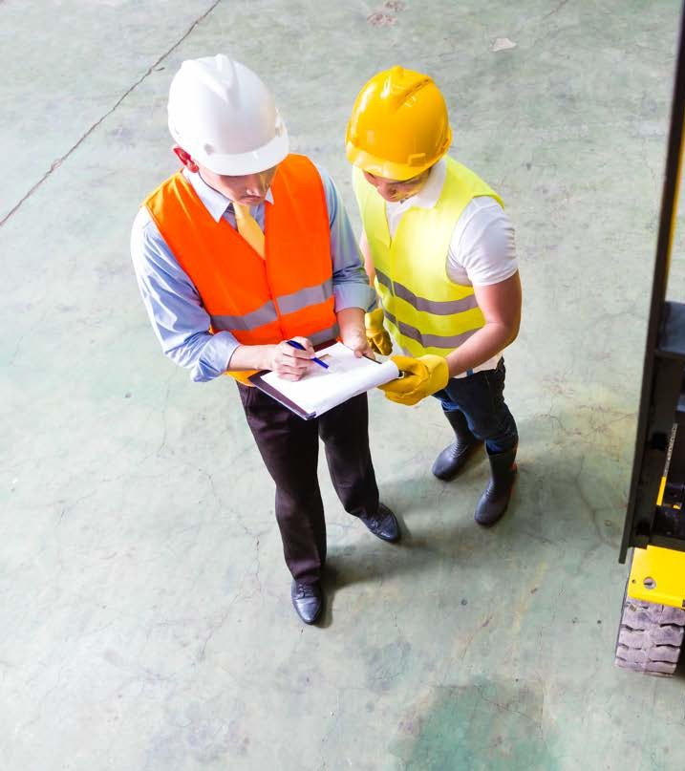
WHS procedures and instructions
It's important that you identify and
implement WHS procedures and work instructions. These will include:
completing required documentation following WHS guidelines
following procedures for work area housekeeping
handling, using and storing toxic and hazardous chemicals according to
workplace procedures.

Slide 44
WHS record-
keeping systems
To assist in the identification of hazards, and assessment and control of risks, your workplace should have tools or templates to complete. This will ensure that any
team member filling out the template can be confident that they are providing the
required information and following the required steps.

Slide 45
Procedures for removing and cleaning spills
Place the appropriate hazard sign to warn workers and patients of the spill
Access the nearest spill kit. 3. Apply the appropriate PPE.
For surface spills use a paper towel to absorb the spill. Then clean and sanitise the area. For floor
spills, use a mop or absorbent material to soak up the spill. Clean, sanitise and dry the area.
Dispose of the waste according to the organisation's policies and procedures.
An example of spill management YouTube video.

Slide 46
Learning Activity 9 Waste Disposal
Your task is to take the information you have learnt about the correct disposal of waste and apply it to answer the following questions.
Questions:
1. List four types of waste that you may need to dispose of in the health services industry.
• Chemical waste – cleaning products
• Blood-stained bandages – band-aids
• Plastic packing – surgical instruments and food packaging
• Food – prepared meals (e.g. aged care facility, hospital)
2. How would you dispose of each of these types of waste safely?
• Bio-can or bag for blood-stained items.
• Recycling bin for plastic and paper.
• Food items – compost
• Chemical waste – wearing PPE as per manufacturer’s instructions
3. What is a biological hazard bio-can?
It is a safe way to dispose of sharps and blood-stained items, which may have the potential to spread disease and illness.
4. What should you do if you have a sharp to dispose of but no bio-can available?
Use a sealable plastic container or plastic bottle. It must be made of hard plastic and have a lid.
5. What should be worn at all times when handling waste? Why?
PPE – gloves to prevent exposure to unhygienic waste with the potential to spread illness and disease.

Slide 47
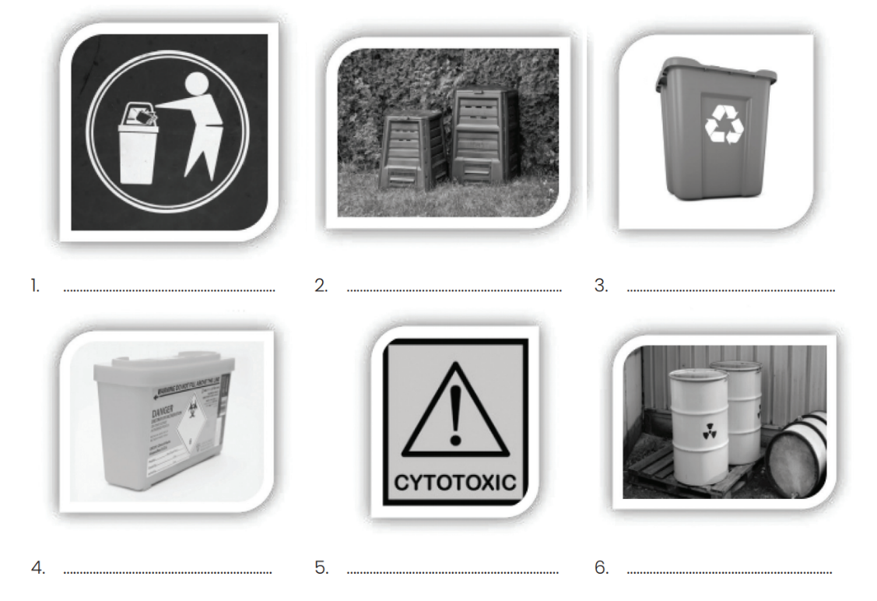
Learning Activity 9 Waste Disposal
6. Identify the type of waste, which can be disposed of according to the symbols/images shown below.
1. General waste 2. Compost and foodstuffs. 3. Recyclable items paper, plastic, cans and glass.
4. Bio-waste, sharps and other blood-stained items.
5. Drugs that are carcinogenic, cytostatic, cytotoxic, mutagenic and/or teratogenic. Also all materials associated with the administration of cytotoxins such as needles, IV appliances etc.
6. Chemical waste

Slide 48
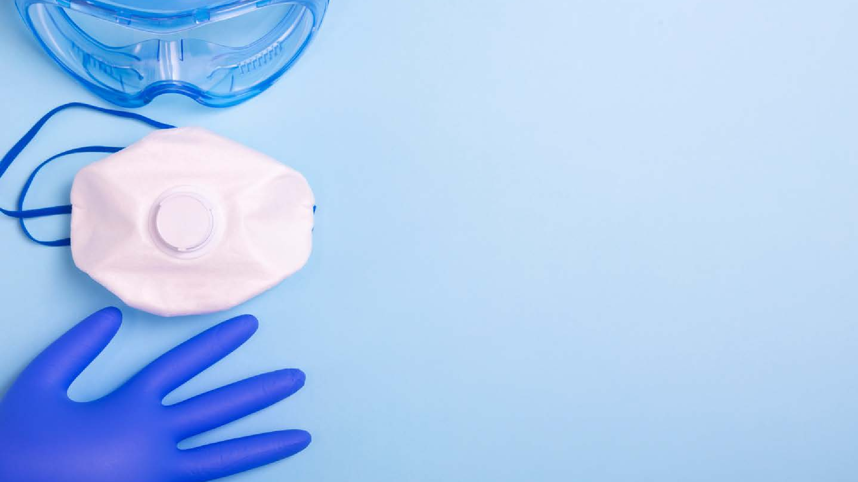
Following PPE requirements
Personal Protective Equipment is
used to prevent or minimise injuries in the workplace. Everyone has a
responsibility for health and safety in the workplace, and once trained, you will know how and when to use
Personal Protective Equipment and, if applicable, how to care for it.

Slide 49
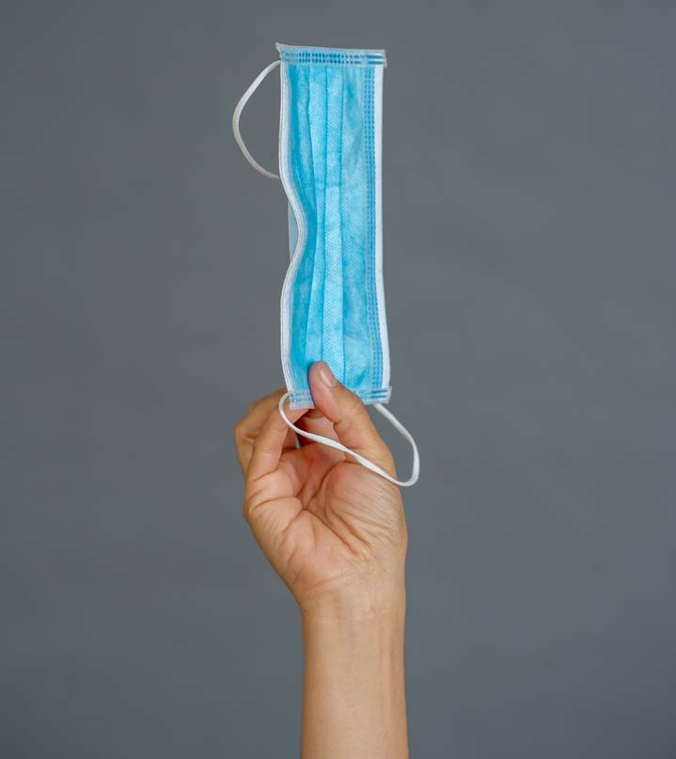
Types of PPE
The following PPE must be worn when required for specific tasks. The PPE
must only be used for its intended purpose.
disposable gloves goggles
face mask face shield
waterproof aprons/gowns disinfectant
safety hair nets.

Slide 50
Participate in WHS
consultative processes
As an employee, it is important that you play your
part in WHS. This comes in the form of working in a safe manner, identifying hazards and risks, and
reporting them when necessary. There is, however, an additional expectation that should be
encouraged by your employer and any nominated health and safety representatives, and that is
contributing to such things as workplace meetings, inspections and other WHS consultative activities.

Slide 51
Reporting unsafe work practices, incidents
and accidents
It is crucial that all incidents or near misses are reported via the proper channels within a workplace. Earlier in this unit
we discussed who you would raise these issues with, and in the next section we will discuss how this should be done.
Once the correct process is followed within the workplace, those in charge need to determine whether the incident is required to be reported to Work Safe.
Watch YouTube on how reporting should occur in the workplace
Notes:
Discuss mandatory reporting of unsafe practice. Watch YouTube on how reporting should occur in the workplace

Slide 52
Reflecting on your own safe work practices
Reflective practice is the aim to consciously reflect upon one’s action to sustain a process of
continuous learning. What this means in the
context of safe work practices is that you reflect at the end of a set period – such as a shift – and you ascertain what went right, what went wrong, and
where there is room for improvement.
By consistently reflecting on and refining your safe work practices, you will continuously improve.

Slide 53
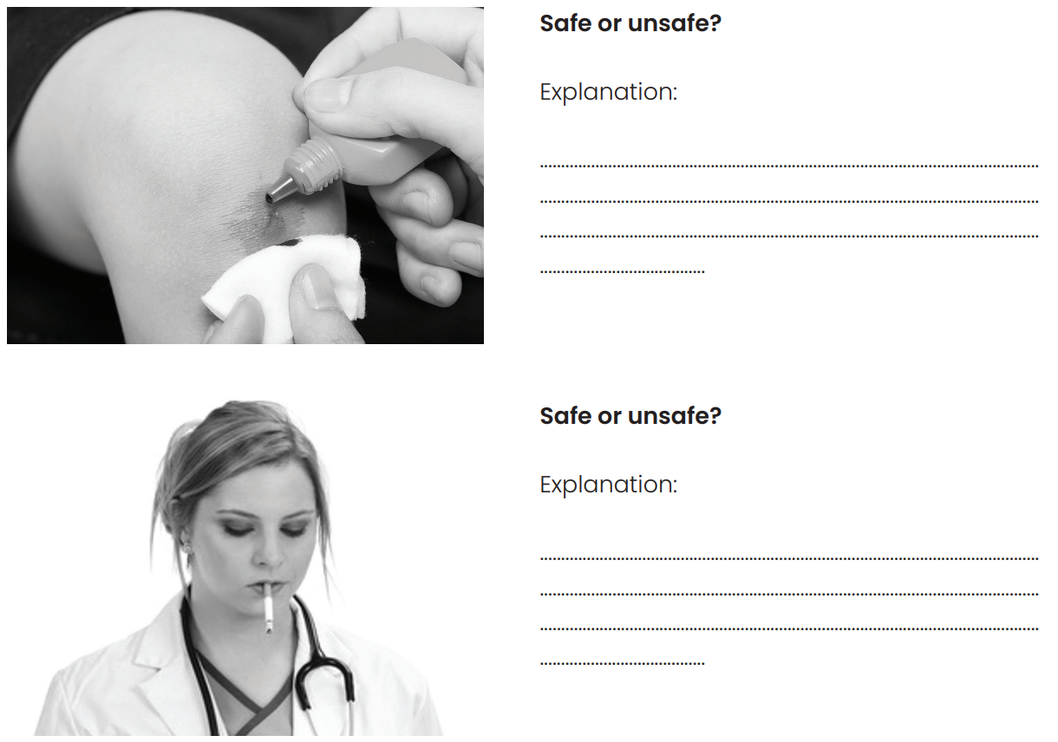
Learning Activity 10 Safe and unsafe work practices
Your task is to take the information you have learnt about the correct disposal of waste and apply it to answer the following questions.
Safe or unsafe? Unsafe
Explanation:
The work practice is unsafe for a few reasons.
The health services worker is not wearing
gloves to administer care to the patient. The
worker could contract an infection or cause an
infection risk to the patient.
Safe or unsafe? Unsafe
Explanation:
This work practice is unsafe and unhygienic.
The worker poses a health risk to patients and
other workers by smoking and handling
equipment that will come in contact with
others. Debris from the cigarette may
contaminate the stethoscope, which would
then cause a risk to a patient if it was used.

Slide 54
Learning Activity 10 Safe and unsafe work practices
Your task is to take the information you have learnt about the correct disposal of waste and apply it to answer the following questions.
Safe or unsafe? Unsafe
Explanation:
This work practice is unsafe and the health
services worker is using a sharp without any
personal protective equipment such as gloves.
This poses an infection risk to both the patient
and the worker.

Slide 55
Signs and symptoms of stress and fatigue
being particularly over sensitive
crying and becoming upset for no real reason being moody, irritable and short-tempered
cold symptoms such as a runny nose or sore throat
being unable to concentrate and feeling sluggish
being negative
drinking or smoking to relax
feeling depressed and avoiding opportunities to socialise with others
feeling worried or anxious.
Notes:
Access Headsup website and discuss workplace stress and fatigue.
Access Promoting the mental health of health services staff and discuss how we can promote good mental health in ourselves when working in health and community sector.
Elicit responses to question “What strategies do you use when you are stressed?”

Slide 56
Learning Checkpoint 4
1. Explain WHS housekeeping.
Sample response:
Work health and safety housekeeping include the tasks undertaken to ensure that the
facility and all equipment is clean.
2. Identify the types of housekeeping tasks you may complete in the following health services roles.
• nurse at an aged care facility
• cleaning medical equipment
• disposing of medical waste such as needles
• restocking of medical supplies
• carer at a brain injury rehabilitation centre
• cleaning equipment such a hoists
• disposing of equipment used for grooming such as razors
• restocking of supplies, such as disposable gloves
• operating theatre technician
• cleaning surgical instruments and operating services
• restocking of supplies, such as disposable gloves
• medical receptionist at a GP clinic
• cleaning of desks, waiting rooms and examination equipment
• organising the disposal of medical waste
• restocking of supplies, such as disposable gloves and ear guards for thermometers.

Slide 57
Learning Checkpoint 4
3. Explain why wearing gloves is an important part of workplace health and safety. List five tasks you think you would need to wear gloves for when working in the health services industry.
Gloves protect the hands from contact with any infectious waste, bacteria or other sources of contamination. Tasks you would need to wear gloves for include:
• Surgical activities
• Administering injections and certain medications.
• Serving food
• When assisting patients with toileting
• When there Is risk of exposure to blood, urine, faeces and saliva.
4. Outline two sterilisation methods used in the health services industry and three items that would need to be sterilised.
• Using a commercial grade sanitising solution such as Cleansan
• Combining water and household bleach to the ratio of 1.5 teaspoons of bleach to 3.8 litres of water.
• Using an electric steam sanitiser
• Using boiling water - place all items to be sanitised in a saucepan and cover them with water, bring to the boil and allow it to boil rapidly for 5 minutes
• Dishwasher using the correct type of detergent or sanitising solution and using and the hottest rinse cycle Items that need to be sanitised include:
• Surgical equipment
• Medical devices
• Eating and drinking utensils
• Food surfaces
• Any reusable items that could penetrate the skin.

Slide 58
Learning Checkpoint 4
5. Explain why it is important to involve employees in WHS processes and inspections.
Sample responses:
They know their duties well as they do them every day, therefore they are in the best position to point out any hazards and potential dangers that could cause injury. Involving employees also ensures that they have ownership over work health and safety practices in the workplace and are therefore more likely to follow the practices and be safety conscious.
6. Briefly explain why it is important to take the time to reflect on your work practices to ensure they are safe.
Sample responses:
It is important that you take the time to reflect and think about how you conduct your work and consider if you are always as safety conscious as you should be or do you often cut corners to save time and effort. Reflecting on your work practices can highlight areas for improvement and changes that you should make to the way you conduct your work to increase your safety and the safety of those around you.
7. Explain why it is important that you monitor your own stress and fatigue levels.
• To ensure that you remain healthy; physically, mentally and socially
• To ensure that you don’t suffer from compassion fatigue
• To ensure that you are preforming your best
• To determine if you need a rest and time to unwind.
8. If you are feeling stressed at work outline the appropriate person you should inform.
A designated person such as a supervisor or manager

Slide 59
1 Short Answer Questions
1. Who is the respective authority for WHS within your state?
VIC: Worksafe Victoria
NSW: SafeWork NSW
2. When it comes to WHS legislation, health care employees have a number of rights and responsibilities. Identify and explain two (2) rights and two (2) responsibilities? You must discuss duty of care in your answer.
• Duty of Care - To take reasonable care in relation to the health and safety of themselves and other people in the workplace.
• To cooperate with the employer and others with regard to responsibilities under WHS legislation.
• Right to a safe environment, free from harassment.
• Right to equal opportunity.
3. What are two (2) rights and two (2) responsibilities of a health care employer? You must discuss duty of care in your answer.
• The manager or supervisor is responsible for the day-to-day implementation of safety measures.
• Management must also provide training, information and safety equipment.
• If management is made aware of unsafe work conditions and fail to act, they will be held responsible.
• Right to hire an employee.
• Right to manage work and give instructions and regulations relating to work management.
• Right to dismiss and dissolve a contract of employment within the limits provided by
4. If you are asked to handle hazardous chemicals in your workplace, what two (2) pieces of PPE should you be wearing as part of WHS standards?
• You should wear gloves and goggles.

Slide 60
1 Short Answer Questions
5. When we talk about infection control, this may be caused by organic substances in our work environment. What are four (4) examples of these? • Blood
• Saliva
• Tissues
• Mucous
• Urine
• Faeces
6. Carry out research and identify what the nine (9) classes of dangerous goods classifications? List these below.
• Explosives
• Gases
• Flammable liquids
• Flammable solids
• Oxidising substances
• Poisons and infectious substances
• Radioactive substances
• Corrosives
• Miscellaneous Dangerous Goods

Slide 61
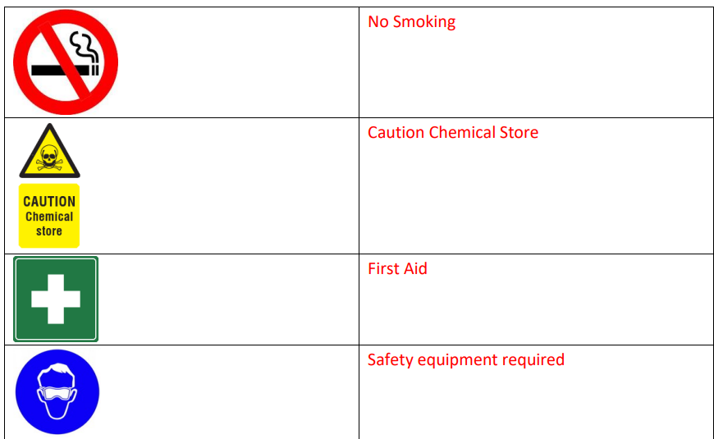
1 Short Answer Questions
7. Identify the following signs.

Slide 62
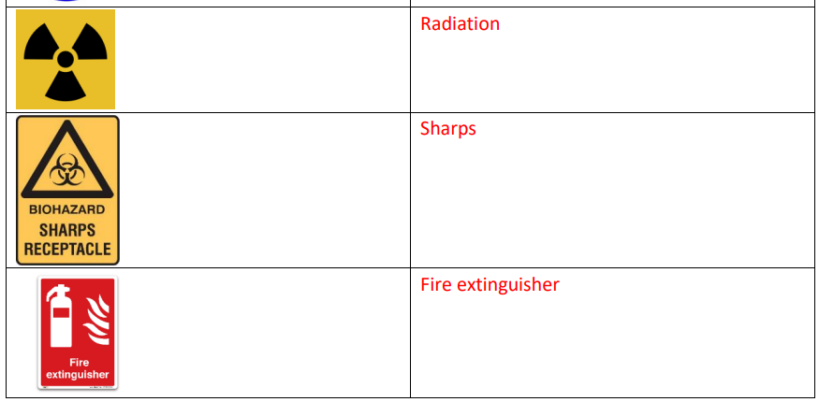
1 Short Answer Questions
7. Identify the following signs.

Slide 63
1 Short Answer Questions
8. What is the definition of a hazard?
A hazard is a situation or thing that has the potential to harm a person.
9. List three (3) potential workplace hazards relevant to the health industry?
• Needle pricks
• Bodily fluids
• Infection Contamination
• Staff stress levels
10. List two (2) workplace emergency procedures you may need to follow in a healthcare work environment?
• Emergency evacuation procedure
• Medical emergency response – loss of consciousness
11. List three (3) policies that you would find in the workplace that relate to workplace health and safety (WHS).
• Patient Care Policies
• Mandatory Reporting
• Employee Health and Safety
• Security
• Data Privacy
• Drug Handling
12. Outline two (2) workplace procedures that could assist an organisation in identifying and addressing any hazards.
• Hazard assessment procedures which can include the use of a checklist to guide inspections of facilities.
• Risk control assessments which include assessing each hazard and identifying methods to control the risks associated with the hazards (application of the hierarchy of control method).

Slide 64
1 Short Answer Questions
13. Identify and list two (2) ways to maintain your currency of safe work practices in relation to workplace systems, use of equipment and following correct procedures in the context of healthcare.
• Undertaking additional training.
• Participating in OHS meetings.
• Reviewing workplace policies and procedures.
• Seeking advice from a supervising member of staff.
14. Workplace Health and Safety regulations give us guidelines on how to act safely in the workplace. How do these regulations direct us to carry out (hazardous) manual handling tasks in healthcare e.g., lifting patients?
Three key requirements in this Regulation are:
• Avoidance of manual handling activities which involve a risk of injury.
• Risk assessment of manual handling tasks which cannot be avoided.
• Reduction of the risk from manual handling activities

Slide 65
2 Performance Demonstration
For this task, you are required to complete the activities listed below. There are four (4) separate activities/tasks. Your assessor will assess your performance against the marking criteria listed below.
Each student will be assessed as an individual at all times. However, some tasks require input from others, e.g., meeting discussions.
• Task 1: Identifying Hazards and Assessing Risks
• Task 2: Emergency Evacuation (Simulation)
• Task 3: Apply WHS Procedures and Reporting Protocols (Manual Handling)
• Task 4: WHS Meeting
IMPORTANT: You must actively participate in all required activities. You must also submit the following three (3) documents as supporting evidence.
Evidence Submission Checklist:
• Hazard Identification Form (Appendix 1)
• Email (Appendix 2)
• Incident Accident_ Form (Appendix 3)

Slide 66
2 Performance Demonstration
Task 1: Identifying Hazards and Assessing Risks
You will be split into small groups for this exercise.
You will be allocated a space within your learning environment; it might be a room, an outdoor area, a playing field etc. The space should simulate a place you could come across while working in the health/community field of work. You are required to go and examine this area and use the
workplace policies and procedures of your place of learning (as supplied by your assessor) to identify any existing or potential hazards in the environment. You are to document them on the template found in your IVET Student Portal titled HAZARD_IDENTIFICATION_FORM.
Once you have done this, you are to return to the classroom and undertake a risk assessment, based on the hazards that you have identified. You should use the matrix on the template to score the risks accordingly.
You should then identify the person within the organisation that these issues should be reported to and draft an email to them outlining your findings. This should be done on the form in your IVET
Student Portal titled HAZARD_IDENTIFICATION_EMAIL.
A copy of this email and a copy of the report should be uploaded to the IVET portal.

Slide 67
2 Performance Demonstration
Task 2: Emergency Evacuation (Simulation)
In this role-play, you will be required to:
• Follow workplace emergency procedures.
As a class, you will run through a workplace emergency drill in response to a possible fire in the building.
You should follow the instructions given to you by your assessor and complete the emergency evacuation procedure as directed.

Slide 68
2 Performance Demonstration
Task 3: Apply WHS Procedures and Reporting Protocols (Manual Handling)
You will be given access to appropriate workplace policies and procedures prior to the role-play so that you understand the expectations. (Manual handling procedures: Lifting procedure for a weight over 16kg)
Read the case study and then participate in the role-play.
In this role-play, you will be required to:
Discuss the case study.
Take appropriate actions to maintain safe practices in the context of the case study.
Report any incidents and injuries, making sure to follow the correct workplace reporting procedures.
Complete the Incident_Accident_Report form and submit this to your manager.
Case Study
Your assessor will be acting as your work colleague, a mailroom worker who has just received a delivery of new office equipment.
You can clearly see the weight of several parcels identified on the outside of the boxes – all 25kg.
Your colleague is lifting and carrying the boxes past you as you work on reception. You are to inform them of the organisation’s Manual Handling procedure for anything over 16kg, and what they should do instead.
They will then role-play a lifting injury when lifting the third parcel.
After sending them to see the first aid officer, you should fill out the required paperwork to report the incident.

Slide 69
2 Performance Demonstration
Task 4: WHS Meeting
As a class, you will attend a Workplace Safety Meeting. This will be convened by your assessor. You should take turns to discuss your findings based upon the examination of your nominated area.
This should include:
• Raising any potential WHS issues you discovered in your area, and any suggestions you might have to minimise or resolve them.
• Collectively discuss what improvements could be made to the WHS policies/procedures that you utilised in task 1- 3.
• Each student should address an area that is causing them stress or fatigue, i.e., the flickering lights above my desk are causing me to have headaches, or I am constantly worried I am going to trip on the uneven concrete outside the front of the office. This can be something that was
truly identified, or it can be something that you create for the purpose of this meeting. It does not need to be included in the risk assessment or drafted email.
• You should then formulate a combined checklist as a class that documents all the suggestions.

