Slide 1
Sequences and recurrence relations

Slide 2
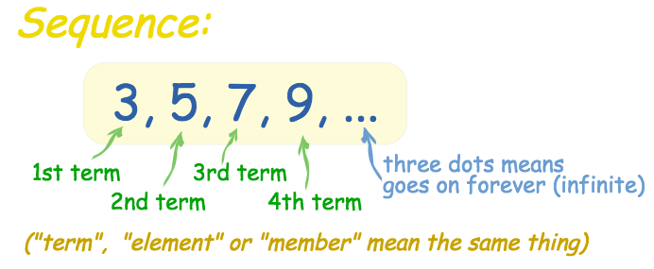
Sequence
A sequence is a list of numbers in a particular order.
The numbers or items in a sequence are called the terms of the sequence.
Each of the numbers in a sequence is called a term.

Slide 3
A sequence in which a constant (d) can be added to each term to get the next term is called an
Arithmetic Sequence.
The constant (d) is called the
Definition
Common Difference.
To find the common difference (d), subtracting any pair of successive terms.
t₁
t₂
t₃
t₄
t₅
2 5 8 11 14
3
3
3
3
Notes:
Constant = fixed amount

Slide 4
Naming the terms in a sequence
2 8 14 20 26 32
$t_{1}$ $t_{2}$ $t_{3}$ $t_{4}$ $t_{5}$ $t_{6}$
$t_{1}$=2 $t_{2}$=8 $t_{3}$=14 $t_{4}$=20 $t_{5}$=26 $t_{6}$=32

Slide 5
Geometric Sequences
r=3
r=$\frac{1}{2}$
In geometric sequences, you multiply by a common ratio, r, each time.
r=$Common Ratio$

Slide 6
Arithmetic vs. Geometric Sequences
Arithmetic Sequences
Increases by the common difference d
Addition or Subtraction
d = $t_{n}$ – $t_{n−1}$
Geometric Sequences
Increases by the common ratio r
Multiplication or Division
r = $\frac{t_{n}}{t_{n−1}}$
Common difference d
=any term $−$ the previous term
=$t_{2}−$ $t_{1}$= $t_{3} − t_{2}$= $t_{4} − t_{3}$
=…

Slide 7
Generating a sequence of terms
Write down the first five terms of the sequence with a starting value of 5 and the rule ‘double the number and then subtract 3’.
5
2×5−3=7
2×7−3=11
2×11−3=19
2×19−3=35
The sequence is 5, 7, 11, 19, 35, …

Slide 8
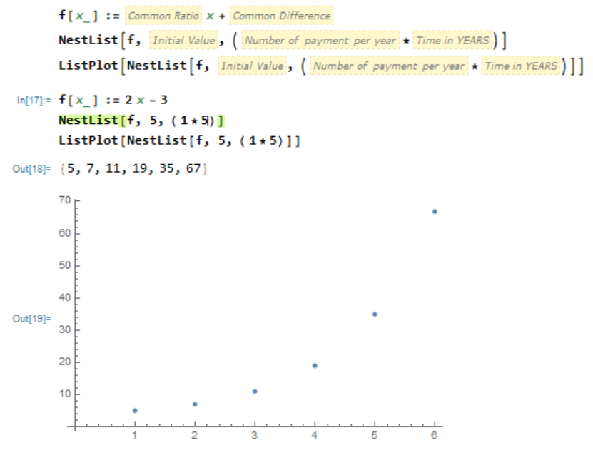
Using Mathematica to generate a sequence of numbers from a rule
To generate the first five terms of the sequence with a starting value of 5 and the rule ‘double and then subtract 3’.
Command No. 1

Slide 9
Recurrence Relation
A recurrence relation is a mathematical rule that we can use to generate a sequence. It has two parts:
a starting point: the value of one of the terms in the sequence
a rule that can be used to generate successive terms in the sequence.

Slide 10
Recurrence Relation
For example, in words, a recursion rule that can be used to generate the sequence:
10,15,20,…
can be written as follows:
Start with 10.
To obtain the next term, add 5 to the current term and repeat the process.

Slide 11
Recurrence Relation
symbolic form
Let 𝑉𝑛 be the term in the sequence after 𝑛 iterations (Each time we apply the rule it is called an iteration).
Note: Because of the way we defined Vn, the starting value of 𝑛 is 0. At the start there have been no applications of the rule. This is the most appropriate starting point for financial modelling.

Slide 12
Generating a sequence from a recurrence relation
Write down the first five terms of the sequence defined by the recurrence relation
$V_{0}$ =9, $V_{n+1}$ = $V_{n}$ −4
showing the values of the first four iterations.
$V_{0}$ =9
${V_{1}=V}_{0}$ −4 = 9−4 =5
$V_{2}$ = $V_{1}$ −4=5−4=1 $V_{3}$ = $V_{2}$ −4=1−4=−3 $V_{4}$ = $V_{3}$ −4=−3−4=−7
The sequence is 9, 5, 1, −3, −7, …

Slide 13
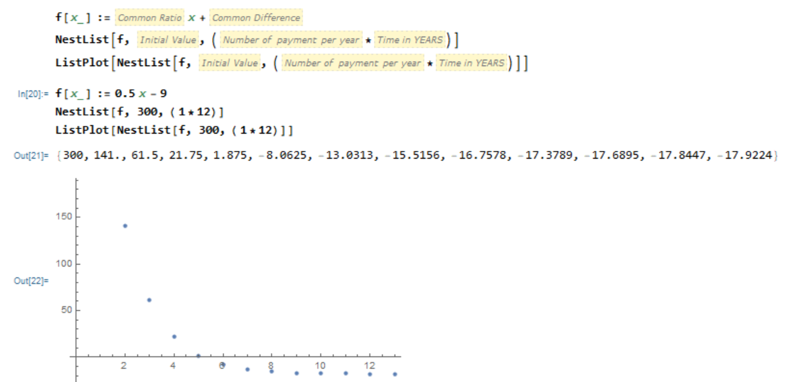
Using Mathematica to generate sequences from recurrence relations
A sequence is generated by the recurrence relation
$V_{0}$ =300, $V_{n+1}$ = ${0.5V}_{n}$−9.
Use Mathematica to generate this sequence and determine how many terms of the sequence are positive.
Command No. 1
The first five terms of the sequence are positive.
Notes:
Pear Deck:https://app.peardeck.com/presenter/txxmmtkzk/projector?returnTo=gslides

