Slide 1
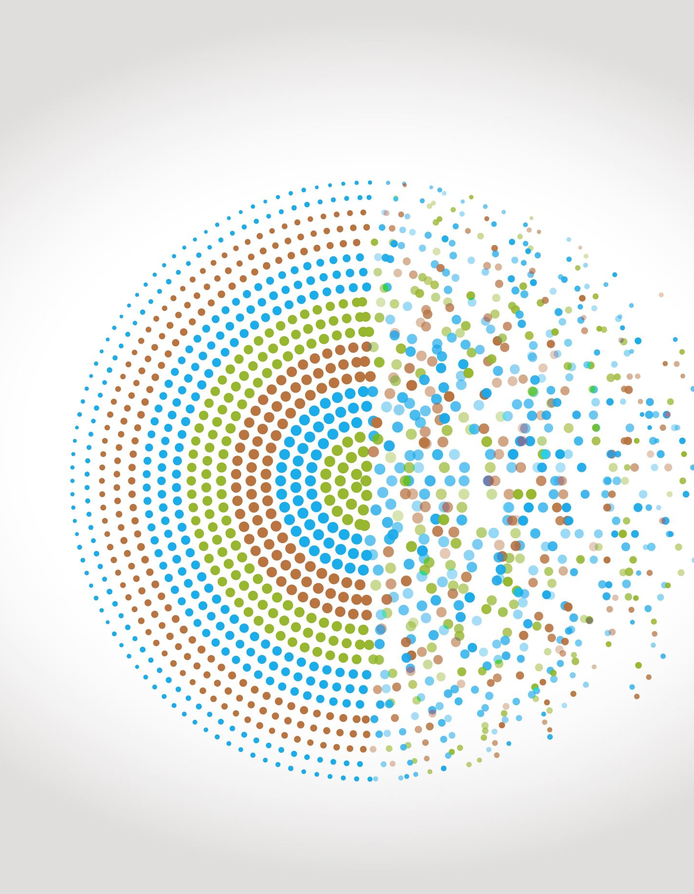
Modelling geometric growth and decay
7D
https://dashboard.blooket.com/set/6507923af3eb74a0c98b08c8
https://play.blooket.com/host?id=6747882db8d55150a13895dc
https://play.blooket.com/host?id=67478ccf9d40e5f58c69de67
https://dashboard.blooket.com/set/630c42e0aa05729fcc13c31d

Slide 2
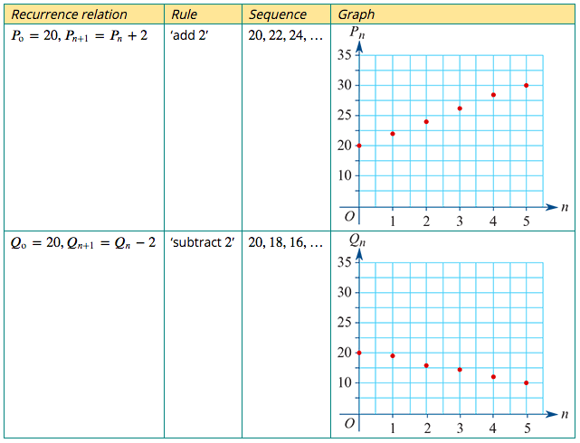
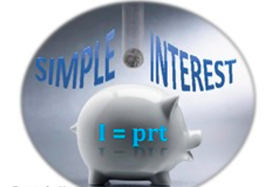
A recurrence model for linear growth and decay
The recurrence relations: $P_{0}$=20, $P_{n+1}$= $P_{n}$+ 2 $Q_{0}$=20, $Q_{n+1}$= $Q_{n}−$ 2
linear growth
Model and investigate simple interest loans and investments, as well as flat rate depreciation and unit cost depreciation of assets
linear decay

Slide 3
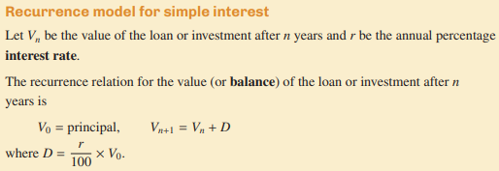
Recurrence Relation for linear Arithmetic growth and decay

Slide 4
Rules for linear Arithmetic growth and decay

Slide 5
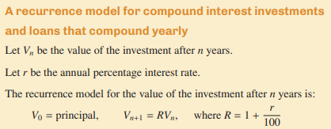
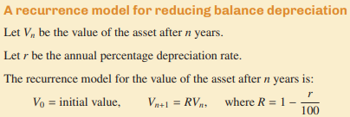
Recurrence Relation for Geometric growth and decay

Slide 6
Solving a 2 Step Equation Using Onion Skins
Solve : 9000 = 3000 + 2a
9000 = 3000 + 2a
Solution for a is: a= $\frac{9000−3000}{2}$
a= $\frac{9000−3000}{2}$=3000

Slide 7
Solving a 2 Step Equation Using Onion Skins
Solve : 9000 = 3000 - 2a
9000 = 3000 – 2a
Solution for a is: a= $\frac{9000−3000}{−2}$
a= $\frac{9000−3000}{−2}$= –3000

Slide 8
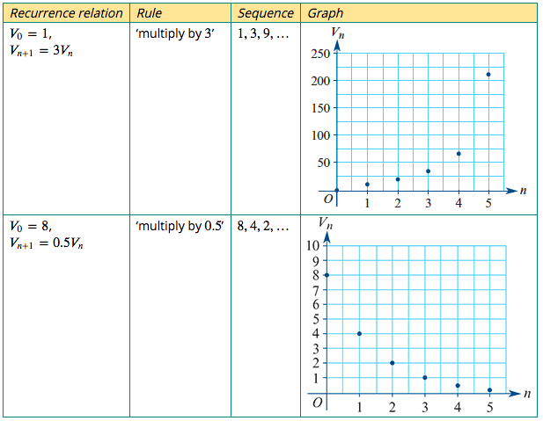
A recurrence model for geometric growth and decay
$V_{0}$=1, $V_{n+1}$=3$V_{n}$
$V_{0}$=8, $V_{n+1}$=0.5$V_{n}$

Slide 9
A recurrence model for geometric growth and decay
As a general rule, if 𝑅 is a constant, a recurrence relation rule of the form:
$V_{n+1}$=𝑅 $V_{n}$ for 𝑅 > 1, can be used to model geometric growth.
$V_{n+1}$=𝑅 $V_{n}$ for 0 < 𝑅 < 1, can be used to model geometric decay.

Slide 10
Compound interest investments and loans
Consider an investment of $5000 that pays 8% interest per annum, compounding yearly. This means that the investment’s value increases by 8% each year.
Let $V_{n}$ be the value of the investment after 𝑛 years.
$V_{0}$ =$2000
value next year = this year's value + interest earned
$V_{n+1}$ = $V_{n}$ +$\frac{8}{100}$× $V_{n}$= $V_{n}$ +0.08× $V_{n}$
$V_{n+1}$ =1.08 $V_{n}$

Slide 11
A recurrence model for compound interest investments and loans that compound yearly
Let $V_{n}$ be the value of the investment after 𝑛 years.
Let 𝑟 be the percentage interest per compound period.
The recurrence model for the value of the investment after 𝑛 compounding periods is:
$V_{0}$ = principal, $V_{n+1}$ =𝑅 $V_{n}$ where 𝑅=1+$\frac{r}{100}$

Slide 12
Modelling compound interest with a recurrence relation 1
The following recurrence relation can be used to model a compound interest investment of $2000 paying interest at the rate of 7.5% per annum.
$V_{0}$ =2000, $V_{n+1}$ =1.075× $V_{n}$
In the recurrence relation, $V_{n}$ is the value of the investment after 𝑛 years.
1. Use the recurrence relation to find the value of the investment after 1, 2 and 3 years.
$V_{0}$ =2000,
$V_{1}$=1.075×2000=2150,
$V_{2}$=1.075×2150=2311.25,
$V_{3}$=1.075×2311.25=2484.59

Slide 13
Modelling compound interest with a recurrence relation 1
The following recurrence relation can be used to model a compound interest investment of $2000 paying interest at the rate of 7.5% per annum.
$V_{0}$ =2000, $V_{n+1}$ =1.075× $V_{n}$
In the recurrence relation, $V_{n}$ is the value of the investment after 𝑛 years.
2. Determine when the value of the investment will be first exceed $2500.
Command No. 8c
2. After 4 years, the investment will first exceed $2500

Slide 14
Modelling compound interest with a recurrence relation 1
The following recurrence relation can be used to model a compound interest investment of $2000 paying interest at the rate of 7.5% per annum.
$V_{0}$ =2000, $V_{n+1}$ =1.075× $V_{n}$
In the recurrence relation, $V_{n}$ is the value of the investment after 𝑛 years.
2. Determine when the value of the investment will be first exceed $2500.
The rule for Compound $V_{n}$ =2000 ×${1.075}^{n}$
2500= 2000 ×${1.075}^{n}$
$÷2000$ $÷2000$
1.25= ${1.075}^{n}$ → n=Log${1.075}^{1.25}$=$\frac{(log1.25)}{(log1.075)}$=3.08547
Command No. 8c
2. After 4 years, the investment will first exceed $2500

Slide 15
Modelling compound interest with a recurrence relation 1
The following recurrence relation can be used to model a compound interest investment of $2000 paying interest at the rate of 7.5% per annum.
$V_{0}$ =2000, $V_{n+1}$ =1.075× $V_{n}$
In the recurrence relation, $V_{n}$ is the value of the investment after 𝑛 years.
3. Write down the recurrence relation if $1500 was invested at a compound interest rate of 6.0% per annum.
3. $V_{0}$ =1500 and 𝑟=6
Calculate the value or 𝑅. The value of the investment will grow over time, so 𝑅=1+$\frac{r}{100}$=1+ $\frac{6}{100}$=1.06
$V_{0}$ =1500, $V_{n+1}$ =1.06× $V_{n}$

Slide 16
Compound interest with different compounding periods
Ben borrows $5000 from a bank. He will pay interest at the rate of 4.5% per annum.
Let $V_{n}$ be the value of the loan after 𝑛 compounding periods.
Write down a recurrence relation to model the value of Ben’s loan if interest is compounded:
1. yearly
$V_{0}$ = principal, $V_{n+1}$ =𝑅 $V_{n}$ where 𝑅=1+$\frac{r}{100}$
𝑅=1+ $\frac{4.5}{100}$=1.045
$V_{0}$ =5000, $V_{n+1}$ =1.045× $V_{n}$

Slide 17
Compound interest with different compounding periods
Ben borrows $5000 from a bank. He will pay interest at the rate of 4.5% per annum.
Let $V_{n}$ be the value of the loan after 𝑛 compounding periods.
Write down a recurrence relation to model the value of Ben’s loan if interest is compounded:
2. quarterly
2. $V_{0}$ = principal, $V_{n+1}$ =𝑅 $V_{n}$ where 𝑅=1+$\frac{r}{100}$
The interest rate is 4.5% per annum. The quarterly rate is $\frac{4.5}{4}$=1.125.
𝑅=1+ $\frac{1.125}{100}$=1.01125
$V_{0}$=5000, $V_{n+1}$ =1.01125× $V_{n}$

Slide 18
Compound interest with different compounding periods
Ben borrows $5000 from a bank. He will pay interest at the rate of 4.5% per annum.
Let $V_{n}$ be the value of the loan after 𝑛 compounding periods.
Write down a recurrence relation to model the value of Ben’s loan if interest is compounded:
3. monthly.
3. $V_{0}$ = principal, $V_{n+1}$ =𝑅 $V_{n}$ where 𝑅=1+$\frac{r}{100}$
The interest rate is 4.5% per annum. The monthly rate is $\frac{4.5}{12}$=0.375.
𝑅=1+ $\frac{0.375}{100}$=1.00375
$V_{0}$ =5000, $V_{n+1}$=1.00375× $V_{n}$

Slide 19
Reducing-balance depreciation
Reducing-balance depreciation is another method of depreciation – one where the value of an asset decays geometrically. Each year, the value will be reduced by a percentage, 𝑟%, of the previous year’s value. The calculations are very similar to compounding interest, but with decay in value, rather than growth.

Slide 20
A recurrence model for reducing balance depreciation
Let $V_{n}$ be the value of the asset after 𝑛 years.
Let 𝑟 be the annual percentage depreciation.
The recurrence model for the value of the investment after 𝑛 years is:
$V_{0}$ = initial value, $V_{n+1}$ =𝑅 $V_{n}$ where 𝑅=1$−\frac{r}{100}$

Slide 21
Modelling reducing-balance depreciation with recurrence relations
The following recurrence relation can be used to model the value of office furniture with a purchase price of $6900, depreciating at a reducing-balance rate of 7% per annum.
$V_{0}$ =6900, $V_{n+1}$ =0.93× $V_{n}$
In the recurrence relation, $V_{n}$ is the value of the office furniture after 𝑛 years.
1. Use the recurrence relation to find the value of the office furniture, correct to the nearest cent, after 1, 2 and 3 years.
1. $V_{0}$ =6900
$V_{1}$ =0.93×6900=6417
$V_{2}$ =0.93×6417=5967.81
$V_{3}$ =0.93×5967.81=5550.06

Slide 22
Modelling reducing-balance depreciation with recurrence relations
The following recurrence relation can be used to model the value of office furniture with a purchase price of $6900, depreciating at a reducing-balance rate of 7% per annum.
$V_{0}$ =6900, $V_{n+1}$ =0.93× $V_{n}$
In the recurrence relation, $V_{n}$ is the value of the office furniture after 𝑛 years.
2. Determine when the value of the investment will first be less than $5000.
Command No. 11c
2. The value of the furniture drops below $5000 after 5 years.

Slide 23
Modelling reducing-balance depreciation with recurrence relations
The following recurrence relation can be used to model the value of office furniture with a purchase price of $6900, depreciating at a reducing-balance rate of 7% per annum.
$V_{0}$ =6900, $V_{n+1}$ =0.93× $V_{n}$
In the recurrence relation, $V_{n}$ is the value of the office furniture after 𝑛 years.
2. Determine when the value of the investment will first be less than $5000.
The rule for Compound $V_{n}$ =6900 ×${0.93}^{n}$
5000= 6900 ×${0.93}^{n}$
$÷6900$ $÷6900$
0.7246= ${0.93}^{n}$ → n=Log${0.93}^{0.7246}$=$\frac{(log0.7246)}{(log0.93)}$=4.4389
Command No. 11c
2. The value of the furniture drops below $5000 after 5 years.

Slide 24
Modelling reducing-balance depreciation with recurrence relations
The following recurrence relation can be used to model the value of office furniture with a purchase price of $6900, depreciating at a reducing-balance rate of 7% per annum.
$V_{0}$ =6900, $V_{n+1}$ =0.93× $V_{n}$
In the recurrence relation, $V_{n}$ is the value of the office furniture after 𝑛 years.
3. Write down the recurrence relation if the furniture was initially valued at $7500 and is depreciating at a reducing-balance rate of 8.4% per annum.
3. $V_{0}$ =7500
Calculate the value or 𝑅. The depreciation rate is 8.4% per annum.
𝑅=1−$\frac{8.4}{100}$ or 𝑅=0.916
$V_{0}$ =7500, $V_{n+1}$ =0.916× $V_{n}$

