Slide 1
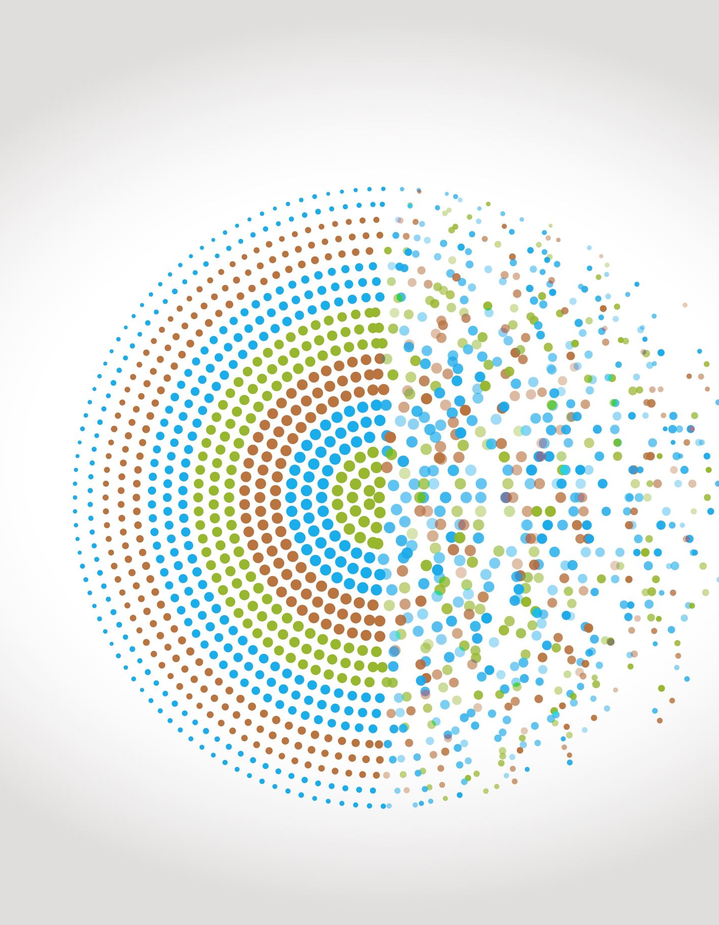
Modelling geometric growth and decay
7E
https://dashboard.blooket.com/set/6507923af3eb74a0c98b08c8
https://play.blooket.com/host?id=6747882db8d55150a13895dc
https://play.blooket.com/host?id=67478ccf9d40e5f58c69de67
https://dashboard.blooket.com/set/630c42e0aa05729fcc13c31d

Slide 2
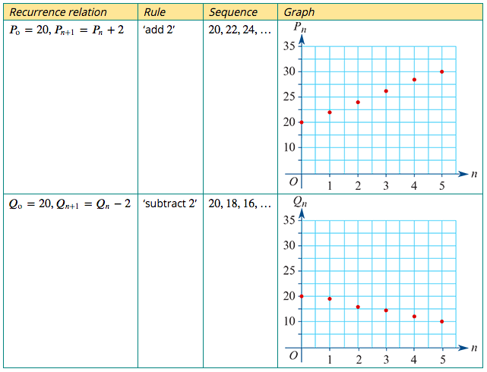
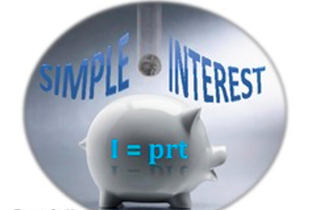
A recurrence model for linear growth and decay
The recurrence relations: $P_{0}$=20, $P_{n+1}$= $P_{n}$+ 2 $Q_{0}$=20, $Q_{n+1}$= $Q_{n}−$ 2
linear growth
Model and investigate simple interest loans and investments, as well as flat rate depreciation and unit cost depreciation of assets
linear decay

Slide 3
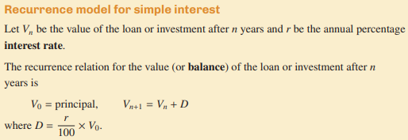
Recurrence Relation for linear Arithmetic growth and decay

Slide 4
Rules for linear Arithmetic growth and decay

Slide 5
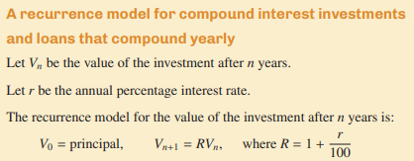
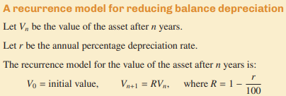
Recurrence Relation for Geometric growth and decay

Slide 6
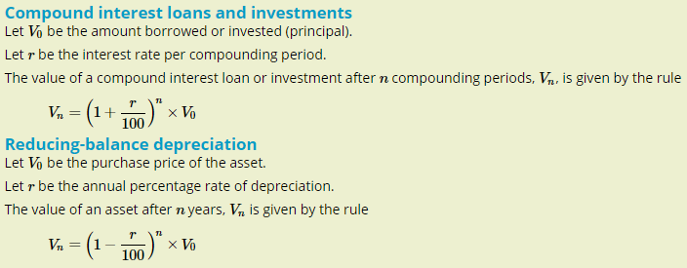
A rules for the nth term in a sequence representing geometric growth or decay

Slide 7
Solving a 2 Step Equation Using Onion Skins
Solve : 9000 = 3000 + 2a
9000 = 3000 + 2a
Solution for a is: a= $\frac{9000−3000}{2}$
a= $\frac{9000−3000}{2}$=3000

Slide 8
Solving a 2 Step Equation Using Onion Skins
Solve : 9000 = 3000 - 2a
9000 = 3000 – 2a
Solution for a is: a= $\frac{9000−3000}{−2}$
a= $\frac{9000−3000}{−2}$= –3000

Slide 9
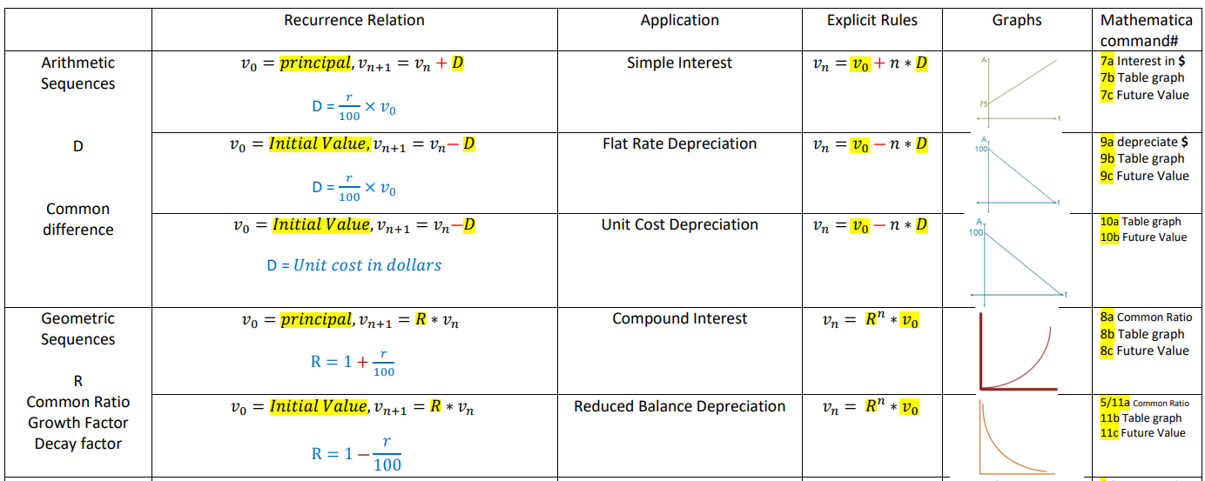

Slide 10
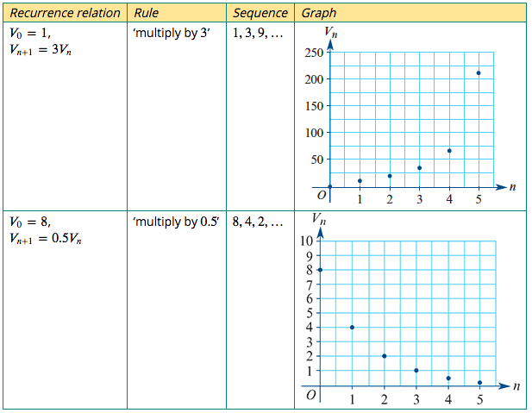
A recurrence model for geometric growth and decay
$V_{0}$=1, $V_{n+1}$=3$V_{n}$
$V_{0}$=8, $V_{n+1}$=0.5$V_{n}$

Slide 11
A recurrence model for geometric growth and decay
As a general rule, if 𝑅 is a constant, a recurrence relation rule of the form:
$V_{n+1}$=𝑅 $V_{n}$ for 𝑅 > 1, can be used to model geometric growth.
$V_{n+1}$=𝑅 $V_{n}$ for 0 < 𝑅 < 1, can be used to model geometric decay.

Slide 12
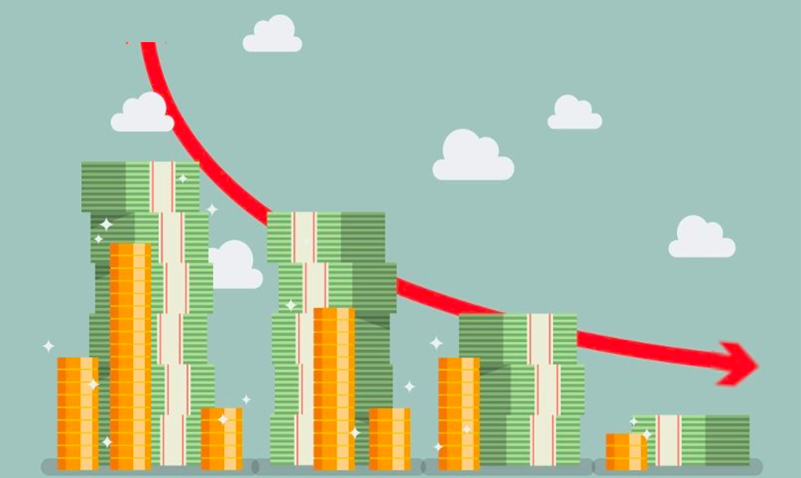
A recurrence model for reducing balance depreciation
Let $V_{n}$ be the value of the asset after 𝑛 years.
Let 𝑟 be the annual percentage depreciation.
The recurrence model for the value of the investment after 𝑛 years is:
$V_{0}$ = initial value, $V_{n+1}$ =𝑅 $V_{n}$ where 𝑅=1$−\frac{r}{100}$
Compound Interest
Reducing Balance Depreciation

Slide 13
Compound interest investments and loans
Consider an investment of $5000 that pays 8% interest per annum, compounding yearly. This means that the investment’s value increases by 8% each year.
Let $V_{n}$ be the value of the investment after 𝑛 years.
$V_{0}$ =$2000
value next year = this year's value + interest earned
$V_{n+1}$ = $V_{n}$ +$\frac{8}{100}$× $V_{n}$= $V_{n}$ +0.08× $V_{n}$
$V_{n+1}$ =1.08 $V_{n}$

Slide 14
A recurrence model for compound interest investments and loans that compound yearly
Let $V_{n}$ be the value of the investment after 𝑛 years.
Let 𝑟 be the percentage interest per compound period.
The recurrence model for the value of the investment after 𝑛 compounding periods is:
$V_{0}$ = principal, $V_{n+1}$ =𝑅 $V_{n}$ where 𝑅=1+$\frac{r}{100}$

Slide 15
Modelling compound interest with a recurrence relation 1
The following recurrence relation can be used to model a compound interest investment of $2000 paying interest at the rate of 7.5% per annum.
$V_{0}$ =2000, $V_{n+1}$ =1.075× $V_{n}$
In the recurrence relation, $V_{n}$ is the value of the investment after 𝑛 years.
1. Use the recurrence relation to find the value of the investment after 1, 2 and 3 years.
$V_{0}$ =2000,
$V_{1}$=1.075×2000=2150,
$V_{2}$=1.075×2150=2311.25,
$V_{3}$=1.075×2311.25=2484.59

Slide 16
Modelling compound interest with a recurrence relation 1
The following recurrence relation can be used to model a compound interest investment of $2000 paying interest at the rate of 7.5% per annum.
$V_{0}$ =2000, $V_{n+1}$ =1.075× $V_{n}$
In the recurrence relation, $V_{n}$ is the value of the investment after 𝑛 years.
2. Determine when the value of the investment will be first exceed $2500.
Command No. 8c
2. After 4 years, the investment will first exceed $2500

Slide 17
Modelling compound interest with a recurrence relation 1
The following recurrence relation can be used to model a compound interest investment of $2000 paying interest at the rate of 7.5% per annum.
$V_{0}$ =2000, $V_{n+1}$ =1.075× $V_{n}$
In the recurrence relation, $V_{n}$ is the value of the investment after 𝑛 years.
2. Determine when the value of the investment will be first exceed $2500.
The rule for Compound $V_{n}$ =2000 ×${1.075}^{n}$
2500= 2000 ×${1.075}^{n}$
$÷2000$ $÷2000$
1.25= ${1.075}^{n}$ → n=Log${1.075}^{1.25}$=$\frac{(log1.25)}{(log1.075)}$=3.08547
Command No. 8c
2. After 4 years, the investment will first exceed $2500

Slide 18
Modelling compound interest with a recurrence relation 1
The following recurrence relation can be used to model a compound interest investment of $2000 paying interest at the rate of 7.5% per annum.
$V_{0}$ =2000, $V_{n+1}$ =1.075× $V_{n}$
In the recurrence relation, $V_{n}$ is the value of the investment after 𝑛 years.
3. Write down the recurrence relation if $1500 was invested at a compound interest rate of 6.0% per annum.
3. $V_{0}$ =1500 and 𝑟=6
Calculate the value or 𝑅. The value of the investment will grow over time, so 𝑅=1+$\frac{r}{100}$=1+ $\frac{6}{100}$=1.06
$V_{0}$ =1500, $V_{n+1}$ =1.06× $V_{n}$

Slide 19
Compound interest with different compounding periods
Ben borrows $5000 from a bank. He will pay interest at the rate of 4.5% per annum.
Let $V_{n}$ be the value of the loan after 𝑛 compounding periods.
Write down a recurrence relation to model the value of Ben’s loan if interest is compounded:
1. yearly
$V_{0}$ = principal, $V_{n+1}$ =𝑅 $V_{n}$ where 𝑅=1+$\frac{r}{100}$
𝑅=1+ $\frac{4.5}{100}$=1.045
$V_{0}$ =5000, $V_{n+1}$ =1.045× $V_{n}$

Slide 20
Compound interest with different compounding periods
Ben borrows $5000 from a bank. He will pay interest at the rate of 4.5% per annum.
Let $V_{n}$ be the value of the loan after 𝑛 compounding periods.
Write down a recurrence relation to model the value of Ben’s loan if interest is compounded:
2. quarterly
2. $V_{0}$ = principal, $V_{n+1}$ =𝑅 $V_{n}$ where 𝑅=1+$\frac{r}{100}$
The interest rate is 4.5% per annum. The quarterly rate is $\frac{4.5}{4}$=1.125.
𝑅=1+ $\frac{1.125}{100}$=1.01125
$V_{0}$=5000, $V_{n+1}$ =1.01125× $V_{n}$

Slide 21
Compound interest with different compounding periods
Ben borrows $5000 from a bank. He will pay interest at the rate of 4.5% per annum.
Let $V_{n}$ be the value of the loan after 𝑛 compounding periods.
Write down a recurrence relation to model the value of Ben’s loan if interest is compounded:
3. monthly.
3. $V_{0}$ = principal, $V_{n+1}$ =𝑅 $V_{n}$ where 𝑅=1+$\frac{r}{100}$
The interest rate is 4.5% per annum. The monthly rate is $\frac{4.5}{12}$=0.375.
𝑅=1+ $\frac{0.375}{100}$=1.00375
$V_{0}$ =5000, $V_{n+1}$=1.00375× $V_{n}$

Slide 22
Reducing-balance depreciation
Reducing-balance depreciation is another method of depreciation – one where the value of an asset decays geometrically. Each year, the value will be reduced by a percentage, 𝑟%, of the previous year’s value. The calculations are very similar to compounding interest, but with decay in value, rather than growth.

Slide 23
A recurrence model for reducing balance depreciation
Let $V_{n}$ be the value of the asset after 𝑛 years.
Let 𝑟 be the annual percentage depreciation.
The recurrence model for the value of the investment after 𝑛 years is:
$V_{0}$ = initial value, $V_{n+1}$ =𝑅 $V_{n}$ where 𝑅=1$−\frac{r}{100}$

Slide 24
Modelling reducing-balance depreciation with recurrence relations
The following recurrence relation can be used to model the value of office furniture with a purchase price of $6900, depreciating at a reducing-balance rate of 7% per annum.
$V_{0}$ =6900, $V_{n+1}$ =0.93× $V_{n}$
In the recurrence relation, $V_{n}$ is the value of the office furniture after 𝑛 years.
1. Use the recurrence relation to find the value of the office furniture, correct to the nearest cent, after 1, 2 and 3 years.
1. $V_{0}$ =6900
$V_{1}$ =0.93×6900=6417
$V_{2}$ =0.93×6417=5967.81
$V_{3}$ =0.93×5967.81=5550.06

Slide 25
Modelling reducing-balance depreciation with recurrence relations
The following recurrence relation can be used to model the value of office furniture with a purchase price of $6900, depreciating at a reducing-balance rate of 7% per annum.
$V_{0}$ =6900, $V_{n+1}$ =0.93× $V_{n}$
In the recurrence relation, $V_{n}$ is the value of the office furniture after 𝑛 years.
2. Determine when the value of the investment will first be less than $5000.
Command No. 11c
2. The value of the furniture drops below $5000 after 5 years.

Slide 26
Modelling reducing-balance depreciation with recurrence relations
The following recurrence relation can be used to model the value of office furniture with a purchase price of $6900, depreciating at a reducing-balance rate of 7% per annum.
$V_{0}$ =6900, $V_{n+1}$ =0.93× $V_{n}$
In the recurrence relation, $V_{n}$ is the value of the office furniture after 𝑛 years.
2. Determine when the value of the investment will first be less than $5000.
The rule for Compound $V_{n}$ =6900 ×${0.93}^{n}$
5000= 6900 ×${0.93}^{n}$
$÷6900$ $÷6900$
0.7246= ${0.93}^{n}$ → n=Log${0.93}^{0.7246}$=$\frac{(log0.7246)}{(log0.93)}$=4.4389
2. The value of the furniture drops below $5000 after 5 years.

Slide 27
Modelling reducing-balance depreciation with recurrence relations
The following recurrence relation can be used to model the value of office furniture with a purchase price of $6900, depreciating at a reducing-balance rate of 7% per annum.
$V_{0}$ =6900, $V_{n+1}$ =0.93× $V_{n}$
In the recurrence relation, $V_{n}$ is the value of the office furniture after 𝑛 years.
3. Write down the recurrence relation if the furniture was initially valued at $7500 and is depreciating at a reducing-balance rate of 8.4% per annum.
3. $V_{0}$ =7500
Calculate the value or 𝑅. The depreciation rate is 8.4% per annum.
𝑅=1−$\frac{8.4}{100}$ or 𝑅=0.916
$V_{0}$ =7500, $V_{n+1}$ =0.916× $V_{n}$

Slide 28
A rule for individual terms of a geometric growth and decay sequence
We invest $2000 in a compound interest investment paying 5% interest per annum, compounding yearly. If we let $V_{n}$ be the value of the investment after 𝑛 years, we can use the following recurrence relation to model this investment:
$V_{0}$=2000, $V_{n+1}$=1.05 $V_{n}$
Using this recurrence relation we can write out the sequence of terms generated as follows:
$V_{0}$=2000
$V_{1}$=1.05 $V_{0}$
$V_{2}$=1.05 $V_{1}$ =1.05 ×(1.05 $V_{0}$)= ${1.05}^{2}$ × $V_{0}$
$V_{3}$=1.05 $V_{2}$ = 1.05 ×(${1.05}^{2}$ $V_{0}$)= ${1.05}^{3}$ × $V_{0}$
$V_{4}$=1.05 $V_{3}$ = 1.05 ×(${1.05}^{3}$ $V_{0}$)= ${1.05}^{4}$ × $V_{0}$
Following this pattern, after 𝑛 year’s interest has been added, we can write:
$V_{n}$=${1.05}^{n}$× $V_{0}$

Slide 29
Using a rule to find the value of an investment
A principal value of $10000 is invested in an account earning compound interest at the rate of 9% per annum. The rule for the value of the investment after 𝑛 years, $V_{n}$, is shown below.
$V_{n}$= ${1.09}^{n}$×10000
1. Find the value of the investment after 4 years, correct to the nearest cent.
2. Find the amount of interest earned after 4 years, correct to the nearest cent.
3. Find the amount of interest earned in the fourth year, correct to the nearest cent.
4. If the interest compounds monthly instead of yearly, write down a rule for the value of the investment after 𝑛 months.
5. Use this rule to find the value of the investment after 4 years (48 months).
1. $V_{4}$= ${1.09}^{4}$×10000 =14115.816...= $14115.82
2. $14115.82−$10000=$4115.82
3. $V_{3}$= ${1.09}^{3}$×10000 =12950.29
9% 𝑜𝑓 $V_{3}$=0.09×12950.29=1165.53 was earned in the $4^{th}$year
4. 𝑟=$\frac{9\%}{12}$=0.75% 𝑅=1+ $\frac{0.75}{100}$=1.0075 $V_{n}$= ${1.0075}^{n}$×10000
5. $V_{48}$= ${1.0075}^{48}$×10000 = $14314.05

Slide 30
Calculating the value and total depreciation of an asset after reducing-balance depreciation
A computer system costs $9500 to buy, and decreases in value with reducing-balance depreciation of 20% each year. A recurrence relation that can be used to model the value of the computer system after 𝑛 years, 𝑉𝑛, is shown below.
$V_{0}$ =9500, $V_{n+1}$ =0.8× $V_{n}$
1. Write down the rule for the value of the computer system after 𝑛 years.
2. Use the rule to find the value of the computer system after 8 years. Write your answer, correct to the nearest cent.
3. Calculate the total depreciation of the computer after 8 years.
$V_{0}$ =9500 𝑅=1−$\frac{20}{100}$=0.8 $V_{n}$=$R^{n}$× $V_{0} V_{n} \text{=}{0.8}^{n}\text{× }$9500
$V_{n} \text{=}{0.8}^{8}\text{× }$9500 =1593.835...= $1593.84
Depreciation=$9500−$1593.84=$7906.16
After 8 years, the computer system has depreciated by $7906.16.

Slide 31
Using Mathematica to solve geometric growth and decay problems
How many years will it take an investment of $2000, paying compound interest at 6% per annum, to grow above $3000? Write your answer correct to the nearest year.
$V_{0}$=2000 𝑅=1+$\frac{6}{100}$=1.06 $V_{n}$=3000
$V_{n}$=$R^{n}$× $V_{0}$ 3000= ${1.06}^{n}$×2000
Command No. 8c
After 6.95... years, the value of the investment is $3000. It will grow above $3000 after 7 years.

Slide 32
Using Mathematica to solve geometric growth and decay problems
How many years will it take an investment of $2000, paying compound interest at 6% per annum, to grow above $3000? Write your answer correct to the nearest year.
$V_{0}$=2000 𝑅=1+$\frac{6}{100}$=1.06 $V_{n}$=3000
$V_{n}$=$R^{n}$× $V_{0}$ 3000= ${1.06}^{n}$×2000
3000= 2000 ×${1.06}^{n}$
$÷2000$ $÷2000$
1.5= ${1.06}^{n}$ → n=Log${1.06}^{1.5}$=$\frac{(log1.5)}{(log1.06)}$=6.9585
Command No. 8c
After 6.95... years, the value of the investment is $3000. It will grow above $3000 after 7 years.

Slide 33
Using Mathematica to solve geometric growth and decay problems
An industrial weaving company purchased a new loom at a cost of $56000. It has an estimated value of $15000 after 10 years of operation. If the value of the loom is depreciated using a reducing-balance method, what is the annual rate of depreciation? Write your answer correct to one decimal place.
$V_{0}$=56000 $V_{n}$=15000 𝑅=1−$\frac{r}{100}$ 𝑛=10
Substitute into the rule for the $n^{th}$term of a sequence.
$V_{n}$=$R^{n}$× $V_{0}$ 15000= ${\text{(}\text{1−}\frac{r}{100})}^{10}$×56000
Command No. 11c
The annual rate of depreciation is 12.3%, correct to one decimal place.

Slide 34
Using Mathematica to solve geometric growth and decay problems
An industrial weaving company purchased a new loom at a cost of $56000. It has an estimated value of $15000 after 10 years of operation. If the value of the loom is depreciated using a reducing-balance method, what is the annual rate of depreciation? Write your answer correct to one decimal place.
$V_{0}$=56000 $V_{n}$=15000 𝑅=1−$\frac{r}{100}$ 𝑛=10
Substitute into the rule for the $n^{th}$term of a sequence.
$V_{n}$=$R^{n}$× $V_{0}$ 15000= ${\text{(}\text{1−}\frac{r}{100})}^{10}$×56000
15000= 56000 ×${\text{(}\text{1−}\frac{r}{100})}^{10}$
$÷56000$ $÷56000$
0.2679=${\text{(}\text{1−}\frac{r}{100})}^{10}$ → 10=Log${\text{(}\text{1−}\frac{r}{100})}^{0.2679}$=$\frac{(log0.2679)}{(log\text{(}\text{1−}\frac{r}{100}))}$
→ log $\text{(}\text{1−}\frac{r}{100})$= $\frac{(log0.2679)}{10}$ =$−$0.05720
$$\text{1−}\frac{r}{100}= {10}^{−\text{0.05720}}=0.8766$$
→ r= 12.34
The annual rate of depreciation is 12.3%, correct to one decimal place.

