Slide 1

Introduction to matrices
7A

Slide 2
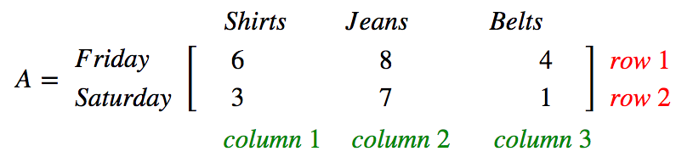
A matrix is an array of numbers
For example
A market stall operates on Friday and Saturday. Sales could be recorded using matrix A.
Rows | Columns
Friday sales are listed in row 1. | The number of shirts sold is listed in column 1.
Saturday sales are listed in row 2. | The number of pairs of jeans sold is listed in column 2.
 | The number of belts sold is listed in column 3.

Slide 3
A matrix is an array of numbers
For example
A market stall operates on Friday and Saturday. Sales could be recorded using matrix A.
We can read the following information from the matrix:
on Friday 8 pairs of jeans were sold
on Saturday 1 belt was sold
the total number of items sold on Friday was 6+8+4=18
the total number of belts sold was 4+1=5.

Slide 4
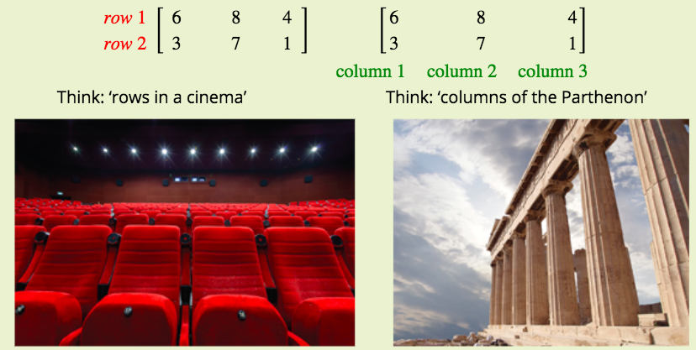
Order/Size/Dimension of a matrix
The order (or size) of a matrix is written as:
number of rows × number of columns
The order of matrix A in the market stall example above is 2×3; that is, 2 rows×3 columns. It is called a ‘two by three’ matrix.
In writing down the order of a matrix, Rows first, then columns.
Remember: When you walk into a cinema, you go to your row first.
Matrices are usually named using capital letters such as A,B,O.

Slide 5

A matrix with R rows and C columns is called an
R X C Matrix.
This is called the ORDER/SIZE/DIMENSION of the matrix.
Each entry in the matrix is called an ELEMENT.

Slide 6
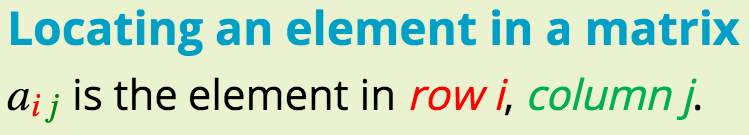
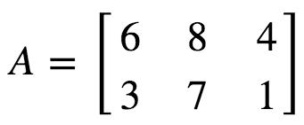
Elements of a matrix
The numbers within a matrix are called its elements.
For example, in the matrix:
element a22 is in row 2, column 2 and its value is 7.
element a13 is in row 1, column 3 and its value is 4

Slide 7
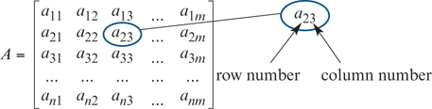

Some Notation
For the matrix A, which has 𝑛n rows and 𝑚m columns, we write:
Thus:
$a_{21}$ represents the element in the 2nd row and the 1st column
$a_{12}$ represents the element in the 1st row and the 2nd column
$a_{22}$ represents the element in the 2nd row and the 2nd column
$a_{mn}$ represents the element in the $m^{th}$ row and the $n^{th}$column.

Slide 8
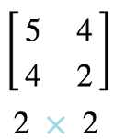
TYPES OF MATRICES
NAME | DESCRIPTION | EXAMPLE
Row matrix | A matrix with only 1 row
Column matrix | A matrix with only I column
Square matrix | the number of rows equals the number of columns
Zero (Null) matrix | A matrix with all zero entries

Slide 9

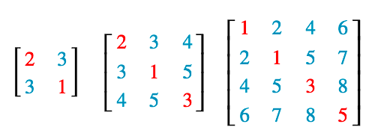
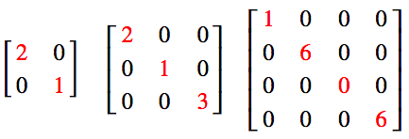
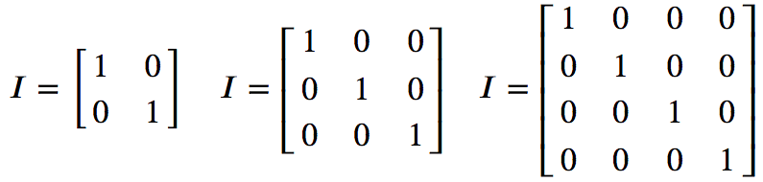
TYPES OF MATRICES
NAME | DESCRIPTION | EXAMPLE
Transpose of a matrix | a new matrix that is formed by interchanging the rows and columns.
Symmetric matrices | A matrix A is called symmetric if A^{T}= A
Diagonal matrices | if all of the elements off the leading diagonal are zero.
Identity matrices | This is denoted by the letter I and has zero entries except for 1’s on the diagonal.

Slide 10
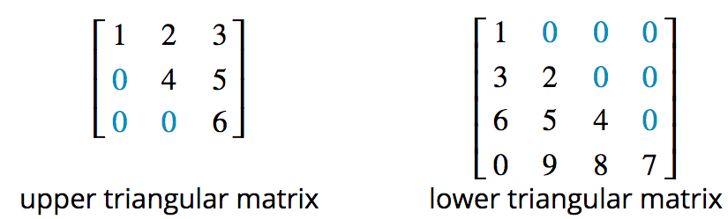
TYPES OF MATRICES
NAME | DESCRIPTION | EXAMPLE
Triangular matrices | 1. An upper triangular matrix: all elements below the leading diagonal are zeros. 2. A lower triangular matrix: all elements above the leading diagonal are zeros.

Slide 11

Row matrices
A row matrix has a single row of elements.
In matrix A, the Friday sales from the market stall can be represented by a 1×3 row matrix.

Slide 12

Column matrices
A column matrix has a single column of elements.
In matrix A, the sales of jeans from the market stall can be represented by a 2×1 column matrix.

Slide 13
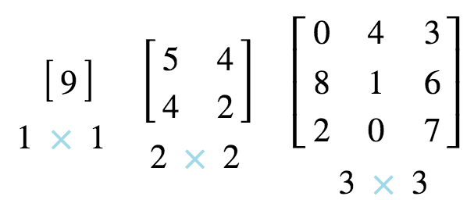
Square matrices
In square matrices the number of rows equals the number of columns.
Here are three examples.

Slide 14
The ZERO or NULL Matrix
Has every element ZERO.
Adding or subtracting the NULL Matrix will have no effect.
MULTIPLYING by the NULL Matrix will create another NULL MATRIX.

Slide 15
The Transpose of a Matrix: A^{T}
The transpose of a matrix is a new matrix that is formed by interchanging the rows and columns.
The transpose of A is denoted by A^{T}

Slide 16
Transpose
Definition: Given an mxn matrix A, the transpose of A is the nxm matrix, denoted by A^{T}, whose columns are formed from the corresponding rows of A.
In other words, the i^{th} row of A^{T} is the i^{th} column of A for all i.
Example: Let
What is A^{T} ?

Slide 17

Example of a transpose
Thus,
If A = A', then A is symmetric

Slide 18
Symmetric matrices
Defn - A matrix A is called symmetric if A^{T}= A
Defn - A symmetric matrix is a square matrix that is unchanged by transposition (switching rows and columns). In a symmetric matrix, the elements above the leading diagonal are a mirror image of the elements below the diagonal. Three are shown.

Slide 19
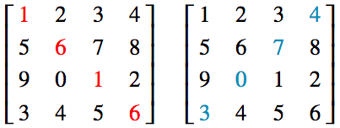
Diagonals of a Matrix
A square matrix has two diagonals:
In practice, the diagonal going downwards from left to right in the matrix (coloured red) turns out to be more important than the other diagonal (coloured blue), so we give it a special name: the leading diagonal.

Slide 20
Diagonal Matrices
A square matrix is called a diagonal matrix if all of the elements off the leading diagonal are zero. The elements on the leading diagonal may or may not be zero.
The matrices below are all diagonal matrices:

Slide 21
Diagonal Matrices
Definition: If A is an nxn matrix, then the line joining (1,1) entry, (2,2) entry,…,(n,n) entry is called the diagonal (or the leading diagonal) of the matrix.
Definition: Any nxn matrix D is called diagonal matrix if each entry not on the diagonal is 0.
For example,

Slide 22
Identity Matrix
Definition: Diagonal matrices in which all of the elements in the diagonal are of special importance. They are called identity or unit matrices and have their own name and symbol (𝐼).
Every order of square matrix has its own identity matrix, three of which are shown opposite.
Square matrix with ones on the diagonal and zeros elsewhere.
It can be easily proved that if A is an mxn matrix, then

Slide 23
The UNIT or IDENTITY MATRIX I
A VERY IMPORTANT MATRIX. (Later work!)
These are always SQUARE MATRICES
This is denoted by the letter I and has zero entries except for 1’s on the diagonal.
MULTIPLYING by the IDENTITY Matrix will create the SAME MATRIX. In a similar way to Multiplying a number by 1

Slide 24

Multiplying a matrix by the identity gives the matrix back again.
What is AI?
What is IA?
identity matrix
an n × n matrix with ones on the main diagonal and zeros elsewhere

Slide 25
Triangular Matrices
Triangular matrices come in two types:
1. An upper triangular matrix is a square matrix in which all elements below the leading diagonal are zeros.
2. A lower triangular matrix is a square matrix in which all elements above the leading diagonal are zeros.
Examples of triangular matrices are shown.

Slide 26
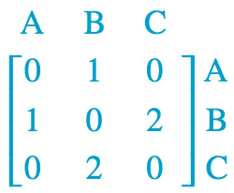
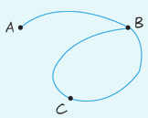
Using matrices to model practical situations
A network diagram of points (vertices) joined by lines (edges).
The network diagram drawn shows the ways to travel between three towns, A,B and C.
Use a matrix to represent the connections. Each element should describe the number of ways to travel directly from one town to another.
What information is given by the sum of the second column of the matrix?
b. The second column shows the number of roads directly connected to town B.
The sum of the second column is the total number of roads directly connected to town B.
1+0+2=3

Slide 27
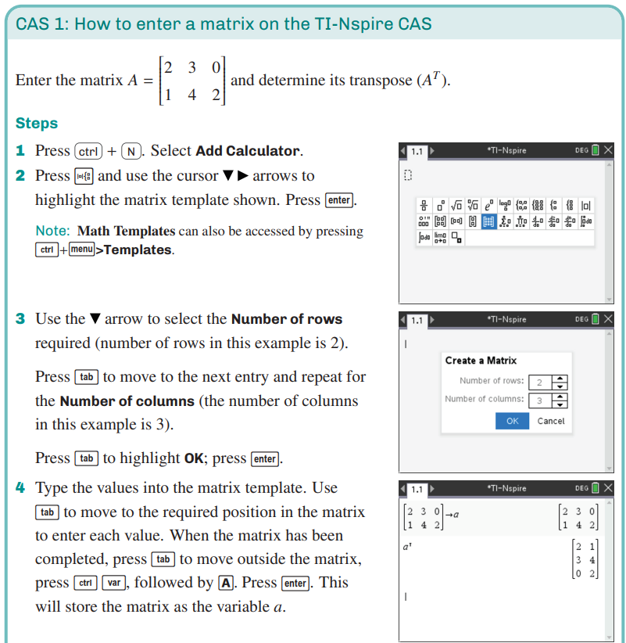
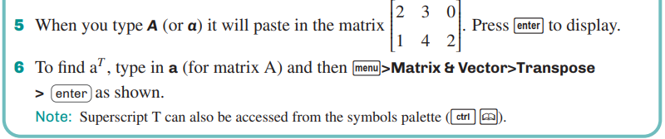
Entering a matrix into CAS
CAS Notes 7.1

Slide 28


Where to use Matrices?
To store numerical information in a data table.
To carry codes that encrypt credit-card numbers for internet transmission.
To carry all the information needed to solve sets of simultaneous equations.
To represent network diagrams.

Slide 29
Using a matrix to represent data tables
The numerical information in a data table is frequently presented in rows and columns. As such, it is relatively straight forward process to convert this information into matrix form.

Slide 30
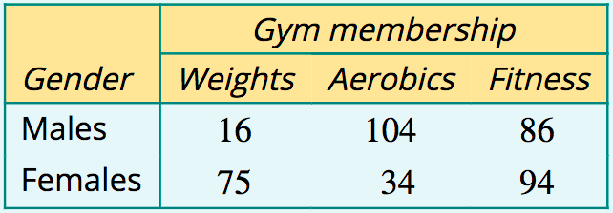
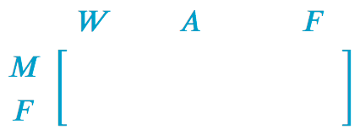


Representing information in a table by a matrix
The table below shows the three types of membership of a local gym and the number of males and females enrolled in each. Construct a matrix to display the numerical information in the table.

Slide 31
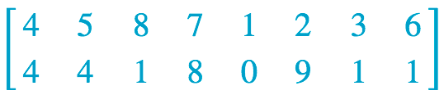
Entering a credit card number into a matrix
Convert the 16-digit credit card number: 4454817810293161 into a 2×8 matrix, listing the digits in pairs, one under the other. Ignore the spaces.

Slide 32

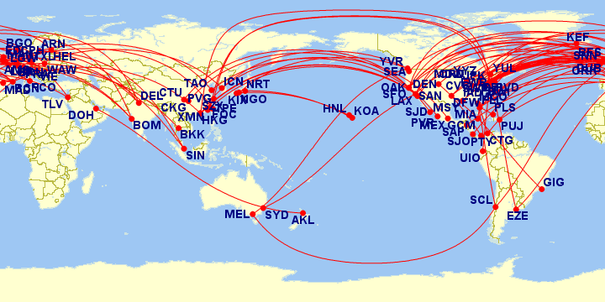
Using matrices to represent network diagrams
Network diagrams consist of a series of numbered or labelled points joined in various ways. They are a powerful way of representing and studying things as different as friendship networks, airline routes, electrical circuits and road links between towns.

Slide 33
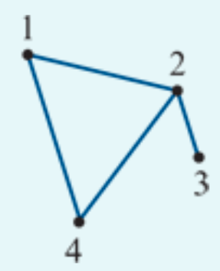
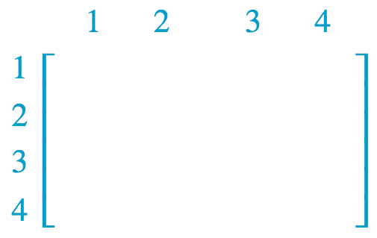
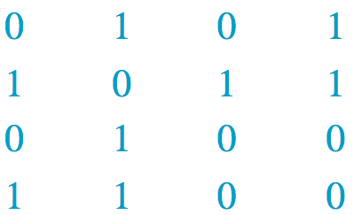
Representing a network diagram by a matrix
Represent the network diagram shown opposite as a 4×4 matrix 𝐴, where:
matrix element =1 if the two points are joined by a line
matrix element =0 if the two points are not connected.

Slide 34
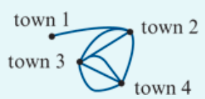
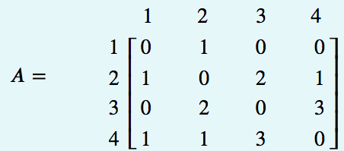
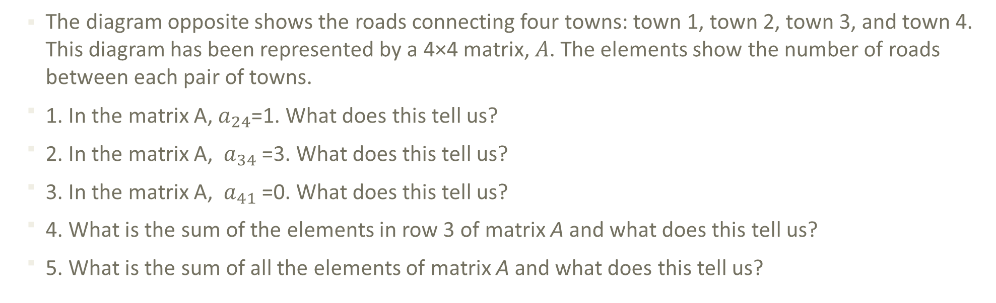
Interpreting a matrix representing a network diagram
The diagram opposite shows the roads connecting four towns: town 1, town 2, town 3, and town 4. This diagram has been represented by a 4×4 matrix, 𝐴. The elements show the number of roads between each pair of towns.
1. In the matrix A, $a_{24}$=1. What does this tell us?
2. In the matrix A, $a_{34}$=3. What does this tell us?
3. In the matrix A, $a_{41}$=0. What does this tell us?
4. What is the sum of the elements in row 3 of matrix A and what does this tell us?
5. What is the sum of all the elements of matrix A and what does this tell us?
1. 1 road between town 2 & 4;
2. 3 road between town 3 & 4;
3. 0 road between town 4 & 1;
4. total 5 roads between town 3 & others;
5. total 14 roads you can travel between towns.

