Slide 1

Introduction to graphs and networks
Lesson 8A

Slide 2
Learning Intention: The graph theory
The elements of graph: Vertices, Edges, Degree of a Vertex
Euler's rule
Describing graphs: Simple graphs, Isolated vertex, Degenerate graphs, Connected graphs and bridges
Describing graphs: Complete graphs, Subgraphs, Equivalent (Isomorphic) graphs, Planar graphs

Slide 3
Friendship network

Slide 5
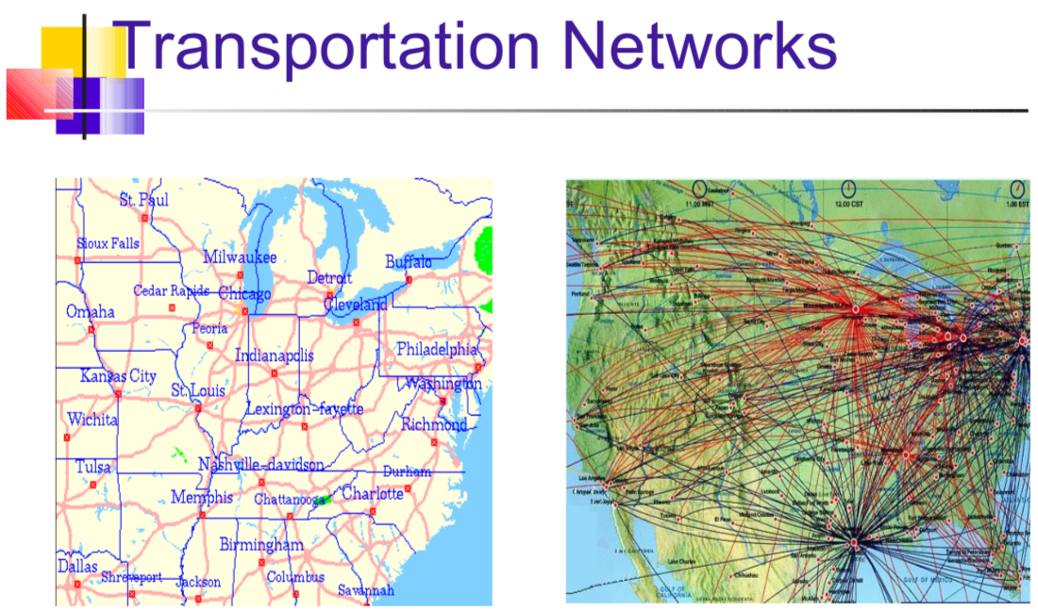

Slide 6
internet

Slide 7
In New York City, garbage collection, curb sweeping, snow removal, and other municipal services have been scheduled and organized using graph theory since the 1970s and the improved efficiency has yielded savings estimated in the tens of millions of dollars annually.

Slide 8
https://www.youtube.com/watch?v=nZwSo4vfw6c
Notes:
the königsberg bridge problem

Slide 9
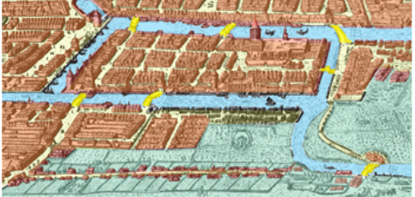
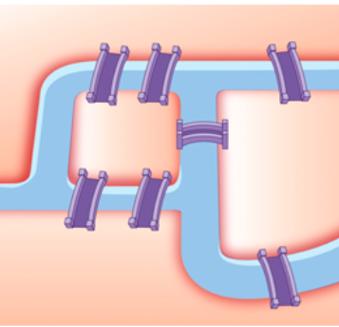
The problem simplified

Slide 10
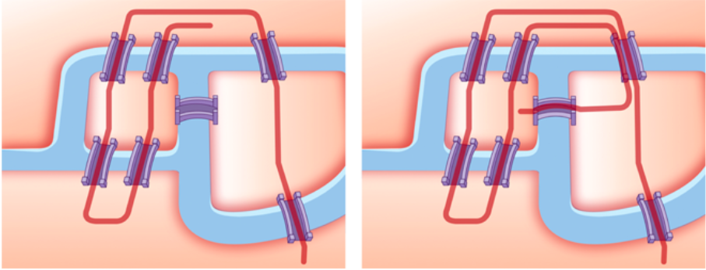
Can a continuous walk be planned so that all bridges are crossed only once?

Slide 11
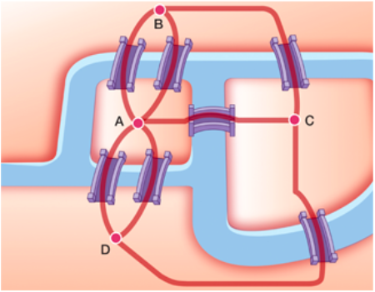
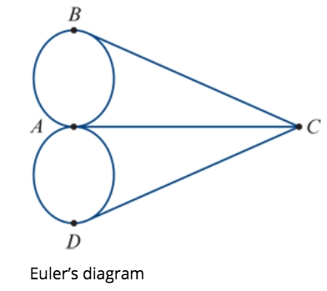
a simplified diagram to represent the situation---a graph.

Slide 12
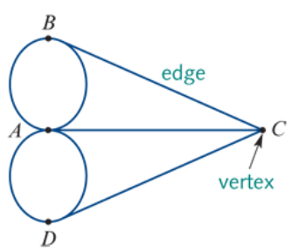
What is a graph?
A graph is made up of dots and lines joining these dots.
The dots in a graph are called vertices (plural of vertex). These vertices represent the riverbanks and the islands.
The lines in a graph are called edges. These edges represent the bridges.

Slide 13
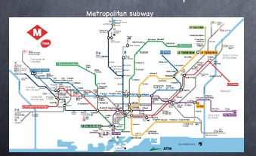
In the Real-World
Vertices may represent things such as people, places or region.
Edges may represent connections such as roads, bridges or relationships.
What are the edges, and what do they represent?
What about the vertices?

Slide 14
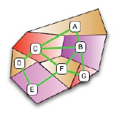
Degree of the Vertex
The number of edges attached to the vertex.
Euler found that the solution of the Königsberg bridge problem was connected to the degree of each vertex.
What is the degree of vertex A?
What is the degree of vertex C?
2
4

Slide 15
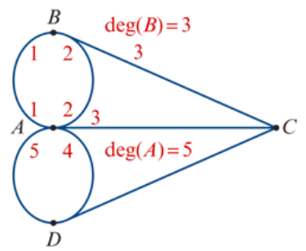
Degree of the Vertex
For the Königsberg bridge graph:
the degree of vertex 𝐴 is 5 (because five edges are attached to vertex 𝐴): write this as deg(𝐴)=5
vertices 𝐵,𝐶 and 𝐷 are all of degree 3 (three edges touch each of these vertices): write this as deg(𝐵)=3, etc.
The degree ----even or odd.
Even: even number of edges (2, 4, 6,…) attached to the vertex.
Odd: odd number of edges (1, 3, 5,…) to the vertex.
All four vertices in the Königsberg bridge graph have an odd degree.

Slide 16
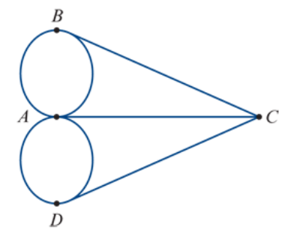
Euler’s discovery
A graph with all odd vertices cannot be traced or drawn without lifting the pencil or going over the same edge more than once.
Can all even vertices or only two odd vertices do that? Yes.

Slide 17
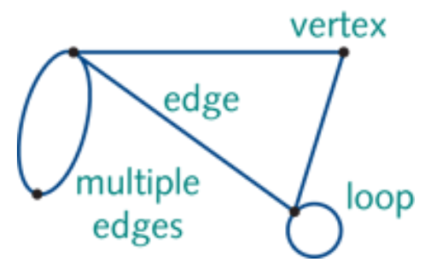
Graph elements: definitions
A graph is a diagram that consists of a set of points called vertices that are joined by a set of lines called edges. Each edge joins two vertices.
A loop is an edge in a graph that joins a vertex in a graph to itself.
Two or more edges that connect the same vertices are called multiple edges.
A
D
B
C

Slide 18
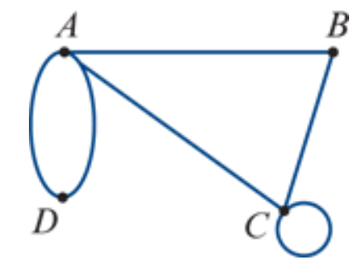
The degree of a vertex
deg(𝐴)=4
The degree of a vertex is the number of edges attached to the vertex. The degree of a vertex is denoted deg(𝑉).
A loop contributes two degrees to a vertex because a loop is attached to its vertex at both ends.
In any graph, the sum of degrees of the vertices is equal to twice the number of edges.
A loop contributes one edge to the graph.
$$e_{4}$$
deg(𝐵)=2
$$e_{1}$$
$$e_{3}$$
$$e_{2}$$
$$e_{5}$$
deg(𝐶)=4
deg(𝐷)=2
$$e_{6}$$
deg(𝐴) + deg(𝐵) + deg(𝐶) + deg(𝐷) = 4+2+4+2=12 =6 $× 2$

Slide 19
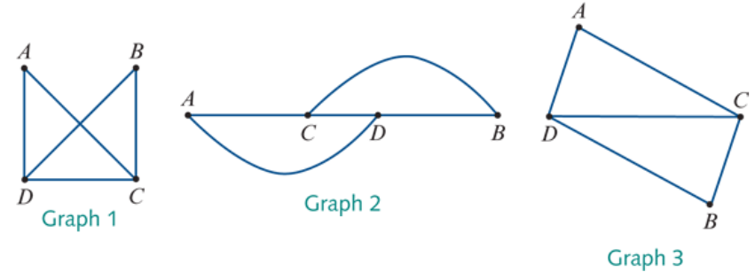
Equivalent (Isomorphic) graphs
Different looking graphs can contain the same information. When this happens, we say that these graphs are equivalent or isomorphic.
deg(𝐴)=2
deg(𝐴)=2
deg(B)=2
$$e_{3}$$
$$e_{4}$$
$$e_{1}$$
deg(𝐴)=2
deg(C)=3
$$e_{1}$$
deg(B)=2
$$e_{5}$$
$$e_{1}$$
$$e_{4}$$
$$e_{3}$$
$$e_{5}$$
$$e_{2}$$
$$e_{2}$$
deg(C)=3
deg(D)=3
$$e_{3}$$
deg(D)=3
$$e_{2}$$
$$e_{5}$$
$$e_{4}$$
deg(C)=3
deg(D)=3
deg(B)=2
Two graphs are said to be isomorphic (equivalent) if:
they have the same numbers of edges and vertices
corresponding vertices have the same degree and the edges connect the same vertices.
Rules

Slide 20
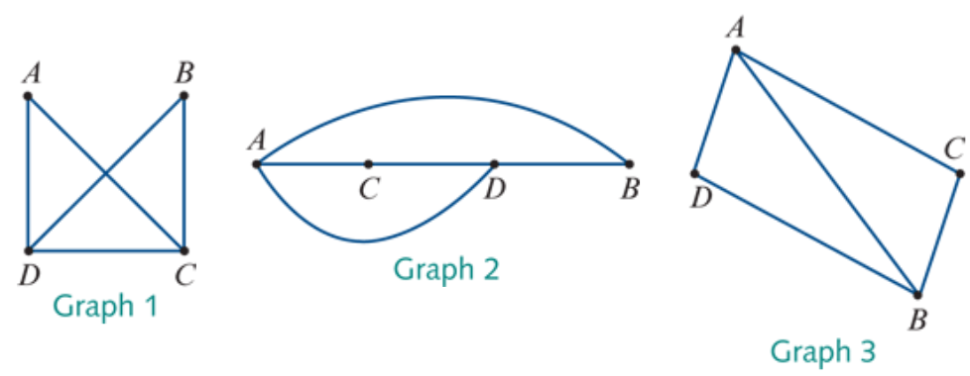
Example: The same numbers of edges and vertices.
Not the same degree and the edges do not connect the same vertices.
Equivalent (Isomorphic) graphs
Not Isomorphic
deg(𝐴)=3
deg(𝐴)=2
deg(𝐴)=3
deg(B)=2
deg(B)=3

Slide 21
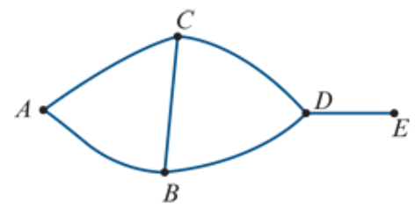
Simple graphs
Simple graphs do not have any loops. There are no duplicate or multiple edges either.

Slide 22
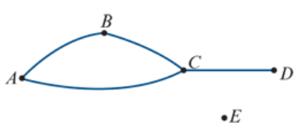
Isolated vertex
A graph has an isolated vertex if there is a vertex that is not connected to another vertex by an edge.
The isolated vertex in this graph is EE, because it is not connected to any other vertex by an edge.

Slide 23
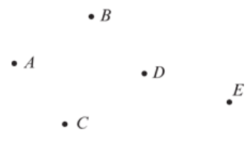
Degenerate graphs
Degenerate graphs have all vertices isolated. This means that there are no edges in the graph at all.

Slide 24
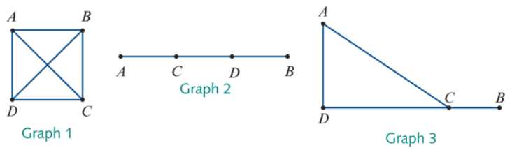
Connected graphs
A graph is connected if every vertex in the graph is accessible from every other vertex in the graph along a path formed by the edges of the graph.

Slide 25
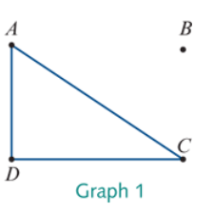
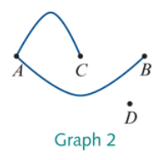
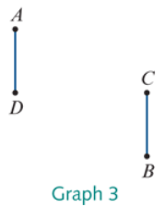
Connected graphs
Not Connected
The three graphs below are not connected, because there is not a path along the edges that connects vertex 𝐴 (for example) to every other vertex in the graph.

Slide 26
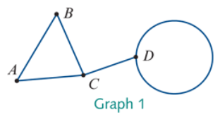
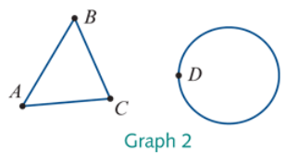
Bridges
A bridge is an edge in a connected graph that, if removed, leaves the graph disconnected.
bridge
A bridge is a single edge in a connected graph that if removed leaves the graph disconnected. A graph can have more than one bridge.

Slide 27
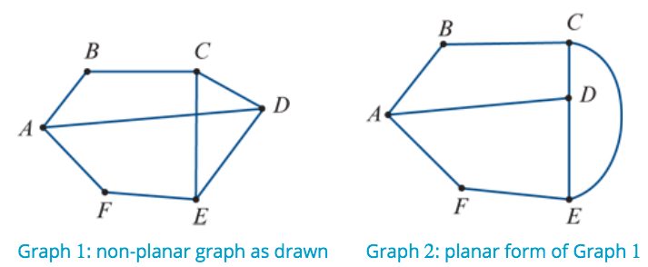
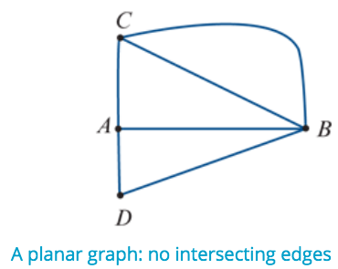
Planar graphs
A planar graph can be drawn on a plane (page surface) so that no edges intersect (cross), except at the vertices.

Slide 28
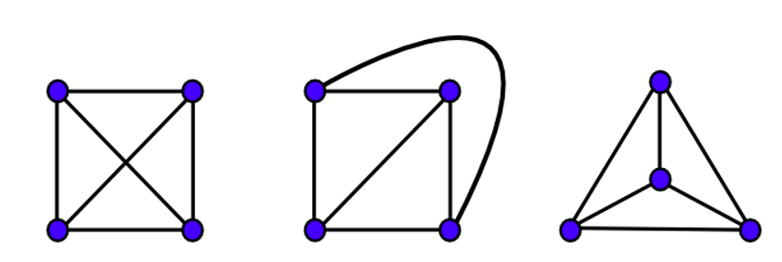

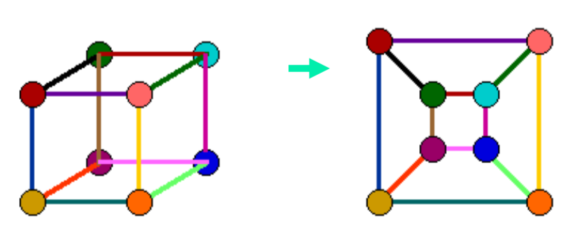
Planar graphs

Slide 29
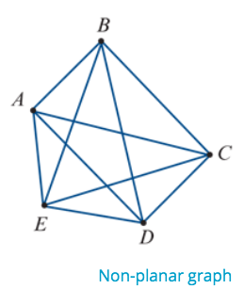
Planar Graphs
Not all graphs are planar.
For example, the graph opposite cannot be redrawn in an equivalent planar form, no matter how hard you try.

Slide 30
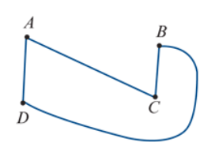
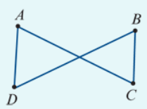
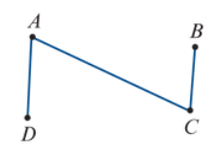
Redrawing a graph in planar form

Slide 31
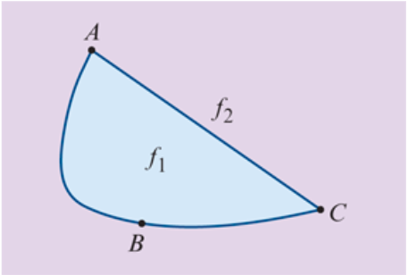
Faces of a graph
The graph opposite can be regarded as dividing the paper it is drawn on into two regions.
In the language of graphs, these regions are called the faces of the graph.
One face, $f_{1}$, is bounded by the graph.
The other face, $f_{2}$, is the region surrounding the graph. This ‘outside’ face is infinite.

Slide 32
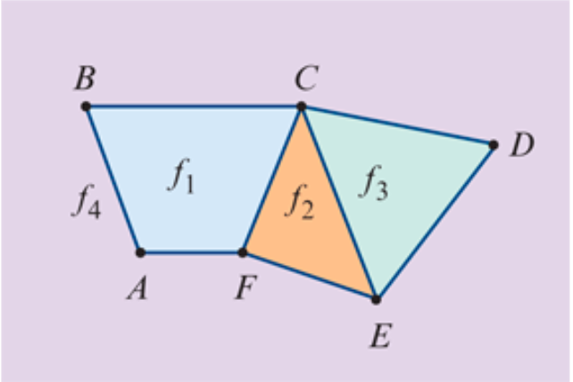
Faces of a graph
The graph opposite divides the paper into four regions, so we say that it has four faces: $f_{1}$, $f_{2}$, $f_{3}$ and $f_{4}$. Here $f_{4}$ is an infinite face.

Slide 33
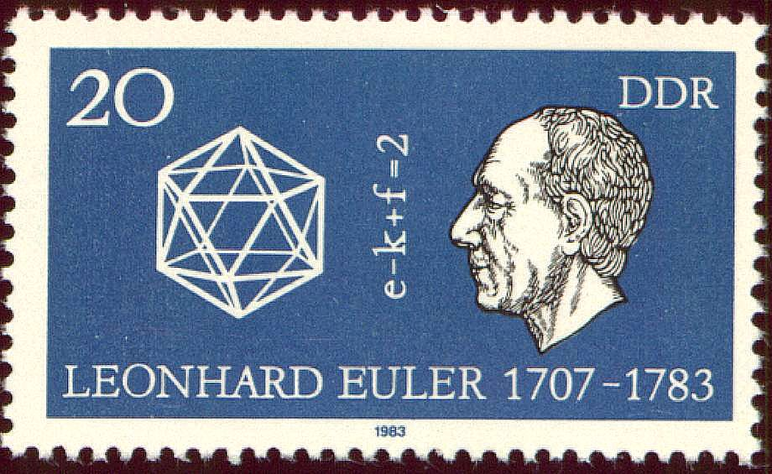
Euler’s Formula
If G is a connected planar graph with v vertices, e edges and f faces, then v – e + f = 2
For a connected planar graph:
number of vertices − number of edges + number of faces=2

Slide 34
7 $−$ 9 + 4 =2

Slide 35
Using Euler’s formula to find the number of faces of a graph
A connected planar graph has four vertices and five edges. Find the number of faces.
Solution
Write down 𝑣 and 𝑒. 𝑣=4, 𝑒=5
Euler's formula: v−e+f=2
Substitute the values of 𝑣 and 𝑒.
4−5+f=2
− 1+f=2
f − 1=2
f=3 The graph has three faces.

Slide 36
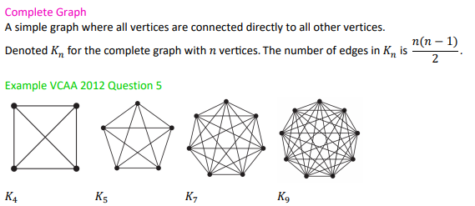

Slide 37
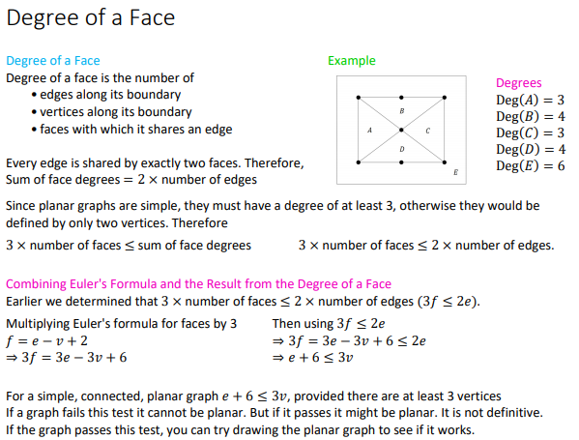


Slide 38
