Slide 1
Associations between two categorical variables
2B

Slide 11
Explanatory Variable
Response Variable

Slide 13
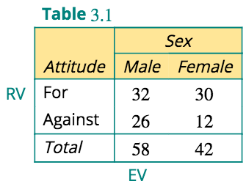
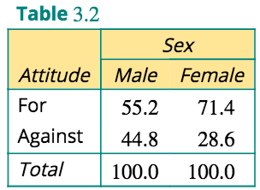

Slide 15
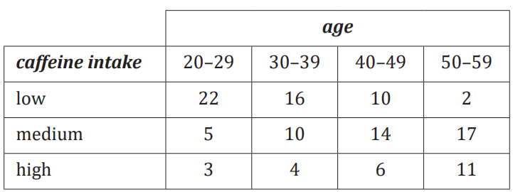
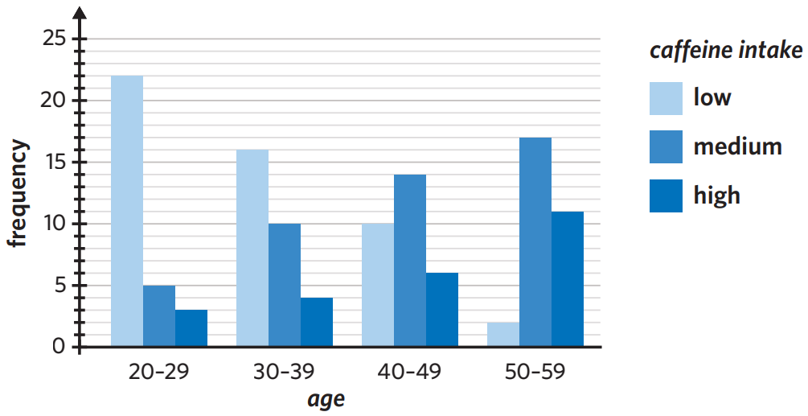
GROUPED BAR CHART

Slide 18
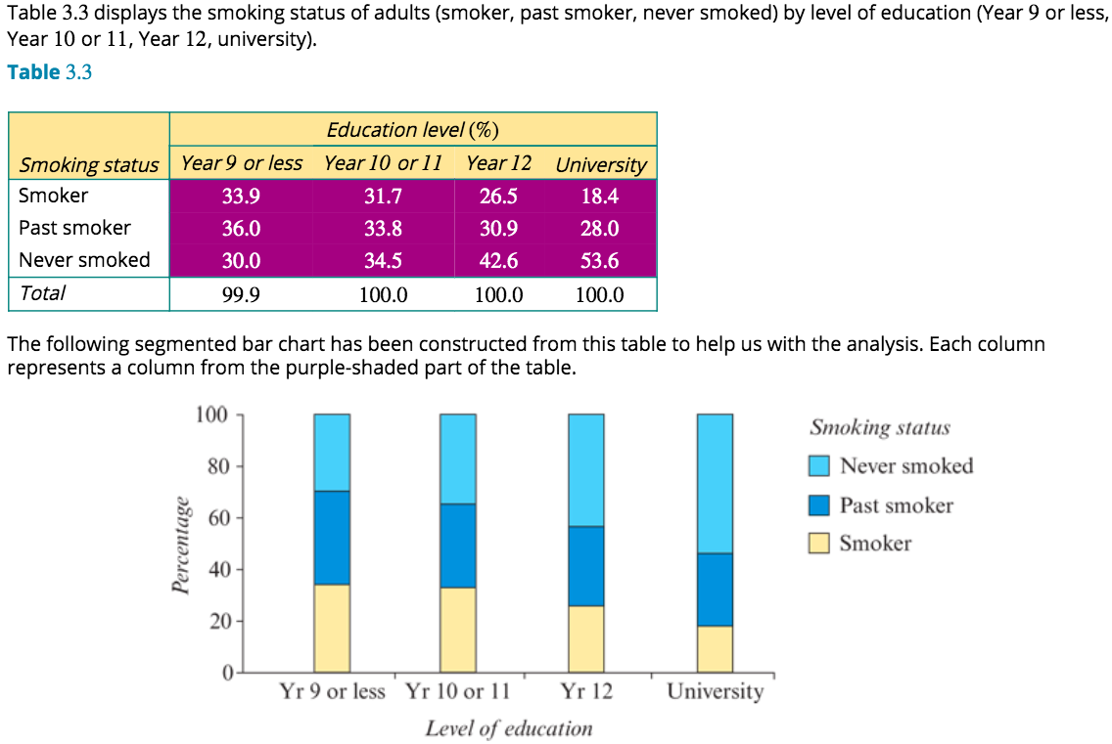
Analysing a situation where two categorical variables have multiple categories

Slide 20
REPORT

Slide 21
exercises & Summary Book
1. Ex page 2A
2. Summary notes

