Slide 1
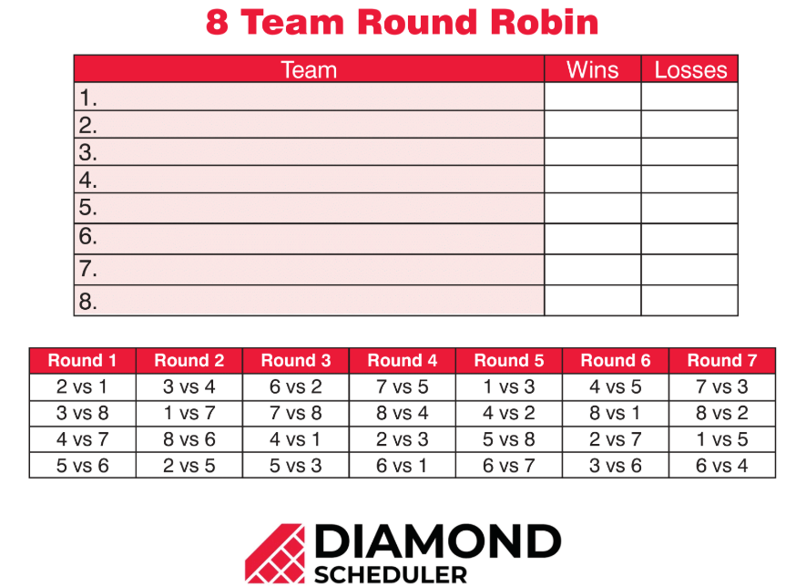
Communication and dominance matrices
7F
V2V Enabled Intelligent Transportation System

Slide 2
Communication matrices
A communication matrix is a square binary matrix in which the 1s represent the links in a communication system.

Slide 3
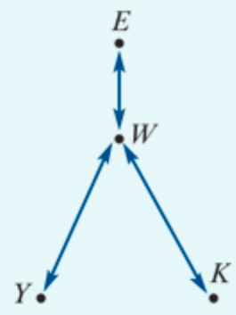
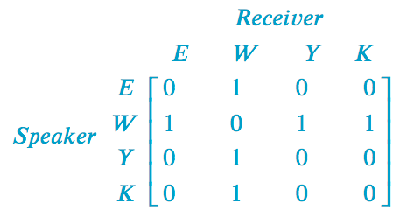
Constructing a communication matrix
Eva, Wong, Yumi and Kim are students who are staying in a backpacker’s hostel. Because they speak different languages, they can have problems communicating. The situation they must deal with is that:
Eva speaks English only
Yumi speaks Japanese only
Kim speaks Korean only
Wong speaks English, Japanese and Korean.
Conveniently, this information can be summarised in a network diagram, as shown above. In this diagram, the arrow linking Eva and Wong indicates that they can communicate directly because they both speak English.
The task is to construct a communication matrix.
Notes:
Designate each element as a ‘1’ or ‘0’ according to the following rules:the element =1 if two people can communicate directly because they speak the same language
the element =0 if two people cannot communicate directly because they do not have a common language.

Slide 4
one-step & two-step communication link
For example, we can see from the network diagram that Eva, who speaks only English, cannot communicate directly with Yumi, who speaks only Japanese. We call this a one-step communication link.
However, Eva can communicate with Yumi by sending a message via Wong, who speaks both English and Japanese. In the language of communication systems we call this a two-step communication link.

Slide 5
one-step & two-step communication link
A one-step communication link is when communication can occur directly between two people in the network.
We can see that W has a one-step communication link with each of the other 3 members of the network, and each of the other three have only a single one-step communication link (with W).
However, Y,K and E can still communicate with each other, by using W as an intermediary. For example:
K can communicate with Y using the links: 𝐾 → 𝑊 → 𝑌. This is called a two-step communication link, because there are two steps (and one intermediary).
Question:
Determine all the two-step communication links in this network?

Slide 6
The power of the matrix → 2-step communication link
The power of the matrix representation is that squaring the communication matrix generates a matrix that identifies all possible two-step communication links in a communication network. For example, if we call the communication matrix 𝐶, we have:

Slide 7
The power of the matrix → 2-step communication link
Multiplying the two 1’s together in the 3rd row and 1st column represents the two step link: Y→ 𝑊 → 𝐸

Slide 8
Redundant communication links
Two-step links that have the same sender and receiver are said to be redundant communication links because they do not contribute to the communication between different people.

Slide 9
Redundant communication links
Consider the element 3 in $C^{2}$ circled:
Each time we multiply 1 by 1 we are representing a 2 step communication link with the communicator and the receiver being the same person:
The first product of 1⋅1 corresponds to: 𝑊 → 𝐸 → 𝑊, which is a redundant communication link.
The product of 0⋅0 corresponds to 𝑊 → 𝑊 → 𝑊, which is not a communication link at all.
The second product of 1⋅1 corresponds to: 𝑊 → 𝑌 → 𝑊, which is a redundant communication link .
The third product of 1⋅1 corresponds to: 𝑊 → K → 𝑊, which is a redundant communication link.

Slide 10
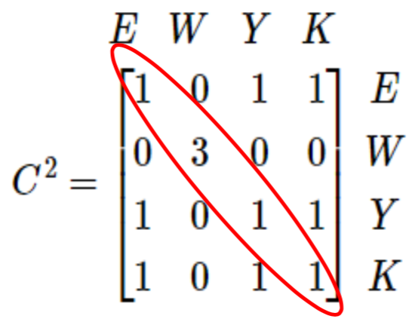
All of the non-zero elements in the leading diagonal of a communication matrix, or its powers, represent redundant links in the matrix.
However, all of the remaining non-zero elements represent meaningful two-step communication links.
For example, the 1 in row Y, column K represents the two-step communication link that enables Yumi to send a message to Kim.

Slide 11
The total number of one step and two-step communication links
If we want to find the total number of one step and two-step communication links we calculate the matrix:
SUMMARY
𝑻 = 𝑪 + $C^{2}$

Slide 12
Analysing communication matrices
A communication matrix (𝐶) is a square binary matrix in which the 1s are used to identify the direct (one-step) links in the communication system.
The number of two-step links in a communication system can be identified by squaring its communication matrix.
The total number of one and two-step links in a communication system can be found by evaluating the matrix sum 𝑇=𝐶+$C^{2}$.
Note: In all cases, the non-zero diagonal elements of a communication matrix (or its power) represent redundant communication links.

Slide 13
Dominance matrix
Is a square binary matrix in which 1s represent one-step dominance between members of a group. The same approach as communication networks can be used to analyse problems.

Slide 14
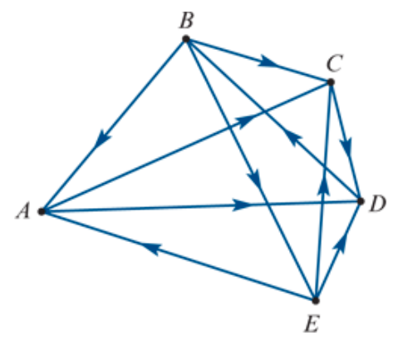
Dominance
For example, five players – Anna, Birgit, Cas, Di and Emma – played in a round-robin tournament of tennis to see who was the dominant (best) player.
The results were as follows:
Anna defeated Cas and Di. (A→C, A→D)
Birgit defeated Anna, Cas and Emma (B→A, B→C, B→E)
Cas defeated Di (C→D)
Di defeated Birgit (D→B)
Emma defeated Anna, Cas and Di (E→A, E→C, E→D).
We can use a network diagram to display the results graphically, as shown above. In this diagram, the arrow from 𝐵 to 𝐴 tells us that, when they played, Birgit defeated Anna.
Both Birgit and Emma had three wins each so there is a tie. How can we resolve this situation and see who is the best player? One way of doing this is to calculate a dominance score for each player. We do this by a constructing a series of dominance matrices.
Notes:
A round-robin tournament is one in which each of the participants play each other once.

Slide 15
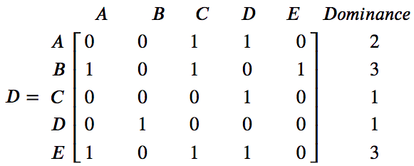
One-step dominances
The first dominance matrix, 𝐷, records the number of one-step dominances between the players.
For example, Anna has a one-step dominance over Cas because, when they played, Anna beat Cas.
This matrix can be used to calculate a one-step dominance score for each player, by summing each of the rows of the matrix. According to this analysis, 𝐵 and 𝐸 are equally dominant with a dominance score of 3.

Slide 16
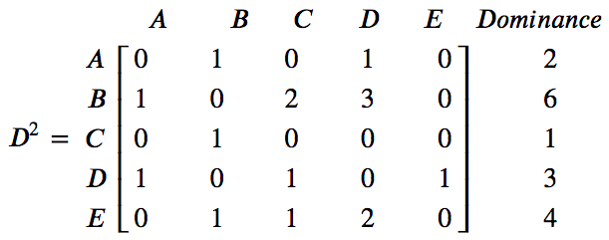
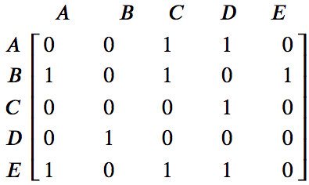
Two-step dominances
$$×$$
$$=$$
$$\begin{matrix}1 \\ 0 \\ \begin{aligned}1 \\ 0 \\ 1\end{aligned}\end{matrix}$$
$$\begin{matrix}[1 & 0 & 1 0 1]\end{matrix}$$
$$×$$
$=$ 1$×1 +0×0 +1×1 +0×0 +1×1 =3$
A two-step dominance occurs when a player beats another player who has beaten someone else. For example, Birgit has a two-step dominance over Di because Birgit defeated Cas who defeated Di.
The first product of 1×1 corresponds to: B → A → D.
The third product of 1×1 corresponds to: B → C → D.
The fifth product of 1×1 corresponds to: B → E → D.

Slide 17
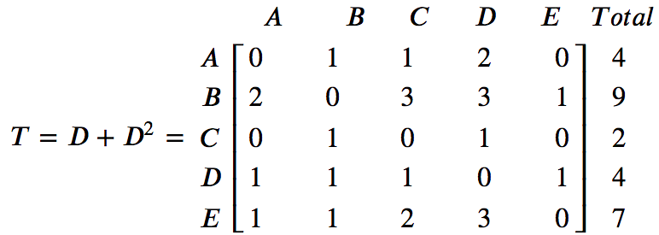
Total dominance scores
We can combine the information contained in both 𝐷 and $D^{2}$ by calculating a new matrix 𝑇=𝐷+ $D^{2}$.
Using these total dominance scores:
Birgit is the top-ranked player with a total dominance score of 9
Eva is second with a total score of 7
Anne and Di are equal third with a total score of 4
Cas is the bottom-ranked player with a total score of 2.

Slide 18
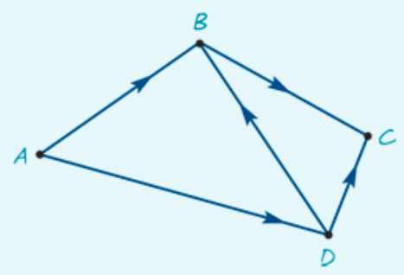
Determining dominance
Four people, 𝐴,𝐵,𝐶 and 𝐷, have been asked to form a committee to decide on the location of a new toxic waste dump.
From previous experience, it is known that:
𝐴 influences the decisions of 𝐵 and 𝐷
𝐵 influences the decisions of 𝐶
𝐶 influences the decisions of no one
𝐷 influences the decisions of 𝐶 and 𝐵.
1. Use the graph to construct a dominance matrix that takes into account both one-step and two-step dominances.
2. From this matrix, determine who is the most influential person on the committee.

Slide 19
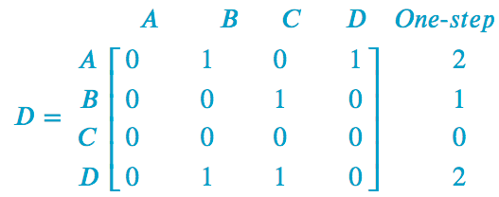
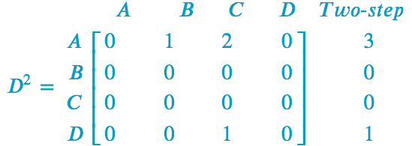
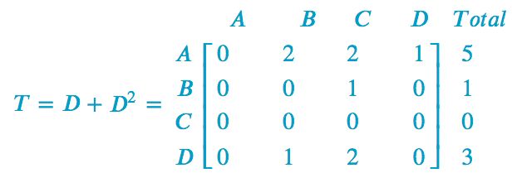
Determining dominance
1. Use the graph to construct a dominance matrix that takes into account both one-step and two-step dominances.
2. From this matrix, determine who is the most influential person on the committee.
Person 𝐴 is the most influential person with a total dominance score of 5.

Slide 20
CAS Calculator
CAS Notes 7.8

