Slide 1
8B Graphs, networks and matrices
Lesson 8B
Notes:
https://www.transum.org/software/SW/Starter_of_the_day/students/Anagrams.asp?Level=2

Slide 2
Learning Intentions
Graphs, networks and matrices

Slide 4
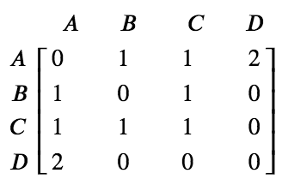
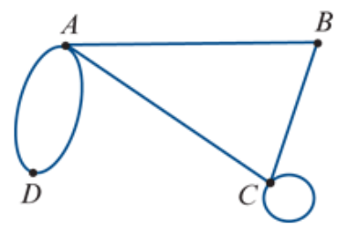
Adjacency matrices
An adjacency matrix is a square matrix that uses a zero or an integer to record the number of edges connecting each pair of vertices in the graph.
0
1
2
$$e_{1}$$
$$e_{2}$$
1

Slide 5
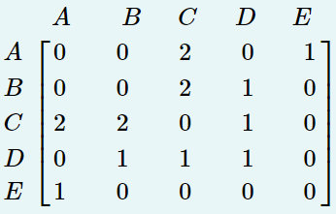
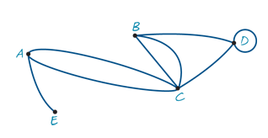
Drawing a graph from an adjacency matrix
A
C
E
D
B

Slide 6
Adjacency matrices
The adjacency matrix A of a graph is an n×n matrix in which, for example, the entry in row C and column F is the number of edges joining vertices C and F.
A loop is a single edge connecting a vertex to itself.
Loops are counted as one edge.

Slide 8
exercises & Summary Book
1. Ex8B Q3,4,6,9,10,15
2. Summary notes for Homework.

