Slide 1
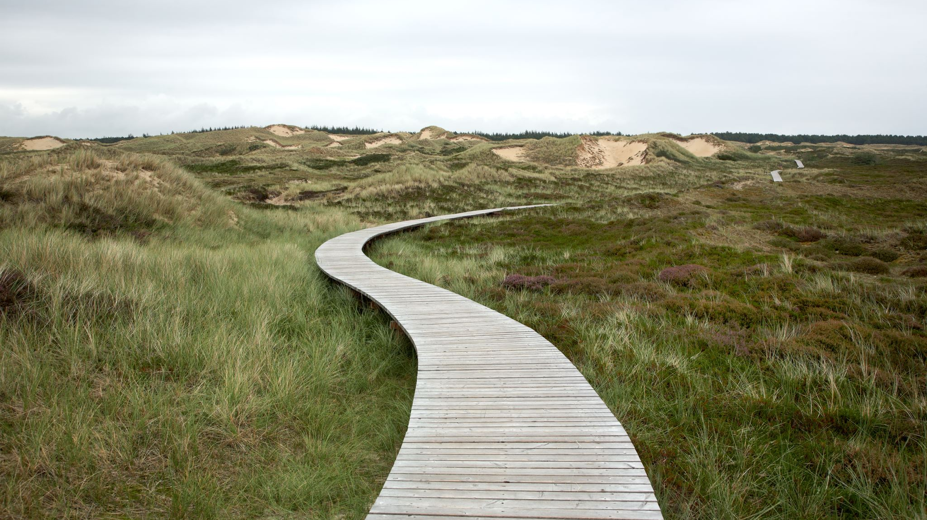
Exploring and travelling problems
8C

Slide 2
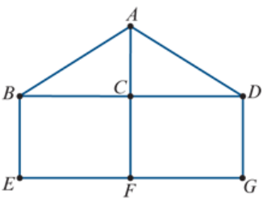
Learning Intentions
Walk
Trail
Path
Circuit
Cycle

Slide 3
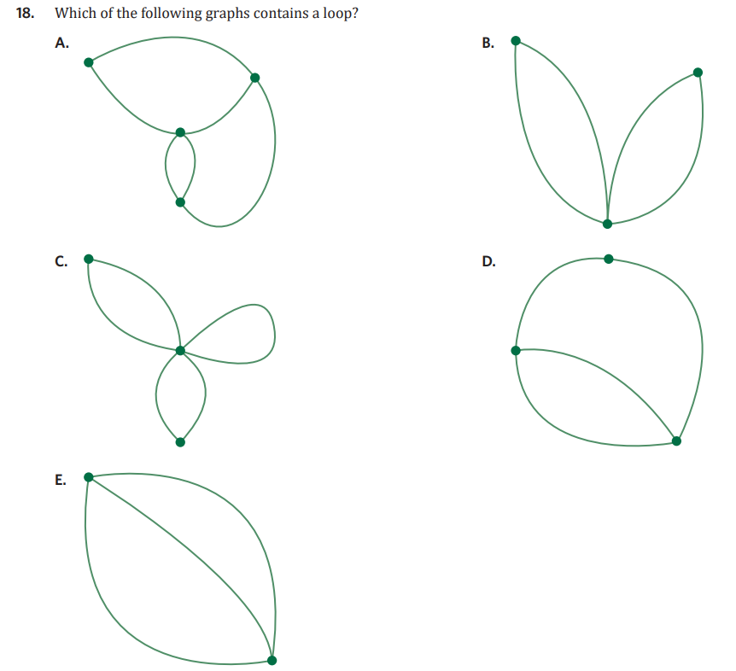

Slide 4

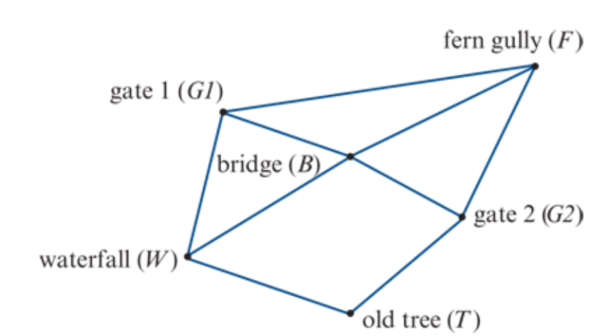
Practical problems
Practical problems: designing a postal delivery route or solving the Königsberg bridge problem.
To solve such problems you will need to know about a number of concepts

Slide 5
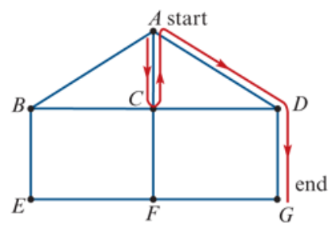
Walk
Start
A walk is a sequence of edges, linking successive vertices, that connects two different vertices in a graph.
The red line in the graph opposite traces out a walk. This walk can be written down by listing the vertices in the order they are visited: A−C−A−D−G.
Finish

Slide 6
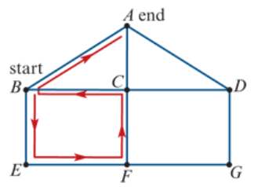
Trail
Finish
A trail is a walk with no repeated edges.
The red line in the graph opposite traces out a trail. This trail can be written down by listing the vertices in the order they are visited: B−E−F−C−B−A.
Note: There are no repeated edges in this trail, but one vertex (B) is repeated.
Start

Slide 7
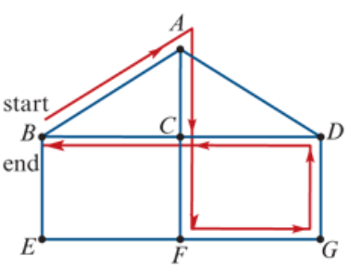
Circuit
A circuit is a trail (no repeated edges) that starts and ends at the same vertex. Circuits are also called closed trails.
The red line in the graph opposite traces out a circuit. This circuit can be written down by listing the vertices in the order they are visited: A−C−F−G−D−C−B−A.
Note: There are no repeated edges in this circuit, but one vertex, C, is repeated. The start and end vertices are also repeated because of the definition of a circuit.
Start
Finish

Slide 8
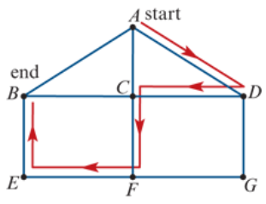
Path
Start
A path is a walk with no repeated edges and no repeated vertices.
The red line in the graph opposite traces out a path. This path can be written down by listing the vertices in the order they are visited: A−D−C−F−E−B.
Finish

Slide 9
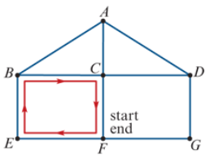
Cycle
A cycle is a path (no repeated edges, no repeated vertices) that starts and ends at the same vertex. The start and end vertex is an exception to repeated vertices. Cycles are also called closed paths.
The red line in the graph opposite traces out a cycle. This cycle can be written down by listing the vertices in the order they are visited: F−E−B−C−F.
Note: There are no repeated edges and no repeated vertices in this cycle, except for the start and end vertices.
Start
Finish

Slide 10
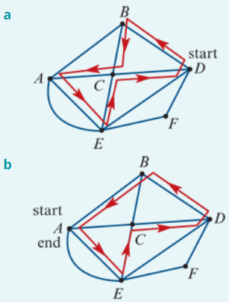
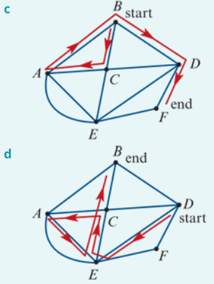
Identifying types of walks
Circuit
Cycle
Trail
Walk

Slide 11
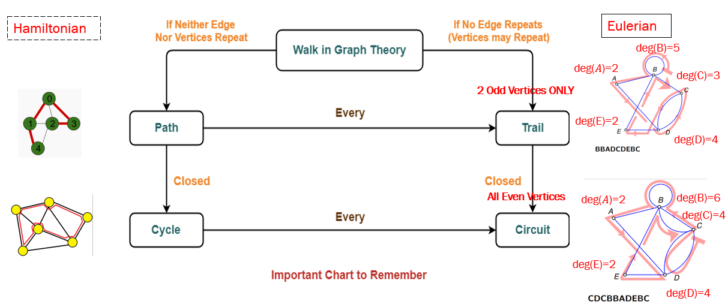

Slide 12
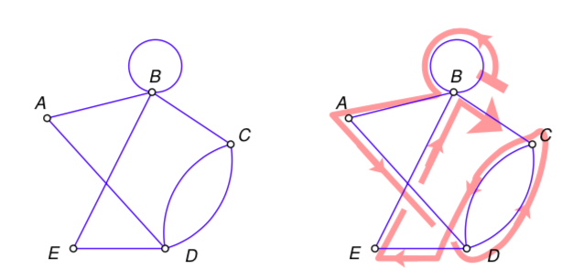
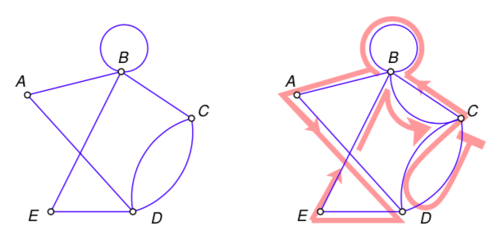
Eulerian trails and circuits
An Eulerian trail is a trail that includes every edge in a graph.
An Eulerian circuit is a circuit that includes every edge in a graph.
An Eulerian trail starts and ends at different vertices.
An Eulerian circuit starts and ends at the same vertex.
An Eulerian trail: BBADCDEBC
An Eulerian circuit: CDCBBADEBC

Slide 13
The Criterion for Eulerian trails
Only traversable graphs
If a graph has an Eulerian trail, then it must have exactly two odd vertices.
Or, to put it another way,
If the number of odd vertices in a graph is anything other than 2, then the graph cannot have an Eulerian trail.

Slide 14

The Criterion for Eulerian Circuits
Only traversable graphs
If a graph has an Eulerian circuit, then all of its vertices must be even vertices.
Or, to put it another way,
If the number of odd vertices in a graph is anything other than 0, then the graph cannot have an Eulerian circuit.

Slide 15
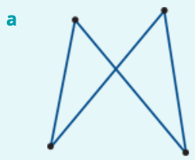
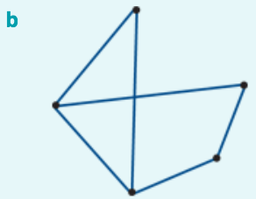
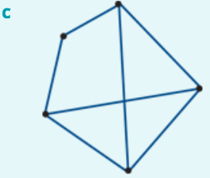

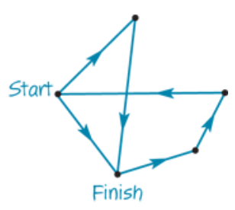
Identifying Eulerian trails and circuits
deg(𝐴)=2
deg(B)=2
deg(𝐴)=2
deg(𝐴)=3
deg(E)=2
deg(B)=2
deg(E)=3
deg(B)=3
deg(D)=3
deg(C)=2
deg(D)=2
deg(C)=2
deg(D)=3
deg(C)=3
Neither: more than two odd vertices
Eulerian circuit: all even vertices
Eulerian trail: two odd vertices, the rest even.

Slide 16
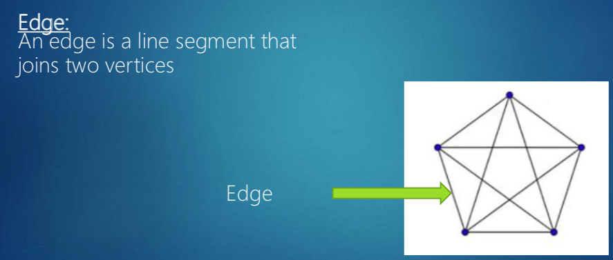
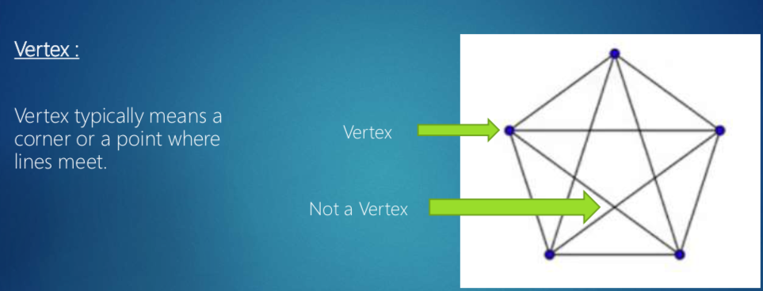
Difference between Euler & Hamilton
Eulerian trails and circuits focus on edges.
Hamiltonian paths and cycles focus on vertices.

Slide 17
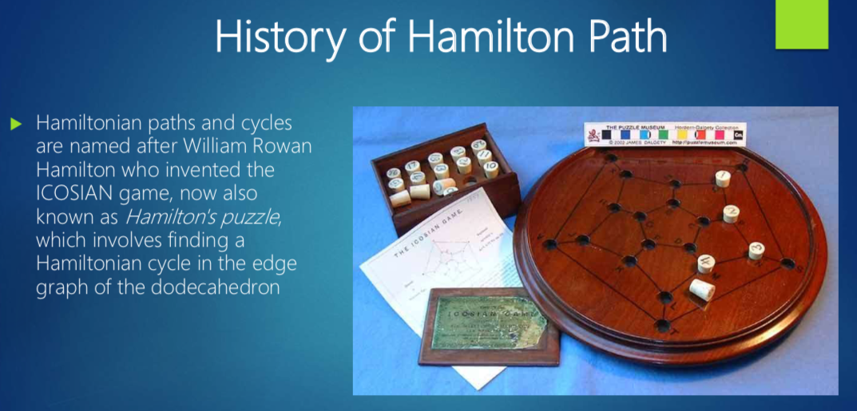

Slide 18
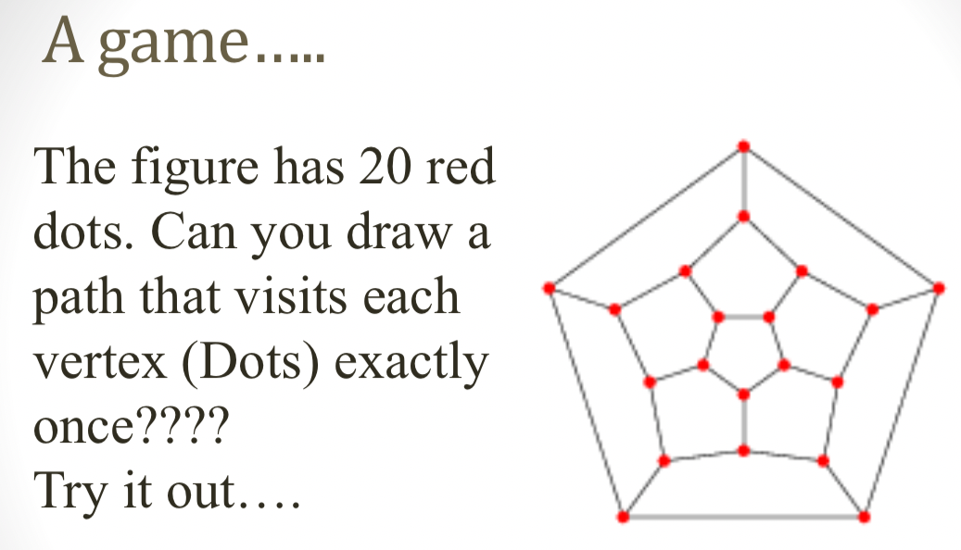

Slide 19
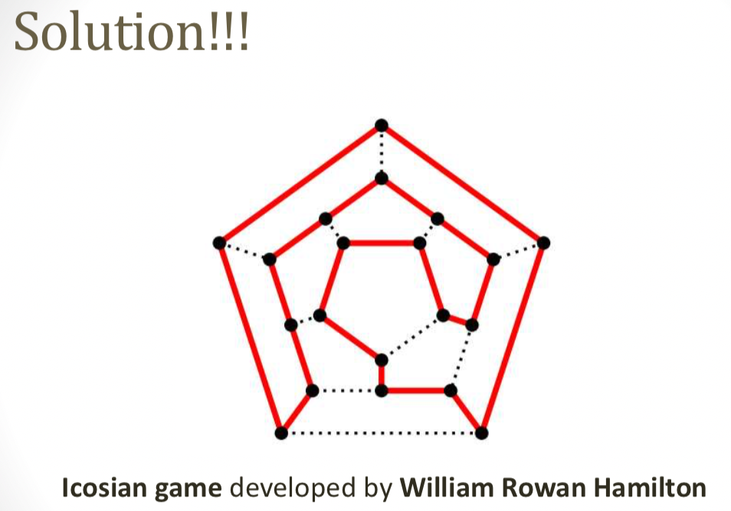

Slide 20
Hamiltonian paths and cycles
A Hamiltonian path passes through every vertex in a connected graph. It may or may or may not involve all of the edges in the graph.
A Hamiltonian cycle is a Hamiltonian path that starts and finishes at the same vertex.

Slide 21
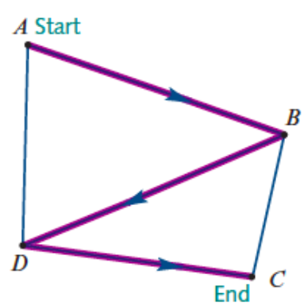
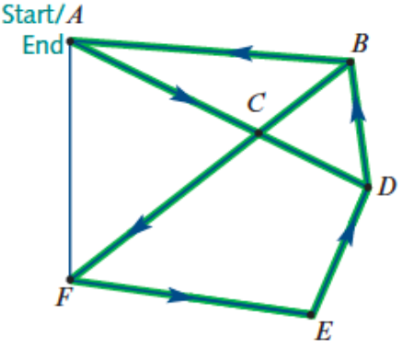
Hamiltonian path: 𝐴-𝐵-𝐷-𝐶
Hamiltonian cycle: 𝐴-𝐶-𝐹-𝐸-𝐷-𝐵-𝐴

Slide 22
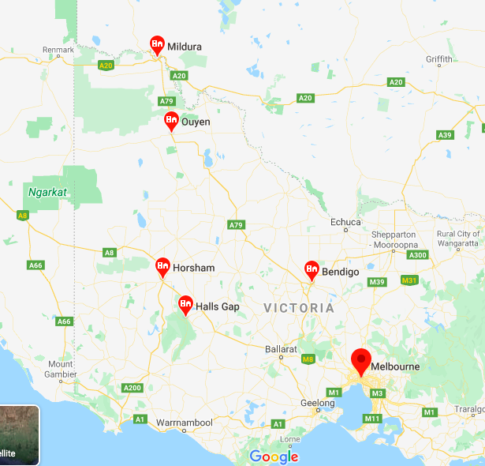
Applications of Hamiltonian paths
Hamiltonian paths You plan a trip from Melbourne to Mildura, with visits to Bendigo, Halls Gap, Horsham, Stawell and Ouyen on the way, but do not want to visit any town more than once.

Slide 23
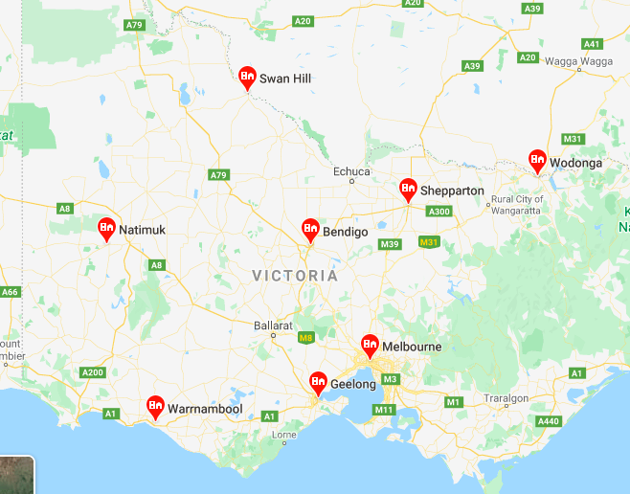
Applications of Hamiltonian cycles
A courier leaves her depot to make a succession of deliveries to a variety of locations before returning to her depot. She does not like to go past each location more than once.
A tourist plans to visit all of the historic sites in a city without visiting each more than once.
You are planning a trip from Melbourne to visit Shepparton, Wodonga, Bendigo, Swan Hill, Natimuk, Warrnambool and Geelong before returning to Melbourne. You don’t want to visit any town more than once.

Slide 24
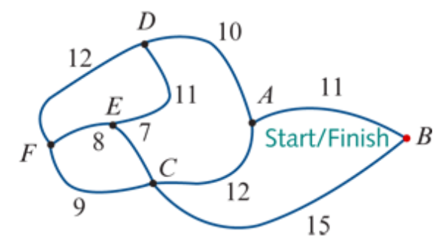
Finding Hamilton Cycle
A
C
B
D
C
A
E
F
E
F
F
B
E
A
D
F
F
D
F
E
C
D
E
A
F
D
C
A
B
D
C
A-D-E-F-C-B-A
A-B-C-F-E-D-A
A-D-F-E-C-B-A
A-B-C-E-F-D-A
B
A
A
A
E
D
D
E
C
A
B
A
F
A
A
E
D
A
B
A
A
A
A

