Slide 1
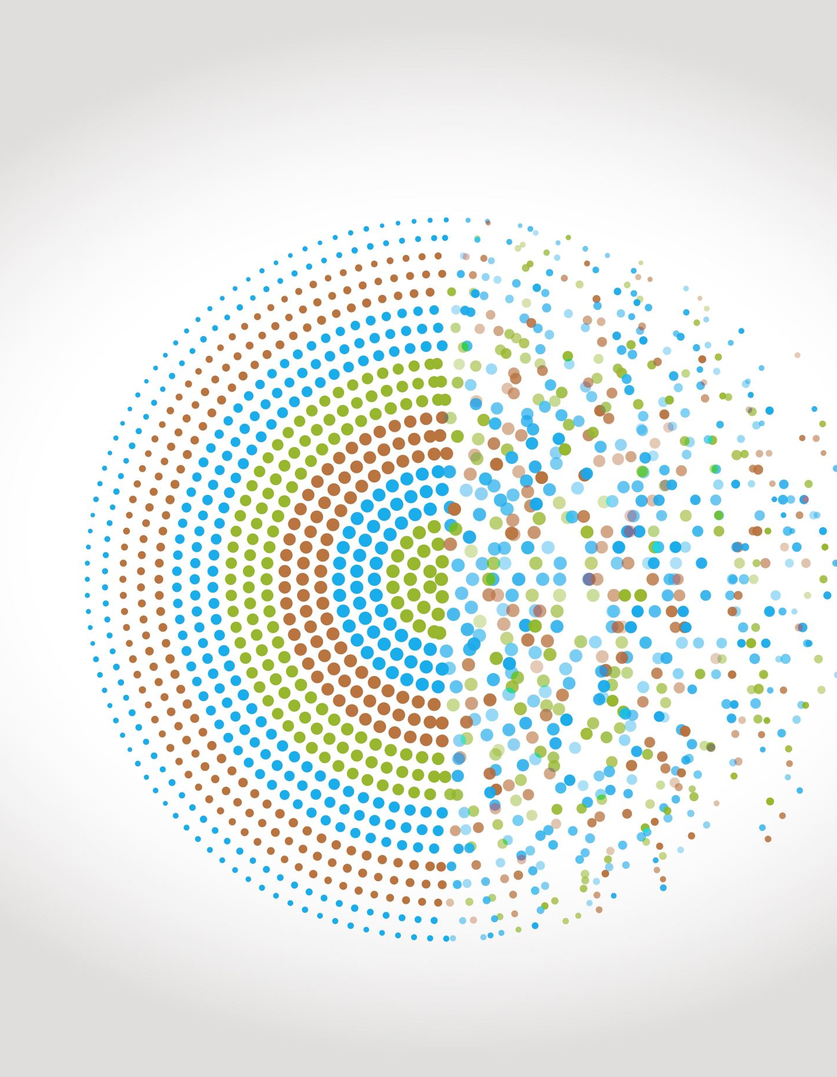
Reducing balance depreciation – recurrence relations
5C
https://dashboard.blooket.com/set/6507923af3eb74a0c98b08c8
https://play.blooket.com/host?id=6747882db8d55150a13895dc
https://play.blooket.com/host?id=67478ccf9d40e5f58c69de67
https://dashboard.blooket.com/set/630c42e0aa05729fcc13c31d

Slide 3
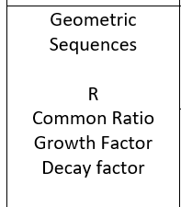
Reducing-balance depreciation
Reducing-balance depreciation is another method of depreciation – one where the value of an asset decays geometrically. Each year, the value will be reduced by a percentage, 𝑟%, of the previous year’s value. The calculations are very similar to compounding interest, but with decay in value, rather than growth.

Slide 4
A recurrence model for reducing balance depreciation
Let $V_{n}$ be the value of the asset after 𝑛 years.
Let 𝑟 be the annual percentage depreciation.
The recurrence model for the value of the investment after 𝑛 years is:
$V_{0}$ = initial value, $V_{n+1}$ =𝑅 $V_{n}$ where 𝑅=1$−\frac{r}{100}$

Slide 5
Modelling reducing-balance depreciation with recurrence relations
The following recurrence relation can be used to model the value of office furniture with a purchase price of $6900, depreciating at a reducing-balance rate of 7% per annum.
$V_{0}$ =6900, $V_{n+1}$ =0.93× $V_{n}$
In the recurrence relation, $V_{n}$ is the value of the office furniture after 𝑛 years.
1. Use the recurrence relation to find the value of the office furniture, correct to the nearest cent, after 1, 2 and 3 years.
1. $V_{0}$ =6900
$V_{1}$ =0.93×6900=6417
$V_{2}$ =0.93×6417=5967.81
$V_{3}$ =0.93×5967.81=5550.06

Slide 6
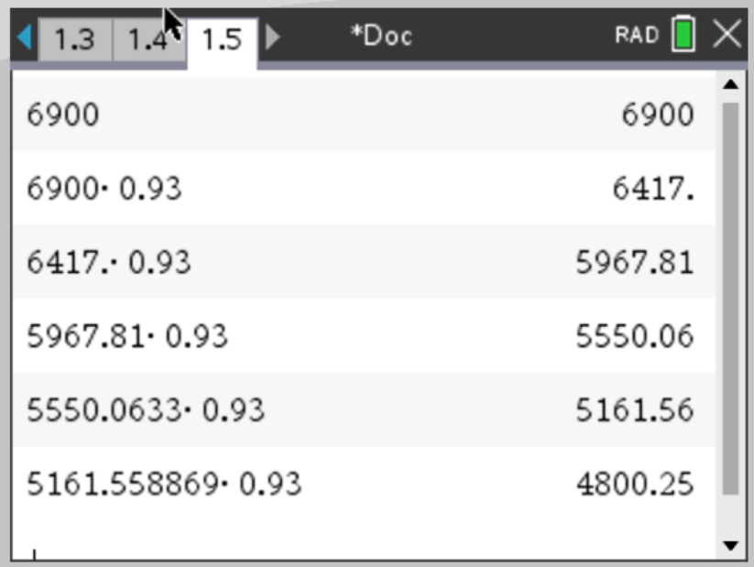
Modelling reducing-balance depreciation with recurrence relations
The following recurrence relation can be used to model the value of office furniture with a purchase price of $6900, depreciating at a reducing-balance rate of 7% per annum.
$V_{0}$ =6900, $V_{n+1}$ =0.93× $V_{n}$
In the recurrence relation, $V_{n}$ is the value of the office furniture after 𝑛 years.
2. Determine when the value of the investment will first be less than $5000.
CAS Notes 5.6
2. The value of the furniture drops below $5000 after 5 years.
CAS Notes 6.16.5

Slide 7
Modelling reducing-balance depreciation with recurrence relations
The following recurrence relation can be used to model the value of office furniture with a purchase price of $6900, depreciating at a reducing-balance rate of 7% per annum.
$V_{0}$ =6900, $V_{n+1}$ =0.93× $V_{n}$
In the recurrence relation, $V_{n}$ is the value of the office furniture after 𝑛 years.
3. Write down the recurrence relation if the furniture was initially valued at $7500 and is depreciating at a reducing-balance rate of 8.4% per annum.
3. $V_{0}$ =7500
Calculate the value or 𝑅. The depreciation rate is 8.4% per annum.
𝑅=1−$\frac{8.4}{100}$ or 𝑅=0.916
$V_{0}$ =7500, $V_{n+1}$ =0.916× $V_{n}$

