Slide 1
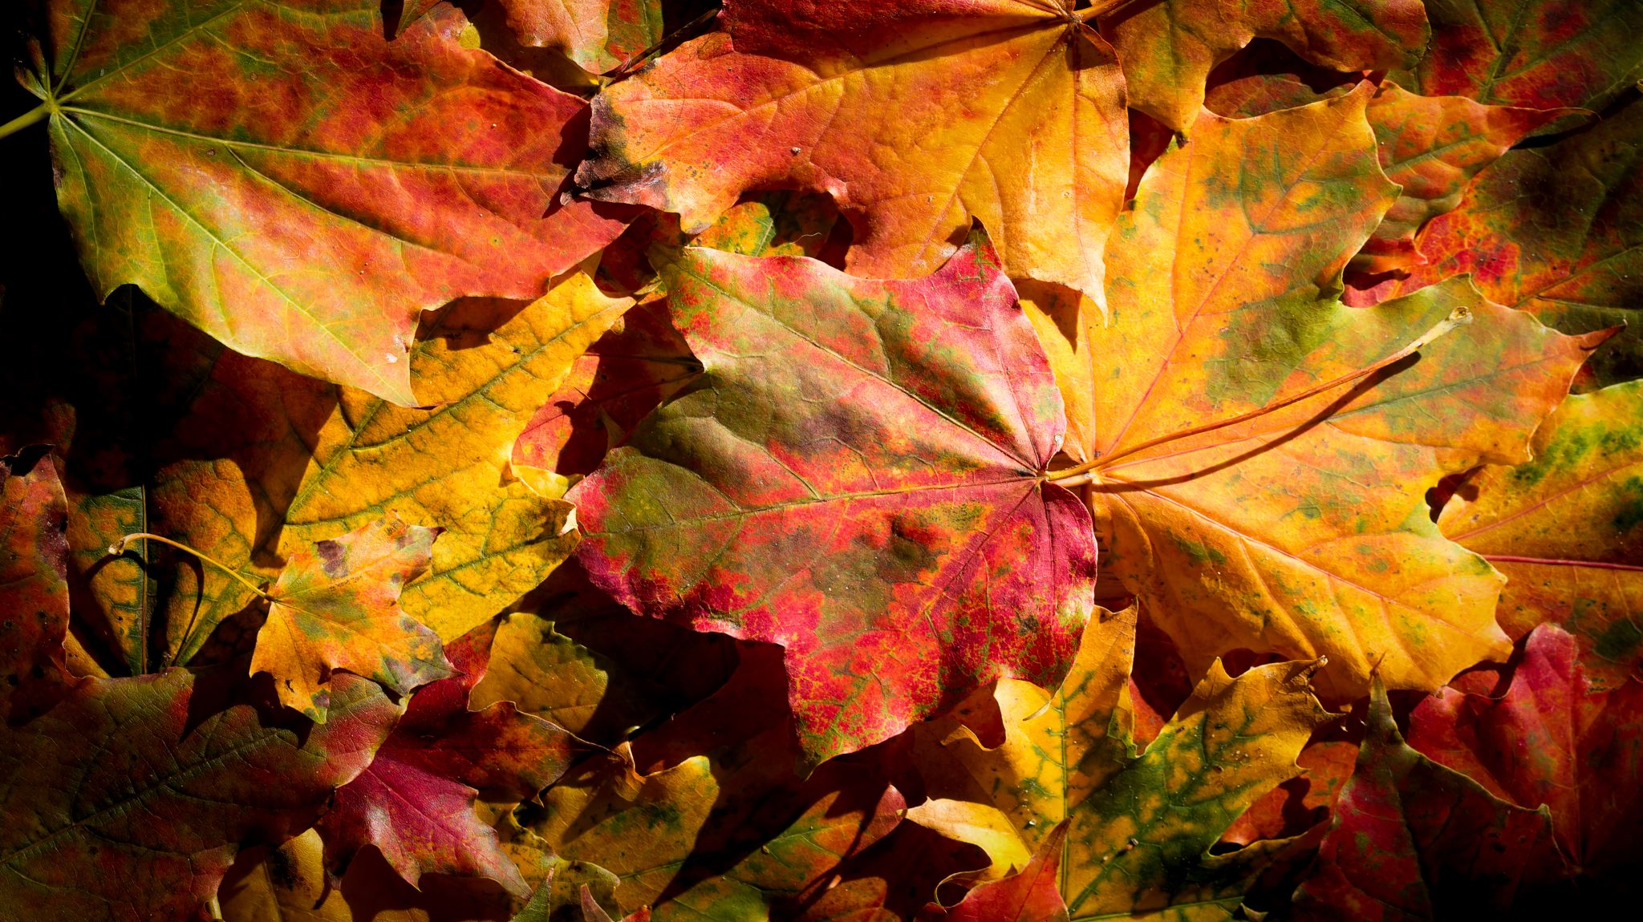
Simple interest
5E
Notes:
2,4,5,8,9,12

Slide 2
Starter =2 marks

Slide 3
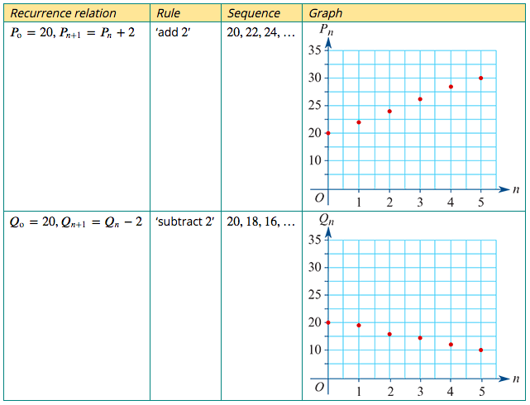
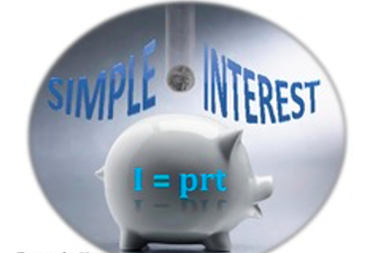
A recurrence model for linear growth and decay
The recurrence relations: $P_{0}$=20, $P_{n+1}$= $P_{n}$+ 2 $Q_{0}$=20, $Q_{n+1}$= $Q_{n}−$ 2
linear growth
Model and investigate simple interest loans and investments, as well as flat rate depreciation and unit cost depreciation of assets
linear decay

Slide 4
Simple interest growth
Let $V_{n}$ be the value of the loan or investment after 𝑛 years.
Let 𝑟 be the percentage interest rate.
The recurrence relation for the value of the loan or investment after 𝑛 years is
$V_{0}$ = principal, $V_{n+1}$ = $V_{n}$ +𝐷
where 𝐷=$\frac{\text{r}}{100}$× $V_{0}$.
Sometimes higher-level Q’s
r = $\frac{D\text{×}100}{V_{0}}$OR $V_{0}$ = $\frac{D\text{×}100}{\text{r}}$

Slide 5
Modelling a simple interest with a recurrence relation
Cheryl invests $5000 in an investment account that pays 4.8% per annum simple interest.
Model this simple investment using a recurrence relation of the form:
$V_{0}$ = principal, $V_{n+1}$ = $V_{n}$ +𝐷 where 𝐷=$\frac{\text{r}}{100}$× $V_{0}$.
𝑉𝑛 is the value of the investment after 𝑛 years.
$V_{0}$ =5000
𝑟=4.8%
𝐷=$\frac{4.8}{100}$×5000=240
$V_{0}$ =5000, $V_{n+1}$ = $V_{n}$ +240.

Slide 6
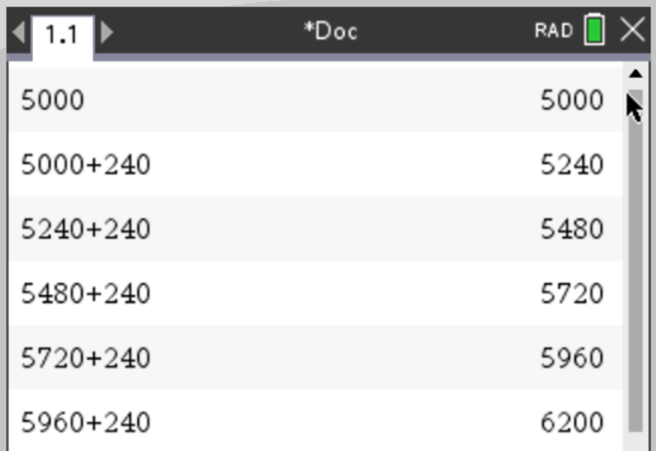
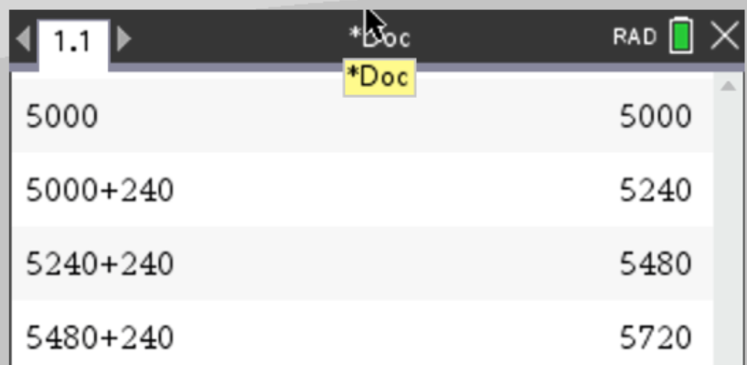
Using a recurrence relation to analyse a simple interest investment
Cheryl’s simple interest investment is modelled by
$V_{0}$ =5000, $V_{n+1}$ = $V_{n}$ +240.
where $V_{n}$ is the value of the investment after 𝑛 years.
a. Use the model to determine the value of Cheryl’s investment after 3 years.
b. When will Cheryl’s investment first exceed $6000, and what will its value be then?
CAS Notes 5.2
a. $5720
b. After 5 years; $6200.

Slide 7
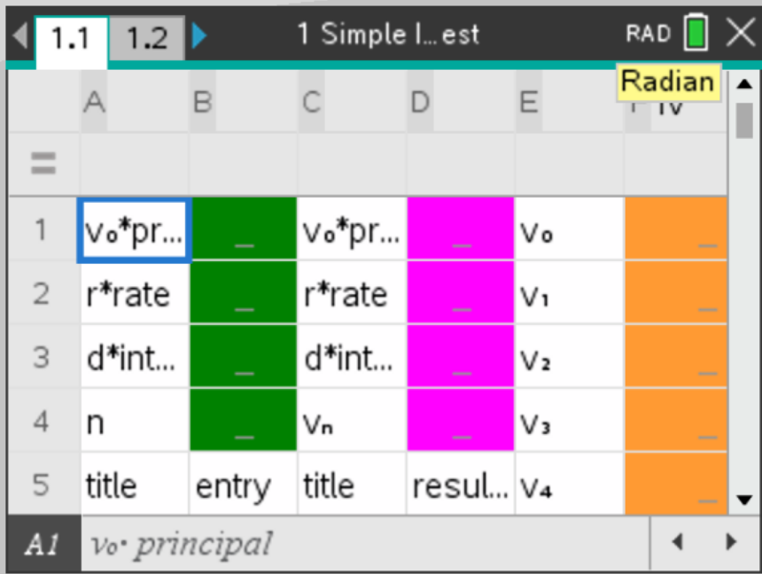
Using a recurrence relation to analyse a simple interest investment
Cheryl’s simple interest investment is modelled by
$V_{0}$ =5000, $V_{n+1}$ = $V_{n}$ +240.
where $V_{n}$ is the value of the investment after 𝑛 years.
a. Use the model to determine the value of Cheryl’s investment after 3 years.
b. When will Cheryl’s investment first exceed $6000, and what will its value be then?
CAS Notes 6.16.1
Green area=input
Pink & Orange= output
a. $5720
b. After 5 years; $6200.

Slide 8
Modelling simple interest using a rule
Joan invests $5000 in an account paying a simple interest rate of 4.5% per year.
a. Construct a rule that will calculate the value of the investment, $V_{n}$, after n years.
D =$\frac{r}{100}×v_{0}$ = $\frac{4.5}{100}×5000$= 225
$V_{n}$ =5000+n*225 Or $V_{n}$ = $5000$+225n
b. Use the rule to calculate the value of the investment after five years.
$V_{5}$ = $5000$+225*5 = $ 6125.00
a. $V_{n}$ = $5000$+225n
b. After 5 years; $6125.

