Slide 1
Minimum connector problems
8D
Notes:
2-5, 7, 9, 10

Slide 2
Learning Intentions
Tree
Spanning Trees
Minimum Spanning Trees
Prim’s Algorithm

Slide 3
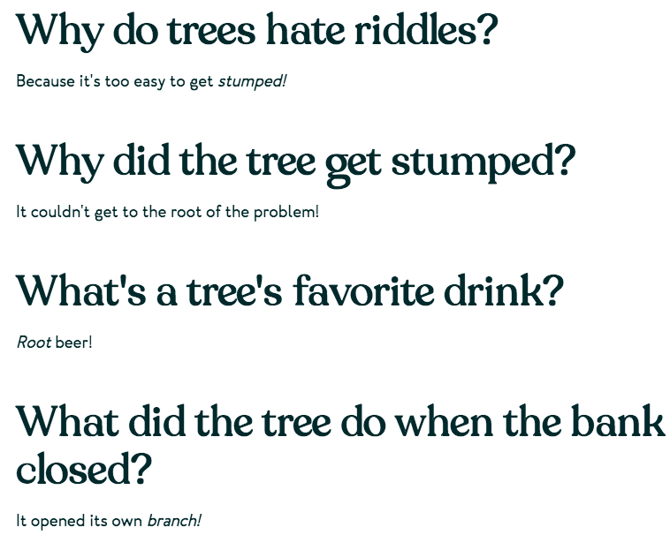

Slide 4
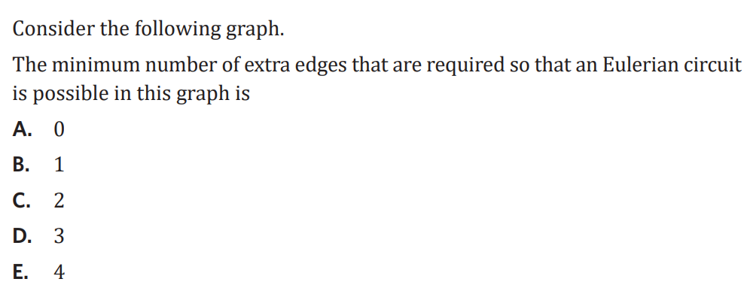
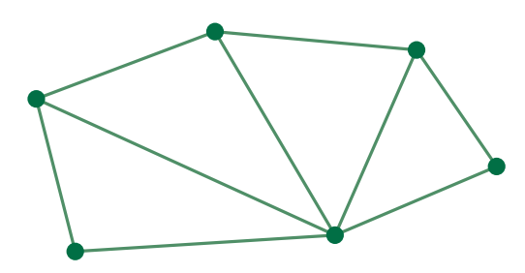
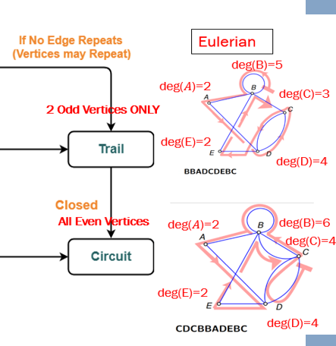
3
3
3
2
2
5

Slide 6
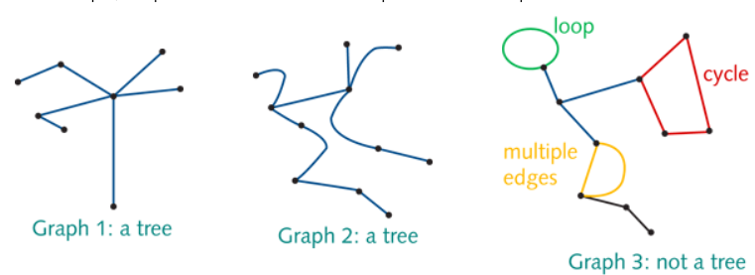
Tree
A connected graph that contains no cycles, multiple edges or loops. A tree may be part of a larger graph.
Graph 1, a tree, has 8 vertices and 7 edges.
Graph 2, a tree, has 11 vertices and 10 edges.

Slide 7
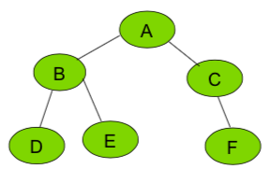
Rule connecting the number of edges of a graph to the number of vertices
A tree with 𝑛 vertices has 𝑛−1 edges.

Slide 8
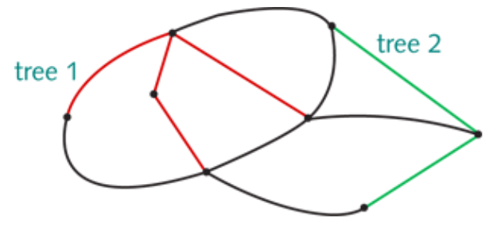
every connected graph contains one or more trees

Slide 9
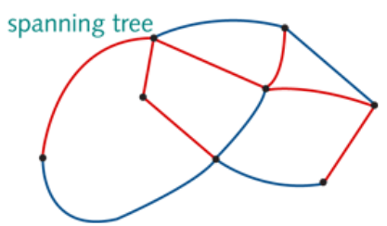
Spanning trees
A spanning tree is a tree that connects all of the vertices in a connected graph.
8 vertices. 8−1=7 edges

Slide 10
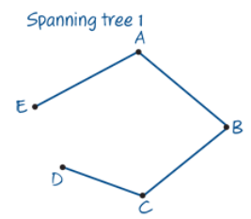
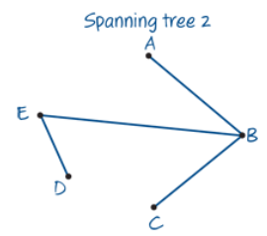
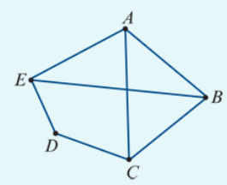
Finding a spanning tree in a network
Find two spanning trees for the graph shown below right corner.
The graph has 5 vertices and 7 edges. A spanning tree will have 5 (𝑛) vertices and 4 (𝑛−1) edges.
To form a spanning tree, remove any 3 edges, provided that:
All the vertices remain connected; There are no multiple edges or loops.

Slide 11
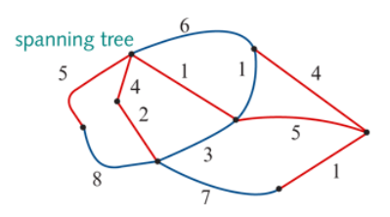
Minimum spanning tree
A minimum spanning tree = the spanning tree of minimum length (may be minimum distance, minimum time, minimum cost, etc.). There may be more than one minimum spanning tree in a weighted graph.
For weighted graphs or networks, it is possible to determine the ‘length’ of each spanning tree by adding up the weights of the edges in the tree.
For the spanning tree shown here:
Length=5+4+2+1+5+4+1=22 units

Slide 12
Prim’s algorithm for finding a minimum spanning tree
Choose a starting vertex (any will do). Inspect the edges starting from this vertex and choose the one with the lowest weight. (If two edges have the same weight, the choice can be arbitrary.)
Next, inspect the edges starting from the vertices. Choose the edge with the lowest weight.
Repeat the process until all the vertices are connected and then stop. The result is a minimum spanning tree.

Slide 13
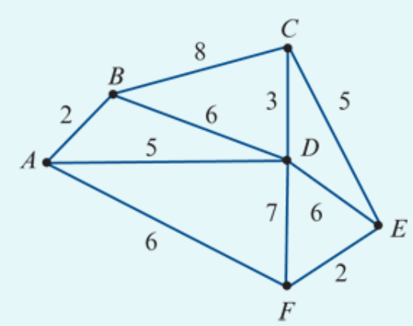
Applying Prim’s algorithm
Apply Prim’s algorithm to obtain a minimum spanning tree for the network shown and calculate its length.
Minimum spanning tree
Length =2+5+3+5+2=17 units

Slide 14
Connector problems
Minimum spanning trees represent the least weight required to keep all of the vertices connected in the graph. If the edges of a graph represent the cost of connecting towns to a gas pipeline, then the total weight of the minimum spanning tree would represent the minimum cost of connecting the towns to the gas. This is an example of a connector problem, where the cost of keeping towns or other objects connected together is important to make as low as possible.

Slide 15
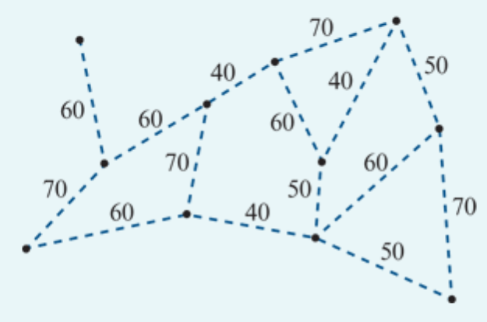
Solving a connector problem
At a showgrounds, 11 locations require access to water. These locations are represented by vertices on the network diagram shown. The dashed lines on the network diagram represent possible water pipe connections between adjacent locations. The numbers on the dashed lines show the minimum length of pipe, in metres, required to connect these locations.
On the diagram, show where these water pipes will be placed.
Calculate the total length, in metres, of water pipe that is required.

