Slide 1
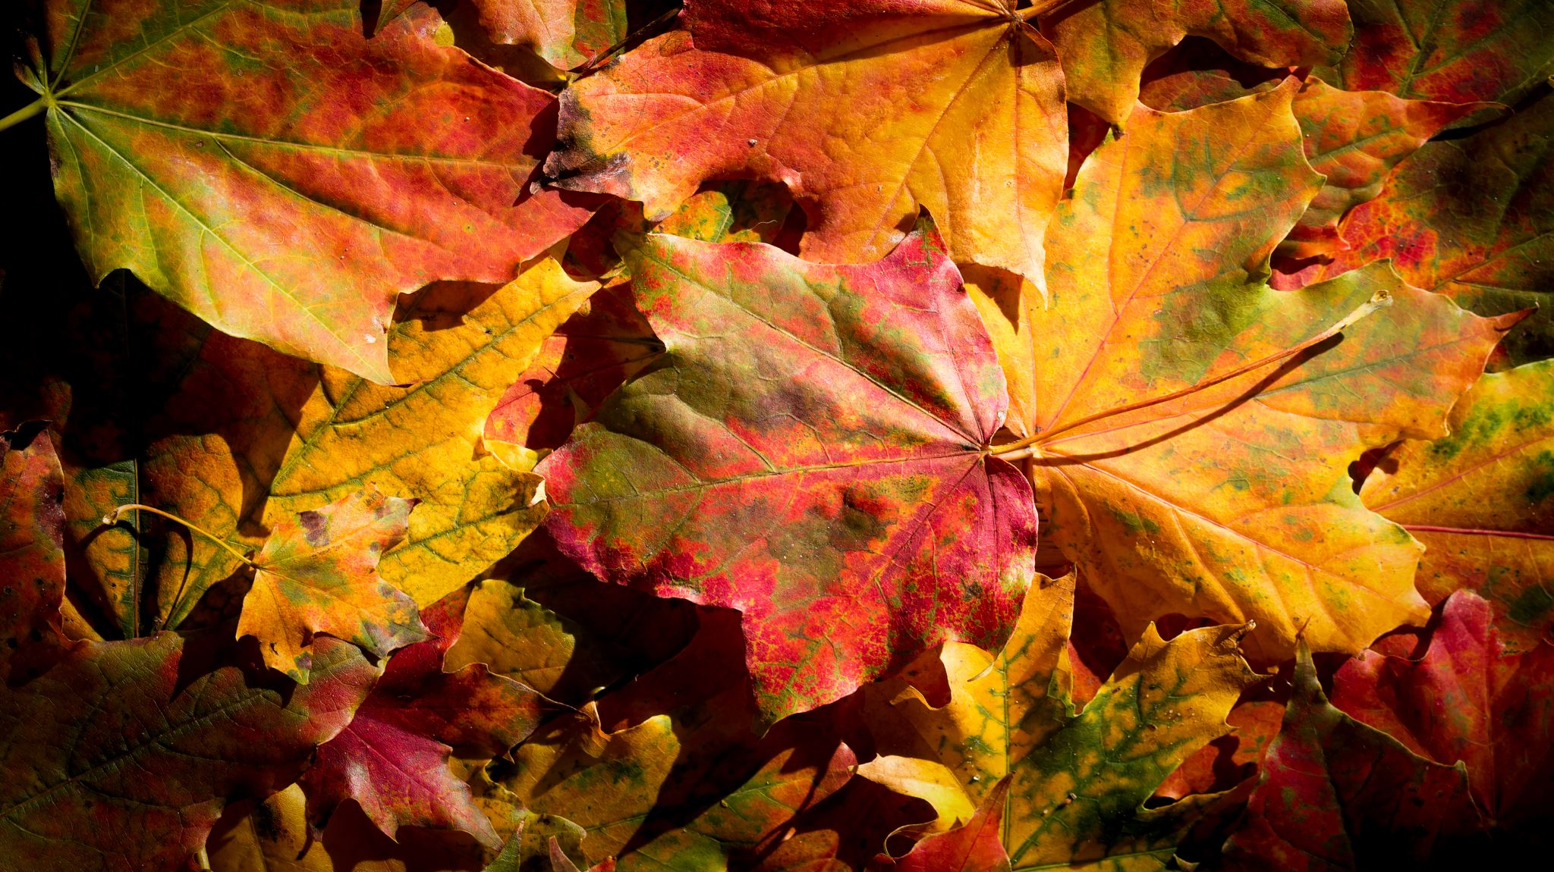
Flat rate and unit cost depreciation – recurrence relations
5B

Slide 2
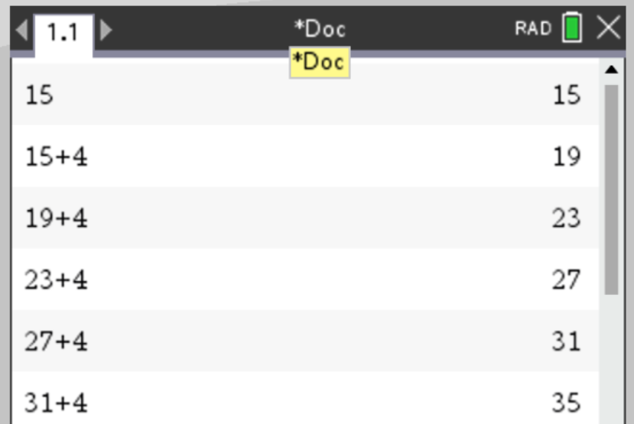
Starter =2 marks
CAS Notes 5.1

Slide 3
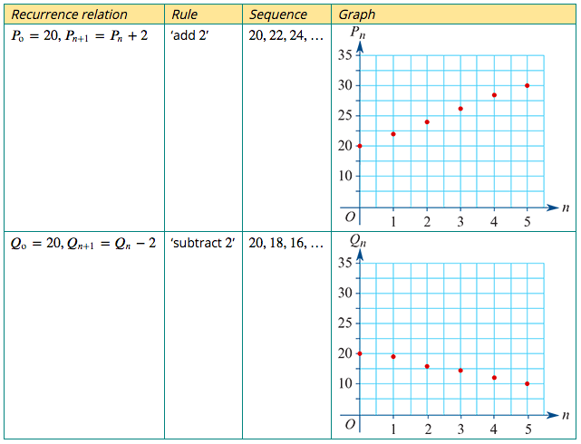
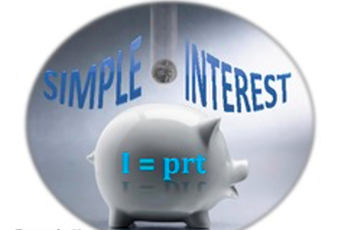
A recurrence model for linear growth and decay
The recurrence relations: $P_{0}$=20, $P_{n+1}$= $P_{n}$+ 2 $Q_{0}$=20, $Q_{n+1}$= $Q_{n}−$ 2
linear growth
Model and investigate simple interest loans and investments, as well as flat rate depreciation and unit cost depreciation of assets
linear decay

Slide 4
Depreciation: the reduction in value of an item over time
After a certain amount of time, or when the value of an item is depreciated to a certain amount, called its scrap value, the item will be sold or disposed of.
Flat-rate depreciation
Depreciation where the value of an item is reduced by the same amount every year. Equivalent/opposite to Simple Interest.
Unit-cost depreciation
Depreciation based on how many units have been produced/consumed by the object being depreciated. For example, a machine filling bottles of drink maybe depreciated by 0.001 cents per bottle it fills.

Slide 5
Recurrence model for flat-rate depreciation
Let $V_{n}$ be the value of the asset after 𝑛 years.
Let 𝑟 be the percentage depreciation rate.
The recurrence relation for the value of the asset after 𝑛 years is
$V_{0}$ = initial value of the asset, $V_{n+1}$ = $V_{n}$ $−$𝐷
where 𝐷=$\frac{\text{r}}{100}$× $V_{0}$.
Sometimes higher-level Q’s
r = $\frac{D\text{×}100}{V_{0}}$OR $V_{0}$ = $\frac{D\text{×}100}{\text{r}}$

Slide 6
Modelling flat rate depreciation with a recurrence relation
A new car was purchased for $24000 in 2014. The car depreciates by 20% of its purchase price each year. Model the depreciating value of this car using a recurrence relation of the form:
$V_{0}$ = initial value of the asset, $V_{n+1}$ = $V_{n}$ $−$𝐷 where 𝐷=$\frac{\text{r}}{100}$× $V_{0}$.
$V_{n}$ is the value of the car after n years depreciation.
$V_{0}$ =24000
𝑟=20%
𝐷= $\frac{\text{20}}{100}$×24000=4800
$V_{0}$ =24000, $V_{n+1}$ = $V_{n}$ $−$4800

Slide 7
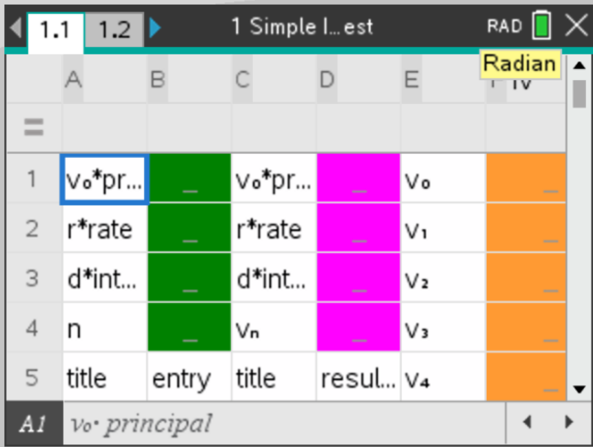
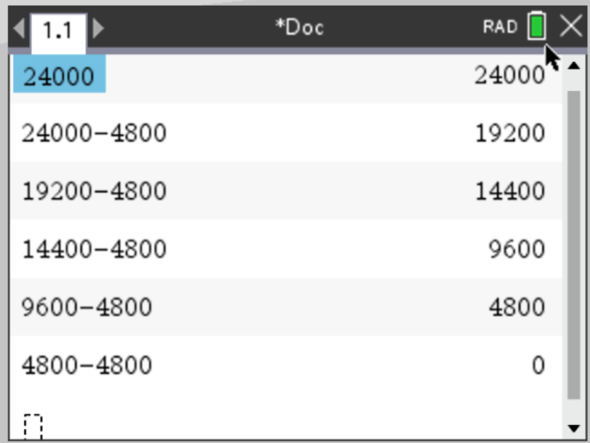
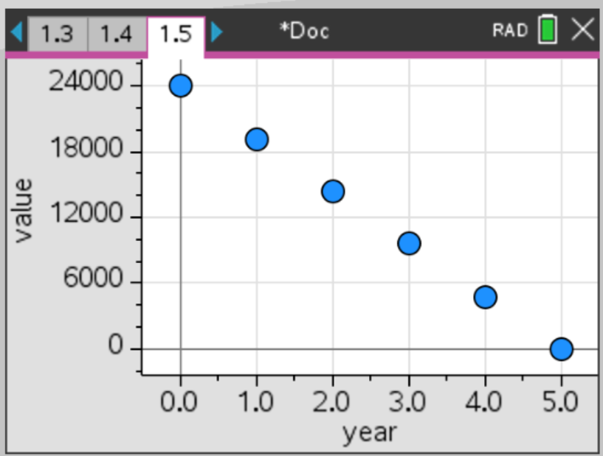
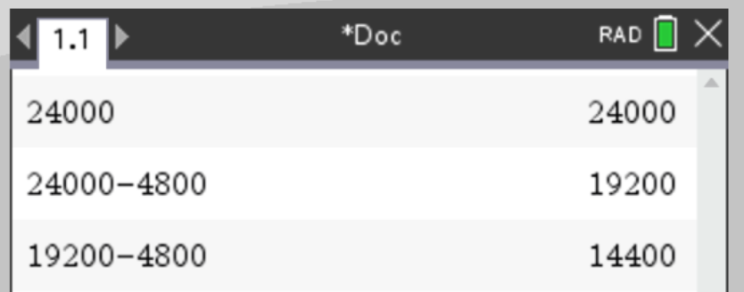
Using a recurrence relation to analyse flat rate depreciation
CAS Notes 5.3
The flat rate depreciation of a car is modelled by
$V_{0}$ =24000, $V_{n+1}$ = $V_{n}$ $−$4800
where $V_{n}$ is the value of the car after 𝑛 years.
a. Use the model to determine the value of the car after 2 years.
b. If the car was purchased in 2014, in what year will the car’s value depreciate to zero?
CAS Notes 6.16.2
Green area=input
Pink & Orange= output
a. $14400.
b. In 2019, after 5 years depreciation

Slide 8
Recurrence model for unit-cost depreciation
Let $V_{n}$ be the value of the asset after 𝑛 units of use.
Let D be the the cost per unit of use.
The recurrence relation for the value of the asset after 𝑛 units of use is
$V_{0}$ = initial value of the asset, $V_{n+1}$ = $V_{n}$ $−$𝐷

Slide 9
Modelling unit cost depreciation with a recurrence relation
A professional gardener purchased a lawn mower for $270. The mower depreciates in value by $3.50 each time it is used.
Model the depreciating value of this mower using a recurrence relation of the form:
$V_{0}$ = initial value of the asset, $V_{n+1}$ = $V_{n}$ $−$𝐷 where 𝐷= the depreciation in value per use
$V_{n}$ is the value of the mower after being used to mow n lawns.
$V_{0}$=270
𝐷=3.50
$V_{0}$=270, $V_{n+1}$ = $V_{n}$ $−$3.50

Slide 10
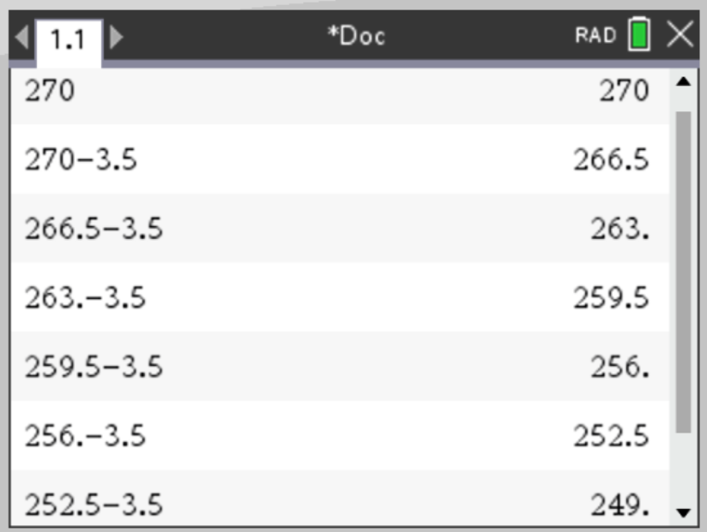
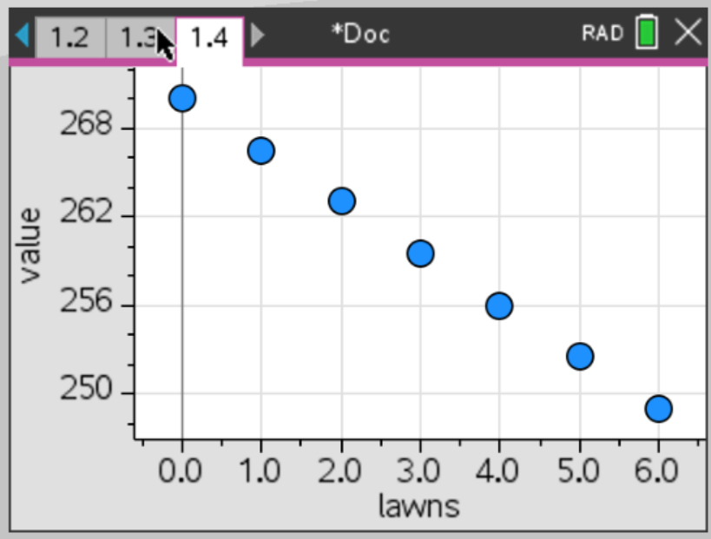
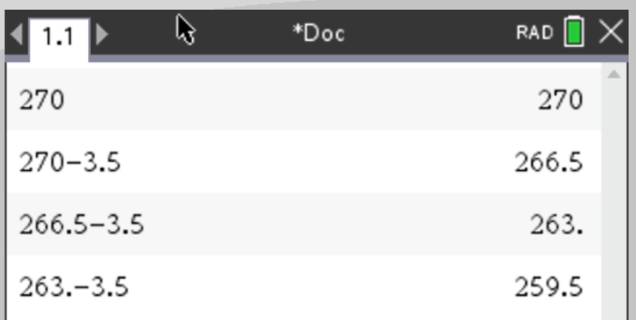
Using a recurrence relation to analyse unit cost depreciation
CAS Notes 5.4
The depreciated value of the lawn mower is modelled by
$V_{0}$=270, $V_{n+1}$ = $V_{n}$ $−$3.50
where $V_{n}$ is the value of the mower after being used to mow 𝑛 lawns.
a. Use the model to determine the value of the mower after it has been used three times.
b. How many times can the mower be used before its depreciated value is less than $250?
CAS Notes 6.16.3
$259.50
After six mows

