Slide 1
📱 Mobile Phone Use (or not)
During Class Time:
➡ 1st offence: Turn it off and put it away. ➡2nd offence: Time out process followed (you may be returning to class quickly!). Phone placed in a safe (Assistant Principal’s Office or Community Office) until the end of the day. ➡If you refuse: You will be sent home immediately and receive a one-day suspension.
During Recess & Lunchtime:
➡ You’ll be asked to turn it off and put it away. ➡If you refuse: Your phone will go in a safe until the end of the day. ➡If you refuse again: You will be sent home immediately and receive a one-day suspension.
Notes:
Feedback:
Set clear boundaries with classes and stick to them.
If students have their bags on the tables and are hiding behind them, I’d be suspicious. Again, go back to the boundaries and stick to them.
No one wants to be the weak link. Students have commented where they are seeing staff not following this. Losing that relational trus

Slide 2
Change is hard:
Who set a New Years Resolution?
What strategies help and hinder your own goal setting?

Slide 3
Change is difficult!
The Stats:
92% of people fail to achieve their New Year’s resolutions
Only 16% of managers feel their employees effectively set and achieve goals – Poor goal-setting skills aren’t just a student issue!
Strategies:
People are 42% more likely to achieve their goals if they write them down
Social support increases motivation by 78%
Having a specific accountability appointment boosts success to 95%
Students who set specific, challenging goals perform 30% better than those with vague or no goals

Slide 4
Step 1: Identify the Goal (Desired Change)
Goal: "I will improve my attendance to 90% this semester.“
Step 2: Identify Driving Forces (Things that Encourage Improvement)
Supportive Family
Engaging Classes
Peer Influence
Clear Academic Goals
Teacher Support
Step 3: Identify Restraining Forces (Things that Prevent or Hinder Attendance)
Health Issues
Lack of Motivation
Sleep Issues
Transportation Problems
Personal or Family Issues
Peer Pressure

Slide 5
Example Force Field Analysis for Improving Attendance:
Driving Forces | Restraining Forces
- Supportive family and friends | - Health issues (frequent illness)
- Engaging and interesting classes | - Lack of motivation for school
- Desire to improve grades | - Difficulty waking up in the morning
- Teachers who offer extra help | - Transportation issues
- Peer accountability (friends) | - Personal/family challenges

Slide 6
1. Green Light (Go) - Positive actions and strategies
Set Specific, Measurable Goals:
Example: "I will attend 90% of my classes this semester."
Focus on Time Management:
Example: "I will wake up 30 minutes earlier every school day to avoid being late."
Build Positive Habits:
Example: "I will track my attendance weekly to ensure I’m meeting my goal."
Create a Routine:
Example: "I will prepare my school bag the night before to reduce morning stress and improve my chances of getting to school on time."
Seek Support if Needed:
Example: "If I’m feeling overwhelmed, I’ll reach out to a counsellor or teacher for help."

Slide 7
2. Yellow Light (Caution) - Areas to review and improve for more effective goals:
Ensure Goals are Realistic:
Example: "I will attend at least 90% of my classes for the next month".
Break Large Goals into Smaller Steps:
Example: "I will focus on improving attendance one week at a time and track my progress."
Monitor and Adjust Regularly:
Example: "I will check my attendance every two weeks and adjust my routine as needed."
Incorporate Strategies for Overcoming Barriers:
Example: "If I miss class due to illness, I will make sure to catch up on homework within two days."

Slide 8
3. Red Light (Stop) - Goals or behaviours that should be avoided:
Unrealistic Goals:
Example: "I will never miss school again" might set students up for failure if unforeseen circumstances arise. It's better to aim for improvement without the pressure of perfection.
Setting Goals Without Reflection:
Example: "I’ll just go to school every day without thinking about why I might miss."
Not Tracking Progress:
Example: "I won’t track my attendance or progress."
If you don’t track their progress, you might not notice when things go wrong or when you’re off track. Tracking is a key part of improving attendance.
Ignoring External Support:
Example: "I’ll just manage my attendance on my own and never talk to anyone."

Slide 9
Mindmap: the current situation
Be sensitive and mindful of ‘triggers’ or shame
Depersonalise the story
Increase empathy and broad cultural lense
Linking barriers to strategies

Slide 10
Mindmap: the current situation
Be sensitive and mindful of ‘triggers’ or shame
Depersonalise the story
Increase empathy and broad cultural lense
Linking barriers to strategies

Slide 11
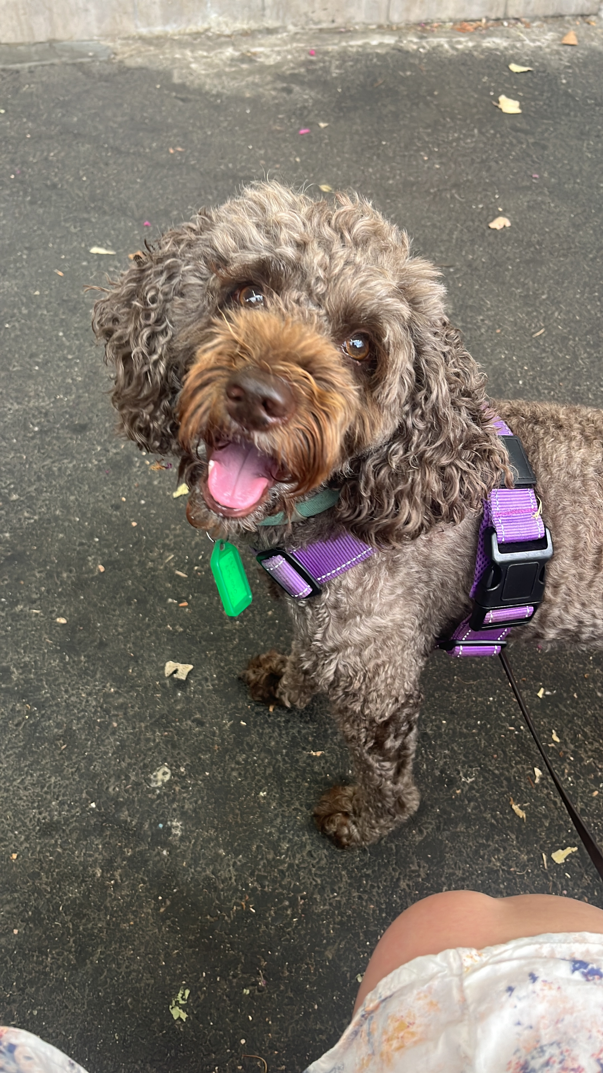
Attendance Goal Setting!
This is what we've been saying at Assemblies and out to the Parent Community:
Consistent attendance is one of the most significant factors in ensuring your success at school
When you’re at school you get:
The opportunity to develop your skills and knowledge to help you later in life
Help and support from teachers and other TC staff
To hang out with friends and classmates
To get involved with all the extra-curricular opportunities at TC
Remember that if you are studying a VCE subject you require a minimum attendance rate of 80% (for each subject)
If you are unwell and unable to attend school:
Reach out to your classroom teachers via Microsoft Teams to find out what work you’ve missed and to ask any questions about it
Talk to your Community Team or the Wellbeing Team if you are finding attending regularly a challenge

Slide 12
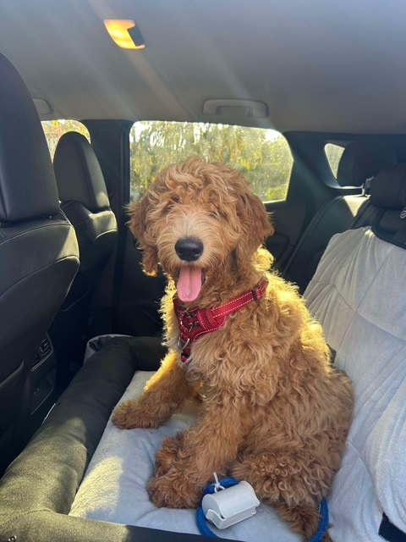
Example SMART goals
"By the end of Semester 1, I will have an attendance level of 95%"
"By the end of Unit 1, I will have an attendance level of over 80% in each of my VCE subjects"
"By the end of Semester 1, I will have attended all of my Period 1 classes on time"
"By the end of term 2, I will attend 90% of my instrumental lessons"
"My attendance is solid, but I leave class every period at least once. By the end of term 2, I will leave class only once a week."
"I tend to skip Connect. By the end of semester, I will attend 3 out of 4 Connect sessions."
“My attendance is actually doing really well, so instead my goal is to engage in classroom discussions. I will ask one question per class.”

Slide 13
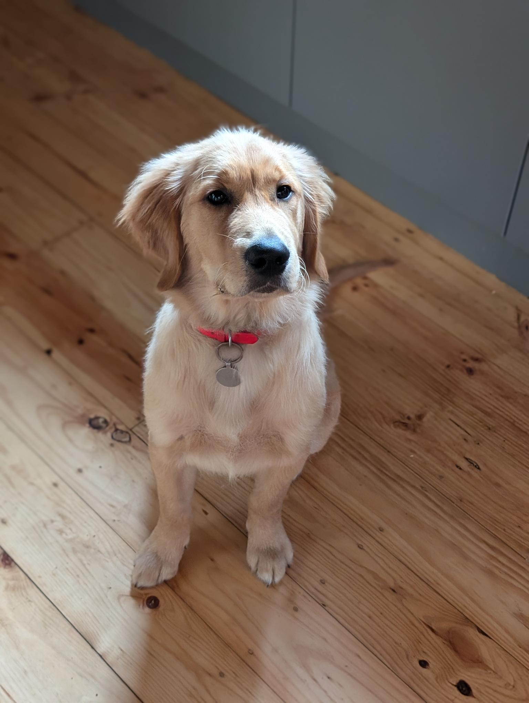
Mechanics of Making Attendance Goals Visible to Students, Parents and Staff
1. After you have gone through Force Field Analysis, then you are using Traffic Light Thinking for the goal creation. When you are ready:
2. You need to message Lyn in Teams chat your goal.
3. Lyn will copy and paste your Attendance Goal into "Attendance Goal Setting”
(See examples)
Notes:
KKAT 10

Slide 14
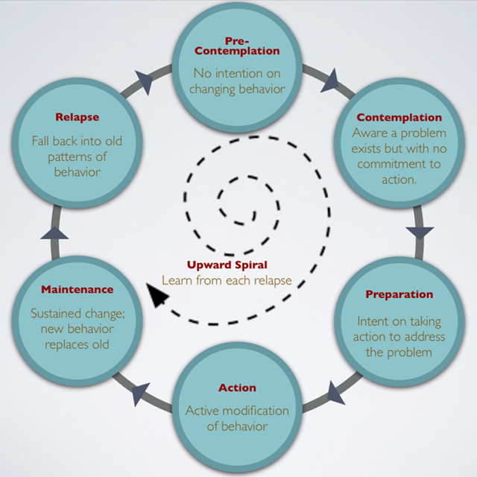

Slide 15
General steps to setting goals
1) What is the current situation?
2) What is a better situation?
3) What are some strategies we could try?
4) Pick a strategy
5) Set a Smart Goal
6) Review and go again…

