Slide 1

Reducing balance loans
6B
Notes:
https://create.kahoot.it/details/7421e2c3-fadc-48a3-b2c8-39ca0e88de17
https://quizizz.com/admin/quiz/63589318c7a75b001da7827c?source=quiz_share
https://quizizz.com/admin/quiz/5e97b45d1fe5c8001be16198?source=quiz_share
https://quizizz.com/admin/quiz/5bf74a64901287001a0c64ae?source=quiz_share

Slide 2
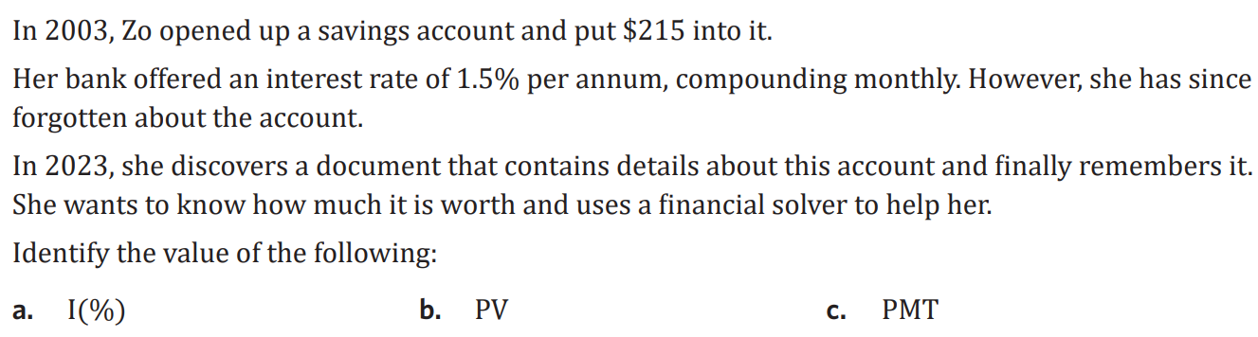

Slide 3
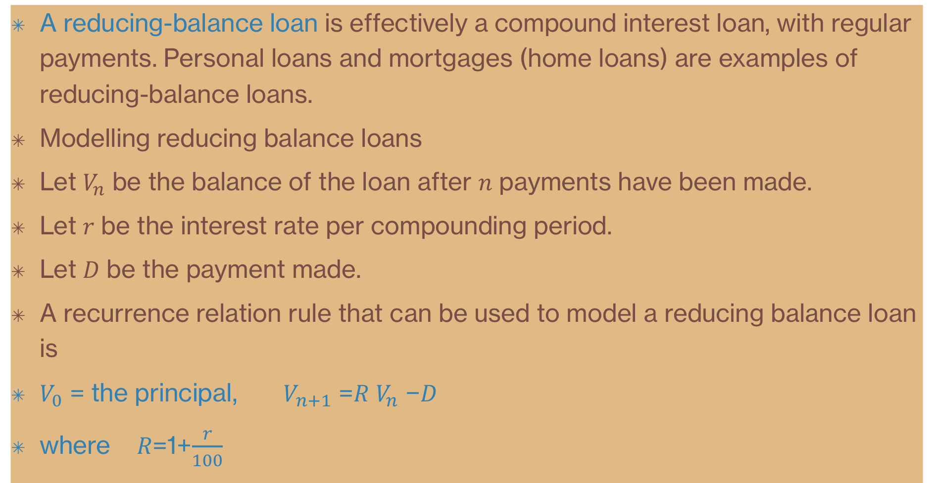
Reducing-balance loans
A reducing-balance loan is effectively a compound interest loan, with regular payments. Personal loans and mortgages (home loans) are examples of reducing-balance loans.
Modelling reducing balance loans
Let $V_{n}$ be the balance of the loan after 𝑛 payments have been made.
Let 𝑟 be the interest rate per compounding period.
Let 𝐷 be the payment made.
A recurrence relation rule that can be used to model a reducing balance loan is
$V_{0}$ = the principal, $V_{n+1}$ =𝑅 $V_{n}$ −𝐷
where 𝑅=1+$\frac{r}{100}$

Slide 4

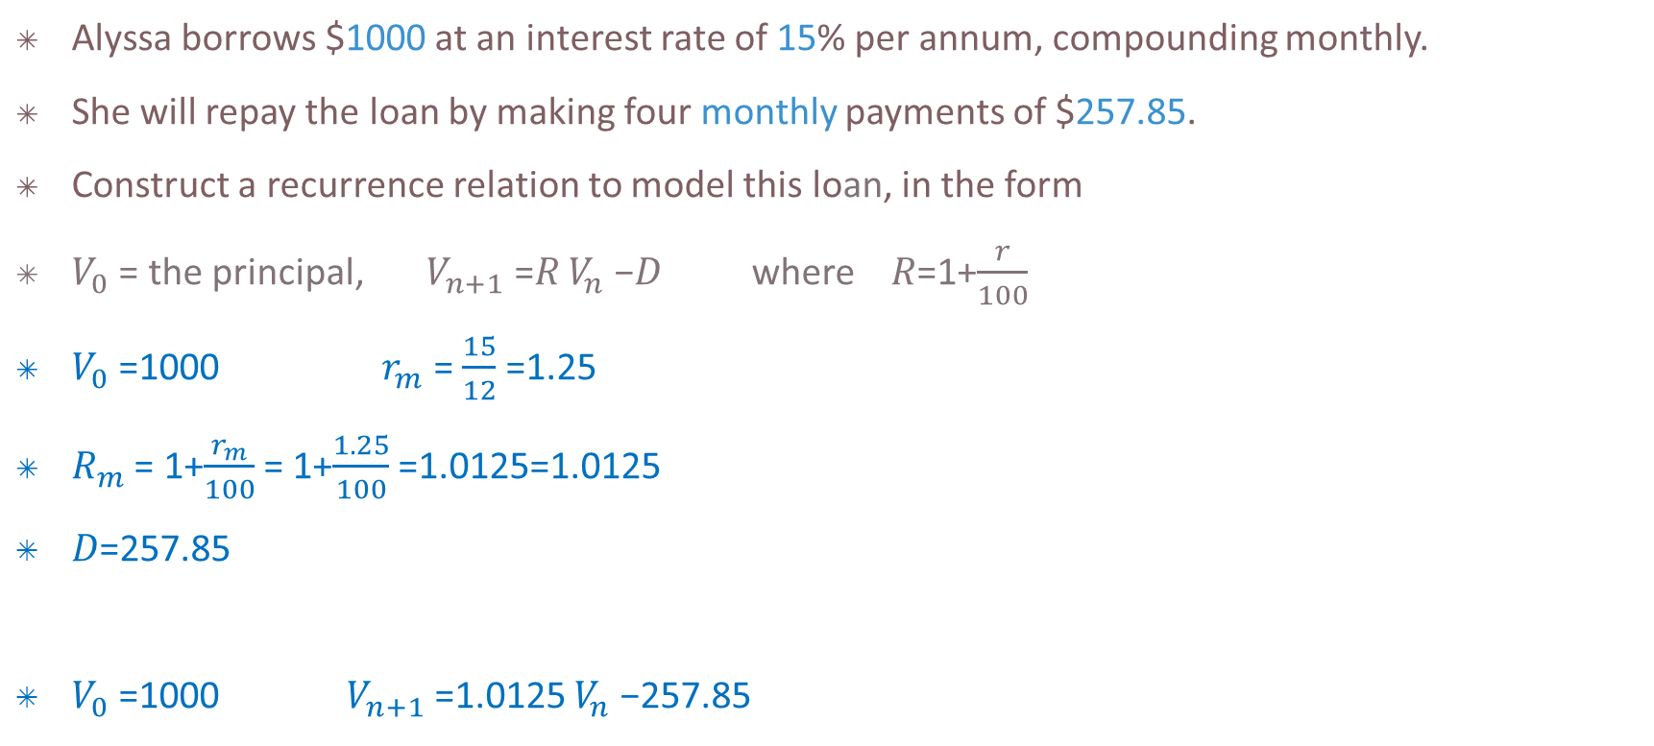
Modelling a reducing-balance loan with a recurrence relation
Alyssa borrows $1000 at an interest rate of 15% per annum, compounding monthly.
She will repay the loan by making four monthly payments of $257.85.
Construct a recurrence relation to model this loan, in the form
$V_{0}$ = the principal, $V_{n+1}$ =𝑅 $V_{n}$ −𝐷 where 𝑅=1+$\frac{r}{100}$
$V_{0}$ =1000 $r_{m}$ = $\frac{15}{12}$=1.25
$R_{m}$ = 1+$\frac{r_{m}}{100}$= 1+$\frac{1.25}{100}$=1.0125=1.0125
𝐷=257.85
$V_{0}$ =1000 $V_{n+1}$ =1.0125 $V_{n}$ −257.85

Slide 5
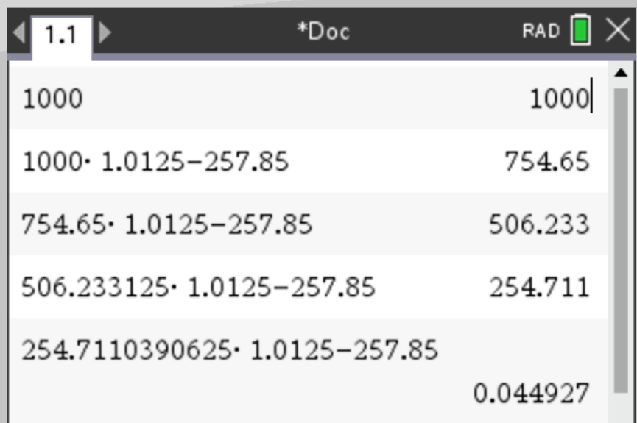
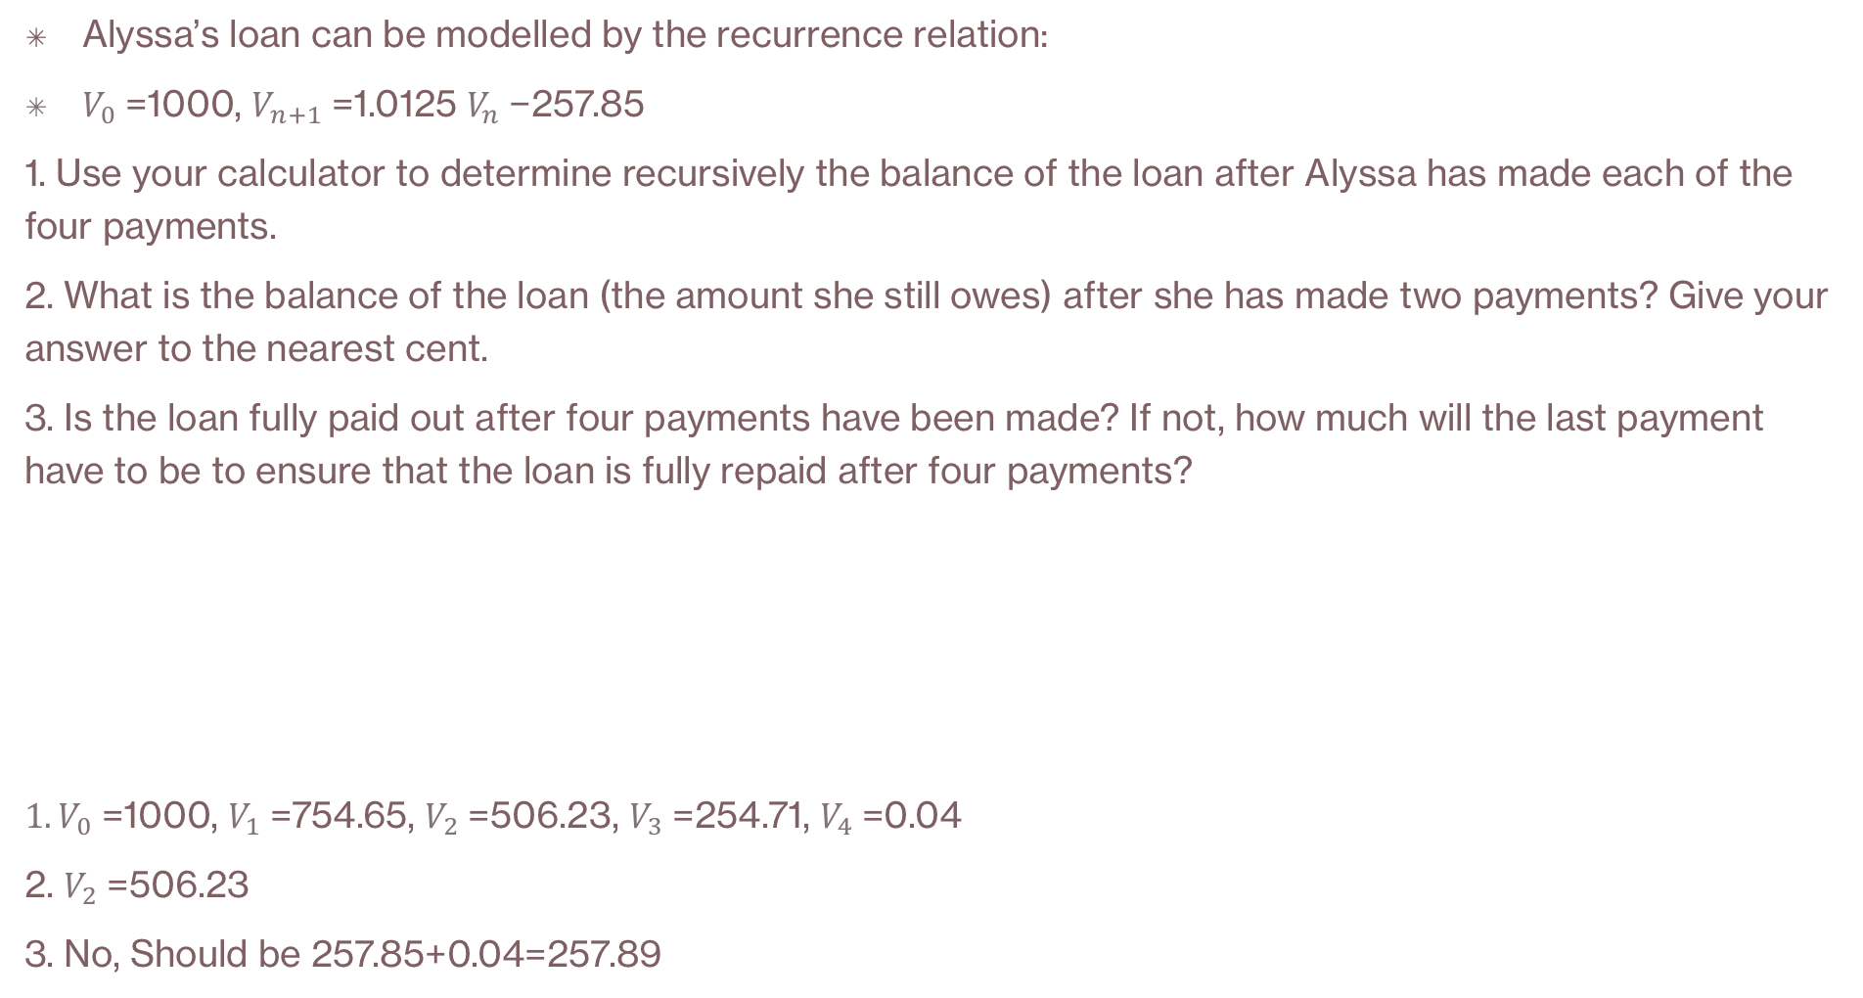
Using a recurrence relation to analyse a reducing-balance loan
Alyssa’s loan can be modelled by the recurrence relation:
$V_{0}$=1000, $V_{n+1}$=1.0125 $V_{n}$−257.85
1. Use your calculator to determine recursively the balance of the loan after Alyssa has made each of the four payments.
2. What is the balance of the loan (the amount she still owes) after she has made two payments? Give your answer to the nearest cent.
3. Is the loan fully paid out after four payments have been made? If not, how much will the last payment have to be to ensure that the loan is fully repaid after four payments?
${1. V}_{0}$=1000, $V_{1}$=754.65, $V_{2}$=506.23, $V_{3}$=254.71, $V_{4}$=0.04
2. $V_{2}$=506.23
3. No, Should be 257.85+0.04=257.89
CAS Notes 6.1
CAS Notes 6.16.7

Slide 6
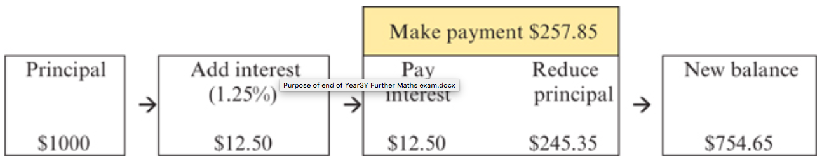
Amortisation tables
The interest
repayment
The principal
Loans that are repaid by making regular payments until the balance of the loan is zero are called amortising loans.
Alyssa’s loan from Example. Interest on the $1000 loan was charged at the rate of 1.25% per month and the loan was to be repaid with four monthly payments of $257.85. The first step in the amortisation process is shown in the diagram below.
Month 1
$245.35 = ($257.85−$12.50)
1.25% of $1000=$12.50
$754.65 =($1000−$245.35)

Slide 7
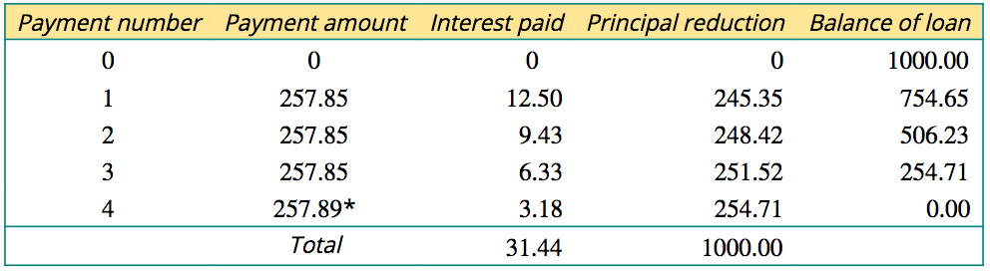
Amortisation tables
Interest paid = interest rate per payment period × unpaid balance
For example, when payment 1 is made, interest paid =1.25% of 1000=$12.50
1031.44
Principal reduction = payment made - interest paid
For example, when payment 1 is made, principal reduction =257.85−12.50=$245.35
Balance of loan = balance owing - reduction in balance
For example, when payment1 is made, reduction in balance =1000−245.35=$754.65

Slide 8
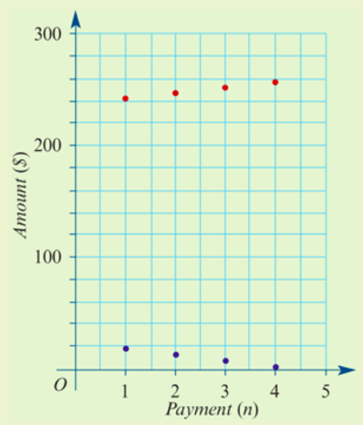
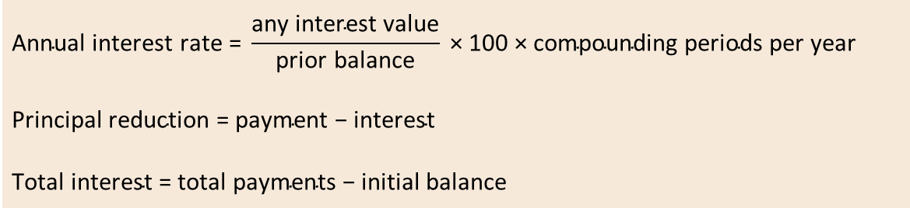
Properties of a reducing balance loan
the amount of principal paid
the amount of interest paid
$$\text{Annual} \text{interest} \text{rat}\text{e} \text{=} \frac{\text{any} \text{interest} \text{value}}{\text{prior} \text{balance}} \text{×} \text{100} \text{×} \text{compounding} \text{periods} \text{per} \text{year}$$
$$\text{Principal} \text{reduction} \text{=} \text{payment} \text{−} \text{interest}$$
$$\text{Total} \text{interest} \text{=} \text{total} \text{payment}\text{s} \text{−} \text{initial} \text{balance}$$

Slide 9
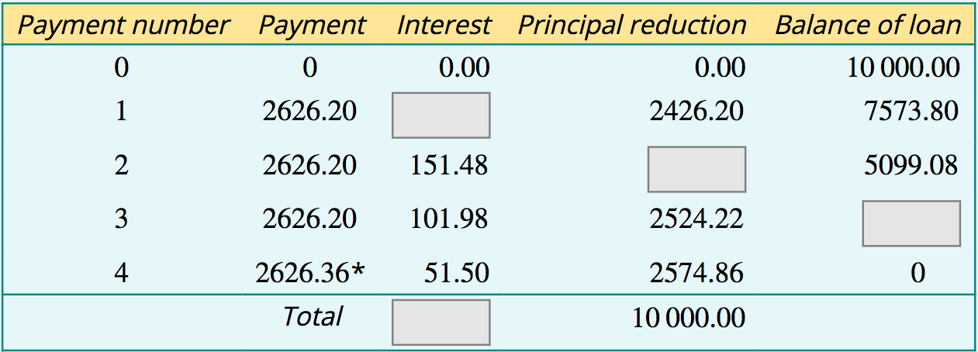
Reading and interpreting an amortisation table
A business borrows $10000 at a rate of 8% per annum. The loan is to be repaid by making four quarterly payments of $2626.20. The amortisation table for this loan is shown below.
*the final payment has been adjusted so that the final balance is zero.
a. Determine, to the nearest cent:
1. the quarterly interest rate
2. the interest paid when payment 1 is made using the quarterly interest rate
3. the principal repaid from payment 2
4. the balance of the loan after payment 3 has been made
5. the total cost of repaying the loan
b. verify that the total amount of interest paid = total cost of the loan - principal
Interest paid = 2% of $10000 = $200
Principal reduction = 2626.20−151.48 = $2474.72
Balance of the loan after 3 payments = 5099.08−2524.22 = $2574.86
Quarterly interest rate=8/4=2% or 0.02
Total cost = 3×2626.20+2626.36 = $10504.96
Total interest=$10504.96−10000=$504.96

Slide 10
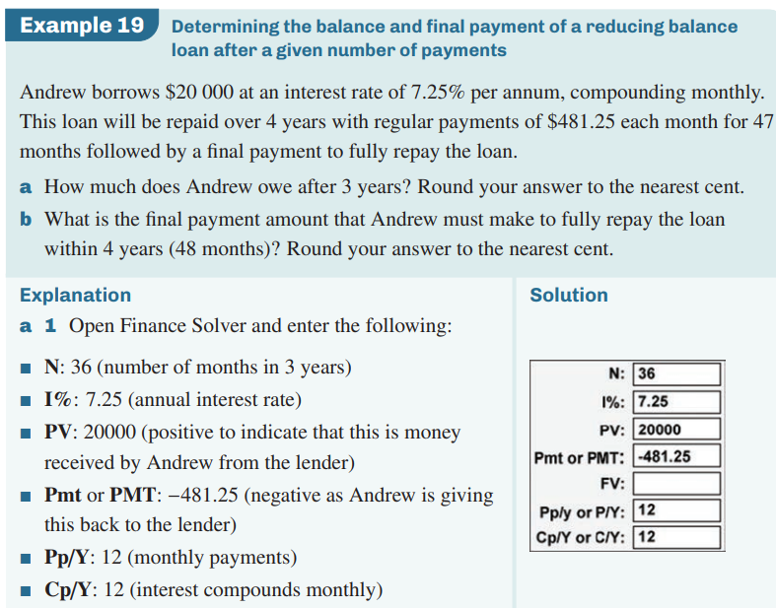
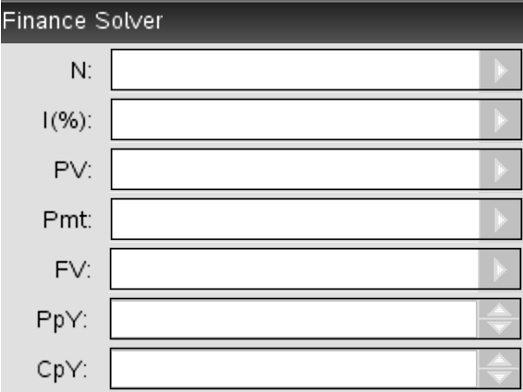
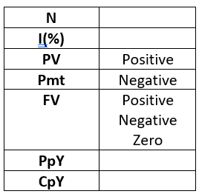
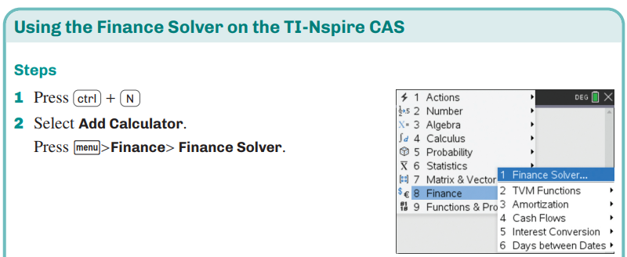
Reducing balance loans – finance solver
Key takeaway
CAS Notes 6.4,6.6
This is how we fill in the finance solver:
Total number of periods
Annual interest rate
Present value
Payment
Future value
Payment periods per year
Compounding periods per year
Tip!
For PV, Pmt, FV:
A value you RECEIVE is positive
A value you GIVE is negative

Slide 11
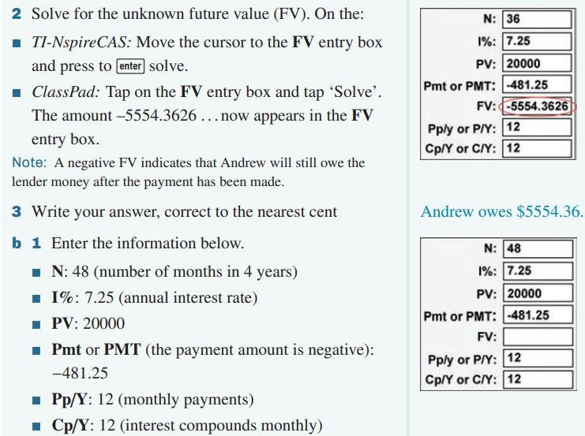
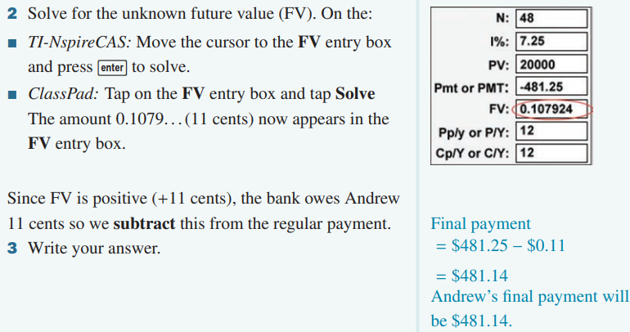
Reducing balance loans – finance solver
CAS Notes 6.4,6.6
Tip!
For PV, Pmt, FV:
A value you RECEIVE is positive
A value you GIVE is negative

