Slide 1
Interest-only loans
8H

Slide 2
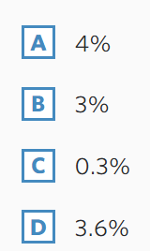

Slide 3
Defining an interest-only loan
Key takeaway
An interest only loan is one where the payment made is equal to the interest. Because of this, the principal is never reduced.
 | Payment | Interest | Principal reduction | Balance
0 | 0.00 | 0.00 | 0.00 | 620 000.00
1 | 1911.67 | 1911.67 | 0.00 | 620 000.00
2 | 1911.67 | 1911.67 | 0.00 | 620 000.00
3 | 1911.67 | 1911.67 | 0.00 | 620 000.00
… | … | … | … | …

Slide 4
Recurrence relations for financial products
$V_{0}=500 000$, $V_{n+1} =1.005{ V}_{n}−2500$
Interest-only loan (formula)
$V_{0}$= $500 000$, $V_{n+1}$= $1.005V_{n} − 2500$
$$1.005=1+0.005$$
$− 2500:$ balance stays constant
$$1=100\%:principal$$
$$0.005=0.5\%:Interest rate$$
D = $\frac{r}{ 100∗p}×v_{0}=\frac{0.05}{ 100∗1}×500 000=2500$
Deep dive
An interest-only loan is a loan you make regular payments towards, without changing the balance owed.
Each period, the value of the loan increases with interest and then decreases with the payment. But because the payment in is equal to the interest added, the principal remains the same!
$V_{n}$ is the value of the loan after $n$ periods.

Slide 5
Interest-only loan
To understand how this happens, consider a loan of $1000, charged 5% interest compounding yearly.
$V_{n+1}$=1.05 $V_{n}$−𝐷 can be used to model this loan. The table below shows the balance of the loan over a 4-year period for three different payment amounts: 𝐷=40,𝐷=50 and 𝐷=60.

Slide 6
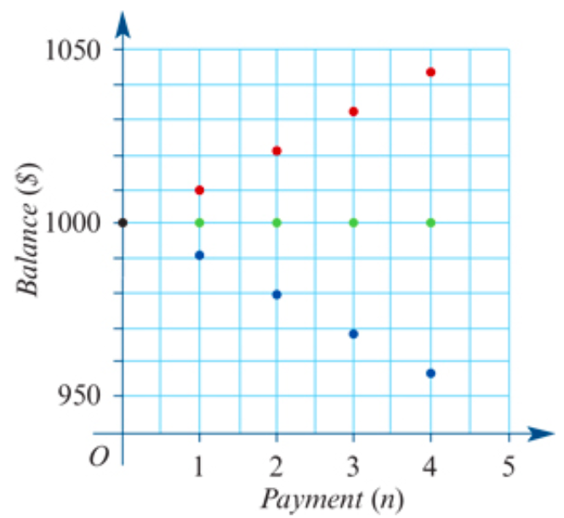
Interest-only loan
Let $V_{0}$ be the principal of the loan.
Let 𝑟 be the interest rate per compounding period.
Let 𝐷 be the regular payment per compounding period.
For interest-only loans:
So, payment 𝐷
= interest charged
= $\frac{r}{100}$× $V_{0}$
$V_{n+1}$=1.05 $V_{n}$−𝐷 𝐷=40
$V_{n+1}$=1.05 $V_{n}$−𝐷 𝐷=50
$V_{n+1}$=1.05 $V_{n}$−𝐷 𝐷=60

Slide 7
Repaying an interest-only loan
Jane borrows $50000 to buy some shares. Jane negotiates an interest-only loan for this amount, at an interest rate of 9% per annum, compounding monthly. What is the monthly amount Jane will be required to pay?
$V_{0}$=50000
$r_{m}$= $\frac{9}{12}=$0.75%
D= $\frac{r_{m}}{100}$× $V_{0}=\frac{0.75}{100}\text{× }\text{50000 }$=375
Jane will need to repay $375 every month on this interest-only loan.

Slide 8
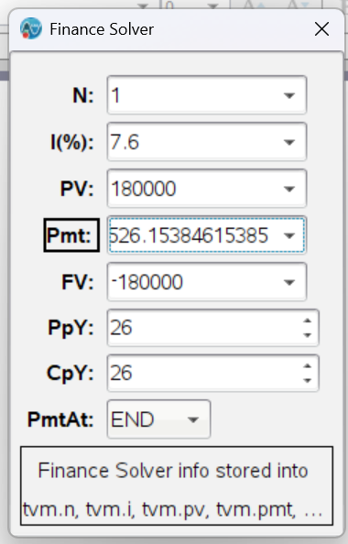
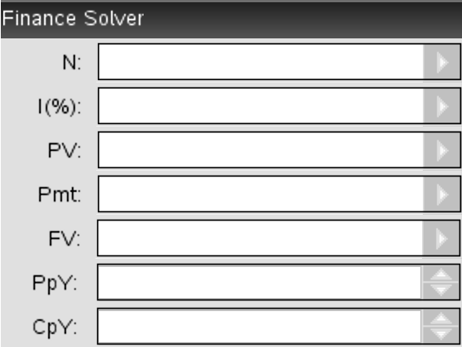
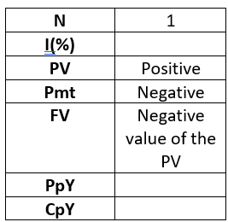
Repaying an interest-only loan using a financial solver
Stuart borrows $180000 to buy a house. He negotiates an interest-only loan for this amount, at an interest rate of 7.6% per annum, compounding fortnightly. What is the fortnightly payment, correct to the nearest cent?
Stuart will need to repay $526.15 every fortnight.
Total number of periods
Annual interest rate
Present value
Payment
Future value
CAS Notes 6.16.6
Payment periods per year
Compounding periods per year
CAS Notes 6.13

