Slide 1
Perpetuities
6E
Notes:
1-4,8,9

Slide 2
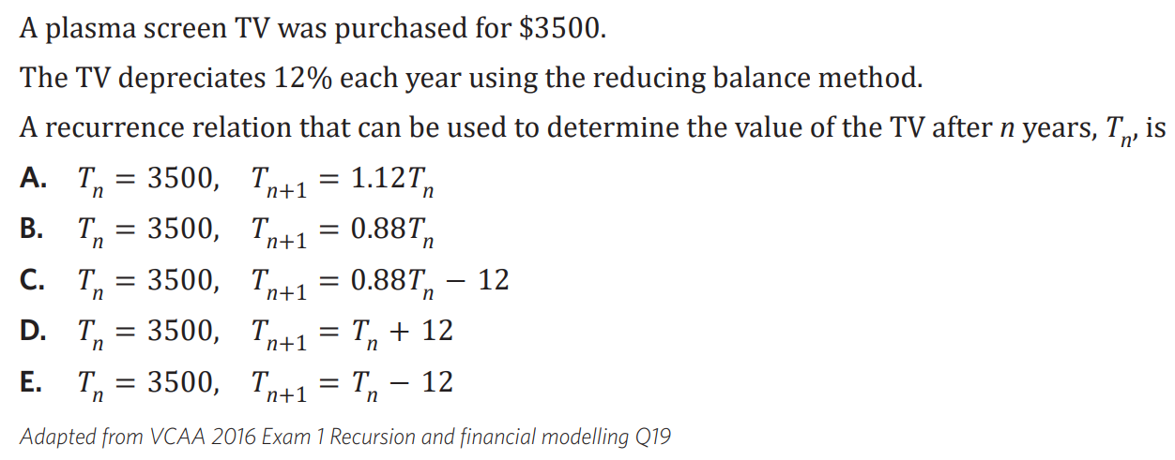

Slide 3
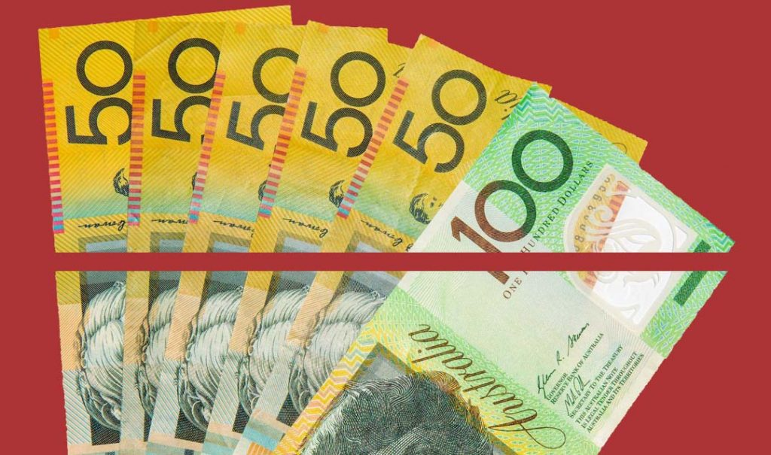
Perpetuities: Special annuity
Reducing Balance Loan
Loan
identical
Annuities
Fixed term pension
interest-only loan
Loan
identical
payment received=interest earned
Perpetuities
Investment
Notes:
https://www.youtube.com/watch?v=mUVwvw2toXM

Slide 4
Recurrence relations for financial products
$V_{0}=500 000$, $V_{n+1} =1.005{ V}_{n}−2500$
Perpetuity (formula)
$V_{0}=$ $500 000$, $V_{n+1}=$ $1.005V_{n} −2500$
$$1.005=1+0.005$$
$− 2500:$ balance stays constant
$$1=100\%:principal$$
$$0.005=0.5\%:Interest rate$$
D = $\frac{r}{ 100}×v_{0}=\frac{0.05}{ 100}×500 000=2500$
Deep dive
A perpetuity is an investment that makes regular payments to you and can continue making payments forever.
Each period, the value of the investment increases with interest and then decreases with the payment. However, because the payment out is equal to the interest gained, the principal remains the same!
$V_{n}$ is the value of the investment after $n$ periods.
Perpetuity is a type of annuity.

Slide 5
Calculating the withdrawal from a perpetuity
Elizabeth invests her superannuation payout of $500 000 into a perpetuity that will provide a monthly income without using any of the initial investment.
If the interest rate for the perpetuity is 6% per annum, what monthly payment will Elizabeth receive?
$V_{0}$=500,000.
$r_{m}$=$\frac{6}{12}$=0.5. interest $ is 0.5% 0f $500,000
𝐷= $\frac{r_{m}}{100}$× $V_{0}$= $\frac{0.5}{100}$×500000=2500
Elizabeth will receive $2500 every month from her investment.

Slide 6
Calculating the investment required to establish a perpetuity
How much money will need to be invested in a perpetuity account, earning interest of 4.2% per annum compounding monthly, if $200 will be withdrawn every month? Write your answer to the nearest dollar.
$r_{m}$=$\frac{4.2}{12}$%=0.35%.
The amount withdrawn each month is $200 so 𝐷=200.
𝐷= $\frac{r_{m}}{100}$×$V_{0}$
200= $\frac{0.35}{100}$×$V_{0}$= 0.0035× $V_{0}$
$V_{0}$= $\frac{200}{0.0035}$=57142.867
$57143 will need to be invested to establish the perpetuity investment.
CAS Notes solve

Slide 7
Calculating the interest rate of a perpetuity
A university mathematics faculty has $30000 to invest. It intends to award an annual mathematics prize of $1500 with the interest earned from investing this money in a perpetuity.
What is the minimum interest rate that will allow this prize to be awarded indefinitely?
Prize=𝑟% of investment
1500= 𝑟%×30000
1500 =$\frac{r}{100}$×30000
1500=𝑟×300
𝑟= $\frac{1500}{300}$=5
The minimum annual interest rate to award this prize indefinitely is 5%.
CAS Notes solve

Slide 8
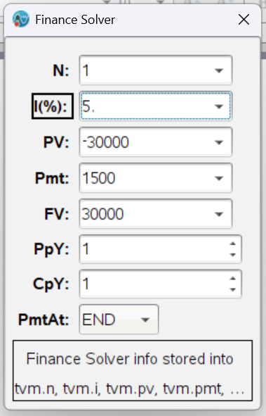
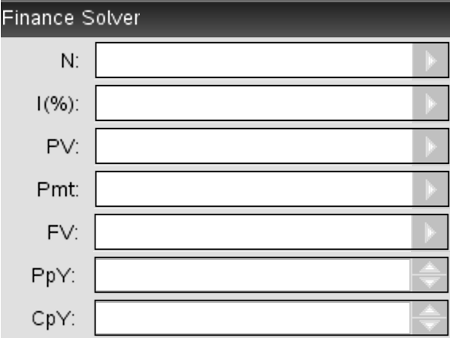
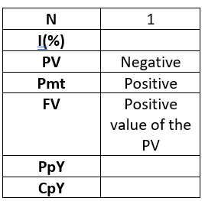
Calculating the interest rate of a perpetuity
CAS Notes 6.14
A university mathematics faculty has $30000 to invest. It intends to award an annual mathematics prize of $1500 with the interest earned from investing this money in a perpetuity.
What is the minimum interest rate that will allow this prize to be awarded indefinitely?
The minimum annual interest rate to award this prize indefinitely is 5%.
Total number of periods
Annual interest rate
Present value
Payment
Future value
Payment periods per year
Compounding periods per year

Slide 9
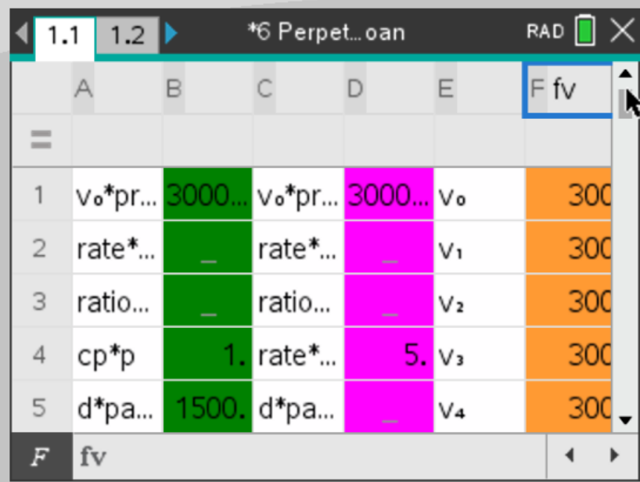
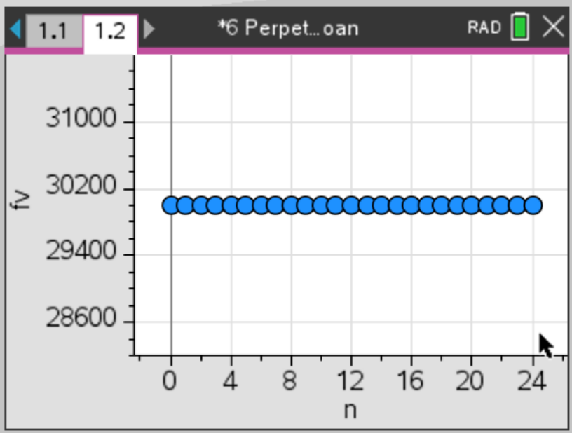
Calculating the interest rate of a perpetuity
CAS Notes 6.14
CAS Notes 6.16.6
A university mathematics faculty has $30000 to invest. It intends to award an annual mathematics prize of $1500 with the interest earned from investing this money in a perpetuity.
What is the minimum interest rate that will allow this prize to be awarded indefinitely?
The minimum annual interest rate to award this prize indefinitely is 5%.

