Slide 1
Categorical Distribution
1B
Notes:
2-8

Slide 3
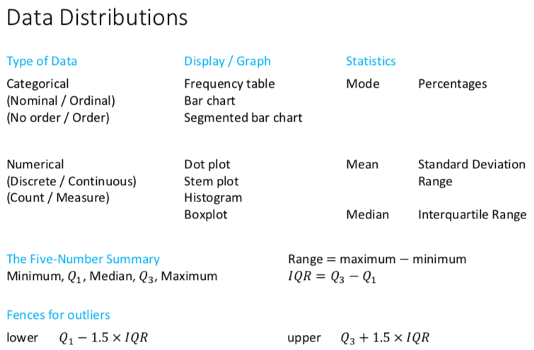

Slide 4
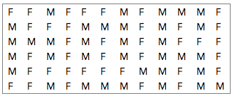
Sex | Frequency
 | Number | Percentage
Female | 37 | 51.4
Male | 35 | 48.6
Total | 72 | 100.0

Slide 5
Titanic
The ship Titanic sank in 1912 with the loss of most of its passengers
809 of the 1,309 passengers and crew died
= 61.8%
Statistics: Did class (of travel) affect survival? Were ‘wealthy’ people more likely to survive on board the Titanic?
Notes:
Ask the audience what the null and hypothesis might be, what type of data we would have and what test we should consider using.

Slide 6
Titanic Tickets sold for each Class
 | Died | Survived | Total
1st Class | 200 | 123 | 323
2nd Class | 171 | 106 | 277
3rd Class | 438 | 271 | 709
Total | 809 | 500 | 1,309
Number of tickets sold

Slide 7
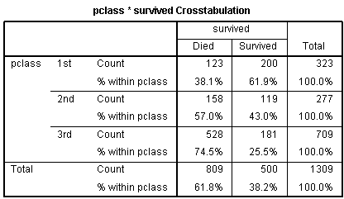
Did class affect survival? Solution
%’s within each class are preferable
Notes:
The question of interest is whether the class of an individual affected their chance of survival.
As there are different numbers in the classes, the percentages within those who died are misleading in option 1. There were 709 people in 3rd class but only 323 and 277 in 1st and 2nd class respectively so we would expect a higher % of 3rd class people in both the died and survived categories. It’s clear that people in the lower classes were much more likely to have died. 74.5% of those in 3rd class died but only 38.1% of those in 1st class.

Slide 8
Sex | Frequency
 | Number | Percentage
Female | 6 | 54.5
Male | 5 | 45.5
Total | 11 | 100.0
Note:
If the variable was ordinal, say year level, with possible values ‘Year 10’, ‘Year 11’ and ‘Year 12’, it would make sense to group the data values in that order.
The Total should always equal the total number of observations – in this case, 11. The percentages should add to 100%.

Slide 9
Bar chart
A statistical graph used to display the frequency distribution of categorical data.

Slide 10
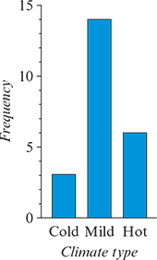
Climate type | Frequency
 | Number | Percentage
Cold | 3 | 13.0
Mild | 14 | 60.9
Hot | 6 | 26.1
Total | 23 | 100.0
1. Ordinal

Slide 11
Stacked or segmented bar charts
A statistical graph used to display the information contained in a two-way frequency table. It is a useful tool for identifying associations between two categorical variables.
A legend is required to identify which segment represents which category

Slide 12
The horizontal axis has no label.
Label the vertical axis ‘Percentage’. Mark the scale in tens.
Draw a single bar of height 100. Divide the bar into three by inserting dividing lines at 13%and 76.9% (13+60.9%).
The bottom segment = the countries with a cold climate. The middle segment = the countries with a mild climate. The top segment = the countries with a mild climate. Shade (or colour) the segments differently.
A legend to identify each shaded segments.
Reading segmented bar chart.

Slide 13
The mode or modal category
The mode is the most frequently occurring value or category.

Slide 14
Answering statistical questions involving categorical variables
Briefly summarise the context in which the data were collected including the number of individuals involved in the study.
If there is a clear modal category, ensure that it is mentioned.
Include frequencies or percentages in the report. Percentages are preferred.
If there are a lot of categories, it is not necessary to mention every category, but the modal category should always be mentioned.

Slide 16
exercises & Summary Book
1. Ex page 1B 2-8
2. Summary notes

