Slide 1
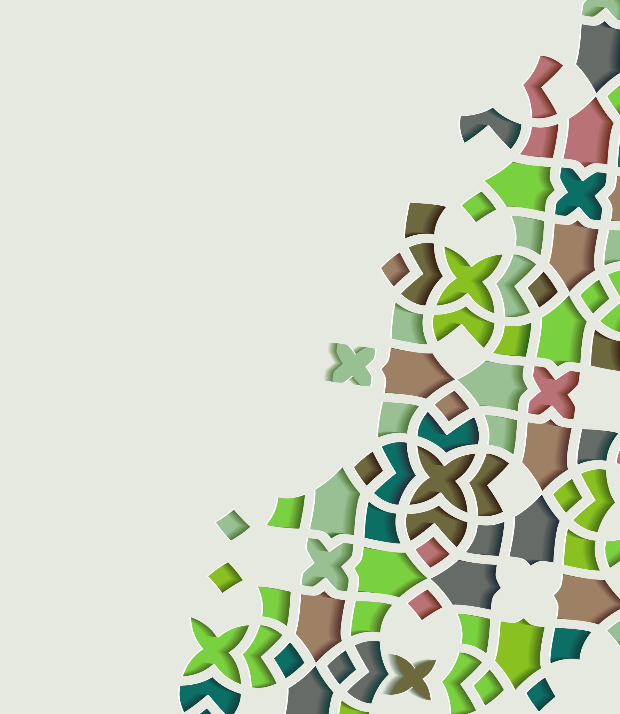
Describing numerical data
1F
Notes:
https://create.kahoot.it/details/d10947ff-e260-400e-98f7-d1a11eaa1603
https://create.kahoot.it/details/9194c2c7-83bf-46bc-8dae-611d9f67b285
https://create.kahoot.it/details/eab4a192-093b-4904-8eb0-6455e4448081

Slide 2
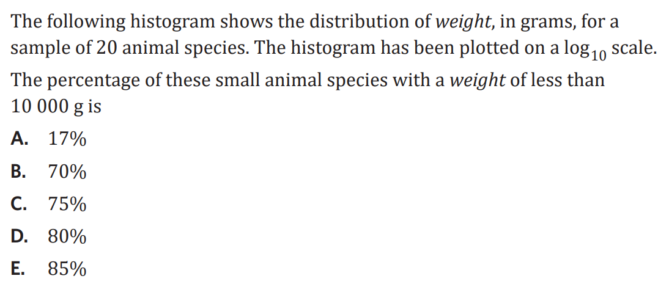
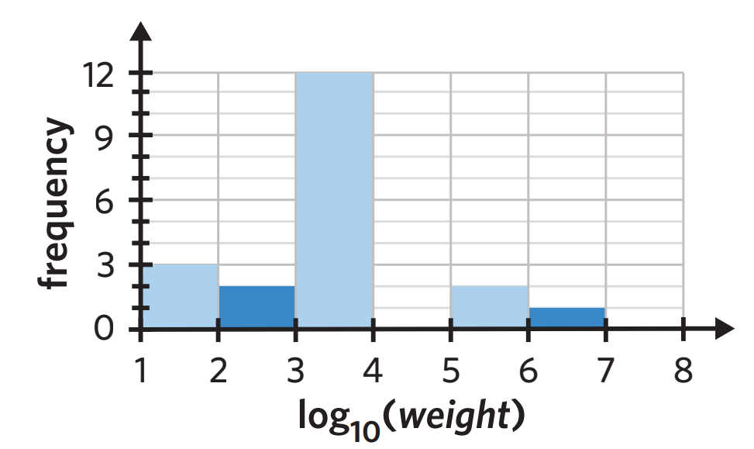

Slide 3
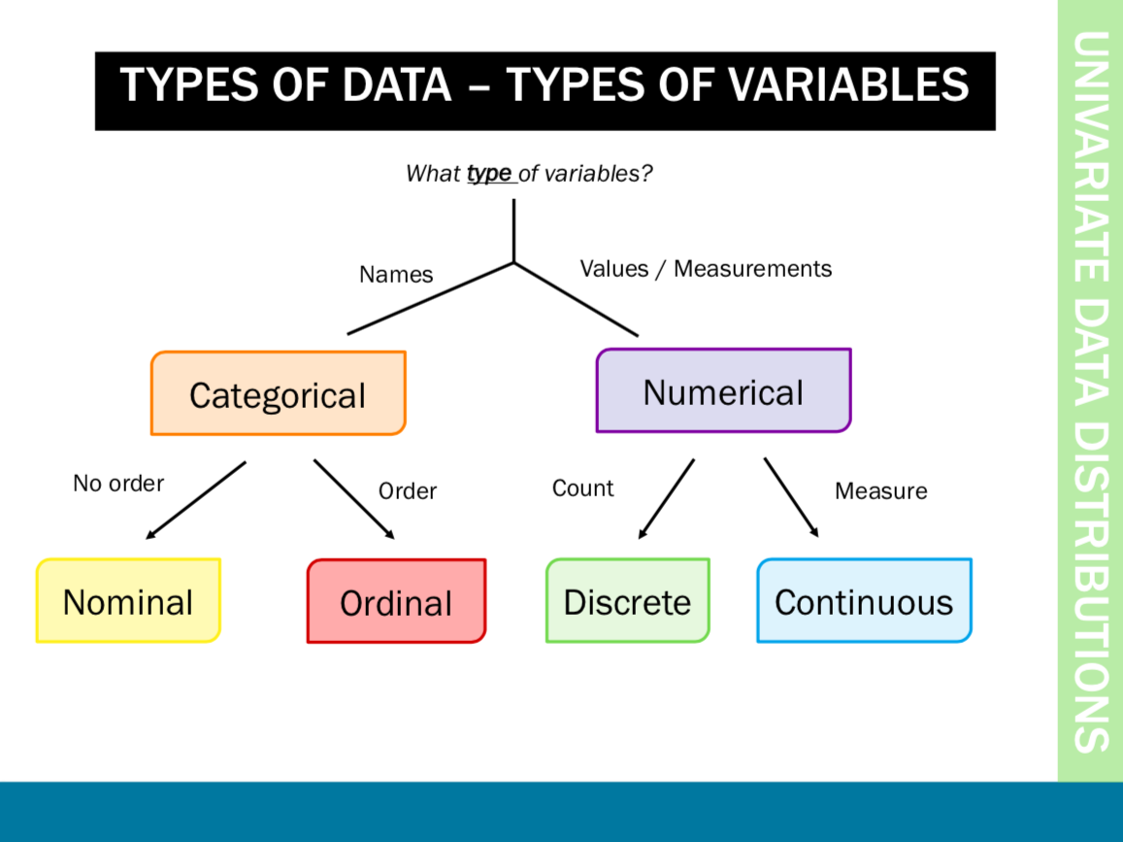

Slide 4
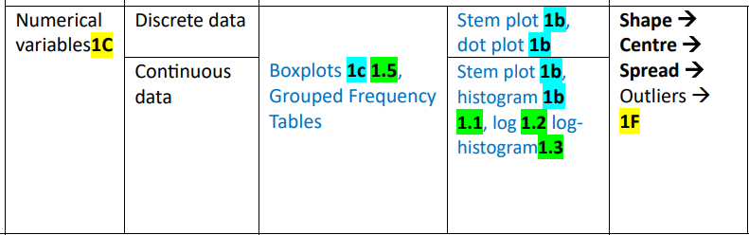
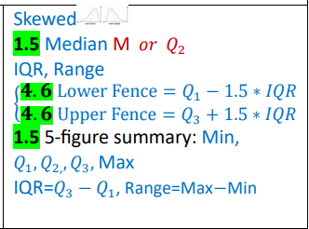
Describing numerical data

Slide 5
What to look for in a histogram?
Symmetric distributions
shape and outliers
centre
spread
Skewed distributions

Slide 6
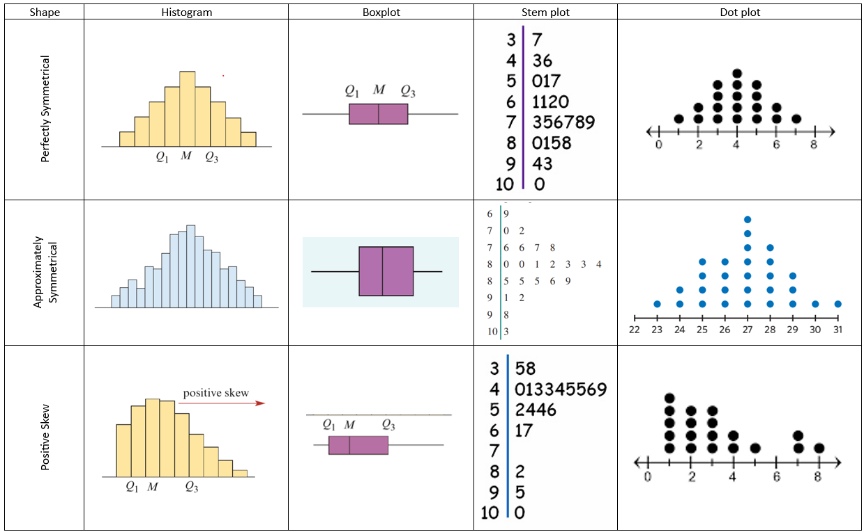

Slide 7
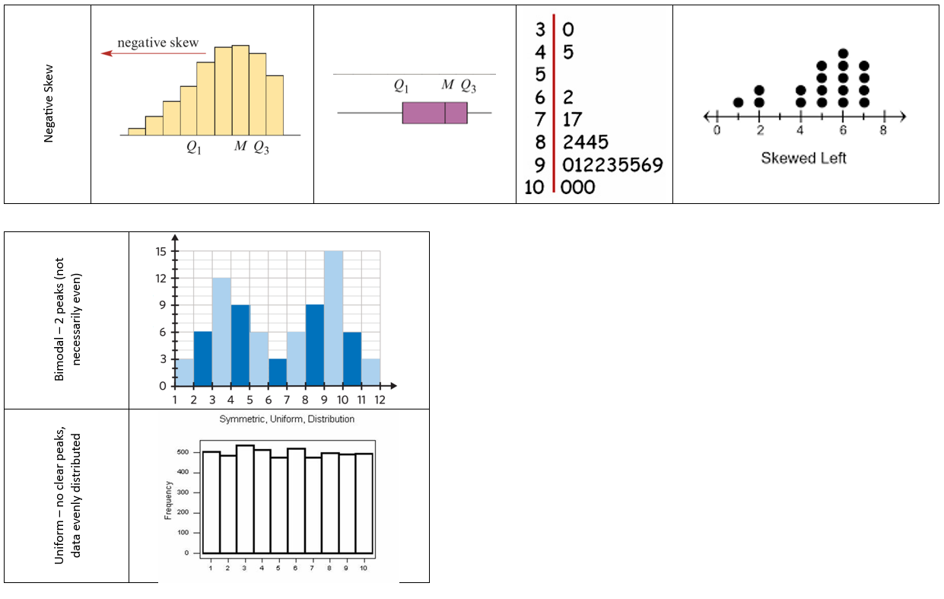

Slide 8

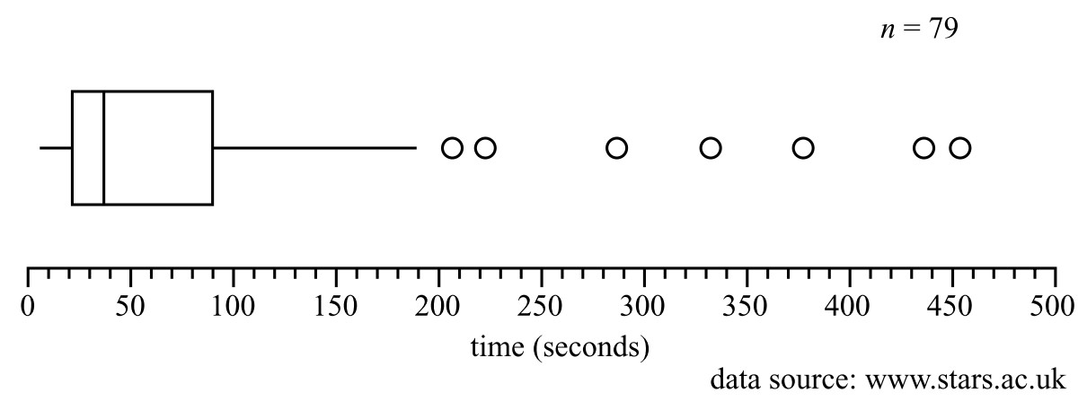
Outliers
Outliers are any data values that stand out from the main body of data.

Slide 9
Centre of a distribution
In general: use the mean if you do not have any outliers and use the median if you have outliers or if your graph is very skewed.
Histograms 6 to 8 display the distribution of test scores for three different classes taking the same subject. They are identical in shape, but differ in where they are located along the axis

Slide 10
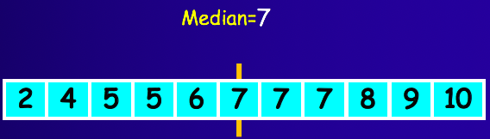
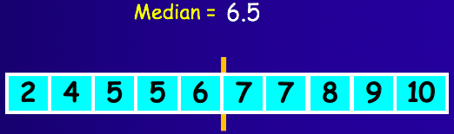
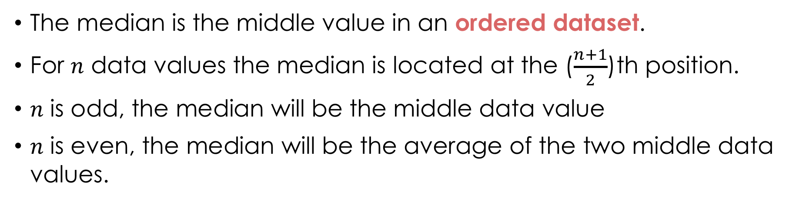
Determining the median
The median is the middle value in an ordered dataset.
For 𝑛 data values the median is located at the ($\frac{n+1}{2}$)th position.
𝑛 is odd, the median will be the middle data value
𝑛 is even, the median will be the average of the two middle data values.

Slide 11
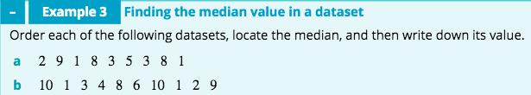






Slide 12
Spread
Range
Range = largest value - smallest value
Histogram 10 has a spread (maximum range) of 22(22−0) units. This is considerably greater than the spread of histogram 11 which has a spread of 12(18−6) units.

Slide 13
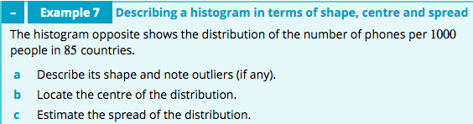
Shape and outliers | The distribution is positively skewed. There are no outliers.
Centre: Count up the frequencies from either end to find the middle interval. | The distribution is centred between 170 and 340 phones per 1000 people.
Spread: Use the maximum range to estimate the spread. | Spread=1020−0=1020 phones/1000 people
Report
For these 85 countries, the distribution of the number of phones per 1000 people is positively skewed. The centre of the distribution lies between 170 and 340 phones/1000 people. The spread of the distribution is 1020 phones/1000 people. There are no outliers.

Slide 14
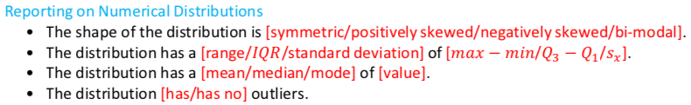
Report writing: Shape, Centre, Spread
Report
For these 85 countries, the distribution of the number of phones per 1000 people is positively skewed. The centre of the distribution lies between 170 and 340 phones/1000 people. The spread of the distribution is 1020 phones/1000 people. There are no outliers.

Slide 15
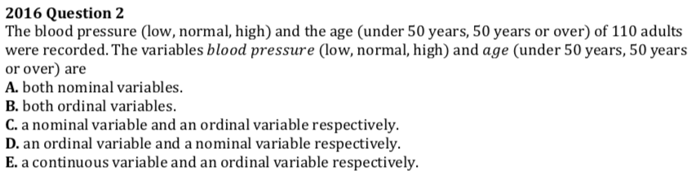
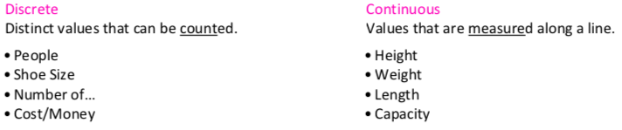
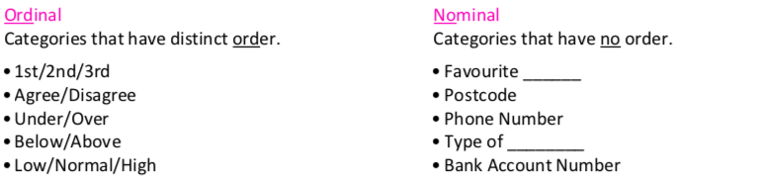

Slide 16
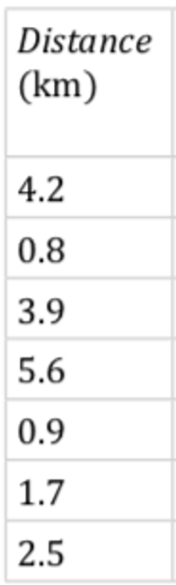
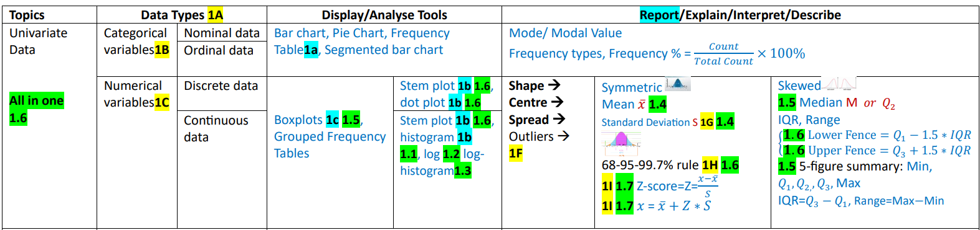
Formatives
For the following sets of data: determine the type of data, appropriately graph the data and write a sentence to summarise your findings.

Slide 17
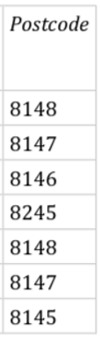
Formatives
For the following sets of data: determine the type of data, appropriately graph the data and write a sentence to summarise your findings.

Slide 18
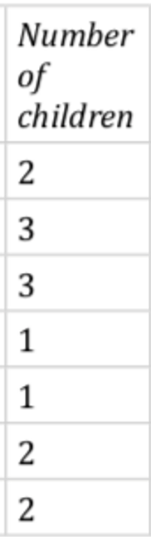
Formatives
For the following sets of data: determine the type of data, appropriately graph the data and write a sentence to summarise your findings.

Slide 19
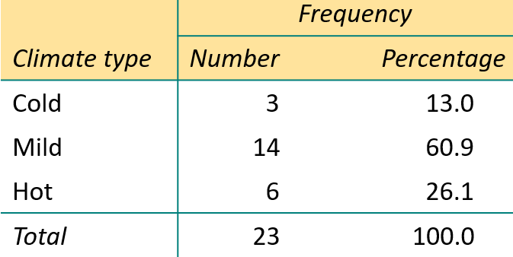
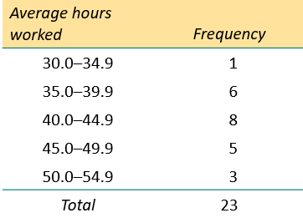


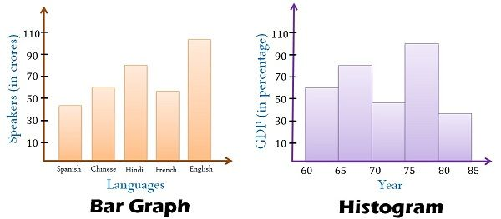




Difference between Histogram & Bar Chart

Slide 20
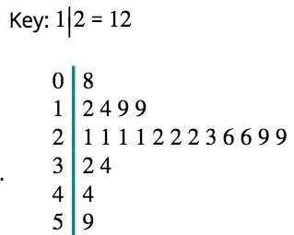

Stem Plot / Stem and Leaf Plot
A method for displaying data in which each observation is split into two parts, a ’stem’ and ‘leaf’.
An alternative display to a histogram.
Suitable for small to medium sized data sets.
N=21

Slide 21

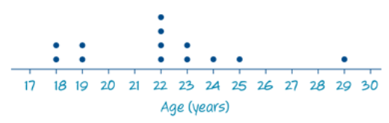

The dot plot
A statistical graph that uses dots to display individual data values on a number line. Suitable for small sets of data only.
N=13

Slide 22
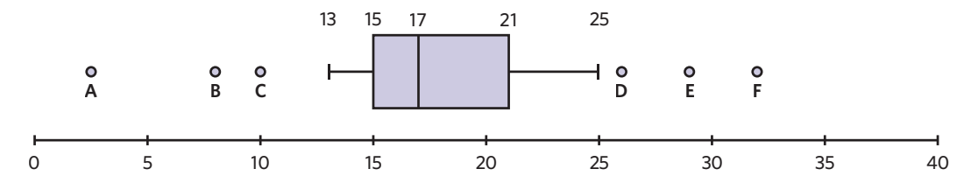
Box Plot

Slide 23
    exercises & Summary Book
1. Ex page 1C
2. Summary notes

