Slide 1

Log scales and graphs
1D
Notes:
https://create.kahoot.it/details/8503689f-5537-4188-96d5-58f81716a202
https://create.kahoot.it/details/482c4b74-a6b0-46a3-b3e8-a1b08f378329
1-4,6,7,11

Slide 2
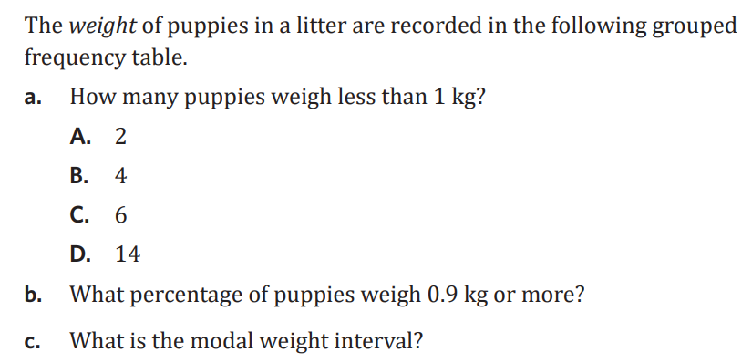
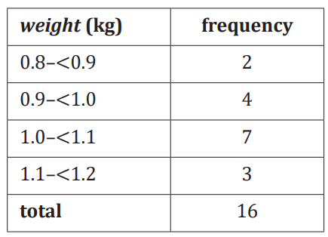

Slide 3
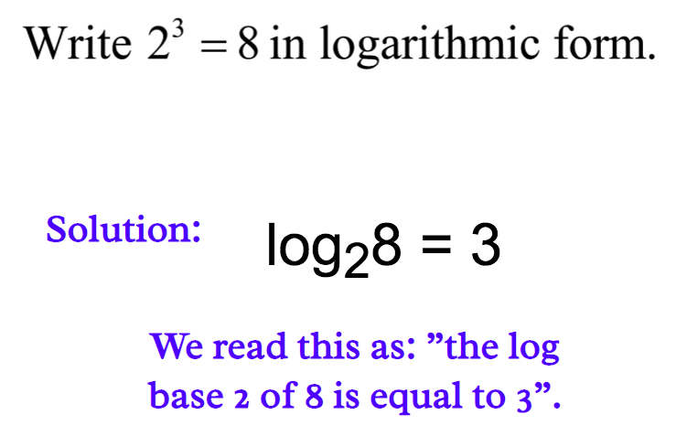
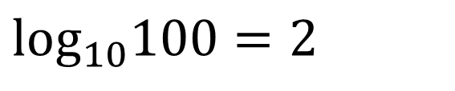
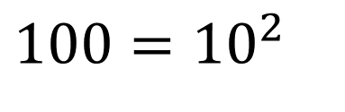

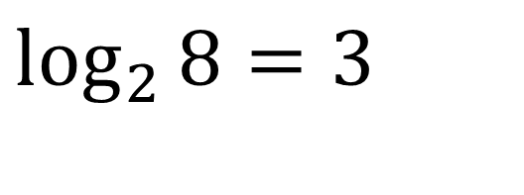
https://www.youtube.com/watch?v=zzu2POfYv0Y
Logarithm
$$100={10}^{2}$$
$$\text{lo}{\text{g}}_{10}100=2$$
Convert to log form:
Convert to exponential form:
$$2^{3}=8$$
$$\log_{2}{8}=3$$

Slide 4
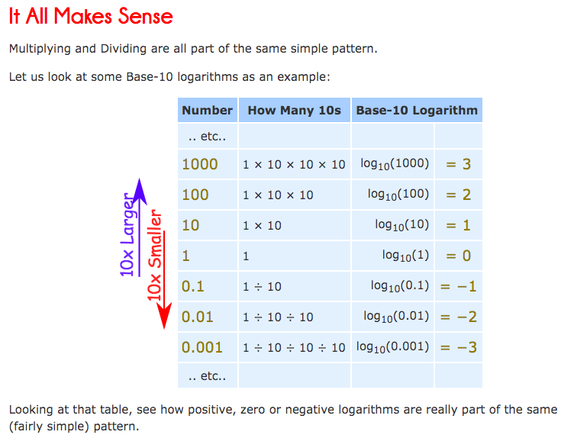
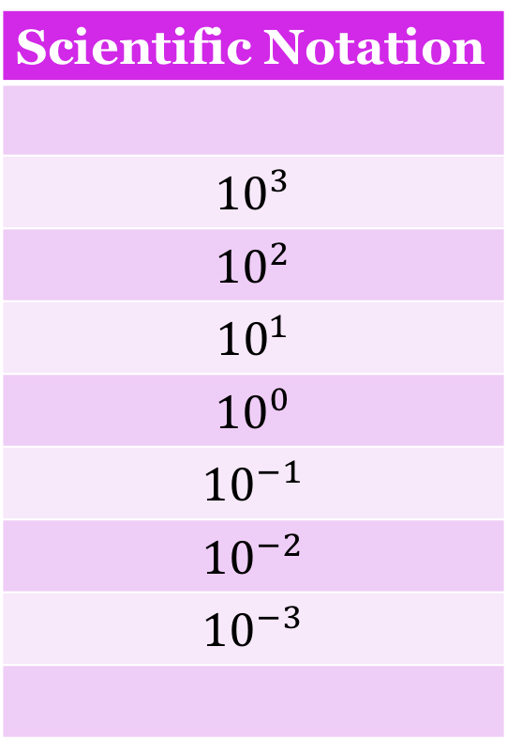
Scientific Notation
$${10}^{3}$$
$${10}^{2}$$
$${10}^{1}$$
$${10}^{0}$$
$${10}^{−1}$$
$${10}^{−2}$$
$${10}^{−3}$$

Slide 5
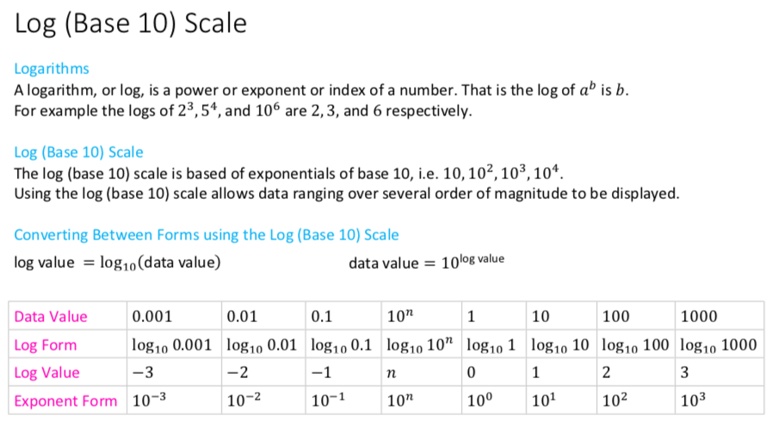

Slide 6
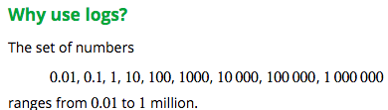
Properties of logs to the base 10
If a number is greater than one, its log to the base 10 is greater than zero.
If a number is greater than zero but less than one, its log to the base 10 is negative.
If the number is zero, then its log is undefined.

Slide 7
Why use logarithm?
The histogram below displays the body weights (in kg) of a number of animal species. Because the animals represented in this dataset have weights ranging from around 1 kg to 90 tonnes (a dinosaur), most of the data are bunched up at one end of the scale and much detail is missing. The distribution of weights is highly positively skewed, with an outlier.

Slide 8

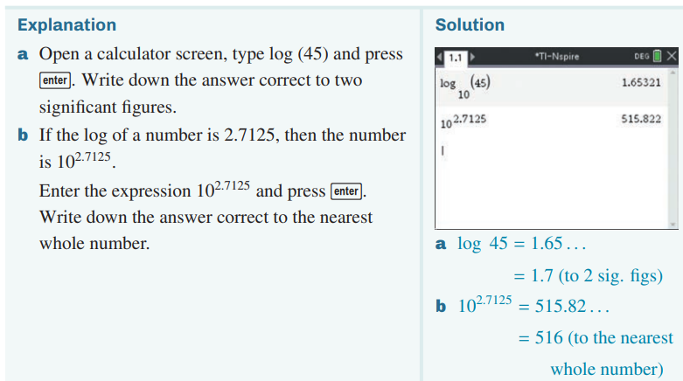
Working with logs
CAS Notes 1.1

Slide 9
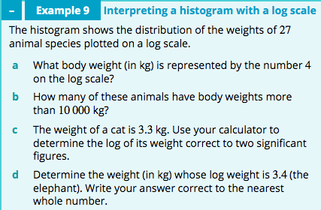
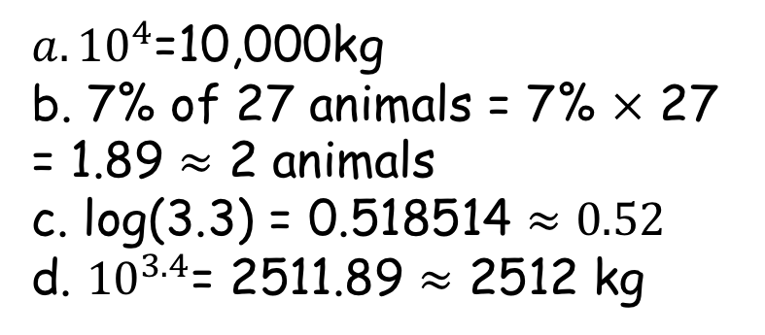
Analysing data displays with a log scale
${a. 10}^{4}$=10,000kg
b. 7% of 27 animals = 7% $×$ 27 = 1.89 $≈$ 2 animals
c. log(3.3) = 0.518514 $≈0.52$
d. ${10}^{3.4}$= 2511.89 $≈$ 2512 kg

Slide 10
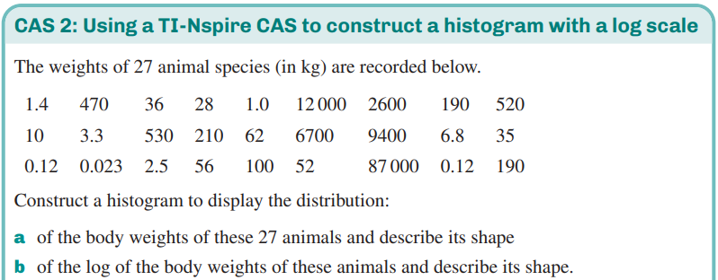
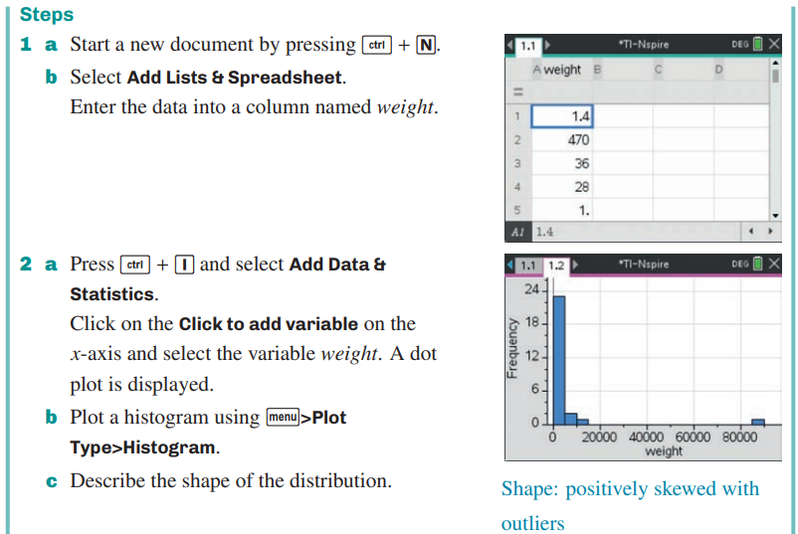
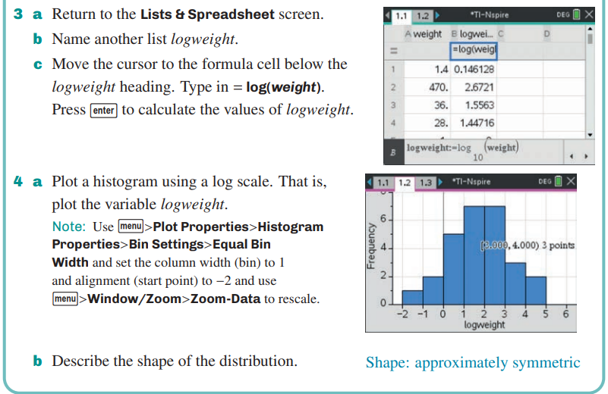
Constructing a histogram with a log scale
CAS Notes 1.3

Slide 11
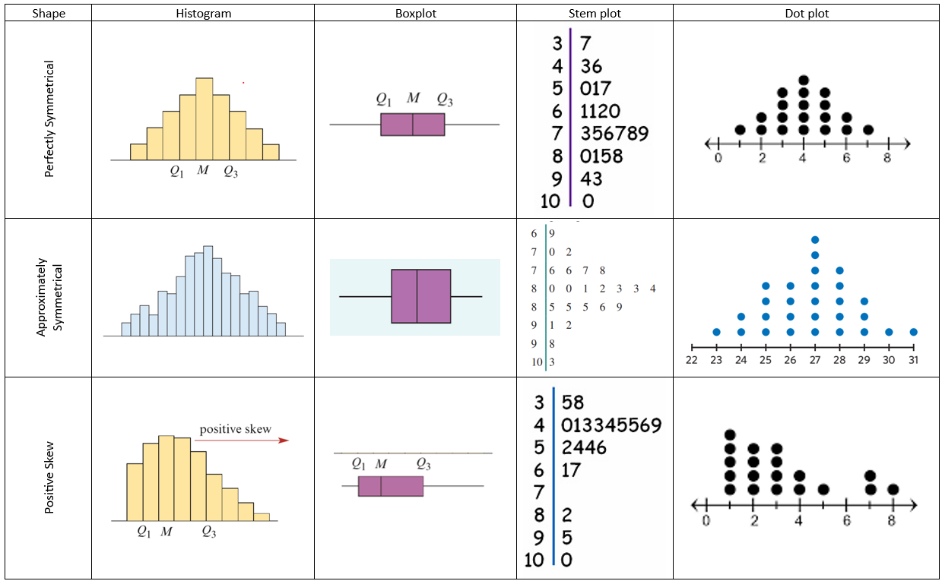
Constructing a histogram with a log scale

Slide 12
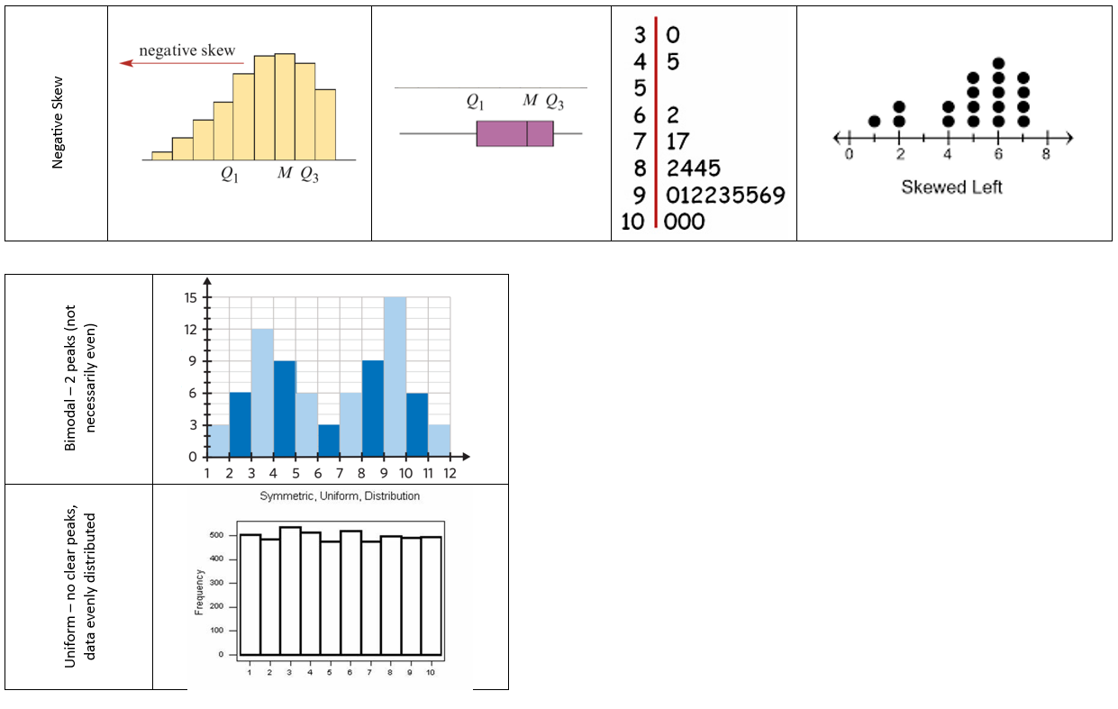
Constructing a histogram with a log scale

Slide 13
    exercises & Summary Book
1. Ex page 1D
2. Summary notes

