Slide 1

z-scores
1I
Notes:
https://create.kahoot.it/details/7d6f53b7-0165-40d8-9dcc-1a3cc2df942d

Slide 2
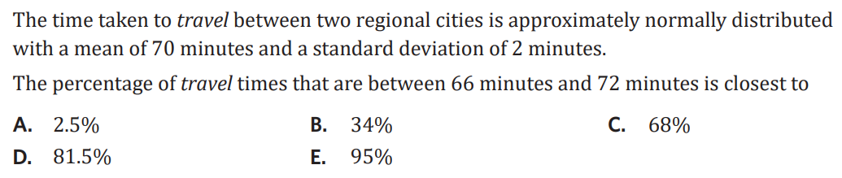
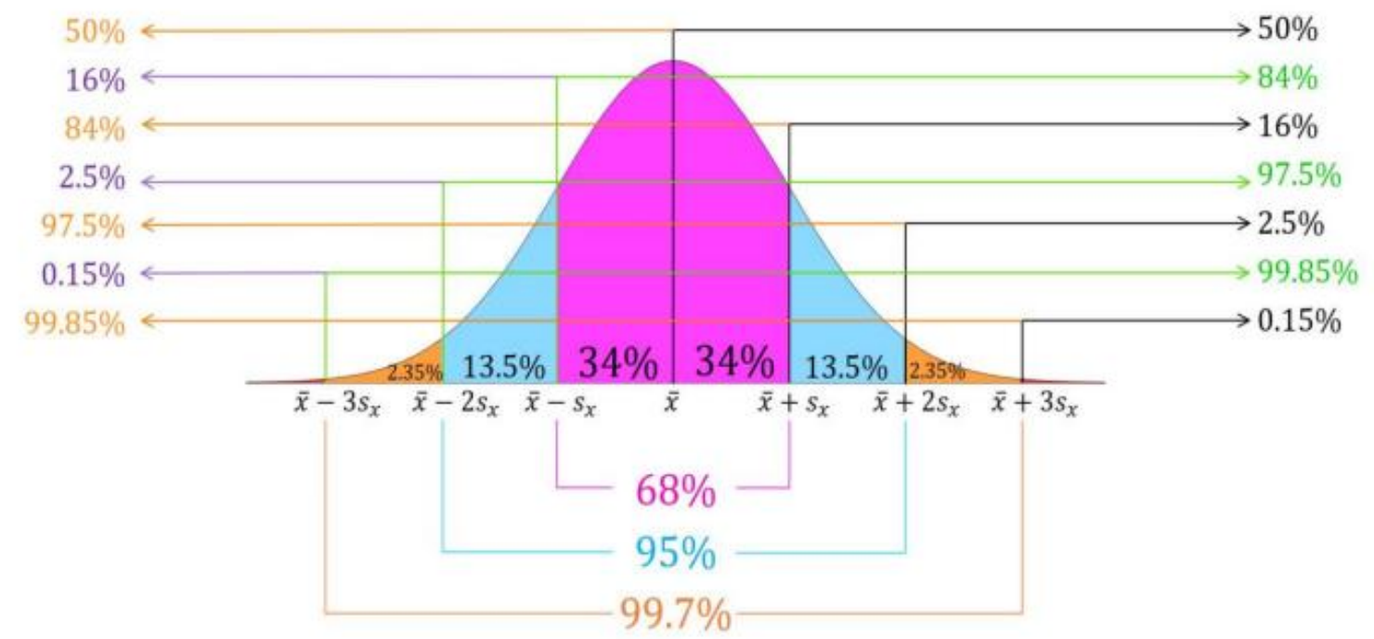
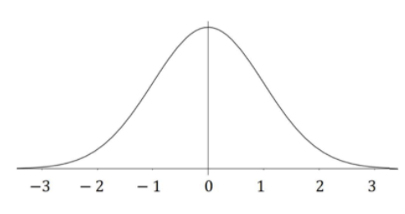

Slide 3
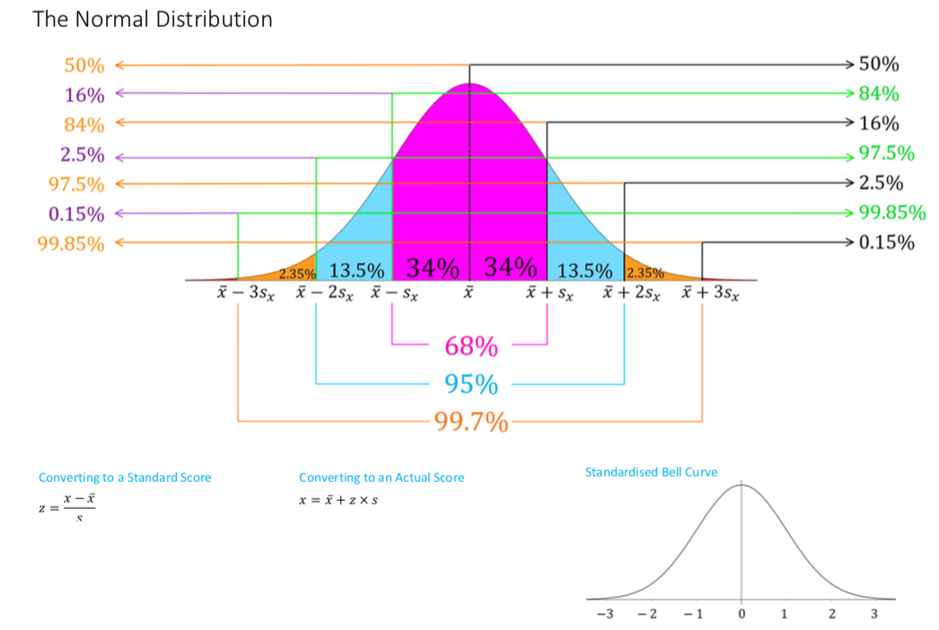

Slide 4
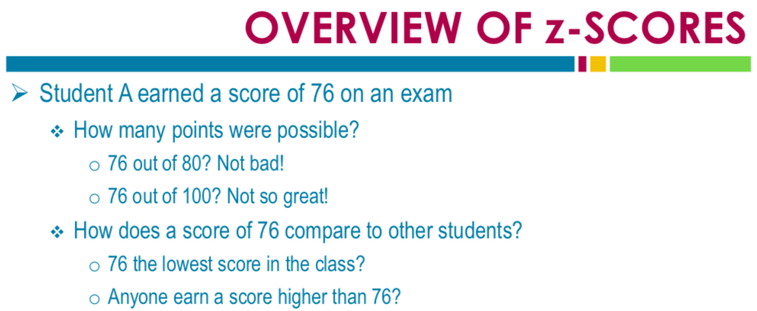
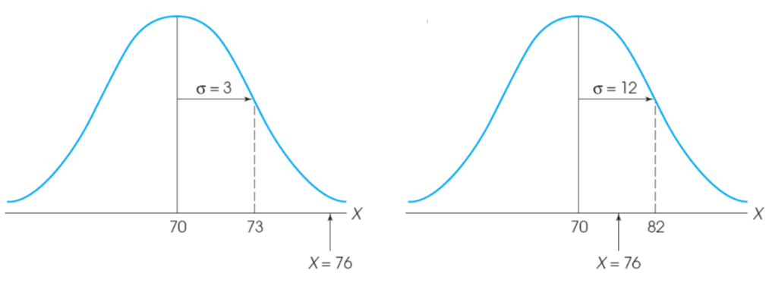
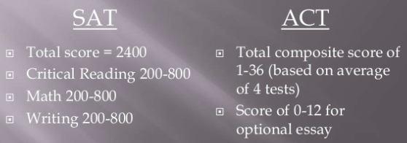

Slide 5
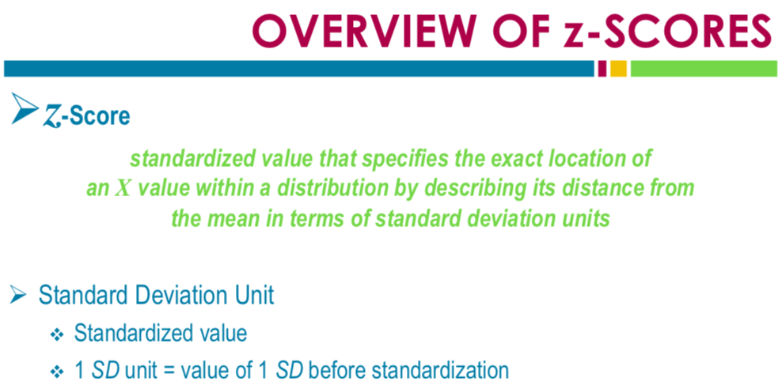
0 1
0 1

Slide 6
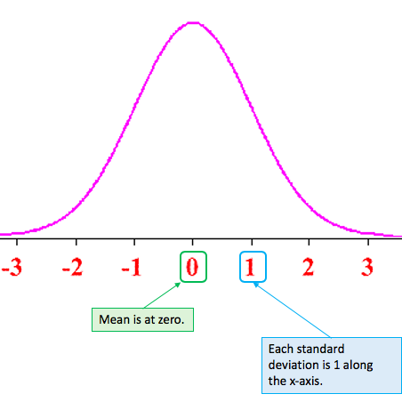

Standardised or z-scores
The value of the standard score gives the distance and direction of a data value from the mean in term of standard deviations.
The rule for calculating a standardized score is

Slide 7
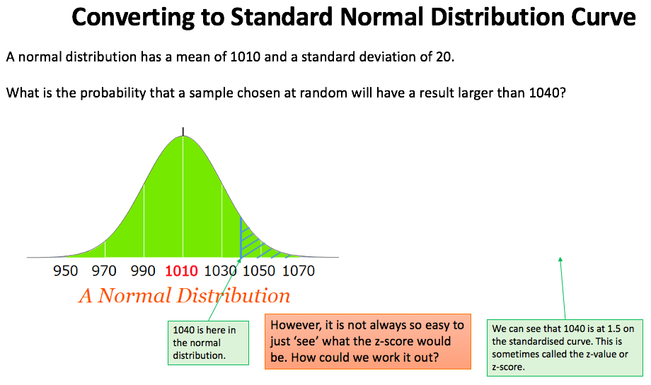

Slide 8
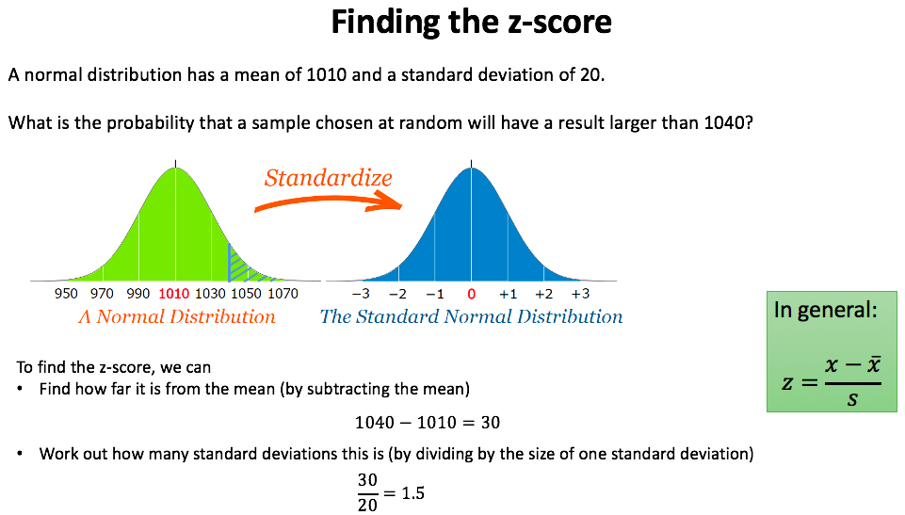

Slide 9
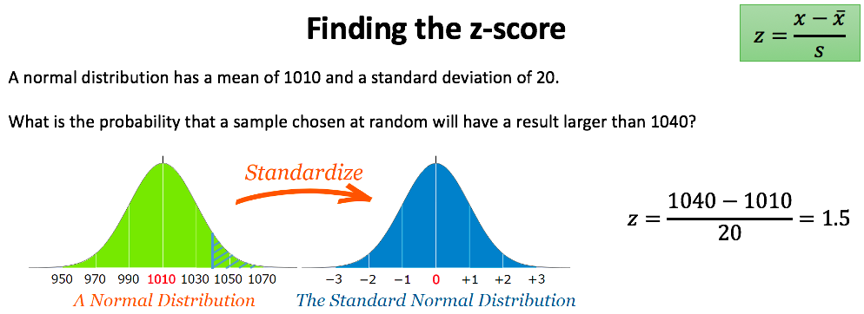
Above 93.32% of the sample group

Slide 10
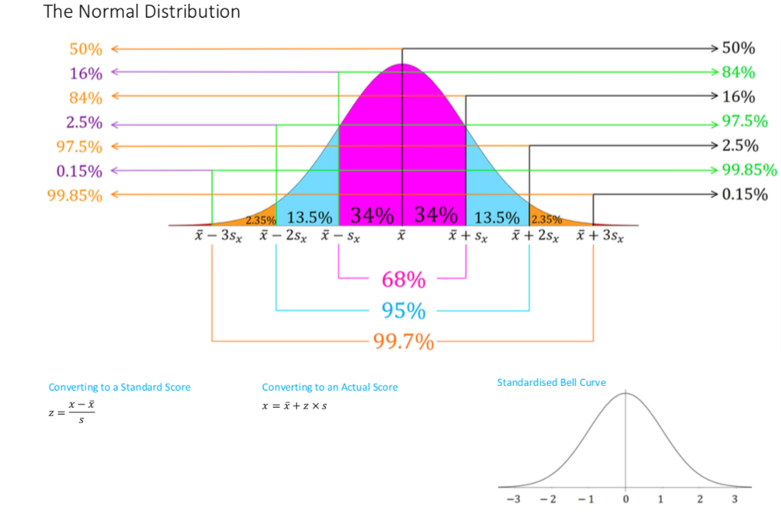

Slide 11
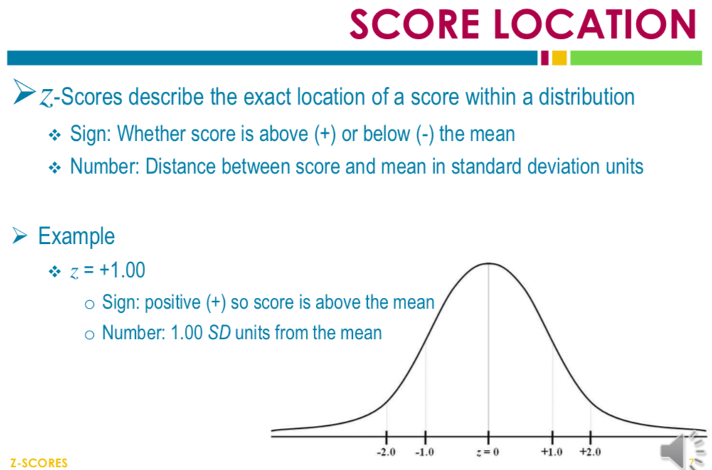
Above 84% of the sample group

Slide 12
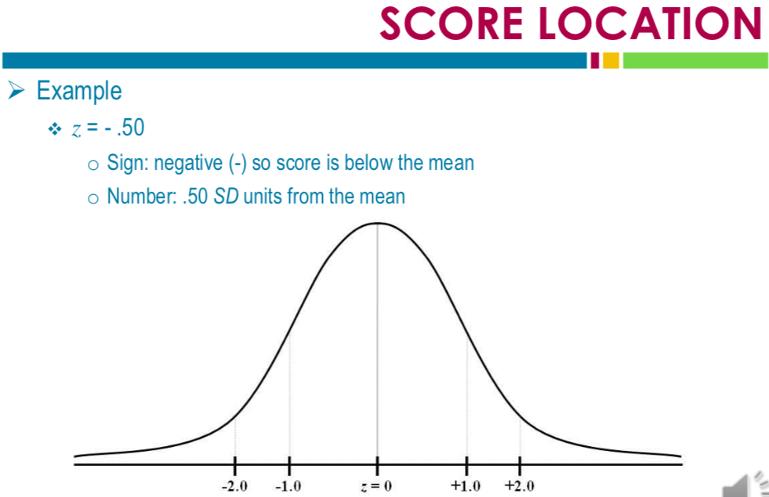
Above 30.85% of the sample group

Slide 13
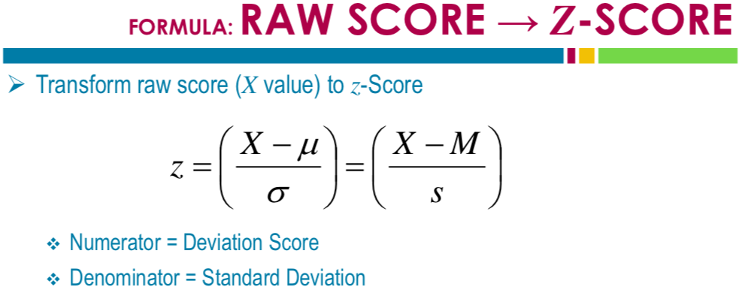

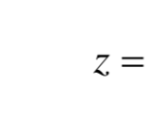

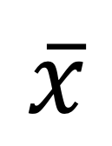
$$\overline{x}$$

Slide 14
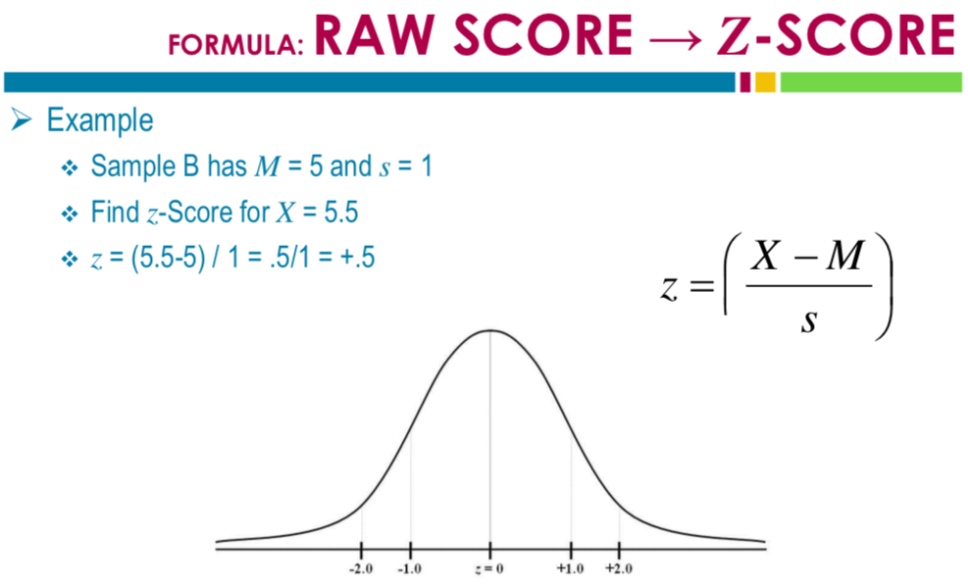

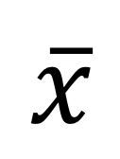
$$\overline{x}$$
$$\overline{x}$$
Above 69.15% of the sample group

Slide 15
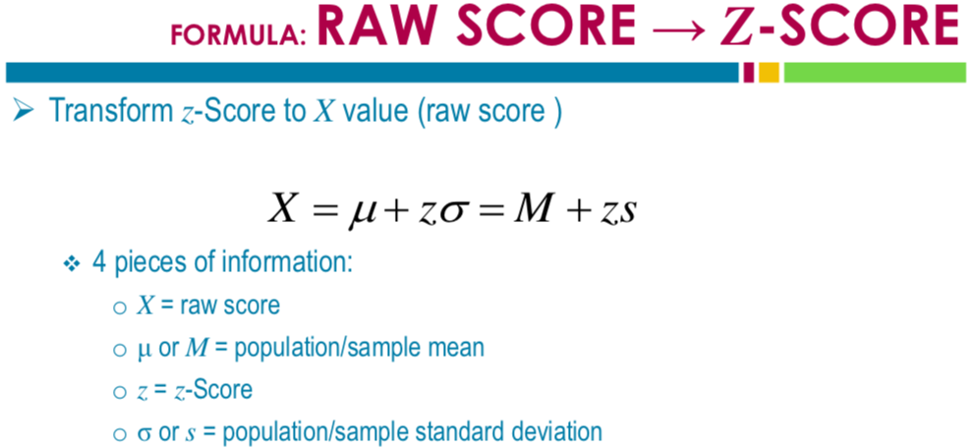




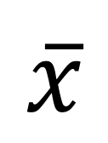
$$\overline{x}$$
$$\overline{x}$$

Slide 16
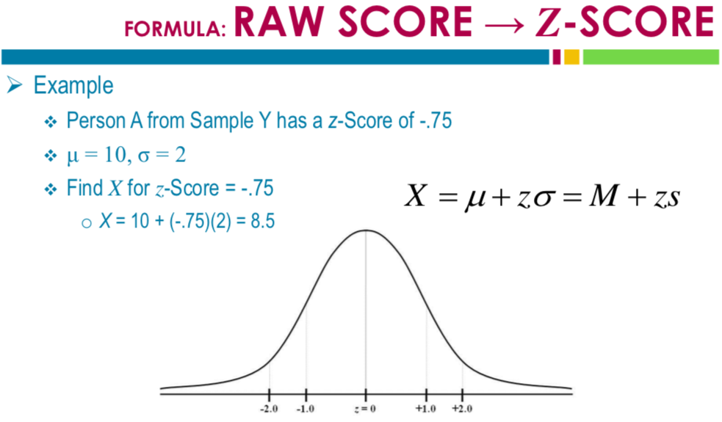




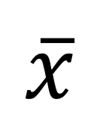
Above 22.66% of the sample group
$$\overline{x}$$
$$\overline{x}$$

Slide 17

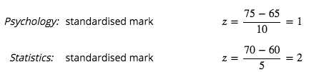
Which subject has the higher score?
Above 84.13% of the sample group
Above 97.73% of the sample group

Slide 18
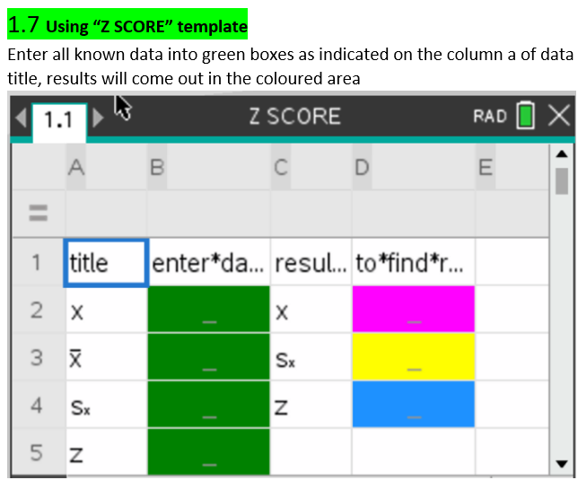

Slide 19
    exercises & Summary Book
1. Ex page 1I
2. Summary notes

