Slide 1
Associations between two categorical variables
2B

Slide 2
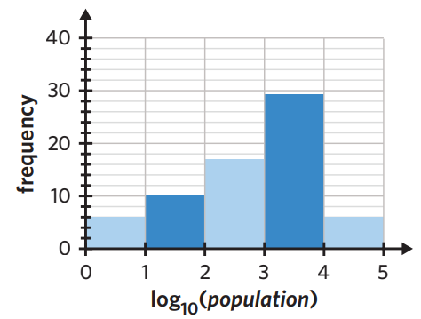
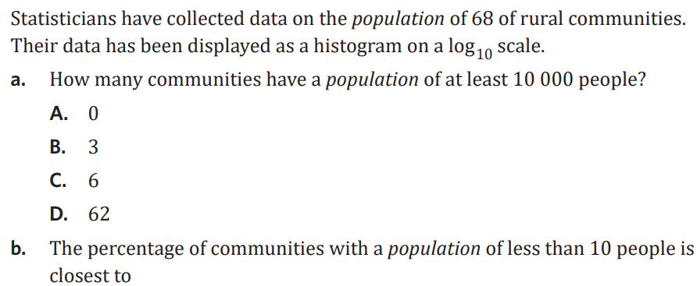

Slide 12
Explanatory Variable
Response Variable

Slide 14
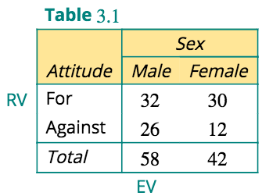
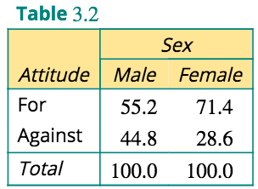

Slide 16
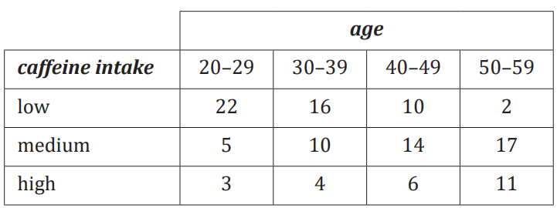
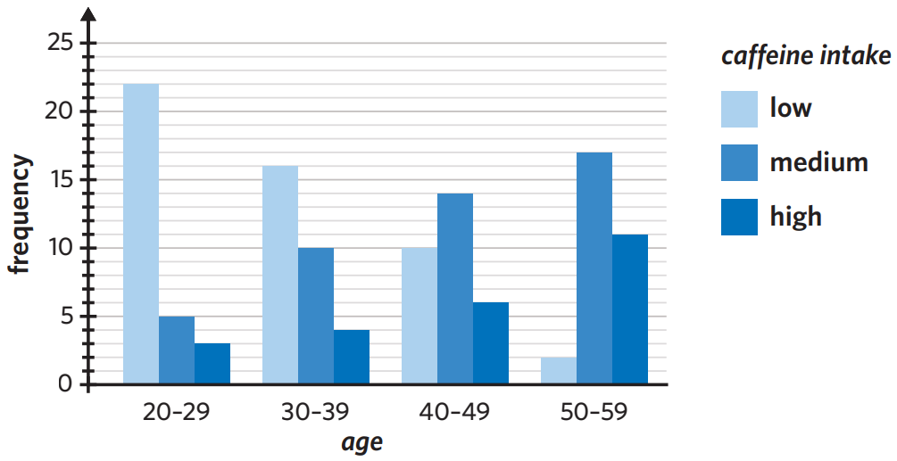
GROUPED BAR CHART

Slide 19
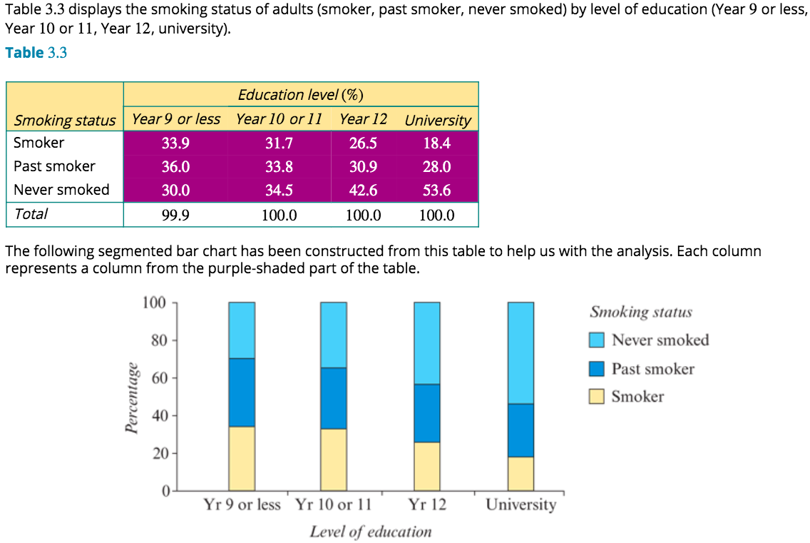
Analysing a situation where two categorical variables have multiple categories

Slide 21
REPORT

Slide 22
exercises & Summary Book
1. Ex page 2A
2. Summary notes

