Slide 1
Associations between numerical and categorical variables
2B
Notes:
https://create.kahoot.it/details/af8643fd-2302-4342-836d-5dfe36f15cc9

Slide 3
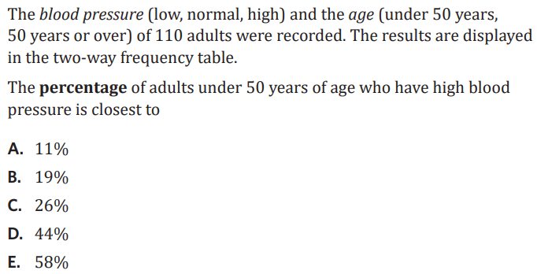
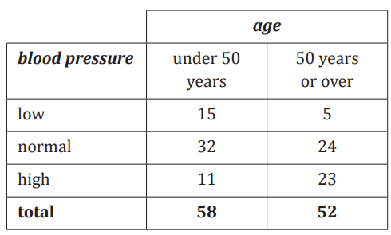

Slide 5
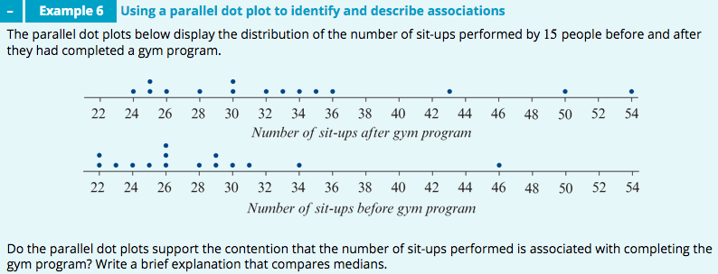
𝑀=32
𝑀=26
Yes; the median number of sit-ups performed after attending the gym program (𝑀=32) is considerably higher than the number of sit-ups performed before attending the gym program (𝑀=26). This indicates that the number of sit-ups performed is associated with completing the gym program.

Slide 8
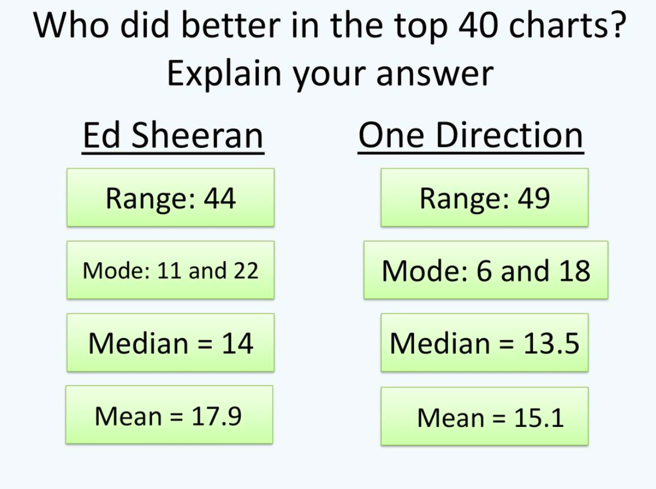

Slide 10
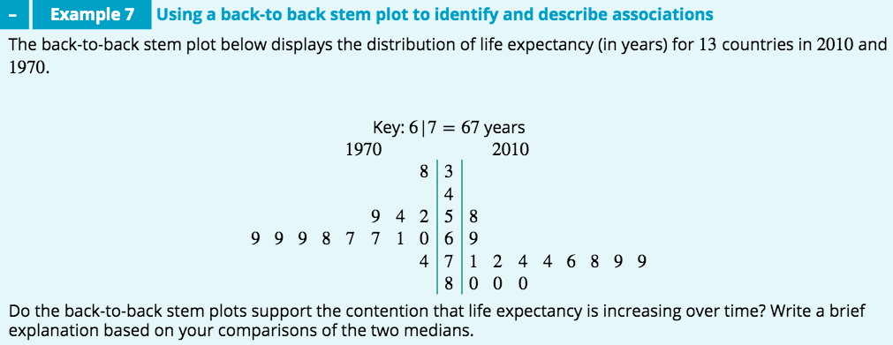
M=76
M=67
Yes: the median life expectancy in 2010 (𝑀=76 years) is considerably higher than the median life expectancy in 1970 (𝑀=67 years). This indicates that life expectancy is increasing over time.

Slide 12
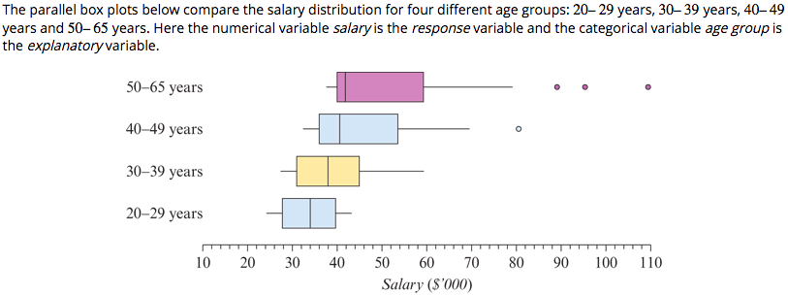
comparing medians
comparing 𝐼𝑄𝑅s and/or ranges
comparing shapes.

Slide 13
exercises & Summary Book
1. Ex page 2B
2. Summary notes

