Slide 1
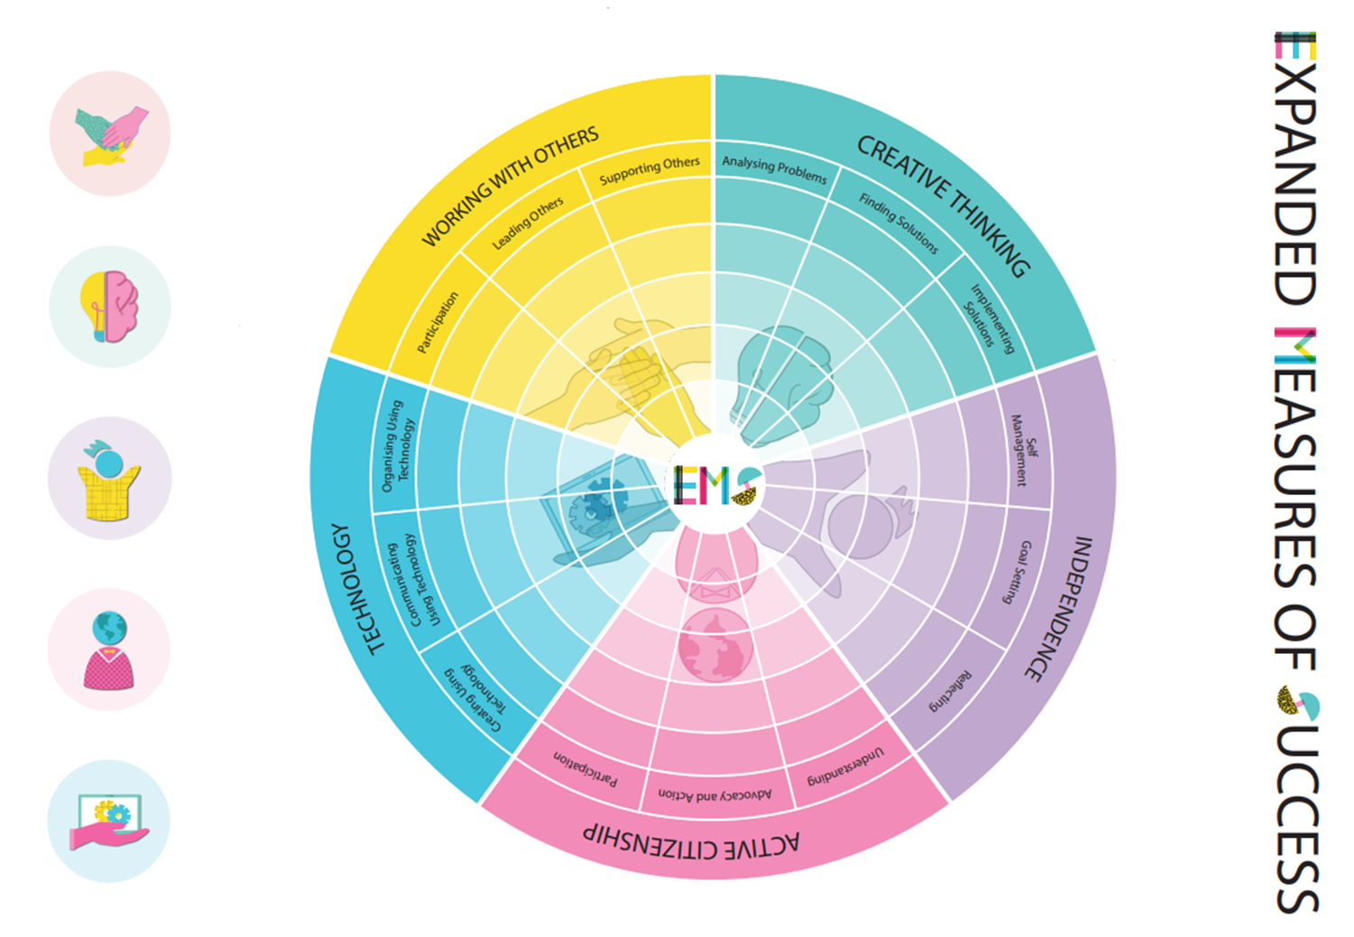
EMS Self Assessment and Goal Setting Connect 2025
Connect 1: Goal Setting
Notes:
It will continue in Lesson 1 every day until the following Thursday.

Slide 2
What are the EMS?
The Expanded Measures of Success (EMS) are TC's way of developing competencies across the curriculum that will prepare students for life beyond their schooling.
At TC we recognise students have and develop a 'tool kit' of social and emotional strengths, alongside passions and interests separate to their academic abilities and knowledge.
We actively identify areas of the EMS that can be developed in our learning, and teach and assess them across all classes.
We are also encouraging students to focus on developing their EMS skills in class and through things they do outside of classes such as scouts, lunchtime clubs, camps, in their places of work, and other areas of their lives.

Slide 3
Why goal setting?
Setting relevant and achievable goals helps you observe, measure and reflect on personal growth
Notes:
We are going to set a personal goal that we hope to work towards during this 'Shark Tank' PBL. At the end of the PBL you will write a reflection about how you went with your goal, and the project overall.

Slide 4
Notes:
You should have heard of the Expanded Measures of Success by now, known as the EMS. You are going to do an activity to see where you think you are now with each of the areas of the EMS.

Slide 5
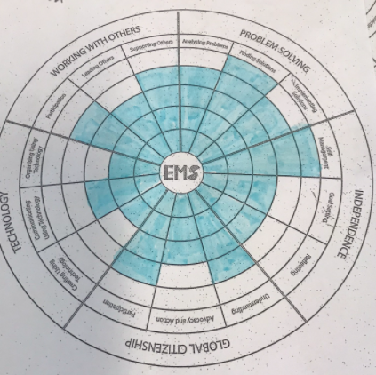
Expanded Measure of Success
Use the heat map worksheet to assess where your levels are currently.
The inner circle represents 0-1 (low). The outer circle is a 5 (high).
This image shows an example of an Entry student from their PBL earlier this year.
Use the rubrics provided to help you self-assess where you are.
This should represent an ‘average’ across different subjects, even though you may display an EMS more in one subject than another.

Slide 6
Self-managing | Relies heavily on external support to work productively. | At times can regulate their own behaviour and time. | Can regulate their own behaviour and manage their time effectively. | Can effectively manage their own behaviour and time, without reliance on external support or control. | Always demonstrates the ability to manage self-regulation, time management and motivation.
Goal setting | Relies heavily on external support to set goals. | Sets and monitors goals with guidance from others. | Sets and monitors goals. | Sets and uses goals to monitor personal growth. | Effectively sets and uses goals to monitor personal growth and adjusts goals as necessary.
Reflecting | Requires prompting to reflect on learning behaviours and areas of success or challenge. | Reflects on learning behaviours and areas of success or challenge. Reluctantly accepts and applies feedback. | Reflects on learning behaviours and areas of success or challenge, accepting and applying feedback. | Reflects on personal growth and development, actively seeking and acting on feedback. | Reflects on personal growth and development, actively seeking and acting on feedback to self-identify their next stages of learning.

Slide 7
Participating (me as a group member) | Can follow basic procedures for working with others. With prompting can participate in group discussions and decision-making processes. | Begins to understand the role of teamwork in achieving and working productively towards outcomes. Can participate in group discussions and decision-making processes. | Can adapt to different group dynamics and adjust communication style accordingly. Works productively towards outcomes. | Anticipates group dynamics and can proactively address potential conflicts. | Anticipates and manage complex group dynamics with ease.
Leading others (me as a group leader) | Demonstrates limited understanding of the importance of teamwork. | With guidance from others contributes effectively towards a shared purpose. | Contributes effectively towards a shared purpose through active participation and encouraging others. | Motivates others to contribute towards a shared purpose, actively encouraging all members of the group. | Supports all team members to work together effectively towards a shared purpose through mentoring and skill development.
Supporting others (me as a group facilitator) | Can identify group members. Solely focussed on individual contribution to group. | Shares ideas and listens to other perspectives. | Supports others in their roles within the group. Shares ideas and listens to other perspectives. Participates in co-creation of solutions. | Able to consider diverse perspectives. Effectively participates in group discussions and decision-making processes. | Effectively participates in group discussions and decision-making processes by including diverse opinions and showing empathy and respect for others.

Slide 8
Analysing problems (critical thinking) | Struggles to identify and define problems, often relying on others to define the issue for them | Begins to understand the problem-solving process and can identify and understand problems, but still relies on others for guidance and support | Can effectively identify and understand problems and explores and defines relevant factors | Consistently demonstrates effective problem-solving process | Consistently demonstrates effective problem-solving skills, approaching challenges in a well-organised way
Finding solutions (creative thinking) | Generates limited solutions and struggles with creative thinking, relying on familiar solutions or solutions provided by others | Struggles with generating a range of options and making decisions. Generates a simple solution with limited evaluation. | Demonstrates some critical thinking in decision-making, weighing the potential outcomes of different options and choosing a preferred solution | Generates and tests various solutions, shows consideration of a range of factors when justifying decisions | Generates and tests a range of innovative solutions, considering a range of options and factors in their decision making, and using these to justify decisions
Implementing solutions | Little progress in implementation of a solution | Implementation of a solution is limited. Little evidence of evaluation. | Implements preferred solution with some evaluation of outcomes and consequences | Implements preferred solutions and evaluates the potential outcomes and consequences | Implements preferred solution, evaluates outcomes and consequences, and makes effective adjustments as necessary

Slide 9
Understanding of different perspectives or issues | Struggles to identify people and causes outside of their immediate community | Begins to identify people and causes outside of their immediate community | Identifies with people and causes outside of their immediate community and has developed an informed perspective on global issues | Demonstrates understanding of and respect for different people and perspectives. Has developed an informed and unbiased understanding of global issues. | Demonstrates understanding of and respect for different people and perspectives. Analyses and synthesises information so as to form an educated and unbiased understanding of global issues.
Advocating | Struggles to advocate for others, and lacks awareness of the importance of community and democracy | Begins to advocate for others, but struggles to fully understand the importance of community and democracy | Advocates for others, and understands the importance of working with community | Consistently advocates for others, and demonstrates a deep understanding of the importance of engaging community and using democracy | Consistently advocates for others, and demonstrates understanding of the importance of engaging community and using democracy
Participating in helping people or causes | Rarely participates in community service or gives their time and resources to help people and causes | Begins to participate in community service or give their time and resources to help people and causes, but with limited understanding of the impact | Participates in community service or gives their time and resources to help people and causes | Consistently participates in community service or gives their time and resources to help people and causes. | Mentors and develops others in global citizenship skills, helping to build their empathy, compassion, and commitment to the greater good.

Slide 10
Creating using technology | Struggles to use technology effectively to create and design products, often requiring assistance from others to complete basic tasks | Begins to understand how to use technology to create and design products, but still relies on others for guidance and support | Can effectively and responsibly use technology to create and design products, completing basic tasks with some independence | Demonstrates effective and ethical use of technology to independently create and design products | Consistently uses technology in innovative ways to support the development of creative ideas or products
Communicating using technology | Struggles to communicate through technology, relying on familiar communication methods | Can communicate through technology, but still relies on others for guidance and support | Can communicate through technology, using mostly appropriate communication tools | Can effectively communicate through technology, using appropriate communication tools for an audience responsibly | Can effectively communicate through technology by selecting appropriate communication tools for a specific audience in an ethical manner
Organising using technology | Relies on others to find and organize information | With guidance and support can find and organize information with technology. | Can find and organize relevant information using technology. | Can find and organize quality information using technology, incorporating appropriate tools and techniques | Can effectively and ethically find and organize information using technology, incorporating appropriate tools and techniques

Slide 11
Expanded Measure of Success – Goal
Use the heat map worksheet to assess where your levels are currently.
Reflect on your areas of strength and weakness.
Identify an area you would like to develop this semester
Send a Teams message to your Connect teacher with your EMS focus area
Outline some steps you could take to progress with this goal

Slide 12
Expanded Measure of Success – End of Semester Reflection
What was your EMS goal for this semester?
Return to your heat map
Have you grown in any of the areas, and specifically in the area of your goal?
Draft a reflection comment to add to your Compass EMS Learning Task

Slide 13
Compass Reflection – Answer in paragraph form
My EMS focus area this semester was…
I chose this EMS because…
Some things I did to achieve this goal were…
Describe how you went with your goal. Did you see personal growth in this area? Give an example that demonstrates this.
Something I could have done better/more was…
What would you like to work on/keep trying to do in the future?

