Slide 1
Fitting a least squares regression line
3A
Notes:
https://www.ck12.org/assessment/tools/geometry-tool/plix.html?eId=MAT.STA.532&questionId=559c182b5aa4136077139e50&artifactID=2325387&backUrl=https%3A//www.ck12.org/statistics/Least-Squares-Regressi
https://forms.gle/JqMs66SYqbR6sk138
https://dashboard.blooket.com/set/629fd29fcd6ca5b0becde8e3
https://dashboard.blooket.com/set/6268c509fb8fac3dad70f8e0

Slide 2
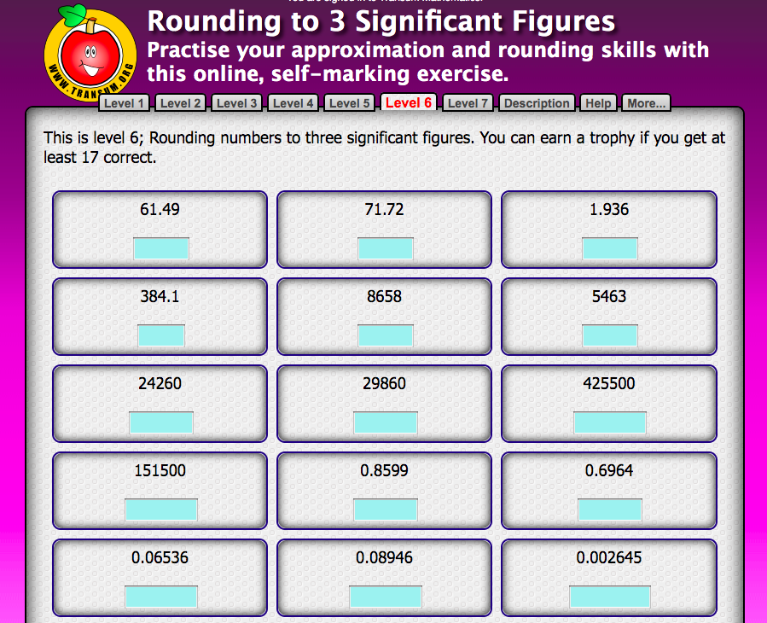
Notes:
https://www.transum.org/Software/SW/Starter_of_the_day/Students/Rounding.asp

Slide 3
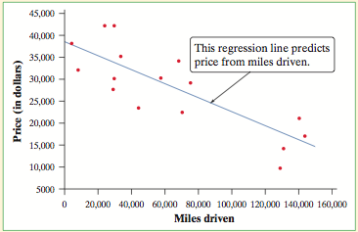
Regression Line
A regression line summarizes the relationship between two variables, EV helps explain or predict RV.
A regression line
We often use a regression line to predict the value of y for a given value of x.

Slide 4
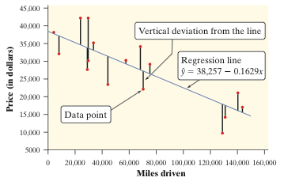
Residuals
In most cases, no line will pass exactly through all the points in a scatterplot. A good regression line makes the vertical distances of the points from the line as small as possible.
A residual is the difference between an actual value of the response variable and the value predicted by the regression line.
residual = actual data value y - predicted value y
residual = y - ŷ

Slide 5
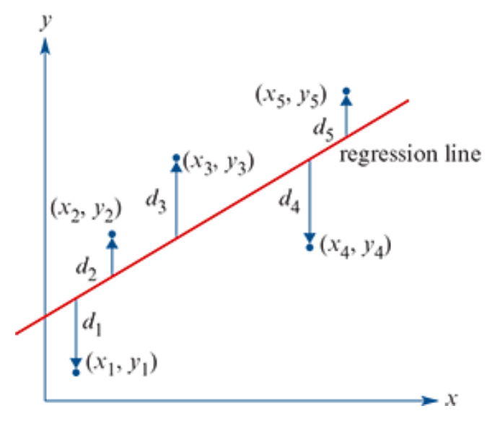
Least Squares Regression Line y=a+bx
The least-squares regression line of y on x is the line that makes the sum of the squared residuals as small as possible.

Slide 6
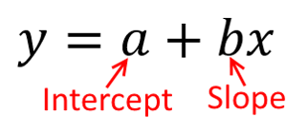
Least Squares Regression Line
The assumptions for fitting a least squares line to data are the same as for using the correlation coefficient, 𝑟. These are that:
1. the data is numerical
2. the association is linear
3. there are no clear outliers.
The equation of the least squares regression line is given by 𝑦=𝑎+𝑏𝑥, where:
the slope (𝑏) is given by 𝑏=$\frac{{rs}_{y}}{s_{x}}$
the intercept (𝑎) is then given by 𝑎= $\overline{y}$−𝑏$\overline{x}$
Here:
𝑟 is the correlation coefficient
$s_{x}$and $s_{y}$ are the standard deviations of 𝑥 and 𝑦
$\overline{x}$and $\overline{y}$are the mean values of 𝑥 and 𝑦.

Slide 7
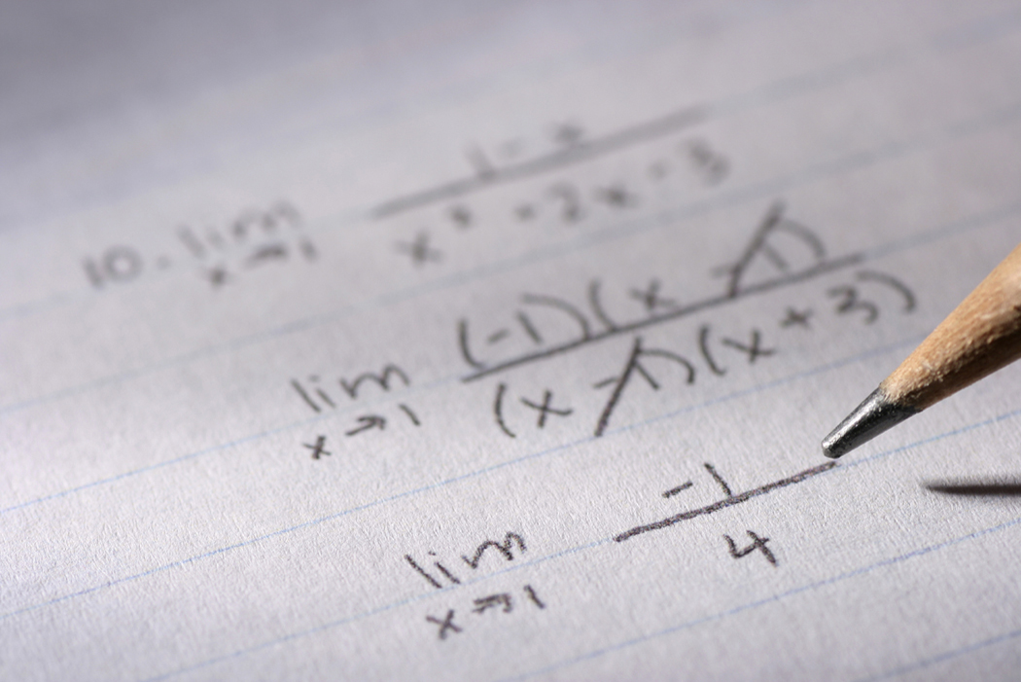
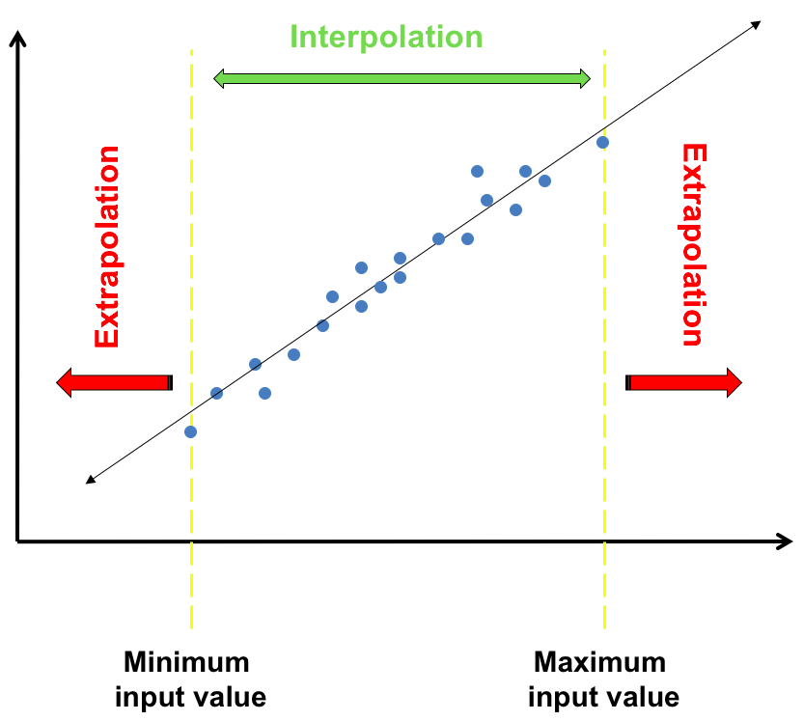
Vocabulary
Interpolation – Using a model to make a prediction within the range of data used to construct the model.
Extrapolation – Using a model to make a prediction beyond the range of data used to construct the model.

Slide 8
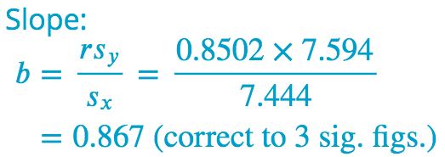
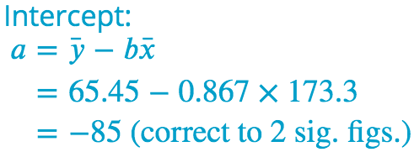
How to determine the equation of a least squares line using the formula
RV…..
EV…..

Slide 9
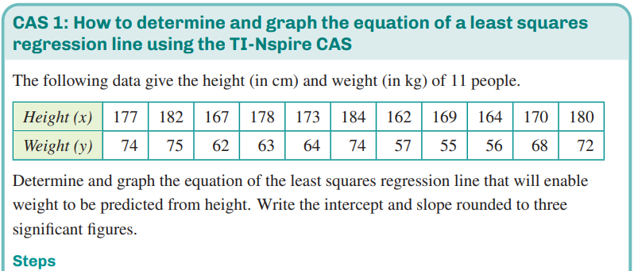
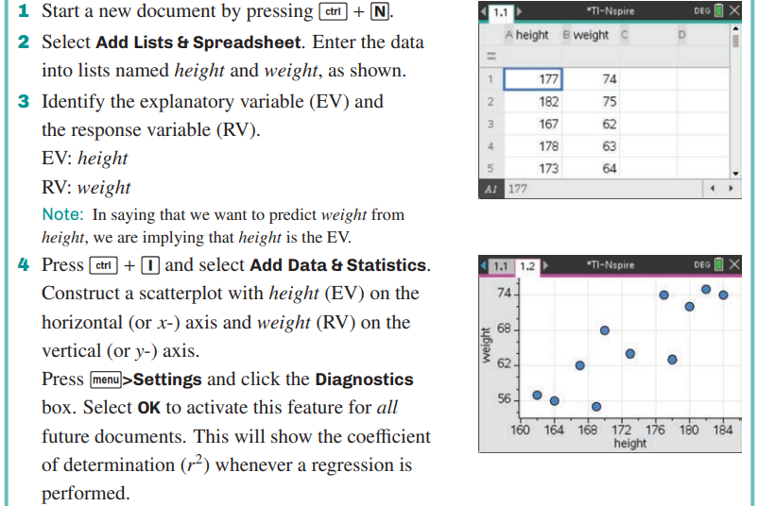
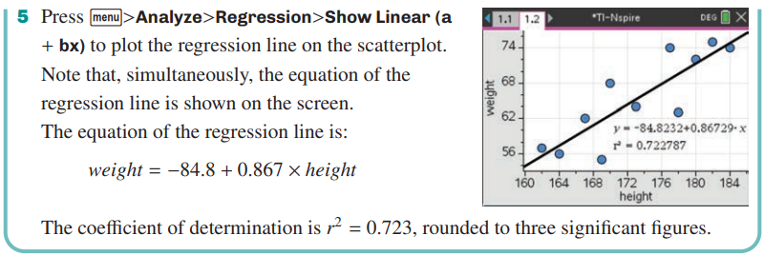
CAS Notes 3.1
Sig. Fig.

Slide 10
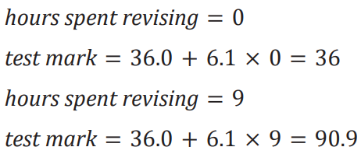
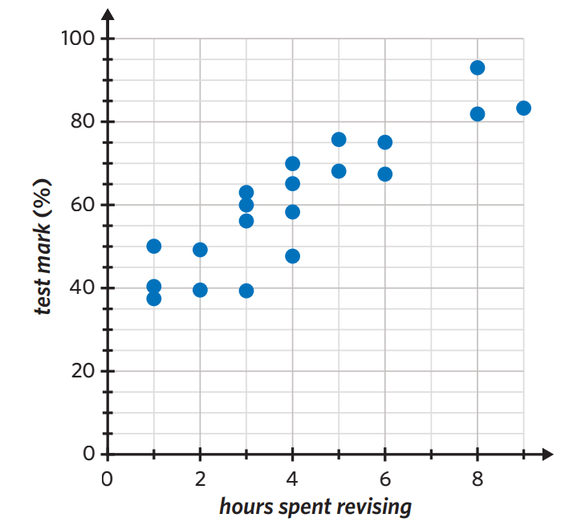
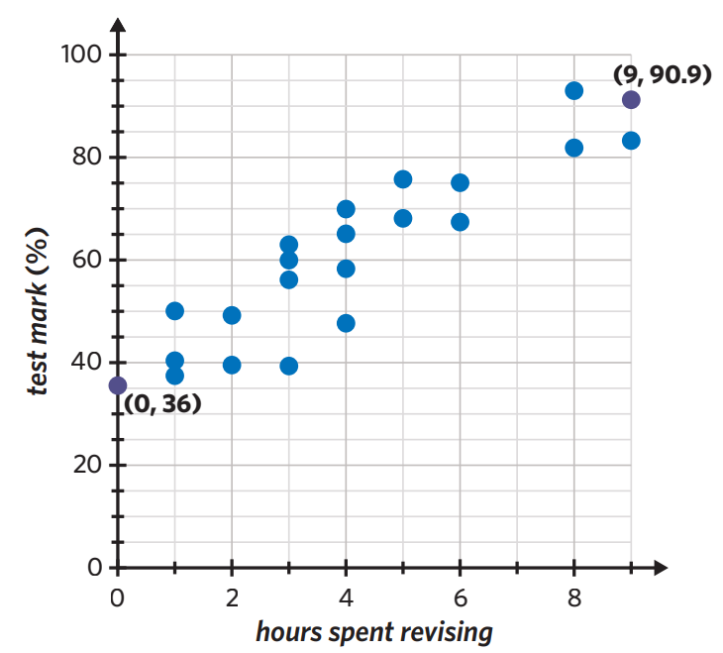
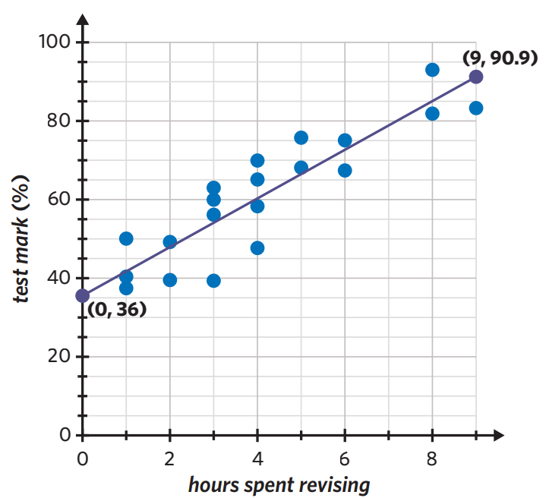
Sketching a least squares regression line from its equation
2 points needed…..

Slide 11
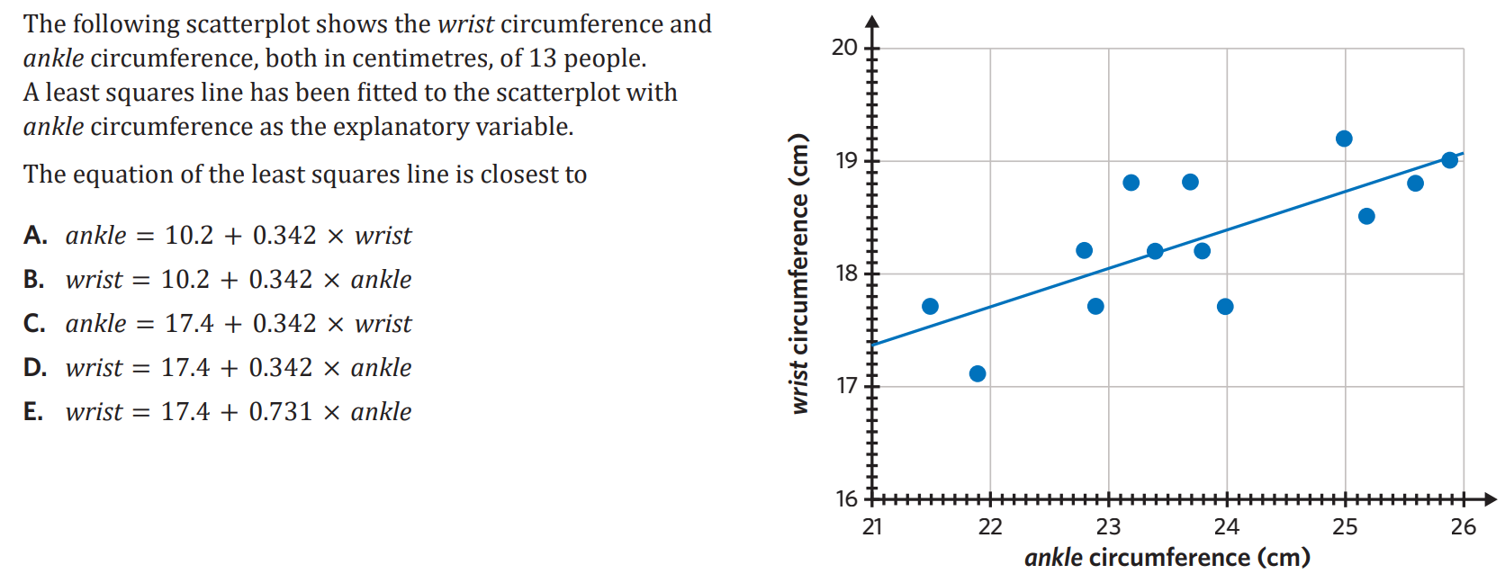
Locate RV…..

Slide 12
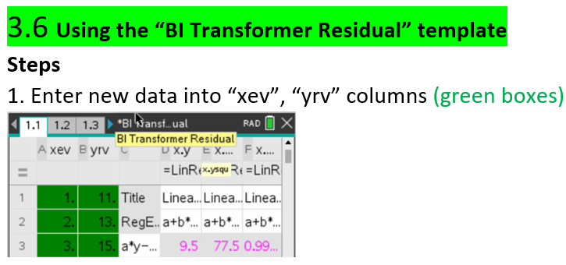
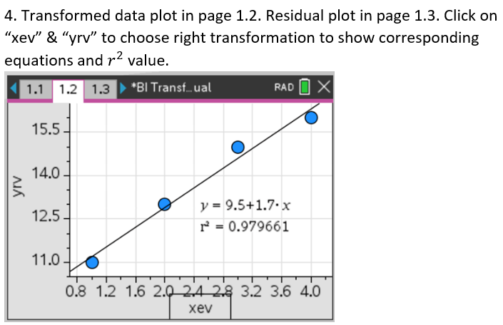
Sig. Fig.
CAS Notes 3.6

Slide 13
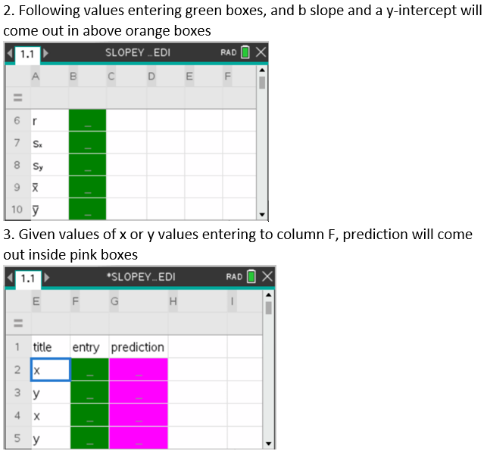
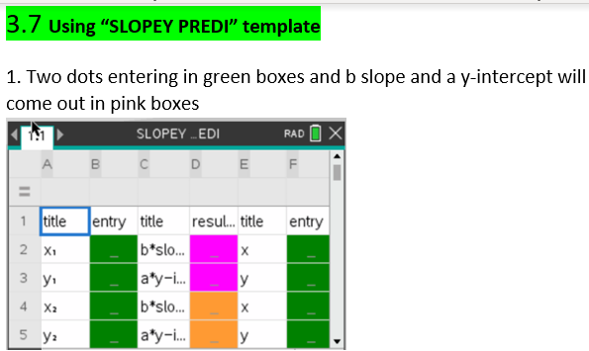
CAS Notes 3.7

Slide 14
Notes:
https://www.transum.org/Maths/Activity/Correlation/Default.asp?Level=0
https://www.transum.org/software/GraphMatch/
https://www.transum.org/software/GraphMatch/Gradient.asp

