Slide 1

Interpreting a least squares regression line
3B
Key words: explain, interpret, show, residual, predict, scatter plot, equation, correlation coefficient, r value, coefficient of determination, r^2 value in %, y-intercept, slope, regression line, residual plot.
Notes:
https://create.kahoot.it/details/a5bdc5c0-bf42-4ad7-99bd-1eb8b93b93be
https://create.kahoot.it/details/a1ec0488-9619-480b-85a5-144a46f314f0
https://create.kahoot.it/details/b34fc759-7058-469b-aa87-c2a2e12422b6
https://create.kahoot.it/details/08a032d4-3683-4ed3-a37e-a4e0062415b6
https://create.kahoot.it/details/68bd89a6-b362-437a-b379-56209258272e
https://create.kahoot.it/details/91fa8455-d2f6-4909-99bc-b5e0e076bee0

Slide 2
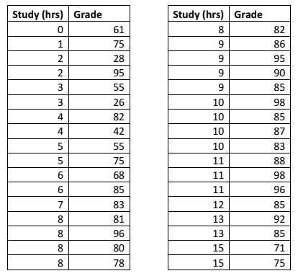
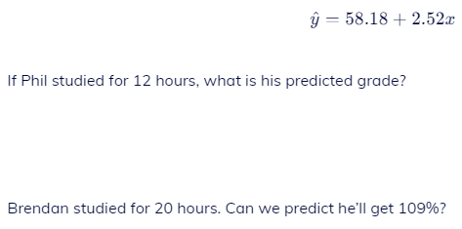
58.18+2.52*12=88.42
58.18+2.52*20=108.58
What is actual Grade value of 12 hours?
85
What is residual of 12 hours?
85-88.42= – 3.42
Notes:
Starter

Slide 3
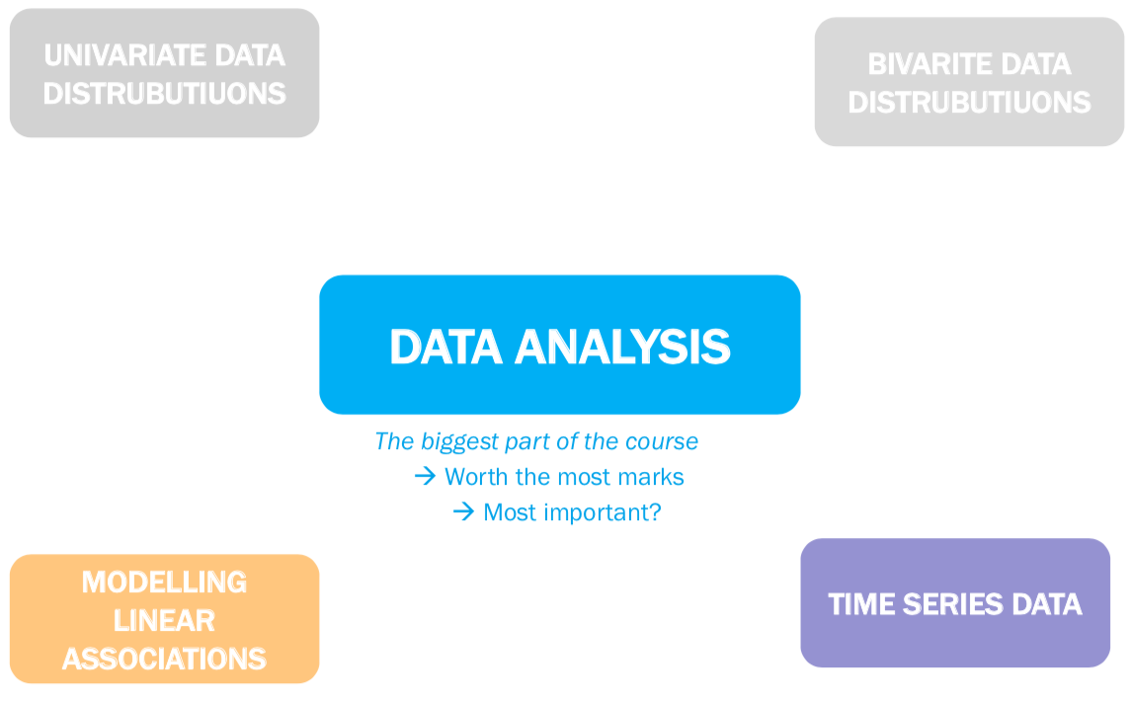

Slide 4
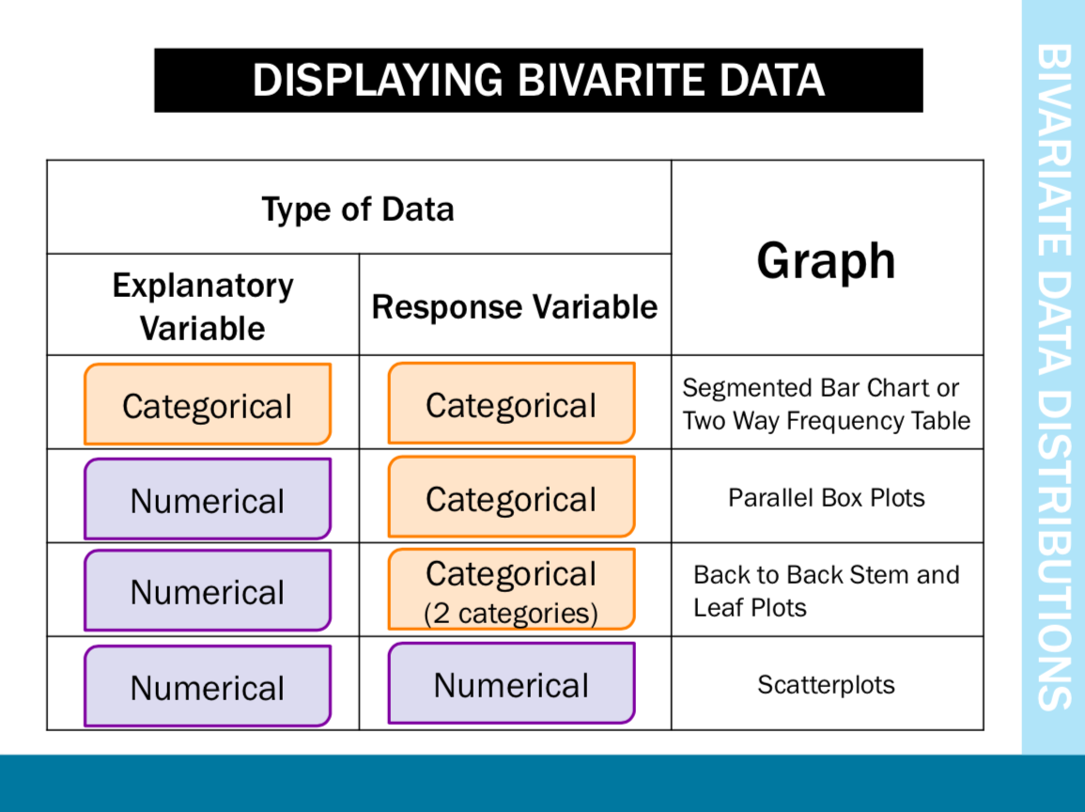

Slide 5
a scatterplot
correlation coefficient
the equation
𝑦-intercept (𝑎) and slope (𝑏)
investigate the nature of an association
indicate the strength of the relationship
Of the regression line
of the least squares line 𝑦=𝑎+𝑏𝑥
1
2
3
4
5
6
7
8
indicate the predictive power of the association
to make predictions
to test the assumption of linearity
on your findings
coefficient of determination
the regression line
residuals and a residual plot
writing a report

Slide 6
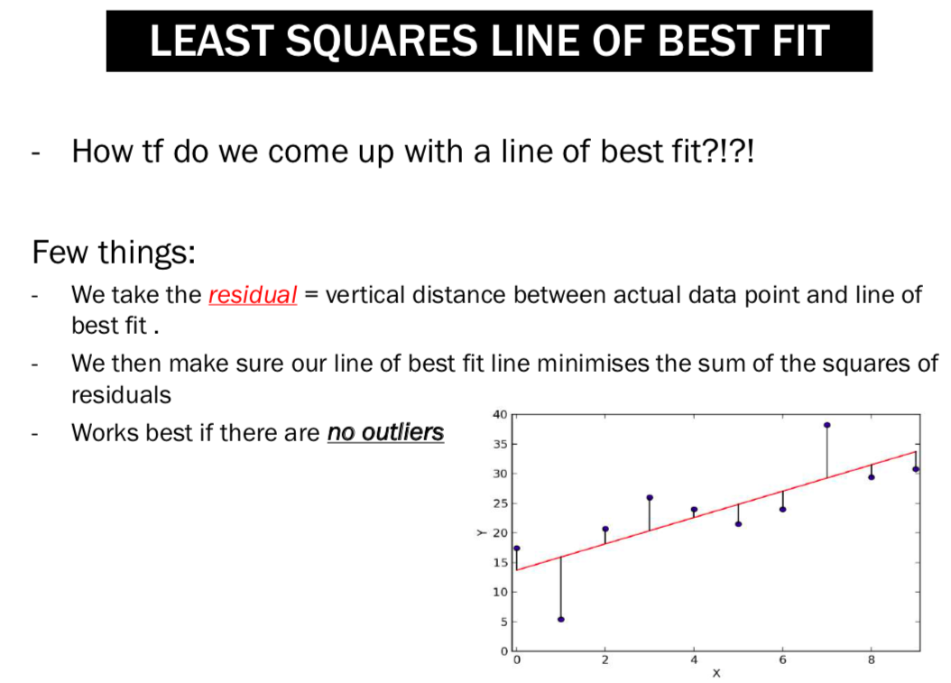

Slide 7
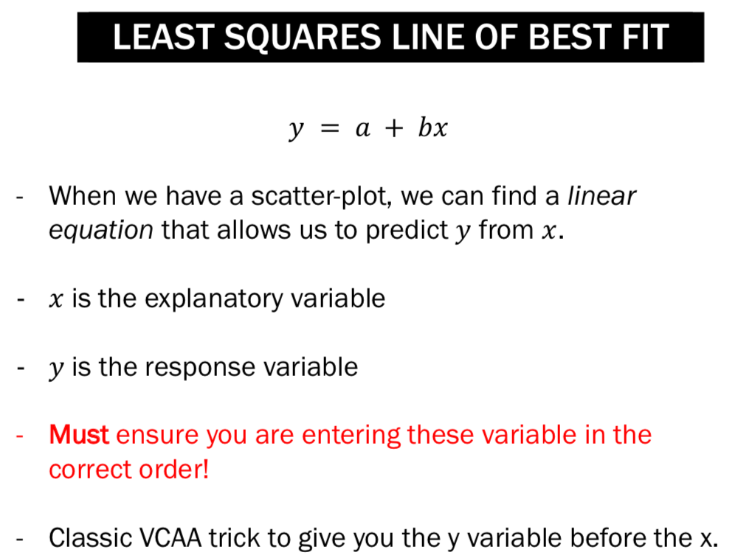

Slide 8

Is it Response, Explanatory Variable?
RV EV

Slide 9
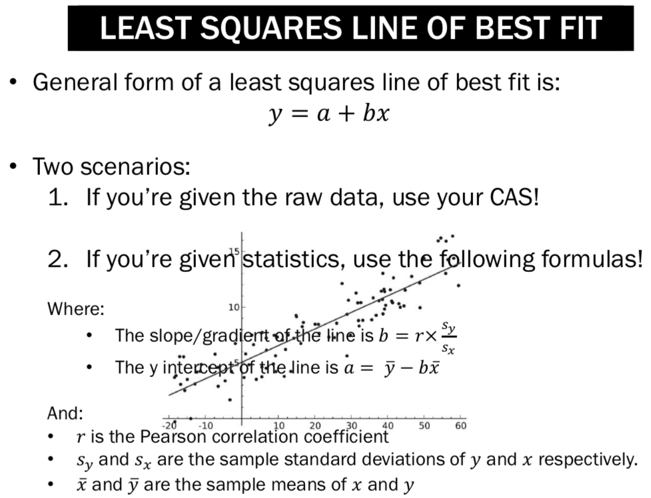


Two scenarios:
If you’re given the raw data, use Mathematica!
If you’re given statistics, use the following formulas!
Where:
The slope/gradient of the line is b=$\frac{rs_{y}}{s_{x}}$
The y intercept of the line is a= $\overline{y} −$ b$\overline{x}$
And:
r is the Pearson correlation coefficient
$s_{y}$ and $s_{x}$ are the standard deviations of y and x respectively.
$\overline{x}$ and $\overline{y}$are the means of x and y.

Slide 10
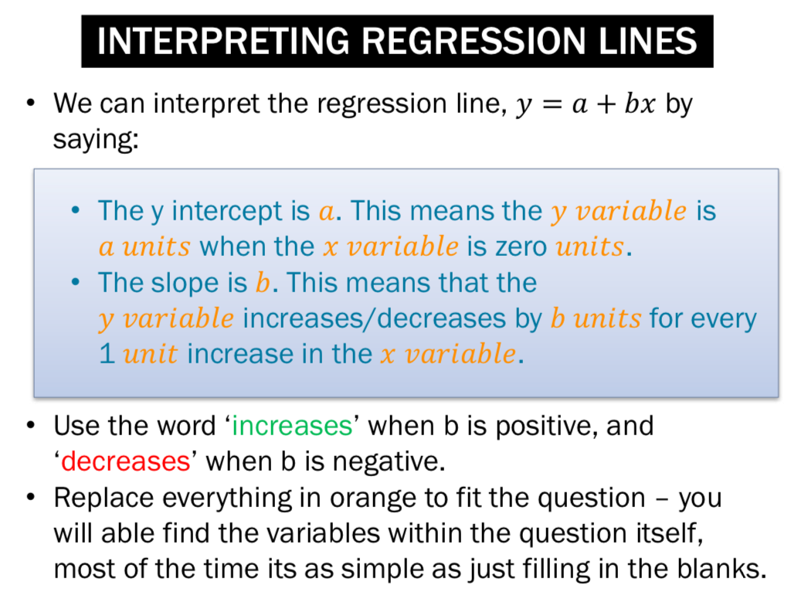
Notes:
Searching key words for questions: explain, interpret, show, residual, predict,

Slide 11
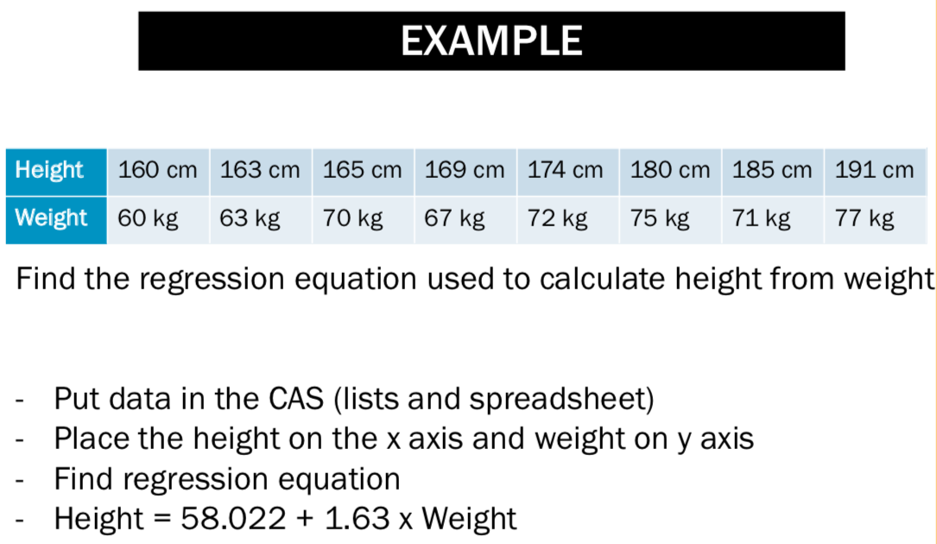
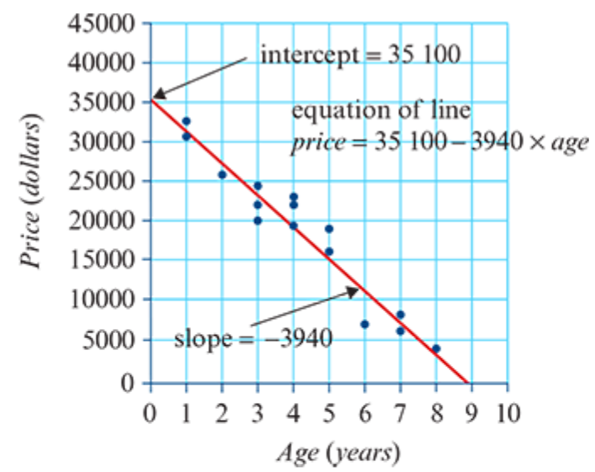



The price of one type of second-hand car changes with time:
price=35100−3940×𝑎𝑔𝑒
Slope=$−$3940
Y-intercept=35 100
Slope: On average, the price of these cars decreases by $3940 each year.
Y-intercept: The new car price is $35 100.

Slide 12

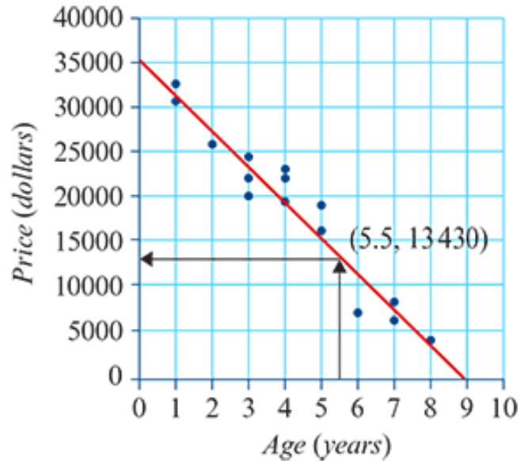

Prediction: Price=35100−3940×5.5=$13430

Slide 13
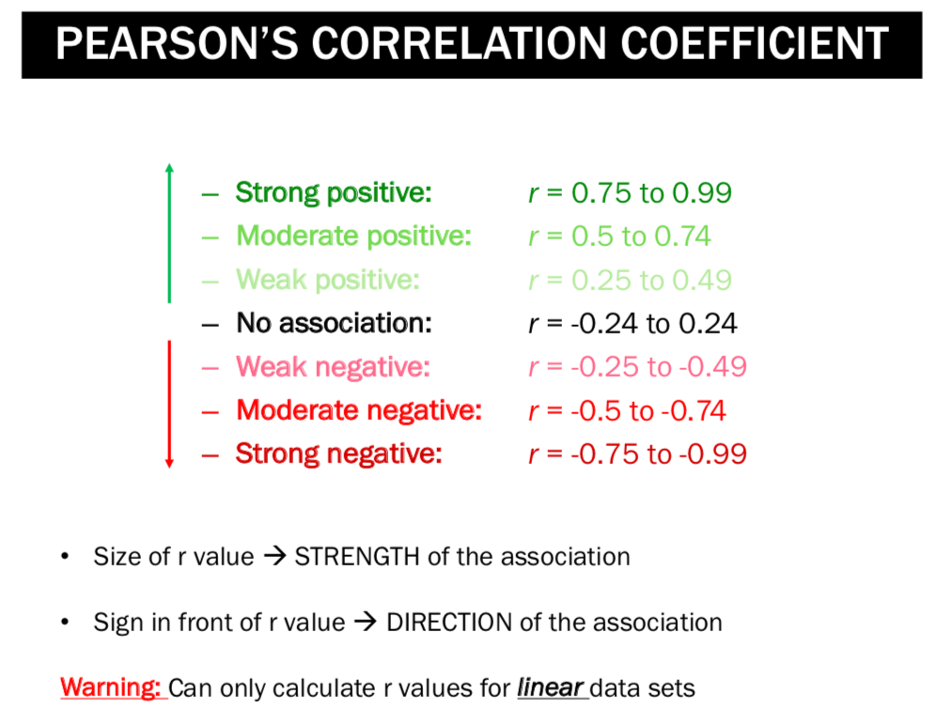
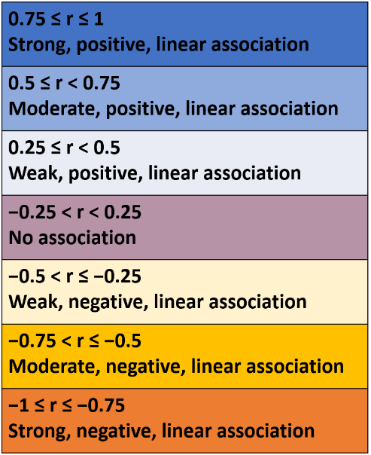


Slide 14
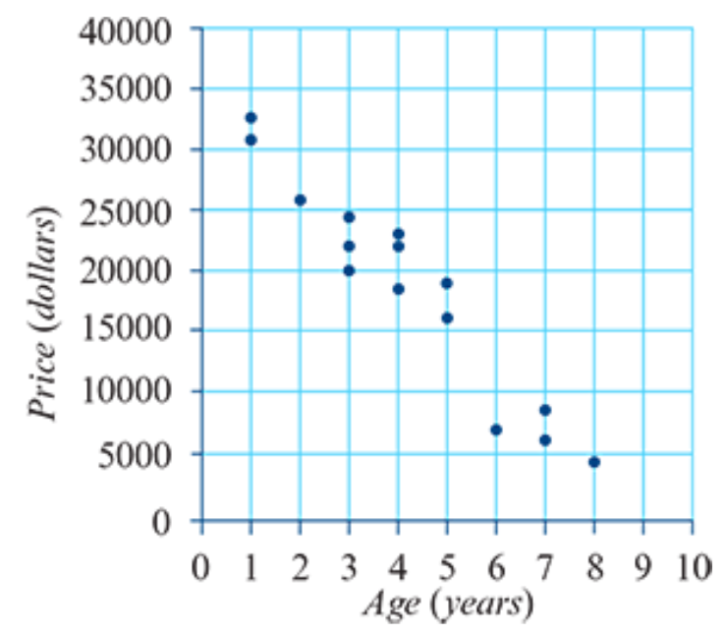


Slide 15
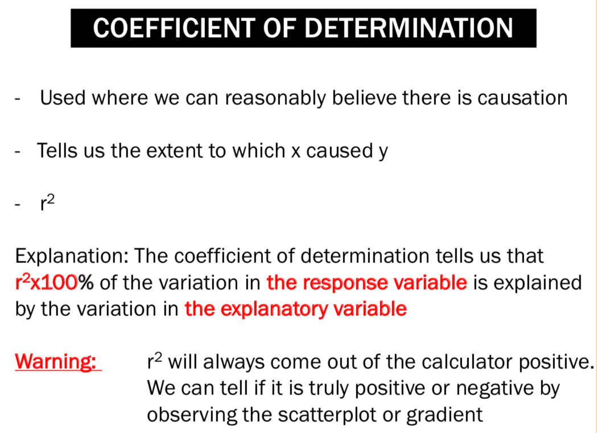
Example:
Example: 93% of the variation in price of the second-hand cars can be explained by the variation in the ages of the cars.

Slide 16
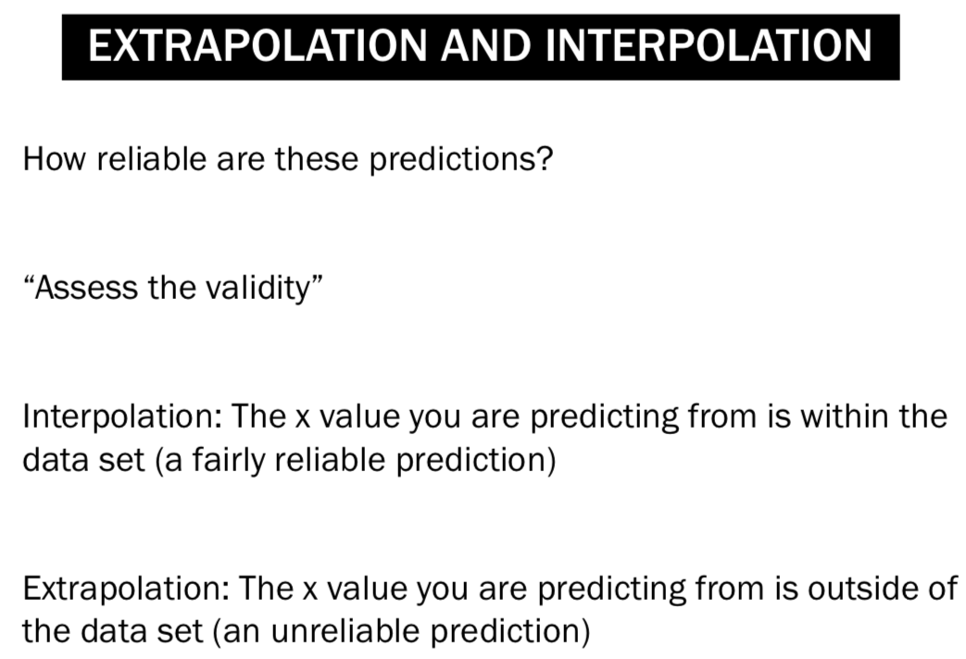
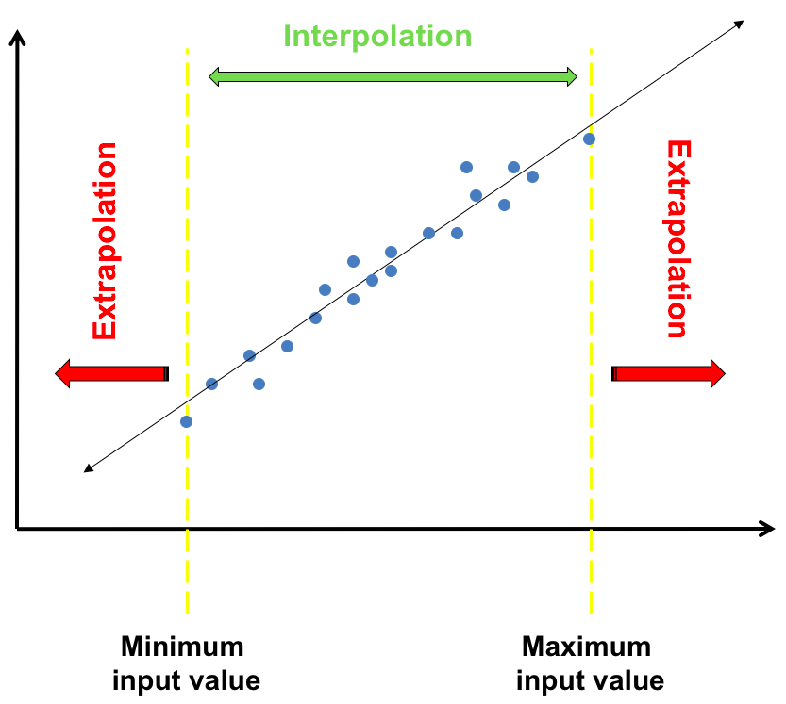

Slide 17
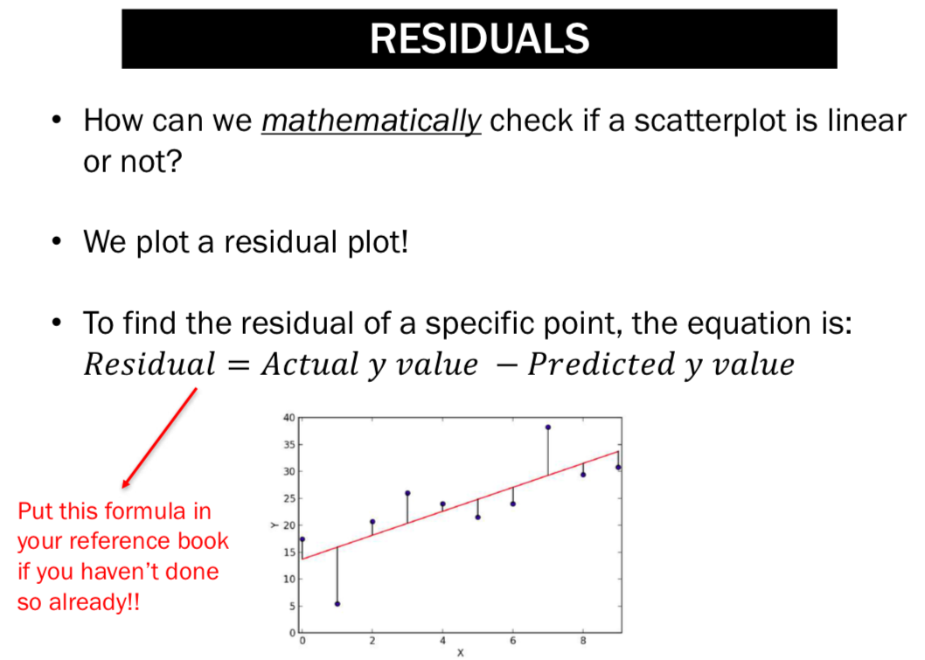
Data points above the regression line have a positive residual.
Data points below the regression line have a negative residual.
Data points on the line have a zero residual.

Slide 18

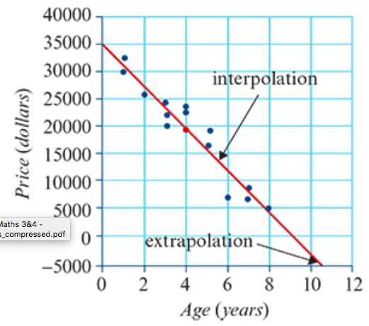
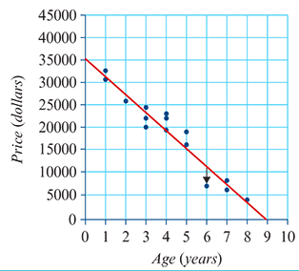
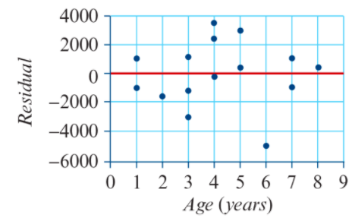

Data points above the regression line have a positive residual.
Data points below the regression line have a negative residual.
Data points on the line have a zero residual.
Actual price: $6500
Predicted price=35100−3940×6=$11460
Residual=actual−predicted=$6500−$11460=−$4960

Slide 19
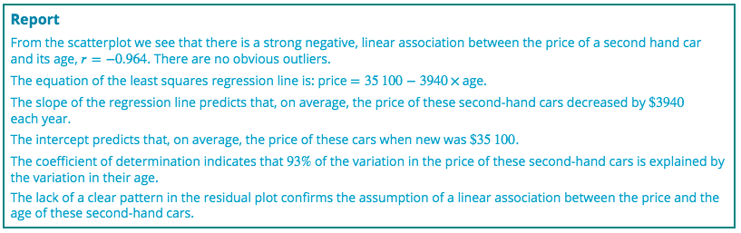
Reporting the results of a regression analysis

Slide 20
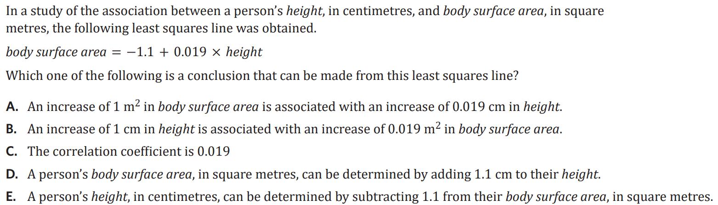
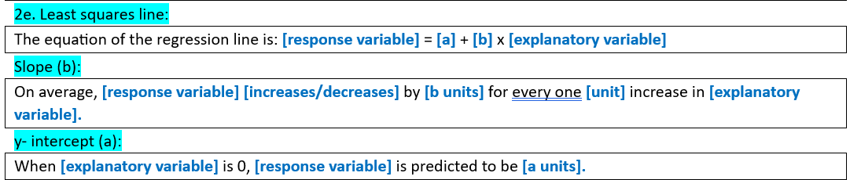
Exam Qs

