Slide 1

Performing a regression analysis
3C
Notes:
https://create.kahoot.it/details/8f168952-75a7-4282-b856-e886a5221608
https://create.kahoot.it/details/a5bbdf92-6b2c-4bc6-9aad-e8ac8233460a
https://create.kahoot.it/details/584a8d17-147d-47e8-a550-59d20becf4aa

Slide 2
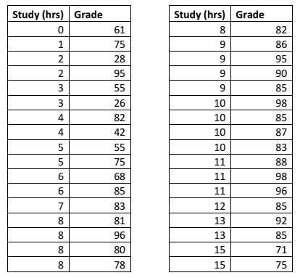
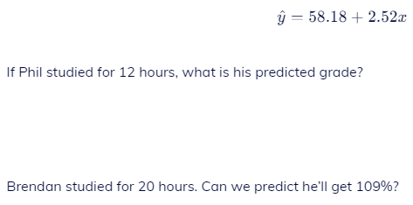
58.18+2.52*12=88.42
58.18+2.52*20=108.58
What is actual Grade value of 12 hours?
85
What is residual of 12 hours?
85-88.42= – 3.42
Notes:
Starter

Slide 3
Correlation
Correlation
  A measure of association between two numerical variables.
Example (positive correlation)
  Typically, in the summer as the temperature increases people are thirstier.
Notes:
Typically, in the summer as the temperature increases people are thirstier. Consider the two numerical variables, temperature and water consumption. We would expect the higher the temperature, the more water a given person would consume. Thus we would say that in the summer time, temperature and water consumption are positively correlated.

Slide 4
Specific Example
Temperature (F)
Water Consumption (ounces)
For seven
random summer days, a person recorded the temperature and their water consumption, during a three-hour period spent outside.
75
16
83
20
85
25
85
27
92
32
97
48
99
48
Notes:
(The data is shown in the table with the temperature placed in increasing order.)

Slide 5
Measuring the Relationship
Pearson’s Sample Correlation Coefficient, r
  measures the direction and the strength of the linear association between two numerical paired variables.

Slide 6
Example of Correlation
Is there an association between:
Children’s IQ and Parents’ IQ
People’s weights and heights
The weight of the cheese and the amount you pay
Number of police patrol and number of crime
Grade on exam and time on exam

Slide 7
Strength of the Association: r²
Coefficient of Determination = r²
General Interpretation: The coefficient of determination tells the percent of the variation in the response variable that is explained (determined) by the model and the explanatory variable.
The degree to which one variable can be predicted from another linearly related variable is given by a statistic called the coefficient of determination.

Slide 8
Interpretation of r²
Example: r² =0.927=92.7%.
Interpretation:
  Almost 93% of the variability in the amount of water consumed is explained by outside temperature using this model.
  Note: Therefore 7% of the variation in the amount of water consumed is not explained by this model using temperature.
Reporting on Coefficient of Determination
Almost[Coefficient of Determination in Percentage] of [response variable RV 𝑦] can be explained by [explanatory variable EV 𝑥].
Notes:
Note: This means that approximately 7% of the variation in the water consumption is not explained by the temperature. So perhaps there is another variable that accounts for the remaining portion of the variation. Can you think of a reasonable variable? Multiple Regression is the name of the method that would include more than one independent variable to predict amount of water people would drink.

Slide 9
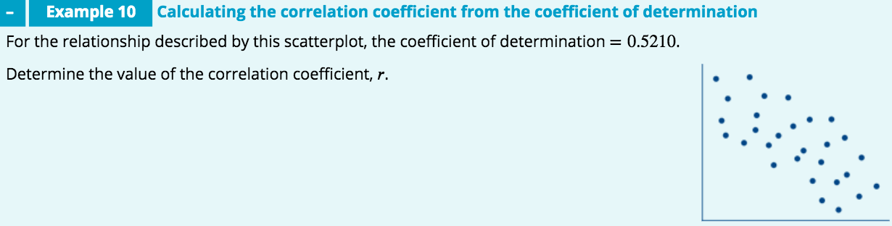


Slide 10
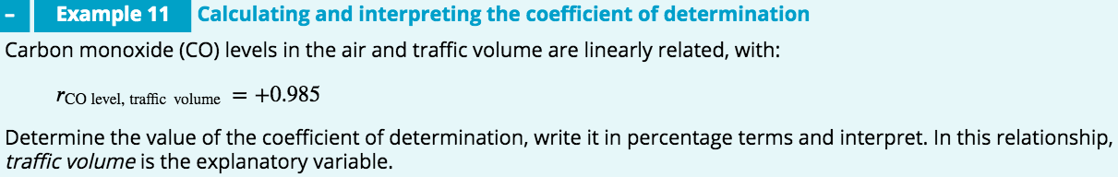

Therefore, 97% of the variation in carbon monoxide levels in the air can be explained by the variation in traffic volume.

Slide 11
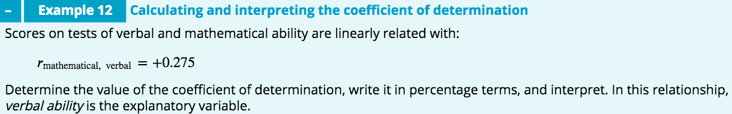

Therefore, only 7.6% of the variation observed in scores on the mathematical ability test can be explained by the variation in scores obtained on the verbal ability test.
Not good predictors as 92.4% of the variation in mathematical ability is explained by other factors.

Slide 12
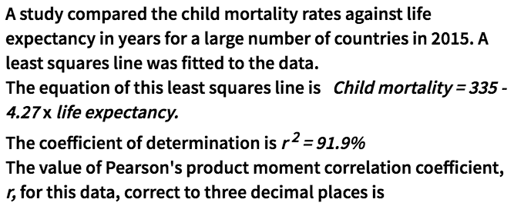
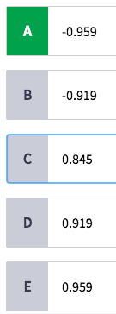
Interpretation of r²
Hint: Y=a+bx, b is slope, a is y-intercept
When b slope is positive, the line goes up, when b slope is negative number, the line goes down. Here the slope b=-4.27

Slide 13
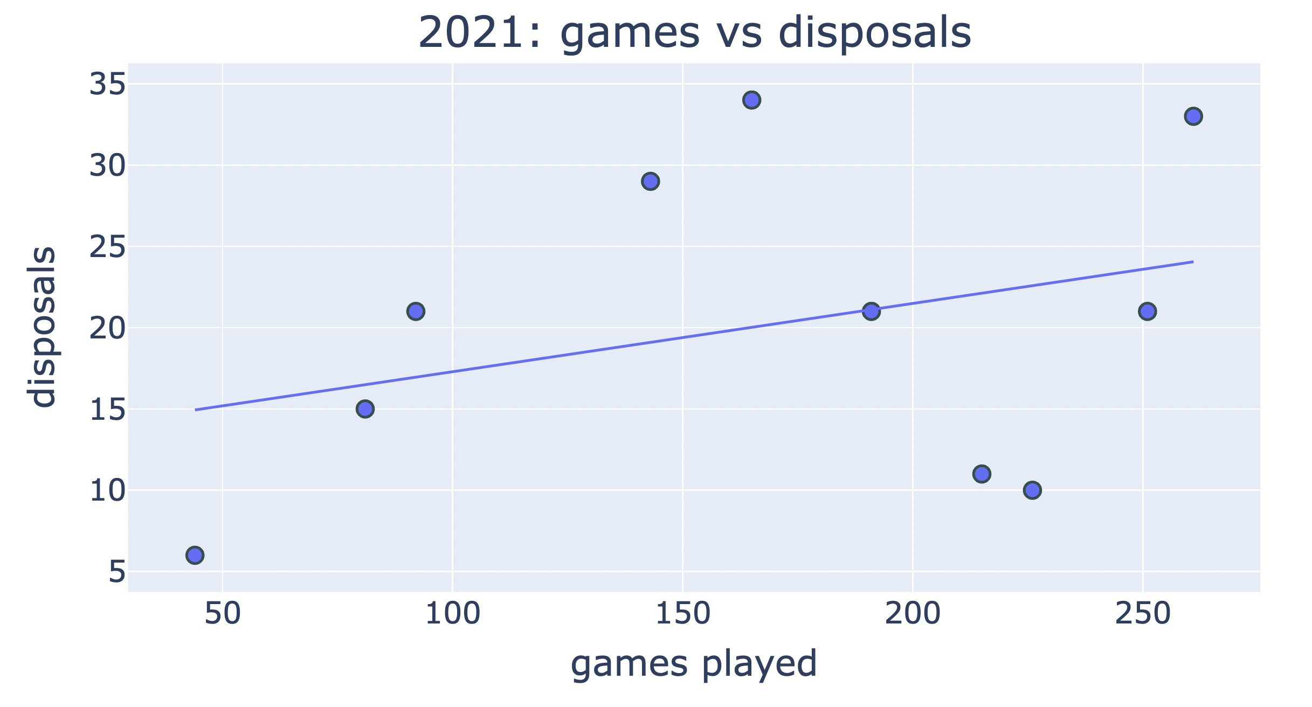
Understanding residuals
$$\text{disposals}\text{ = }13 \text{+} 0.042×\text{games} \text{played}$$

Slide 14
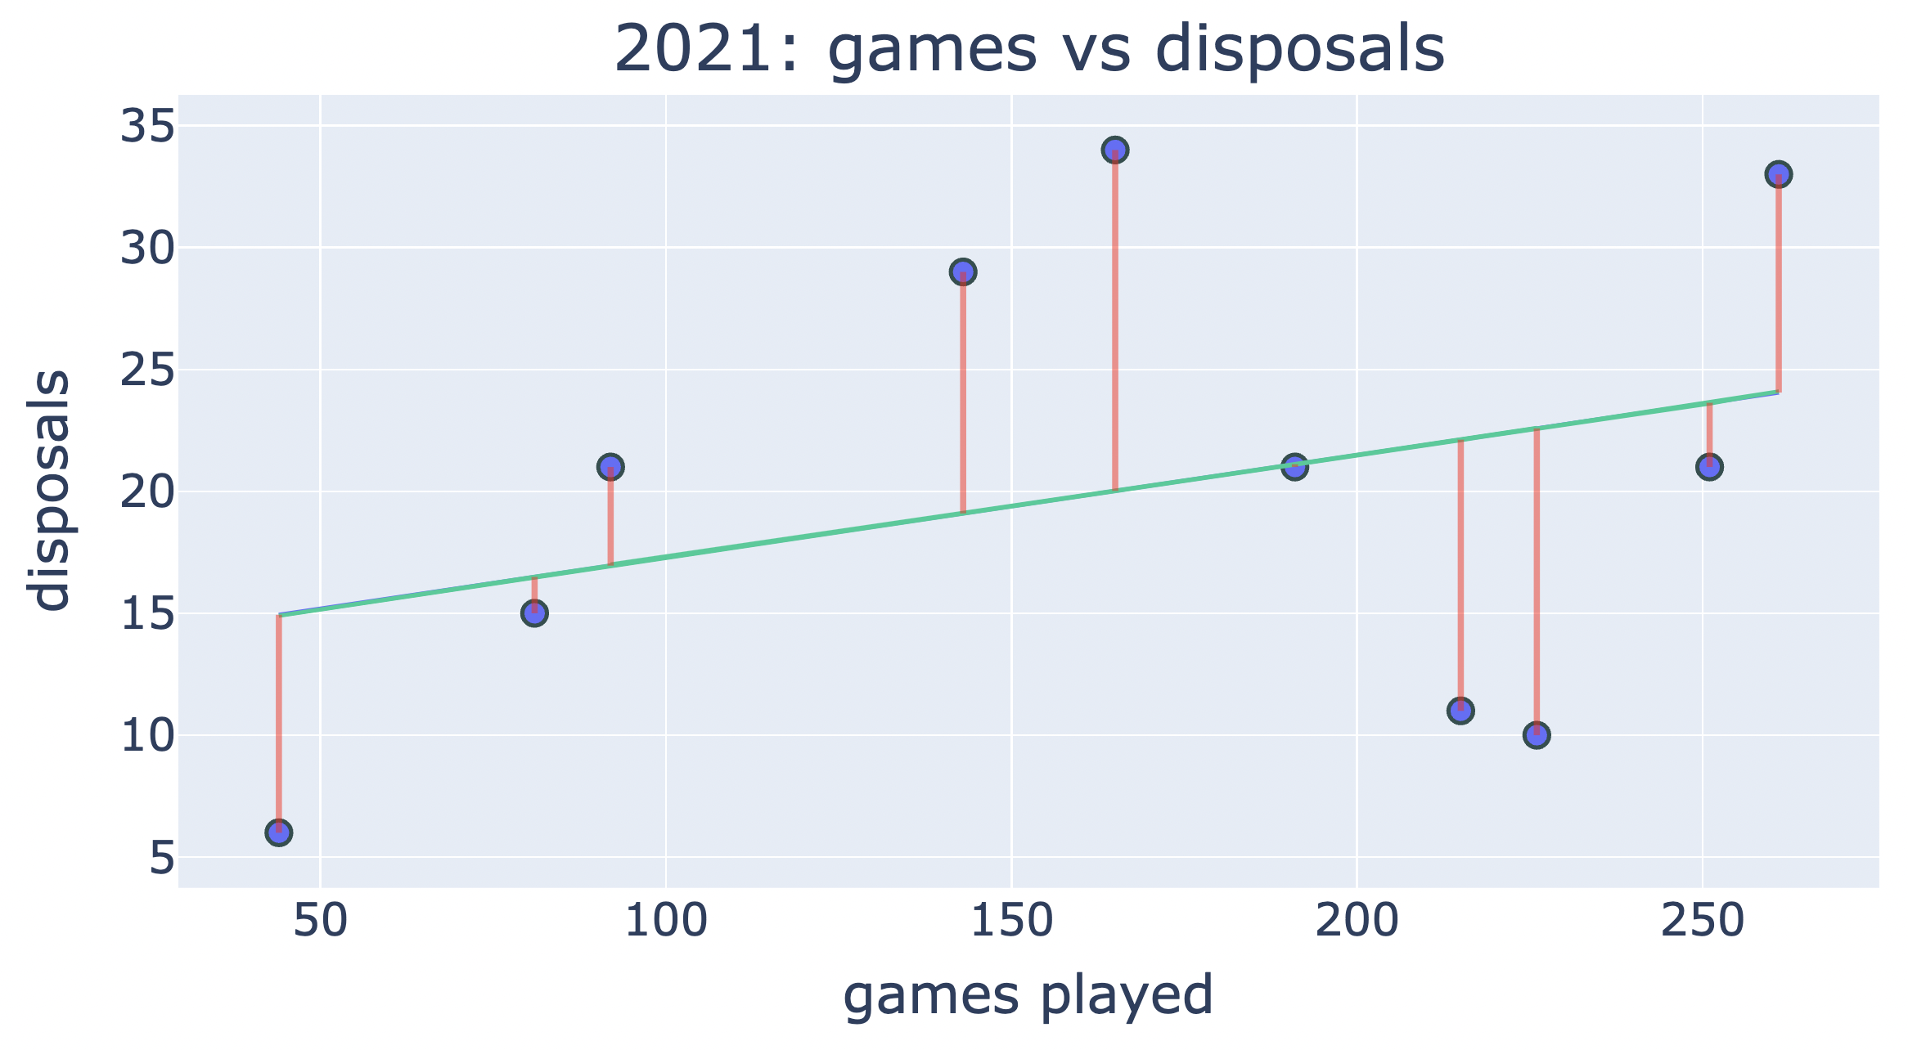
Understanding residuals
$$\text{disposals}\text{ = }13 \text{+} 0.042×\text{games} \text{played}$$

Slide 15
Understanding residuals
+
+
+
-
+
-
-
-
-
$$\text{disposals}\text{ = }13 \text{+} 0.042×\text{games} \text{played}$$

Slide 16
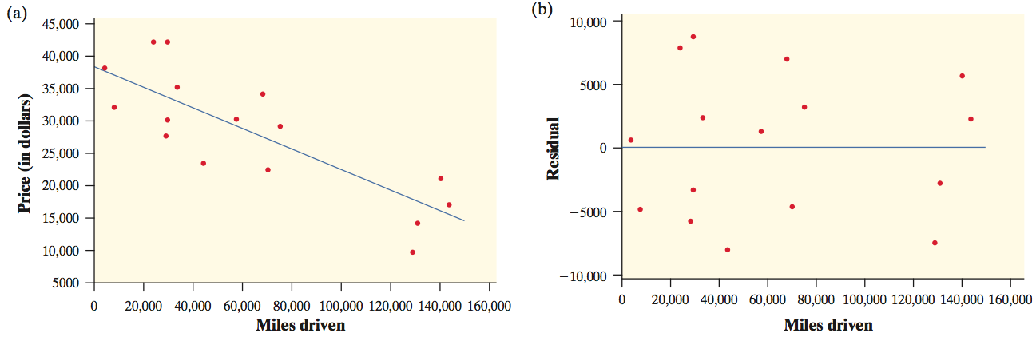
Residual Plots
One of the first principles of data analysis is to look for an overall pattern and for striking departures from the pattern. A regression line describes the overall pattern of a linear relationship between two variables. We see departures from this pattern by looking at the residuals.
A residual plot is a scatterplot of the residuals against the explanatory variable. Residual plots help us assess how well a regression line fits the data.

Slide 17
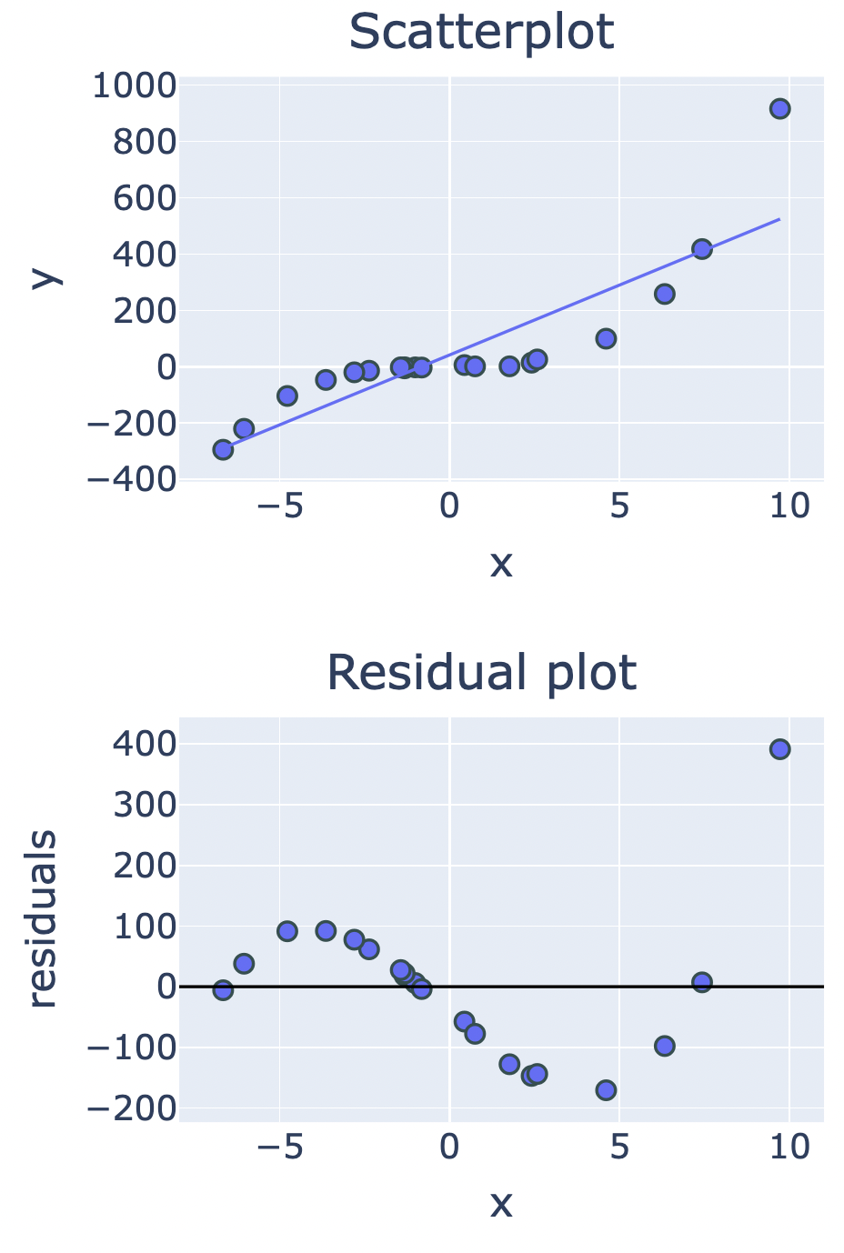
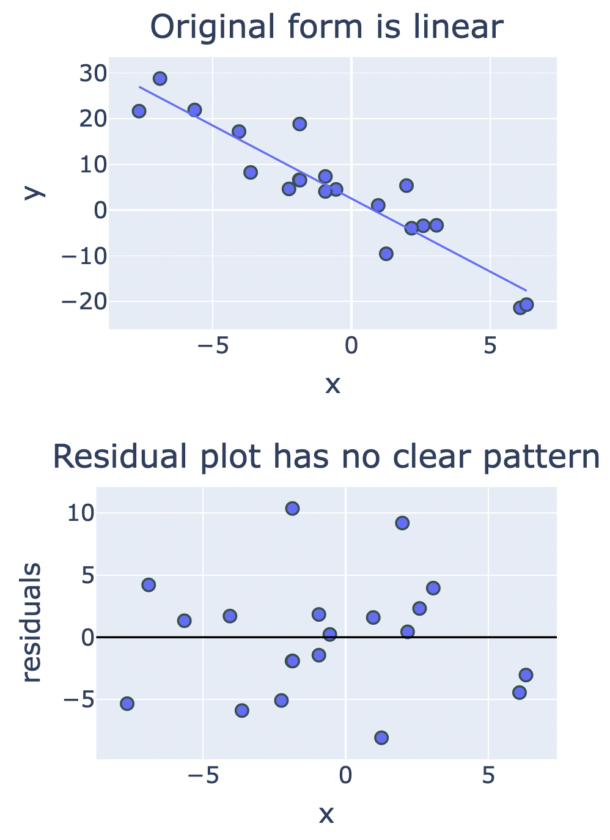
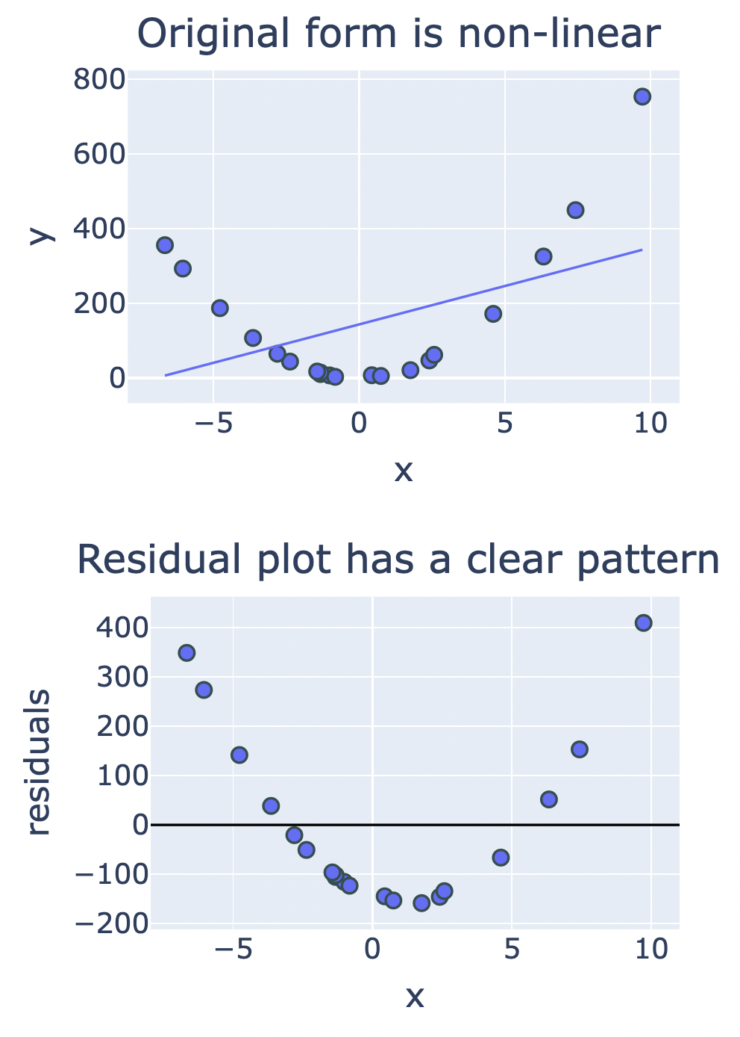
Interpreting residual plots

Slide 18
    exercises & Summary Book
1. Ex page 3C
2. Summary notes

