Slide 1

Data transformation application
3E
Notes:
https://create.kahoot.it/details/469e7171-6a4b-4909-836b-d27bb62f9074
https://quizizz.com/admin/quiz/5ec0a0811401fd001bac3476?source=quiz_share

Slide 2
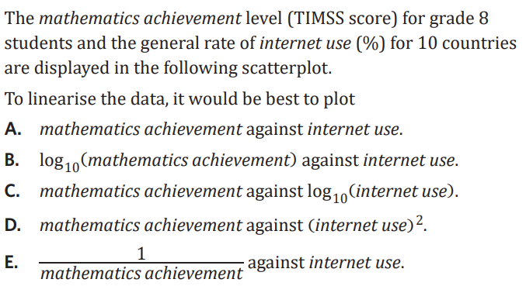
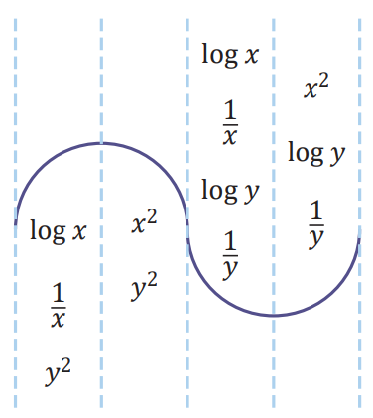
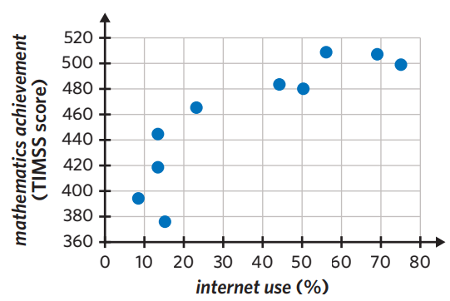

Slide 3



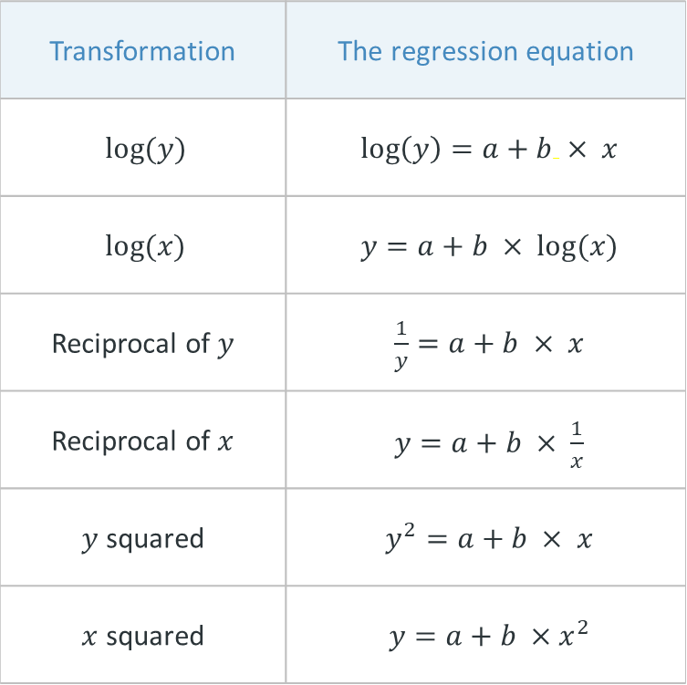

Quick recap – last lesson
Transformation | The regression equation
$log⁡(y)$ | $\log\left(y\right)=a+b × x$
$log⁡(x)$ | $y=a+b × log(x)$
Reciprocal of $y$ | $\frac{1}{y}=a+b × x$
Reciprocal of $x$ | $y=a+b × \frac{1}{x}$
$y$ squared | $y^{2}=a+b × x$
$x$ squared | $y=a+b ×{ x}^{2}$
$$\log\left(x\right) \\ \frac{1}{x}$$
$$y2$$
$$x2$$
$$y2$$
$$\log\left(x\right) \\ \frac{1}{x}$$
$$\log\left(y\right) \\ \frac{1}{y}$$
$$x2$$
$$\log\left(y\right) \\ \frac{1}{y}$$
2e. Least squares line: The equation of the regression line is: [response variable] = [a] + [b] x [explanatory variable]

Slide 4
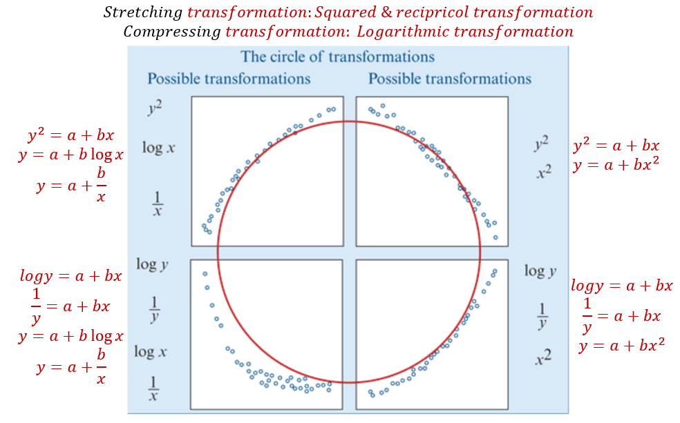

Slide 5
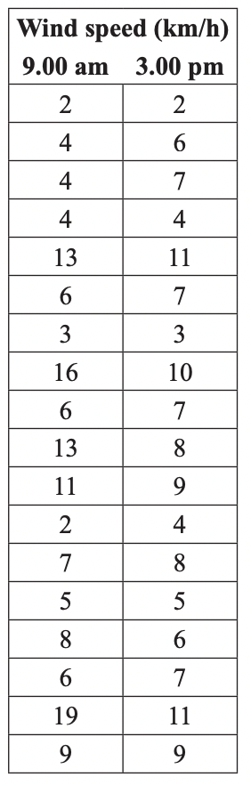
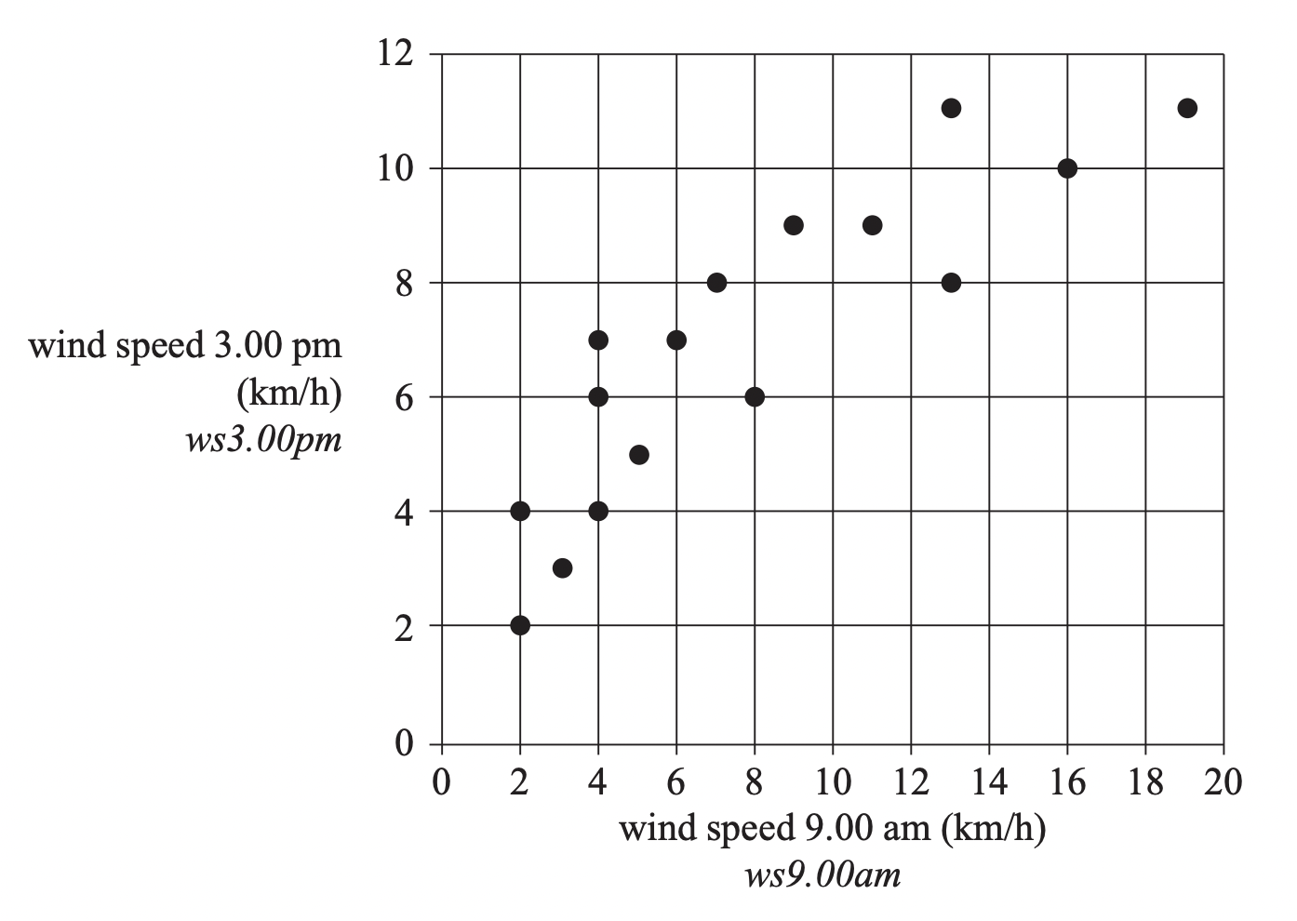
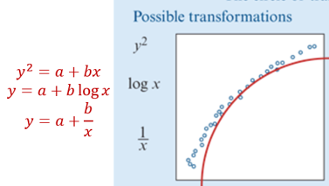
The wind speeds (in km/h) that were recorded at the weather station
at 9.00 am and 3.00 pm respectively on 18 days in November are given
in the table below. A scatterplot has been constructed from this data set.
Let the wind speed at 9.00 am be represented by the variable ws9.00 am and the wind speed at 3.00 pm be represented by the variable ws3.00 pm. The relationship between ws9.00 am and ws3.00 pm shown in the scatterplot above is nonlinear. A squared transformation can be applied
to the variable ws3.00 pm to linearise the data in the scatterplot.

Slide 6
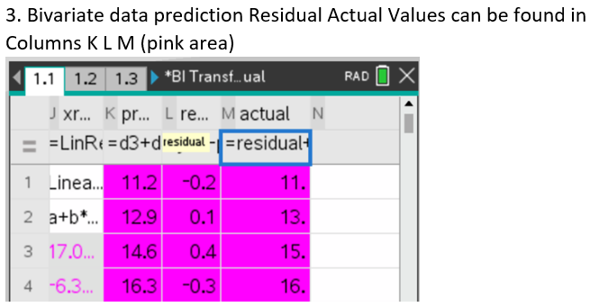
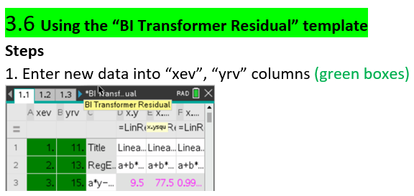
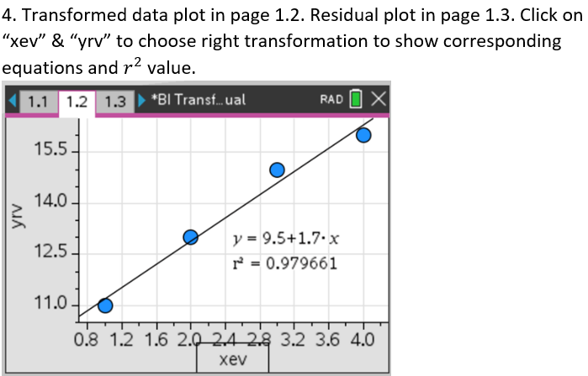
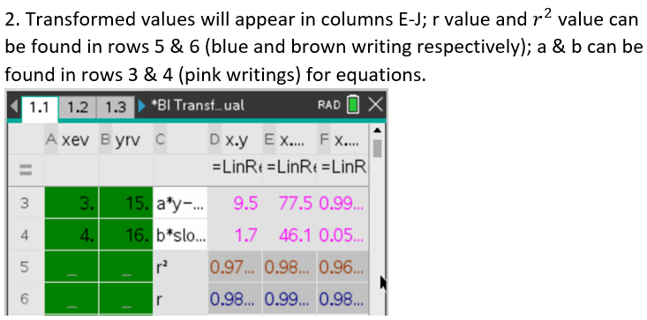
CAS Notes 3.6

Slide 7
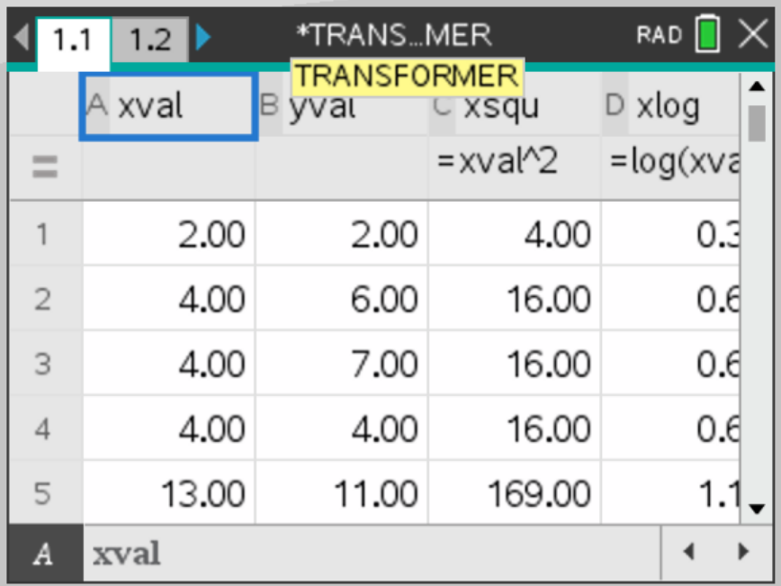
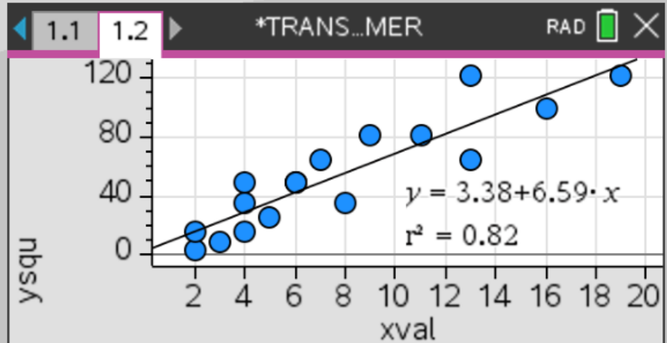
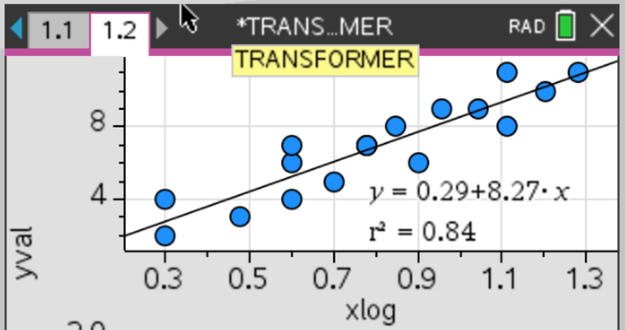
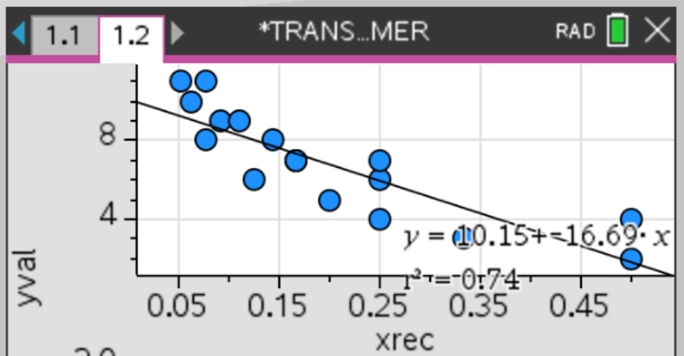



CAS Notes 3.6

Slide 8


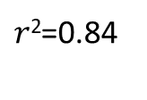

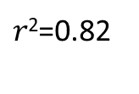





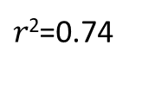
Apply the squared transformation to the variable ws3.00 pm and determine the equation of the least squares regression line that allows (ws3.00 pm)² to be predicted from ws9.00 am. In the boxes provided, write the coefficients for this equation, correct to 3 significant figures.
$$\left(\text{ws}\text{3.00 }\text{pm}\right)\text{2 }\text{=}$$
3.38
$$+$$
6.59
$$× \text{ws}\text{9.00 }\text{am}$$
$r\text{2}$=0.82
$$\left(\text{ws}\text{3.00 }\text{pm}\right) \text{=}$$
0.29
$$+$$
8.27
$$× \text{log}\text{(}\text{ws}\text{9.00 }\text{am}\text{)}$$
$r\text{2}$=0.84
$$\left(\text{ws}\text{3.00 }\text{pm}\right) \text{=}$$
10.2
$$+$$
16.7
$$/ \text{ws}\text{9.00 }\text{am}$$
$r\text{2}$=0.74

