Slide 1

Time series data and their graphs
4A
Notes:
https://quizizz.com/admin/quiz/62fef24aaa19a2001f522911?source=quiz_share

Slide 2
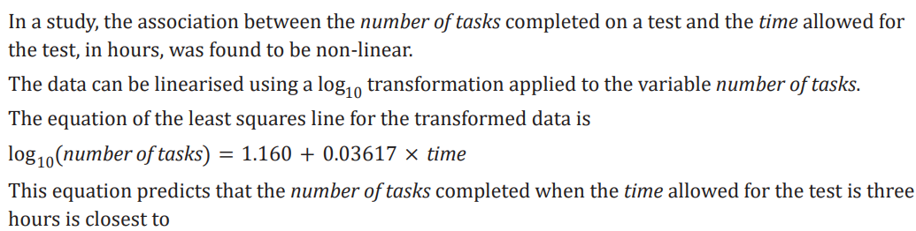

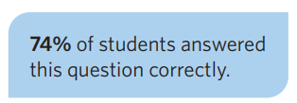

Slide 3
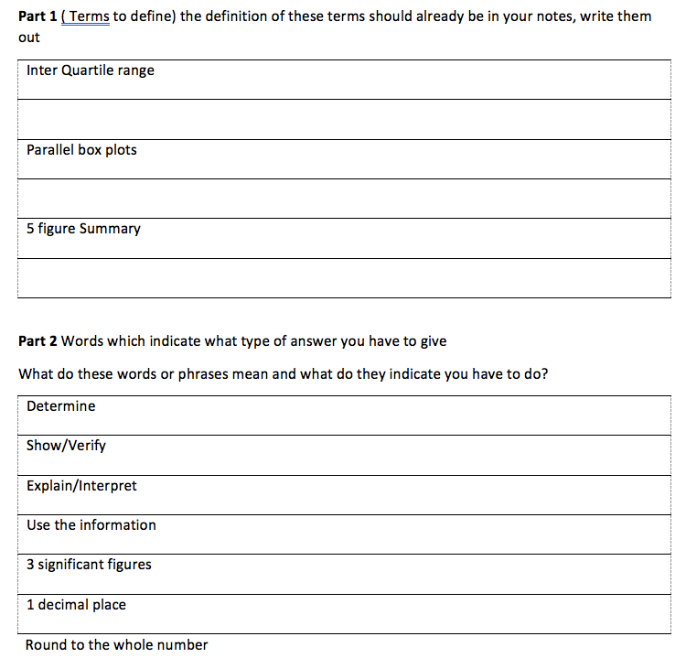
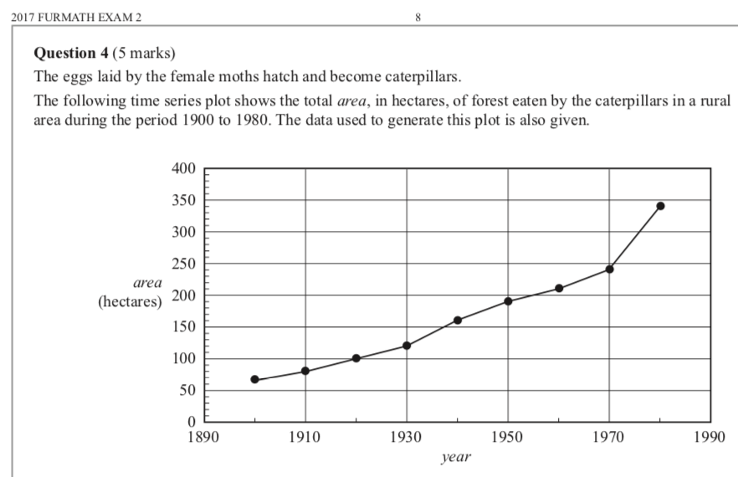


Slide 4
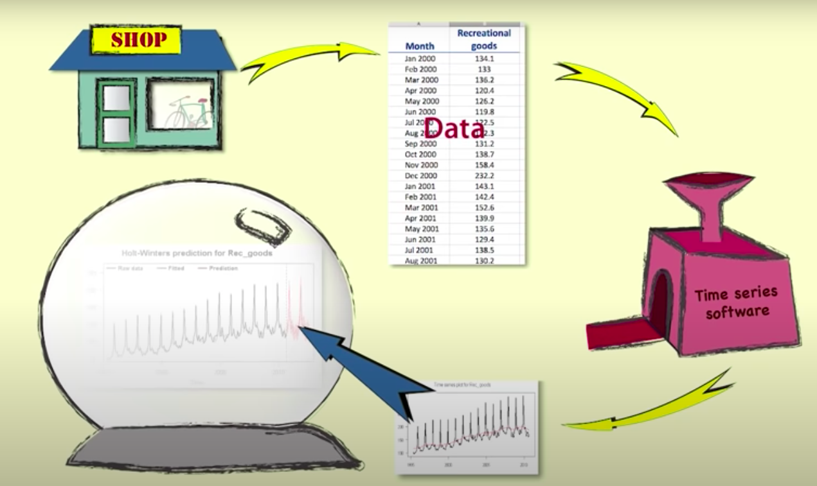
Time Series
Time series data are a special kind of bivariate data, where the explanatory variable is time.
Time series data can be collected Yearly, Quarterly, Monthly, Weekly, Daily, Hourly.

Slide 5
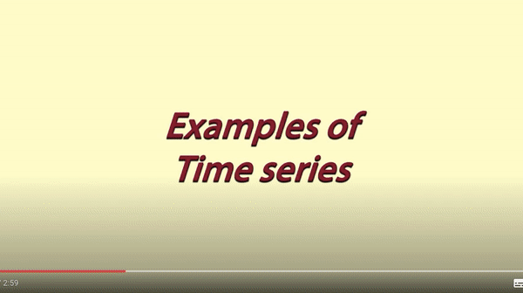
Average monthly temperature
Annual profit for a company
Daily petrol price at a pump
Hourly electricity consumption in a home
Daily taking at a Chinese take-away
Quarterly house sales

Slide 6
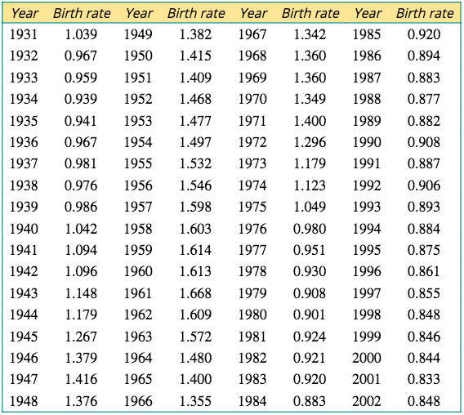
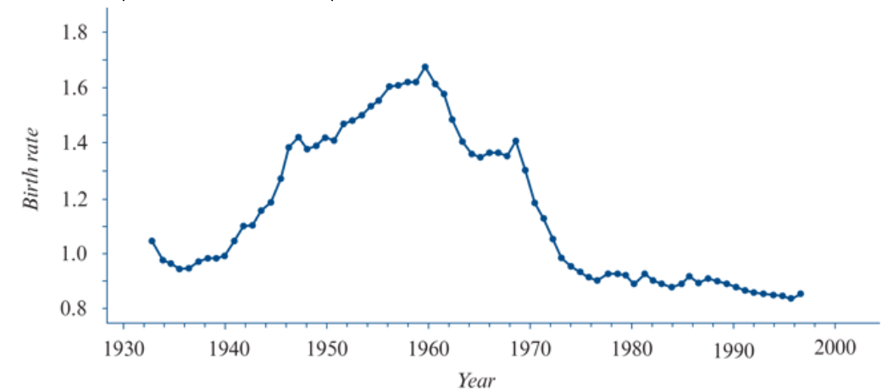
a time series plot
A time series plot is a line graph with time plotted on the horizontal axis. The variable under investigation, the response variable, is plotted on the vertical axis.

Slide 7
Identifying patterns in time series plots
The features we look for in a time series are:
TREND
OUTLIERS
Outliers are present when there are individual values that stand out from the general body of data.
Trend is present when there is a long-term upward or downward movement in a time series.
IRREGULAR FLUCTUATIONS
Irregular (random) fluctuations include all the variations in a time series that we cannot reasonably attribute to systematic changes like trend, cycles, seasonality and structural change or an outlier.
SEASONALITY
Seasonality is present when there is a periodic movement in a time series that has a calendar related period – for example a year, a month or a week.
CYCLES
Cycles are present when there is a periodic movement in a time series. The period is the time it takes for one complete up and down movement in the time series plot. In practice, this term is reserved for periods greater than 1 year.
STRUCTURAL CHANGE
Structural change is present when there is a sudden change in the established pattern of a time series plot.

Slide 8
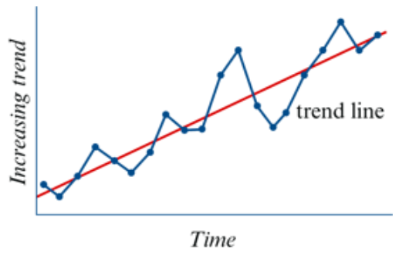
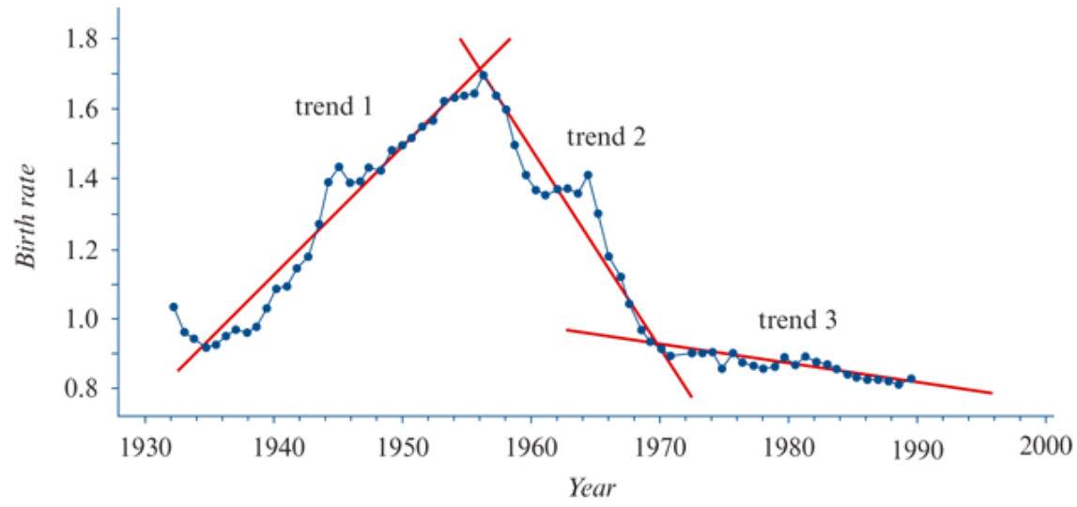
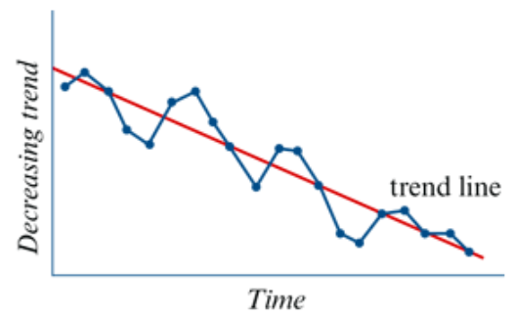

Slide 9
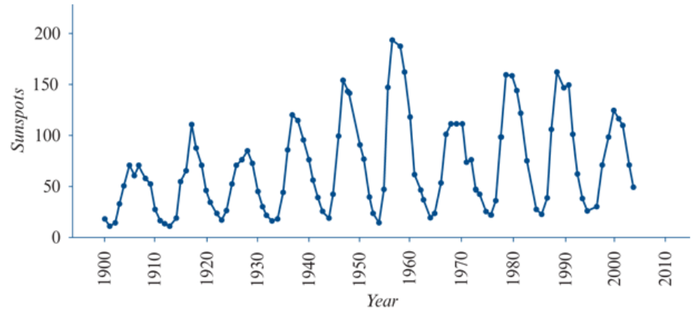
The following plot shows the Sunspots are dark spots visible on the surface of the Sun that come and go over time. activity for the period1900 to 2010. The period of this cycle is approximately 11 years.

Slide 10
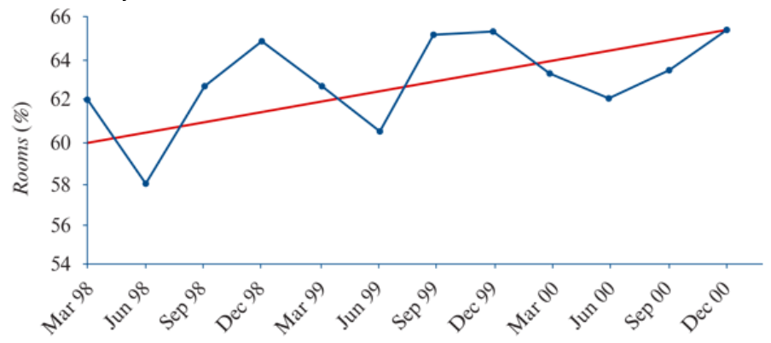
The plot below shows the total percentage of rooms occupied in hotels, motels and other accommodation in Australia by quarter, over the years 1998–2000.
Seasonal movements tend to be more predictable than trends, and occur because of variations in the weather, such as ice-cream sales, or institutional factors, like the increase in the number of unemployed people at the end of the school year.

Slide 11
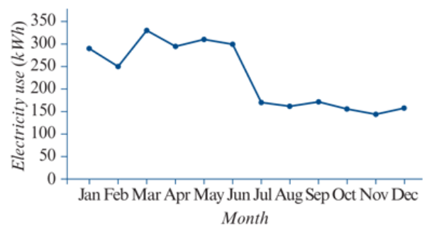
The time series plot below shows the power bill for a rental house (in kWh) for the 1212 months of a year.
This is an example of structural change that can probably be explained by a change in tenants, from a family with two children to a person living alone.

Slide 12
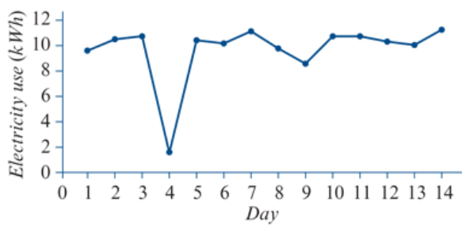
The time series plot below shows the daily power bill for a house (in kWh) for a fortnight.
On this day, the house was without power for 18 hours due to a storm

Slide 13

Following patterns NOT identified.
Trend
Cycles
Or even
Outliers
Structural Change
Seasonality
Notes:
21

Slide 14
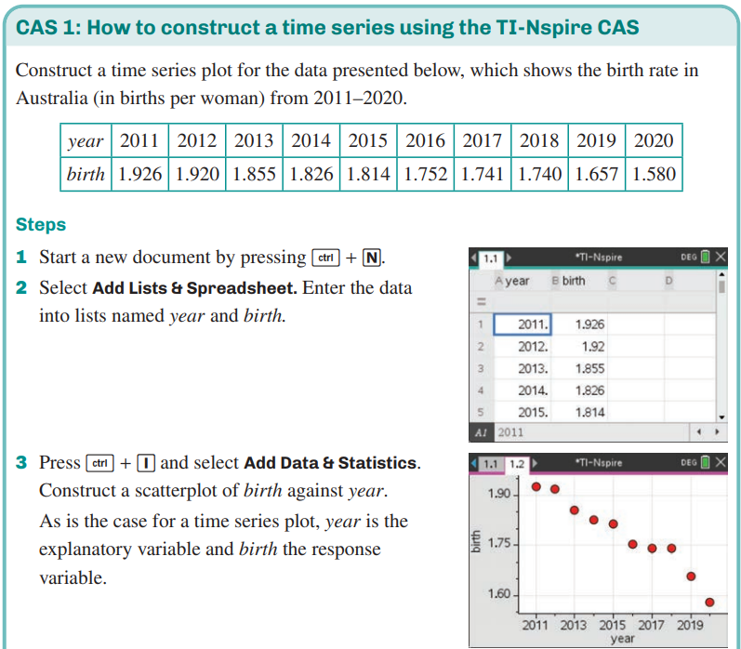
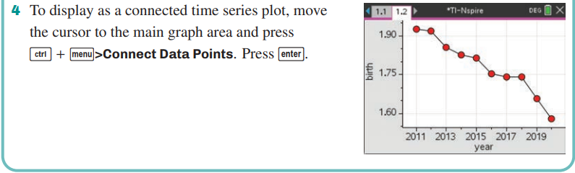
Constructing time series plots
CAS Notes 4.1

