Slide 1
Advanced operations with matrices
7C

Slide 2
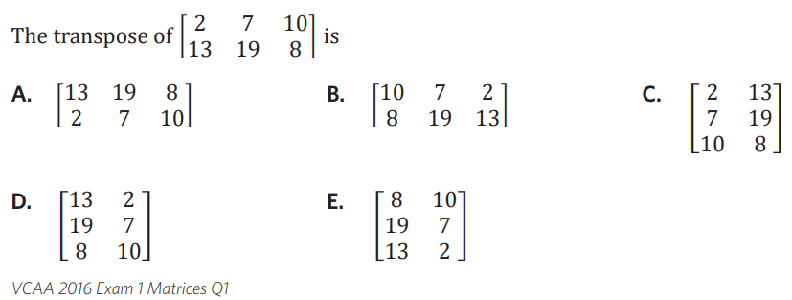

Slide 4
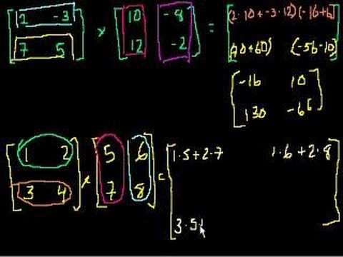
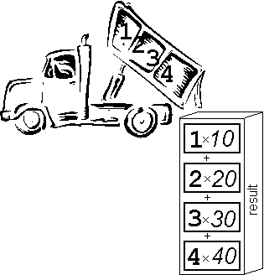
Matrix Multiplication
Notes:
https://create.kahoot.it/details/enter-the-matrix/699d3e3f-3b7a-49c2-958f-5656bdb2afec
Kahoot

Slide 5
What is a matrix?
A Matrix is just rectangular arrays of items
A typical matrix is a rectangular array of numbers arranged in rows and columns.

Slide 6
Sizing a matrix
Order of multiplication is important when multiplying matrices
By convention matrices are “sized” using the number of rows (m) by number of columns (n).

Slide 7
Matrix Addition
Matrices can be added (or subtracted) as long as the 2 matrices are the same size
Simply add or subtract the corresponding components of each matrix.

Slide 8
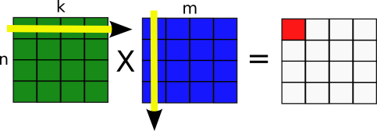
Matrix Multiplication
Multiplying Matrices together
Matrices can only be multiplied if the number of columns in the first is the same as the number of rows in the second.
$$\left[\begin{matrix}5 \\ 5 \\ 8\end{matrix}\right]$$
$$\left[\begin{matrix}\begin{matrix}3 & 2\end{matrix} \\ \begin{matrix}2 & 5\end{matrix} \\ \begin{matrix}6 & −1\end{matrix}\end{matrix}\right]$$
$$=\left[\begin{matrix}\begin{matrix}\begin{matrix}22 & 9\end{matrix} & \begin{matrix}29 & −6\end{matrix}\end{matrix} \\ \begin{matrix}\begin{matrix}22 & 17\end{matrix} & \begin{matrix}45 & 7\end{matrix}\end{matrix} \\ \begin{matrix}\begin{matrix}34 & 3\end{matrix} & \begin{matrix}23 & −27\end{matrix}\end{matrix}\end{matrix}\right]$$
$$\left[\begin{matrix}6 & 5 & −2\end{matrix}\right]$$
$$=\left[39\right]$$
$$\left[\begin{matrix}\begin{matrix}6 & 1 \\ 2 & 3\end{matrix} & \begin{matrix}5 & −4 \\ 7 & 3\end{matrix}\end{matrix}\right]$$
1 x 3
3 x 1
1 x 1
3 x 2
2 x 4
3 x 4
These numbers have to be the same!
These numbers have to be the same!
These numbers give the dimensions of the final matrix!
These numbers give the dimensions of the final matrix!

Slide 9
Example 1
DECIDING WHETHER TWO MATRICES CAN BE MULTIPLIED
Suppose A is a 3 × 2 matrix, while B is a 2 × 4 matrix.
a.
Can the product AB be calculated?
Solution
The following diagram shows that AB can be calculated, because the number of columns of A is equal to the number of rows of B. (Both are 2.)
Matrix A
Matrix B
3 × 2
2 × 4
must match
size of AB
3 × 4

Slide 10
Example 2
DECIDING WHETHER TWO MATRICES CAN BE MULTIPLIED
Suppose A is a 3 × 2 matrix, while B is a 2 × 4 matrix.
b.
If AB can be calculated, what size is it?
Solution
As indicated in the diagram below, the product AB is a 3 x 4 matrix.
Matrix A
Matrix B
3 × 2
2 × 4
must match
size of AB
3 × 4

Slide 11
Example 3
DECIDING WHETHER TWO MATRICES CAN BE MULTIPLIED
Suppose A is a 3 × 2 matrix, while B is a 2 × 4 matrix.
c.
Can BA be calculated?
Solution
The diagram below shows that BA cannot be calculated.
Matrix B
Matrix A
3 × 4
3 × 4
different

Slide 12
Example 4
Matrix A
Matrix B
2 × 2
2 × 4
MULTIPLYING MATRICES
must match
size of AB
2 × 4
Use the definition of matrix multiplication
Perform the operations.

Slide 13
Examples:
Matrix A
Matrix B
2 × 2
2 × 3
must match
size of AB
2 × 3
2(3) + -1(5)
2(-9) + -1(7)
2(2) + -1(-6)
3(3) + 4(5)
3(-9) + 4(7)
3(2) + 4(-6)
$$\left[\begin{matrix}r_{1}c_{1} & r_{1}c_{2} & r_{1}c_{3} \\ r_{2}c_{1} & r_{2}c_{2} & r_{2}c_{3}\end{matrix}\right]$$

Slide 14
Matrix
$\left[\begin{matrix}a & b & c \\ d & e & f\end{matrix}\right]∙\left[\begin{matrix}a & b \\ c & d \\ e & f\end{matrix}\right]$
Multiplying Matrices – order MATTERS
2 x 3
3 x 2
MUST MATCH TO MULTIPLY
Answer will be a 2 x 2

Slide 15
Matrix
$\left[\begin{matrix}a & b \\ c & d \\ e & f\end{matrix}\right]∙\left[\begin{matrix}a & b \\ c & d\end{matrix}\right]$
3 x 2
2 x 2
MUST MATCH TO MULTIPLY
Answer will be a 3 x 2

Slide 16
Matrix
$\left[\begin{matrix}a & b & c \\ d & e & f\end{matrix}\right]∙\left[\begin{matrix}a & b & c \\ d & e & f\end{matrix}\right]$
2 x 3
2 x 3
Don’t match, CANNOT MULTIPLY

Slide 17
Matrix
1. Find $AB$: $A=\left[\begin{matrix}4 & 5 \\ 7 & 2 \\ 1 & 3\end{matrix}\right]$ and $B=\left[\begin{matrix}2 & 3 \\ 5 & 6\end{matrix}\right]$
3 x 2
match
2 x 2
dimensions of product
This is the first row, first column so we take 1st row of A × 1st column of B
3 × 2
write yourself how to get this element
$\left[\begin{matrix}a & d \\ b & e \\ c & f\end{matrix}\right]$
$4\left(2\right)+5(5)$
$4\left(3\right)+5(6)$
$7\left(2\right)+2(5)$
$7\left(3\right)+2(6)$
$1\left(2\right)+3(5)$
$1\left(3\right)+3(6)$
$AB=\left[\begin{matrix}33 & 42 \\ 24 & 33 \\ 17 & 21\end{matrix}\right]$

Slide 18
Multiplying Matrices
3. $A=\left[\begin{matrix}2 & 8 \\ −3 & 0\end{matrix}\right]$ and $B=\left[\begin{matrix}−2 & −8 \\ 3 & 0\end{matrix}\right]$ find $AB$
$\left[\begin{matrix}2 & 8 \\ −3 & 0\end{matrix}\right]\left[\begin{matrix}−2 & −8 \\ 3 & 0\end{matrix}\right]$
$=\left[\begin{matrix}2\left(−2\right)+8(3) & 2\left(−8\right)+8(0) \\ −3\left(−2\right)+0(3) & \end{matrix}\right]$
$=\left[\begin{matrix}2\left(−2\right)+8(3) & 2\left(−8\right)+8(0) \\ −3\left(−2\right)+0(3) & −3\left(−8\right)+0(0)\end{matrix}\right]$
$=\left[\begin{matrix}2\left(−2\right)+8(3) & 2\left(−8\right)+8(0) \\ & \end{matrix}\right]$
$=\left[\begin{matrix}2\left(−2\right)+8(3) & \\ & \end{matrix}\right]$
$=\left[\begin{matrix}20 & −16 \\ 6 & 24\end{matrix}\right]$

Slide 19
Multiplying Matrices
4. $A=\left[\begin{matrix}2 & −1 \\ 3 & 4\end{matrix}\right]$ and $B=\left[\begin{matrix}−3 & 1 \\ 0 & 2\end{matrix}\right]$ find $AB$
$\left[\begin{matrix}2 & −1 \\ 3 & 4\end{matrix}\right]\left[\begin{matrix}−3 & 1 \\ 0 & 2\end{matrix}\right]$
$=\left[\begin{matrix}2\left(−3\right)+(−1)(0) & 2\left(1\right)+(−1)(2) \\ 3\left(−3\right)+4(0) & \end{matrix}\right]$
$=\left[\begin{matrix}2\left(−3\right)+(−1)(0) & 2\left(1\right)+(−1)(2) \\ 3\left(−3\right)+4(0) & 3\left(1\right)+4(2)\end{matrix}\right]$
$=\left[\begin{matrix}2\left(−3\right)+(−1)(0) & \\ & \end{matrix}\right]$
$=\left[\begin{matrix}2\left(−3\right)+(−1)(0) & 2\left(1\right)+(−1)(2) \\ & \end{matrix}\right]$
$=\left[\begin{matrix}−6 & 0 \\ −9 & 11\end{matrix}\right]$

Slide 20
Multiplying Matrices
6. $\left[\begin{matrix}−1 & 1\end{matrix}\right]\left[\begin{matrix}1 & 4 \\ −3 & 5\end{matrix}\right]$
(1 x 2)(2 x 2)
= 1 x 2
$=\left[\begin{matrix}\left(−1\right)\left(1\right)+1(−3) & \end{matrix}\right]$
$=\left[\begin{matrix}\left(−1\right)\left(1\right)+1(−3) & \left(−1\right)\left(4\right)+1(5)\end{matrix}\right]$
$=\left[\begin{matrix}−4 & 1\end{matrix}\right]$

Slide 21
Multiplying Matrices
7. $\left[\begin{matrix}−1 & −2 \\ 0 & 2 \\ 3 & 1\end{matrix}\right]\left[\begin{matrix}−1 & 2 & −3 \\ 2 & 0 & 1\end{matrix}\right]$
(3 x 2)(2 x 3)
= 3 x 3
$=\left[\begin{matrix}\left(−1\right)\left(−1\right)+(−2)(2) & \left(−1\right)\left(2\right)+(−2)(0) & \left(−1\right)\left(−3\right)+(−2)(1) \\ 0\left(−1\right)+2(2) & 0\left(2\right)+2(0) & 0\left(−3\right)+2(1) \\ 3\left(−1\right)+1(2) & 3\left(2\right)+1(0) & \end{matrix}\right]$
$=\left[\begin{matrix}\left(−1\right)\left(−1\right)+(−2)(2) & \left(−1\right)\left(2\right)+(−2)(0) & \left(−1\right)\left(−3\right)+(−2)(1) \\ 0\left(−1\right)+2(2) & 0\left(2\right)+2(0) & 0\left(−3\right)+2(1) \\ 3\left(−1\right)+1(2) & & \end{matrix}\right]$
$=\left[\begin{matrix}\left(−1\right)\left(−1\right)+(−2)(2) & \left(−1\right)\left(2\right)+(−2)(0) & \left(−1\right)\left(−3\right)+(−2)(1) \\ 0\left(−1\right)+2(2) & 0\left(2\right)+2(0) & 0\left(−3\right)+2(1) \\ 3\left(−1\right)+1(2) & 3\left(2\right)+1(0) & 3\left(−3\right)+1(1)\end{matrix}\right]$
$=\left[\begin{matrix}\left(−1\right)\left(−1\right)+(−2)(2) & \left(−1\right)\left(2\right)+(−2)(0) & \left(−1\right)\left(−3\right)+(−2)(1) \\ 0\left(−1\right)+2(2) & 0\left(2\right)+2(0) & 0\left(−3\right)+2(1) \\ & & \end{matrix}\right]$
$=\left[\begin{matrix}\left(−1\right)\left(−1\right)+(−2)(2) & \left(−1\right)\left(2\right)+(−2)(0) & \left(−1\right)\left(−3\right)+(−2)(1) \\ 0\left(−1\right)+2(2) & & \\ & & \end{matrix}\right]$
$=\left[\begin{matrix}\left(−1\right)\left(−1\right)+(−2)(2) & \left(−1\right)\left(2\right)+(−2)(0) & \left(−1\right)\left(−3\right)+(−2)(1) \\ 0\left(−1\right)+2(2) & 0\left(2\right)+2(0) & \\ & & \end{matrix}\right]$
$=\left[\begin{matrix}\left(−1\right)\left(−1\right)+(−2)(2) & & \\ & & \\ & & \end{matrix}\right]$
$=\left[\begin{matrix}\left(−1\right)\left(−1\right)+(−2)(2) & \left(−1\right)\left(2\right)+(−2)(0) & \\ & & \\ & & \end{matrix}\right]$
$=\left[\begin{matrix}\left(−1\right)\left(−1\right)+(−2)(2) & \left(−1\right)\left(2\right)+(−2)(0) & \left(−1\right)\left(−3\right)+(−2)(1) \\ & & \\ & & \end{matrix}\right]$
$=\left[\begin{matrix}−3 & −2 & 1 \\ 4 & 0 & 2 \\ −1 & 6 & −8\end{matrix}\right]$

Slide 22
Multiplying Matrices
8. $\left[\begin{matrix}−1 & 2 & −3 \\ 2 & 0 & 1\end{matrix}\right]\left[\begin{matrix}−1 & −2 \\ 0 & 2 \\ 3 & 1\end{matrix}\right]$
(2 x 3)(3 x 2)
= 2 x 2
$=\left[\begin{matrix}\left(−1\right)\left(−1\right)+2\left(0\right)+(−3)(3) & \\ & \end{matrix}\right]$
$=\left[\begin{matrix}\left(−1\right)\left(−1\right)+2\left(0\right)+(−3)(3) & \left(−1\right)\left(−2\right)+2\left(2\right)+(−3)(1) \\ & \end{matrix}\right]$
$=\left[\begin{matrix}\left(−1\right)\left(−1\right)+2\left(0\right)+(−3)(3) & \left(−1\right)\left(−2\right)+2\left(2\right)+(−3)(1) \\ 2\left(−1\right)+0\left(0\right)+1(3) & 2\left(−2\right)+0\left(2\right)+1(1)\end{matrix}\right]$
$=\left[\begin{matrix}\left(−1\right)\left(−1\right)+2\left(0\right)+(−3)(3) & \left(−1\right)\left(−2\right)+2\left(2\right)+(−3)(1) \\ 2\left(−1\right)+0\left(0\right)+1(3) & \end{matrix}\right]$
$=\left[\begin{matrix}−8 & 3 \\ 1 & −3\end{matrix}\right]$

Slide 23
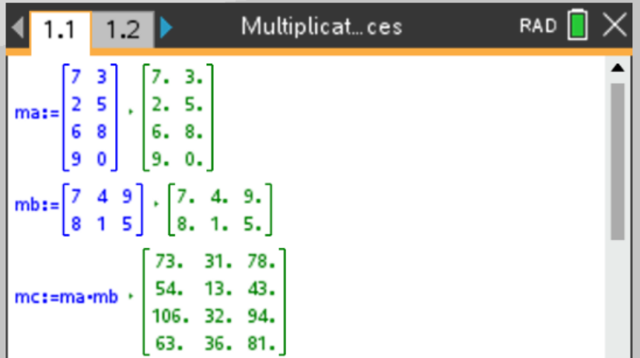
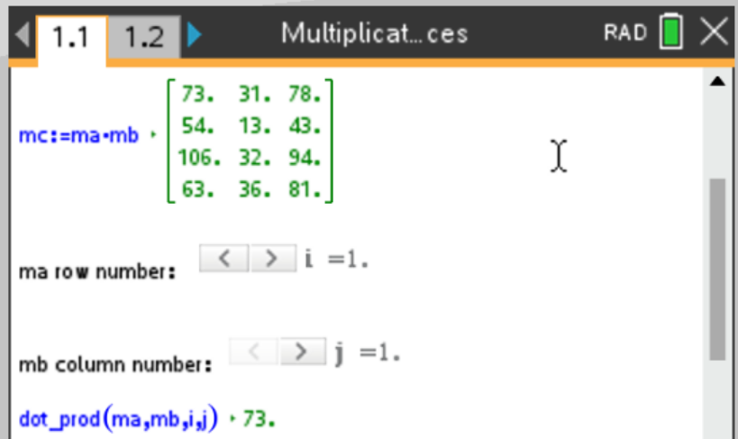
CAS
CAS Notes 7.15
CAS Notes 7.3

Slide 24
Multiplying Matrices
5. $A=\left[\begin{matrix}2 & −1 \\ 3 & 4\end{matrix}\right]$ and $B=\left[\begin{matrix}−3 & 1 \\ 0 & 2\end{matrix}\right]$ find $BA$
$\left[\begin{matrix}−3 & 1 \\ 0 & 2\end{matrix}\right]\left[\begin{matrix}2 & −1 \\ 3 & 4\end{matrix}\right]$
$=\left[\begin{matrix}\left(−3\right)2+(1)(3) & \left(−3\right)(−1)+(1)(4) \\ & \end{matrix}\right]$
$=\left[\begin{matrix}\left(−3\right)2+(1)(3) & \left(−3\right)(−1)+(1)(4) \\ 0\left(2\right)+2(3) & \end{matrix}\right]$
$=\left[\begin{matrix}\left(−3\right)2+(1)(3) & \left(−3\right)(−1)+(1)(4) \\ 0\left(2\right)+2(3) & 0\left(−1\right)+2(4)\end{matrix}\right]$
$=\left[\begin{matrix}\left(−3\right)2+(1)(3) & \\ & \end{matrix}\right]$
$=\left[\begin{matrix}−3 & 7 \\ 6 & 8\end{matrix}\right]$
***NOT the same as AB (#4)!!!!

Slide 25
Matrix
2. Find $A^{2}$: $A=\left[\begin{matrix}4 & 5 \\ 7 & 2 \\ 1 & 3\end{matrix}\right]$
$A^{2}=\left[\begin{matrix}4 & 5 \\ 7 & 2 \\ 1 & 3\end{matrix}\right]\left[\begin{matrix}4 & 5 \\ 7 & 2 \\ 1 & 3\end{matrix}\right]$
$=undefined$
3 x 2
3 x 2
Wait! You Can’t!

Slide 26
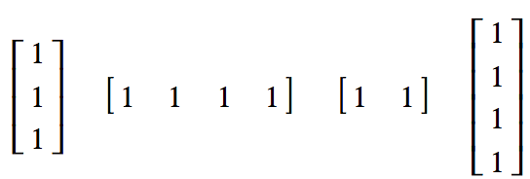
The summing matrix
A row or column matrix in which all the elements are 1 is called a summing matrix.
The matrices below are all examples of summing matrices.
The rules for using a summing matrix to sum the rows and columns of a matrix follow.

Slide 27
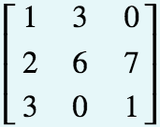
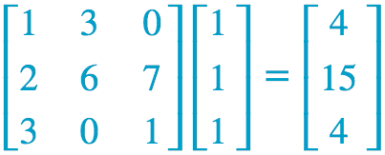
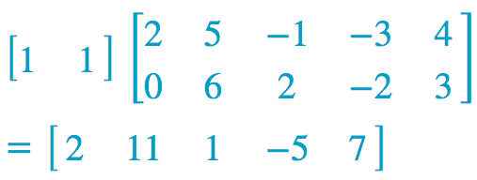
Using matrix multiplication to sum the rows and columns of a matrix
Use matrix multiplication to generate a matrix that:
displays row sums of the matrix
displays the column sums of the matrix
Solutions:
To sum the rows of a 3×3 matrix,
post-multiply a 3×1 summing matrix.
To sum the columns of a 2×5 matrix,
pre-multiply a 1×2 summing matrix.

Slide 28
Displaying assets of simultaneous equations in matrix form
In the next chapter, you will learn to solve sets of simultaneous linear equations using matrices. The first step in this process is to write a set of simultaneous equations in matrix notation using matrix multiplication.

Slide 29
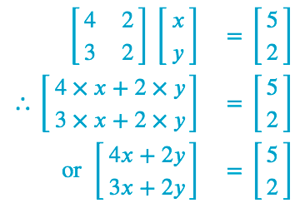
Generating sets of simultaneous equations
Solution
Write out the matrix equation and then multiply out the left-hand side
For the matrices to be equal:
4𝑥+2𝑦 must equal 5
and
3𝑥+2𝑦 must equal 2.
This gives the required pair of simultaneous linear equations.

