Slide 1

Shortest path problems
8F Dijkstra’s Algorithm
Notes:
1,2,4,5,7-9 Need easy way

Slide 2
Real-world Applications:
Urban Navigation: Optimising routes for tourists and residents in cities.
Emergency Evacuation: Planning efficient evacuation routes during emergencies.
Robotics: Pathfinding for robots and drones.
Circuit Design: Optimizing the layout of components on circuit boards.

Slide 3
Learning Intentions
Weighted Graphs
The shortest paths
Dijkstra’s Algorithm
Finding Hamilton Cycles

Slide 4
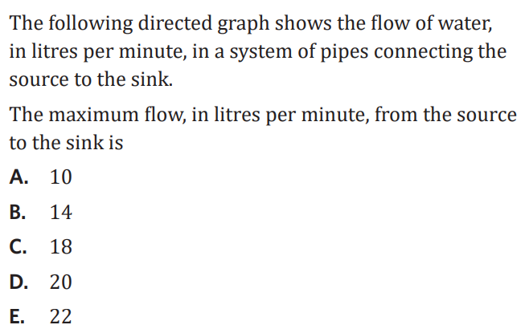
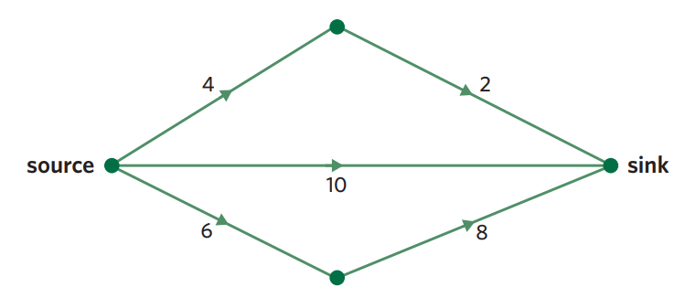

Slide 5
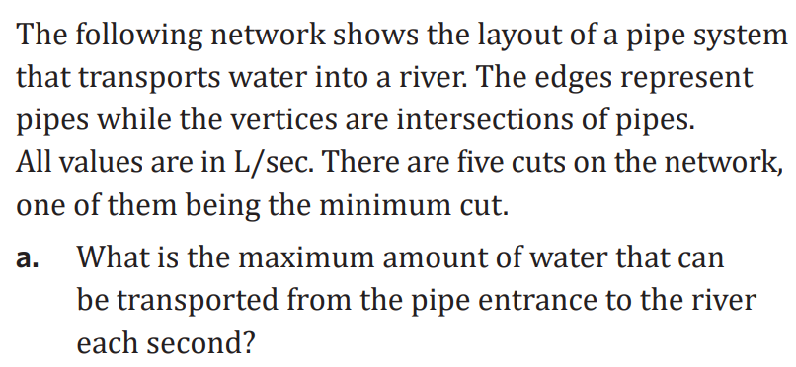
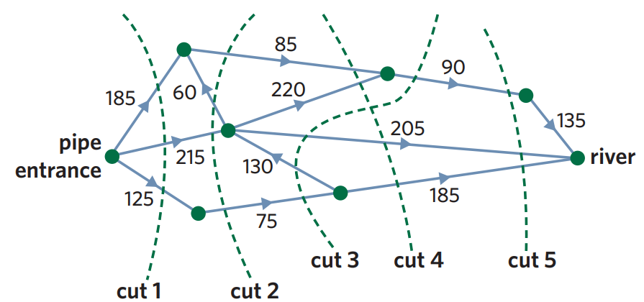

Slide 6
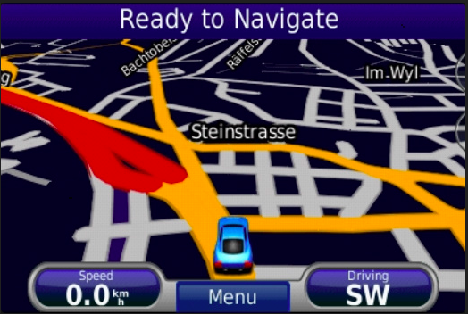
Real life Application
Geographical Maps.
IP routing to find Open shortest Path First.
Telephone network.

Slide 7
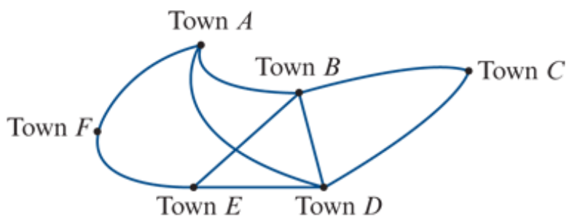
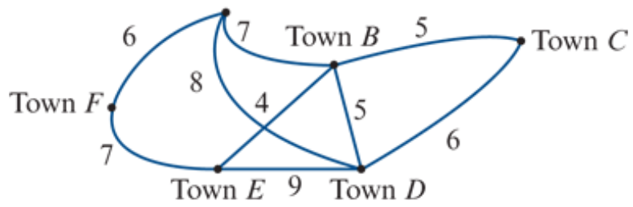
Weighted graphs and networks
A weighted graph is a graph where a number is associated with each edge. These numbers are called weights.
A network is a weighted graph in which the weights are physical quantities, for example, distance, time, cost.

Slide 8
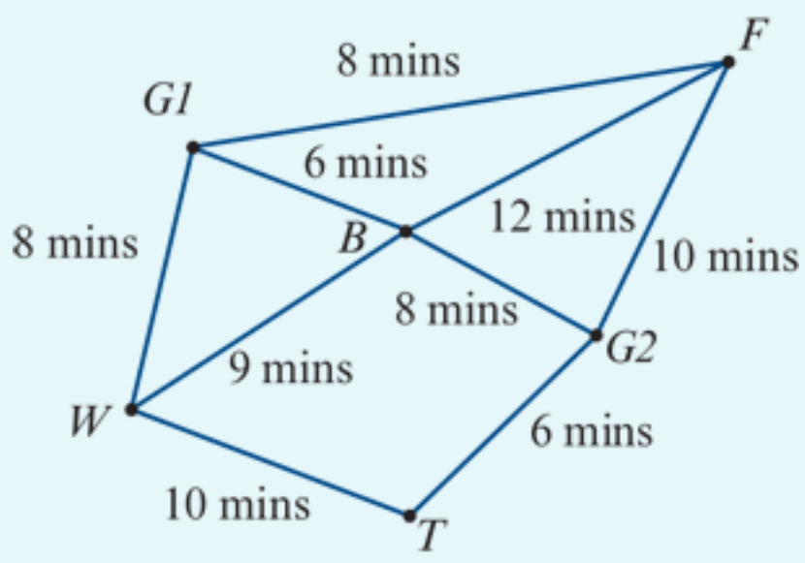
Interpreting a network
The network opposite is used to model the tracks in a forest connecting a suspension bridge (𝐵), a waterfall (𝑊), a very old tree (𝑇) and a fern gully (𝐹).
Walkers can enter or leave the forest through either Gate 1 (𝐺1) or Gate 2 (𝐺2).
The numbers on the edges represent the times (in minutes) taken to walk directly between these places.
a. How long does it take to walk from the bridge directly to the fern gully?
b. How long does it take to walk from the old tree to the fern gully via the waterfall and the bridge?
a. The edge is 𝐵-𝐹. The time taken is 12 minutes.
b. The path is 𝑇-𝑊-𝐵-𝐹. The time taken is 10+9+12=31 minutes.

Slide 9
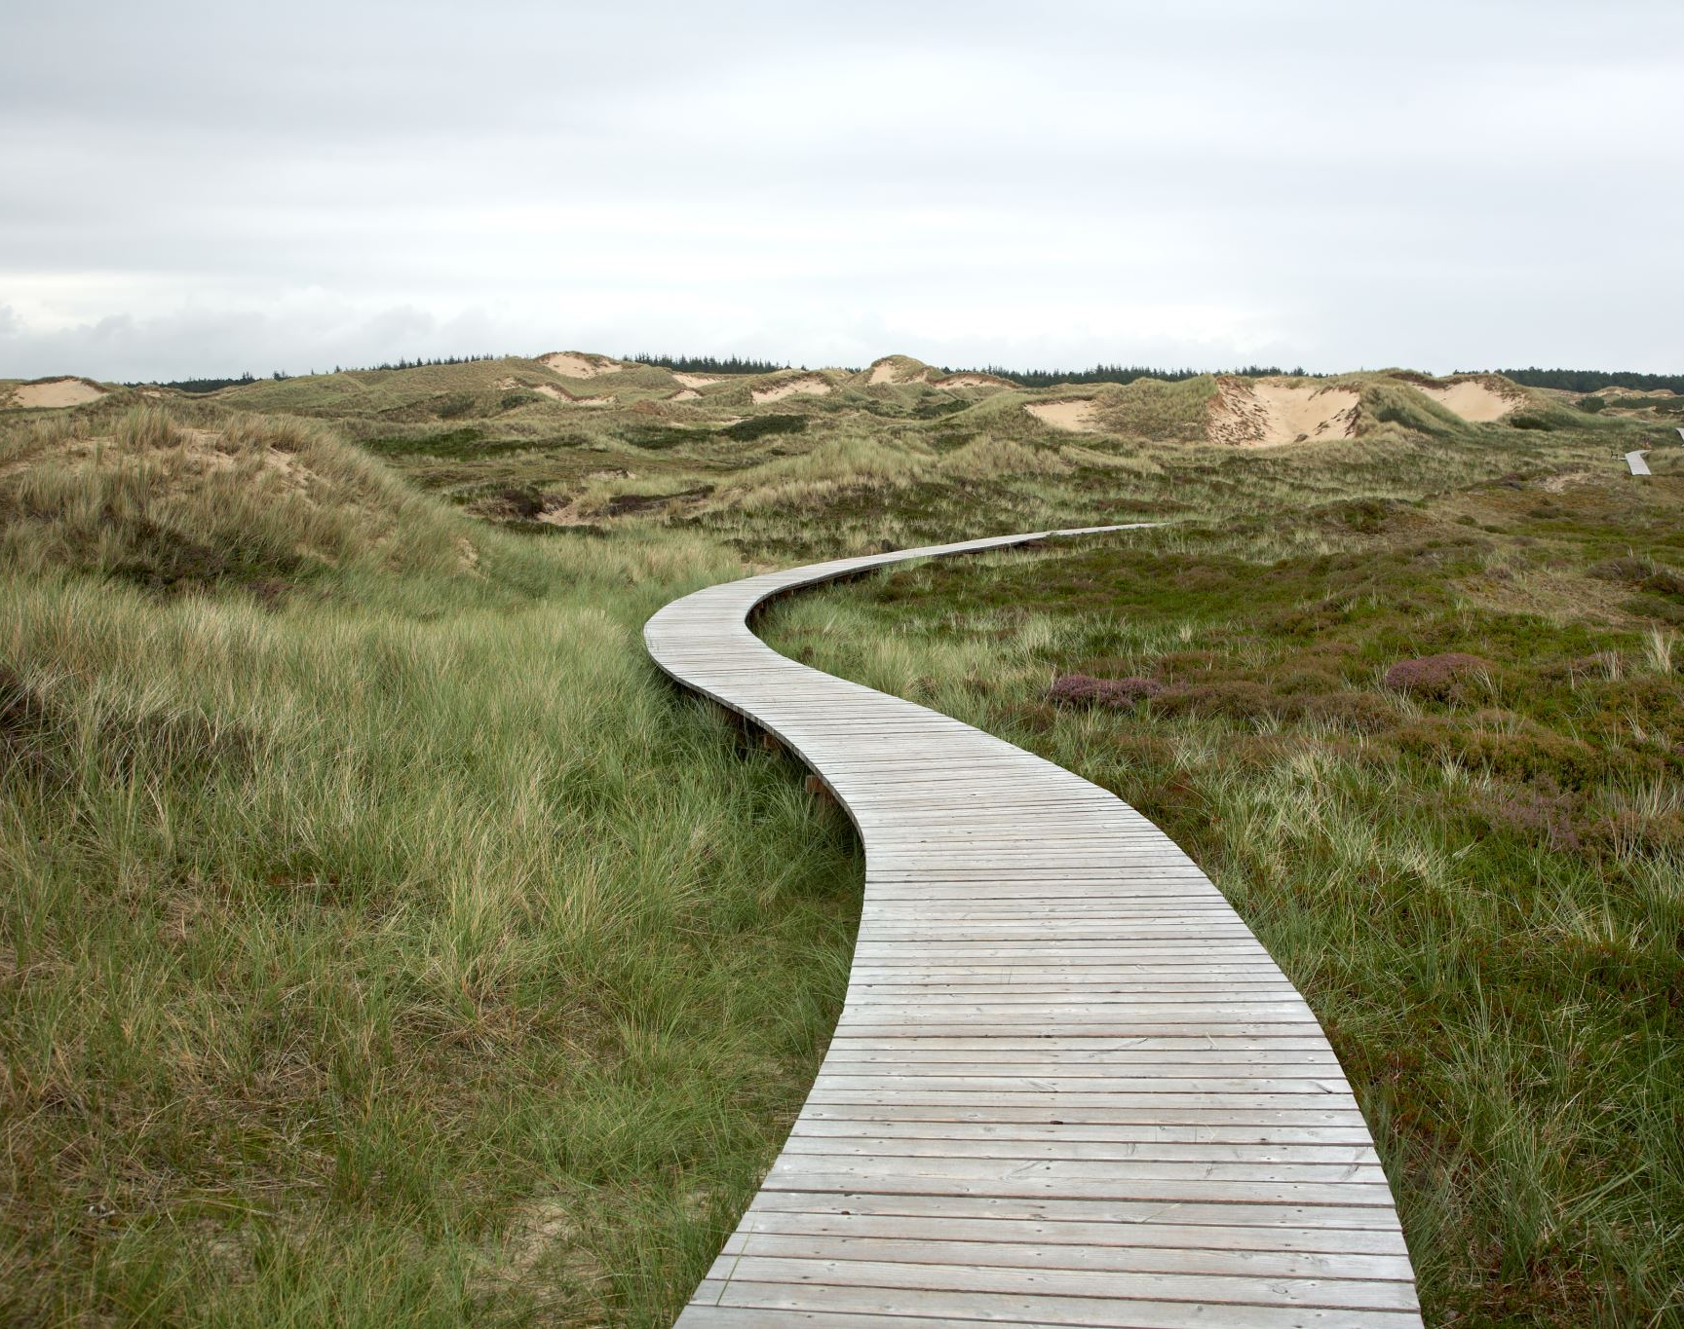
The shortest path problem
Determining the shortest distance or time or the least cost to move around a network is called the shortest path problem.

Slide 10
Finding the shortest path by inspection
Find the shortest route between Town 𝐶 and Town 𝐹 in the previous network opposite.
𝐶-𝐷-𝐸-𝐹: The distance is 6+9+7=22 km.
𝐶-𝐵-𝐸-𝐹: The distance is 5+4+7=16 km.
𝐶-𝐵-𝐴-𝐹: The distance is 5+7+6=18 km.
The shortest path is 𝐶-𝐵-𝐸-𝐹.
Notes:
https://www.youtube.com/watch?v=wtdtkJgcYUM
https://www.youtube.com/watch?v=pVfj6mxhdMw

Slide 11
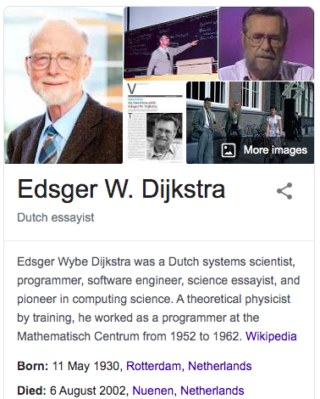
Finding the shortest path by Dijkstra’s Algorithm

Slide 12
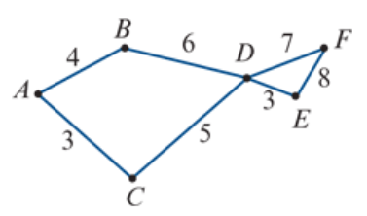



Finding the shortest path by Dijkstra’s Algorithm
Find the shortest path from vertex 𝐴 to vertex 𝐸 in this network. The numbers represent time in hours.
 | B | C | D | E | F
A | 4 | 3 | X | X | X
4
19
C | 4 | 3 | 8 | X | X
10
15
B | 4 | 3 | 8 | X | X
D | 4 | 3 | 8 | 11 | 15
8
E | 4 | 3 | 8 | 11 | 15
11
F | 4 | 3 | 8 | 11 | 15
A C D E
3
3 + 5 + 3 = 11 Hours

Slide 13

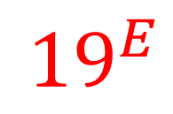
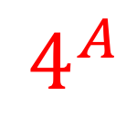


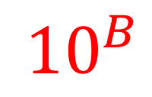
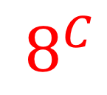

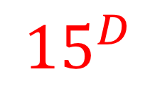
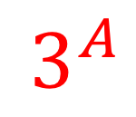
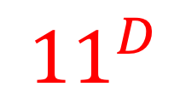
Finding the shortest path by Dijkstra’s Algorithm
Find the shortest path from vertex 𝐴 to vertex 𝐸 in this network. The numbers represent time in hours.
$${10}^{B}$$
$$4^{A}$$
$${15}^{D}$$
$${19}^{E}$$
From Starting vertex.
The shortest edge first.
Write distance from the starting vertex.
Label the last vertex passing by.
Cover all edges from this vertex.
Find the next shortest distance vertex to start over again.
Until all vertices and edges covered.
$$8^{C}$$
0
$${11}^{D}$$
3+5+3=11 Hours
$$3^{A}$$
$${Weights from starting vertex}^{the last passing by vertex}$$

Slide 14
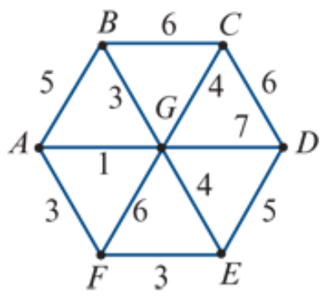


Finding the shortest path by Dijkstra’s Algorithm
Find the shortest path from vertex 𝐵 to vertex 𝐹 in this network. The numbers represent time in minutes.
7
 | A | C | D | E | F | G
6
B | 5 | 6 | X | X | X | 3
3
12
G | 4 | 6 | 10 | 7 | 9 | 3
5
10
A | 4 | 6 | 10 | 7 | 7 | 3
4
12
C | 4 | 6 | 10 | 7 | 7 | 3
7
F | 4 | 6 | 10 | 7 | 7 | 3
9
10
E | 4 | 6 | 10 | 7 | 7 | 3
7
B G A D
D | 4 | 6 | 10 | 7 | 7 | 3
3 + 1 + 3 = 7 minutes

Slide 15
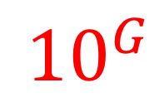

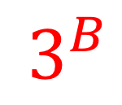
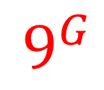
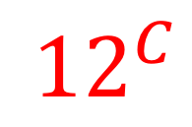
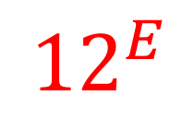




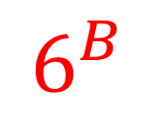

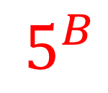
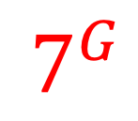
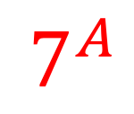
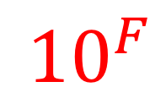



Finding the shortest path by Dijkstra’s Algorithm
Find the shortest path from vertex 𝐵 to vertex 𝐹 in this network. The numbers represent time in minutes.
0
$$6^{B}$$
$$7^{G}$$
From Starting vertex.
The shortest edge first.
Write distance from the starting vertex.
Label the last vertex passing by.
Cover all edges from this vertex.
Find the next shortest distance vertex to start over again.
Until all vertices and edges covered.
$${12}^{E}$$
$$4^{G}$$
$$5^{B}$$
$$3^{B}$$
$${10}^{G}$$
$${12}^{C}$$
3+1+3=7 minutes
$$7^{A}$$
$$9^{G}$$
$${10}^{F}$$
$$7^{G}$$
$${Weights from starting vertex}^{the last passing by vertex}$$

Slide 16
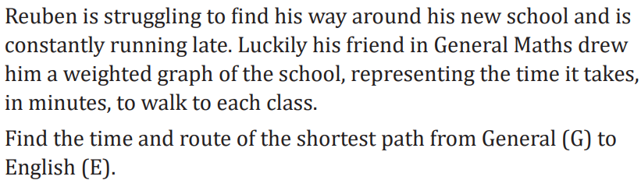
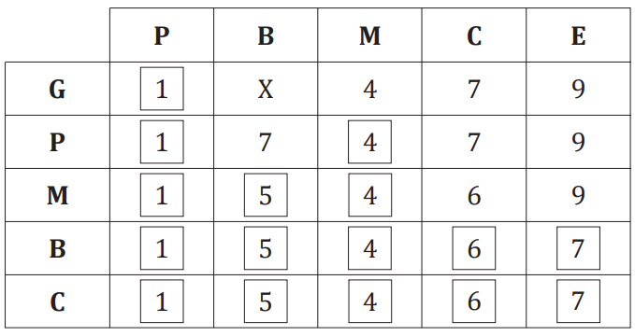
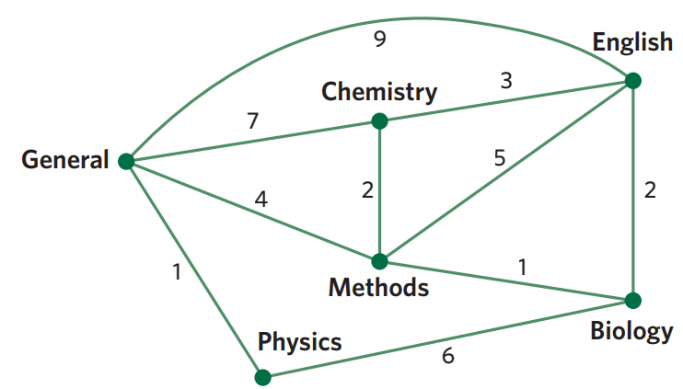

Slide 18
Dijkstra’s Algorithm steps
Draw a nxn table, n is vertices number.
Write all vertices names on the top row 1.
Write starting vertex name at the beginning of row 2.
Write all distances from starting point on the row 2, the rest no connection will be X’s.
Put a square around the smallest number on row 2. The smallest number vertex from row 2 will go to the beginning of row 3.
Write accumulating distance on row 3 from this new vertex, the rest numbers can be from above row.
Repeating step 5, 6 until all table filled.
Circle all intersection vertex on the table (e.g A-A, B-B)
Find the end vertex.
Use arrows to retreat on the column before the number changes.
Find the vertex from this new row.
Repeat step 10, 11 until trace back to starting vertex.

