Slide 1
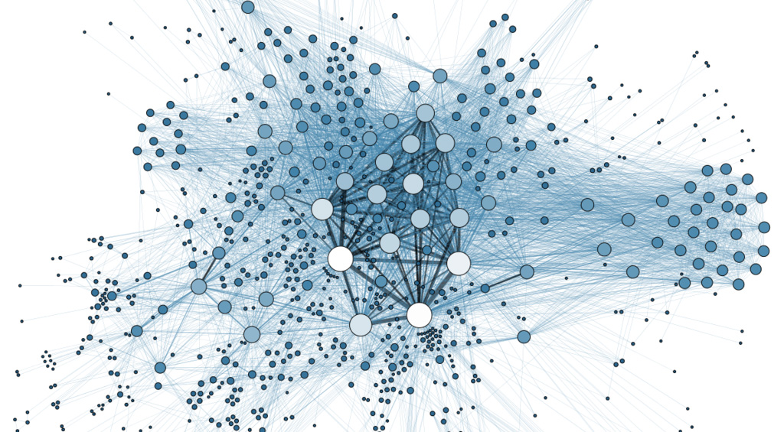
Networks and Decision Mathematics
Advice

Slide 2
Contents
Definitions of graphs
Types of graphs
Eulerian Trails and Circuits
Hamilton Paths and Cycles
Euler’s formula for Planar graphs: v+f=e+2
Minimum Spanning Tree
Shortest path by Dijkstra’s Algorithm
Maximum Flow= Minimum Cut
Allocation by Hungarian Algorithm
Scheduling problem to find critical path

Slide 3
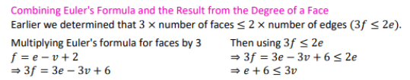
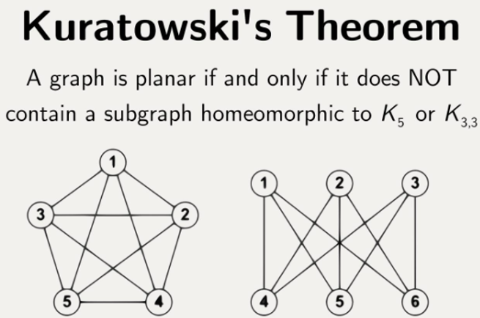
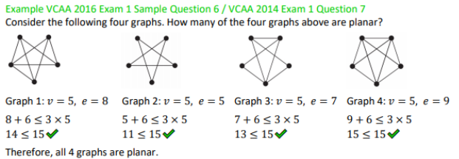

Slide 4
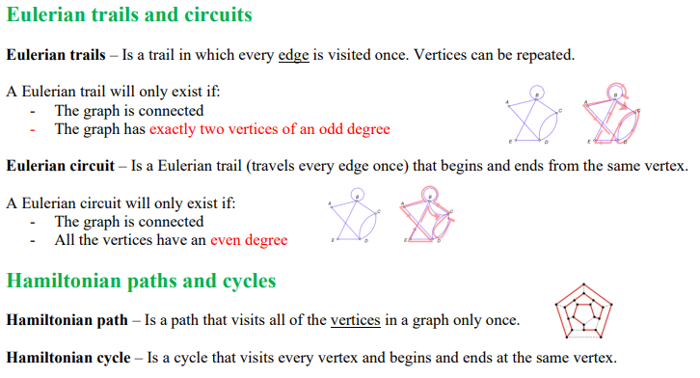

Slide 5
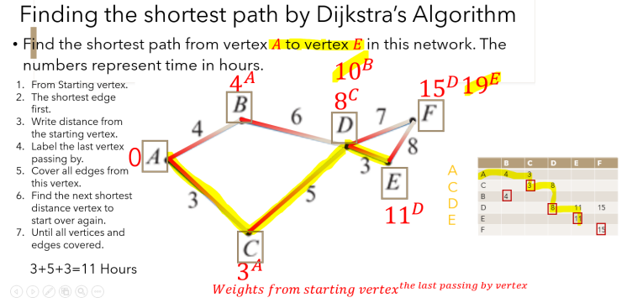

Slide 6
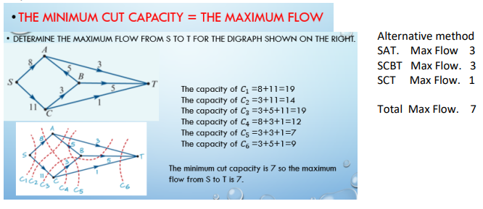

Slide 7
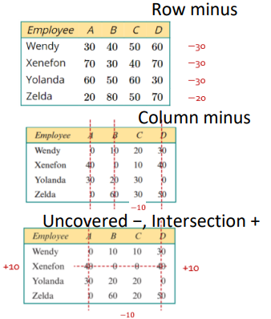
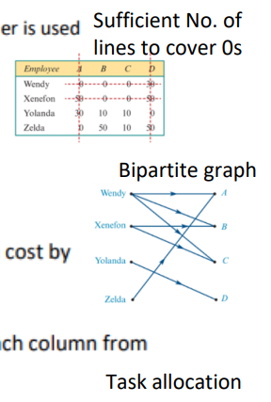
Hungarian Algorithm

Slide 8
