Slide 1

Recurrence relations and their graphs
https://www.youtube.com/shorts/726zqQUwDlw Bobbie
https://www.youtube.com/shorts/rcOVRKtJROs
https://www.youtube.com/shorts/DAZpqGb1Jsw Ash
https://www.youtube.com/watch?v=mfEC_ktG68Y Bobbie

Slide 2

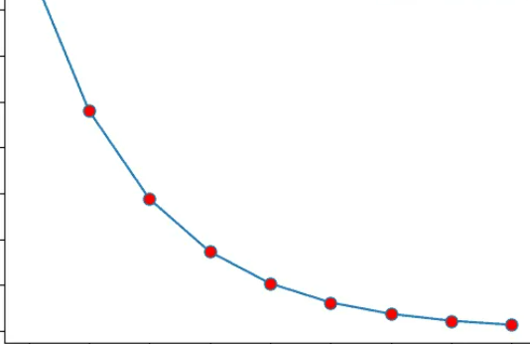
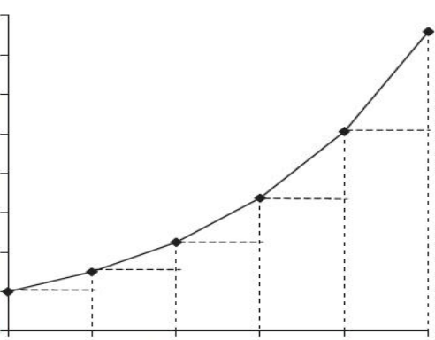
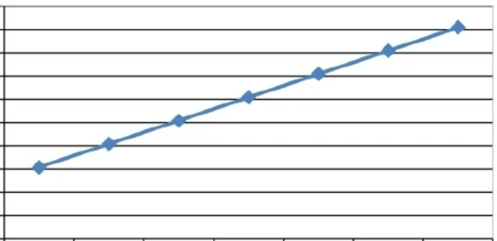
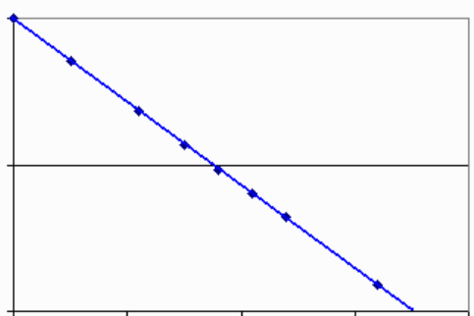



5A Recurrence Relations & their graphs
Sequence: list of numbers written succession.
Term: each number in a sequence.
Ellipses (…) shows the sequence continues in the same fashion.
Recurrence Relation: formula that links each term in a pattern-based sequence to the next.
There are two parts:
The initial value (a) $t_{0}$=a
The pattern
Arithro-geometric
Combination of linear and geometric
Multiplication and addition / subtraction
$t_{0}$ = a , $t_{n+1}$ = R × $t_{n}$ ± D
Example: ×2+1
Write RR: 11, 23, 47 …
$t_{0}$ = 11 , $t_{n+1}$ = 2 × $t_{n}$ + 1
Linear growth / decay
Increases or decreases by a constant amount.
“common difference” = D
RR : $t_{0}$ = a , $t_{n+1}$ = $t_{n}$ ± D
first term next term previous term
+ = increase / Growth Common
− = decrease / decay difference
Examples: $t_{0}$ $t_{1}$ $t_{2}$ $t_{3}$
1. Write the RR for: 30, 23, 16, 9 …
$t_{0}$=30 , $t_{n+1}$= $t_{n}$−7 $t_{1}$−$t_{0}$: 23 − 30= − 7
$t_{2}$−$t_{1}$: 16 − 23= − 7
2. Write the first 5 terms for:
$t_{0}$=150 , $t_{n+1}$= $t_{n}$+24
$t_{0}$ $t_{1}$ $t_{2}$ $t_{3}$ $t_{4}$
150 174 198 222 246
Geometric growth / decay
Increases or decreases by a common ratio.
“common ratio” =R
RR: $t_{0}$ = a , $t_{n+1}$ = R × $t_{n}$
R > 1 = increase
R < 1 = decrease
Examples: : $t_{0}$ $t_{1}$ $t_{2}$
1. RR for: 100, 90, 81 …
$t_{0}$=100 , $t_{n+1}$= 0.9 × $t_{n}$ $\frac{t_{1}}{t_{0}}$: $\frac{90}{100}$ = 0.9
$\frac{t_{2}}{t_{1}}$: $\frac{81}{90}$ = 0.9
2. First 5 terms of: $t_{0}$=10 , $t_{n+1}$= 2.5 × $t_{n}$
10, 25, 62.5, 156.25, 390.63
Growth
Growth
Decay
Decay
Notes:
Board notes

Slide 3
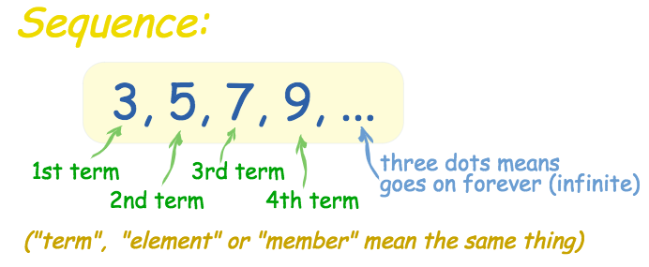
Sequence
A sequence is a list of numbers in a particular order.
The numbers or items in a sequence are called the terms of the sequence.
Each of the numbers in a sequence is called a term.

Slide 4
A sequence in which a constant (d) can be added to each term to get the next term is called an
Arithmetic Sequence.
The constant (d) is called the
Definition
Common Difference.
To find the common difference (d), subtracting any pair of successive terms.
t₁
t₂
t₃
t₄
t₅
2 5 8 11 14
3
3
3
3
Notes:
Constant = fixed amount

Slide 5
Naming the terms in a sequence
2 8 14 20 26 32
$t_{1}$ $t_{2}$ $t_{3}$ $t_{4}$ $t_{5}$ $t_{6}$
$t_{1}$=2 $t_{2}$=8 $t_{3}$=14 $t_{4}$=20 $t_{5}$=26 $t_{6}$=32

Slide 6
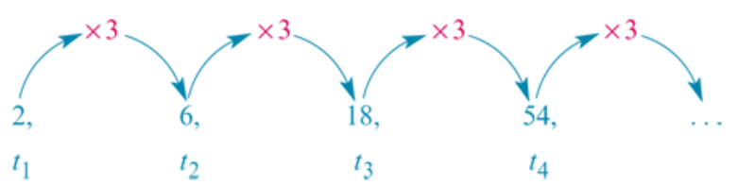
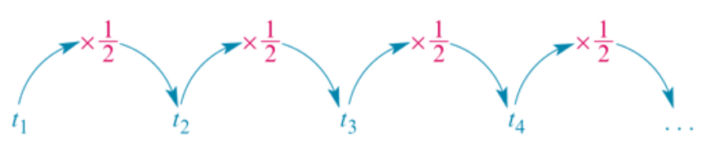
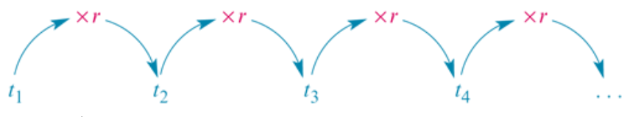
Geometric Sequences
r=3
r=$\frac{1}{2}$
In geometric sequences, you multiply by a common ratio, r, each time.
r=$Common Ratio$

Slide 7


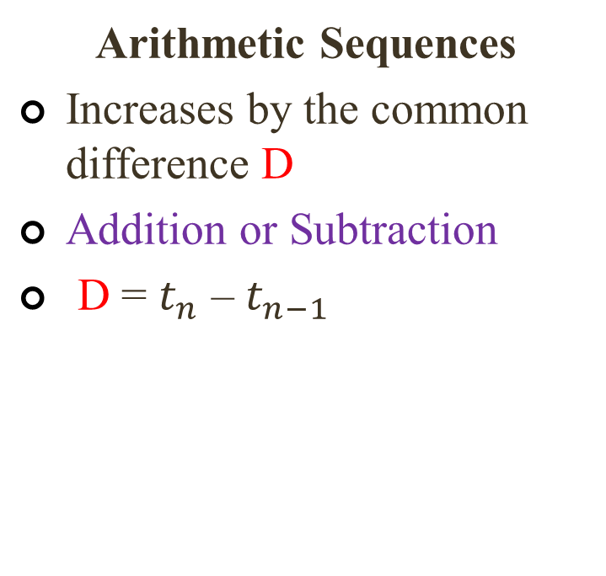
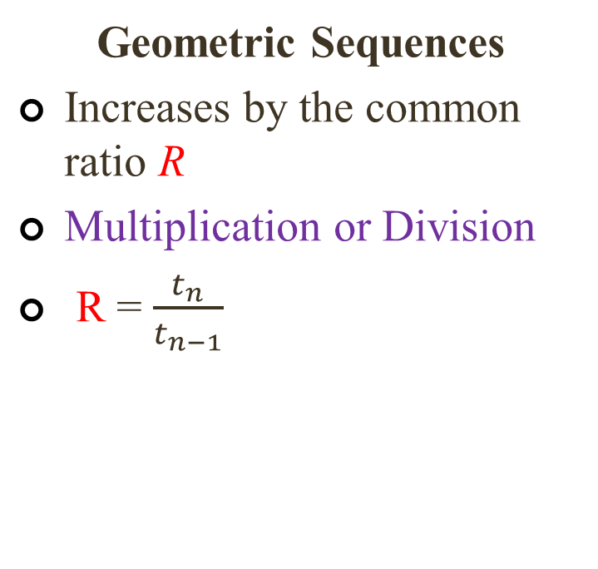
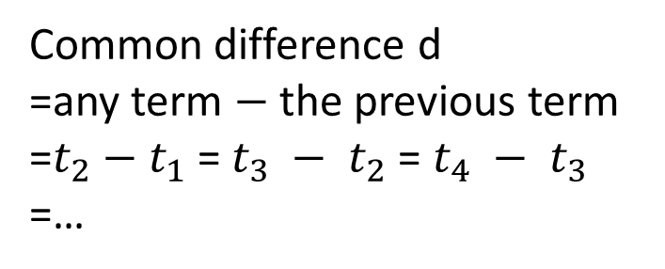
Arithmetic vs. Geometric Sequences
Arithmetic Sequences
Increases by the common difference D
Addition or Subtraction
D = $t_{n}$ – $t_{n−1}$
Geometric Sequences
Increases by the common ratio R
Multiplication or Division
R = $\frac{t_{n}}{t_{n−1}}$
Common difference d
=any term $−$ the previous term
=$t_{2}−$ $t_{1}$= $t_{3} − t_{2}$= $t_{4} − t_{3}$
=…

Slide 8
Generating a sequence of terms
Write down the first five terms of the sequence with a starting value of 5 and the rule ‘double the number and then subtract 3’.
5
2×5−3=7
2×7−3=11
2×11−3=19
2×19−3=35
The sequence is 5, 7, 11, 19, 35, …

Slide 9
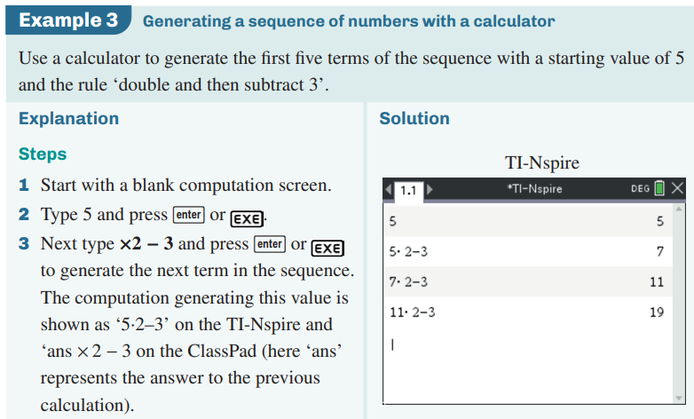
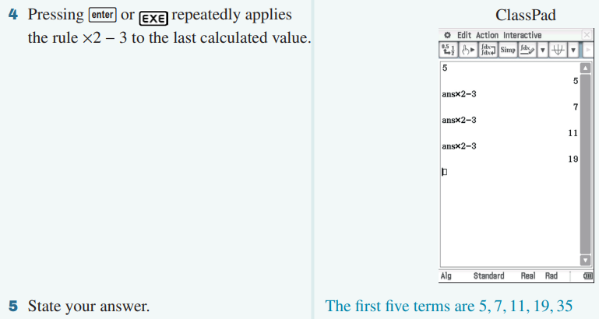
Generating a sequence of terms using a recurrence relation
To generate the first five terms of the sequence with a starting value of 5 and the rule ‘double and then subtract 3’.
CAS Notes 5.1

Slide 10
Recurrence Relation
A recurrence relation is a mathematical rule that we can use to generate a sequence. It has two parts:
a starting point: the value of one of the terms in the sequence
a rule that can be used to generate successive terms in the sequence.

Slide 11
Recurrence Relation
For example, in words, a recursion rule that can be used to generate the sequence:
10,15,20,…
can be written as follows:
Start with 10.
To obtain the next term, add 5 to the current term and repeat the process.

Slide 12
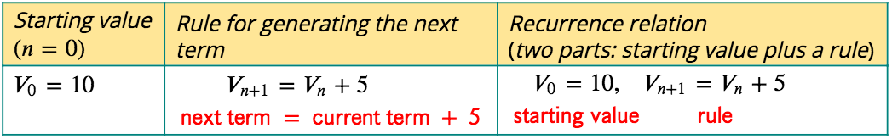
Recurrence Relation
symbolic form
Let 𝑉𝑛 be the term in the sequence after 𝑛 iterations (Each time we apply the rule it is called an iteration).
Note: Because of the way we defined Vn, the starting value of 𝑛 is 0. At the start there have been no applications of the rule. This is the most appropriate starting point for financial modelling.

Slide 13
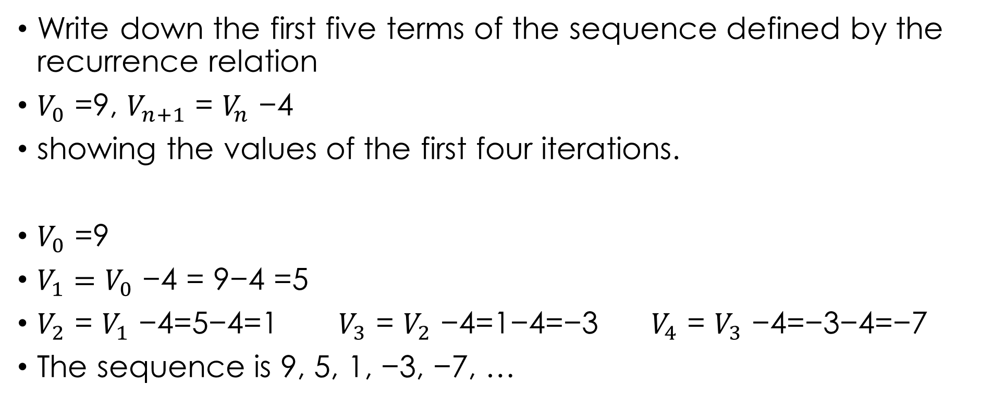
Generating a sequence from a recurrence relation
Write down the first five terms of the sequence defined by the recurrence relation
$V_{0}$ =9, $V_{n+1}$ = $V_{n}$ −4
showing the values of the first four iterations.
$V_{0}$ =9
${V_{1}=V}_{0}$ −4 = 9−4 =5
$V_{2}$ = $V_{1}$ −4=5−4=1 $V_{3}$ = $V_{2}$ −4=1−4=−3 $V_{4}$ = $V_{3}$ −4=−3−4=−7
The sequence is 9, 5, 1, −3, −7, …

Slide 14
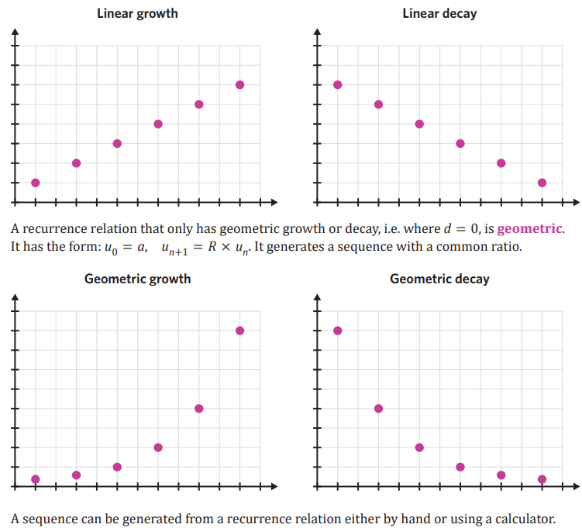
Generating a sequence of terms using a recurrence relation

