Slide 1
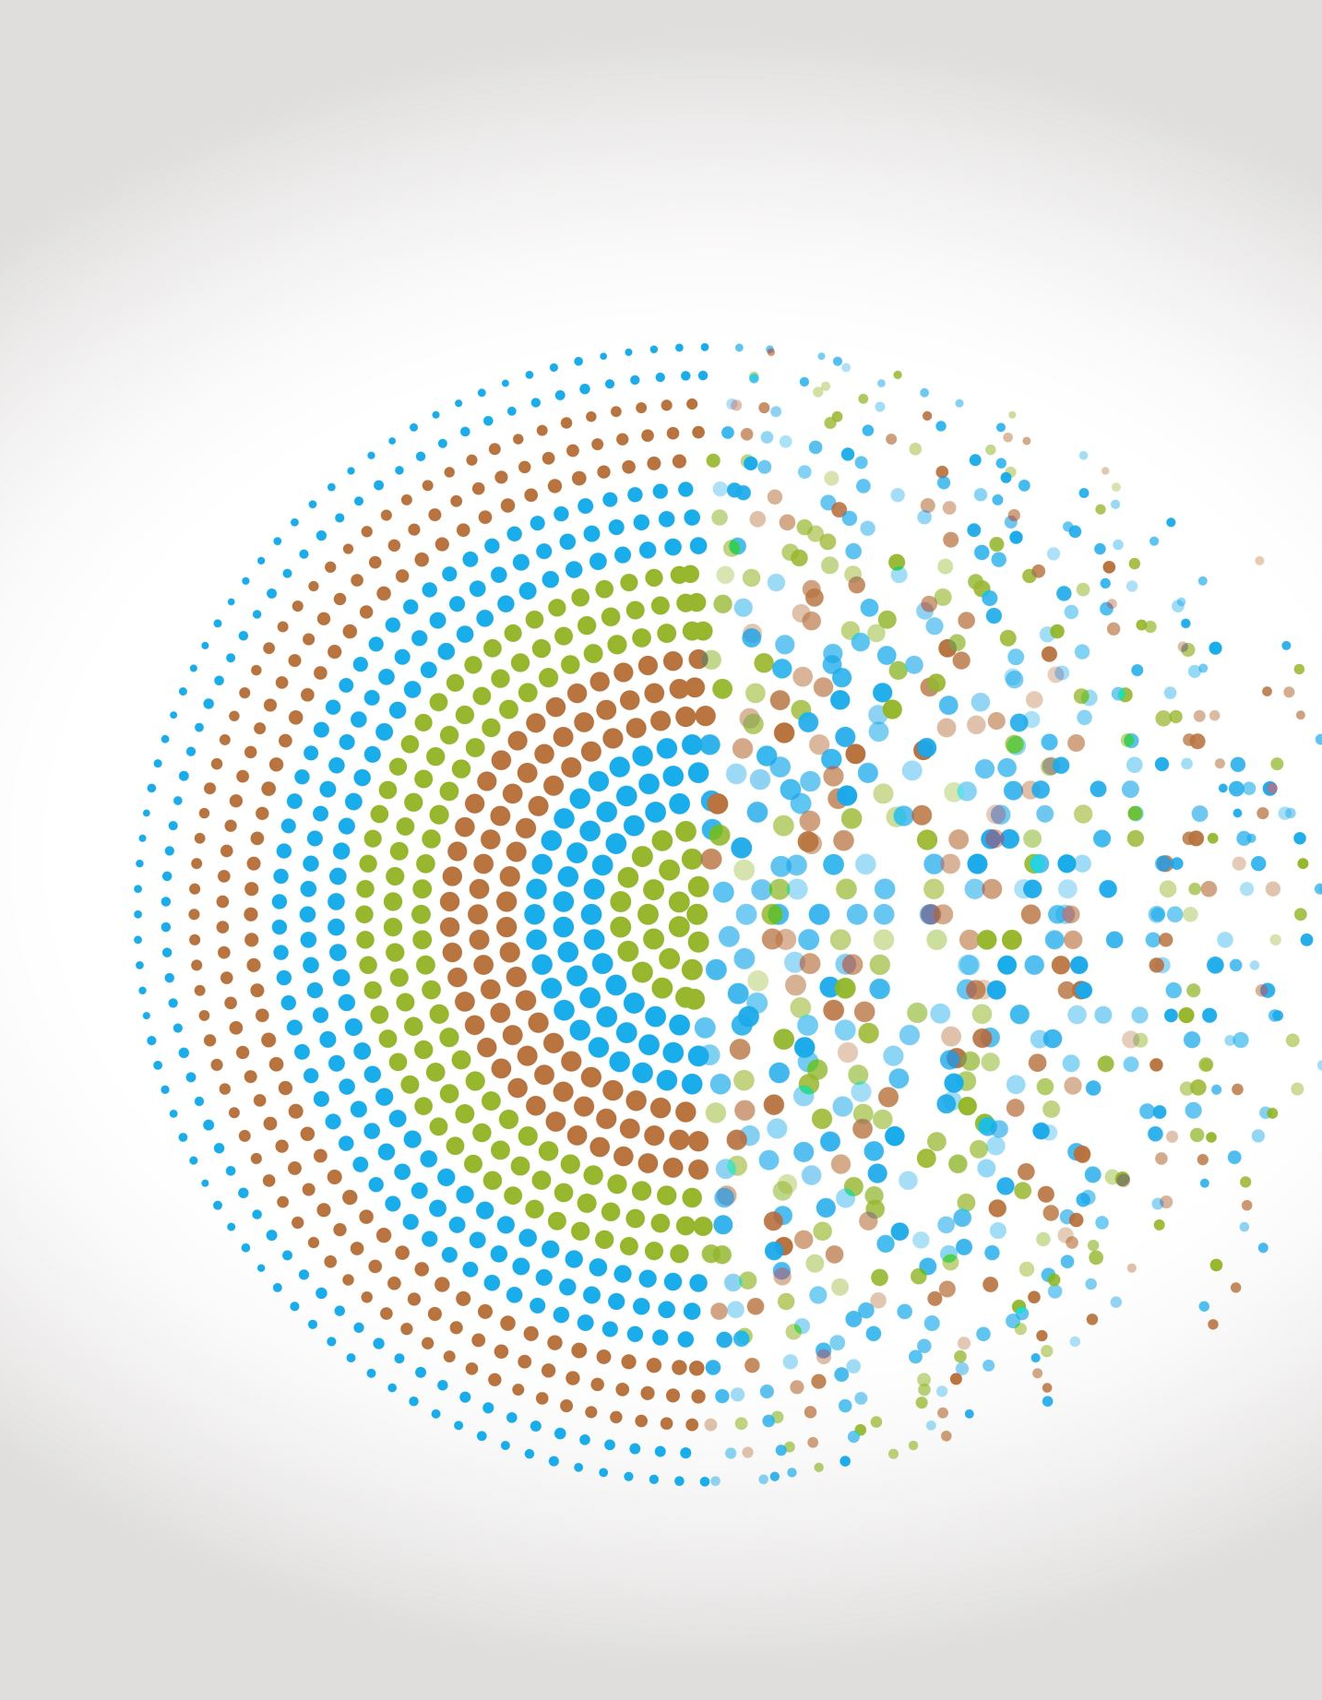
Reducing balance depreciation – recurrence relations
5C
https://dashboard.blooket.com/set/6507923af3eb74a0c98b08c8
https://play.blooket.com/host?id=6747882db8d55150a13895dc
https://play.blooket.com/host?id=67478ccf9d40e5f58c69de67
https://dashboard.blooket.com/set/630c42e0aa05729fcc13c31d

Slide 2
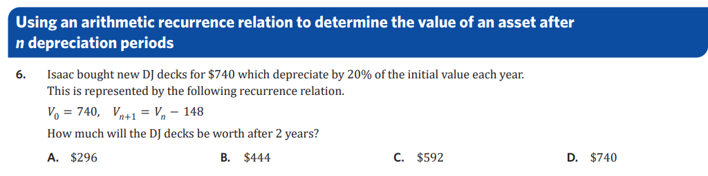

Slide 3



5C: Reducing balance depreciation
depreciation is by a fixed ratio per period (rather than a fixed amount like flat-rate or unit cost)
depreciates by a percentage of its previous value
amount of depreciation decreases each time period as the value decreases
RR $V_{0}=initial value,V_{n+1}=R×V_{n}$
$R=1−\frac{r}{100}$ $r=$depreciation rate per period (%)
$V_{n+1}=$next term $V_{n}=$previous term
Example: Office furniture cost $6900 and depreciates by 6.4% per annum.
a) write the RR:
1. calculate R:
$$R=1−\frac{6.4}{100}=0.936$$
R is below 1 ∴ geometric decay will occur
2. fill in RR:
$$V_{0}=6900, V_{n+1}=0.936×V_{n}$$
b) using recursion determine the value of the office furniture after 3 years:
$$V_{0}=6900 \\ V_{1}=R×V_{0}=0.936×6900=6458.4 \\ V_{2}=R×V_{1}=0.936×6458.4=6045.06 \\ V_{3}=R×V_{2}=0.936×6045.06=5658.18$$
c) In the 3-year period, how much has the office furniture depreciated by?
$$V_{0}−V_{3}=6900−5658.18=1241.82$$
d) When will the office furniture first drop below $5000?
use CAS trick: 6900 → enter × 0.936 → keep hitting enter until value drops below 5000
$$V_{5}=4957.41$$
→ after 5 years.
e) the printer is worth $3200 when new, given the RR to model depreciation, what is the depreciation rate?
$V_{0}=3200,V_{n+1}=0.872×V_{n}$ R solve ($0.872=1−\frac{r}{100}, r) r=12.8\%$

Slide 4
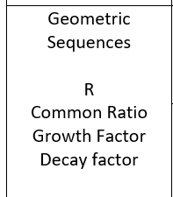
Reducing-balance depreciation
Reducing-balance depreciation is another method of depreciation – one where the value of an asset decays geometrically. Each year, the value will be reduced by a percentage, 𝑟%, of the previous year’s value. The calculations are very similar to compounding interest, but with decay in value, rather than growth.

Slide 5
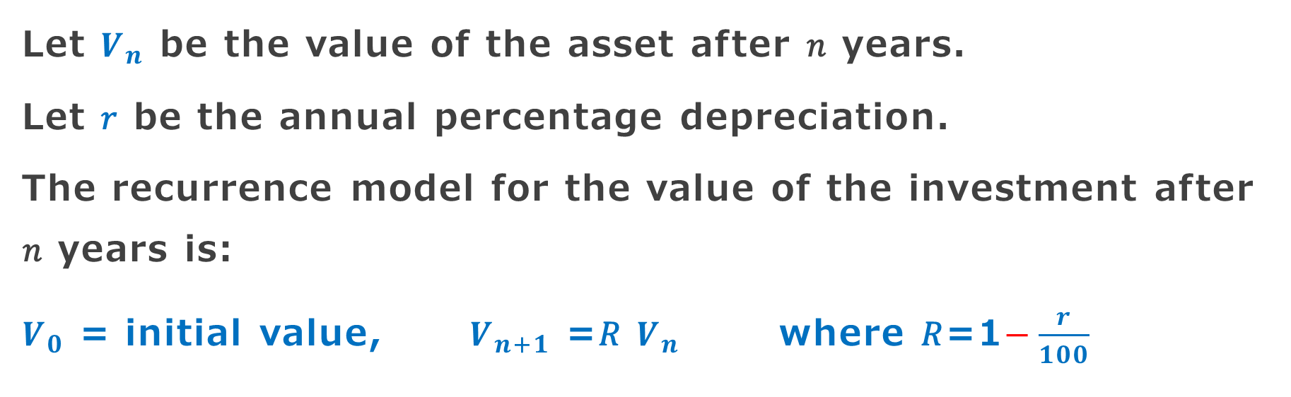
A recurrence model for reducing balance depreciation
Let $V_{n}$ be the value of the asset after 𝑛 years.
Let 𝑟 be the annual percentage depreciation.
The recurrence model for the value of the investment after 𝑛 years is:
$V_{0}$ = initial value, $V_{n+1}$ =𝑅 $V_{n}$ where 𝑅=1$−\frac{r}{100}$

Slide 6


Modelling reducing-balance depreciation with recurrence relations
The following recurrence relation can be used to model the value of office furniture with a purchase price of $6900, depreciating at a reducing-balance rate of 7% per annum.
$V_{0}$ =6900, $V_{n+1}$ =0.93× $V_{n}$
In the recurrence relation, $V_{n}$ is the value of the office furniture after 𝑛 years.
1. Use the recurrence relation to find the value of the office furniture, correct to the nearest cent, after 1, 2 and 3 years.
1. $V_{0}$ =6900
$V_{1}$ =0.93×6900=6417
$V_{2}$ =0.93×6417=5967.81
$V_{3}$ =0.93×5967.81=5550.06

Slide 7
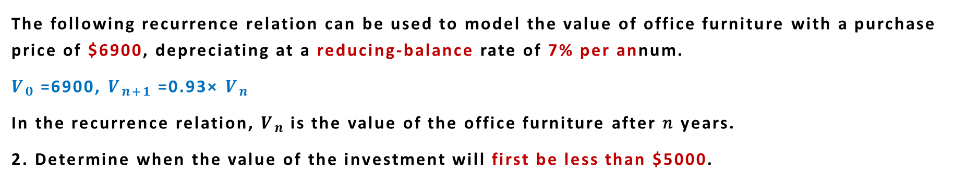
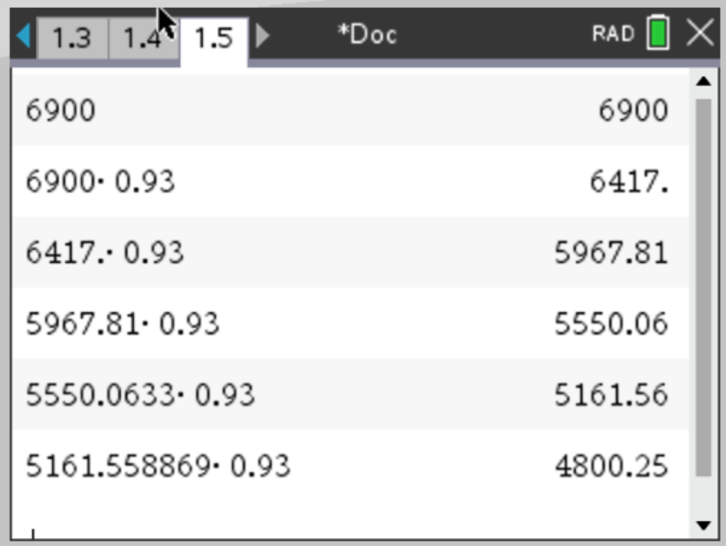
Modelling reducing-balance depreciation with recurrence relations
The following recurrence relation can be used to model the value of office furniture with a purchase price of $6900, depreciating at a reducing-balance rate of 7% per annum.
$V_{0}$ =6900, $V_{n+1}$ =0.93× $V_{n}$
In the recurrence relation, $V_{n}$ is the value of the office furniture after 𝑛 years.
2. Determine when the value of the investment will first be less than $5000.
CAS Notes 5.6
2. The value of the furniture drops below $5000 after 5 years.
CAS Notes 6.16.5

Slide 8

Modelling reducing-balance depreciation with recurrence relations
The following recurrence relation can be used to model the value of office furniture with a purchase price of $6900, depreciating at a reducing-balance rate of 7% per annum.
$V_{0}$ =6900, $V_{n+1}$ =0.93× $V_{n}$
In the recurrence relation, $V_{n}$ is the value of the office furniture after 𝑛 years.
3. Write down the recurrence relation if the furniture was initially valued at $7500 and is depreciating at a reducing-balance rate of 8.4% per annum.
3. $V_{0}$ =7500
Calculate the value or 𝑅. The depreciation rate is 8.4% per annum.
𝑅=1−$\frac{8.4}{100}$ or 𝑅=0.916
$V_{0}$ =7500, $V_{n+1}$ =0.916× $V_{n}$

