Slide 1
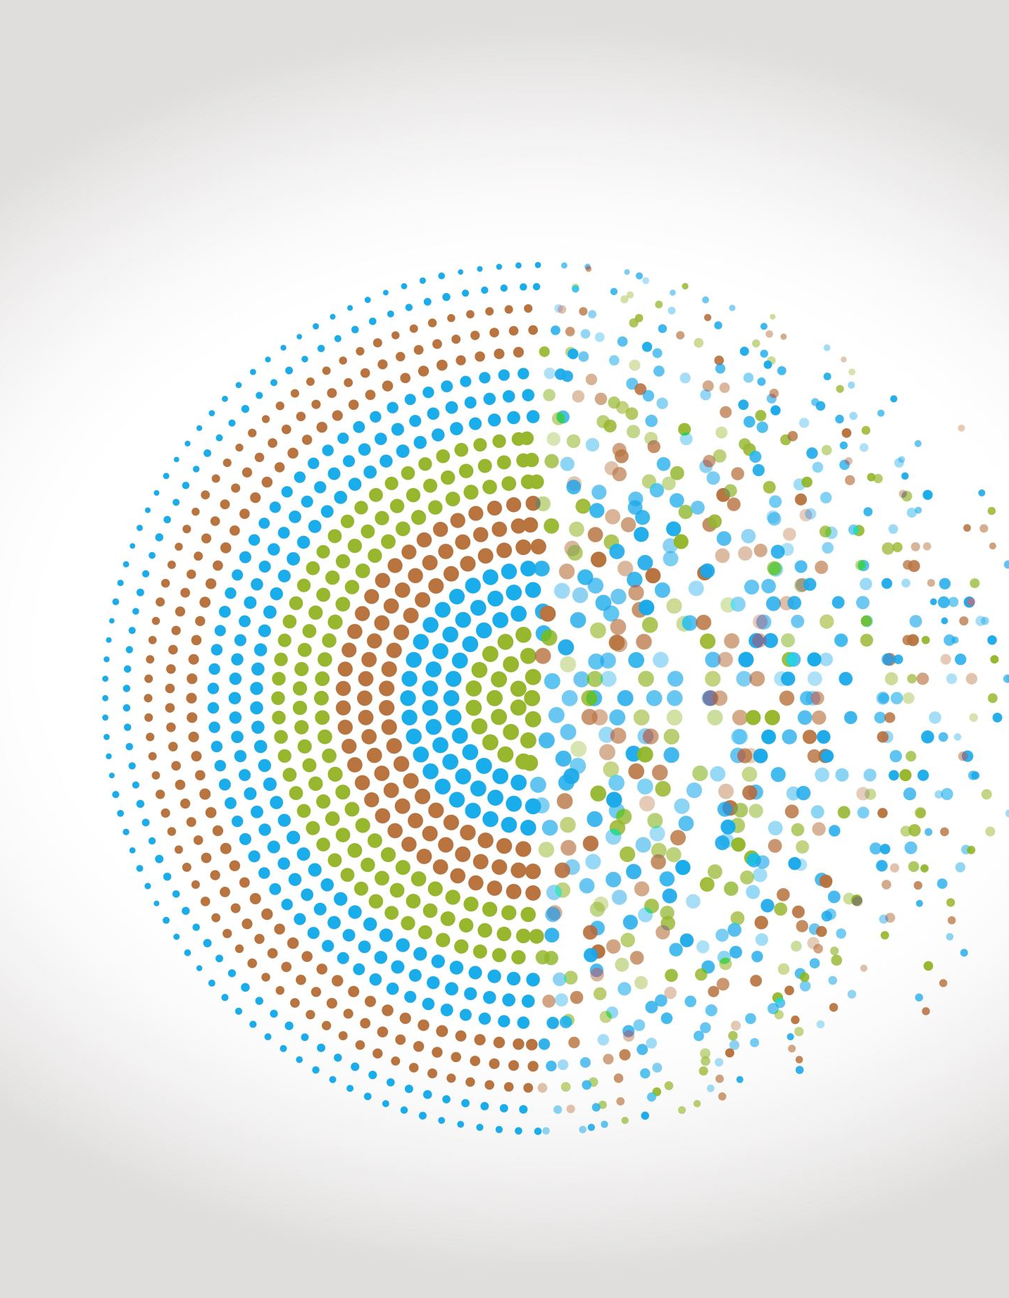
Compound interest
5F
https://dashboard.blooket.com/set/6507923af3eb74a0c98b08c8
https://play.blooket.com/host?id=6747882db8d55150a13895dc
https://play.blooket.com/host?id=67478ccf9d40e5f58c69de67
https://dashboard.blooket.com/set/630c42e0aa05729fcc13c31d
Notes:
3,5,6,10,11,15,16

Slide 2
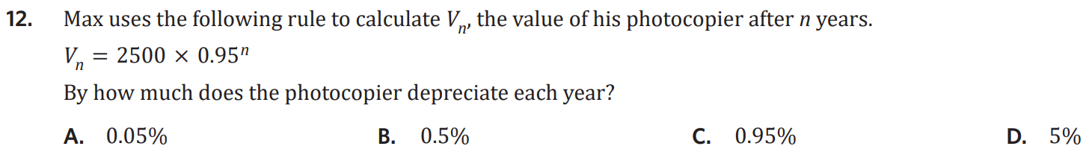
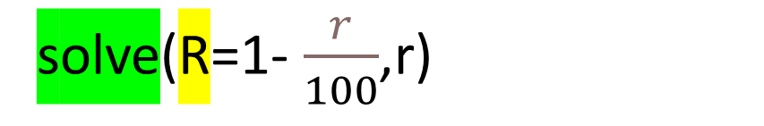
solve(R=1- $\frac{r}{100}$,r)
r = (1-R)*100

Slide 3






Type | Compound periods per year
annual | 1
biannual | 2
quarterly | 4
monthly | 12
fortnightly | 26
weekly | 52
daily | 365
5F Compound Interest
• most common form of interest
• interest is calculated taking into account the principal and any interest earned
• the amount of interest increases each time period
recurrence relation:
V₀ = principal, Vₙ₊₁ = R x Vₙ
R=1+ $\frac{r}{100}$
r = interest rate per compound period
rule: ${\text{V}}_{n}$ = V₀ × R ⁿ
R=1+ $\frac{r}{100}$
r = interest rate per compound
Compound periods
• interest rates are often given as a yearly rate/ per annum
• accounts can compound more frequently than this
the annual interest rate must be converted to the interest rate per compound period
examples:
1. Trent opens a compound interest account with $6500. The bank pays 5.7% interest p.a. compounding quarterly.
a. write the recurrence relation R = 1 + $\frac{5.7/4}{100}$= 1.01425 V₀ = 6500, Vₙ₊₁ = 1.01425 × Vₙ
b. write the rule Vₙ = 1.01425ⁿ × 6500
c. determine the value after 1 year using recursion (4 comp periods) V₁ = 1.01425 × 6500 = 6592.63 V₂ = 1.01425 × 6592.63 = 6686.57 V₃ = 1.01425 × 6688.57 = 6781.85 V₄ = 1.01425 × 6781.85 = 6878.49
d. Determine the value after 4 years
$$V_{16} =6500×\left(1.01425{\left.)\right.}^{16}≈8151.43\right.$$
e. How much interest was earned in 4 years?
$$V_{16}−V_{0}=8151.43−6500=1651.43$$
2. . The rule models a compound interest account (compounding monthly)
$$V_{n}=8710×\left(1.0075{\left.)\right.}^{n}\right.$$
a. What is the annual interest rate?
Solve(1.0075$=1+\frac{r}{100},r) r=0.75×12=9\%$
Solve(1.0075$=1+\frac{r/12}{100},r) r=9\%$
b. When will the account reach $10,000?
Solve (1000=8710 $×$ ${1.0075}^{n},n)$
$n≈18.48$ =19 months
c. How much interest was earned in the 3rd year?
$$V_{24}=8710×\left(1.0075{\left.)\right.}^{24}=10,420.76\right.$$
$$V_{36}=8710×\left(1.0075{\left.)\right.}^{36}=11,398.30\right.$$
$$V_{36}−V_{24}=977.46$$
Divide the annual interest rate by the compound period
e.g.
6% pa, compounding monthly
$\frac{6\%}{12}$ = 0.5% monthly
$$V_{0}$$
$$V_{12}$$
$$V_{24}$$
$$V_{36}$$
1st yr
2nd yr
3rd yr
Notes:
Board notes

Slide 4
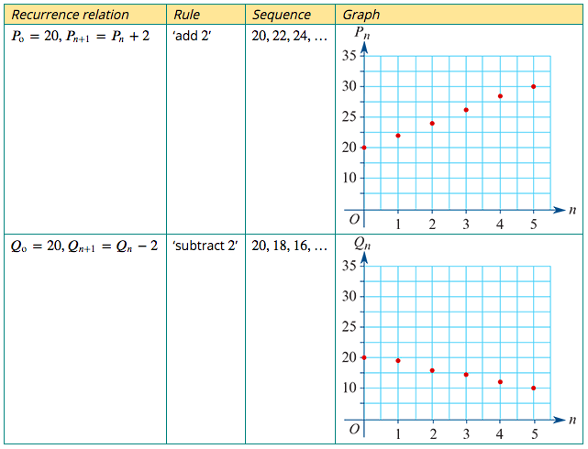
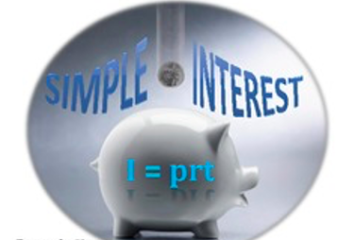
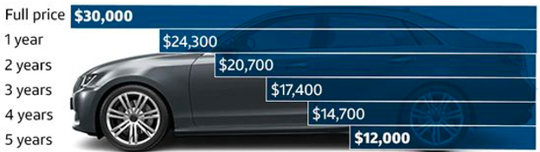
A recurrence model for linear growth and decay
The recurrence relations: $P_{0}$=20, $P_{n+1}$= $P_{n}$+ 2 $Q_{0}$=20, $Q_{n+1}$= $Q_{n}−$ 2
linear growth
Model and investigate simple interest loans and investments, as well as flat rate depreciation and unit cost depreciation of assets
linear decay

Slide 5
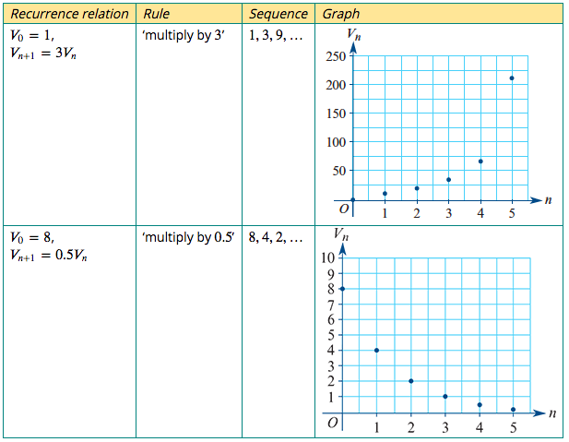

A recurrence model for geometric growth and decay
$V_{0}$=1, $V_{n+1}$=3$V_{n}$
$V_{0}$=8, $V_{n+1}$=0.5$V_{n}$

Slide 6

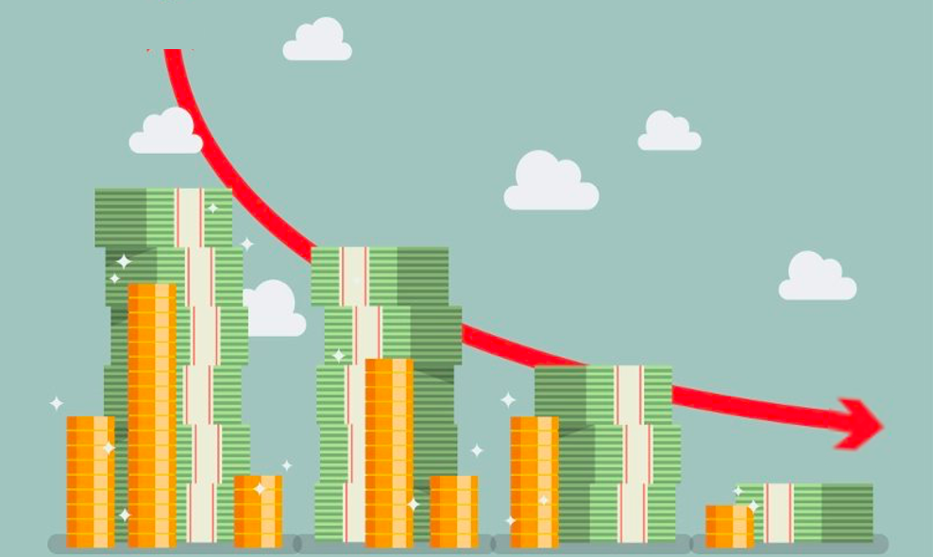
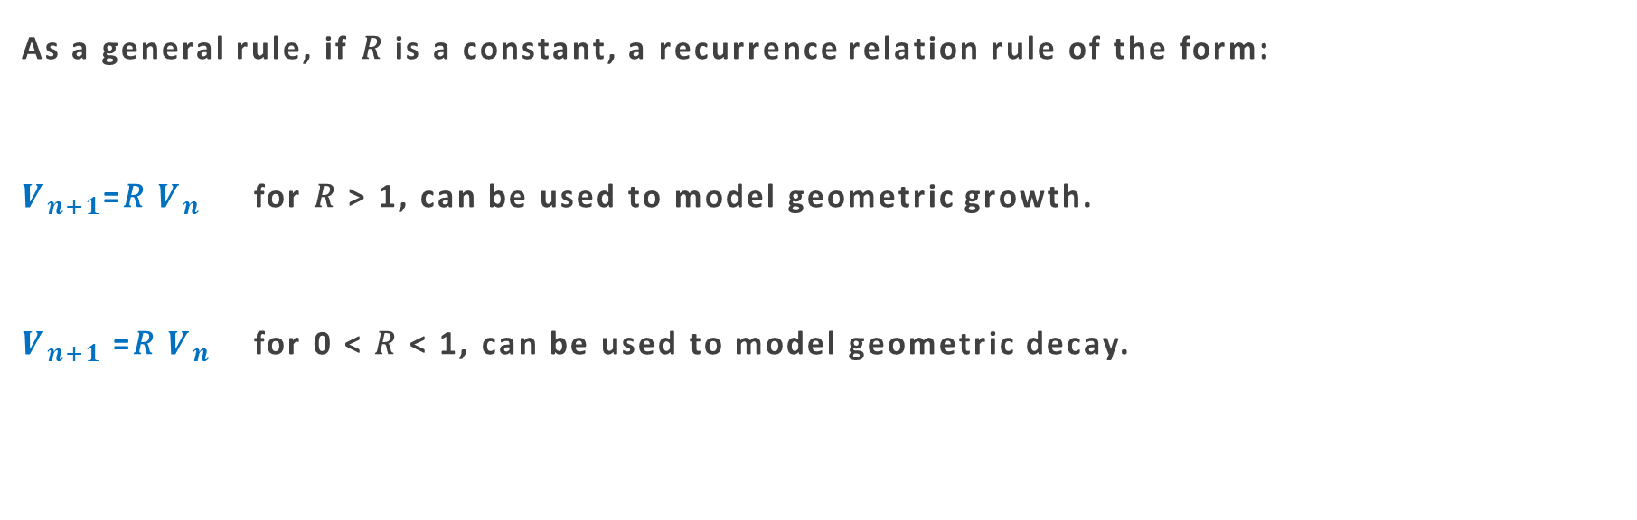
A recurrence model for geometric growth and decay
As a general rule, if 𝑅 is a constant, a recurrence relation rule of the form:
$V_{n+1}$=𝑅 $V_{n}$ for 𝑅 > 1, can be used to model geometric growth.
$V_{n+1}$=𝑅 $V_{n}$ for 0 < 𝑅 < 1, can be used to model geometric decay.
Compound Interest
Reducing Balance Depreciation

Slide 7
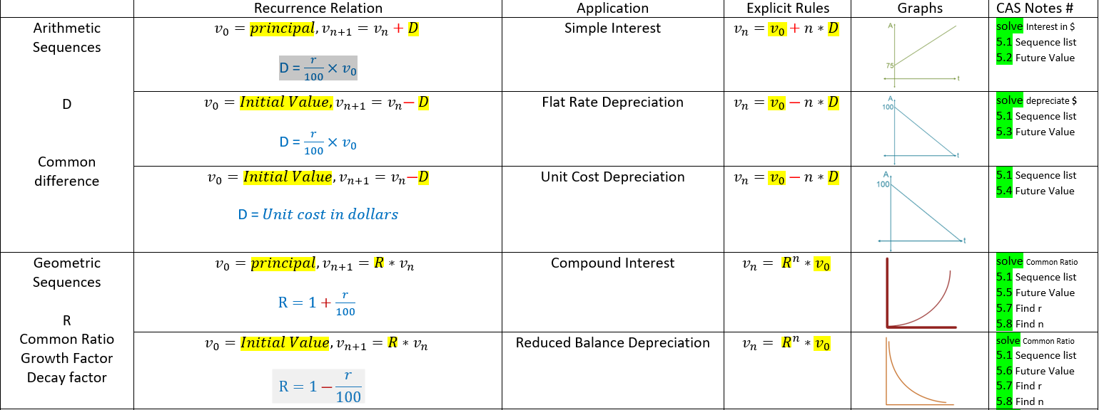

Slide 8


Compound interest investments
Consider an investment of $5000 that pays 8% interest per annum, compounding yearly. This means that the investment’s value increases by 8% each year.
Let $V_{n}$ be the value of the investment after 𝑛 years.
$V_{0}$ =$5000
value next year = this year's value + interest earned
$V_{n+1}$ = $V_{n}$ +$\frac{8}{100}$× $V_{n}$= $V_{n}$ +0.08× $V_{n}$
$V_{n+1}$ =1.08 $V_{n}$

Slide 9
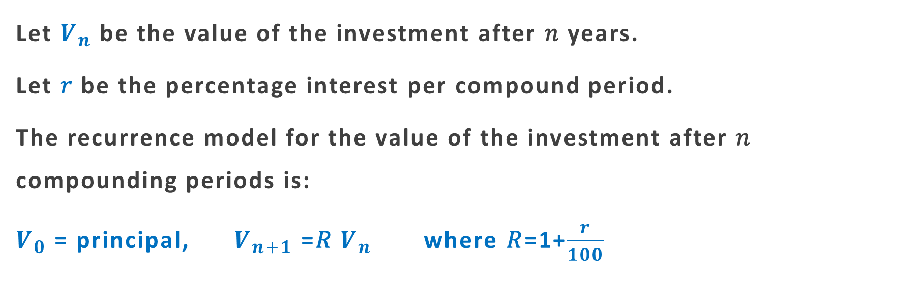

A recurrence model for compound interest investments and loans that compound yearly
Let $V_{n}$ be the value of the investment after 𝑛 years.
Let 𝑟 be the percentage interest per compound period.
The recurrence model for the value of the investment after 𝑛 compounding periods is:
$V_{0}$ = principal, $V_{n+1}$ =𝑅 $V_{n}$ where 𝑅=1+$\frac{r}{100}$
solve(R=1+ $\frac{r}{100}$,r)
r = (R-1)*100

Slide 10

Modelling compound interest with a recurrence relation 1
The following recurrence relation can be used to model a compound interest investment of $2000 paying interest at the rate of 7.5% per annum.
$V_{0}$ =2000, $V_{n+1}$ =1.075× $V_{n}$
In the recurrence relation, $V_{n}$ is the value of the investment after 𝑛 years.
1. Use the recurrence relation to find the value of the investment after 1, 2 and 3 years.
$V_{0}$ =2000,
$V_{1}$=1.075×2000=2150,
$V_{2}$=1.075×2150=2311.25,
$V_{3}$=1.075×2311.25=2484.59
CAS Notes 5.5
CAS Notes 6.16.4

Slide 11
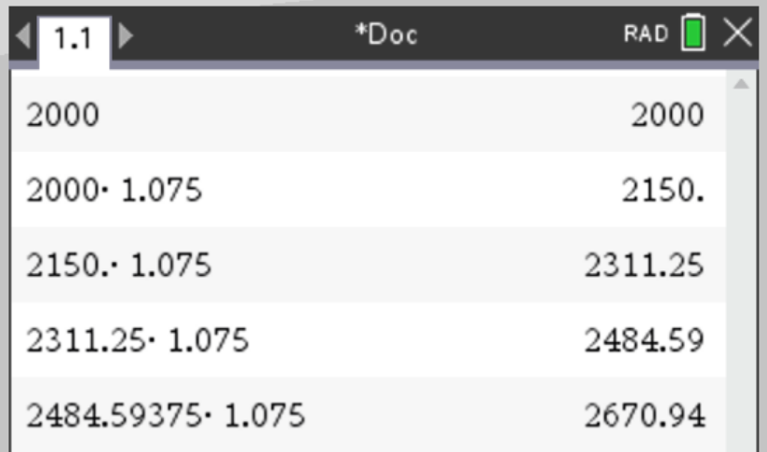

Modelling compound interest with a recurrence relation 1
The following recurrence relation can be used to model a compound interest investment of $2000 paying interest at the rate of 7.5% per annum.
$V_{0}$ =2000, $V_{n+1}$ =1.075× $V_{n}$
In the recurrence relation, $V_{n}$ is the value of the investment after 𝑛 years.
2. Determine when the value of the investment will be first exceed $2500.
CAS Notes 5.5
2. After 4 years, the investment will first exceed $2500
CAS Notes 6.16.4

Slide 12
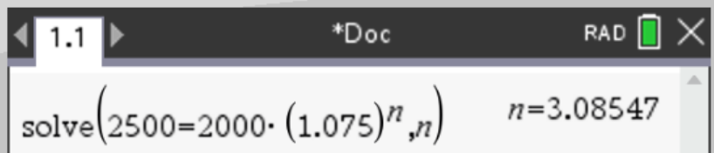

Modelling compound interest with a recurrence relation 1
The following recurrence relation can be used to model a compound interest investment of $2000 paying interest at the rate of 7.5% per annum.
$V_{0}$ =2000, $V_{n+1}$ =1.075× $V_{n}$
In the recurrence relation, $V_{n}$ is the value of the investment after 𝑛 years.
2. Determine when the value of the investment will be first exceed $2500.
The rule for Compound $V_{n}$ =2000 ×${1.075}^{n}$
2500= 2000 ×${1.075}^{n}$
$÷2000$ $÷2000$
1.25= ${1.075}^{n}$ → n=Log${1.075}^{1.25}$=$\frac{(log1.25)}{(log1.075)}$=3.08547
CAS Notes solve
2. After 4 years, the investment will first exceed $2500

Slide 13

Modelling compound interest with a recurrence relation 1
3. Write down the recurrence relation if $1500 was invested at a compound interest rate of 6.0% per annum.
3. $V_{0}$ =1500 and 𝑟=6
Calculate the value or 𝑅. The value of the investment will grow over time, so
𝑅=1+$\frac{r}{100}$ = 1+ $\frac{6}{100}$=1.06
$V_{0}$ =1500, $V_{n+1}$ =1.06× $V_{n}$

Slide 14
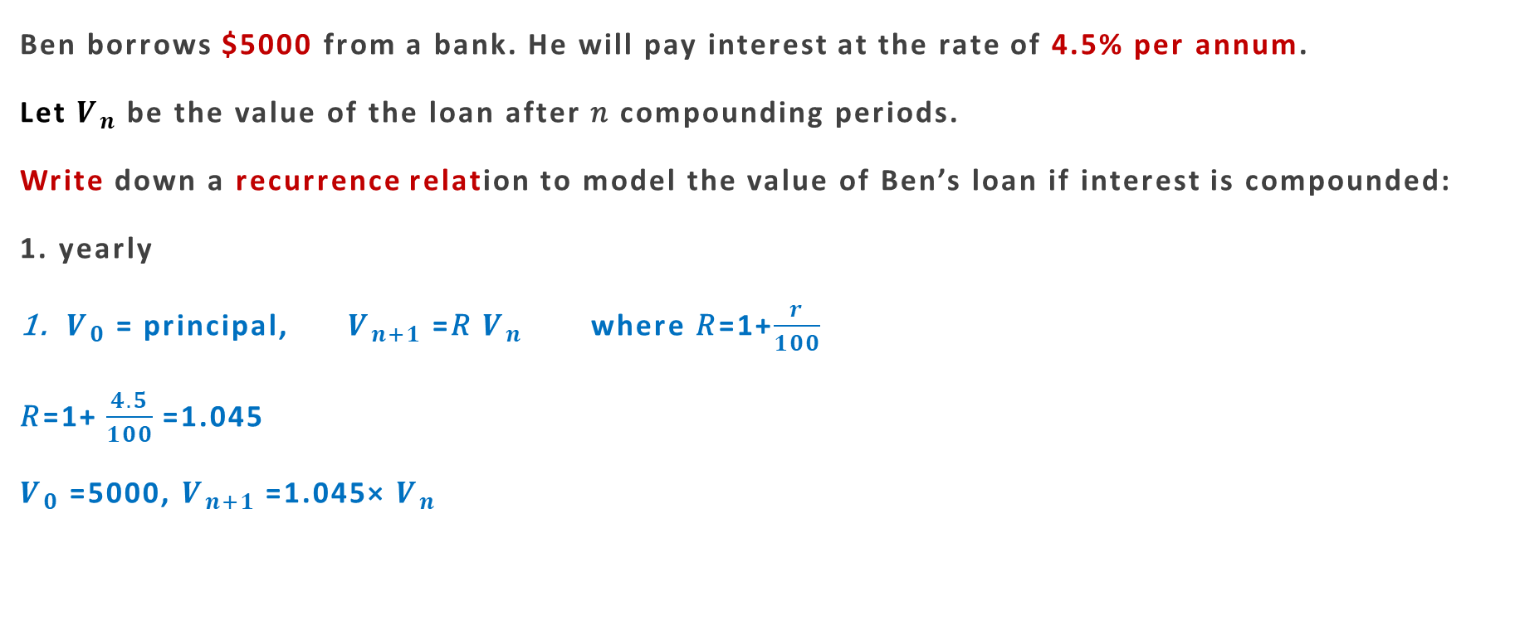
Compound interest with different compounding periods
Ben borrows $5000 from a bank. He will pay interest at the rate of 4.5% per annum.
Let $V_{n}$ be the value of the loan after 𝑛 compounding periods.
Write down a recurrence relation to model the value of Ben’s loan if interest is compounded:
1. yearly
$V_{0}$ = principal, $V_{n+1}$ =𝑅 $V_{n}$ where 𝑅=1+$\frac{r}{100}$
𝑅=1+ $\frac{4.5}{100}$=1.045
$V_{0}$ =5000, $V_{n+1}$ =1.045× $V_{n}$

Slide 15

Compound interest with different compounding periods
Ben borrows $5000 from a bank. He will pay interest at the rate of 4.5% per annum.
Let $V_{n}$ be the value of the loan after 𝑛 compounding periods.
Write down a recurrence relation to model the value of Ben’s loan if interest is compounded:
2. quarterly
2. $V_{0}$ = principal, $V_{n+1}$ =𝑅 $V_{n}$ where 𝑅=1+$\frac{r}{100}$
The interest rate is 4.5% per annum. The quarterly rate is $\frac{4.5}{4}$=1.125.
𝑅=1+ $\frac{1.125}{100}$=1.01125
$V_{0}$=5000, $V_{n+1}$ =1.01125× $V_{n}$

Slide 16

Compound interest with different compounding periods
Ben borrows $5000 from a bank. He will pay interest at the rate of 4.5% per annum.
Let $V_{n}$ be the value of the loan after 𝑛 compounding periods.
Write down a recurrence relation to model the value of Ben’s loan if interest is compounded:
3. monthly.
3. $V_{0}$ = principal, $V_{n+1}$ =𝑅 $V_{n}$ where 𝑅=1+$\frac{r}{100}$
The interest rate is 4.5% per annum. The monthly rate is $\frac{4.5}{12}$=0.375.
𝑅=1+ $\frac{0.375}{100}$=1.00375
$V_{0}$ =5000, $V_{n+1}$=1.00375× $V_{n}$

Slide 17
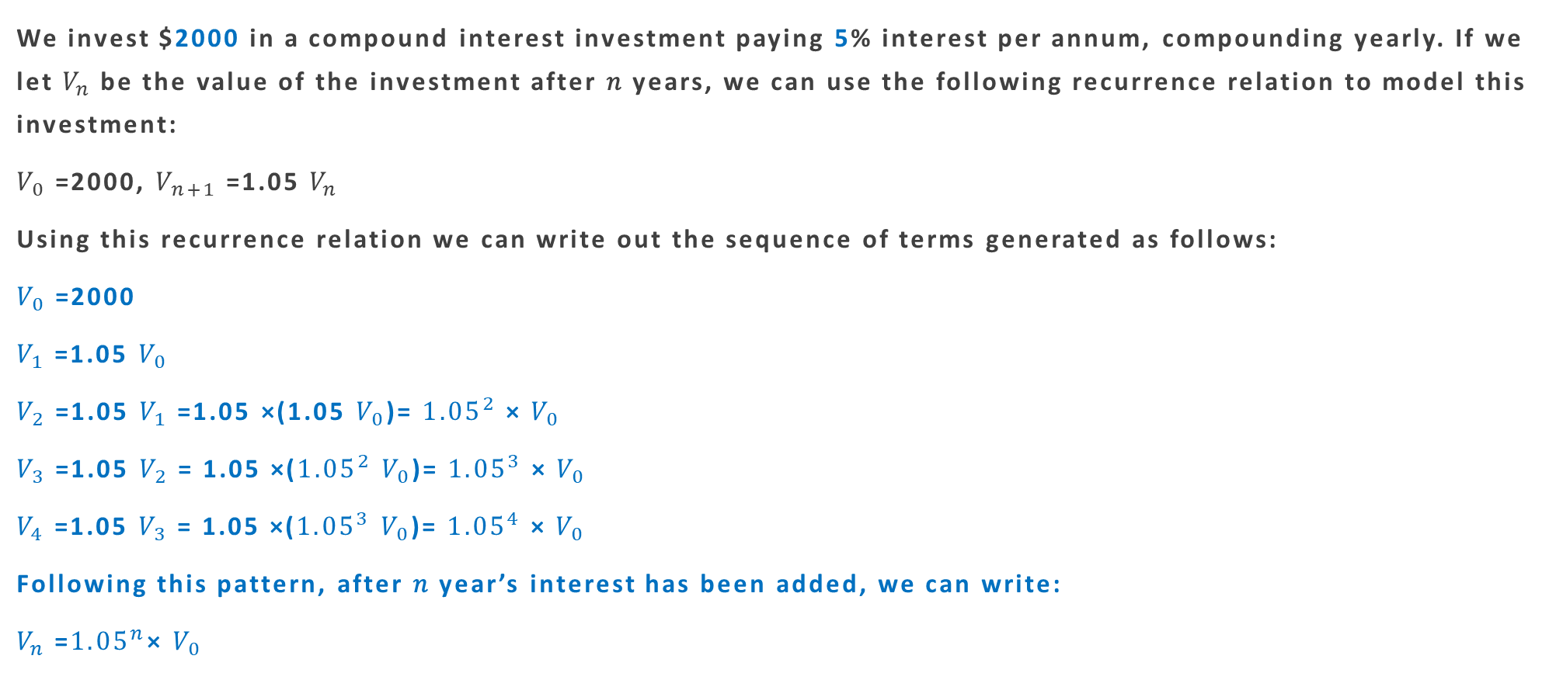
A rule for individual terms of a geometric growth sequence
We invest $2000 in a compound interest investment paying 5% interest per annum, compounding yearly. If we let $V_{n}$ be the value of the investment after 𝑛 years, we can use the following recurrence relation to model this investment:
$V_{0}$=2000, $V_{n+1}$=1.05 $V_{n}$
Using this recurrence relation we can write out the sequence of terms generated as follows:
$V_{0}$=2000
$V_{1}$=1.05 $V_{0}$
$V_{2}$=1.05 $V_{1}$ =1.05 ×(1.05 $V_{0}$)= ${1.05}^{2}$ × $V_{0}$
$V_{3}$=1.05 $V_{2}$ = 1.05 ×(${1.05}^{2}$ $V_{0}$)= ${1.05}^{3}$ × $V_{0}$
$V_{4}$=1.05 $V_{3}$ = 1.05 ×(${1.05}^{3}$ $V_{0}$)= ${1.05}^{4}$ × $V_{0}$
Following this pattern, after 𝑛 year’s interest has been added, we can write:
$V_{n}$=${1.05}^{n}$× $V_{0}$

Slide 18

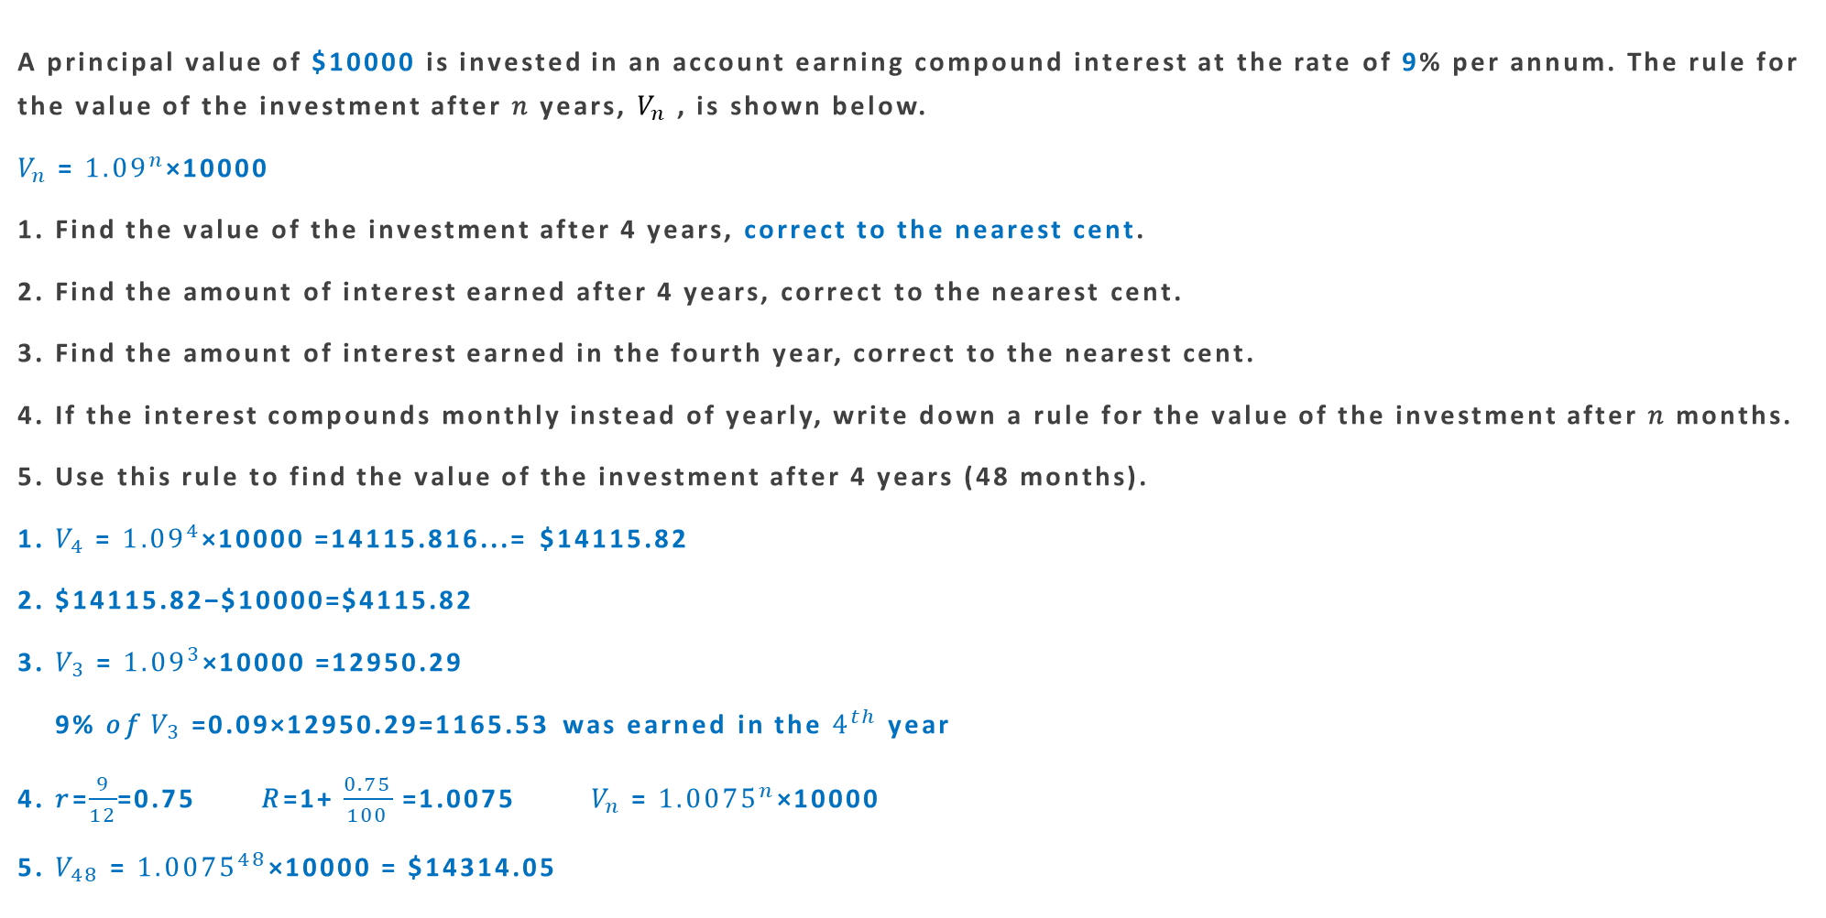
Using a rule to find the value of an investment
A principal value of $10000 is invested in an account earning compound interest at the rate of 9% per annum. The rule for the value of the investment after 𝑛 years, $V_{n}$, is shown below.
$V_{n}$= ${1.09}^{n}$×10000
1. Find the value of the investment after 4 years, correct to the nearest cent.
2. Find the amount of interest earned after 4 years, correct to the nearest cent.
3. Find the amount of interest earned in the fourth year, correct to the nearest cent.
4. If the interest compounds monthly instead of yearly, write down a rule for the value of the investment after 𝑛 months.
5. Use this rule to find the value of the investment after 4 years (48 months).
1. $V_{4}$= ${1.09}^{4}$×10000 =14115.816...= $14115.82
2. $14115.82−$10000=$4115.82
3. $V_{3}$= ${1.09}^{3}$×10000 =12950.29
9% 𝑜𝑓 $V_{3}$=0.09×12950.29=1165.53 was earned in the $4^{th}$year
4. 𝑟=$\frac{9}{12}$=0.75 𝑅=1+ $\frac{0.75}{100}$=1.0075 $V_{n}$= ${1.0075}^{n}$×10000
5. $V_{48}$= ${1.0075}^{48}$×10000 = $14314.05

Slide 19
