Slide 1

Amortisation Annuities
6D
Notes:
1,2,4,7,8,10,12

Slide 2
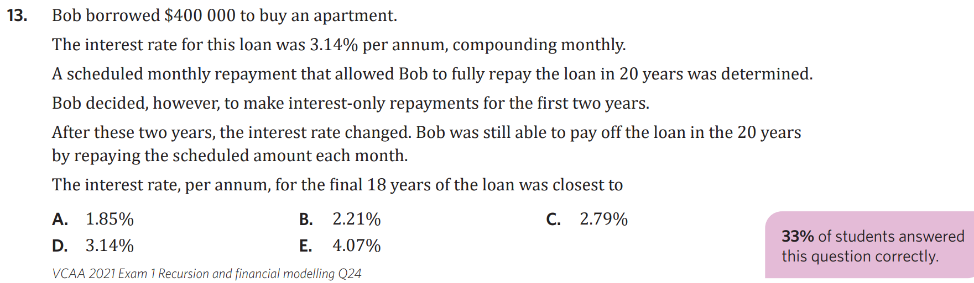
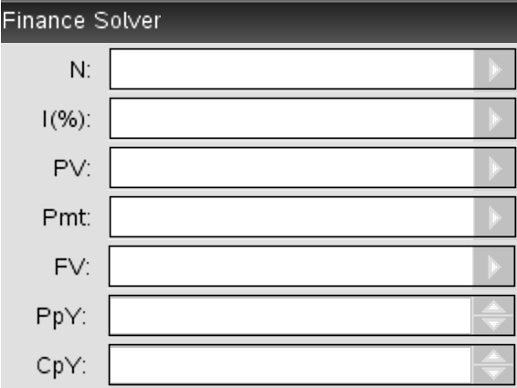
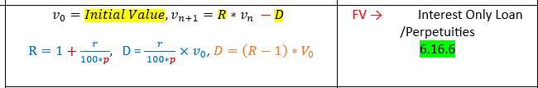
Step 1. Pmt
Total number of periods
Annual interest rate
Present value
Payment
Step 2.
Future value
N | I | PV | Pmt | FV | Ppy | Cpy
Payment periods per year
Compounding periods per year

Slide 3



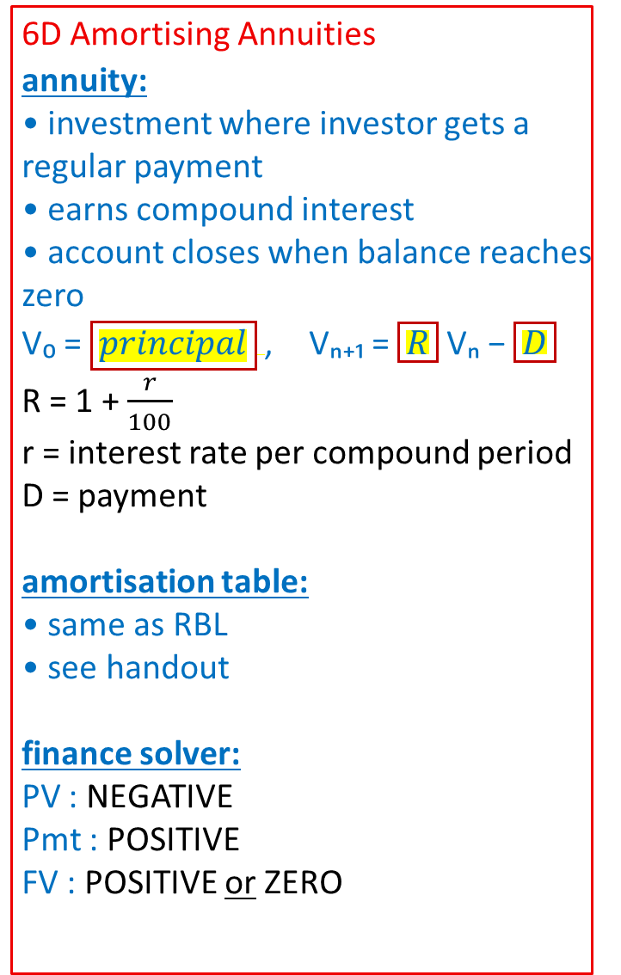
6D Amortising Annuities
annuity:
• investment where investor gets a regular payment
• earns compound interest
• account closes when balance reaches zero
V₀ = $\boxed{principal}$, Vₙ₊₁ = $\boxed{R}$ Vₙ − $\boxed{D}$
R = 1 + $\frac{r}{100}$
r = interest rate per compound period
D = payment
amortisation table:
• same as RBL
• see handout
finance solver:
PV : NEGATIVE
Pmt : POSITIVE
FV : POSITIVE or ZERO
examples:
1. The following table displays Karen’s annuity account. Payments and interest are monthly.
Pmt # Pmt $ interest Prin red. balance
0 0 0 0 120,000
1 1300 699.60 600.40 119,399.60
2 1300 696.10 603.90 118,795.70
3 1300 692.97 607.03 118,188.67
a. calculate the monthly and annual interest rate
$\frac{699.60}{120 000}$× 100 = 0.583 monthly
× 12= 6.996 ≈ 7% annual
b. write the RR
R = 1 + $\frac{7/12}{100}$ =1.00583
V₀ = 120 000, Vₙ₊₁ = 1.00583 × Vₙ − 1300
c. complete the third line of the amortisation table.
interest: $\frac{7/12}{100}$ × 118795.70 = 692.97
d. determine how many months the annuity will last.
N $\boxed{132.93}$ → 133 months.
I 7
PV −120000
Pmt 1300
FV 0
Cpy/Ppy 12/12
∴ annuity will last 133 months.
−
−
=
=
Notes:
Board notes

Slide 4
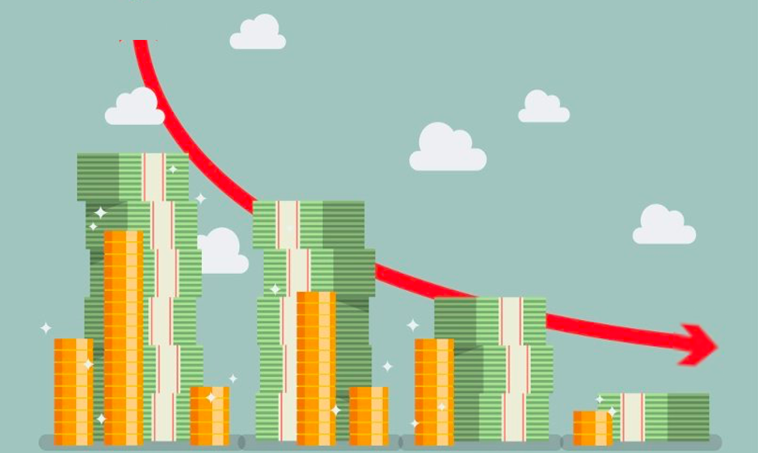
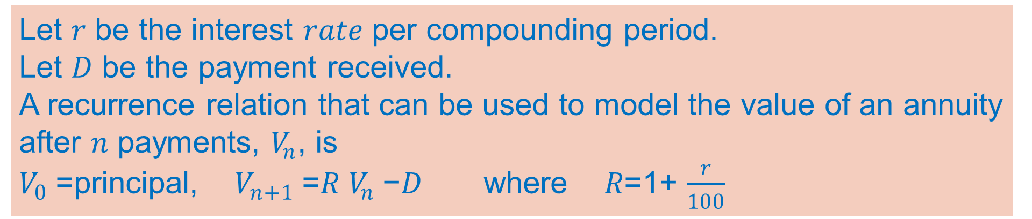
Modelling an annuity
Reducing Balance Loan
Loan
identical
Annuities
Fixed term pension
Let 𝑟 be the interest 𝑟𝑎𝑡𝑒 per compounding period.
Let 𝐷 be the payment received.
A recurrence relation that can be used to model the value of an annuity after 𝑛 payments, $V_{n}$, is
$V_{0}$=principal, $V_{n+1}$=𝑅 $V_{n}$−𝐷 where 𝑅=1+ $\frac{r}{100}$

Slide 5

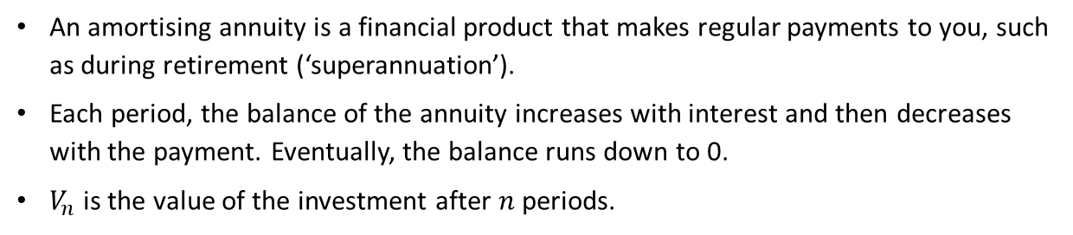
Amortising annuities – recurrence relations
Amortising annuity
$V_{0}=\text{500 000}$, $V_{n + 1}=\text{1.005}V_{n} −\text{3220}$
Key takeaway
An amortising annuity is a financial product that makes regular payments to you, such as during retirement (‘superannuation’).
Each period, the balance of the annuity increases with interest and then decreases with the payment. Eventually, the balance runs down to 0.
$V_{n}$ is the value of the investment after $n$ periods.

Slide 6
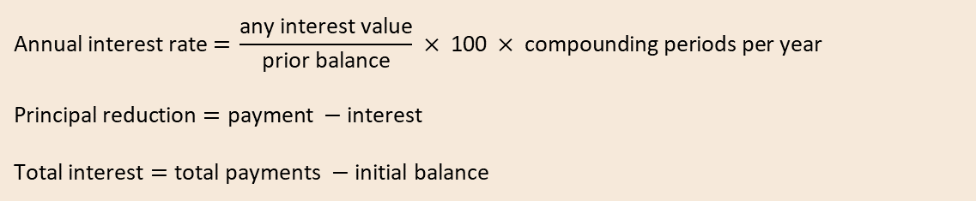
Amortising annuity – amortisation table
Key takeaway
A reducing balance loan’s amortisation table has three key features:
Balance: drops to zero over time
Payment: constant. Often has an adjustment on the final payment.
Interest: decreases over time
(as the balance gets smaller, the interest on it gets smaller)
 | Payment | Interest | Principal reduction | Balance
0 | 0.00 | 0.00 | 0.00 | 500 000.00
1 | 3222.00 | 2500.00 | 722.00 | 499 278.00
2 | 3222.00 | 2496.39 | 725.61 | 498 552.39
… | … | … | … | …
298 | 3222.00 | 46.17 | 3175.83 | 6057.74
299 | 3222.00 | 30.29 | 3191.71 | 2866.03
300 | 2880.36 | 14.33 | 2866.03 | 0.00
$$\text{Annual} \text{interest} \text{rat}\text{e} \text{=} \frac{\text{any} \text{interest} \text{value}}{\text{prior} \text{balance}} × \text{100} × \text{compounding} \text{periods} \text{per} \text{year}$$
$$\text{Principal} \text{reduction}=\text{payment} −\text{interest}$$
$$\text{Total} \text{interest}=\text{total} \text{payments} −\text{initial} \text{balance}$$

Slide 7

Amortising annuity – amortisation table
 | Payment | Interest | Principal reduction | Balance
0 | 0.00 | 0.00 | 0.00 | 500 000.00
1 | 3222.00 | 2500.00 | 722.00 | 499 278.00
2 | 3222.00 | 2496.39 | 725.61 | 498 552.39
… | … | … | … | …
298 | 3222.00 | 46.17 | 3175.83 | 6057.74
299 | 3222.00 | 30.29 | 3191.71 | 2866.03
300 | 2880.36 | 14.33 | 2866.03 | 0.00
This table represents the amortisation
of a $500 000 reducing balance loan, at 6% p.a. with monthly repayments.
Calculations
$V_{0}=\text{500 000}$, $V_{n + \text{1}} =\text{1.005}V_{n} − \text{3222}$

Slide 8
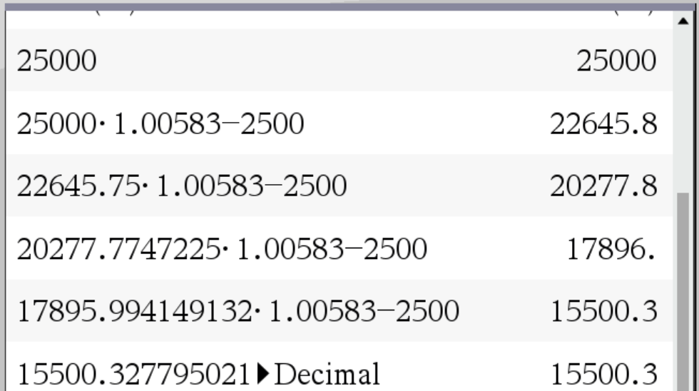


Using recurrence relations to model amortising annuities
Tom invests $25 000 in an annuity with an interest rate of 7% per annum, compounding monthly.
This annuity will provide him with a monthly income of $2500.
a. Construct a recurrence relation that can be used to model Vn, the value of this annuity after n compounding periods. Round R to 5 decimal places.
b. Calculate the value of the investment after 4 months.
$V_{0}$ = the principal, $V_{n+1}$ =𝑅 $V_{n}$ −𝐷 where 𝑅=1+$\frac{r}{100}$
$V_{0}$ =25,000 $r_{m}$ = $\frac{7}{12}$=0.58333
$R_{m}$ = 1+$\frac{r_{m}}{100}$= 1+$\frac{0.58333}{100}$=1.005833=1.00583
𝐷=2500
$V_{0}$ =25,000 $V_{n+1}$ =1.00583 $V_{n}$ −2500
CAS Notes 6.3
CAS Notes 6.16.7
The value of investment after 4 months is $15,500.33

Slide 9
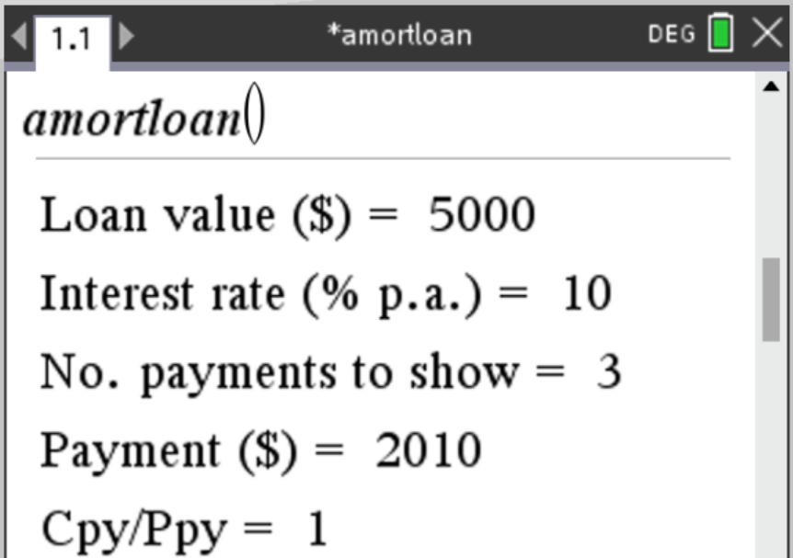
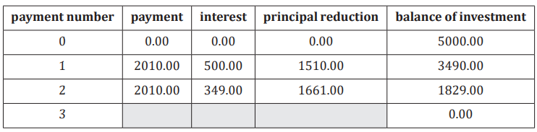
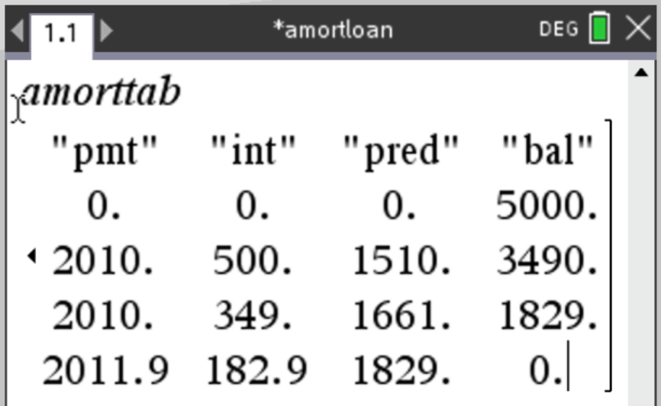

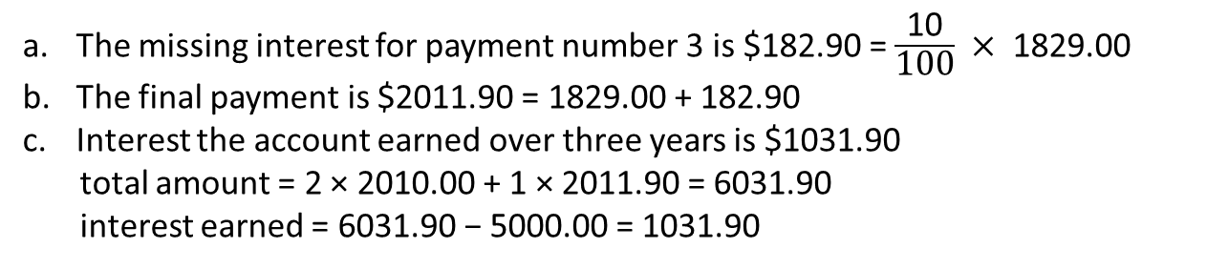
Using amortisation tables to solve problems involving amortising annuities
Mike invests $5000 in an annuity account paying interest at 10% per annum. Mike wants to receive a payment of $2010 per year. This is modelled using the following amortisation table.
Mike wants the final payment amount adjusted so that the annuity will be fully paid out after payment number 3. a. Calculate the missing interest for payment number 3.
b. Calculate the final payment that Mike will receive for this annuity.
c. How much interest has the account earned over three years?
The missing interest for payment number 3 is $182.90 = $\frac{\text{10}}{\text{100}} × \text{1829.00}$
The final payment is $2011.90 = 1829.00 + 182.90
Interest the account earned over three years is $1031.90
total amount = 2 × 2010.00 + 1 × 2011.90 = 6031.90
interest earned = 6031.90 − 5000.00 = 1031.90
CAS Notes 6.15

Slide 10
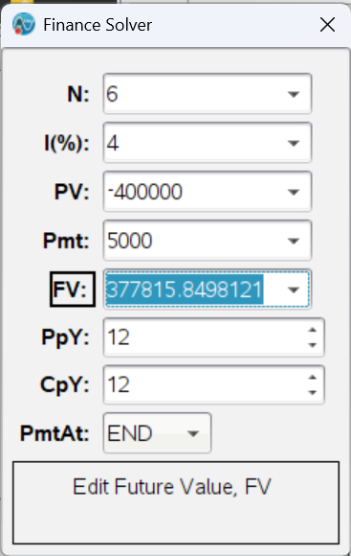
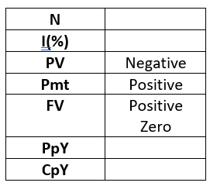
Amortising annuities – finance solver
Chuck invests $400 000 in an annuity with a bank who offers an interest rate of 4% per annum,
compounding monthly. The annuity pays out $5000 per month.
a. What will the annuity be worth after 6 months?
$377,815.85
Total number of periods
Annual interest rate
Present value
Payment
Future value
Payment periods per year
Compounding periods per year
Tip!
For PV, Pmt, FV:
A value you RECEIVE is positive
A value you GIVE is negative
CAS Notes 6.7, 6.10

Slide 11
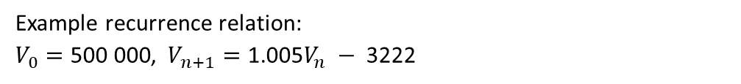
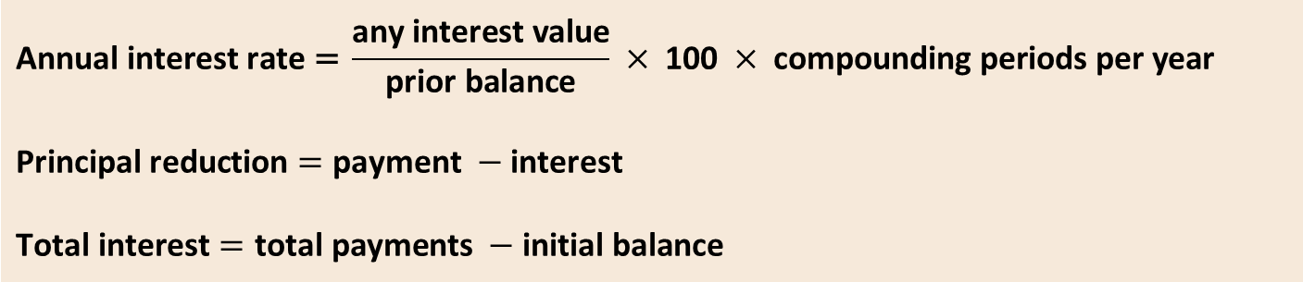
An amortising annuity is a financial product that makes regular payments to you e.g. during retirement (‘superannuation’). Each period, the balance of the annuity increases with interest and then decreases with the payment. Eventually, the balance runs down to 0.
What’s coming next
6E Perpetuities
Example recurrence relation:
$V_{0}=\text{500 000}$, $V_{n+1}=\text{1.005}V_{n} − \text{3222}$
 | Payment | Interest | Principal reduction | Balance
0 | 0.00 | 0.00 | 0.00 | 500 000.00
1 | 3222.00 | 2500.00 | 722.00 | 499 278.00
2 | 3222.00 | 2496.39 | 725.61 | 498 552.39
… | … | … | … | …
298 | 3222.00 | 46.17 | 3175.83 | 6057.74
299 | 3222.00 | 30.29 | 3191.71 | 2866.03
300 | 2880.36 | 14.33 | 2866.03 | 0.00
Total number of periods
Annual interest rate
Present value
Payment
Future value
Payment periods per year
Compounding periods per year
$$\text{Annual} \text{interest} \text{rat}\text{e} \text{=} \frac{\text{any} \text{interest} \text{value}}{\text{prior} \text{balance}} × \text{100} × \text{compounding} \text{periods} \text{per} \text{year}$$
$$\text{Principal} \text{reduction}=\text{payment} −\text{interest}$$
$$\text{Total} \text{interest}=\text{total} \text{payments} −\text{initial} \text{balance}$$

Slide 12
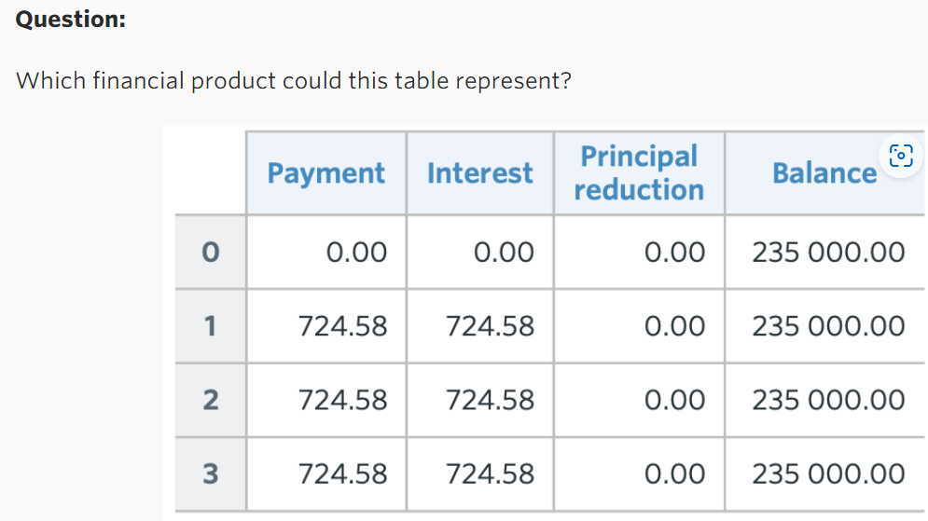
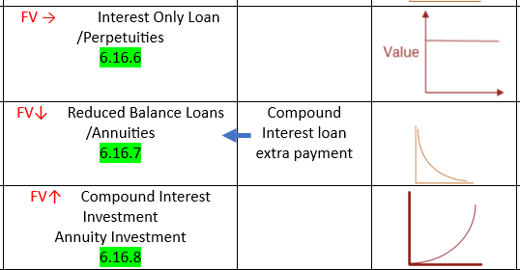
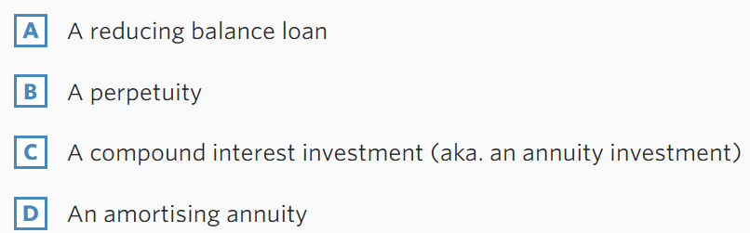

Slide 13
