Slide 1

Advanced operations with matrices
7C

Slide 2
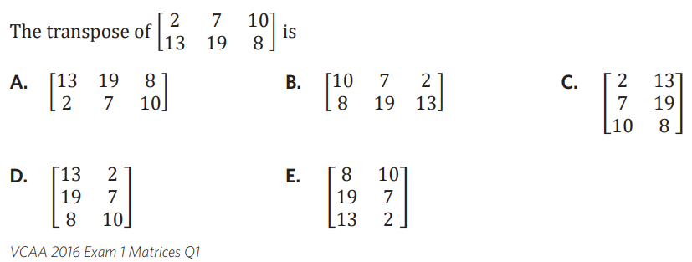


Slide 3
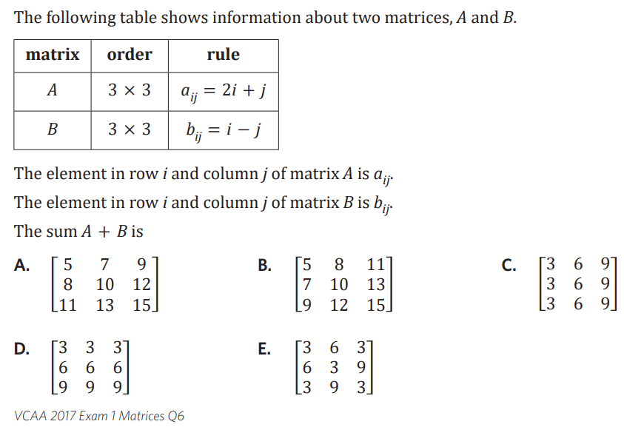

Menu 7 1 a

Slide 4








7C: Matrix multiplication
involves both matrix multiplication and addition
you must check the matrices can be multiplied first
multiplication criteria = the number of columns in the first matrix must equal the number of rows in the second matrix
“defined” = can be multiplied
“not defined” = can’t be multiplied
Example:
1.
2.
Multiplication by hand
multiply the rows of the first matrix by the columns of the second matrix
Dot Product
$\left[1 0\right]⋅\left[\begin{aligned}2 \\ 3\end{aligned}\right]=$ $\left[r_{1}c_{1}\right]$= $\left[\left(1×2)+(0×3\right)\right]$= $\left[2\right]$
Example
1. $\left[\begin{matrix}1 & 0 \\ 2 & 3\end{matrix}\right]⋅\left[\begin{aligned}2 \\ 3\end{aligned}\right]=\left[\begin{aligned}r_{1}c_{1} \\ r_{2}c_{1}\end{aligned}\right]$
2 × 2 2 × 1 2 × 1
$=\left[\begin{aligned}\left(1×2)+(0×3\right) \\ \left(2×2)+(3×3\right)\end{aligned}\right]=\left[\begin{aligned}2 \\ 13\end{aligned}\right]$
2. $\left[\begin{matrix}1 & 2 \\ 3 & 4\end{matrix}\right]⋅\left[\begin{matrix}8 & 6 \\ 4 & 2\end{matrix}\right]=\left[\begin{matrix}r_{1}c_{1} & r_{1}c_{2} \\ r_{2}c_{1} & r_{2}c_{2}\end{matrix}\right]$
2 × 2 2 × 2 2 × 2
$$=\left[\begin{matrix}\left(1×8)+(2×4\right) & \left(1×6)+(2×2\right) \\ \left(3×8)+(4×4\right) & \left(3×6)+(4×2\right)\end{matrix}\right]=\left[\begin{matrix}16 & 10 \\ 40 & 26\end{matrix}\right]$$
Summing matrices
a row or column matrix where all elements are one (1)
→ to sum the rows of an m×n matrix, postmultiply by an n×1 summing matrix
means placing the summing matrix after the matrix
example:
$\left[\begin{matrix}1 & 0 \\ 2 & 3\end{matrix}\right]⋅\left[\begin{aligned}1 \\ 1\end{aligned}\right]=\left[\begin{aligned}1 \\ 5\end{aligned}\right]$
m × n n × 1
2 × 2 2 × 1
n = 2
→ to sum the columns of an m×n matrix, premultiply by a 1×m summing matrix
means placing the summing matrix before the matrix
example:
$$\left[\begin{matrix}1 & 1 & 1\end{matrix}\right]⋅\left[\begin{matrix}4 & 2 & 3 \\ −1 & 0 & −2 \\ 0 & 6 & 1\end{matrix}\right]=\left[\begin{matrix}3 & 8 & 2\end{matrix}\right]$$
1 × m m × n
1 × 3 3 × 3
m = 3
Raising matrices to a Power
only SQUARE matrices can be raised to a power
example:
1. ${\left[\begin{matrix}1 & 2 \\ 3 & 4\end{matrix}\right]}^{2}=\left[\begin{matrix}1 & 2 \\ 3 & 4\end{matrix}\right]⋅\left[\begin{matrix}1 & 2 \\ 3 & 4\end{matrix}\right]$
2 × 2 2 × 2
same # → can be multiplied
2. ${\left[\begin{aligned}1 \\ 2 \\ 3\end{aligned}\right]}^{3}=\left[\begin{aligned}1 \\ 2 \\ 3\end{aligned}\right]⋅\left[\begin{aligned}1 \\ 2 \\ 3\end{aligned}\right]⋅\left[\begin{aligned}1 \\ 2 \\ 3\end{aligned}\right]$ =undefined
3 × 1 3 × 1 3 × 1
not the same #
∴ undefined and can’t be multiplied
$$\left[\begin{aligned}2 4 \\ 0 1\end{aligned}\right]$$
$$\left[\begin{aligned}2 \\ 3\end{aligned}\right]$$
$$=\left[\begin{aligned}16 \\ 3\end{aligned}\right]$$
2 x 1
2 x 2
2 x 1
Column of 1st matrix!
Row of 2nd matrix!
Same number= defined
These two numbers tell us the size of the product
$$\left[\begin{matrix}1 \\ 3 \\ 2\end{matrix}\right]$$
$$\left[\begin{aligned}2 0 \\ 1 3\end{aligned}\right]$$
3 x 1
2 x 2
Not the same
∴ Not defined
Notes:
Board notes

Slide 5
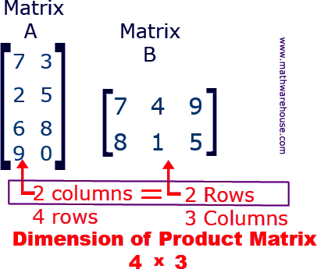
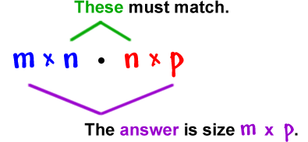
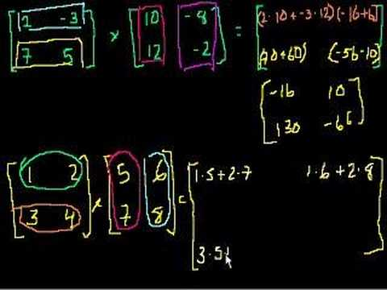
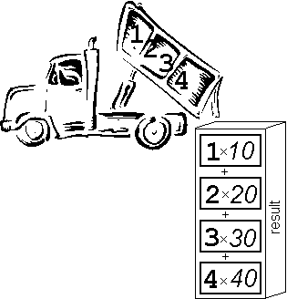
Matrix Multiplication
Notes:
https://create.kahoot.it/details/enter-the-matrix/699d3e3f-3b7a-49c2-958f-5656bdb2afec
Kahoot

Slide 6
What is a matrix?
A Matrix is just rectangular arrays of items
A typical matrix is a rectangular array of numbers arranged in rows and columns.

Slide 7
Sizing a matrix
Order of multiplication is important when multiplying matrices
By convention matrices are “sized” using the number of rows (m) by number of columns (n).

Slide 8
Matrix Addition
Matrices can be added (or subtracted) as long as the 2 matrices are the same size
  Simply add or subtract the corresponding components of each matrix.

Slide 9

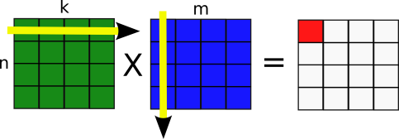
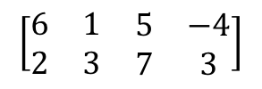

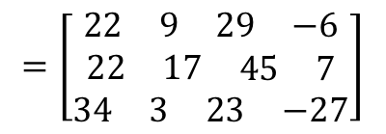



Matrix Multiplication
Multiplying Matrices together
Matrices can only be multiplied if the number of columns in the first is the same as the number of rows in the second.
$$\left[\begin{matrix}5 \\ 5 \\ 8\end{matrix}\right]$$
$$\left[\begin{matrix}\begin{matrix}3 & 2\end{matrix} \\ \begin{matrix}2 & 5\end{matrix} \\ \begin{matrix}6 & −1\end{matrix}\end{matrix}\right]$$
$$=\left[\begin{matrix}\begin{matrix}\begin{matrix}22 & 9\end{matrix} & \begin{matrix}29 & −6\end{matrix}\end{matrix} \\ \begin{matrix}\begin{matrix}22 & 17\end{matrix} & \begin{matrix}45 & 7\end{matrix}\end{matrix} \\ \begin{matrix}\begin{matrix}34 & 3\end{matrix} & \begin{matrix}23 & −27\end{matrix}\end{matrix}\end{matrix}\right]$$
$$\left[\begin{matrix}6 & 5 & −2\end{matrix}\right]$$
$$=\left[39\right]$$
$$\left[\begin{matrix}\begin{matrix}6 & 1 \\ 2 & 3\end{matrix} & \begin{matrix}5 & −4 \\ 7 & 3\end{matrix}\end{matrix}\right]$$
1 x 3
3 x 1
1 x 1
3 x 2
2 x 4
3 x 4
These numbers have to be the same!
These numbers have to be the same!
These numbers give the dimensions of the final matrix!
These numbers give the dimensions of the final matrix!

Slide 10
Example 1
DECIDING WHETHER TWO MATRICES CAN BE MULTIPLIED
Suppose A is a 3 × 2 matrix, while B is a 2 × 4 matrix.
a.
Can the product AB be calculated?
Solution
The following diagram shows that AB can be calculated, because the number of columns of A is equal to the number of rows of B. (Both are 2.)
Matrix A
Matrix B
3 × 2
2 × 4
must match
size of AB
3 × 4

Slide 11
Example 2
DECIDING WHETHER TWO MATRICES CAN BE MULTIPLIED
Suppose A is a 3 × 2 matrix, while B is a 2 × 4 matrix.
b.
If AB can be calculated, what size is it?
Solution
As indicated in the diagram below, the product AB is a 3 x 4 matrix.
Matrix A
Matrix B
3 × 2
2 × 4
must match
size of AB
3 × 4

Slide 12
Example 3
DECIDING WHETHER TWO MATRICES CAN BE MULTIPLIED
Suppose A is a 3 × 2 matrix, while B is a 2 × 4 matrix.
c.
Can BA be calculated?
Solution
The diagram below shows that BA cannot be calculated.
Matrix B
Matrix A
3 × 4
3 × 4
different

Slide 13
Example 4
Matrix A
Matrix B
2 × 2
2 × 4
MULTIPLYING MATRICES
must match
size of AB
2 × 4
Use the definition of matrix multiplication
Perform the operations.

Slide 14
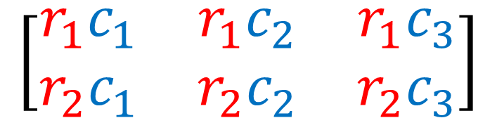
Examples:
Matrix A
Matrix B
2 × 2
2 × 3
must match
size of AB
2 × 3
2(3) + -1(5)
2(-9) + -1(7)
2(2) + -1(-6)
3(3) + 4(5)
3(-9) + 4(7)
3(2) + 4(-6)
$$\left[\begin{matrix}r_{1}c_{1} & r_{1}c_{2} & r_{1}c_{3} \\ r_{2}c_{1} & r_{2}c_{2} & r_{2}c_{3}\end{matrix}\right]$$

Slide 15

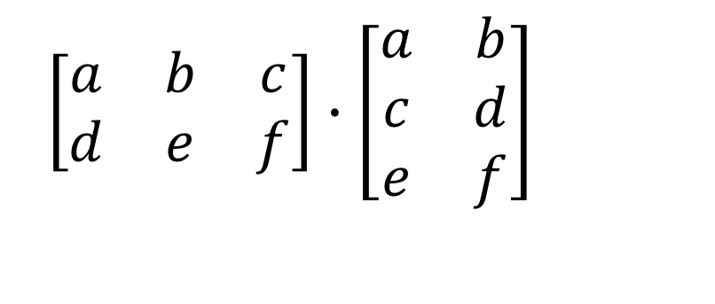
Matrix
$\left[\begin{matrix}a & b & c \\ d & e & f\end{matrix}\right]∙\left[\begin{matrix}a & b \\ c & d \\ e & f\end{matrix}\right]$
Multiplying Matrices – order MATTERS
2 x 3
3 x 2
MUST MATCH TO MULTIPLY
Answer will be a 2 x 2

Slide 16
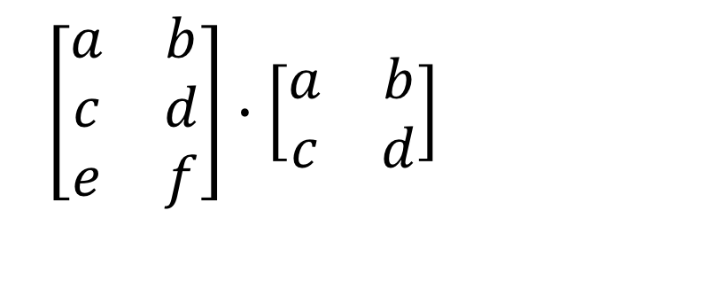
Matrix
$\left[\begin{matrix}a & b \\ c & d \\ e & f\end{matrix}\right]∙\left[\begin{matrix}a & b \\ c & d\end{matrix}\right]$
3 x 2
2 x 2
MUST MATCH TO MULTIPLY
Answer will be a 3 x 2

Slide 17
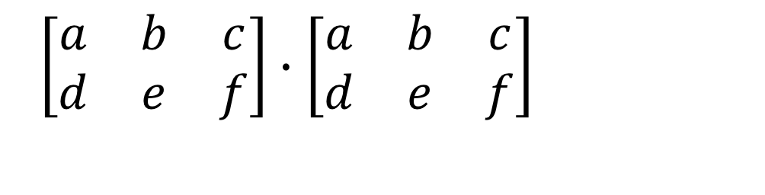
Matrix
$\left[\begin{matrix}a & b & c \\ d & e & f\end{matrix}\right]∙\left[\begin{matrix}a & b & c \\ d & e & f\end{matrix}\right]$
2 x 3
2 x 3
Don’t match, CANNOT MULTIPLY

Slide 18

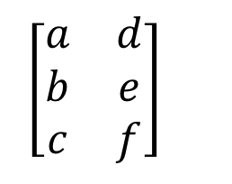

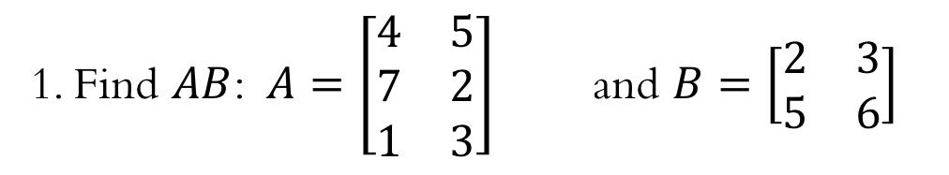





Matrix
1. Find $AB$: $A=\left[\begin{matrix}4 & 5 \\ 7 & 2 \\ 1 & 3\end{matrix}\right]$ and $B=\left[\begin{matrix}2 & 3 \\ 5 & 6\end{matrix}\right]$
3 x 2
match
2 x 2
dimensions of product
This is the first row, first column so we take 1st row of A × 1st column of B
3 × 2
write yourself how to get this element
$\left[\begin{matrix}a & d \\ b & e \\ c & f\end{matrix}\right]$
$4\left(2\right)+5(5)$
$4\left(3\right)+5(6)$
$7\left(2\right)+2(5)$
$7\left(3\right)+2(6)$
$1\left(2\right)+3(5)$
$1\left(3\right)+3(6)$
$AB=\left[\begin{matrix}33 & 42 \\ 24 & 33 \\ 17 & 21\end{matrix}\right]$

Slide 19
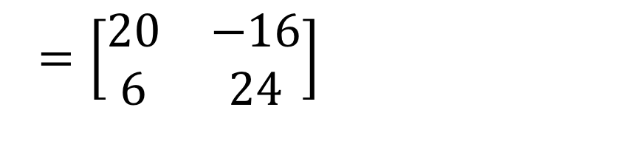
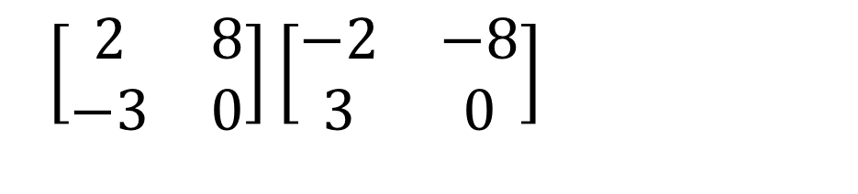
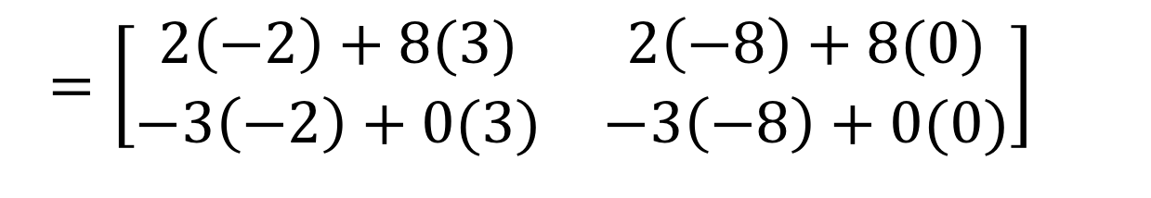
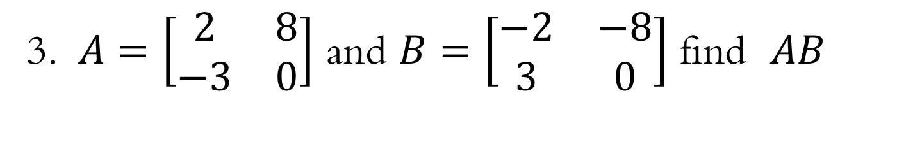
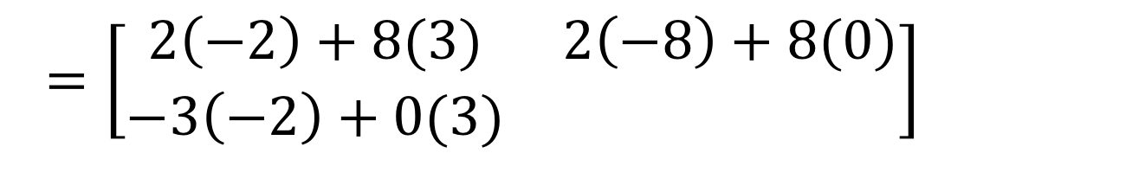
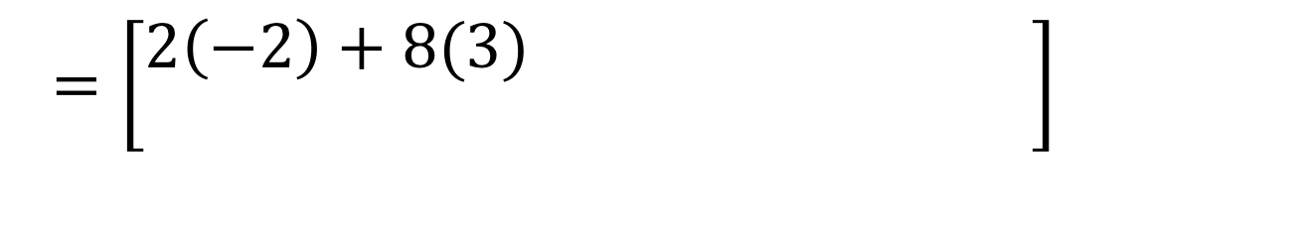
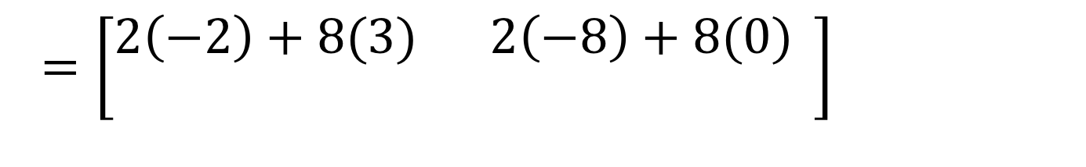
Multiplying Matrices
3. $A=\left[\begin{matrix}2 & 8 \\ −3 & 0\end{matrix}\right]$ and $B=\left[\begin{matrix}−2 & −8 \\ 3 & 0\end{matrix}\right]$ find $AB$
$\left[\begin{matrix}2 & 8 \\ −3 & 0\end{matrix}\right]\left[\begin{matrix}−2 & −8 \\ 3 & 0\end{matrix}\right]$
$=\left[\begin{matrix}2\left(−2\right)+8(3) & 2\left(−8\right)+8(0) \\ −3\left(−2\right)+0(3) & \end{matrix}\right]$
$=\left[\begin{matrix}2\left(−2\right)+8(3) & 2\left(−8\right)+8(0) \\ −3\left(−2\right)+0(3) & −3\left(−8\right)+0(0)\end{matrix}\right]$
$=\left[\begin{matrix}2\left(−2\right)+8(3) & 2\left(−8\right)+8(0) \\ & \end{matrix}\right]$
$=\left[\begin{matrix}2\left(−2\right)+8(3) & \\ & \end{matrix}\right]$
$=\left[\begin{matrix}20 & −16 \\ 6 & 24\end{matrix}\right]$

Slide 20
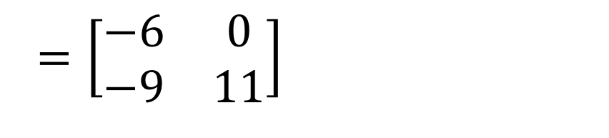
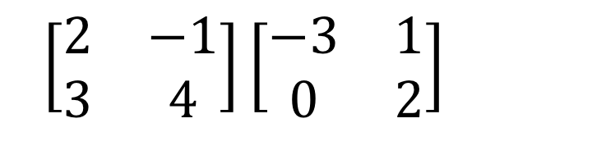
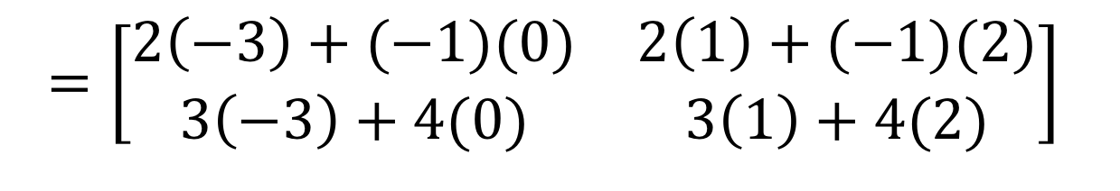
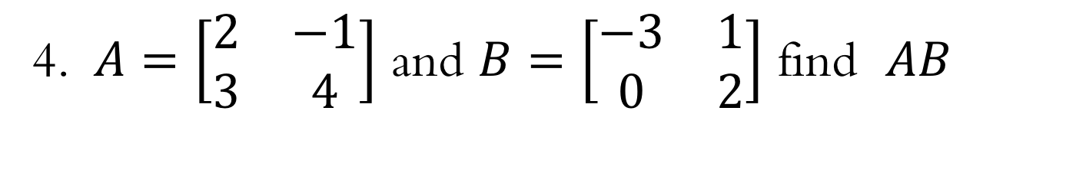
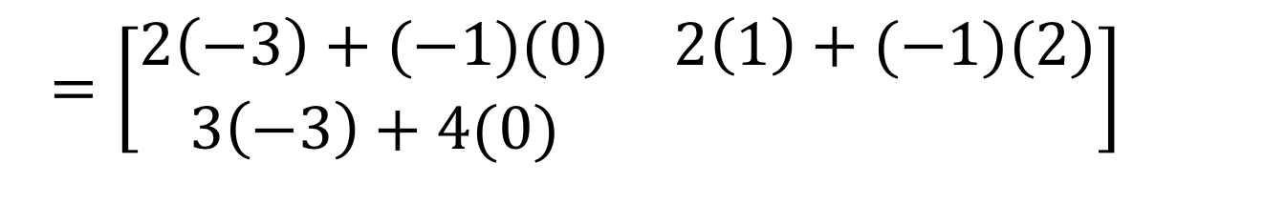
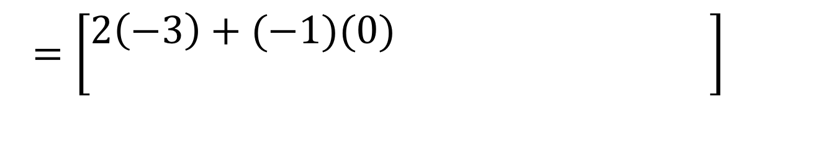
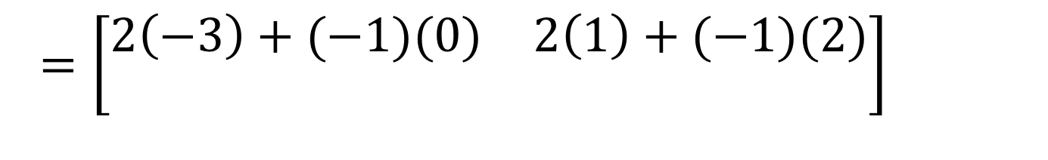
Multiplying Matrices
4. $A=\left[\begin{matrix}2 & −1 \\ 3 & 4\end{matrix}\right]$ and $B=\left[\begin{matrix}−3 & 1 \\ 0 & 2\end{matrix}\right]$ find $AB$
$\left[\begin{matrix}2 & −1 \\ 3 & 4\end{matrix}\right]\left[\begin{matrix}−3 & 1 \\ 0 & 2\end{matrix}\right]$
$=\left[\begin{matrix}2\left(−3\right)+(−1)(0) & 2\left(1\right)+(−1)(2) \\ 3\left(−3\right)+4(0) & \end{matrix}\right]$
$=\left[\begin{matrix}2\left(−3\right)+(−1)(0) & 2\left(1\right)+(−1)(2) \\ 3\left(−3\right)+4(0) & 3\left(1\right)+4(2)\end{matrix}\right]$
$=\left[\begin{matrix}2\left(−3\right)+(−1)(0) & \\ & \end{matrix}\right]$
$=\left[\begin{matrix}2\left(−3\right)+(−1)(0) & 2\left(1\right)+(−1)(2) \\ & \end{matrix}\right]$
$=\left[\begin{matrix}−6 & 0 \\ −9 & 11\end{matrix}\right]$

Slide 21
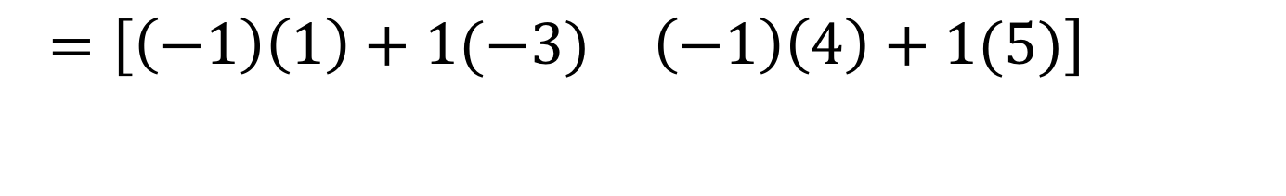
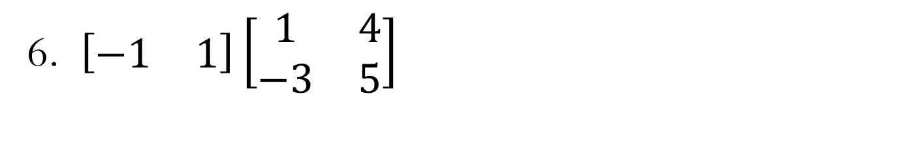
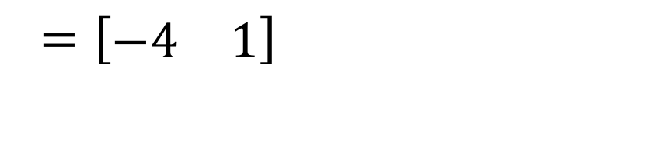
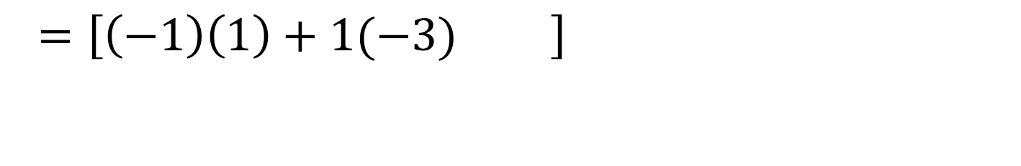
Multiplying Matrices
6. $\left[\begin{matrix}−1 & 1\end{matrix}\right]\left[\begin{matrix}1 & 4 \\ −3 & 5\end{matrix}\right]$
(1 x 2)(2 x 2)
= 1 x 2
$=\left[\begin{matrix}\left(−1\right)\left(1\right)+1(−3) & \end{matrix}\right]$
$=\left[\begin{matrix}\left(−1\right)\left(1\right)+1(−3) & \left(−1\right)\left(4\right)+1(5)\end{matrix}\right]$
$=\left[\begin{matrix}−4 & 1\end{matrix}\right]$

Slide 22
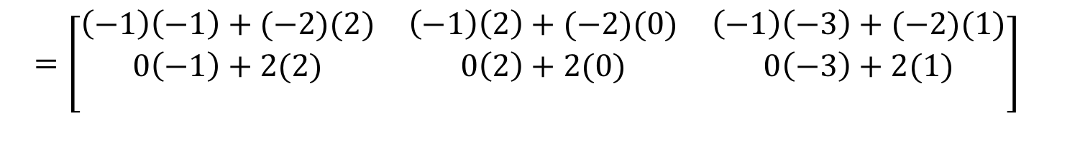
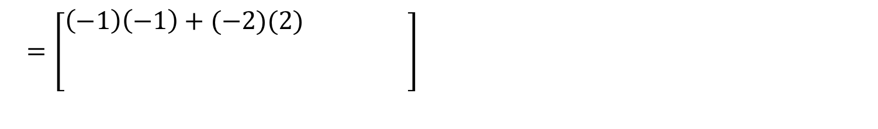
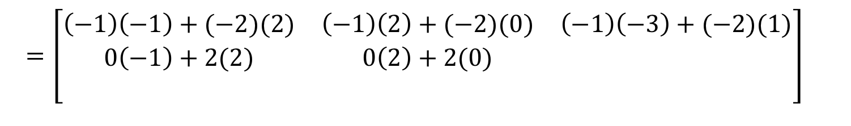
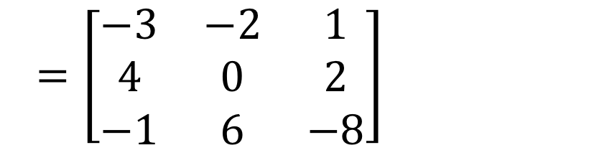
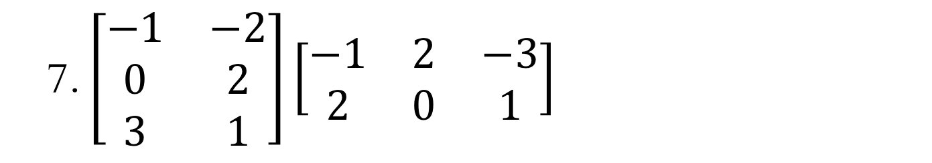
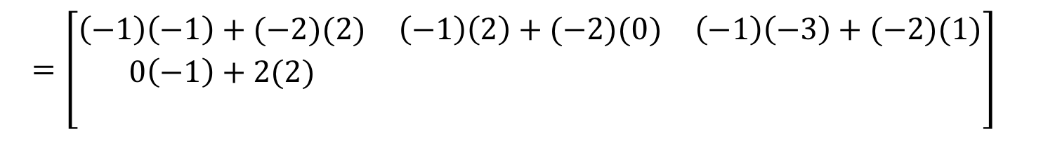
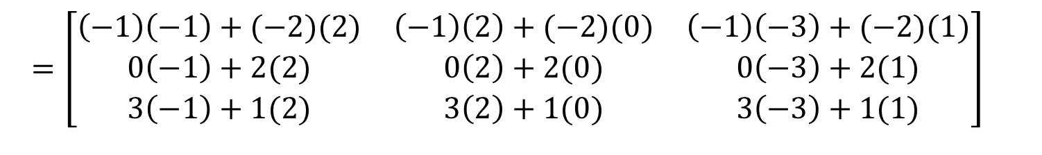
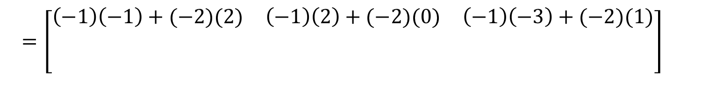
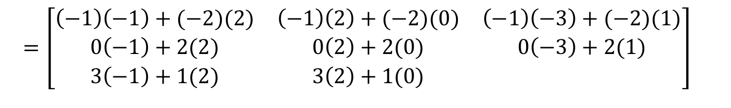
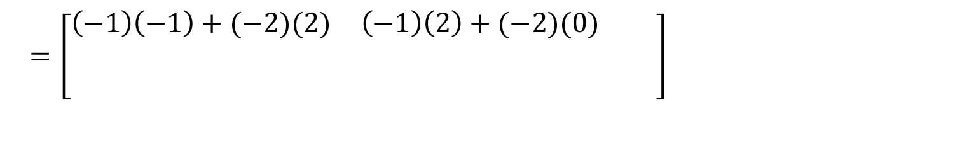
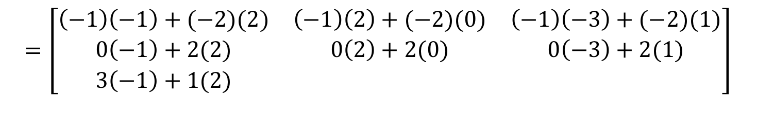
Multiplying Matrices
7. $\left[\begin{matrix}−1 & −2 \\ 0 & 2 \\ 3 & 1\end{matrix}\right]\left[\begin{matrix}−1 & 2 & −3 \\ 2 & 0 & 1\end{matrix}\right]$
(3 x 2)(2 x 3)
= 3 x 3
$=\left[\begin{matrix}\left(−1\right)\left(−1\right)+(−2)(2) & \left(−1\right)\left(2\right)+(−2)(0) & \left(−1\right)\left(−3\right)+(−2)(1) \\ 0\left(−1\right)+2(2) & 0\left(2\right)+2(0) & 0\left(−3\right)+2(1) \\ 3\left(−1\right)+1(2) & 3\left(2\right)+1(0) & \end{matrix}\right]$
$=\left[\begin{matrix}\left(−1\right)\left(−1\right)+(−2)(2) & \left(−1\right)\left(2\right)+(−2)(0) & \left(−1\right)\left(−3\right)+(−2)(1) \\ 0\left(−1\right)+2(2) & 0\left(2\right)+2(0) & 0\left(−3\right)+2(1) \\ 3\left(−1\right)+1(2) & & \end{matrix}\right]$
$=\left[\begin{matrix}\left(−1\right)\left(−1\right)+(−2)(2) & \left(−1\right)\left(2\right)+(−2)(0) & \left(−1\right)\left(−3\right)+(−2)(1) \\ 0\left(−1\right)+2(2) & 0\left(2\right)+2(0) & 0\left(−3\right)+2(1) \\ 3\left(−1\right)+1(2) & 3\left(2\right)+1(0) & 3\left(−3\right)+1(1)\end{matrix}\right]$
$=\left[\begin{matrix}\left(−1\right)\left(−1\right)+(−2)(2) & \left(−1\right)\left(2\right)+(−2)(0) & \left(−1\right)\left(−3\right)+(−2)(1) \\ 0\left(−1\right)+2(2) & 0\left(2\right)+2(0) & 0\left(−3\right)+2(1) \\ & & \end{matrix}\right]$
$=\left[\begin{matrix}\left(−1\right)\left(−1\right)+(−2)(2) & \left(−1\right)\left(2\right)+(−2)(0) & \left(−1\right)\left(−3\right)+(−2)(1) \\ 0\left(−1\right)+2(2) & & \\ & & \end{matrix}\right]$
$=\left[\begin{matrix}\left(−1\right)\left(−1\right)+(−2)(2) & \left(−1\right)\left(2\right)+(−2)(0) & \left(−1\right)\left(−3\right)+(−2)(1) \\ 0\left(−1\right)+2(2) & 0\left(2\right)+2(0) & \\ & & \end{matrix}\right]$
$=\left[\begin{matrix}\left(−1\right)\left(−1\right)+(−2)(2) & & \\ & & \\ & & \end{matrix}\right]$
$=\left[\begin{matrix}\left(−1\right)\left(−1\right)+(−2)(2) & \left(−1\right)\left(2\right)+(−2)(0) & \\ & & \\ & & \end{matrix}\right]$
$=\left[\begin{matrix}\left(−1\right)\left(−1\right)+(−2)(2) & \left(−1\right)\left(2\right)+(−2)(0) & \left(−1\right)\left(−3\right)+(−2)(1) \\ & & \\ & & \end{matrix}\right]$
$=\left[\begin{matrix}−3 & −2 & 1 \\ 4 & 0 & 2 \\ −1 & 6 & −8\end{matrix}\right]$

Slide 23
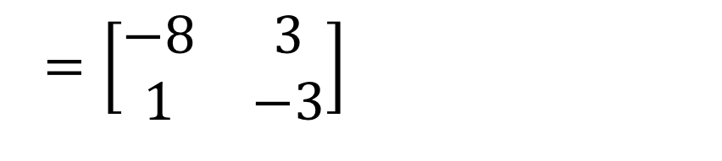
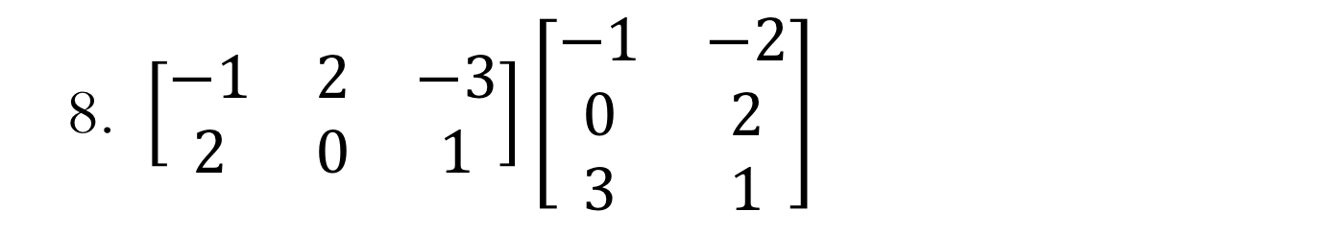




Multiplying Matrices
8. $\left[\begin{matrix}−1 & 2 & −3 \\ 2 & 0 & 1\end{matrix}\right]\left[\begin{matrix}−1 & −2 \\ 0 & 2 \\ 3 & 1\end{matrix}\right]$
(2 x 3)(3 x 2)
= 2 x 2
$=\left[\begin{matrix}\left(−1\right)\left(−1\right)+2\left(0\right)+(−3)(3) & \\ & \end{matrix}\right]$
$=\left[\begin{matrix}\left(−1\right)\left(−1\right)+2\left(0\right)+(−3)(3) & \left(−1\right)\left(−2\right)+2\left(2\right)+(−3)(1) \\ & \end{matrix}\right]$
$=\left[\begin{matrix}\left(−1\right)\left(−1\right)+2\left(0\right)+(−3)(3) & \left(−1\right)\left(−2\right)+2\left(2\right)+(−3)(1) \\ 2\left(−1\right)+0\left(0\right)+1(3) & 2\left(−2\right)+0\left(2\right)+1(1)\end{matrix}\right]$
$=\left[\begin{matrix}\left(−1\right)\left(−1\right)+2\left(0\right)+(−3)(3) & \left(−1\right)\left(−2\right)+2\left(2\right)+(−3)(1) \\ 2\left(−1\right)+0\left(0\right)+1(3) & \end{matrix}\right]$
$=\left[\begin{matrix}−8 & 3 \\ 1 & −3\end{matrix}\right]$

Slide 24




CAS
CAS Notes 7.15
CAS Notes 7.3

Slide 25







Multiplying Matrices
5. $A=\left[\begin{matrix}2 & −1 \\ 3 & 4\end{matrix}\right]$ and $B=\left[\begin{matrix}−3 & 1 \\ 0 & 2\end{matrix}\right]$ find $BA$
$\left[\begin{matrix}−3 & 1 \\ 0 & 2\end{matrix}\right]\left[\begin{matrix}2 & −1 \\ 3 & 4\end{matrix}\right]$
$=\left[\begin{matrix}\left(−3\right)2+(1)(3) & \left(−3\right)(−1)+(1)(4) \\ & \end{matrix}\right]$
$=\left[\begin{matrix}\left(−3\right)2+(1)(3) & \left(−3\right)(−1)+(1)(4) \\ 0\left(2\right)+2(3) & \end{matrix}\right]$
$=\left[\begin{matrix}\left(−3\right)2+(1)(3) & \left(−3\right)(−1)+(1)(4) \\ 0\left(2\right)+2(3) & 0\left(−1\right)+2(4)\end{matrix}\right]$
$=\left[\begin{matrix}\left(−3\right)2+(1)(3) & \\ & \end{matrix}\right]$
$=\left[\begin{matrix}−3 & 7 \\ 6 & 8\end{matrix}\right]$
***NOT the same as AB (#4)!!!!

Slide 26



Matrix
2. Find $A^{2}$: $A=\left[\begin{matrix}4 & 5 \\ 7 & 2 \\ 1 & 3\end{matrix}\right]$
$A^{2}=\left[\begin{matrix}4 & 5 \\ 7 & 2 \\ 1 & 3\end{matrix}\right]\left[\begin{matrix}4 & 5 \\ 7 & 2 \\ 1 & 3\end{matrix}\right]$
$=undefined$
3 x 2
3 x 2
Wait! You Can’t!

Slide 27


The summing matrix
A row or column matrix in which all the elements are 1 is called a summing matrix.
The matrices below are all examples of summing matrices.
The rules for using a summing matrix to sum the rows and columns of a matrix follow.

Slide 28





Using matrix multiplication to sum the rows and columns of a matrix
Use matrix multiplication to generate a matrix that:
displays row sums of the matrix
displays the column sums of the matrix
Solutions:
To sum the rows of a 3×3 matrix,
post-multiply a 3×1 summing matrix.
To sum the columns of a 2×5 matrix,
pre-multiply a 1×2 summing matrix.

Slide 29
Displaying assets of simultaneous equations in matrix form
In the next chapter, you will learn to solve sets of simultaneous linear equations using matrices. The first step in this process is to write a set of simultaneous equations in matrix notation using matrix multiplication.

Slide 30



Generating sets of simultaneous equations
Solution
Write out the matrix equation and then multiply out the left-hand side
For the matrices to be equal:
4𝑥+2𝑦 must equal 5
and
3𝑥+2𝑦 must equal 2.
This gives the required pair of simultaneous linear equations.

