Slide 1

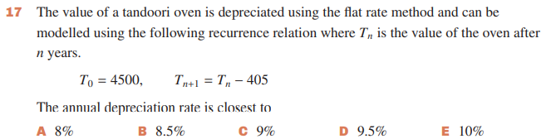
Depreciation – finding the rule for the nth term
5D
Notes:
3,5,6,9,10,11,13,15

Slide 2



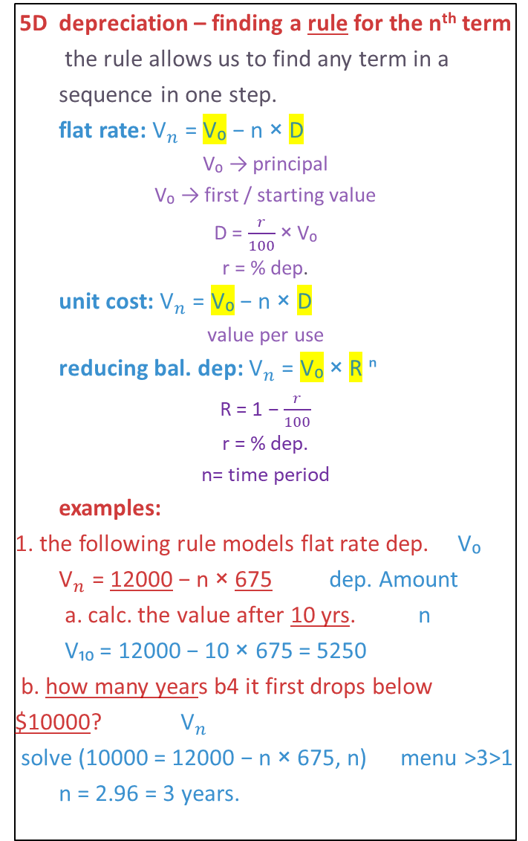
5D depreciation – finding a rule for the n^{th} term
  the rule allows us to find any term in a sequence in one step.
  flat rate: ${\text{V}}_{n}$ = V₀ − n × D
V₀ → principal
V₀ → first / starting value
D = $\frac{r}{100}$× V₀
r = % dep.
  unit cost: ${\text{V}}_{n}$ = V₀ − n × D
value per use
  reducing bal. dep: ${\text{V}}_{n}$ = V₀ × R ⁿ
R = 1 − $\frac{r}{100}$
r = % dep.
n= time period
  examples:
1. the following rule models flat rate dep. V₀
  ${\text{V}}_{n}$ = 12000 − n × 675 dep. Amount
  a. calc. the value after 10 yrs. n
  V₁₀ = 12000 − 10 × 675 = 5250
b. how many years b4 it first drops below $10000? ${\text{V}}_{n}$
solve (10000 = 12000 − n × 675, n) menu >3>1
  n = 2.96 = 3 years.
2. A printer cost $1200, it depreciates by 8% of it’s value each year. r V₀
a. write a rule
D = $\frac{r}{100}$ × V₀ = $\frac{8}{100}$ × 1200 = 96
${\text{V}}_{n}$ = V₀ − n × D
${\text{V}}_{n}$ = 1200 − n × 96
b. what is the value after 10 years?
V₁₀ = 1200 − (10 × 96)
= 1200 − 960 = 240
c. how many years before it first drops below $500?
solve (500 = 1200 − n × 96, n)
n = 7.3 years
3. A hairdryer cost $850, it depreciates by 25¢ per hour.
a. write a rule (n = hours)
  ${\text{V}}_{n}$ = V₀ − nD
  ${\text{V}}_{n}$ = 850 − n × 0.25
b. what is the value after 12 hours of use?
  V₁₂ = 850 − 12 × 0.25
  = 847
c. what is the value if it is used 8.5 hours a day, 6 days a week for 5 weeks?
  8.5 × 6 × 5 = 255 hours (n)
  V₂₅₅ = 850 − 255 × 0.25
  = 786.25
4. calculate the rate of depreciation for a
computer that reduces by the following rule.
  ${\text{V}}_{n}$ = 0.8ⁿ × 9500
  ${\text{V}}_{n}$ = Rⁿ × V₀
  R = 1 − $\frac{r}{100}$
  Solve(0.8 = 1 − $\frac{r}{100}$, r)
  r = 20%
Notes:
Board notes

Slide 3
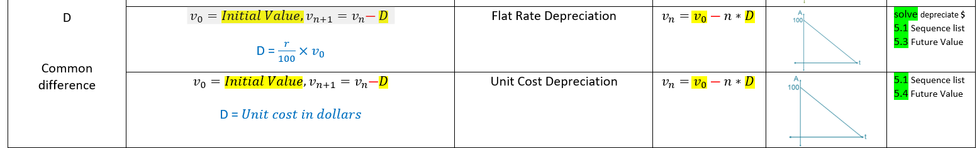
Rules for linear growth and decay

Slide 4

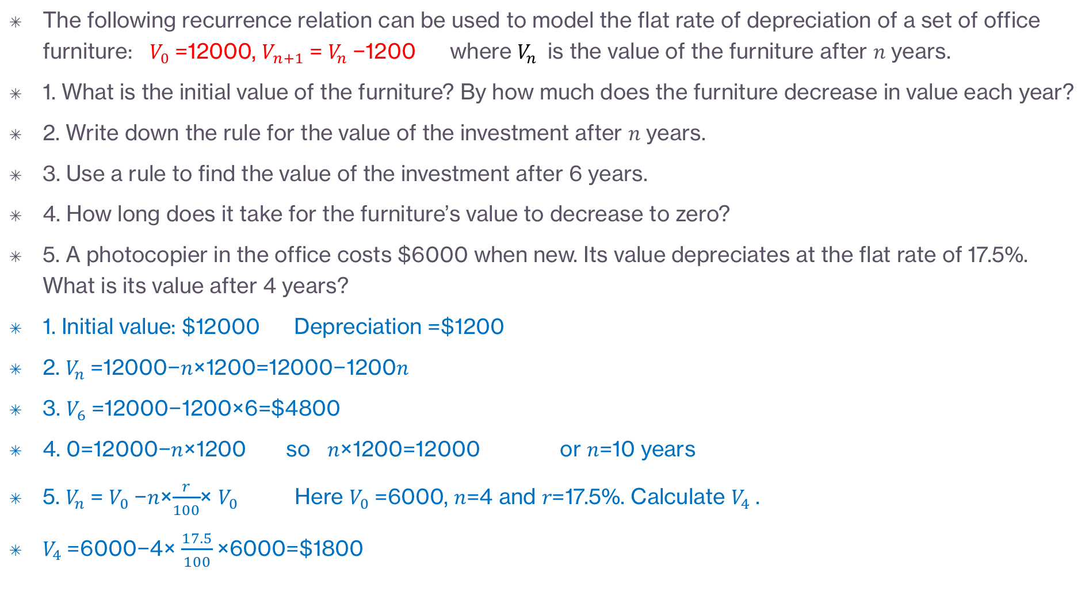
Using a rule for the flat rate of depreciation of an asset
The following recurrence relation can be used to model the flat rate of depreciation of a set of office furniture: $V_{0}$=12000, $V_{n+1}$= $V_{n}$−1200 where $V_{n}$ is the value of the furniture after 𝑛 years.
1. What is the initial value of the furniture? By how much does the furniture decrease in value each year?
2. Write down the rule for the value of the investment after 𝑛 years.
3. Use a rule to find the value of the investment after 6 years.
4. How long does it take for the furniture’s value to decrease to zero?
5. A photocopier in the office costs $6000 when new. Its value depreciates at the flat rate of 17.5%. What is its value after 4 years?
1. Initial value: $12000 Depreciation =$1200
2. $V_{n}$=12000−𝑛×1200=12000−1200𝑛
3. $V_{6}$=12000−1200×6=$4800
4. 0=12000−𝑛×1200 so 𝑛×1200=12000 or 𝑛=10 years
5. $V_{n}$= $V_{0}$−𝑛×$\frac{r}{100}$× $V_{0}$ Here $V_{0}$=6000, 𝑛=4 and 𝑟=17.5%. Calculate $V_{4}$.
$V_{4}$=6000−4× $\frac{17.5}{100}$×6000=$1800

Slide 5
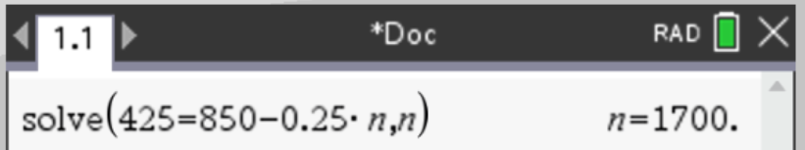
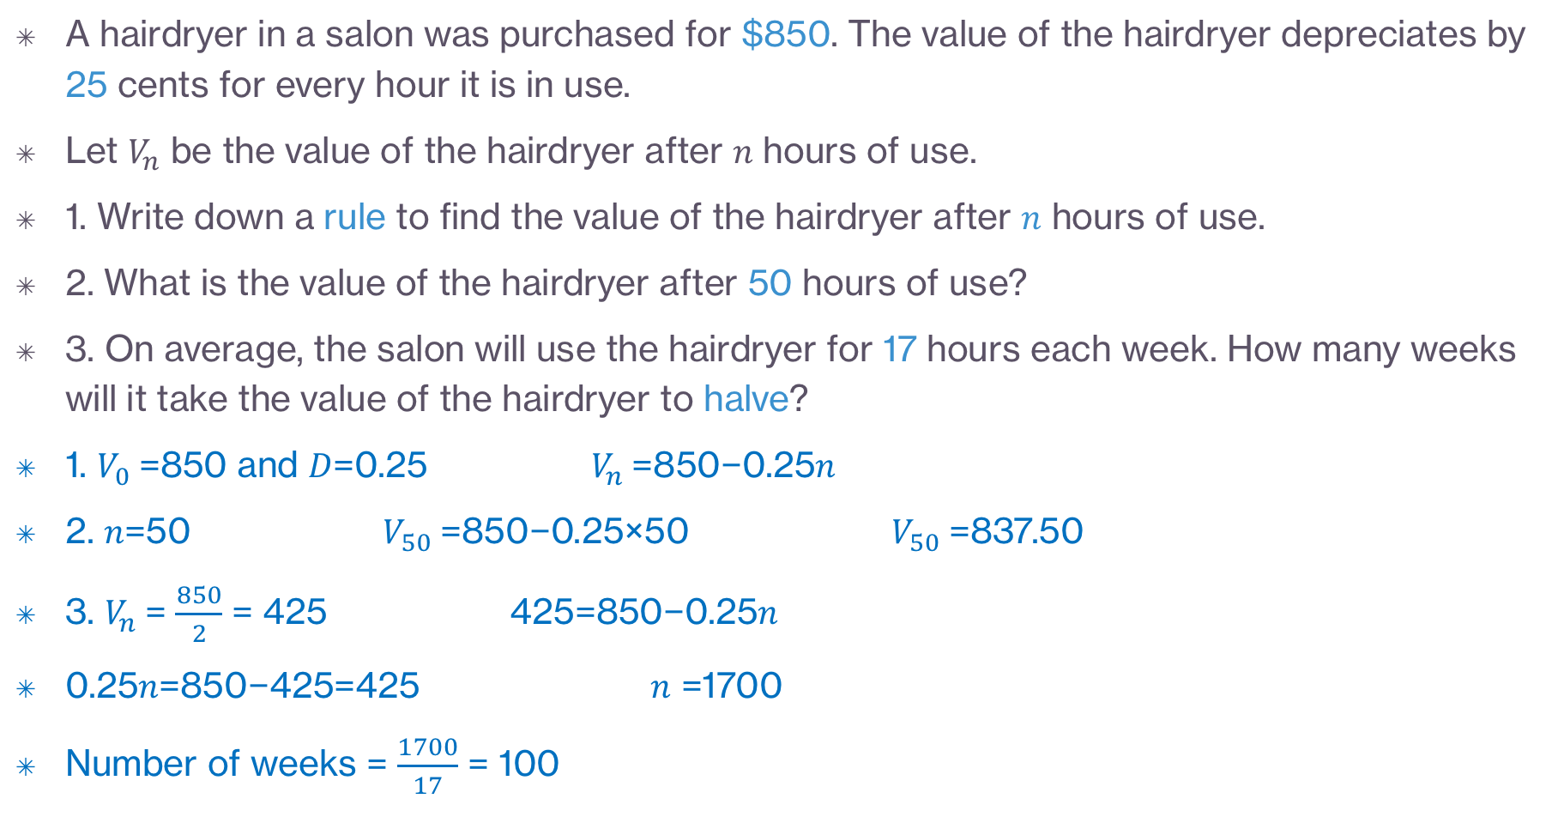
Using a rule to determine the value of an asset with unit-cost depreciation
A hairdryer in a salon was purchased for $850. The value of the hairdryer depreciates by 25 cents for every hour it is in use.
Let $V_{n}$ be the value of the hairdryer after 𝑛 hours of use.
1. Write down a rule to find the value of the hairdryer after 𝑛 hours of use.
2. What is the value of the hairdryer after 50 hours of use?
3. On average, the salon will use the hairdryer for 17 hours each week. How many weeks will it take the value of the hairdryer to halve?
1. $V_{0}$=850 and 𝐷=0.25 $V_{n}$=850−0.25𝑛
2. 𝑛=50 $V_{50}$=850−0.25×50 $V_{50}$=837.50
3. $V_{n}$= $\frac{850}{2}$ = 425 425=850−0.25𝑛
0.25𝑛=850−425=425 𝑛 =1700
Number of weeks = $\frac{1700}{17}$ = 100
CAS Notes solve

Slide 6

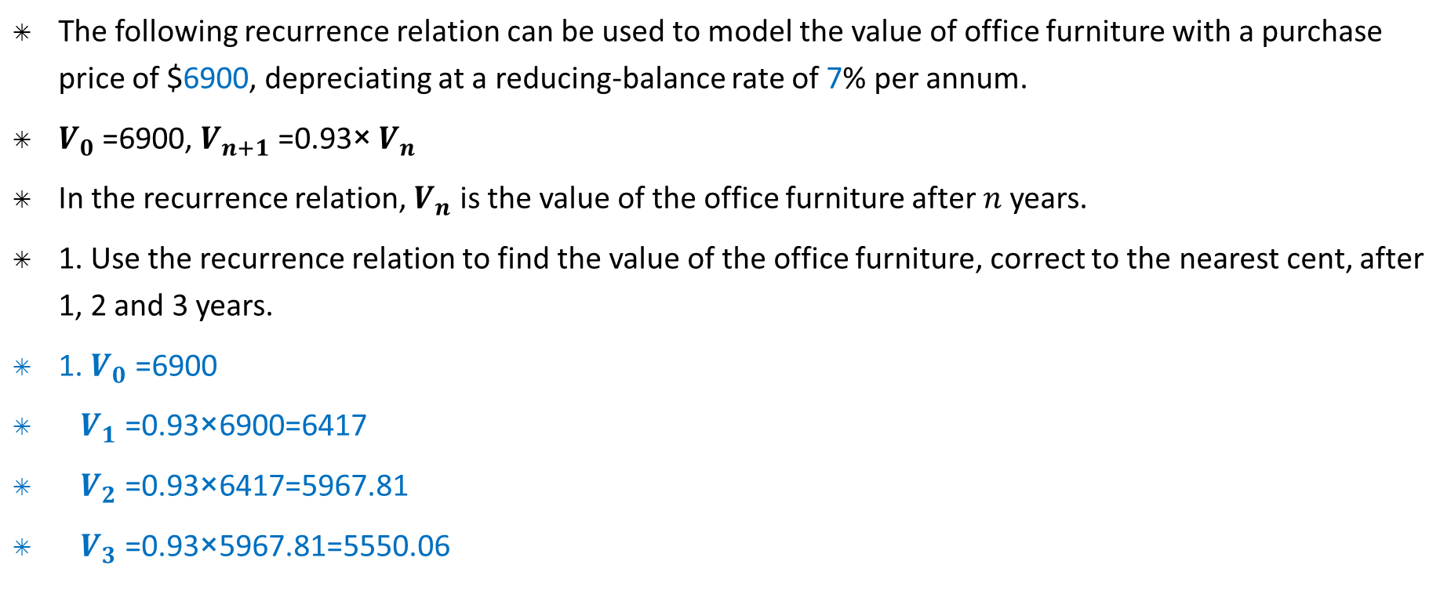
Modelling reducing-balance depreciation with recurrence relations
The following recurrence relation can be used to model the value of office furniture with a purchase price of $6900, depreciating at a reducing-balance rate of 7% per annum.
$V_{0}$ =6900, $V_{n+1}$ =0.93× $V_{n}$
In the recurrence relation, $V_{n}$ is the value of the office furniture after 𝑛 years.
1. Use the recurrence relation to find the value of the office furniture, correct to the nearest cent, after 1, 2 and 3 years.
1. $V_{0}$ =6900
$V_{1}$ =0.93×6900=6417
$V_{2}$ =0.93×6417=5967.81
$V_{3}$ =0.93×5967.81=5550.06

Slide 7
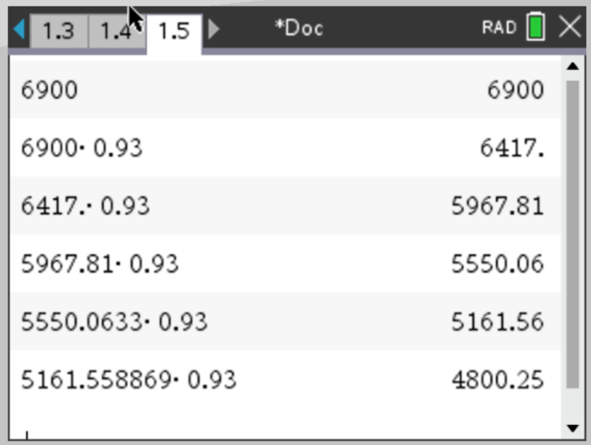
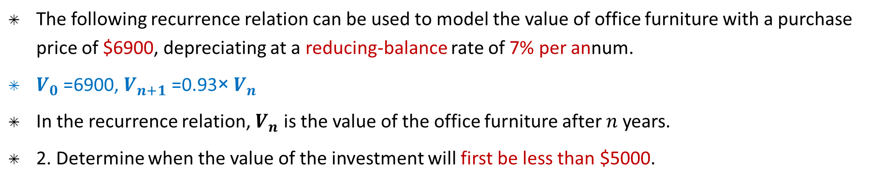
Modelling reducing-balance depreciation with recurrence relations
The following recurrence relation can be used to model the value of office furniture with a purchase price of $6900, depreciating at a reducing-balance rate of 7% per annum.
$V_{0}$ =6900, $V_{n+1}$ =0.93× $V_{n}$
In the recurrence relation, $V_{n}$ is the value of the office furniture after 𝑛 years.
2. Determine when the value of the investment will first be less than $5000.
CAS Notes 5.6
2. The value of the furniture drops below $5000 after 5 years.
CAS Notes 6.16.5

Slide 8
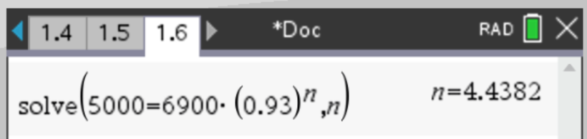
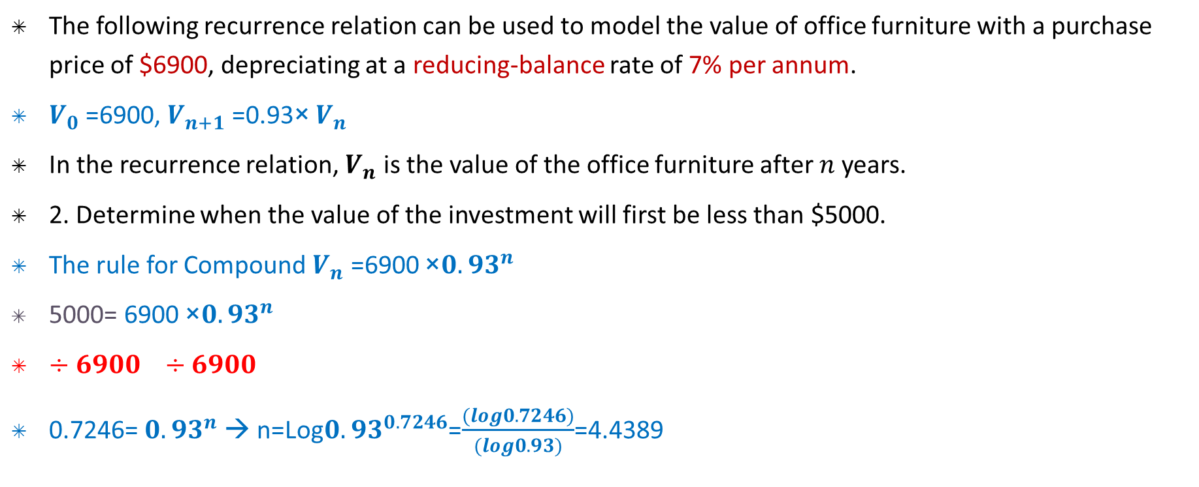
Modelling reducing-balance depreciation with recurrence relations
The following recurrence relation can be used to model the value of office furniture with a purchase price of $6900, depreciating at a reducing-balance rate of 7% per annum.
$V_{0}$ =6900, $V_{n+1}$ =0.93× $V_{n}$
In the recurrence relation, $V_{n}$ is the value of the office furniture after 𝑛 years.
2. Determine when the value of the investment will first be less than $5000.
The rule for Compound $V_{n}$ =6900 ×${0.93}^{n}$
5000= 6900 ×${0.93}^{n}$
$÷6900$ $÷6900$
0.7246= ${0.93}^{n}$ → n=Log${0.93}^{0.7246}$=$\frac{(log0.7246)}{(log0.93)}$=4.4389
CAS Notes solve
2. The value of the furniture drops below $5000 after 5 years.

Slide 9
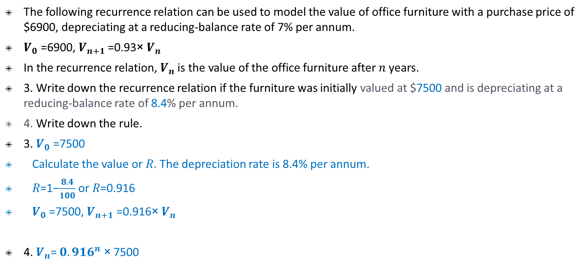
Modelling reducing-balance depreciation
The following recurrence relation can be used to model the value of office furniture with a purchase price of $6900, depreciating at a reducing-balance rate of 7% per annum.
$V_{0}$ =6900, $V_{n+1}$ =0.93× $V_{n}$
In the recurrence relation, $V_{n}$ is the value of the office furniture after 𝑛 years.
3. Write down the recurrence relation if the furniture was initially valued at $7500 and is depreciating at a reducing-balance rate of 8.4% per annum.
4. Write down the rule.
3. $V_{0}$ =7500
Calculate the value or 𝑅. The depreciation rate is 8.4% per annum.
𝑅=1−$\frac{8.4}{100}$ or 𝑅=0.916
$V_{0}$ =7500, $V_{n+1}$ =0.916× $V_{n}$
4. $V_{n}$= ${0.916}^{n} \text{× }$7500

